Slide 1

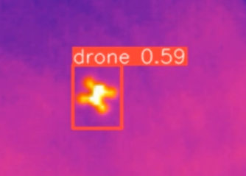
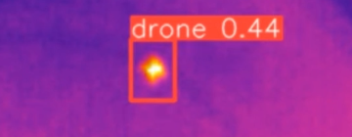
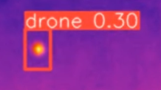
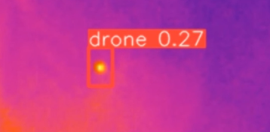
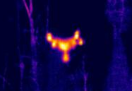
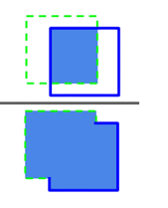
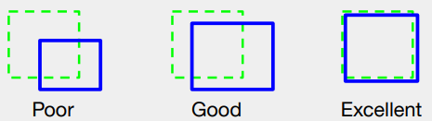
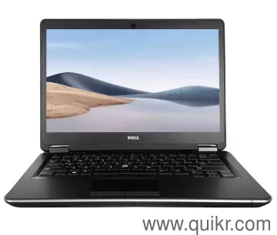
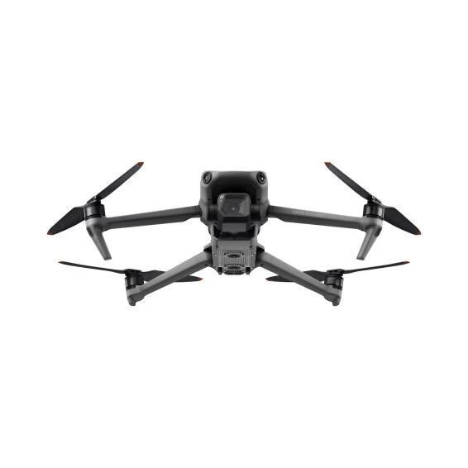
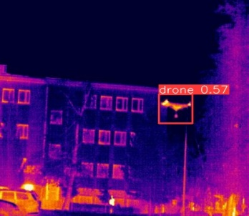

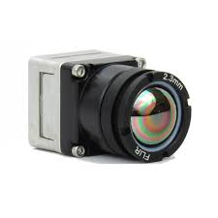
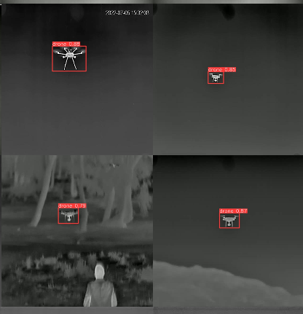
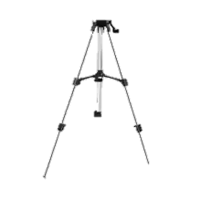
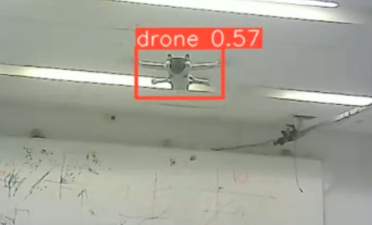





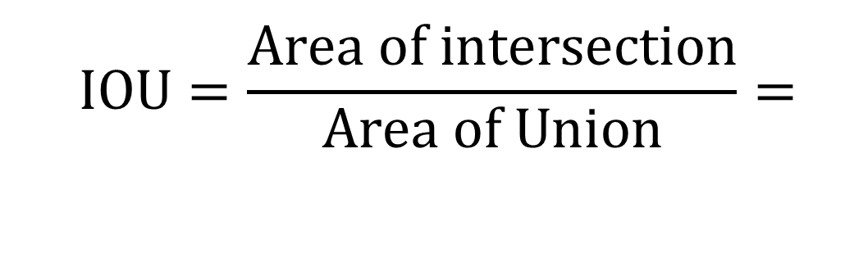


Drone Detection in Flight Using an Infrared Sensor
Project Number: 23-2-1-2985
Names: Idan Levy and Liran Galmidi
Advisor: Amit Twik
Introduction The project focuses on real-time drone detection in flight, leveraging the YOLOv8 algorithm and an infrared sensor. By integrating deep learning-based image processing with IR sensor data, the system ensures rapid and precise detection even in challenging visibility conditions. Project goal The objective is to develop a robust prototype capable of detecting drones and UAVs in real-time using ML algorithm. Motivation The increased accessibility of UAVs has led to their misuse in smuggling, surveillance, and offensive operations, posing security challenges due to their small size, low signature, and variable speeds. Infrared sensor-based systems, coupled with machine learning, offer a promising solution for real-time drone detection. This need is highlighted using drones in warfare, such as in the "Operation Iron Swords" conflict and the war in Ukraine. Implementation and Block diagram | The algorithm detects objects using a bounding box and confidence score, trained on a neural network. A comprehensive dataset of drone images , with labeled ground truth, is used to train the network. The model compares predictions to true bounding boxes to adjust its weights. Real-time field tests assess the system’s integration and performance. The confidence is calculated as: $$Confidence=P_{r}\left(Object\right)∗IOU_{pred}^{truth}$$ Where: $P_{r}$​: The probability that a specific cell contains an object, $IOU_{pred}^{truth}$: The Intersection over Union (IOU) metric, which measures the overlap between the predicted bounding box and the ground truth. Simulations Preparation Stage Prior to integration with the Infrared Sensor- Simulations in Python with over 2,500 images and videos prepared the system for real-time drone detection. Real-time video simulation with a webcam mimicked live scenarios, optimizing YOLOv8's accuracy for dynamic conditions. | Results Real-time field results showed that the system performed effectively across different altitude ranges, with accurate drone detection and bounding boxes. Conclusions The described methodology for drone detection using the YOLOv8 algorithm demonstrates a robust and effective approach for addressing real-world applications of drone surveillance and monitoring. The system met most requirements, with a detection range of 5–20 meters . However, at higher altitudes (around 20m), detecting the small drone with a low thermal signature was more challenging. A sensor with 30-60 FPS is recommended for the real-time detection application. Enhancing the detection capabilities of the algorithm can be achieved by incorporating a richer dataset that includes images of drones at various angles and distances, along with spatial disturbances such as birds. Bibliography [1] P. Andrási, T. Radišić, M. Mustra, and J. Ivosevic, "Night-time Detection of UAVs using Thermal Infrared Camera," Transportation Research Procedia, vol. 28, pp. 183-190, 2017. [2] J. Redmon, S. Divvala, R. Girshick, and A. Farhadi, "You only look once: Unified, real-time object detection," Proc. IEEE Conf. Comput. Vis. Pattern Recognit. (CVPR), 2016, pp. 779- 788.
$$5\left[m\right]$$
$$10\left[m\right]$$
$$15\left[m\right]$$
$$20\left[m\right]$$
$$IOU=\frac{Area of intersection}{Area of Union}=$$
Drone
Infrared Sensor Teledyne Flir
boson 2.3mm
Thermal radiation
type C−USB
Pc
Algorithm Run on Nvidia
GPU for better preformance
Real Time Object Detection Algorithm YOLOv8 In Python Workspace
Real time drone detection in the laboratory using webcam

