Slide 1


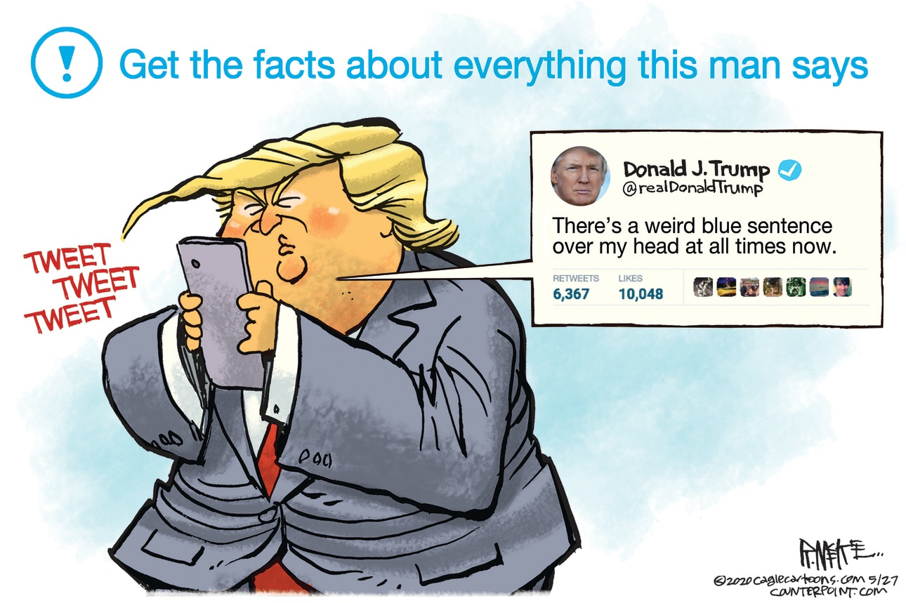


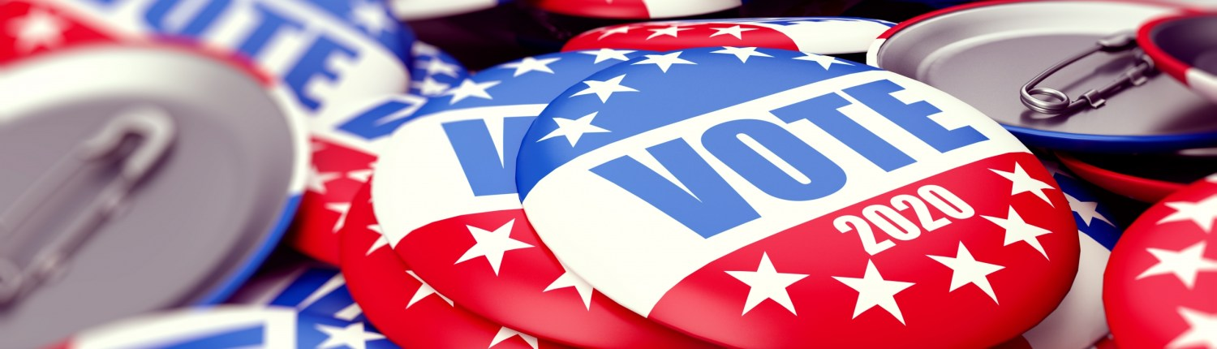

An approach on classifying questionable domain tweets
based on Text Mining techniques
Amanda Tavares Arina Sanches Lirielly Nascimento Marta Barbosa

Slide 2
Outline
1 - Introduction
2 - Dataset description
3 - Data preprocessing
4 - Exploratory data analysis
5 - Models
6 - Conclusion

Slide 3


Introduction
SPLIT
20%
FEATURE
EXTRACTION
TEST
TRAIN
TEXT MINING
Dataset
Dataset
MODEL
SENTIMENT ANALYSIS
80%
CLASSIFICATION
QUESTIONABLE DOMAIN
kNN

Slide 4
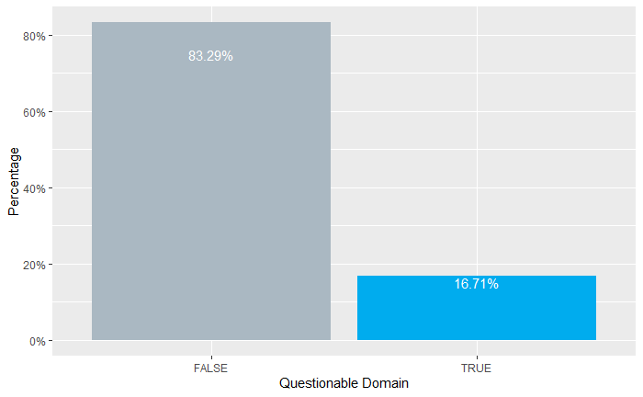
Dataset Description
17.950 tweets
with 10 features
id (numeric)
questionable_domain (binary)
user_friends_count (numeric)
user_followers_count (numeric)
user_favourites_count (numeric)
user_verified (binary)
description (string)
title (string)
favorite_count (numeric)
retweet_count (numeric)
contains_profanity (binary)

Slide 5
Data preprocessing
Features removed :
id
title
favorite_count (High correlation with retweet_count)
Removed :
Punctuation
Symbols
URL
Numbers
Stop words
'â', 's', 't'
Stemming
To lower case

Slide 6
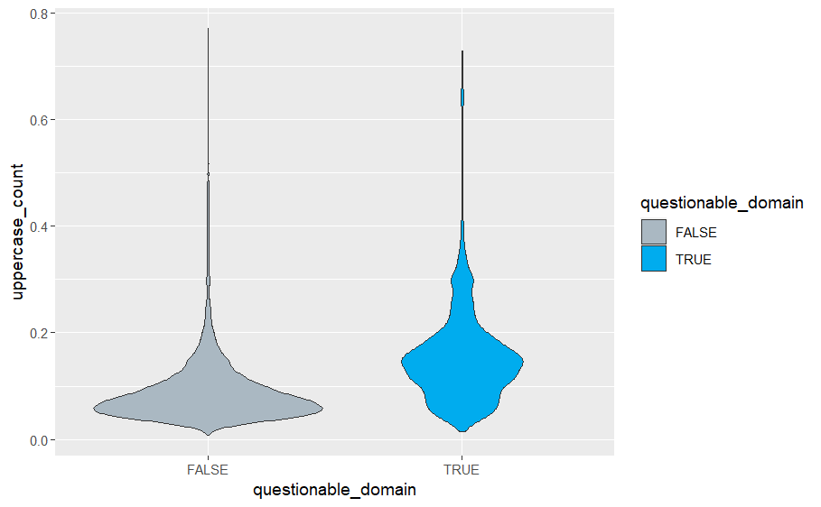
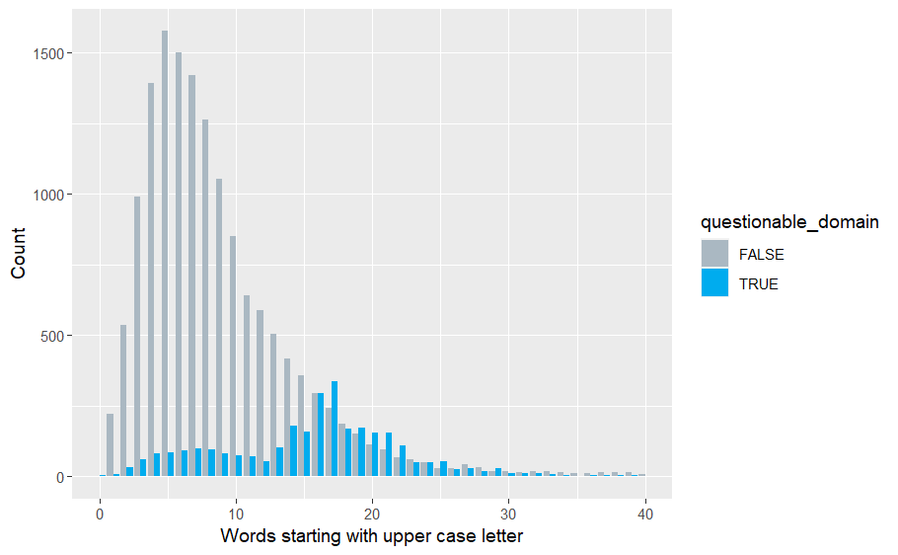
Exploratory Data Analysis
Count of words starting with upper case letters
Upper case words count

Slide 7
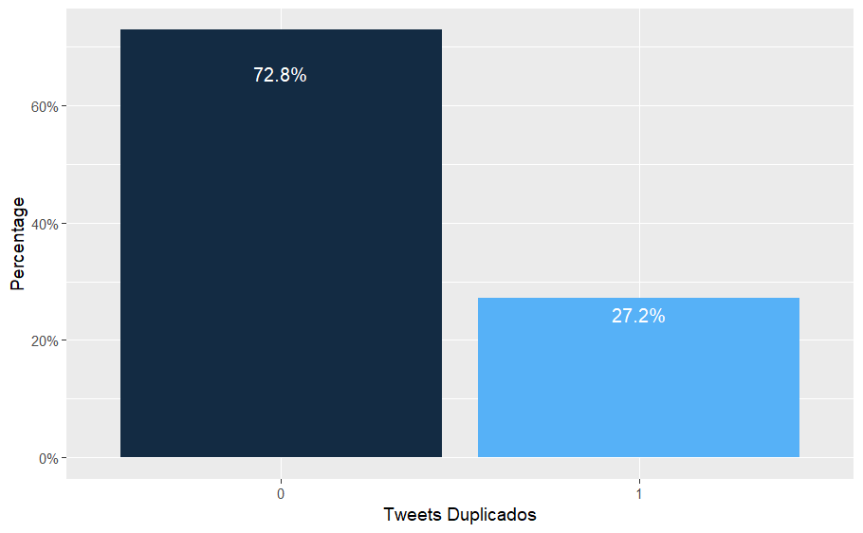
Exploratory Data Analysis
Duplicate tweets percentage

Slide 8
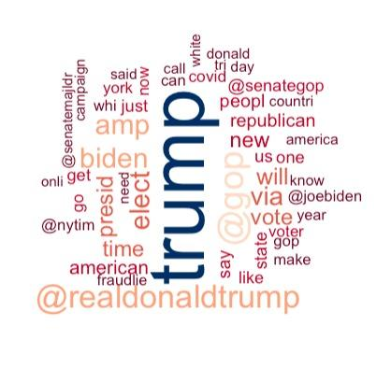
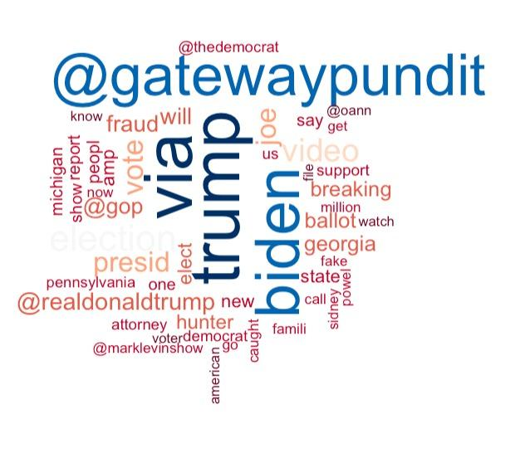
Exploratory Data Analysis
Questionable Domain
FALSE
TRUE

Slide 9
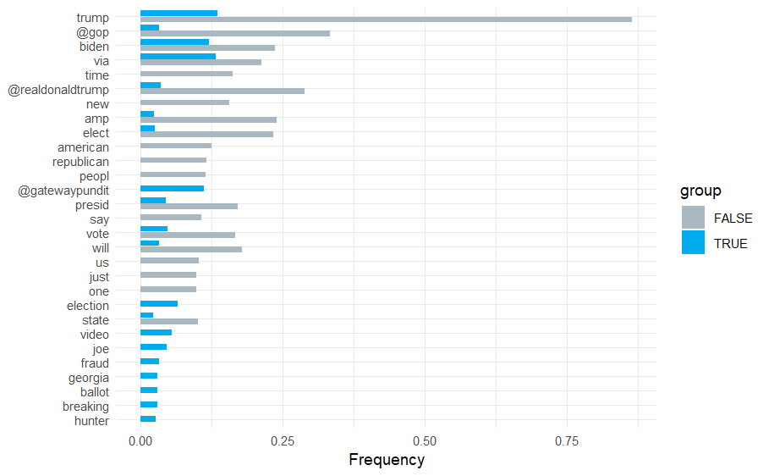
Exploratory Data Analysis
Frequency Analysis

Slide 10
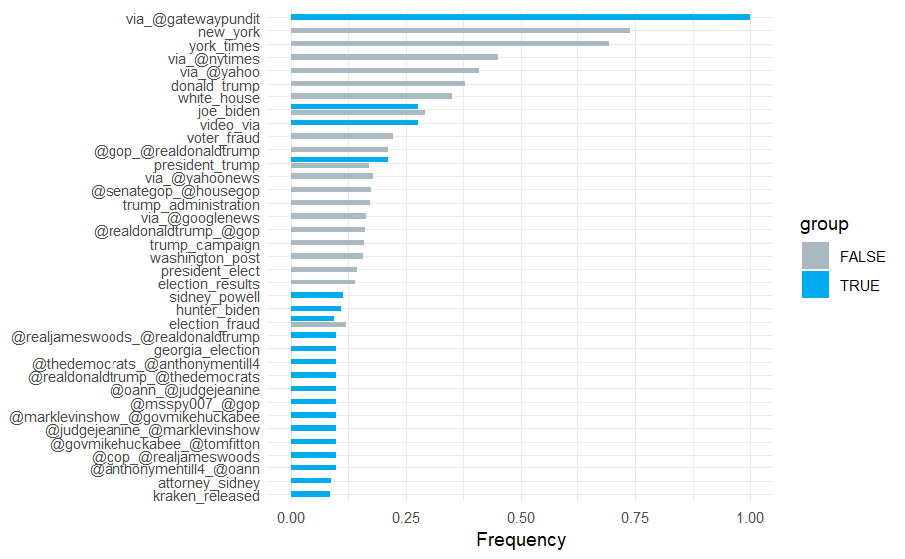
Exploratory Data Analysis
Bi-Gram Analysis

Slide 11
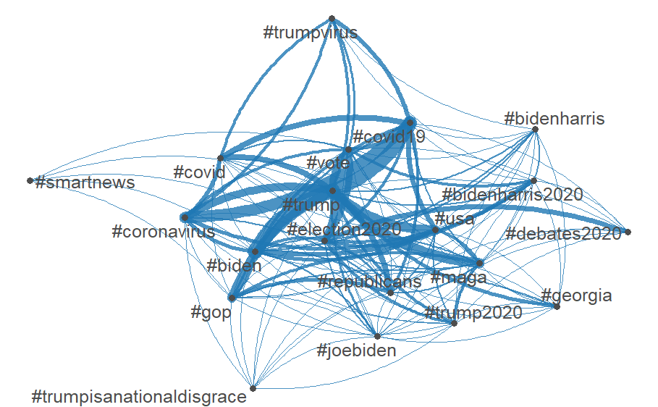
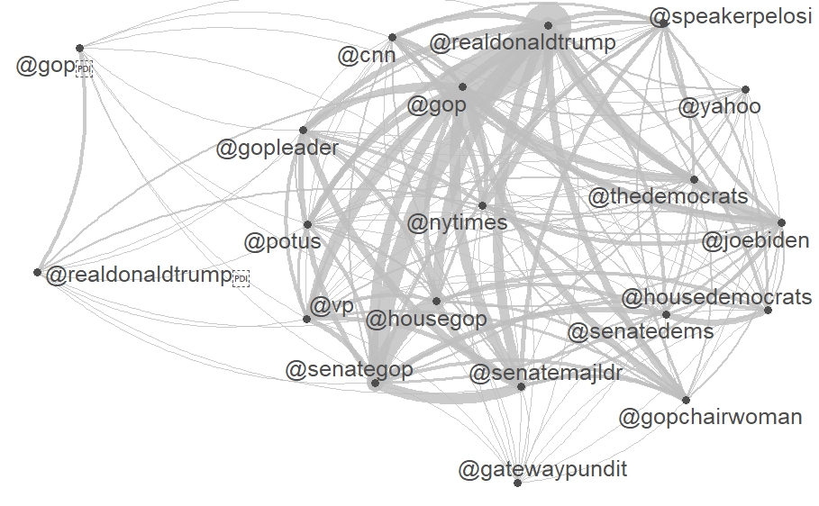
Exploratory Data Analysis
Hashtags
Mentions

Slide 12
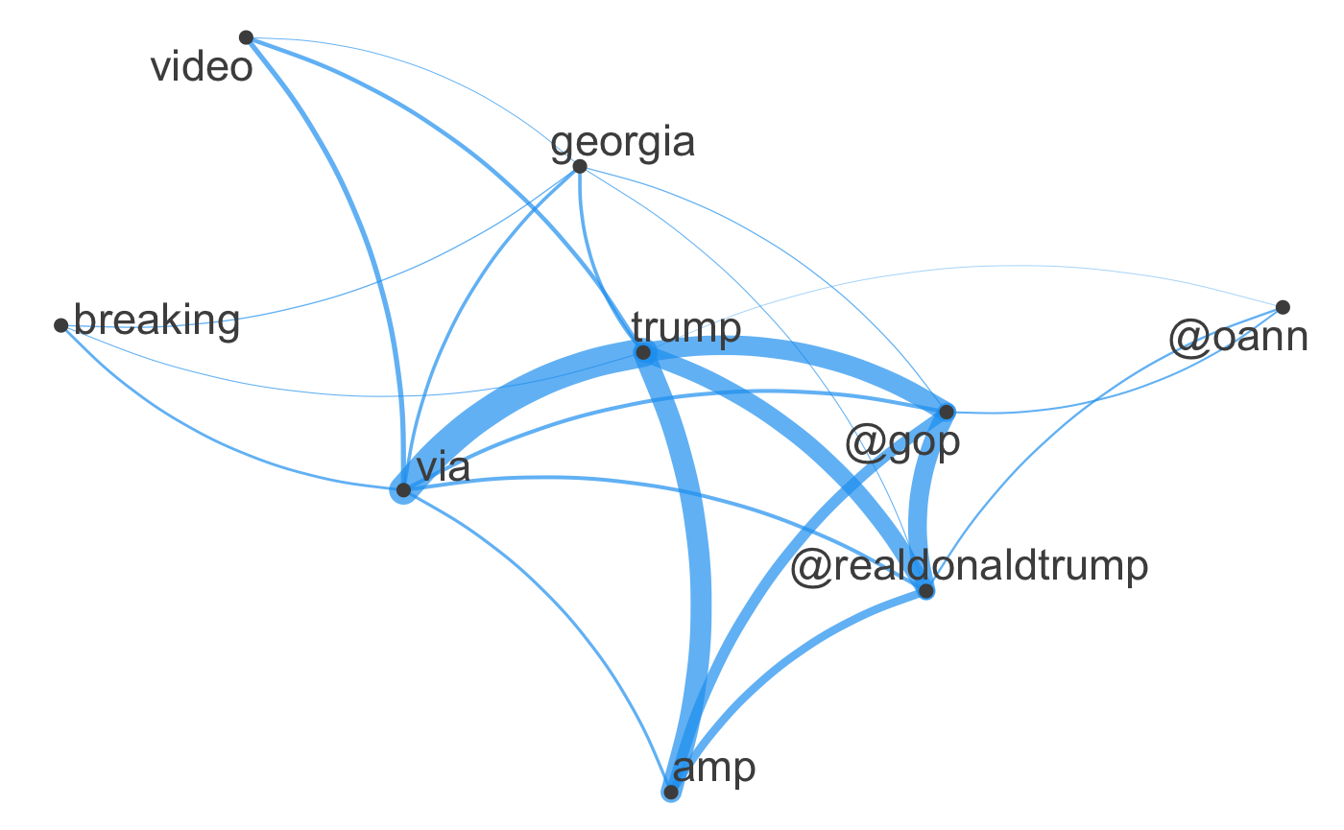
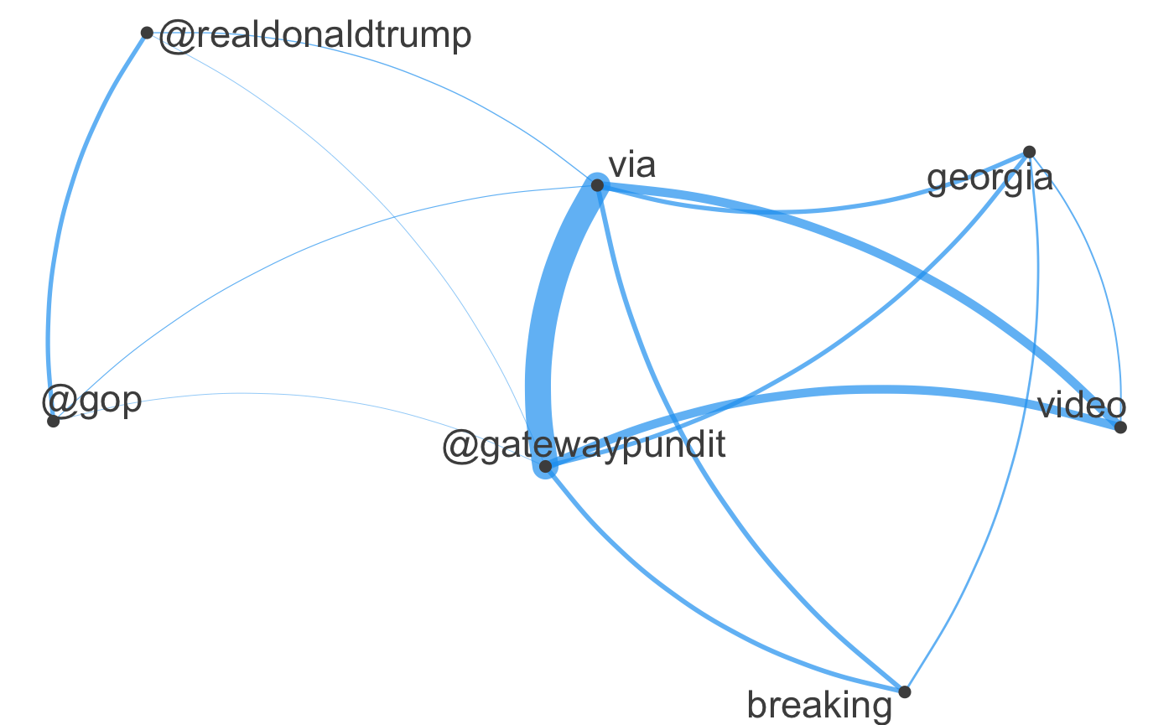
Exploratory Data Analysis
QUESTIONABLE
DOMAIN
TRUE
CO-OCCURENCE NETWORK
Trump
CO-OCCURENCE NETWORK - @gatewaypundit

Slide 13
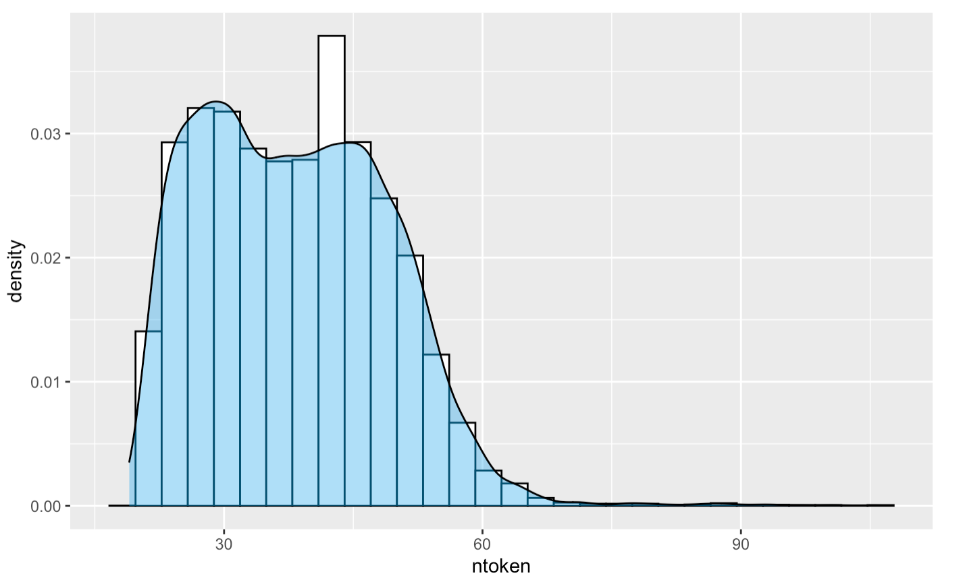
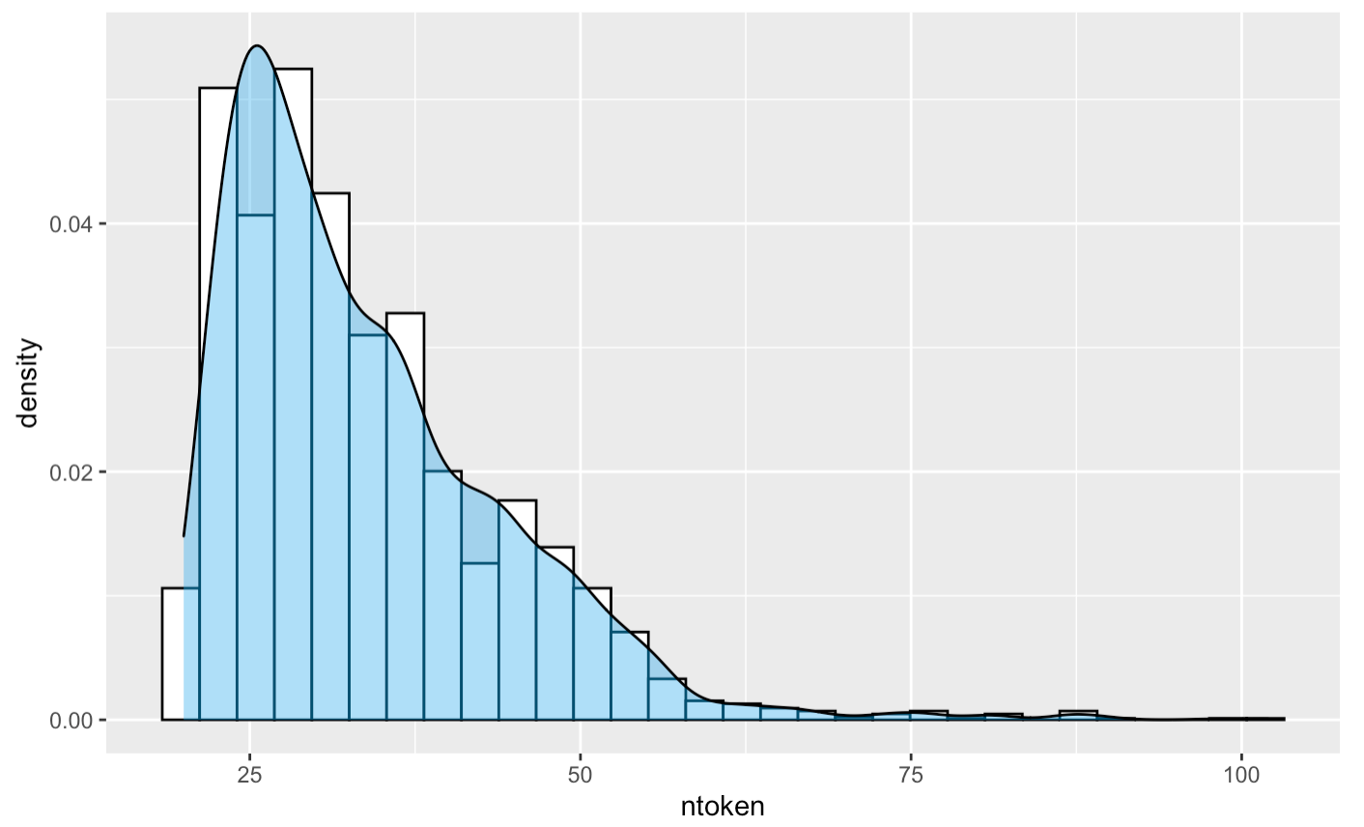
Exploratory Data Analysis
Distribution of Number of tokens by Questionable Domain
FALSE
TRUE

Slide 14
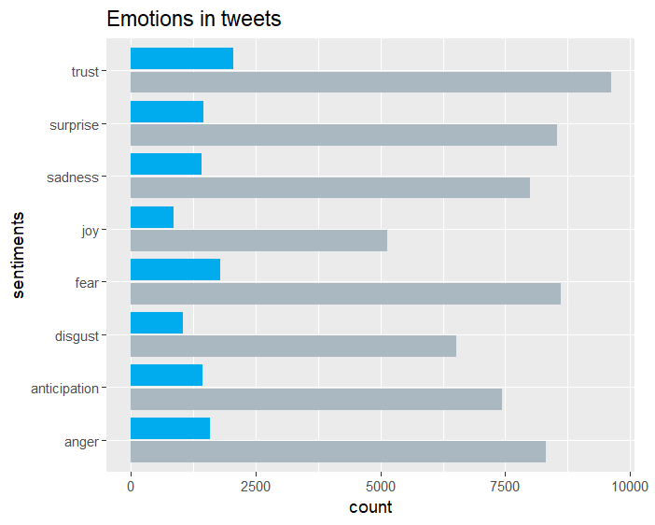
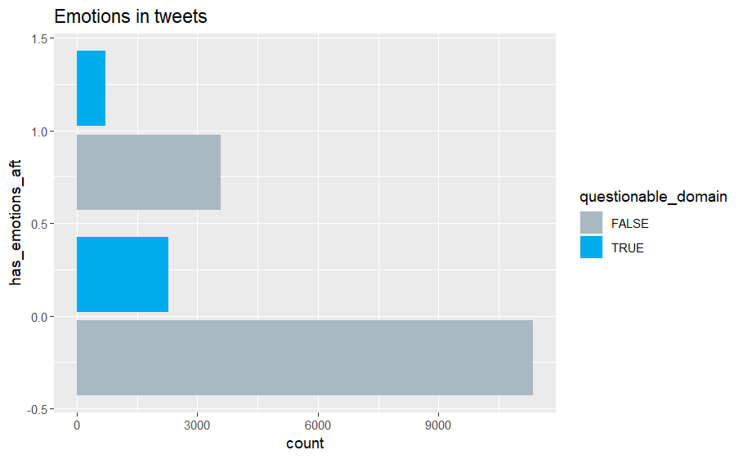
Exploratory Data Analysis
Sentiment Analysis - Syhusete
ANTICIPATION
FEAR
TRUST

Slide 15
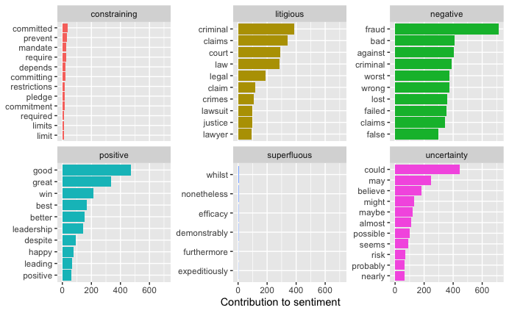
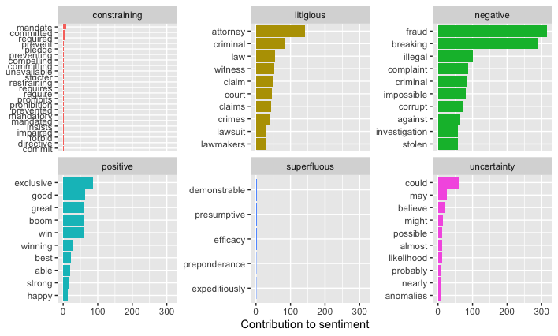
Exploratory Data Analysis
Sentiment Analysis - Loughran Lexicon
FALSE
TRUE

Slide 16
Models
Machine Learning Models
Data Balancing Technique
Logistic Regression
k Nearest Neighbors (11-NN)
Boost Trees (XGBoost)
Naive Bayes
Random OverSampling Examples - Rose
Random Under-sampling
Random Over and Under-sampling
Under and Over-sampling with Smote

Slide 17
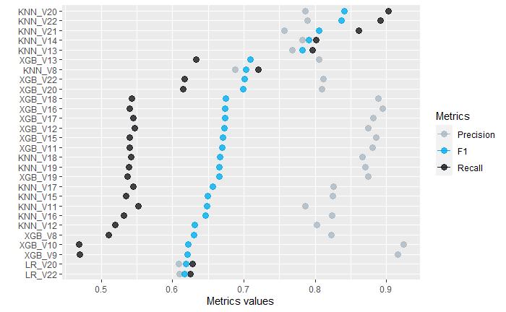
Models

Slide 18


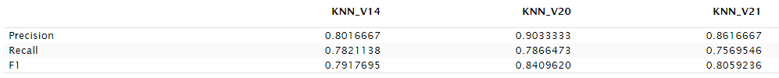
Models
KNN_BL
0.5016181
0.2583333
0.3410341
via_gatewaypundit, uppercase_count, mentions, user_friends_count, user_followers_count, user_favourites_count, new_york, trump, mention_count, donald, hunter_biden, gop, favorite_count, hashtag, retweet_count, sentiment_size, user_verified
user_friends_count, user_followers_count, user_favourites_count, user_verified, retweet_count, contains_profanity, mentions, urls, hashtag, mention_count, hashtag_count, url_count, gop, trump, realdonaldtrump, amp, via_gatewaypundit +new_york, via_nytimes, via_yahoo, donald_trump, white_house, gop_realdonaldtrump, voter_fraud, via_yahoonews, senategop_housegop, via_googlenews, trump_administration, trump_campaign +
president_elect, washington_post, video_via,hunter_biden, exclusive, breaking, uppercase_count, has_emotions_aft, has_emotions_at, has_emotions_af, has_emotions_as, sentiment_size, tweets_dup, bag_of_words, exc_count, exp_count, upper_word_count, number_count, nsentence, ntoken
via_gatewaypundit, uppercase_count, mentions, user_friends_count, user_followers_count, user_favourites_count, new_york, trump, number_count, exp_count, ntoken, gop, mention_count, hunter_biden, bag_of_words, exc_count, nsentence, retweet_count, video, sentiment_size
user_friends_count, user_followers_count, user_favourites_count, user_verified, retweet_count, contains_profanity

Slide 19

Conclusion

Slide 20
References
Przybyła, P., "Detecting Bot Accounts on Twitter by Measuring Message Predictability" (2019)
Romo, J. M., Araujo, L. , "Detecting malicious tweets in trending topics using a statistical analysis of language" (2012)
SreeJagadeesh Malla, P. J. A. Alphonse , "Fake or real news about COVID-19? Pretrained transformer model to detect potential misleading news" (2022)
Bernardes, V., "Linguistic and Emotion-based Identification of Tweets with Fake News: A Case Study" (2021)
Lunardon, N., G. Menardi, and Nicola Torelli. "R package'ROSE': Random Over-Sampling Examples." (2013).

