Slide 1

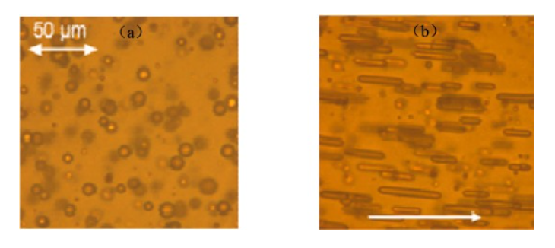
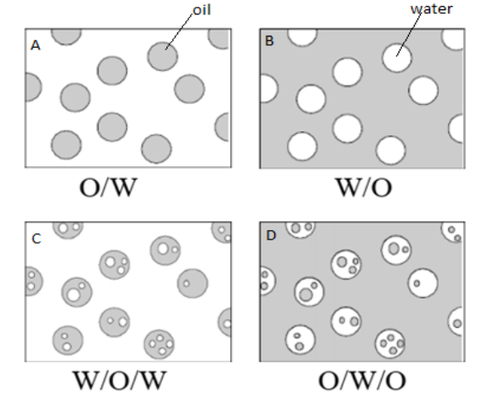
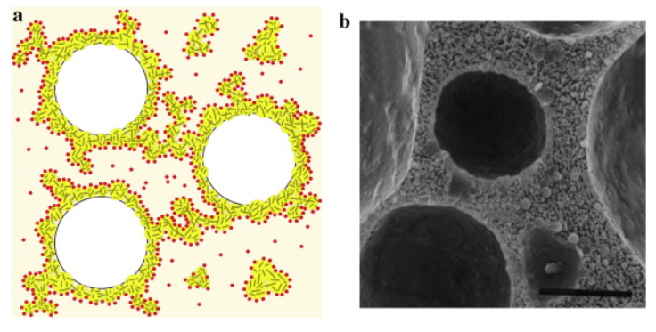
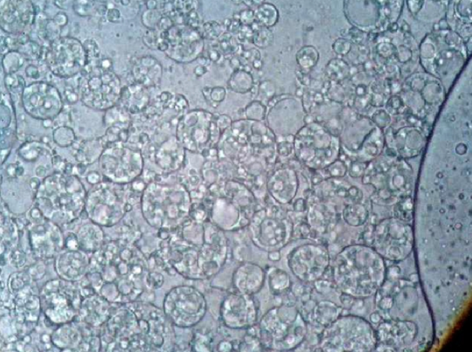
1 / 7
What is the Emulsion?
Simple emulsion
Petroleum Emulsion (W/O)
Zhai et al. (2023)
Multiple emulsion
Abed et al. (2019)
Whipped Cream (O/W)
Rual et al. (2016)
-Petroleum Industry
W/O, O/W(rare)
-Food Industry
O/W, Multiple Emulsion
-Cosmetic Industry
Multiple Emulsion
Cosmetic Multiple Emulsion (W/O/W)
Mahmood et al. (2013)

Slide 2
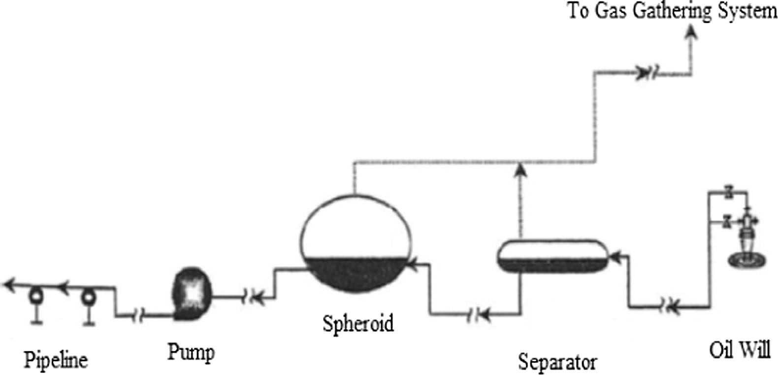
2 / 7
Emulsion (W/O)’s impact on the Petroleum Industry
1) The retention time in the separator is extended to three times pure oil.
Demulsification
Drops the volume fraction below 1%
Fink (2015)
2) The escalation in corrosion rate and scaling (due to the salt content in the formation of water).
3) The pressure drop in flowlines can be up 8 times higher than pure oil.
3
2
1
Upstream equipment for crude oil production
Wang (2005)
Droplet volumetric fraction of emulsion is crucial in various industries.
How to in-line estimate the droplet volumetric fraction?
-Economic Cost
-Time Cost
-Efficiency

Slide 3
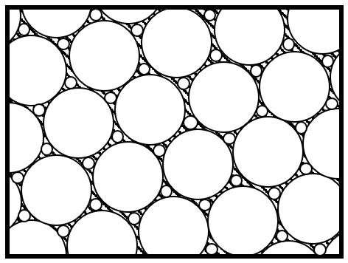
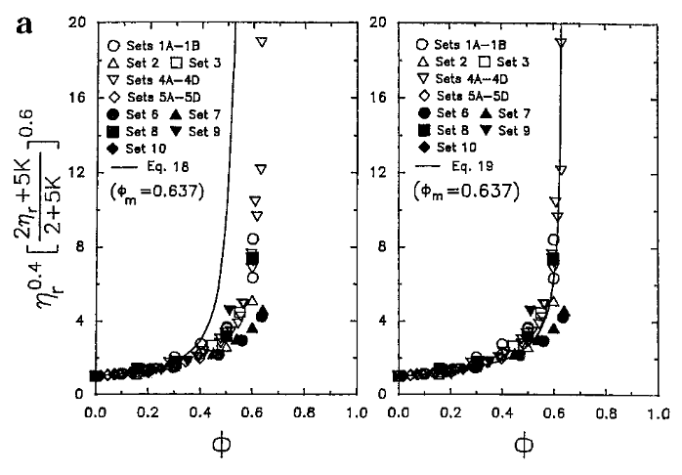
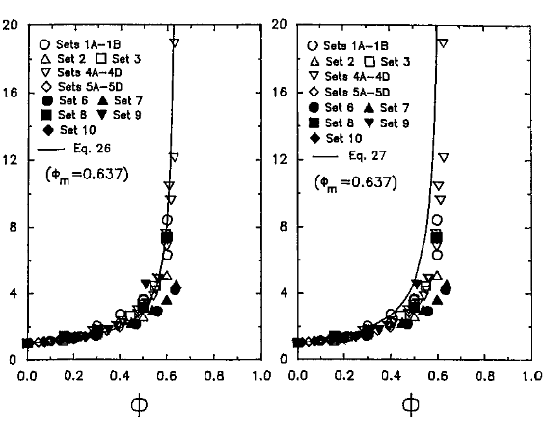
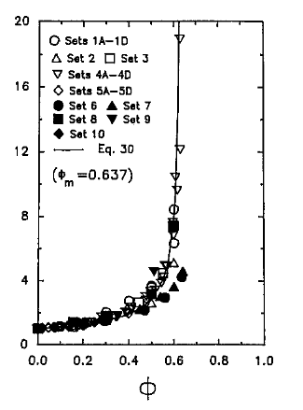
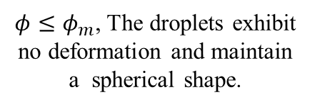
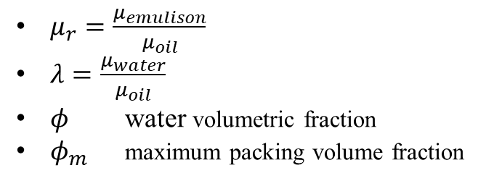
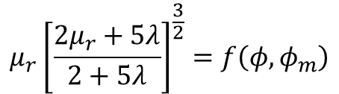

3 / 7
Two-parameter Viscosity Model of Emulsion
*Particle Suspension
$$μ_{r}=f\left(φ,φ_{m}\right)$$
$$μ_{r}{\left[\frac{2μ_{r}+5λ}{2+5λ}\right]}^{\frac{3}{2}}=f\left(φ,φ_{m}\right)$$
Two-Parameter Equations
, Pal (2001)
-Mooney Equation [1]
-Krieger and Dougherty Equation [2]
$μ_{r}=\frac{μ_{emulison}}{μ_{oil}}$
$λ=\frac{μ_{water}}{μ_{oil}}$
$φ$ water volumetric fraction
$φ_{m}$ maximum packing volume fraction
-Eilers Equation [3]
-Roscoe Equation [4]
$φ≤φ_{m}$, The droplets exhibit no deformation and maintain a spherical shape.
-Chong et al. Equation [5]
[1]
[2]
[3]
[4]
[5]
Comparison between the experimental data and the predictions of two-parameter model
Pal (2001)

Slide 4
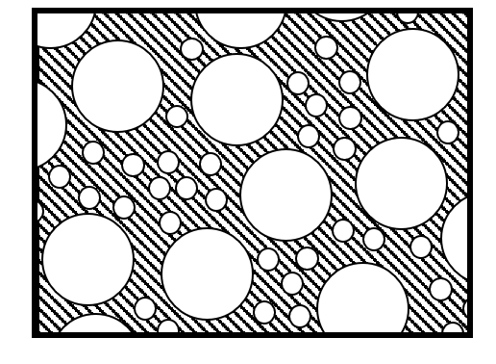
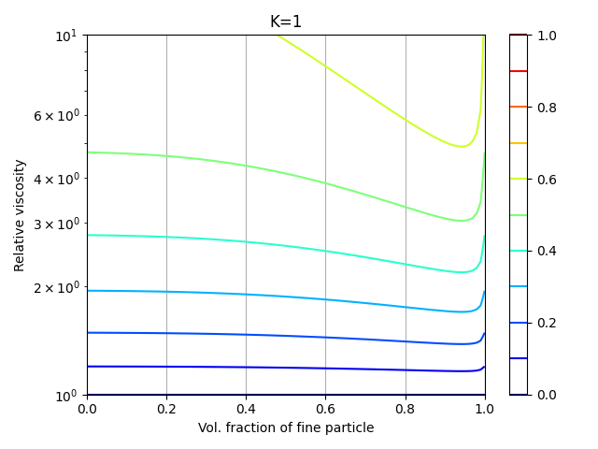
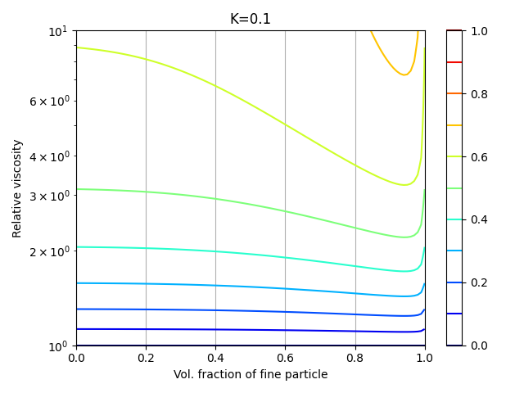
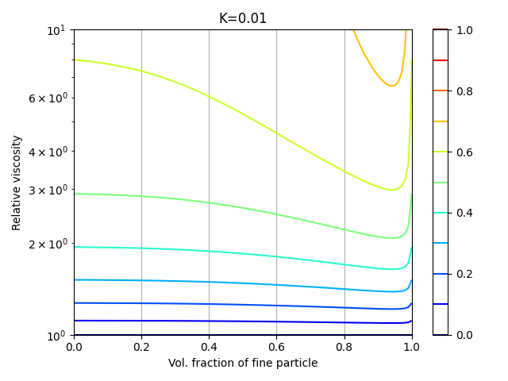
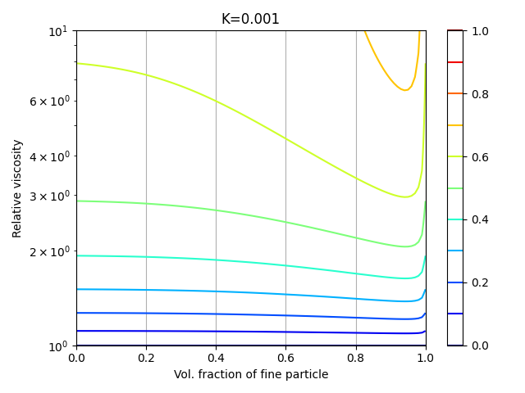


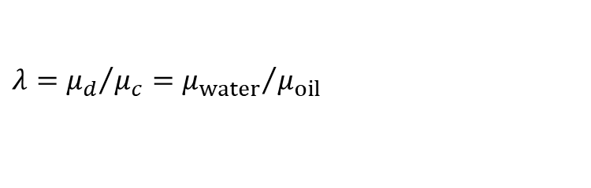


4 / 7
Assume a bimodal emulsion
The droplets size ratio between large and small particles is 5:1
$$λ={μ_{d}}/{μ_{c}={μ_{water}}/{μ_{oil}}}$$
"Bimodal emulsion" indicates the presence of only two distinct droplet sizes in emulsion.
$$λ=1$$
$$λ=0.1$$
40%
40%
$$λ=0.01$$
$$λ=0.001$$
40%
40%

Slide 5

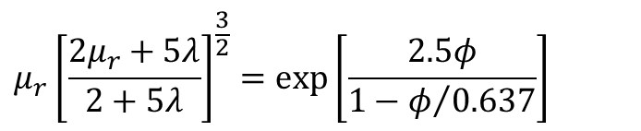
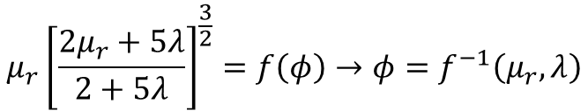
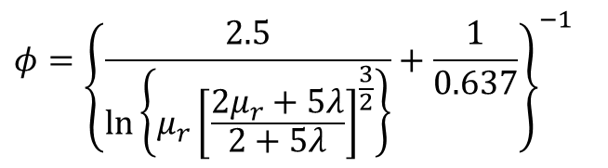
5 / 7
Assume a monodisperse emulsion.
$$D=const→φ_{m}=φ_{m}^{0}=0.637$$
$$μ_{r}{\left[\frac{2μ_{r}+5λ}{2+5λ}\right]}^{\frac{3}{2}}=f\left(φ\right)→φ=f^{−1}\left(μ_{r}, λ\right)$$
Derived by Mooney Equation
$$μ_{r}{\left[\frac{2μ_{r}+5λ}{2+5λ}\right]}^{\frac{3}{2}}=exp\left[\frac{2.5φ}{1−φ/{0.637}}\right]$$
$$φ={\left\{\frac{2.5}{ln\left\{μ_{r}{\left[\frac{2μ_{r}+5λ}{2+5λ}\right]}^{\frac{3}{2}}\right\}}+\frac{1}{0.637}\right\}}^{−1}$$

Slide 6
6 / 7

Slide 7
我要做什么
背景，乳液的行业，测量水有什么好处
我如何发现模型的
首先介绍粘度模型
然后假设为双峰乳液
然后发现跟液滴分布没什么关系
然后推出基本关系式子
最后只要通过实验验证这个式子可以用就行了
然而模型并不好用，那我们就自己拟合
横轴用体积率，纵轴用归一化粘度

Slide 8
乳液是什么
石油工程中体积率有什么用
粘度模型
假设过程，四张图
模型推导过程，以及实验结果
总结
我的课题是什么，从uvp的流场信息计算出粘度信息，然后再计算出体积率
确定了uvp可以用于乳化液
确定估算体积率的方案
实验数据拟合出模型（y轴用左式的项来做）
在改变温度核Ca数的情况是什么，寻找模型
管道实验
大于40%的情况？

Slide 9
The formation of high pressure drops in flowlines.
The increase in pumping and transporting cost of the water–oil mixture through the pumps and pipes.
The destruction of pipeline and production amenities (due to two-phase flow and presence of chloride ions in the aqueous phase).
The escalation in corrosion rate and scaling (due to the salt content in the formation of water).
The tripping of separation equipment in gas/oil separating plants. (GOSPs) which limit the export quality of crude oil.
The lowering of the oil API gravity.
The destroying of downstream processing plant catalysts.
The adversity involved to improve the viscosity of the crude oil (due to small dispersed water drops).
The cost of pumping or transporting the water through pipeline or by tanker, respectively.
•The corrosion of pumps, pipes, production facilities, and downstream distillation columns (due to the existence of chloride ions in aqueous phase).
•The necessity for installation of supplementary equipment to produce export-quality crude oil.
•The poisoning of downstream refinery catalysts.
•The problems pertaining to improved crude oil viscosity due to small dispersed water drops in the crude oil.

Slide 10
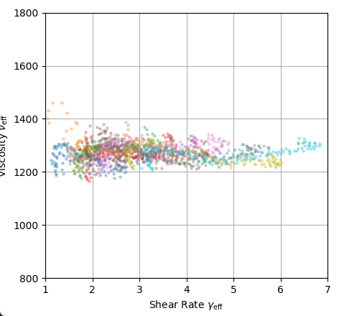
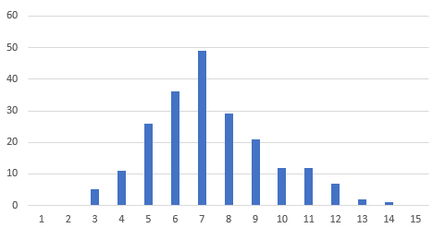
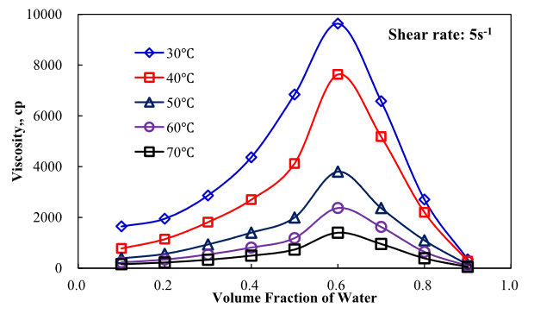
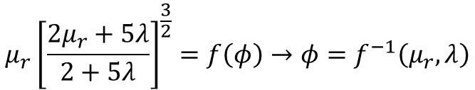

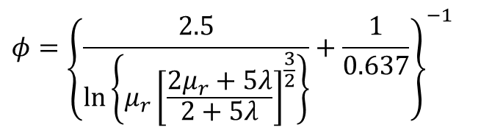




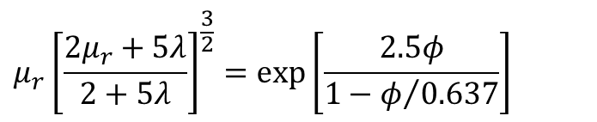
Assume a monodisperse emulsion.
$φ=0.15$, $φ_{m}=0.637$
$$D=const→φ_{m}=φ_{m}^{0}=0.637$$
$μ_{r}=1.18$ (theoretical value)
$$μ_{r}{\left[\frac{2μ_{r}+5λ}{2+5λ}\right]}^{\frac{3}{2}}=f\left(φ\right)→φ=f^{−1}\left(μ_{r}, λ\right)$$
Derived by Mooney Equation
$$μ_{r}{\left[\frac{2μ_{r}+5λ}{2+5λ}\right]}^{\frac{3}{2}}=exp\left[\frac{2.5φ}{1−φ/{0.637}}\right]$$
$$φ={\left\{\frac{2.5}{ln\left\{μ_{r}{\left[\frac{2μ_{r}+5λ}{2+5λ}\right]}^{\frac{3}{2}}\right\}}+\frac{1}{0.637}\right\}}^{−1}$$
real distribution
Conditions
$$N_{Ca}≪1$$
$$φ<0.4$$
Temperature? Emulsifier?
Shi et al. (2018)
Zhai et al. (2023)

Slide 11
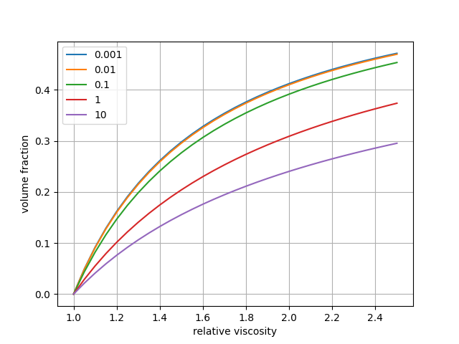
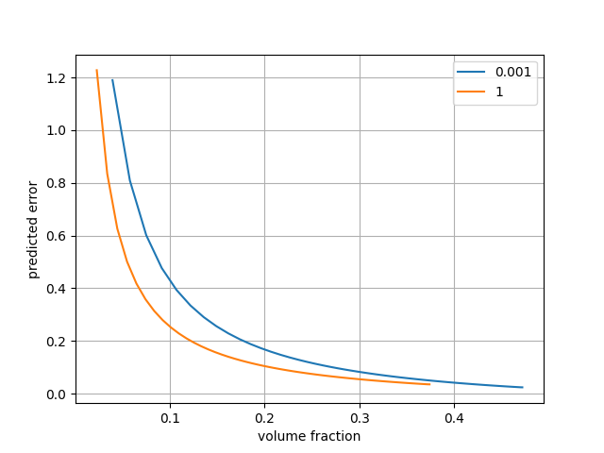
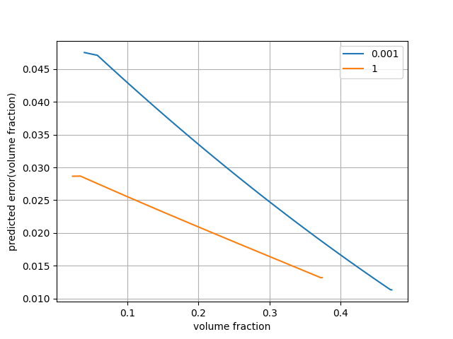
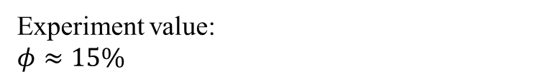
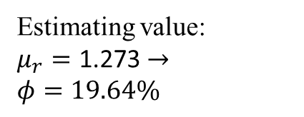
If USR's error is ±5%
Estimating value:
$$μ_{r}=\text{1}\text{.}\text{273}→$$
$$φ=19.64\%$$
Experiment value:
$$φ≈15\%$$

