Slide 1


An In-line Estimation Method of Volume Fraction Based on Simple Emulsion Viscosity Model
シンプル・エマルション粘度モテルに基づく体積率インライン推定法
Weniqng Zheng
Laboratory for flow control
Hokkaido University

Slide 2
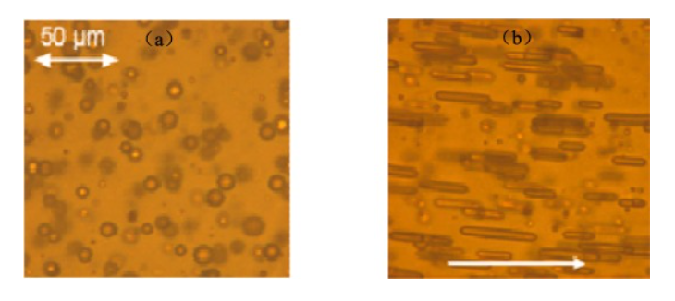
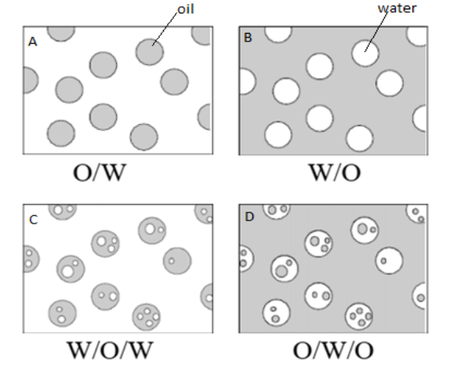
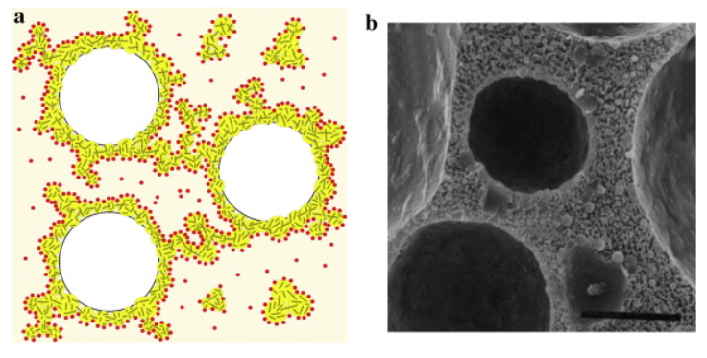
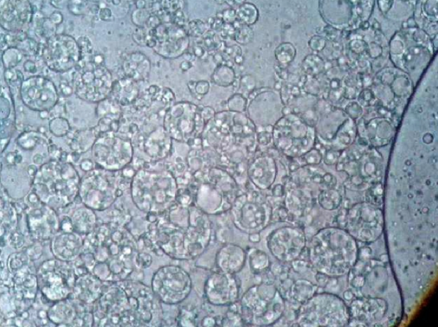
1 / 7
What is the Emulsion?
Simple
emulsion
Petroleum Emulsion (W/O)
Zhai et al. (2023)
Multiple
emulsion
Abed et al. (2019)
Whipped Cream (O/W)
Rual et al. (2016)
-Petroleum Industry
W/O, O/W(rare)
-Food Industry
O/W, Multiple Emulsion
-Cosmetic Industry
Multiple Emulsion
Cosmetic Multiple Emulsion (W/O/W)
Mahmood et al. (2013)

Slide 3
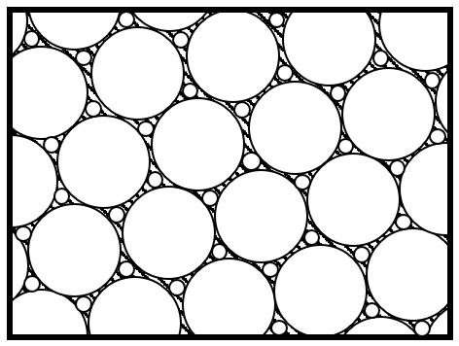
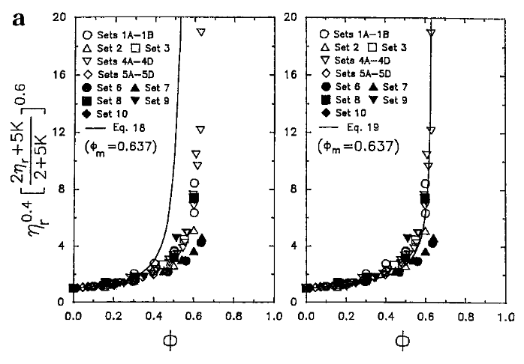
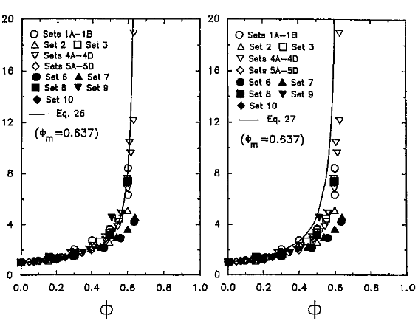
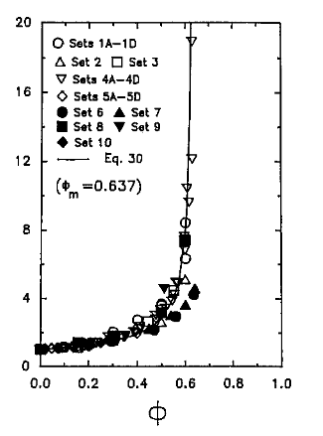
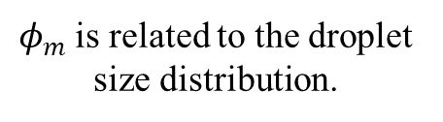
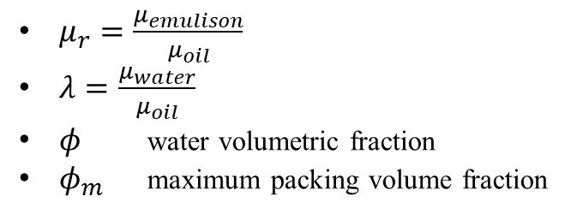
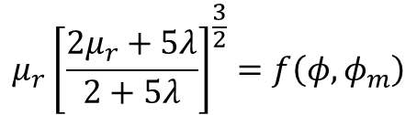

2 / 7
Two-parameter Model of Simple Emulsion
*Particle Suspension
$$μ_{r}=f\left(φ,φ_{m}\right)$$
$$μ_{r}{\left[\frac{2μ_{r}+5λ}{2+5λ}\right]}^{\frac{3}{2}}=f\left(φ,φ_{m}\right)$$
Two-Parameter Equations
, Pal (2001)
-Mooney Equation [1]
$μ_{r}=\frac{μ_{emulison}}{μ_{oil}}$
$λ=\frac{μ_{water}}{μ_{oil}}$
$φ$ water volumetric fraction
$φ_{m}$ maximum packing volume fraction
-Krieger and Dougherty Equation [2]
-Eilers Equation [3]
-Roscoe Equation [4]
$φ_{m}$ is related to the droplet size distribution.
-Chong et al. Equation [5]
[1]
[2]
[3]
[4]
[5]
Comparison between the experimental data and the predictions of two-parameter emulsion model (Pal, 2001)

Slide 4
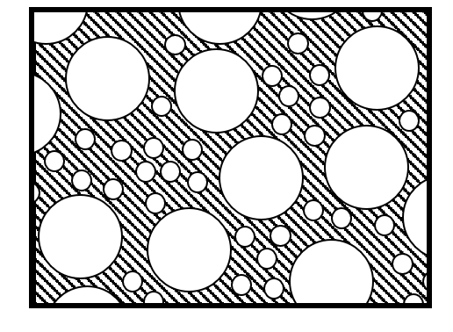
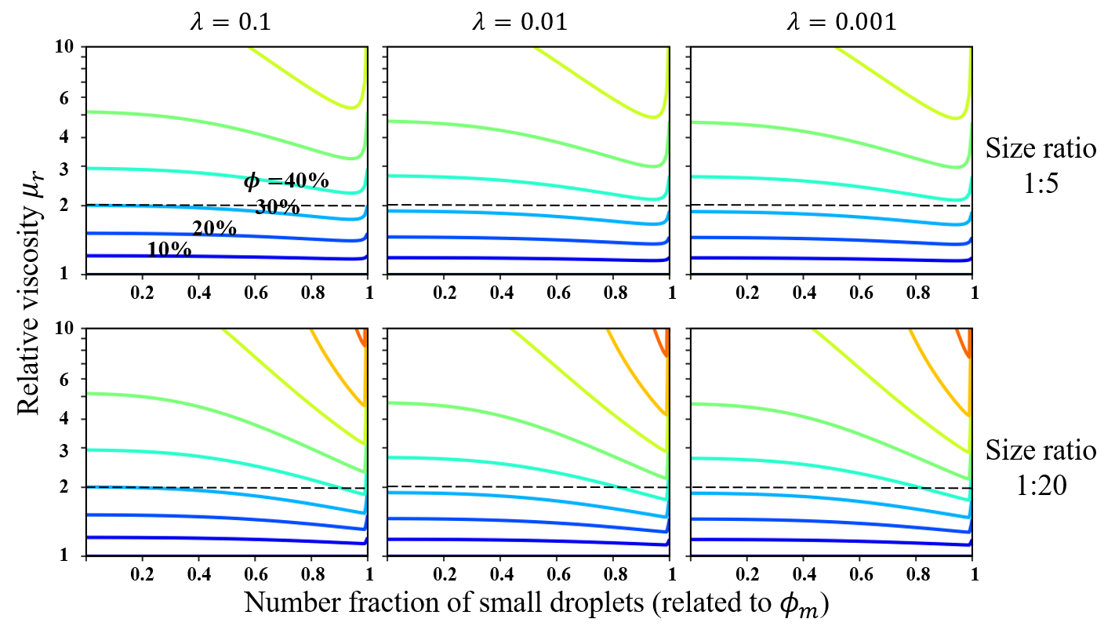
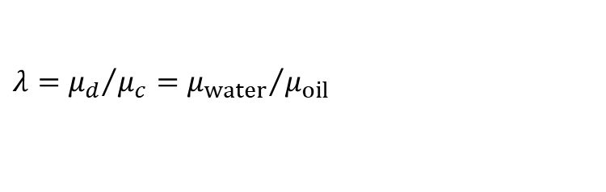
3 / 7
Assuming the presence of only two droplet sizes in emulsion.
$$λ={μ_{d}}/{μ_{c}={μ_{water}}/{μ_{oil}}}$$
The relationship between volume faction, droplet size distribution, and relative viscosity predicted by model.

Slide 5
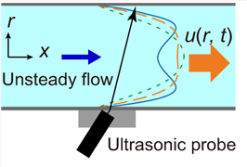

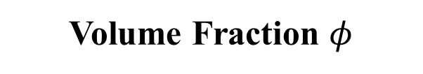
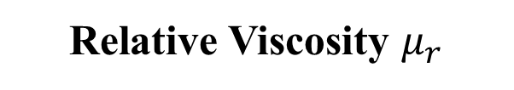

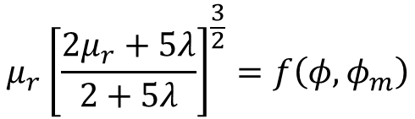
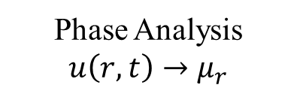
4 / 7
Setting the droplet size to be a constant.
$$D=const→φ_{m}=φ_{m}^{0}=0.637$$
$$μ_{r}{\left[\frac{2μ_{r}+5λ}{2+5λ}\right]}^{\frac{3}{2}}=f\left(φ,φ_{m}\right)$$
$$φ=f^{−1}\left(μ_{r}, λ\right)$$
Unsteady Flow Information
ultrasonic velocity profiling (in-line)
Phase Analysis
$u\left(r,t\right)→μ_{r}$
Relative Viscosity $μ_{r}$
Tasaka et al. (2021)
Volume Fraction $φ$
Viscosity model

Slide 6
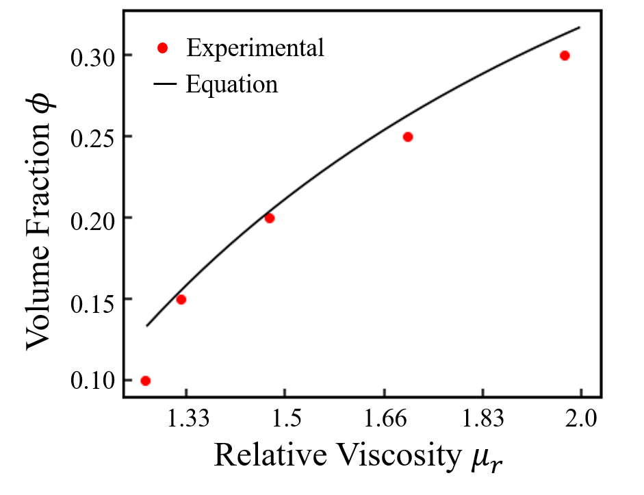
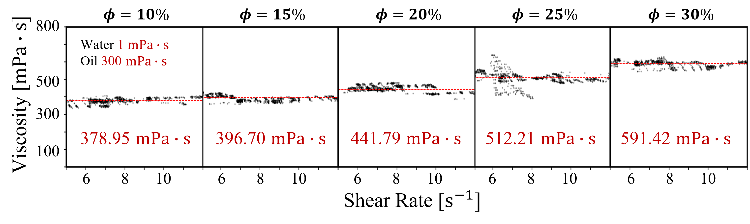
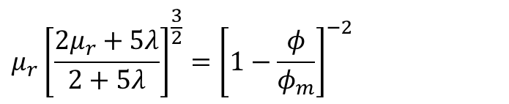

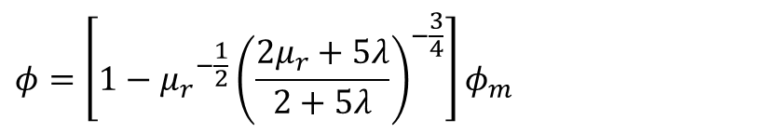
5 / 7
Comparison between the experimental data and the predictions
Derived model by Roscoe Equation
$$μ_{r}{\left[\frac{2μ_{r}+5λ}{2+5λ}\right]}^{\frac{3}{2}}={\left[1−\frac{φ}{φ_{m}}\right]}^{−2}$$
$$φ=\left[1−{μ_{r}}^{−\frac{1}{2}}{\left(\frac{2μ_{r}+5λ}{2+5λ}\right)}^{−\frac{3}{4}}\right]φ_{m}$$
$$φ_{m}=0.637$$
Experimental data of emulsion viscosity by USR.

Slide 7



6 / 7
Summary
Working Conditions of method
Objective
In-line estimating the volume fraction by emulsion viscosity model.
$$N_{Ca}≪1$$
Viscosity
model
$$0.02<φ<φ_{m}$$
Simple emulsion
Finished Parts
Laminar flow
Rheometer
Flow information of emulsions can be obtained by ultrasound.
Volume fraction can be estimated by viscosity model under the conditions.
Experimental result
$$0.15<φ<0.30$$
Future Works
Confirming the precision of the model
Expanding the scope of the method
Conducting pipeline experiment

Slide 10
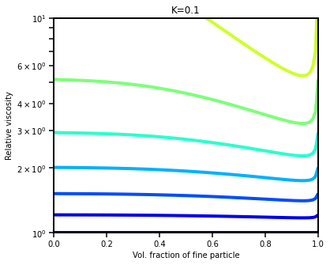
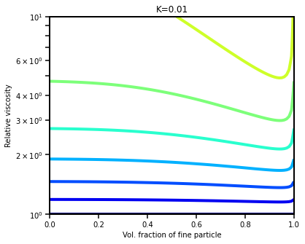

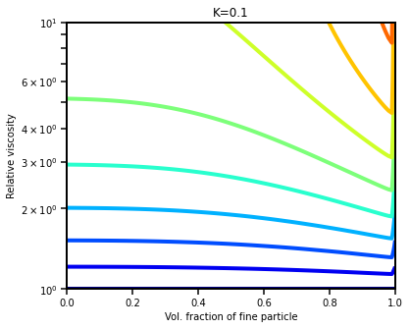
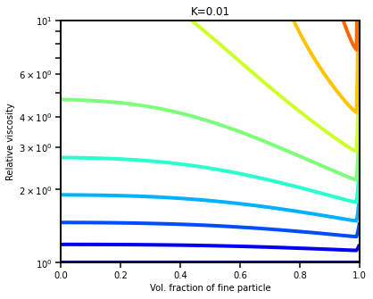
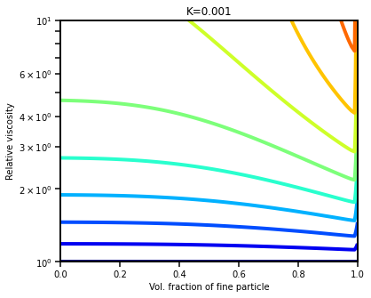

Slide 11
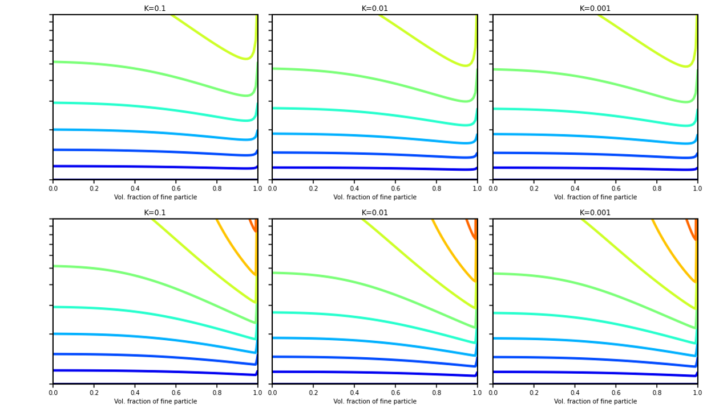






$$λ=0.1$$
$$λ=0.01$$
$$λ=0.001$$
10
6
4
Size ratio
1:5
3
$φ=$40%
2
30%
20%
10%
1
Relative viscosity $μ_{r}$
1
1
1
0.2
0.4
0.6
0.8
0.2
0.4
0.6
0.8
0.2
0.4
0.6
0.8
10
6
4
3
Size ratio
1:20
2
1
0.2
0.4
0.6
0.8
1
0.2
0.4
0.6
0.8
1
0.2
0.4
0.6
0.8
1
Number fraction of small droplets (related to $φ_{m}$)

Slide 12
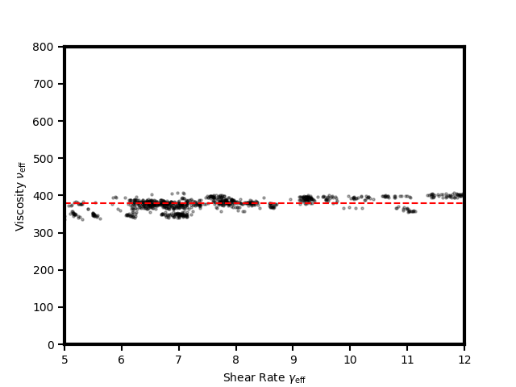
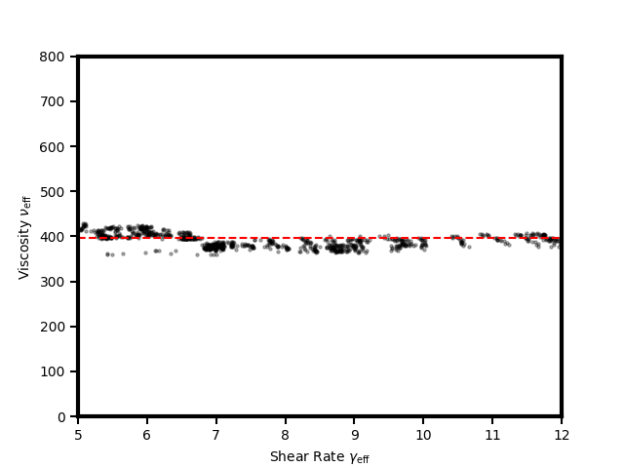
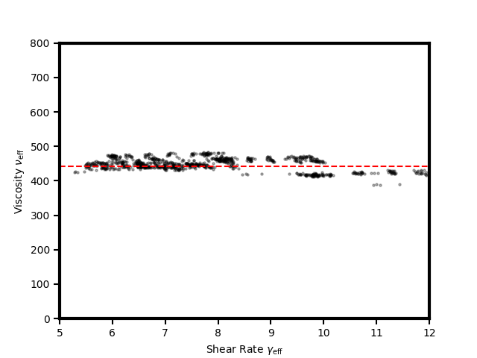
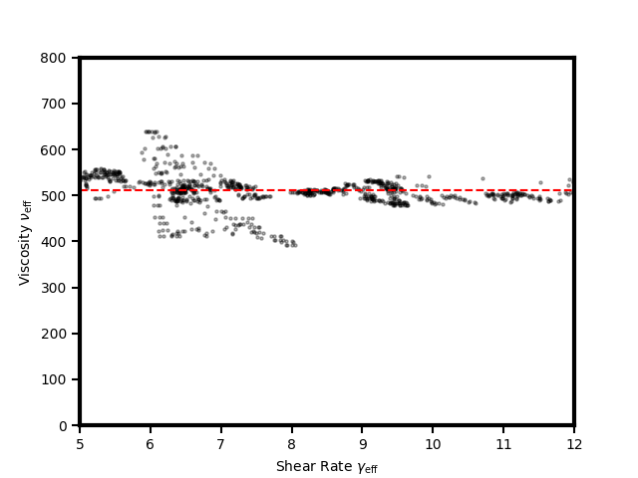
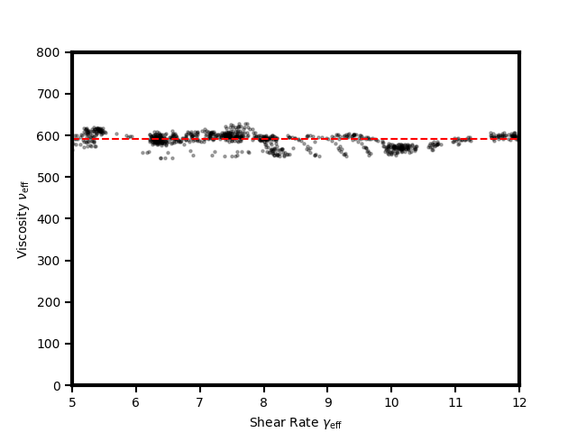
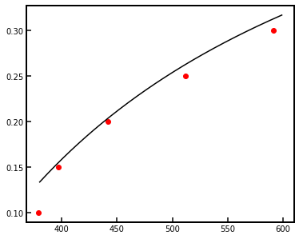

Slide 13
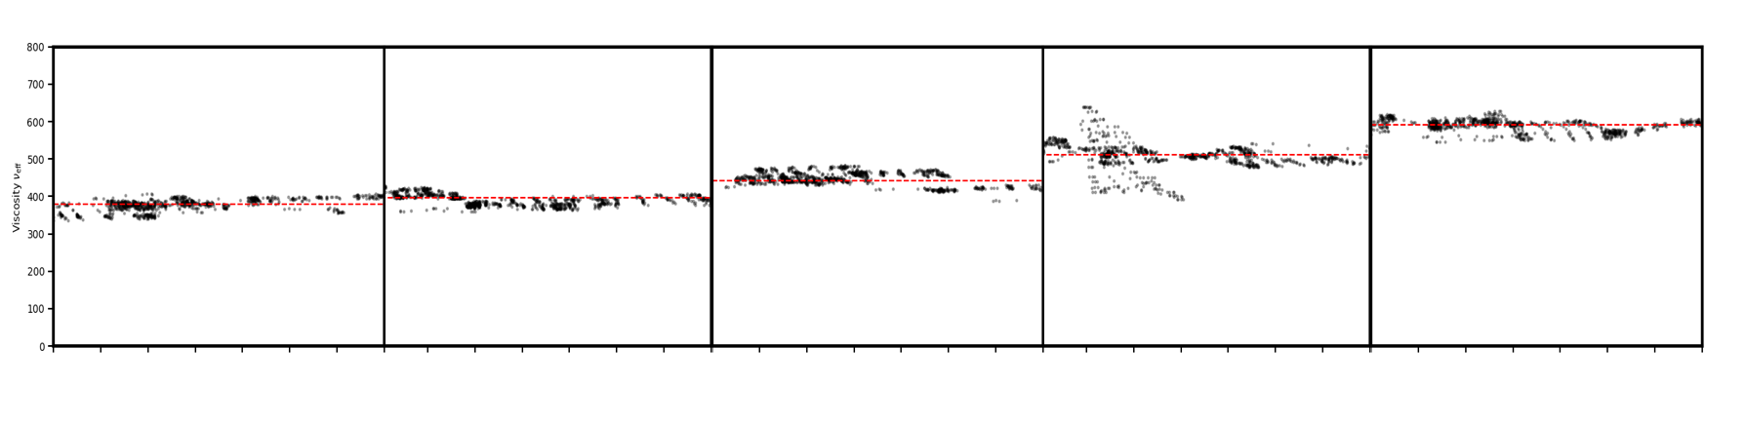













800
$$φ=10\%$$
$$φ=15\%$$
$$φ=20\%$$
$$φ=25\%$$
$$φ=30\%$$
Water 1 $mPa∙s$
Oil 300 $mPa∙s$
500
Viscosity [$mPa∙s]$
300
378.95 $mPa∙s$
396.70 $mPa∙s$
441.79 $mPa∙s$
512.21 $mPa∙s$
591.42 $mPa∙s$
100
6
8
10
6
8
10
6
8
10
6
8
10
6
8
10
Shear Rate [$s^{−1}]$

Slide 14
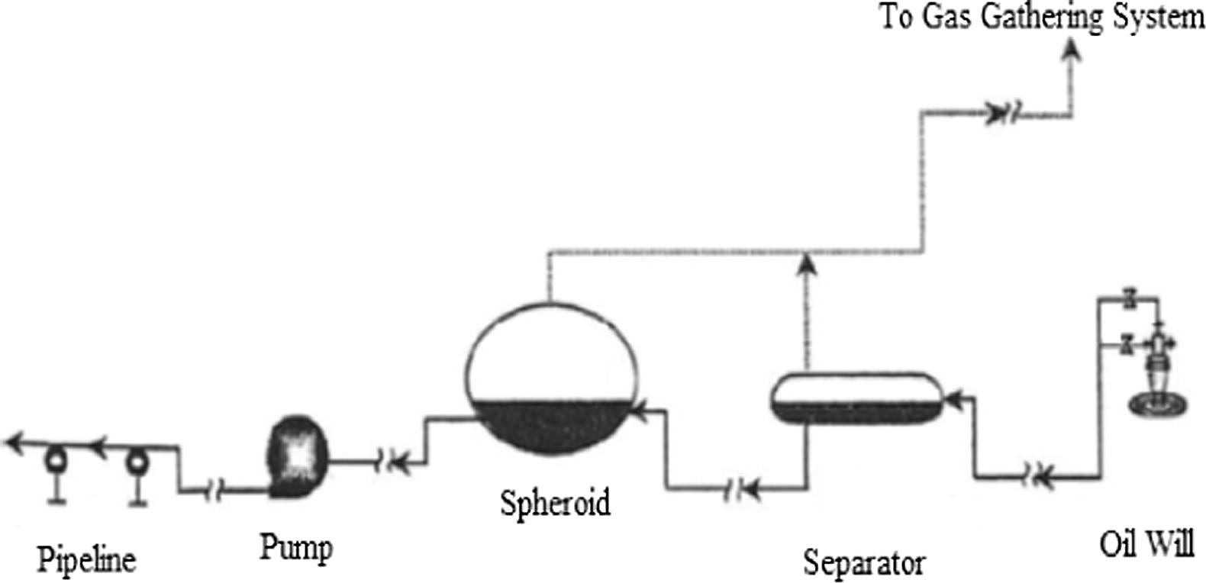
13 / 8
Emulsion (W/O)’s impact on the Petroleum Industry
1) The retention time up 3 times.
Demulsification
Hopes to drop the volume fraction below 1%
Fink (2015)
2) The increasing in corrosion rate and scaling (due to the salt content in the formation of water).
3
1
3) The pressure drop up 8 times.
2
Upstream equipment for crude oil production
Wang (2005)
-Economic Cost
-Time Cost
-Efficiency
How to in-line estimate the volume fraction?

Slide 15
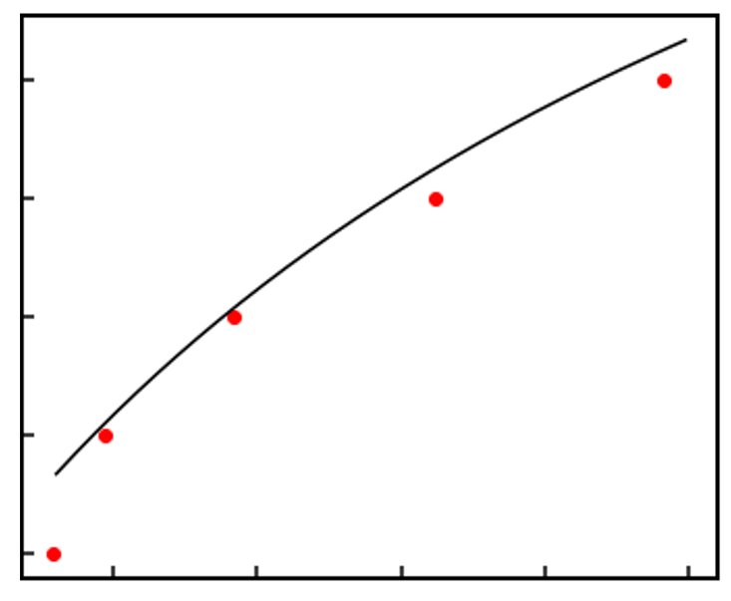
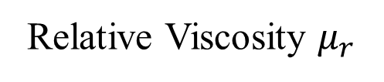
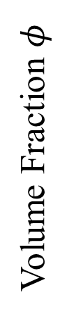
0.30
Experimental
Equation
0.25
Volume Fraction $φ$
0.20
0.15
0.10
1.33
1.5
1.66
1.83
2.0
Relative Viscosity $μ_{r}$

