Slide 1


An In-line Estimation Method of Volume Fraction Based on Emulsion Rheology

Slide 2
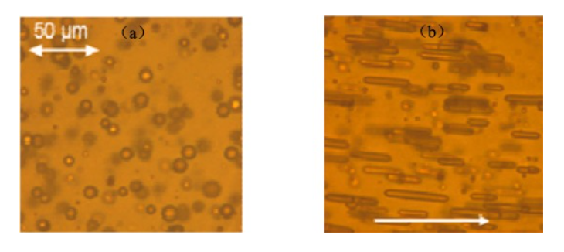
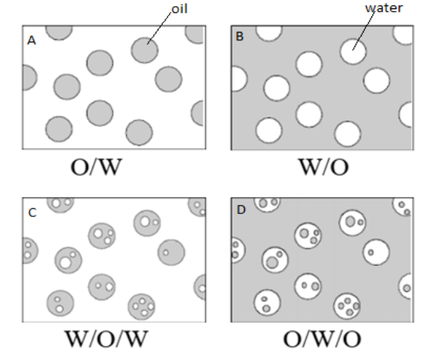
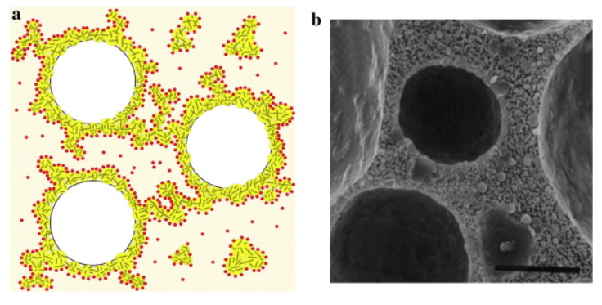
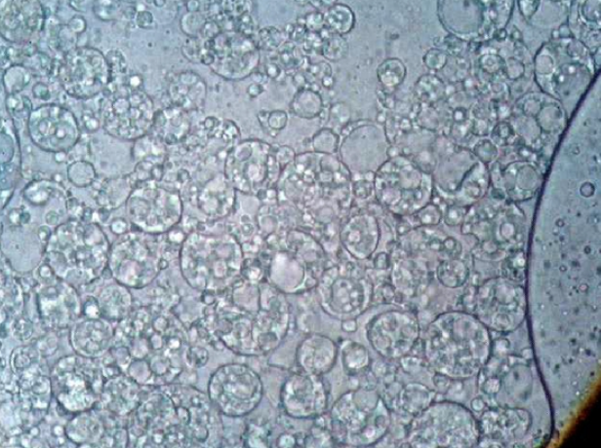
2 / 7
What is the Emulsion?
Simple emulsion
Petroleum Emulsion (W/O)
Zhai et al. (2023)
Multiple emulsion
Abed et al. (2019)
Whipped Cream (O/W)
Rual et al. (2016)
-Petroleum Industry
W/O, O/W(rare)
-Food Industry
O/W, Multiple Emulsion
-Cosmetic Industry
Multiple Emulsion
Cosmetic Multiple Emulsion (W/O/W)
Mahmood et al. (2013)

Slide 3
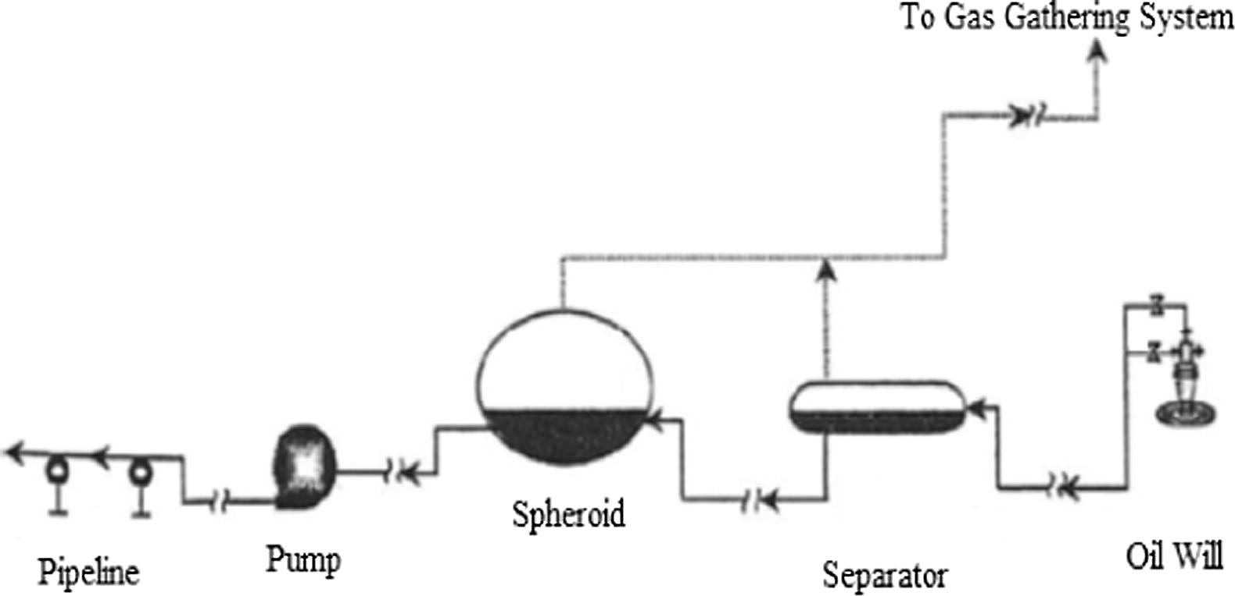
3 / 7
Emulsion (W/O)’s impact on the Petroleum Industry
1) The retention time in the separator is extended to 3 times than pure oil.
Demulsification
Hopes to drop the volume fraction below 1%
Fink (2015)
2) The increasing in corrosion rate and scaling (due to the salt content in the formation of water).
3) The pressure drop in flowlines can be up 8 times higher than pure oil.
3
2
1
Upstream equipment for crude oil production
Wang (2005)
Volume fraction of emulsion is crucial in various industries.
How to in-line estimation the volume fraction?
-Economic Cost
-Time Cost
-Efficiency

Slide 4
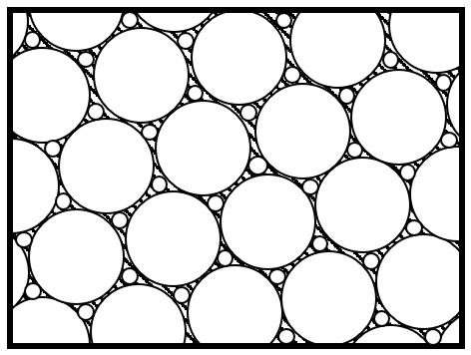
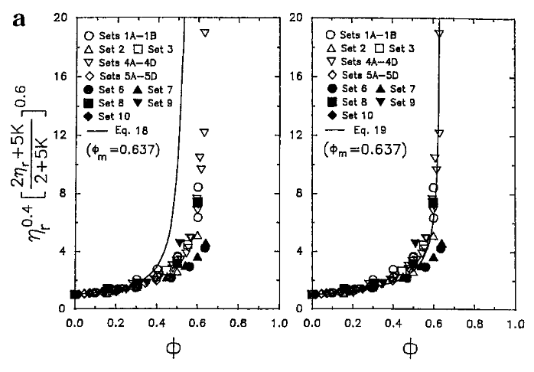
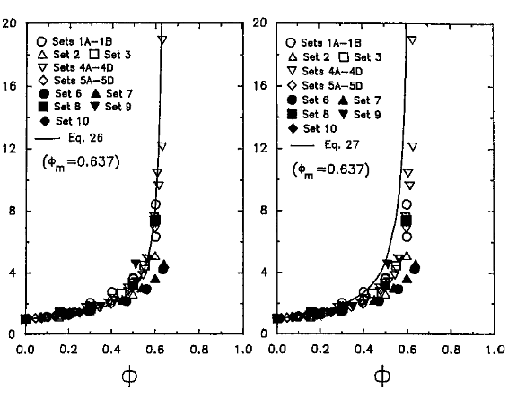
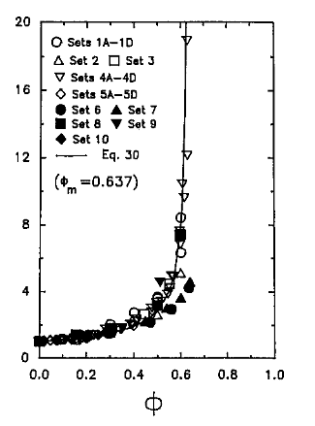

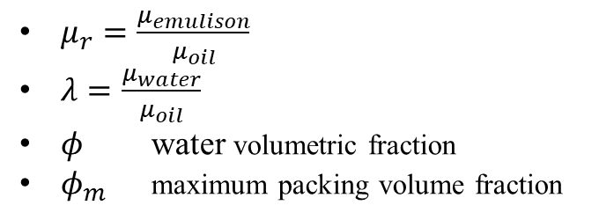
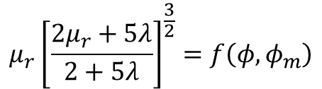

4 / 7
Two-parameter Viscosity Model of Emulsion
*Particle Suspension
$$μ_{r}=f\left(φ,φ_{m}\right)$$
$$μ_{r}{\left[\frac{2μ_{r}+5λ}{2+5λ}\right]}^{\frac{3}{2}}=f\left(φ,φ_{m}\right)$$
Two-Parameter Equations
, Pal (2001)
-Mooney Equation [1]
$μ_{r}=\frac{μ_{emulison}}{μ_{oil}}$
$λ=\frac{μ_{water}}{μ_{oil}}$
$φ$ water volumetric fraction
$φ_{m}$ maximum packing volume fraction
-Krieger and Dougherty Equation [2]
-Eilers Equation [3]
-Roscoe Equation [4]
$φ≤φ_{m}$, The droplets exhibit no deformation and maintain a spherical shape.
$φ_{m}$ is related to the droplet size distribution.
-Chong et al. Equation [5]
[1]
[2]
[3]
[4]
[5]
Comparison between the experimental data and the predictions of two-parameter model
Pal (2001)

Slide 5
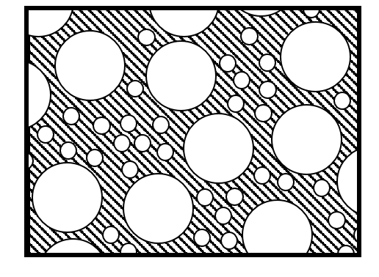
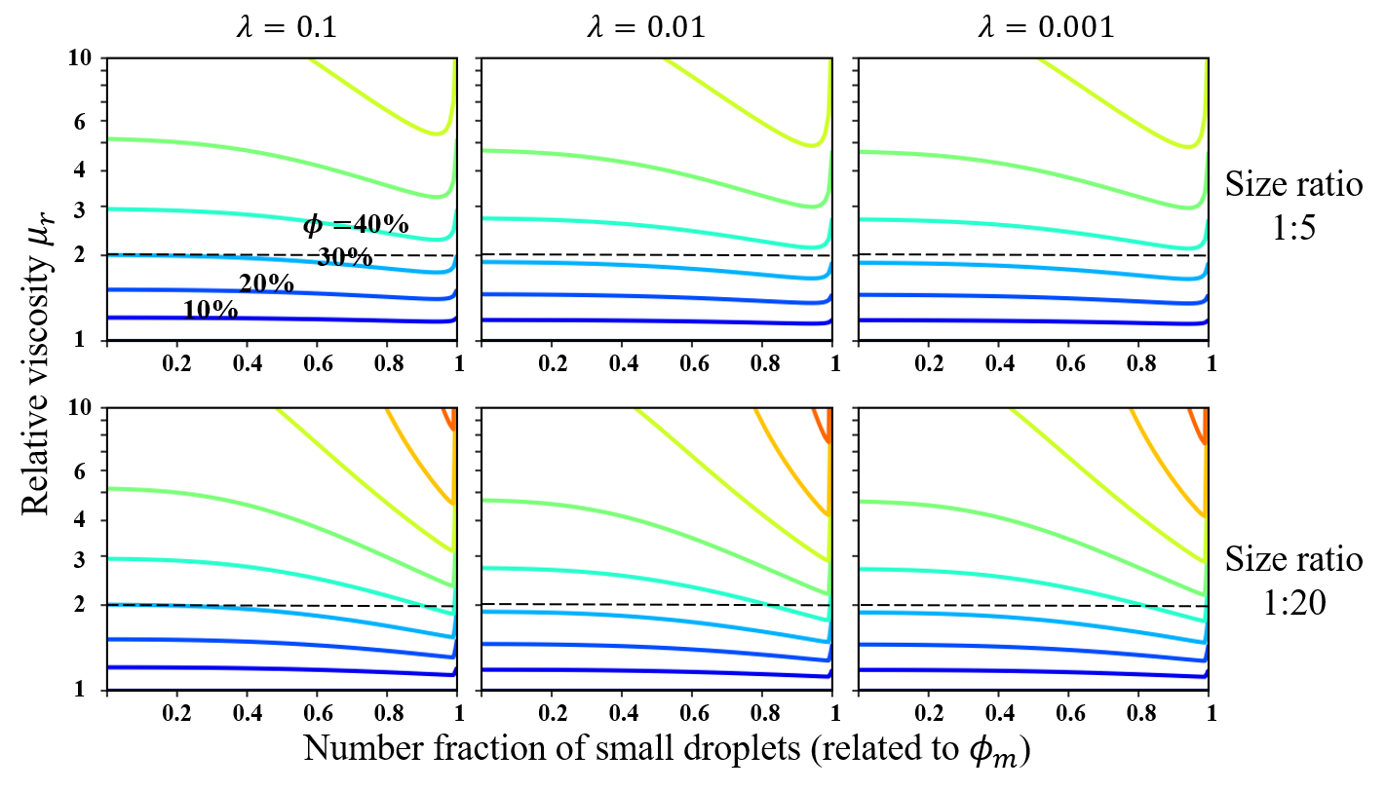
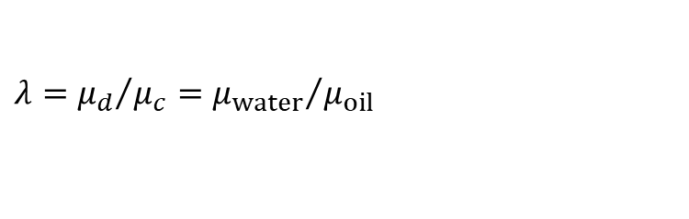
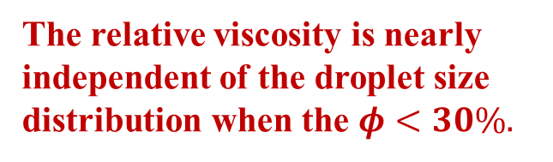
5 / 7
Assuming the presence of only two droplet sizes in emulsion.
The relative viscosity is nearly independent of the droplet size distribution when the $φ<30\%.$
The droplets size ratio (diameter) between large and small droplets is 5:1 and 20:1
$$λ={μ_{d}}/{μ_{c}={μ_{water}}/{μ_{oil}}}$$
The relationship between volume faction, droplet size distribution, and relative viscosity.

Slide 6
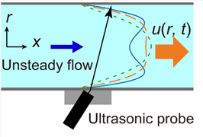

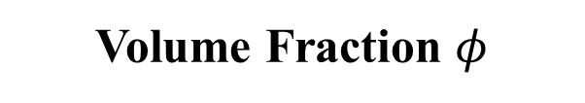
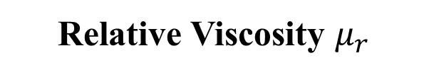

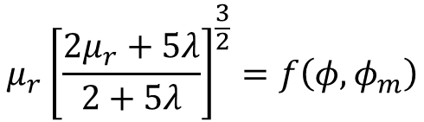
6 / 7
Setting the droplet size to be a constant.
$$D=const→φ_{m}=φ_{m}^{0}=0.637$$
$$μ_{r}{\left[\frac{2μ_{r}+5λ}{2+5λ}\right]}^{\frac{3}{2}}=f\left(φ,φ_{m}\right)$$
$$φ=f^{−1}\left(μ_{r}, λ\right)$$
Unsteady Flow Information
ultrasonic velocity profiling (in-line)
Relative Viscosity $μ_{r}$
Tasaka et al. (2021)
Volume Fraction $φ$

Slide 7
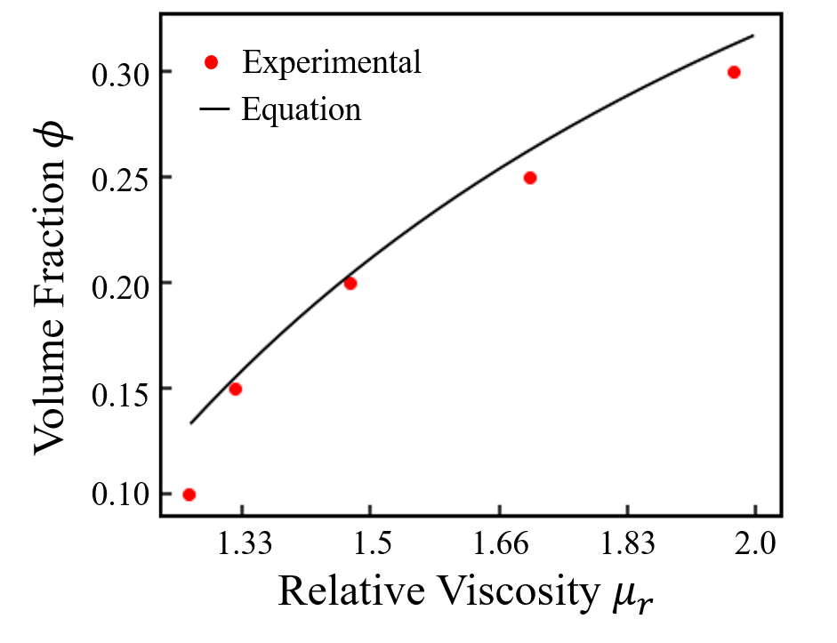
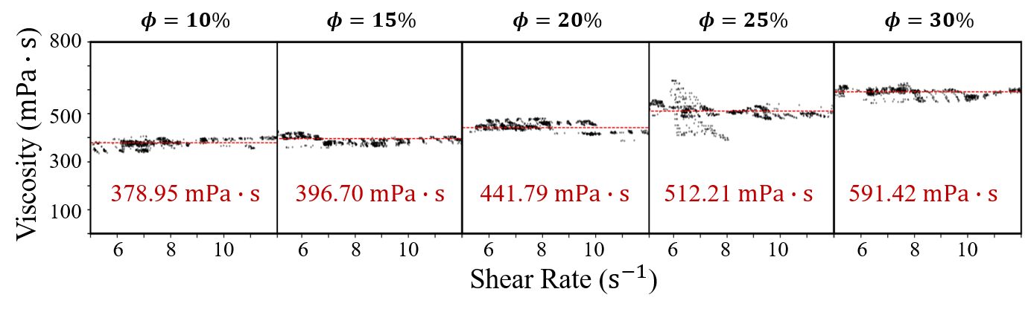
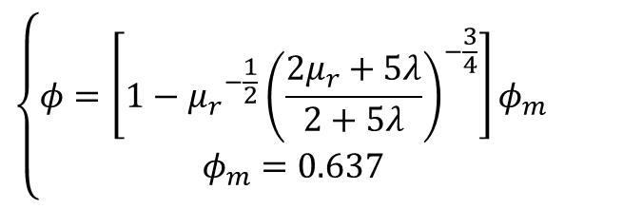
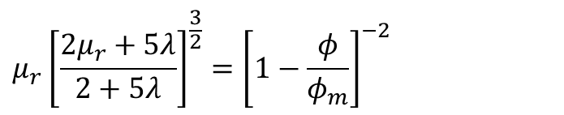
7 / 7
Derived by Roscoe Equation
$$μ_{r}{\left[\frac{2μ_{r}+5λ}{2+5λ}\right]}^{\frac{3}{2}}={\left[1−\frac{φ}{φ_{m}}\right]}^{−2}$$
$$\left\{\begin{aligned}φ=\left[1−{μ_{r}}^{−\frac{1}{2}}{\left(\frac{2μ_{r}+5λ}{2+5λ}\right)}^{−\frac{3}{4}}\right]φ_{m} \\ φ_{m}=0.637\end{aligned}\right.$$
Experimental data of emulsion viscosity by USR.

Slide 10
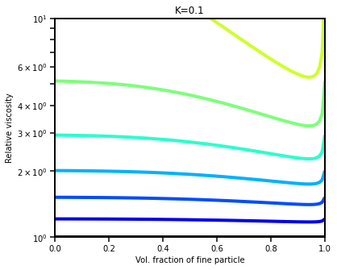
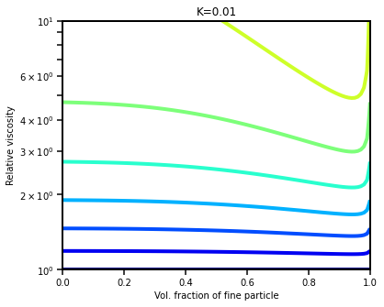

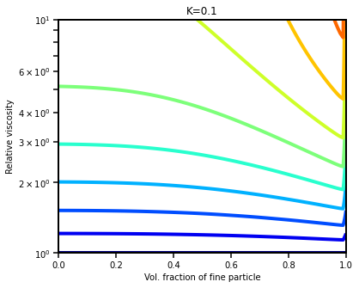
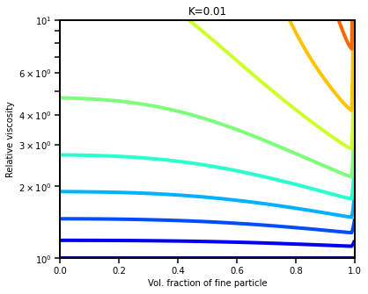
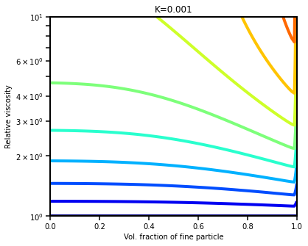

Slide 11
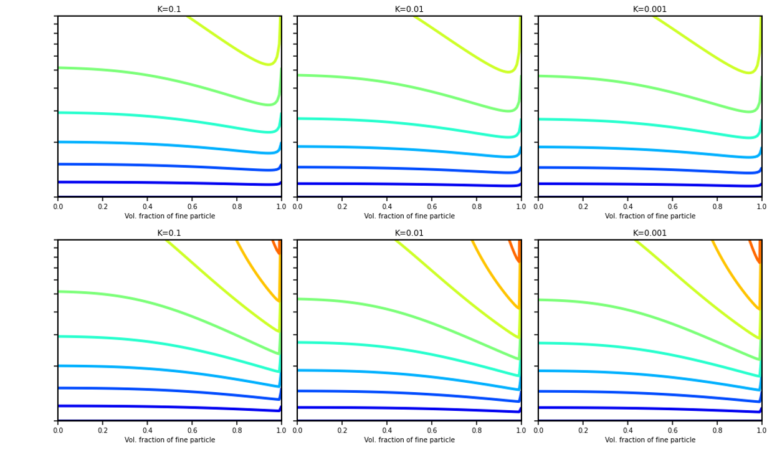






$$λ=0.1$$
$$λ=0.01$$
$$λ=0.001$$
10
6
4
Size ratio
1:5
3
$φ=$40%
2
30%
20%
10%
1
Relative viscosity $μ_{r}$
1
1
1
0.2
0.4
0.6
0.8
0.2
0.4
0.6
0.8
0.2
0.4
0.6
0.8
10
6
4
3
Size ratio
1:20
2
1
0.2
0.4
0.6
0.8
1
0.2
0.4
0.6
0.8
1
0.2
0.4
0.6
0.8
1
Number fraction of small droplets (related to $φ_{m}$)

Slide 12
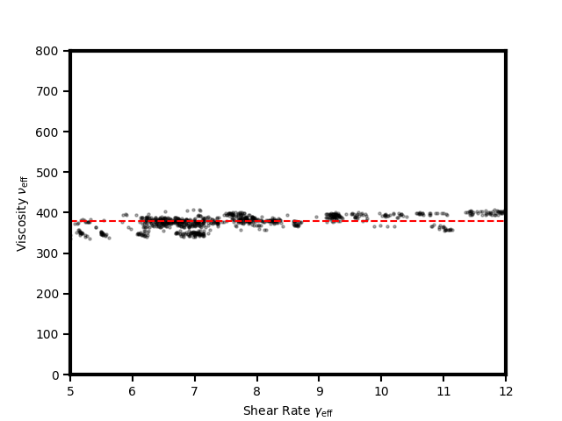
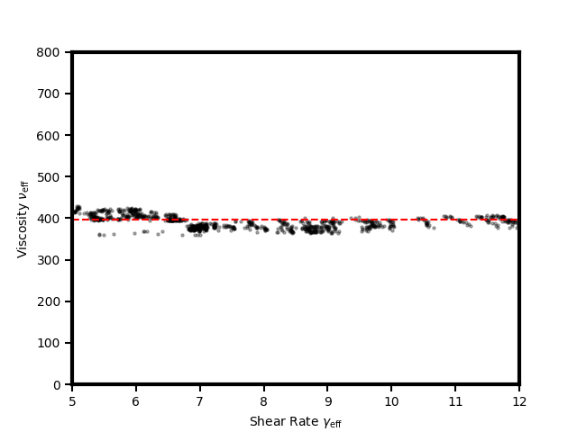
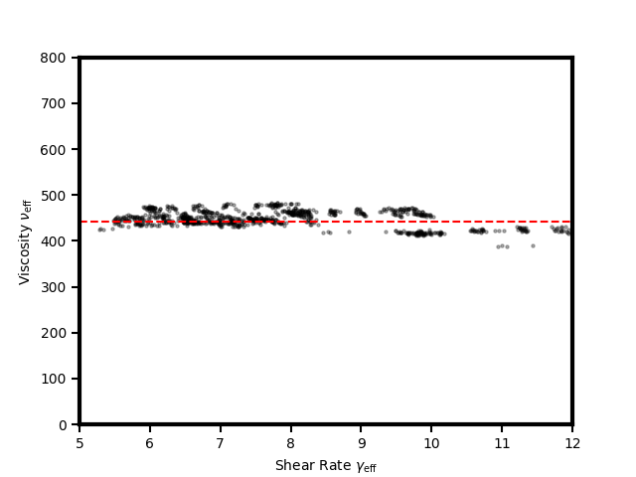
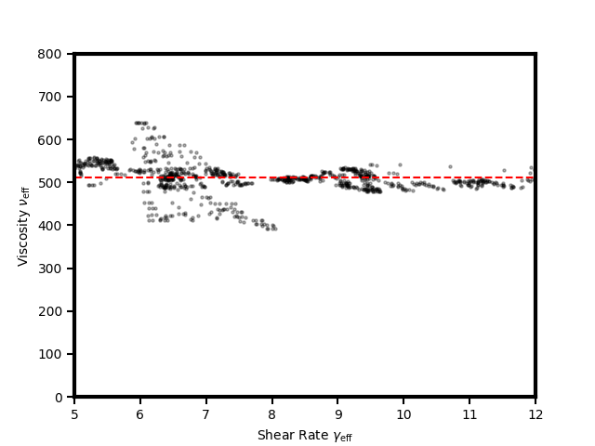
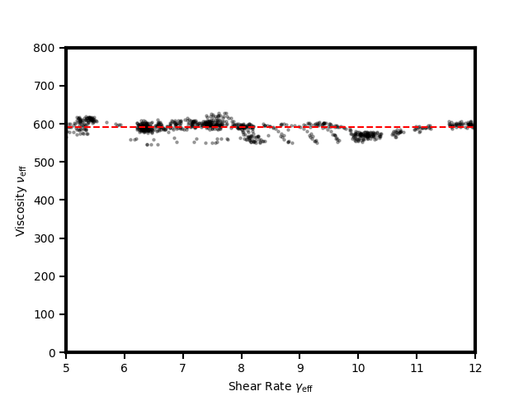
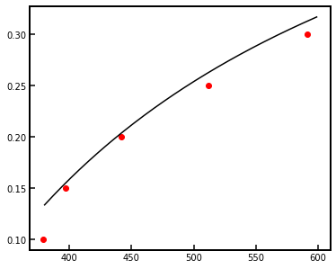

Slide 13
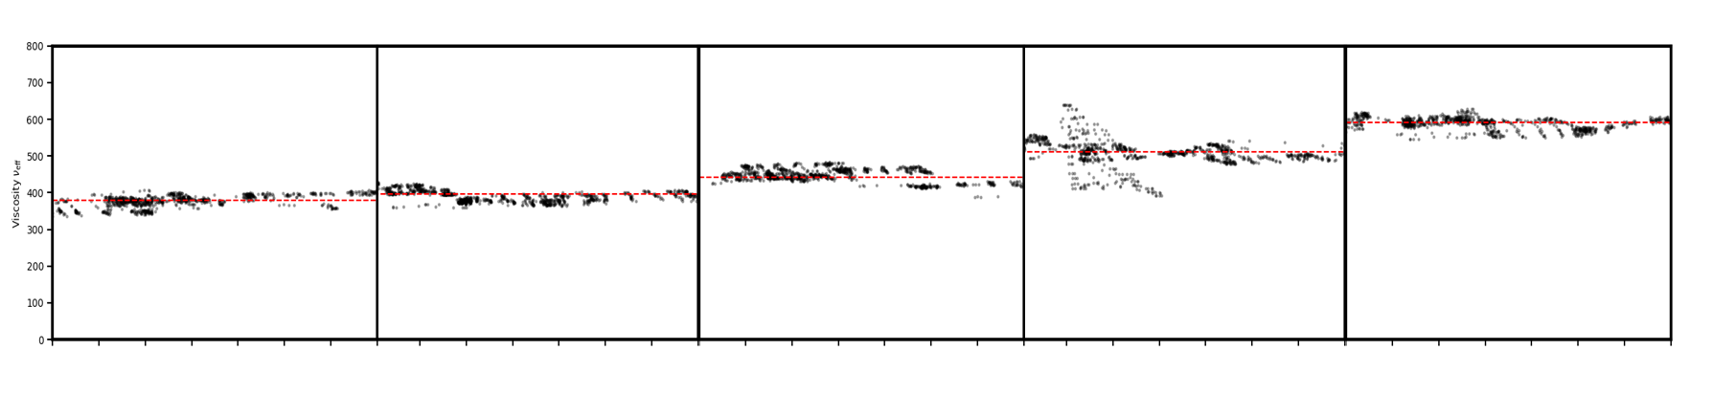












$$φ=10\%$$
$$φ=15\%$$
$$φ=20\%$$
$$φ=25\%$$
$$φ=30\%$$
800
500
Viscosity ($mPa∙s$)
300
378.95 $mPa∙s$
396.70 $mPa∙s$
441.79 $mPa∙s$
512.21 $mPa∙s$
591.42 $mPa∙s$
100
6
8
10
6
8
10
6
8
10
6
8
10
6
8
10
Shear Rate ($s^{−1}$)

Slide 14
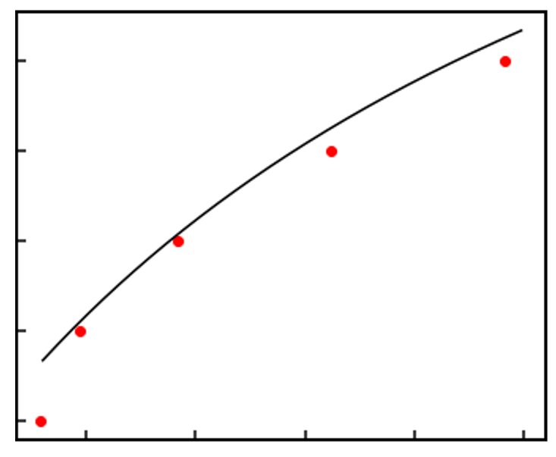
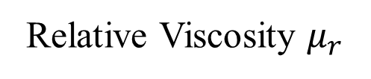
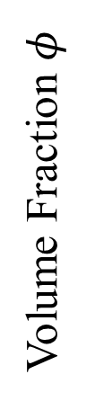
0.30
Experimental
Equation
0.25
Volume Fraction $φ$
0.20
0.15
0.10
1.33
1.5
1.66
1.83
2.0
Relative Viscosity $μ_{r}$

