Slide 1


An In-line Estimation Method of Volume Fraction Based on Simple Emulsion Viscosity Model
シンプル・エマルション粘度モテルに基づく体積率インライン推定法
Weniqng Zheng
Laboratory for flow control
Hokkaido University

Slide 2
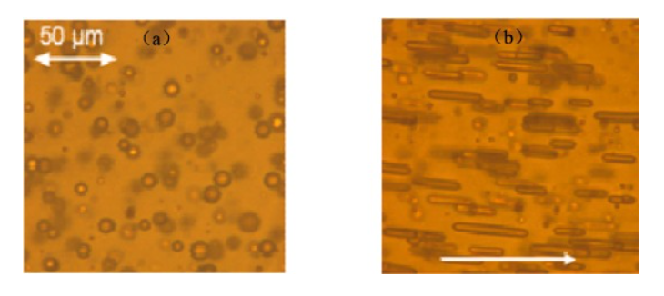
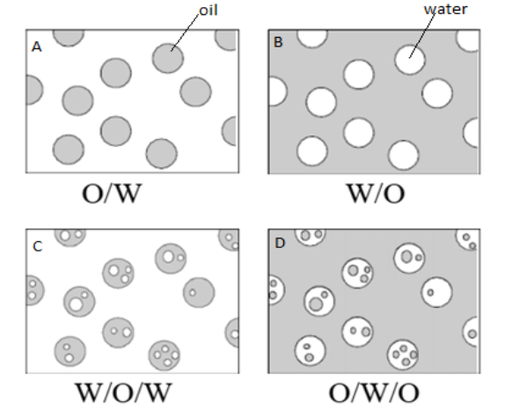
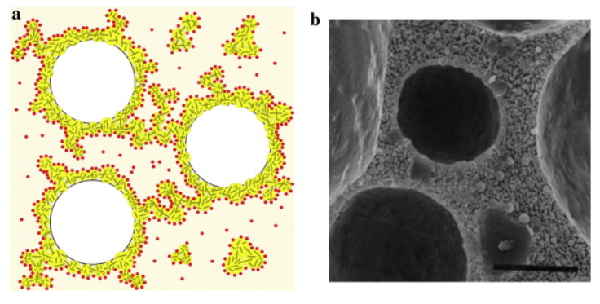
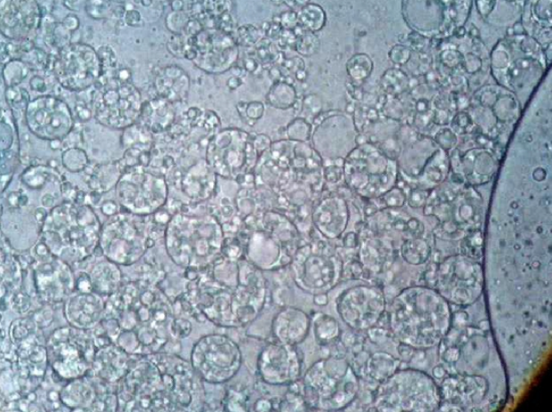
1 / 6
What is the Emulsion?
Simple
emulsion
Petroleum Emulsion (W/O)
Zhai et al. (2023)
Multiple
emulsion
Abed et al. (2019)
Whipped Cream (O/W)
Rual et al. (2016)
-Petroleum Industry
W/O, O/W(rare)
-Food Industry
O/W, Multiple Emulsion
-Cosmetic Industry
Multiple Emulsion
Cosmetic Multiple Emulsion (W/O/W)
Mahmood et al. (2013)

Slide 3
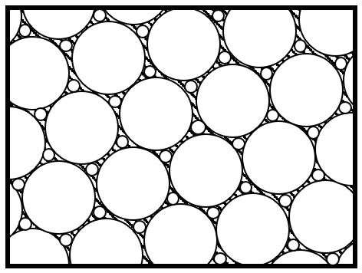
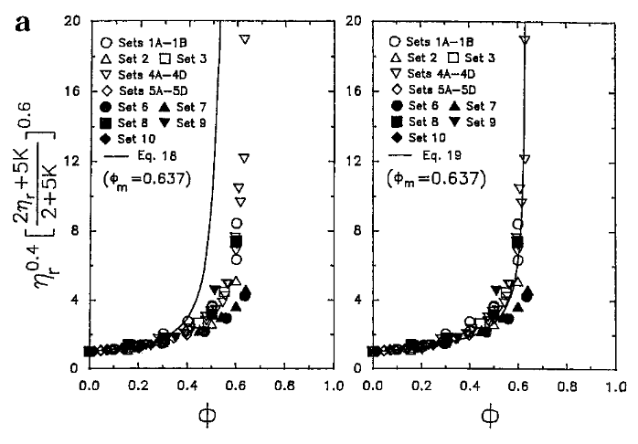
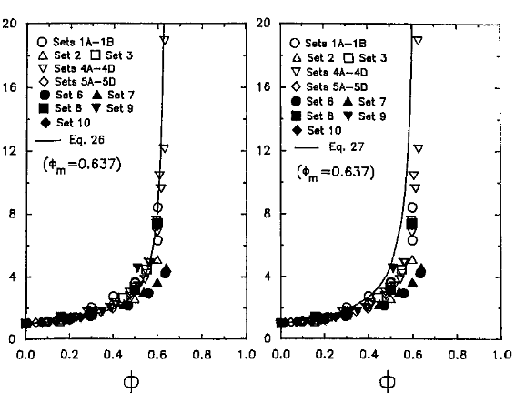
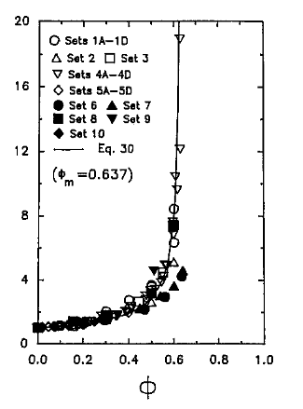
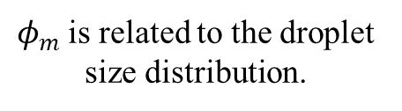
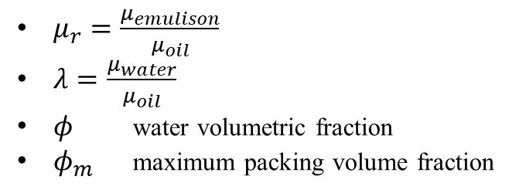
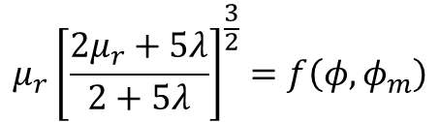

2 / 6
Two-parameter Model of Simple Emulsion
*Particle Suspension
$$μ_{r}=f\left(φ,φ_{m}\right)$$
$$μ_{r}{\left[\frac{2μ_{r}+5λ}{2+5λ}\right]}^{\frac{3}{2}}=f\left(φ,φ_{m}\right)$$
Two-Parameter Equations
, Pal (2001)
-Mooney Equation [1]
$μ_{r}=\frac{μ_{emulison}}{μ_{oil}}$
$λ=\frac{μ_{water}}{μ_{oil}}$
$φ$ water volumetric fraction
$φ_{m}$ maximum packing volume fraction
-Krieger and Dougherty Equation [2]
(For W/O Emulsion)
-Eilers Equation [3]
-Roscoe Equation [4]
$φ_{m}$ is related to the droplet size distribution.
-Chong et al. Equation [5]
[1]
[2]
[3]
[4]
[5]
Comparison between the experimental data and the predictions of two-parameter emulsion model (Pal, 2001)

Slide 4
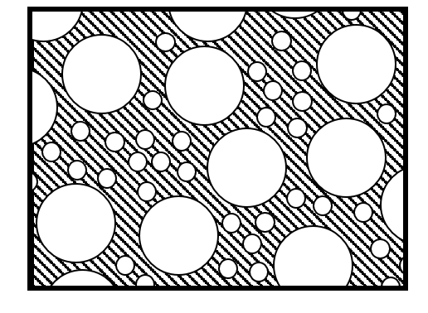
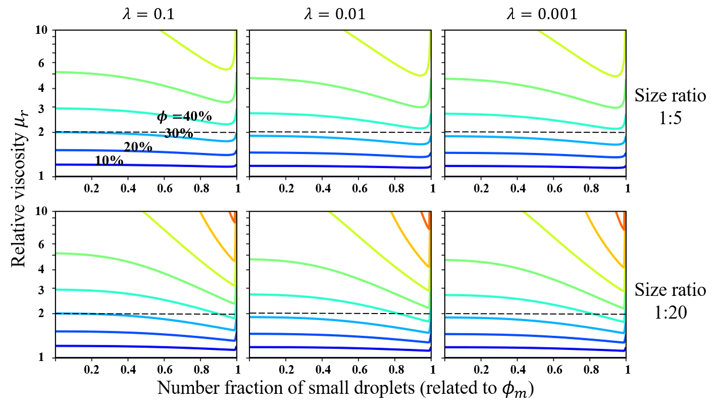
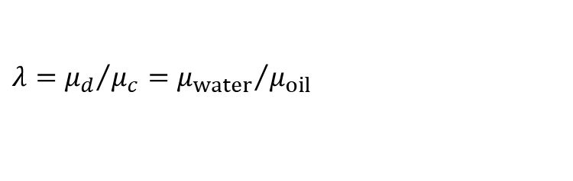
3 / 6
Assuming the presence of only two droplet sizes in emulsion.
$$λ={μ_{d}}/{μ_{c}={μ_{water}}/{μ_{oil}}}$$
The relationship between volume faction, droplet size distribution, and relative viscosity predicted by model.

Slide 5
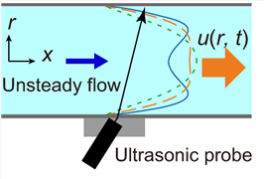
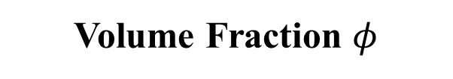

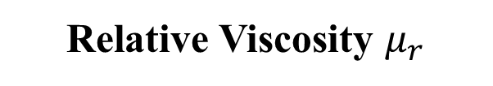

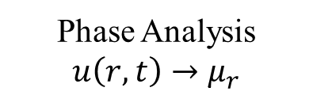
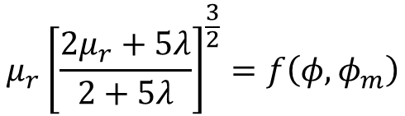
4 / 6
Setting the droplet size to be a constant (when $φ<30\%$)
$$D=const→φ_{m}=φ_{m}^{0}=0.637$$
$$μ_{r}{\left[\frac{2μ_{r}+5λ}{2+5λ}\right]}^{\frac{3}{2}}=f\left(φ,φ_{m}\right)$$
$$φ=f^{−1}\left(μ_{r}, λ\right)$$
Unsteady Flow Information
ultrasonic velocity profiling (in-line)
Phase Analysis
$u\left(r,t\right)→μ_{r}$
Relative Viscosity $μ_{r}$
Tasaka et al. (2021)
Volume Fraction $φ$
Viscosity model

Slide 6
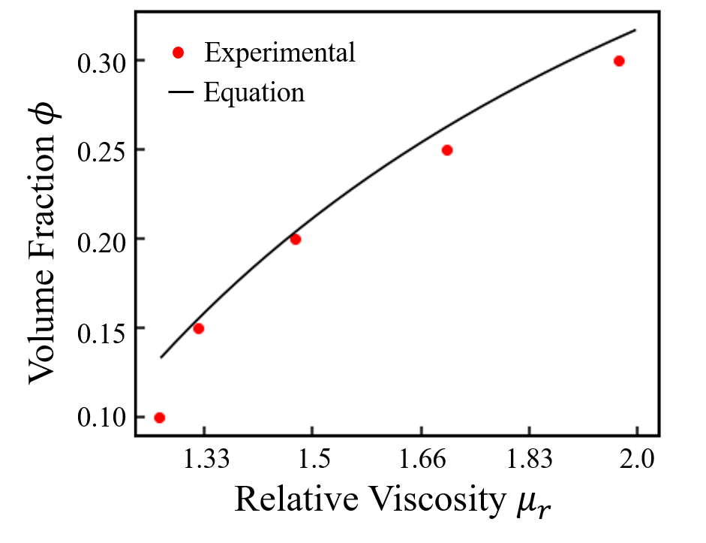
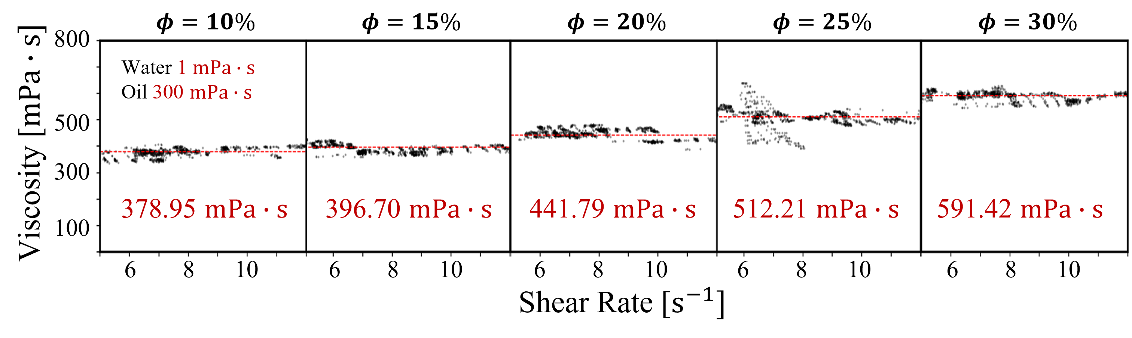
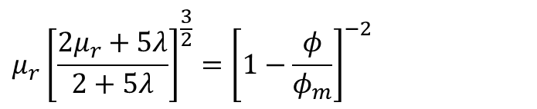

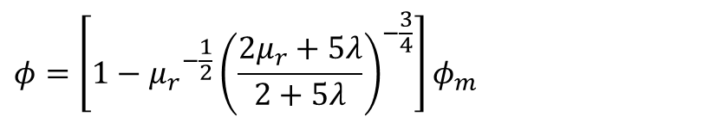
5 / 6
Comparison between the experimental data and the estimations by model
Derived model by Roscoe Equation
$$μ_{r}{\left[\frac{2μ_{r}+5λ}{2+5λ}\right]}^{\frac{3}{2}}={\left[1−\frac{φ}{φ_{m}}\right]}^{−2}$$
$$φ=\left[1−{μ_{r}}^{−\frac{1}{2}}{\left(\frac{2μ_{r}+5λ}{2+5λ}\right)}^{−\frac{3}{4}}\right]φ_{m}$$
$$φ_{m}=0.637$$
Experimental data of emulsion(W/O) viscosity by USR.

Slide 7



6 / 6
Summary
Working Conditions of method
Objective
In-line estimating the volume fraction by emulsion viscosity model.
$$N_{Ca}≪1$$
Viscosity
model
$$0.02<φ<φ_{m}$$
Simple emulsion
Finished Parts
Laminar flow
Rheometer
Flow information of emulsions can be measured by ultrasound.
Volume fraction can be well estimated by viscosity model under the working conditions.
Experimental result
$$0.15<φ<0.30$$
Future Works
Confirming the precision of the method
Expanding the using scope of the method
Conducting pipeline experiment

Slide 10
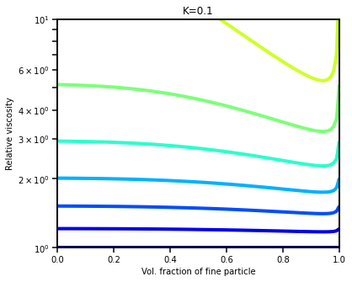
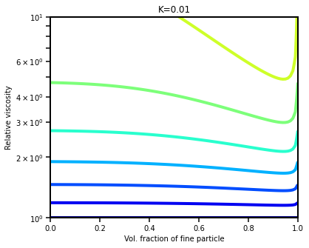

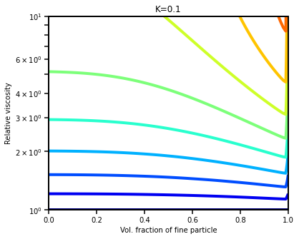
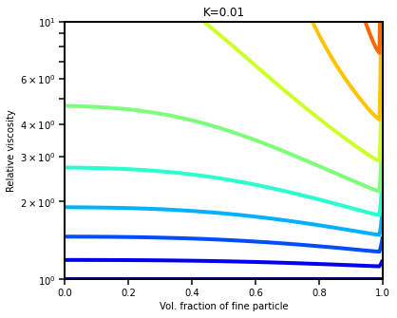
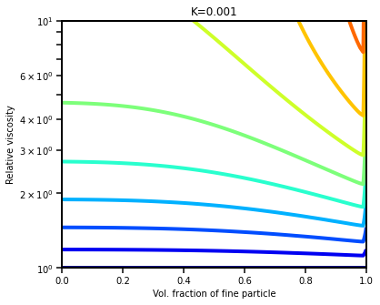

Slide 11
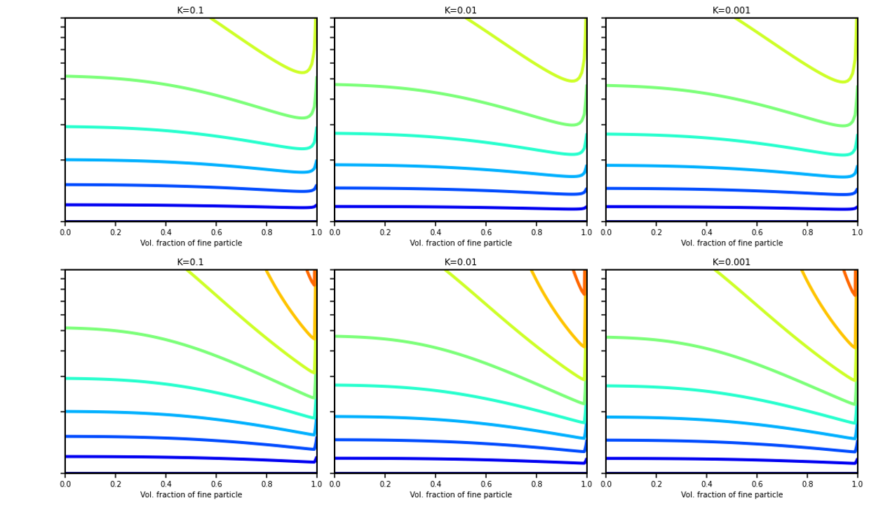






$$λ=0.1$$
$$λ=0.01$$
$$λ=0.001$$
10
6
4
Size ratio
1:5
3
$φ=$40%
2
30%
20%
10%
1
Relative viscosity $μ_{r}$
1
1
1
0.2
0.4
0.6
0.8
0.2
0.4
0.6
0.8
0.2
0.4
0.6
0.8
10
6
4
3
Size ratio
1:20
2
1
0.2
0.4
0.6
0.8
1
0.2
0.4
0.6
0.8
1
0.2
0.4
0.6
0.8
1
Number fraction of small droplets (related to $φ_{m}$)

Slide 12
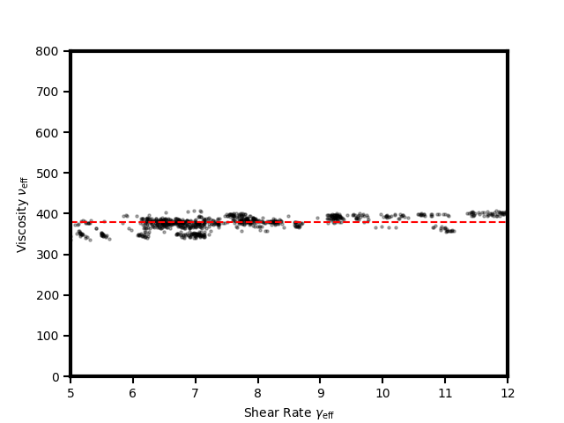
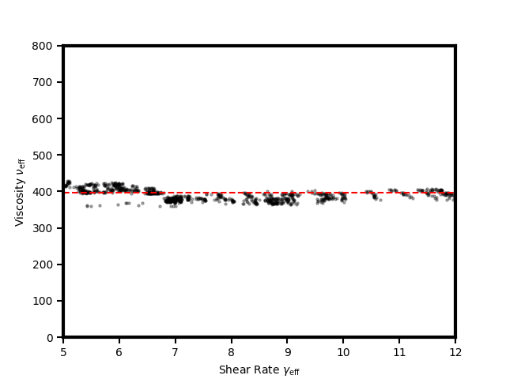
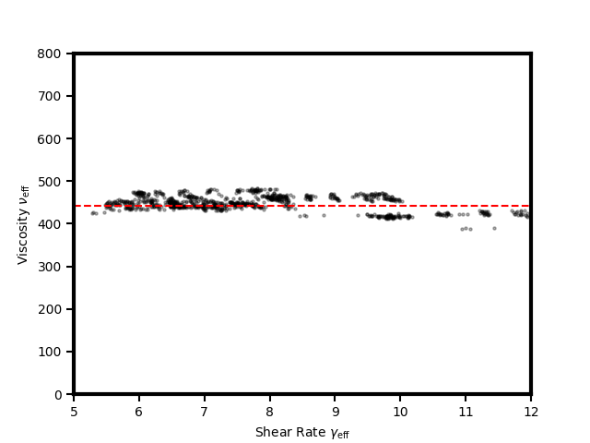
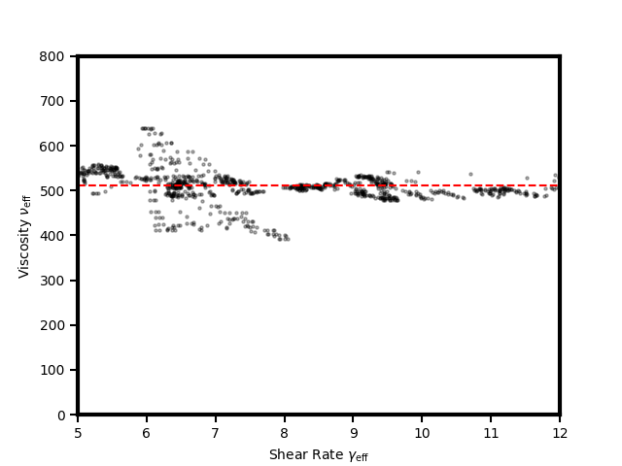
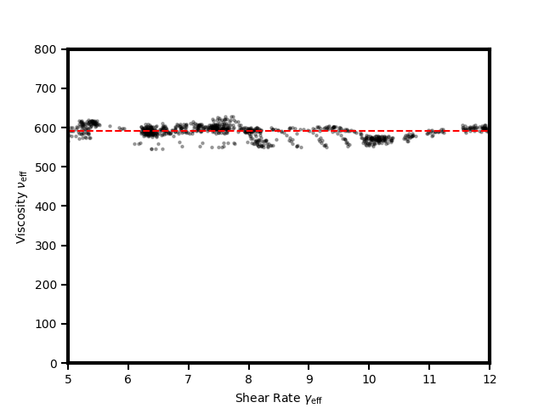
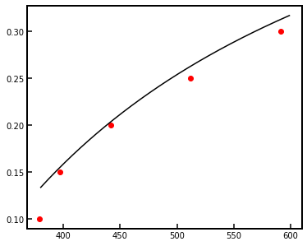

Slide 13
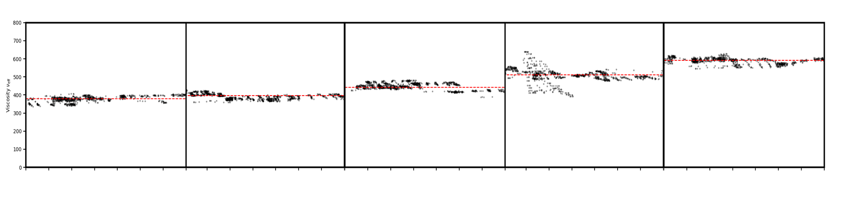













800
$$φ=10\%$$
$$φ=15\%$$
$$φ=20\%$$
$$φ=25\%$$
$$φ=30\%$$
Water 1 $mPa∙s$
Oil 300 $mPa∙s$
500
Viscosity [$mPa∙s]$
300
378.95 $mPa∙s$
396.70 $mPa∙s$
441.79 $mPa∙s$
512.21 $mPa∙s$
591.42 $mPa∙s$
100
6
8
10
6
8
10
6
8
10
6
8
10
6
8
10
Shear Rate [$s^{−1}]$

Slide 14
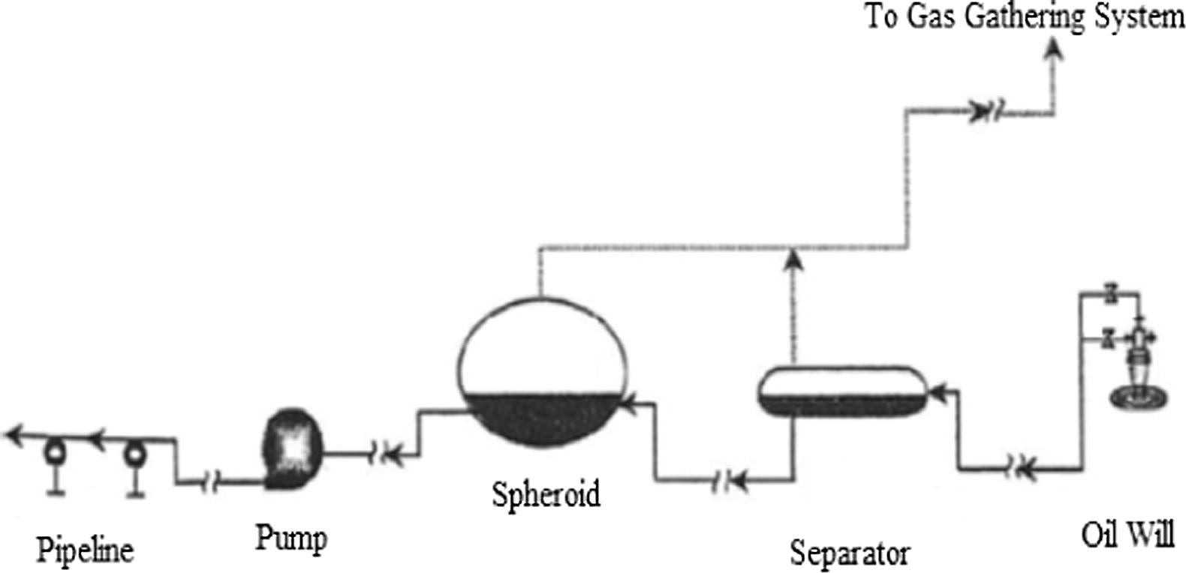
13 / 8
Emulsion (W/O)’s impact on the Petroleum Industry
1) The retention time up 3 times.
Demulsification
Hopes to drop the volume fraction below 1%
Fink (2015)
2) The increasing in corrosion rate and scaling (due to the salt content in the formation of water).
3
1
3) The pressure drop up 8 times.
2
Upstream equipment for crude oil production
Wang (2005)
-Economic Cost
-Time Cost
-Efficiency
How to in-line estimate the volume fraction?

Slide 15
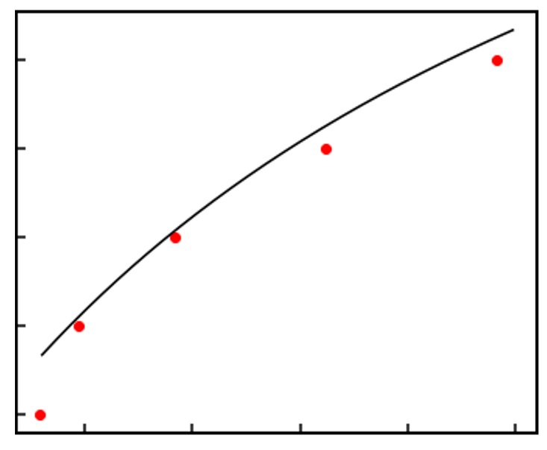
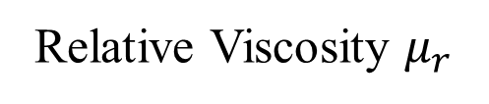
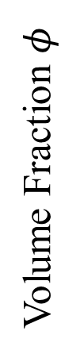
0.30
Experimental
Equation
0.25
Volume Fraction $φ$
0.20
0.15
0.10
1.33
1.5
1.66
1.83
2.0
Relative Viscosity $μ_{r}$

