Slide 1
CAPSTONE 2: Data storytelling
Longevity vs Aggressive Skincare
By Irina Kim

Slide 2
Executive summary
Consumers rate both categories similarly
But 'loves' heavily favor barrier-support products
Mid-price products dominate engagement
Implication: trust & consistency > intensity

Slide 3
Problem
What drives consumer preference in skincare?
Do higher ratings translate to loyalty?
Where should brands invest?
Do consumers prefer aggressive correction or barrier support products?
The skincare and aesthetic industry is undergoing a paradigm shift. Consumers are moving away from "Aggressive Correction"—treatments like high-percentage acids and retinoids that require downtime—toward "Barrier Architecture" (Longevity). This category focuses on ingredients like Centella Asiatica, Ceramides, and Peptides that fortify the skin.

Slide 4
Objective
Analyze relationship between price, ratings, and consumer 'love' signals.

Slide 5
Dataset
Sephora product dataset including price, ratings, and 'loves' count.
Features: price, rating, loves, category
Goal: understand drivers of engagement

Slide 6
Approach
EDA + segmentation + behavioral interpretation.

Slide 7
Key Metric
'Loves' used as proxy for consumer preference and loyalty.
Stronger than ratings for real behavior

Slide 8
Market Landscape
Two categories: Barrier Support vs Aggressive Correction.
Different usage + psychology

Slide 9
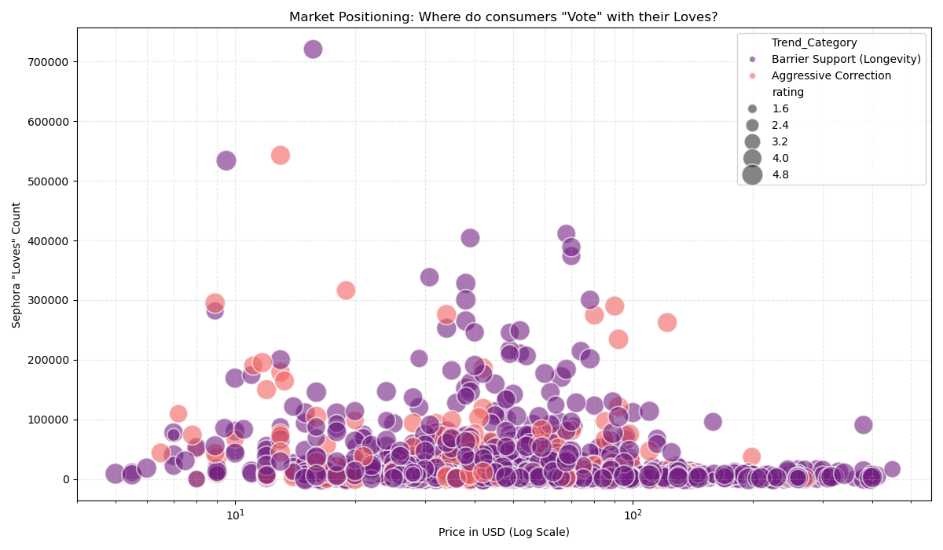
Visualization 1
Price vs Loves reveals clustering in mid-price range.

Slide 10
Insight 1
Barrier support dominates across all price segments.
Consistent usage builds loyalty

Slide 11
Insight 2
High price does not guarantee higher consumer love.

Slide 12
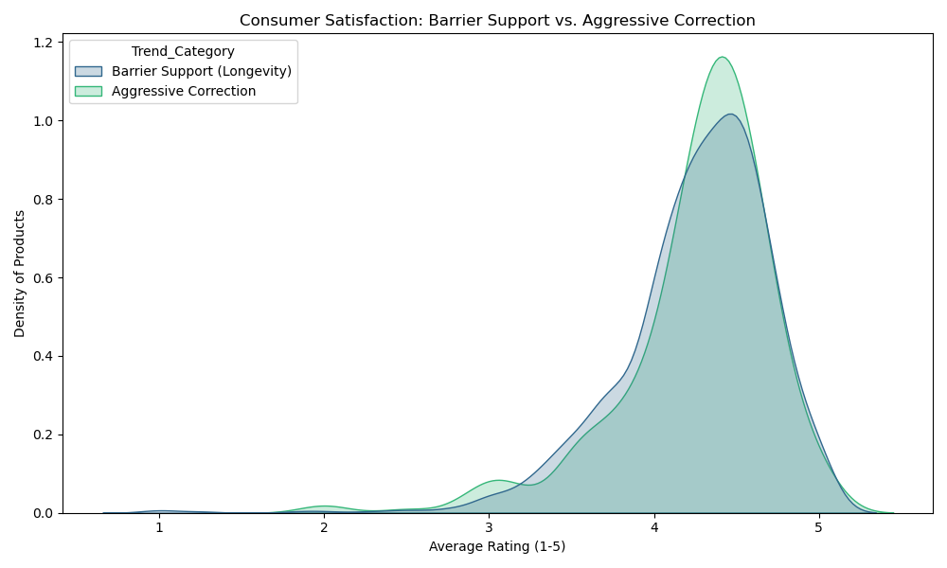
Visualization 2
Ratings distribution shows both categories highly rated.

Slide 13
Insight 3
Ratings are similar, but love/engagement differs.

Slide 14
Behavioral Insight
Consumers trust gentle, consistent products more.

Slide 15
Hypothesis
Barrier products used daily → higher engagement.

Slide 16
Limitation
Lack of frequency or repeat purchase data.

Slide 17
Next Step
Build predictive model for product success.

Slide 18
Model
Predict 'loves' using price, rating, and category.
Regression model (e.g. XGBoost / Linear)
Features: price, rating, category
Target: loves (log-transformed)

Slide 19
Feature Importance (Expected)
Category (strongest driver)
Price (non-linear impact)
Rating (weak predictor)

Slide 20
Prediction Insight
Barrier product at $50 → high engagement potential
Aggressive product at same price → lower expected loves
Optimal pricing window: $30–$80

Slide 21
Business Impact
Prioritize barrier-support product lines
Position around trust & daily use
Avoid over-investing in high-price aggressive SKUs

Slide 22
Strategic Recommendation
Focus on mid-range pricing
Build habit-forming products
Market consistency over transformation

Slide 23
Limitations
No repeat purchase data
No usage frequency
Loves ≠ actual revenue

Slide 24
Next Steps
Add time-series / cohort data
Train production-grade model
Deploy dashboard

Slide 25
Conclusion
Consumers don’t just want results
They want reliability
Longevity wins

