Slide 1
Monopoly Voice Assistant
Made by Liron Revah & Baruh Shalumov

Slide 2
Introduction
The subject for our proposal is a game voice assistant that can help the player play a game without hands using voice only.
This could help people use less keyboard and mouse and let their hand rest or even more important give a chance for people with disabilities a platform to do what they couldn’t do before: play and have fun like everybody else.
There are millions of people that lost their hands for many reasons, they lost the ability to do many things and this project can restore one of them (play a computer game).
Our challenge will be on several parts:
Create an interface that could get data from a game and use the keyboard and mouse on that game. Create a voice assistant that will listen and speak to the user, the assistant could do all the options in the game like pressing bottoms and commentary the game. Our voice assistant will have the option to suggest what a decision to make using statistics or machine learning based on data from previous games.

Slide 3
Why need a voice assistant?
By adding Voice assistant for game software.
This approach can reduce the effort required to make a game accessible for people with disabilities.

Slide 4
Challenges
How to replace the keyboard and mouse ?
How to make a voice assistant ?
How does the voice assistant connect to the game ?
How will the voice assistant listen and understand and speak to the user?

Slide 5
Block diagram
Sound Wave
ASR
Dialog message
TTS
User
Google, Apple, Amazon
Dialog Flow, CoCo
Google, Apple, Amazon

Slide 6
Architecture

Slide 7
Objectives
Planning and realizing a voice assistant:
Writing the algorithm in Python
Designing a dialog flow system
Connection to Google systems
Editing and re-adjusting the game:
Improve game UI and UX interfaces
Planning and realizing a Python Code connection
Connecting the game with the voice assistant (Integration)
Checking the system (System Test)

Slide 8
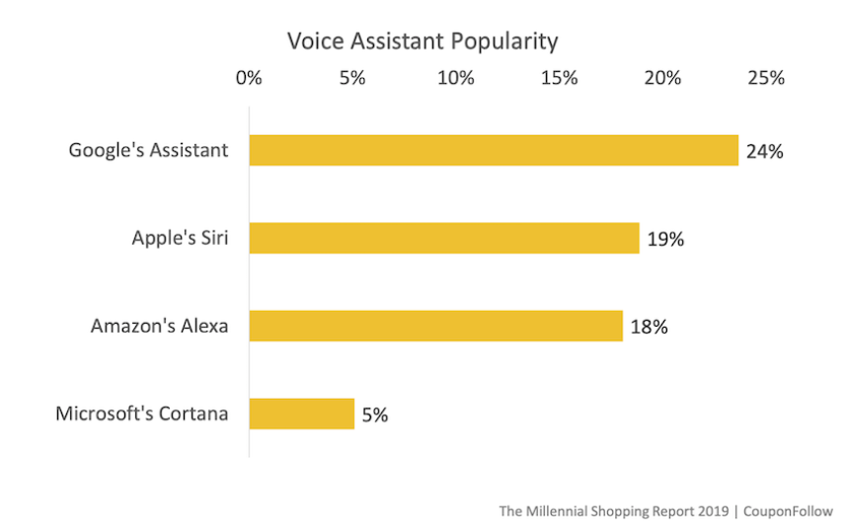
Measurements

Slide 9
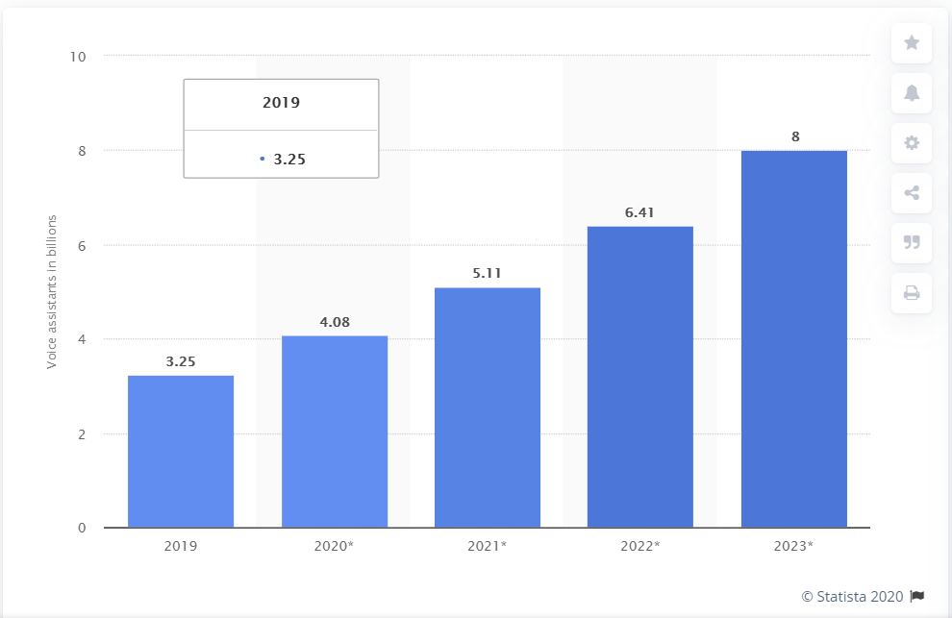
Measurements
Number of digital voice assistants in use worldwide from 2019 to 2023 (in billions)*

Slide 10
Web Page
Let’s start with frontend code

Slide 11
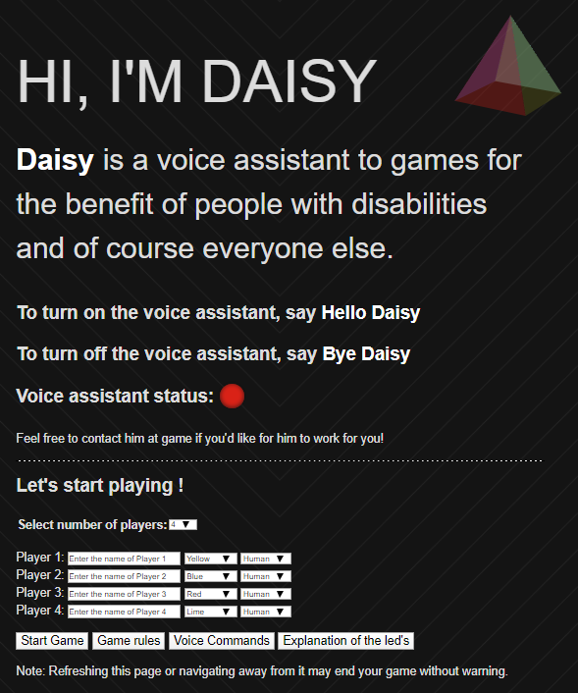
Web Page
The main window of the game, which shows the target audience of the game.
In terms of voice assistant you can see the basic commands for using her voice assistant and status.
The bottom of the site is the start of the game and more information about the game and its capabilities.

Slide 12
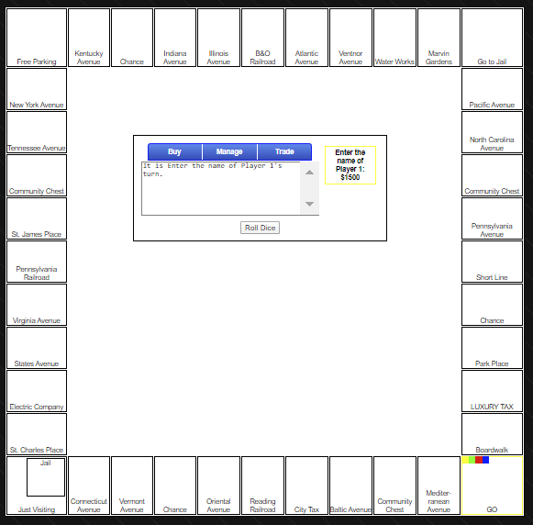
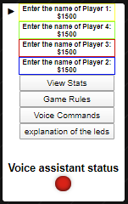
Web Page
Game board
players status

Slide 13
Python & DialogFlow
Let’s start with backend code

Slide 14
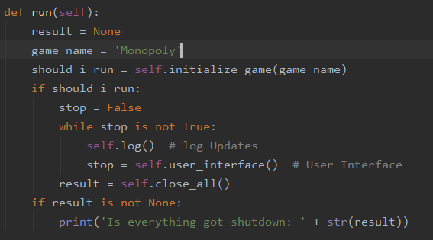
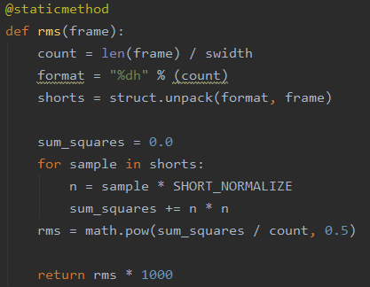
Source code

Slide 15
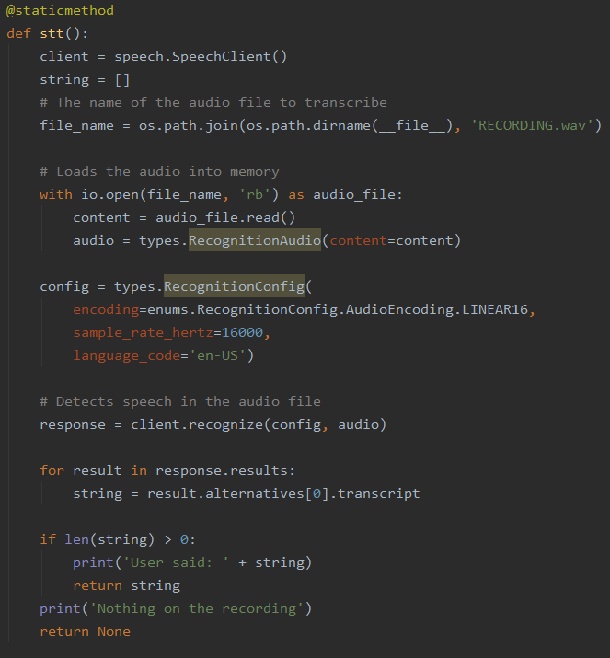
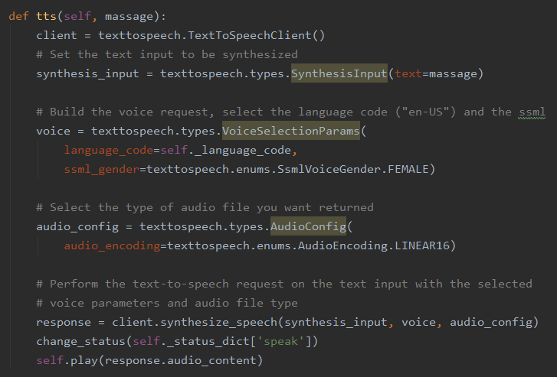
Source code

Slide 16
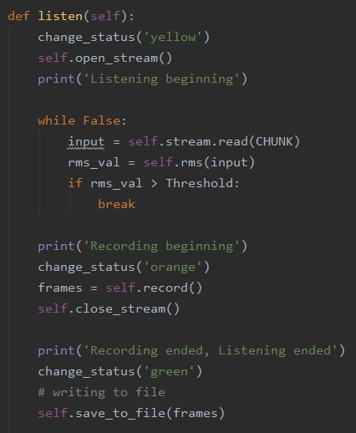
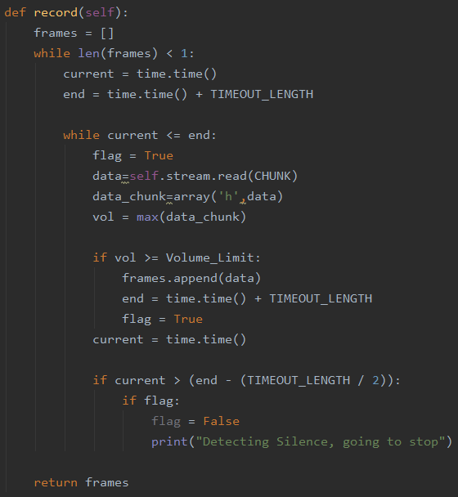
Source code

Slide 17
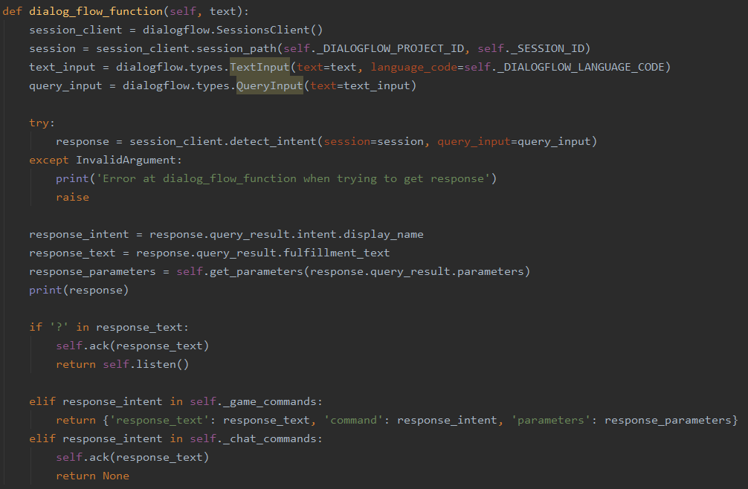
Source code

Slide 18
Summary
Creative and innovative solution
Voice Assistant is a good solution for people with disabilities.
The project demonstrated the ability to turn any game into a voice game

Slide 19
Bibliography and sources
Towards a Low Cost Adaptation of Educational Games for People with Disabilities
Sudoku Access: A Sudoku Game for People with Motor Disabilities
User Experience Comparison of Intelligent Personal Assistants: Alexa, Google Assistant, Siri and Cortana

Slide 20

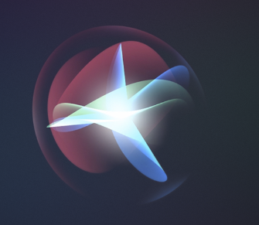


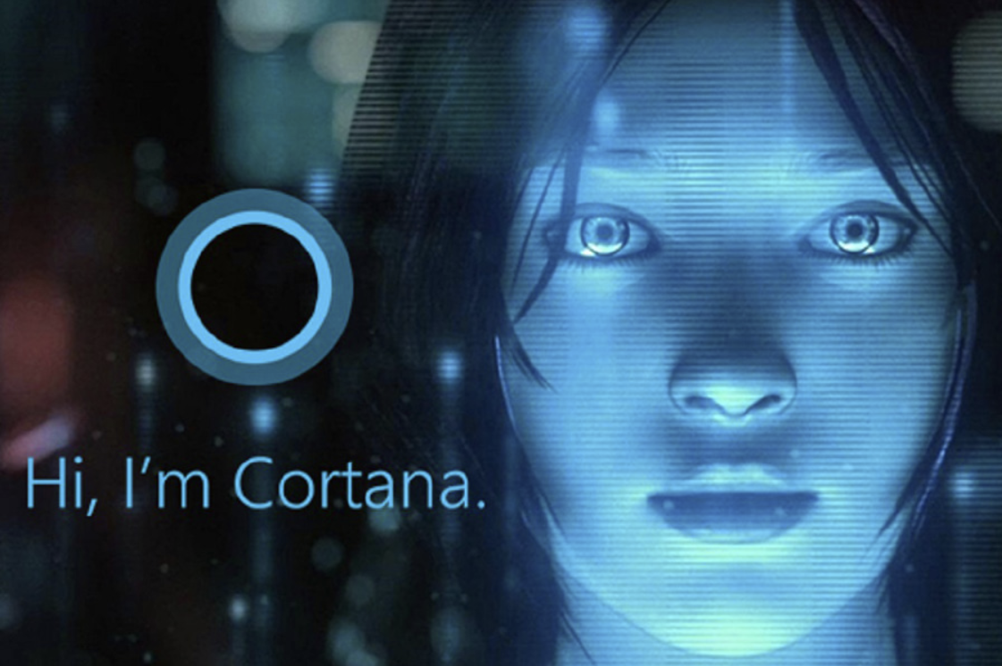
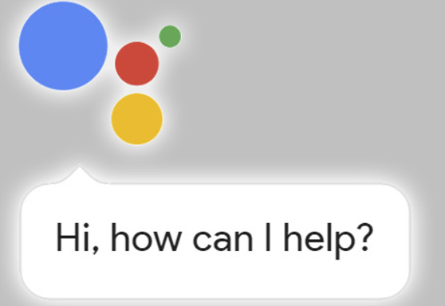

Thanks!
Any questions?

