Slide 1
Superpy
Upgrading Your Shopping Experience
Enter Your Product
Notes:
http://www.free-powerpoint-templates-design.com

Slide 2
01
Motivation
Agenda
02
Libraries Usage
03
Live Demo
04
Suggestions

Slide 3
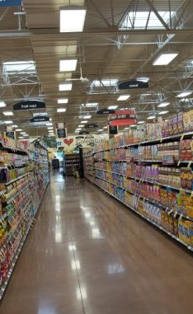
Motivation
Supermarket Shopping
Shopping List:
Imagine that you are shopping in a supermarket, then suddenly, you are lost.
[ Milk,
Eggs,
Bread,
Tomatoes ]
We have a solution!

Slide 4
Problem Definition
Travelling Salesman Problem
1
6
4
4
20
5
0
2
3
7
Notes:
בעיית הסוכן הנוסע (באנגלית: Travelling Salesman Problem ובראשי תיבות TSP)
היא בעיה ידועה בתורת הגרפים ובתורת הסיבוכיות, המעלה את השאלה הבאה: "בהינתן רשימת ערים והמרחק בין כל שתי ערים, מהו המסלול הקצר ביותר, אשר יעבור בכל עיר פעם אחת, ויחזור לעיר ממנה התחיל?"

Slide 5
Libraries Usage
Tkinter
Mlrose
Randomized optimizations algorithms
Gui programming toolkit in Python
GUI
Backend
Object oriented based
Developed to support Georgia Tech’s CS: ML students
GUI
Backend
Includes implementation of TSP
Includes various of widgets and place holders
GUI
Backend

Slide 6
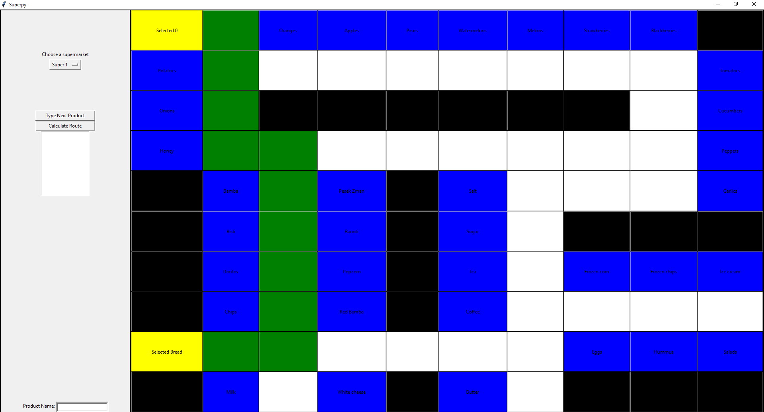
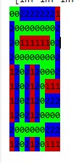
Before & After
Before
After

Slide 7
Algorithms Comparison
Aisle411
Superpy Algorithm
Using “Shortest Path Between 2 Points” algorithm
Using Mlrose’s TSP genetic algorithm.
Accuracy
Accuracy
Since it is a greedy algorithm, its missing often the optimized route
Finding often better routes that Aisle144’s algorithm missed
Runtime
Runtime
Fast, since it is greedy and does less calculation each step
Slower, since its calculating 200 possibilities routes each step

Slide 8
Our Algorithm
START
Calculates Distances
Input Converter
Mlrose’s Algorithm
Output Converter
We are calculating the distances between each item on the shopping list to the others using BFS
In this section we are giving each item a unique index and sending a set of triplets in the format of (i,j,distance between i-j)
Using a genetic algorithm, calculates a route between all the points
Converting the output from the unique indexes to products’ names

Slide 9
Example
Shortest Path Between 2 Points Algorithm
1
6
4
4
20
5
0
2
3
7

Slide 10
Example
Shortest Path Between 2 Points Algorithm
1
6
4
4
20
5
0
2
3
7

Slide 11
Example
Shortest Path Between 2 Points Algorithm
1
6
4
4
20
5
0
2
3
7

Slide 12
Example
Shortest Path Between 2 Points Algorithm
1
6
4
4
20
5
0
2
3
7

Slide 13
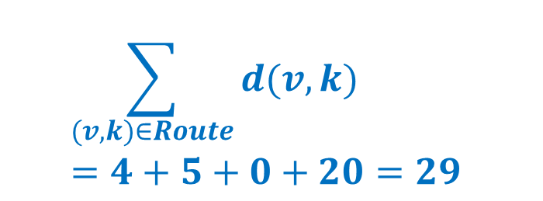
Example
Shortest Path Between 2 Points Algorithm
1
$$\sum_{(v,k)∈Route}{d(v,k)}=4+5+0+20=29$$
6
4
4
20
5
0
2
3
7

Slide 14
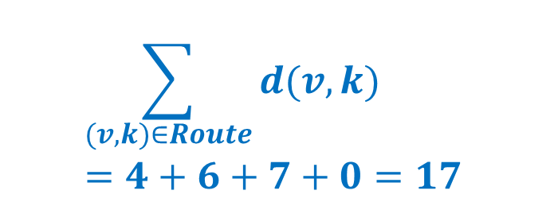
Example
Possible Route
1
$$\sum_{(v,k)∈Route}{d(v,k)}=4+6+7+0=17$$
6
4
4
20
5
0
2
3
7

Slide 15
Live Demo

Slide 16
Improvement Suggestions
Tkinter
Implement a drag and drop functionality for widgets
Make the frame content more flexible when arranging widgets inside it
Mlrose
Implementing auto-tuning mechanism

Slide 17
THANK YOU
Have a nice shopping!

