Slide 1
“Ex1”

Slide 2
HW1 – Overview
Implement Seam Carving
Basic energy formula
Forward-looking formula
Visualize chosen seams:
Both vertical and horizontal
You are provided with a skeleton project:
Nearest neighbor interpolation
You are provided with different utility functions that you can use
We will use Python (version 3.8)
You are provided with setup instructions (pycharm + anaconda)
Note in the instructions, python 3.7 is used (change to 3.8)
Credits: Ben Maman
You may only use numpy and pilllow packages

Slide 3
Seam Carving – Vertical Seams
Steps:
Find seams while image not in the desired size
Calculate cost matrix
Find optimal seam (dynamic programming)
Remove the seam (remember the original indices of the removed seam)
In case of downsizing:
Remove the chosen seams.
In case of upsizing:
Replicate the chosen seams.

Slide 4
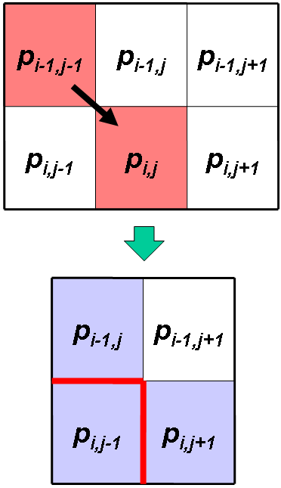
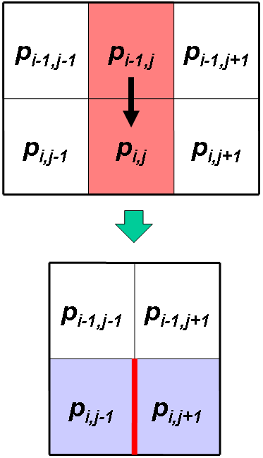
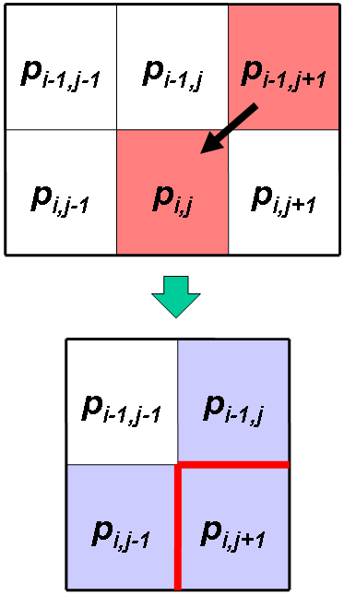



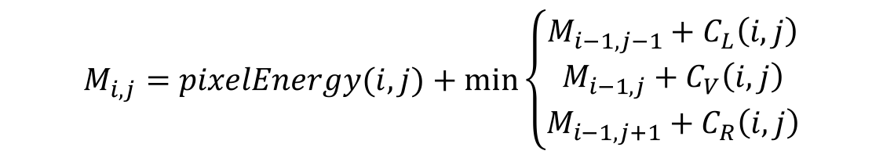
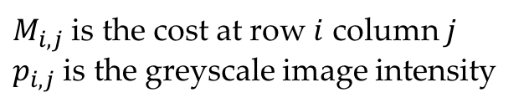
Calculating cost matrix - Vertical Seams
$M_{i,j}$ is the cost at row $i$ column $j$
$p_{i,j}$ is the greyscale image intensity
$$M_{i,j}=pixelEnergy(i,j)+\min\left\{\begin{matrix}M_{i−1,j−1}+C_{L}\left(i,j\right) \\ M_{i−1,j}+C_{V}\left(i,j\right) \\ M_{i−1,j+1}+C_{R}\left(i,j\right)\end{matrix}\right.$$
$$C_{L}$$
$$C_{V}$$
$$C_{R}$$

Slide 5
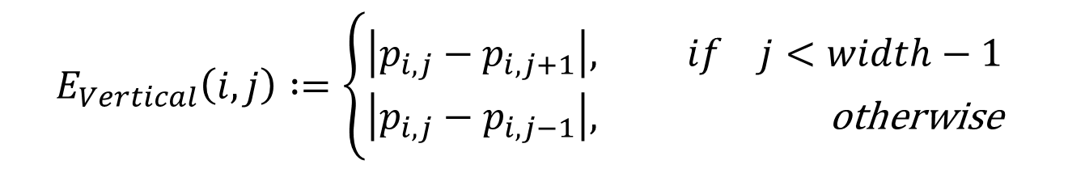
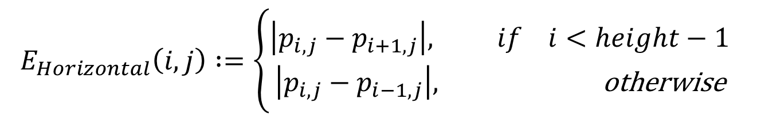
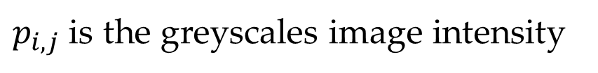
Calculating pixel’s energy
$p_{i,j}$ is the greyscales image intensity
$$E_{Vertical}\left(i,j\right) :=\left\{\begin{aligned}\left|p_{i,j}−p_{i,j+1}\right|, if j<width−1 \\ \left|p_{i,j}−p_{i,j−1}\right|, \text{otherwise} \end{aligned}\right.$$
$$E_{Horizontal}\left(i,j\right) :=\left\{\begin{aligned}\left|p_{i,j}−p_{i+1,j}\right|, if i<height−1 \\ \left|p_{i,j}−p_{i−1,j}\right|, \text{otherwise} \end{aligned}\right.$$

Slide 6
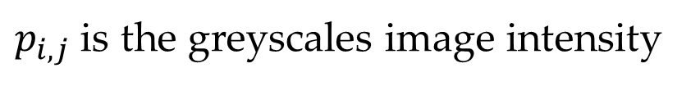
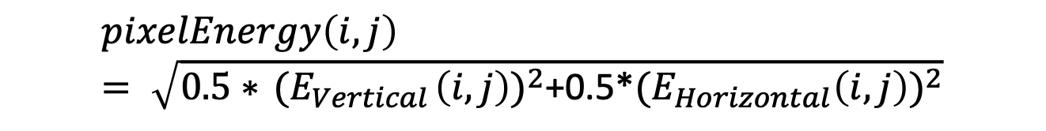
Calculating pixel’s energy
$p_{i,j}$ is the greyscales image intensity
$$pixelEnergy\left(i,j\right)= \sqrt{0.5∗{ (E}_{Vertical}{\left(i,j\right))}^{2}\text{+}\text{0.5∗}{(E}_{Horizontal}{\left(i,j\right))}^{2}}$$

Slide 7
Backtracking the best seam (inverting the formula)
Costs matrix M:
3 | 8 | 12 | 5
9 | 7 | 6 | 12
14 | 9 | 10 | 8
15 | 14 | 15 | 16
3 | 8 | 12 | 5
9 | 7 | 6 | 12
14 | 9 | 10 | 8
15 | 14 | 15 | 16
3 | 8 | 12 | 5
9 | 7 | 6 | 12
14 | 9 | 10 | 8
15 | 14 | 15 | 16
Not necessarily the cell with the minimal value is selected.
3 | 8 | 12 | 5
9 | 7 | 6 | 12
14 | 9 | 10 | 8
15 | 14 | 15 | 16
3 | 8 | 12 | 5
9 | 7 | 6 | 12
14 | 9 | 10 | 8
15 | 14 | 15 | 16

Slide 8
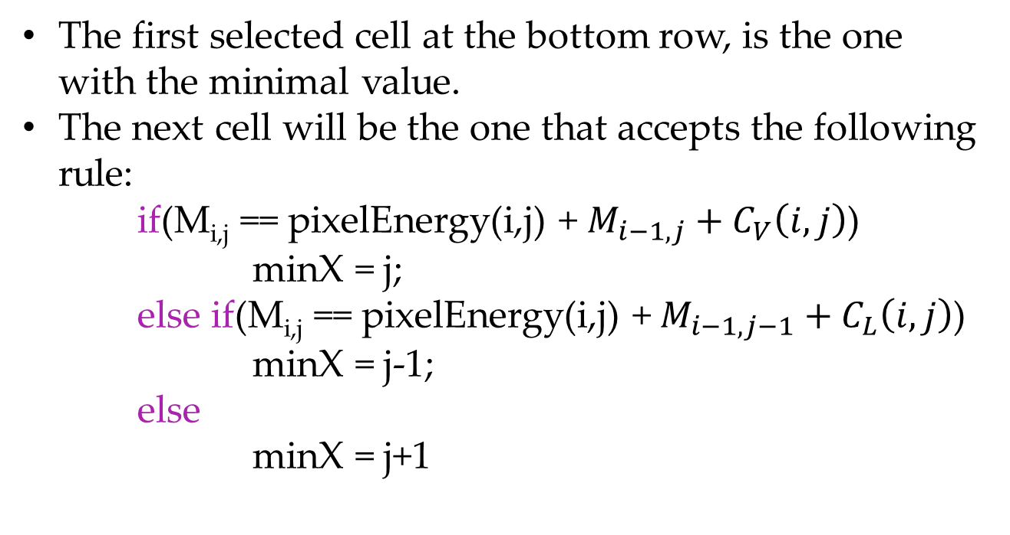
Backtracking the best seam (inverting the formula) - Vertical Case
The first selected cell at the bottom row, is the one with the minimal value.
The next cell will be the one that accepts the following rule:
if(M_{i,j} == pixelEnergy(i,j) + $M_{i−1,j}+C_{V}\left(i,j\right)$)
minX = j;
else if(M_{i,j} == pixelEnergy(i,j) +${ M}_{i−1,j−1} + C_{L}\left(i,j\right)$)
minX = j-1;
else
minX = j+1

Slide 9
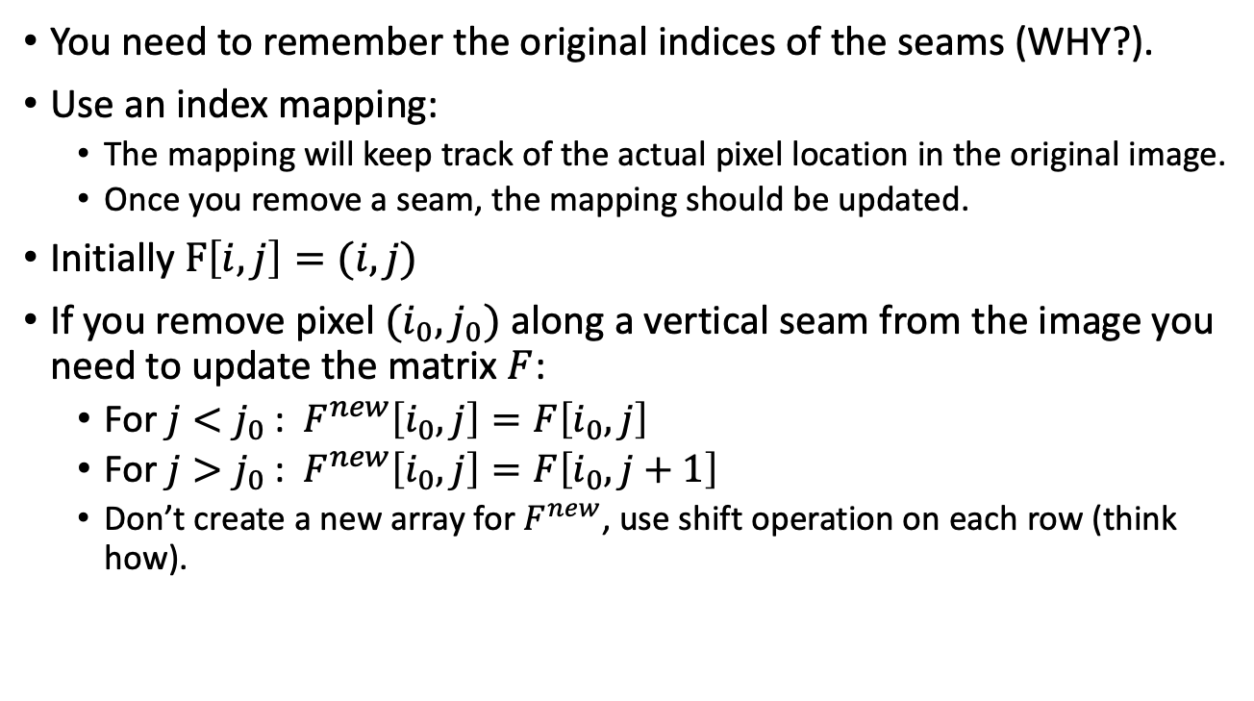
Remembering the indices - Vertical Case
You need to remember the original indices of the seams (WHY?).
Use an index mapping:
The mapping will keep track of the actual pixel location in the original image.
Once you remove a seam, the mapping should be updated.
Initially $F\left[i,j\right]=(i,j)$
If you remove pixel $(i_{0},j_{0})$ along a vertical seam from the image you need to update the matrix $F$:
For $j<j_{0}$ : ${ F}^{new}\left[i_{0},j\right]=F\left[i_{0},j\right]$
For $j>j_{0}$ : ${ F}^{new}\left[i_{0},j\right]=F\left[i_{0},j+1\right]$
Don’t create a new array for $F^{new}$, use shift operation on each row (think how).

Slide 10
Remembering the indices - Vertical Case
3 | 8 | 12 | 5
9 | 7 | 6 | 12
14 | 9 | 10 | 8
15 | 14 | 15 | 16
3 | 8 | 12 | 5
9 | 7 | 6 | 12
14 | 9 | 10 | 8
15 | 14 | 15 | 16
3 | 8 | 12 | 5
9 | 7 | 6 | 12
14 | 9 | 10 | 8
15 | 14 | 15 | 16
3 | 8 | 12 | 5
9 | 7 | 6 | 12
14 | 9 | 10 | 8
15 | 14 | 15 | 16
(0,0) | (0,1) | (0,2) | (0,3)
(1,0) | (1,1) | (1,2) | (1,3)
(2,0) | (2,1) | (2,2) | (2,3)
(3,0) | (3,1) | (3,2) | (3,3)
(0,1) | (0,2) | (0,3)
(1,0) | (1,2) | (1,3)
(2,0) | (2,2) | (2,3)
(3,0) | (3,2) | (3,3)

Slide 11

Remembering the indices - Vertical Case
Keep $I$ updated after removing each seam.
Accessing pixel $(i,j)$ in seam carving is translated into accessing pixel: $F\left[i,j\right]$ in the original image.
Once you find all seams.
Create an empty image with the desired size.
Copy the pixels from the original image.

Slide 12
Seam Carving – Horizontal case
We saw how to handle vertical seams (change image width)
Horizontal case - very similar
To avoid code duplication:
Rotate image 90 degrees Counter Clock-Wise (CCW)
Handle vertical seams on rotated image
Undo rotation - rotate image 90 Clock-Wise (CW)
Note - there are many ways to change image dimension:
Handle width resizing
Rotate and handle height resizing
Rotate back

Slide 13
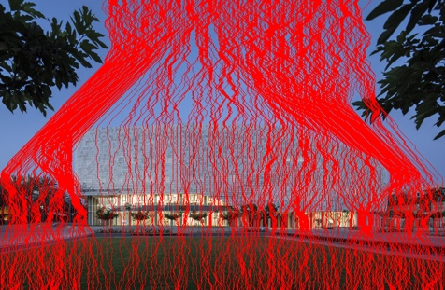
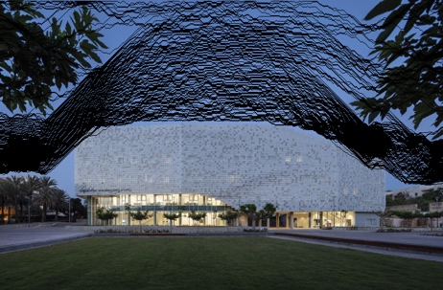
Seam Visualization

Slide 14
Python
The basics of image IO and manipulation

Slide 15
Open Image with Pillow
pil_image = PIL.Image.open(image_path)
numpy_image = np.array(pil_image, dtype=np.float32)
We will represent the pixels using floats so that we will be able to perform divison (relevant for the pixel energy formula)
numpy_image.shape:
Gives the dimensions of the image, for an RGB image, this should return the following tuple - (H,W,3) where H and W are height and with of the image

Slide 16
Working with images
(0,0)
j
Access pixel values with
numpy_image[i,j,:]
Rotating an image 90 Degrees CCW
np.rot90(numpy_image, k=1, axes=(0,1))
Rotating an image 90 Degrees CW
np.rot90(numpy_image, k=-1, axes=(0,1))
Copy an image:
image_copy = numpy_image.copy()
Create a zero_like copy of an image:
zeros_like = np.zeros_like(numpy_image)
zeros_like will have the same shape and dtype as numpy_image, but all values are zero.
Create a new zeros array:
np.zeros((H,W,3), dtype=np.float32)
i
(height-1, width-1)

Slide 17
Working with images – efficient imeplmentation
Efficient implementation of shifting an array at index j:
Fast: A[j:-1] = A[j+1:]
Slow: Equivilant to: for idx in range(j, A.shape[0]-1):
A[idx] = A[idx+1]
Example, A=[1,2,3,4,5,6], j=2, then the array becomes: [1,2,4,5,6,6]
Works for 2D arrays as well (images):
A[:, j:-1] = A[:, j+1:] # Along axis=1, i.e. width
A[j:-1, :] = A[ j+1:, :] # Along axis=0, i.e. height

Slide 18
Working with images
Let us try to calculate the difference between the left and right neighbor of a pixel (i,j):
Output[i,j] = |A[i,j-1] – A[i,j+1]|
If an elemnt is out of boundry just set to zero.
Option 1 (very slow):
for i in range(A.shape[0]): #i = 0…, H-1 for j in range(A.shape[1]): #j = 0,…,W-1 left = 0 if j == 0 else A[i,j-1] right = 0 if j == A.shape[1] -1 else A[i,j+1] Output[I,j] = abs(A[i,j-1] – A[i,j+1])

Slide 19
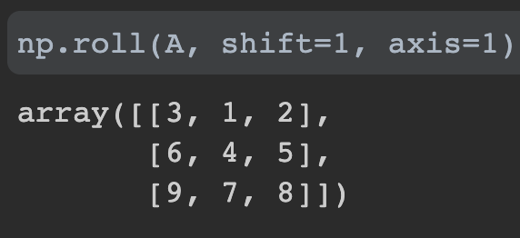
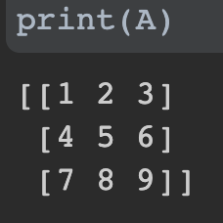
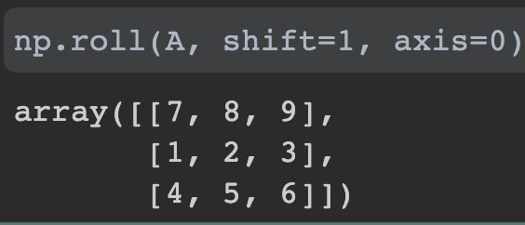
Working with images
Let us try to calculate the difference between the left and right neighbor of a pixel (i,j):
Output[i,j] = |A[i,j-1] – A[i,j+1]|
If an elemnt is out of boundry just set to zero.
Option 2 (using np.roll) - Faster:
Roll along width
Roll along height

Slide 20
Working with images
Let us try to calculate the difference between the left and right neighbor of a pixel (i,j):
Output[i,j] = |A[i,j-1] – A[i,j+1]|
If an elemnt is out of boundry just set to zero.
Option 2 (using np.roll) – Faster:
left = np.roll(A, shift = 1, axis=1) left[:,0] = 0 # Zero the first column in array ### Now left[i,j] = A[i,j-1] if j > 0 else 0 right = np.roll(A, shift = -1, axis=1) right[:, -1] = 0 # Zero the last column in array ### Now right[i,j] = A[i,j+1] if j < W-1 else 0 Output = np.abs(left-right)

Slide 21
Working with images
Let us try to calculate the difference between the left and right neighbor of a pixel (i,j):
Output[i,j] = |A[i,j-1] – A[i,j+1]|
If an elemnt is out of boundry just set to zero.
Option 3 (using np.concatenate – self read) – Fastest:
zero_column = np.broadcast_to([0.], [A.shape[1], 1]) left = np.concatenate([zero_column, A[:, 0:-1]], axis=1) right = np.concatenate([A[:, 1:], zero_column], axis=1) output = np.abs(left-right)

Slide 22
Working with images
Let us compare the two implementations:
Implementation 1 on input 100X100: 6.02 ms
Implementation 2 on input 100x100: 44.7 µs
~x120 times faster!
Implementation 3 on input 100x100: 33.1 µs (30% faster)

Slide 23
Save Image with Pillow
img_data = img_data.astype(np.uint8)
Pixels are stored as 3-bytes (RGB)
pil_img= PIL.Image.fromarray(img_data)
Convert from numpy to PIL
pil_img.save(path)
Save image using pillow

Slide 24
Exercise 1: Any other questions? moabarar@mail.tau.ac.il

