Slide 1
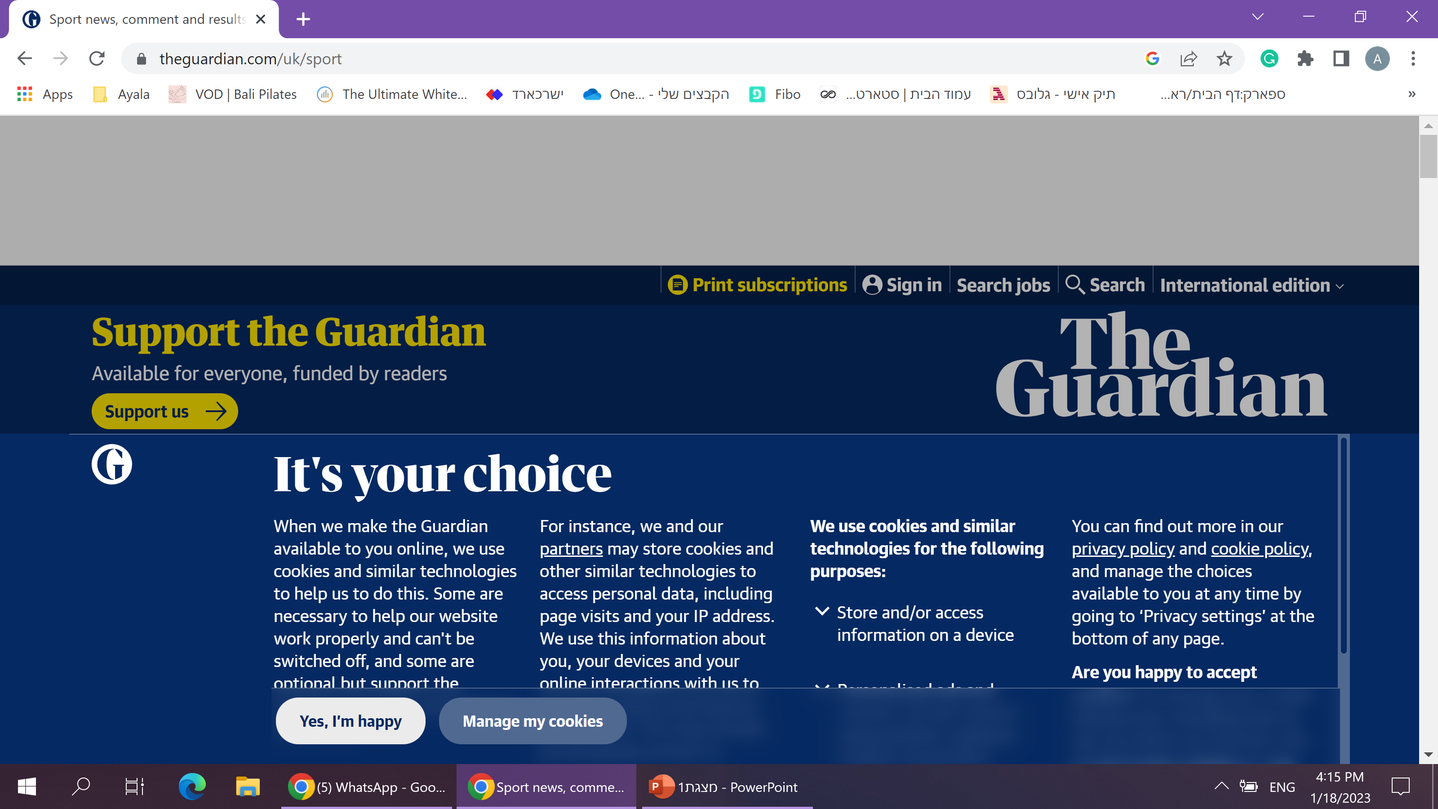






My favorite football website
Football updates – BBC sport | All you need to know about football - Wikipedia | Chris hogan fan’s page
Football statistics
Are you a Football fan?
Do you want to know everything based on real data?
Then this is the right place for you!
Against all odds!
Find all the data you want about teams who won even when the chances seem to be lost
team statistics
Had an argument with a friend about which team is better? Come here and get all the stats needed!
Players chosen in the “draft”
What are the max and min height and weight of players, divided by roles
Players’ stats according to roles
Have you ever wondered who is the best quarterback?
Biggest stadiums by states
Where, according to states, you can watch a game while the potential capacity of the stadium is the largest
Best “draft” choices
Which team got better picks in the draft?

Slide 2

My favorite football website
Football updates – BBC sport | All you need to know about football - Wikipedia | Chris hogan fan’s page
Against all odds!
Find all the data you want about teams who won even when the chances seem to be lost

Slide 3
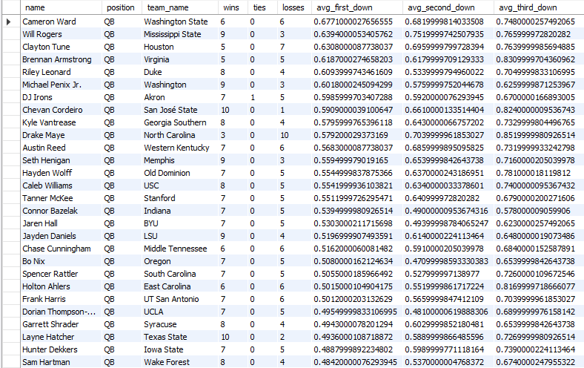
My favorite football website
Football updates – BBC sport | All you need to know about football - Wikipedia | Chris hogan fan’s page
Players’ stats according to roles
Have you ever wondered who is the best quarterback?

Slide 4
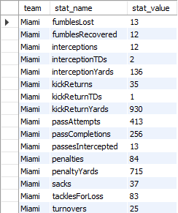
My favorite football website
Football updates – BBC sport | All you need to know about football - Wikipedia | Chris hogan fan’s page
Team’s statistics
Had an argument with a friend about which team is better? Come here and get all the stats needed!

Slide 5
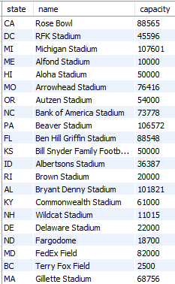
My favorite football website
Football updates – BBC sport | All you need to know about football - Wikipedia | Chris hogan fan’s page
Biggest stadiums by states
Where, according to states, you can watch a game while the potential capacity of the stadium is the largest

Slide 6
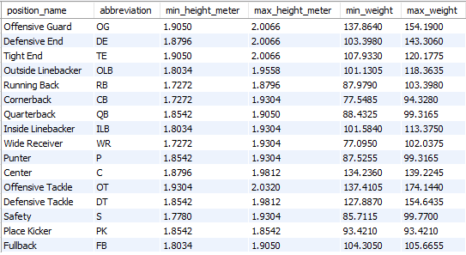
My favorite football website
Football updates – BBC sport | All you need to know about football - Wikipedia | Chris hogan fan’s page
Players chosen in the “draft”
What are the max and min height and weight of players, divided by roles

Slide 7
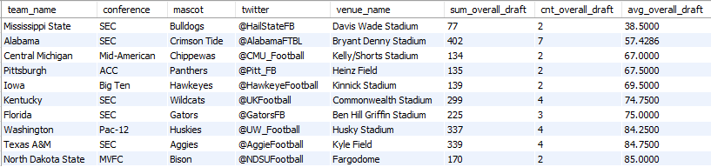
My favorite football website
Football updates – BBC sport | All you need to know about football - Wikipedia | Chris hogan fan’s page
Best “draft” choices
Which team got better picks in the draft?

