Slide 1
Drift and saccadic eye movements depend on the visual spatial bandwidth
Notes:
Personal note….

Slide 2

Questions to keep in mind
Is there a control mechanism to the saccadic movement?
Is there a control mechanism to the drift movement?
What are the controlled parameters of each movement?
What is the inner dynamic of each control loop?
What are the relationships between these two kinds of movements?
s
d

Slide 3
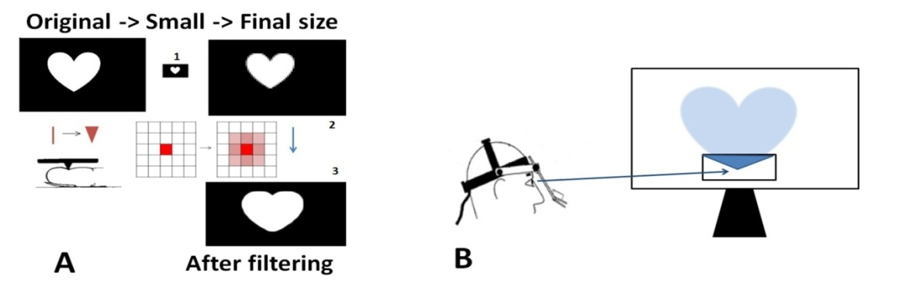
1 Methods
Large : 2.90°/10.80°
Small : 0.24°/0.90 °
Notes:
The vision to touch SenSub device:
3 fingertip pads with 8x4 pins each.
a camera at the tip of the device.
5 alternative force-choice identification task.
Each pin’s height is determined by the intensity of one matched pixel in the camera
A.(1) Reducing the amount of informative pixels.
(2) resizing the image to its final size.
(3) “finger” filtering the image - Elastic Modulus, (Haven, 1989|).
B. Only a window around the participant gaze was revealed.

Slide 4
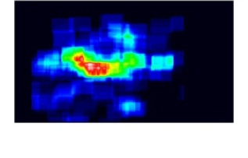
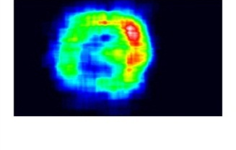
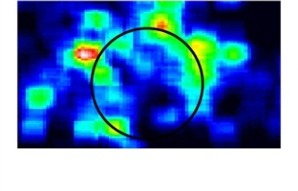
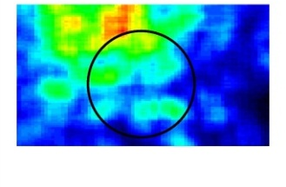
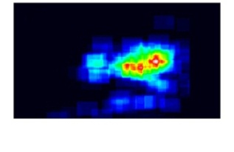
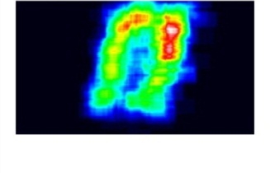
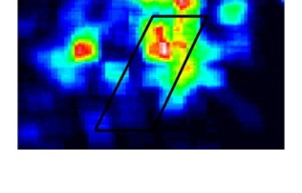
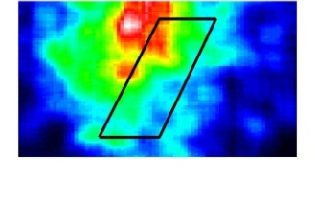
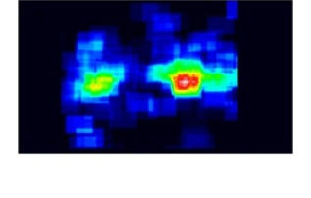
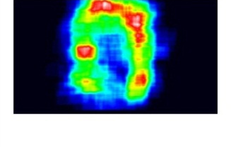
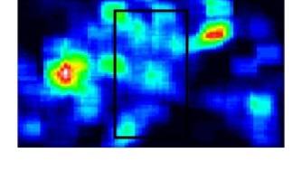
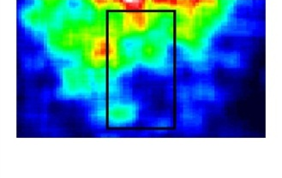
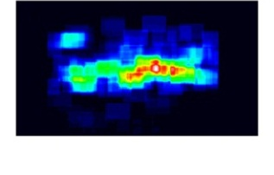
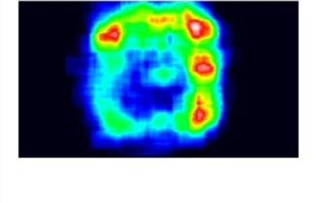
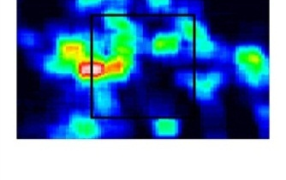
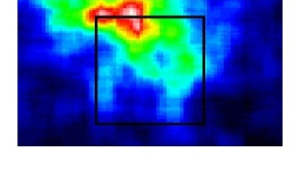
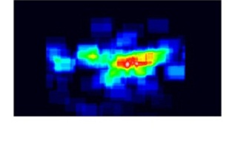
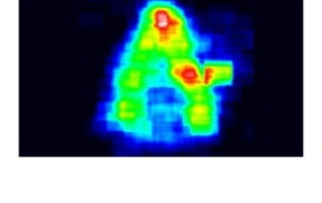
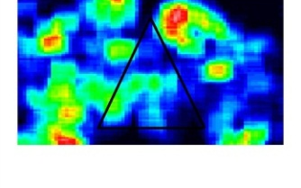
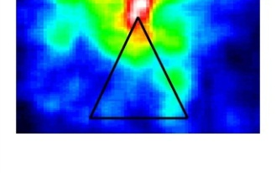
2 Visit rates heat maps
A B C D
5° 5° 1° 1°

Slide 5
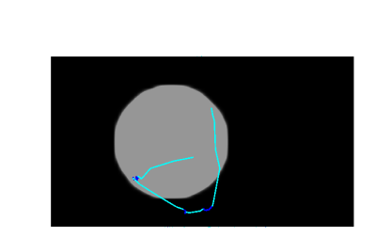
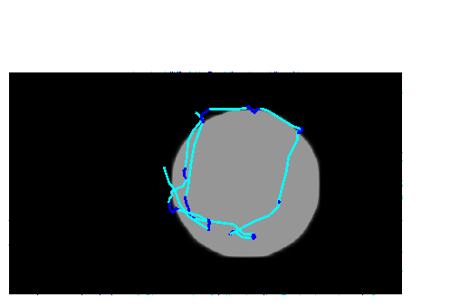
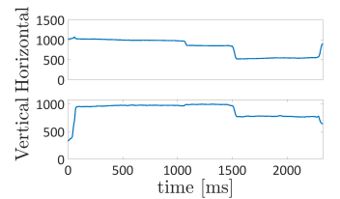
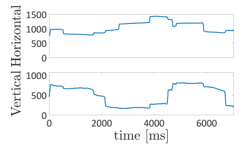
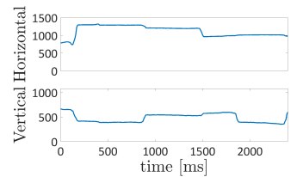
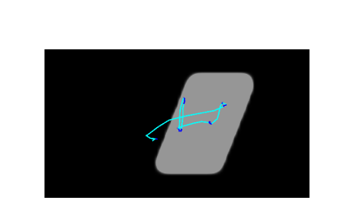
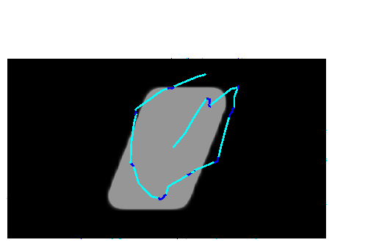
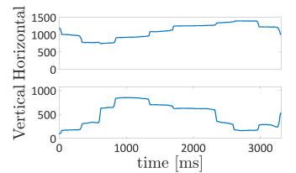
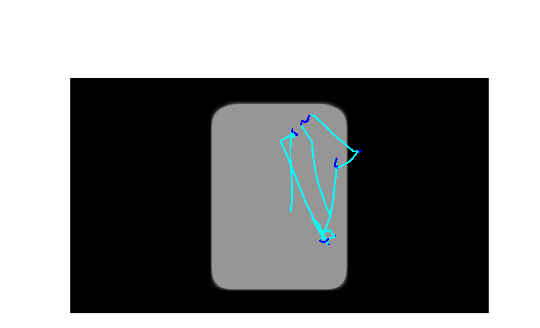
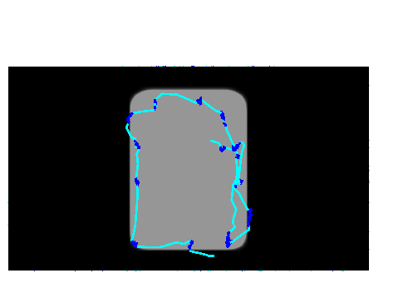
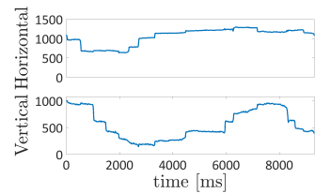
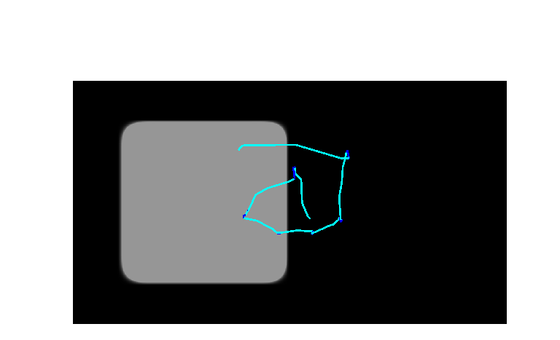
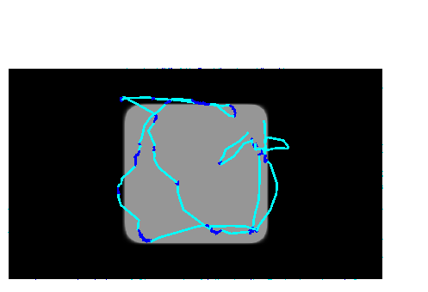
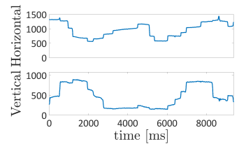
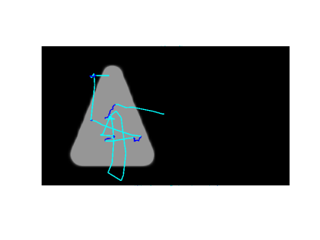
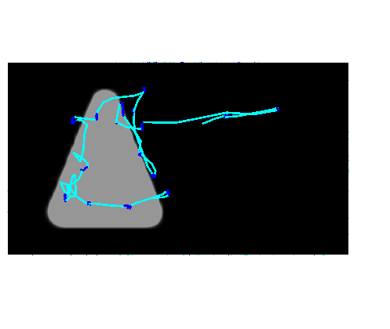
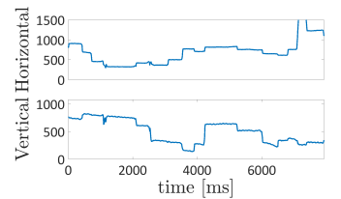
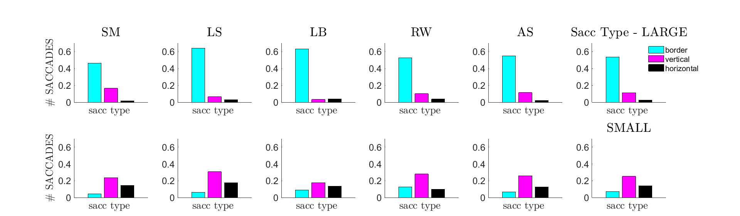
3 Saccades and drift detection
A
B
5°
5°
Notes:
a velocity based algorithm developed by Amos Arieli
(based on previous algorithm introduced by Engbert and Kliegl, 2003
and improved by Bonneh et al., 2010).
saccades (includes all saccades):
min amp=0.16 deg
min velocity=8deg/sec
min peak velocity=16 deg/sec
drifts:
anything between the saccades
min duration=30 msec

Slide 6
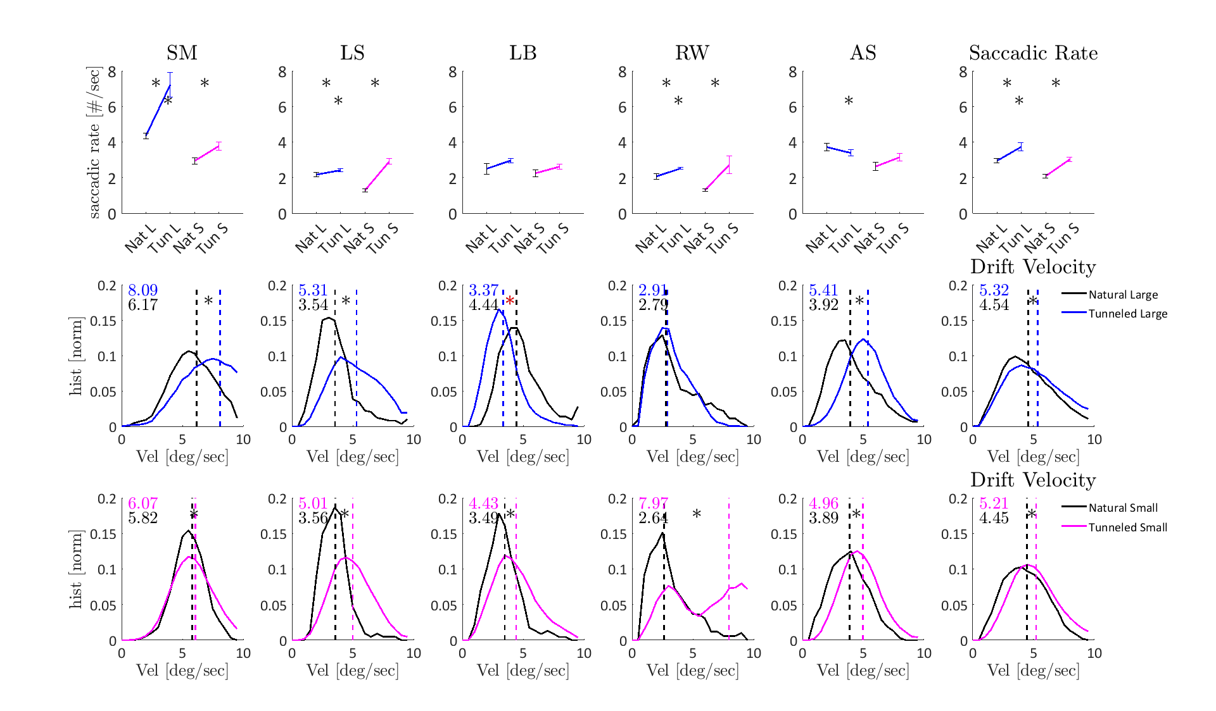
4 Eye movement motor -saccadic rate and drift velocity increased
A
B

Slide 7
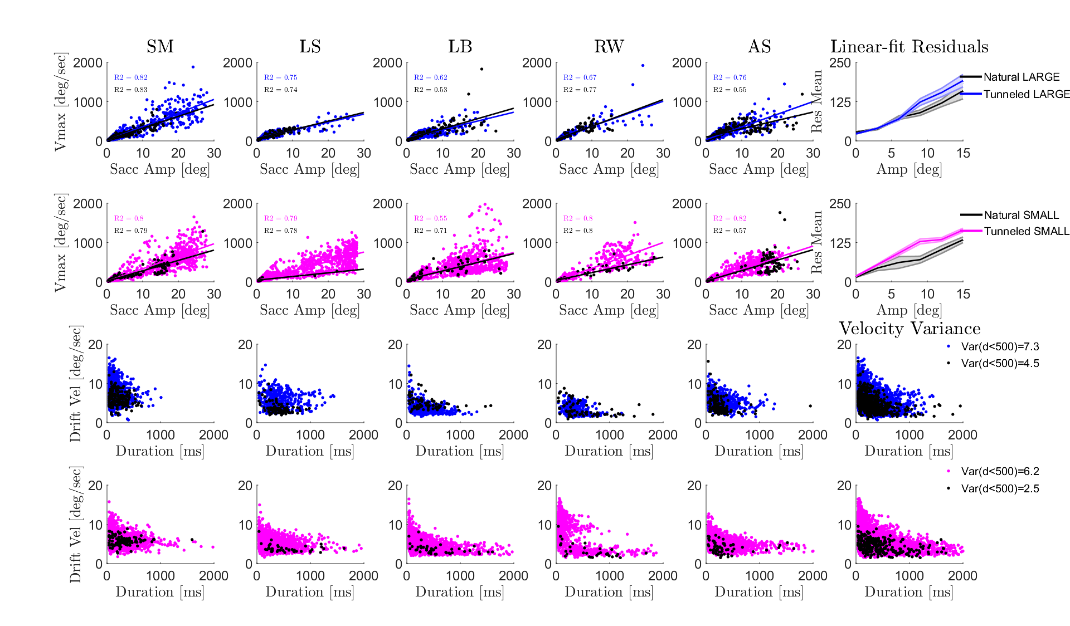
5 Variations -Saccadic main sequence -Drift Velocity
A
B

Slide 8
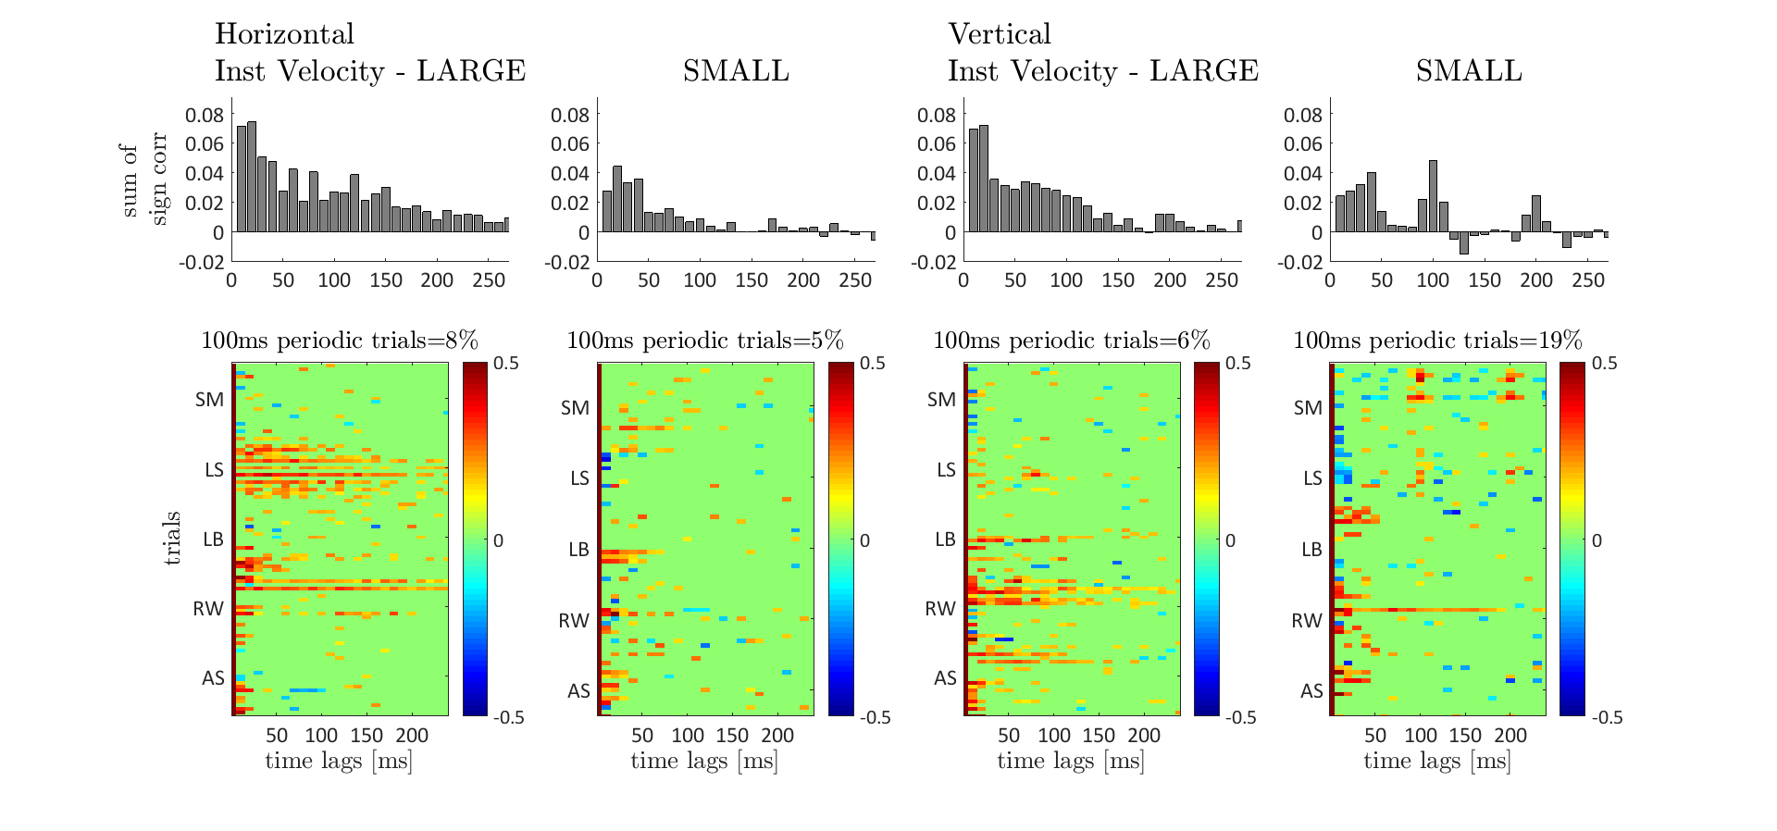
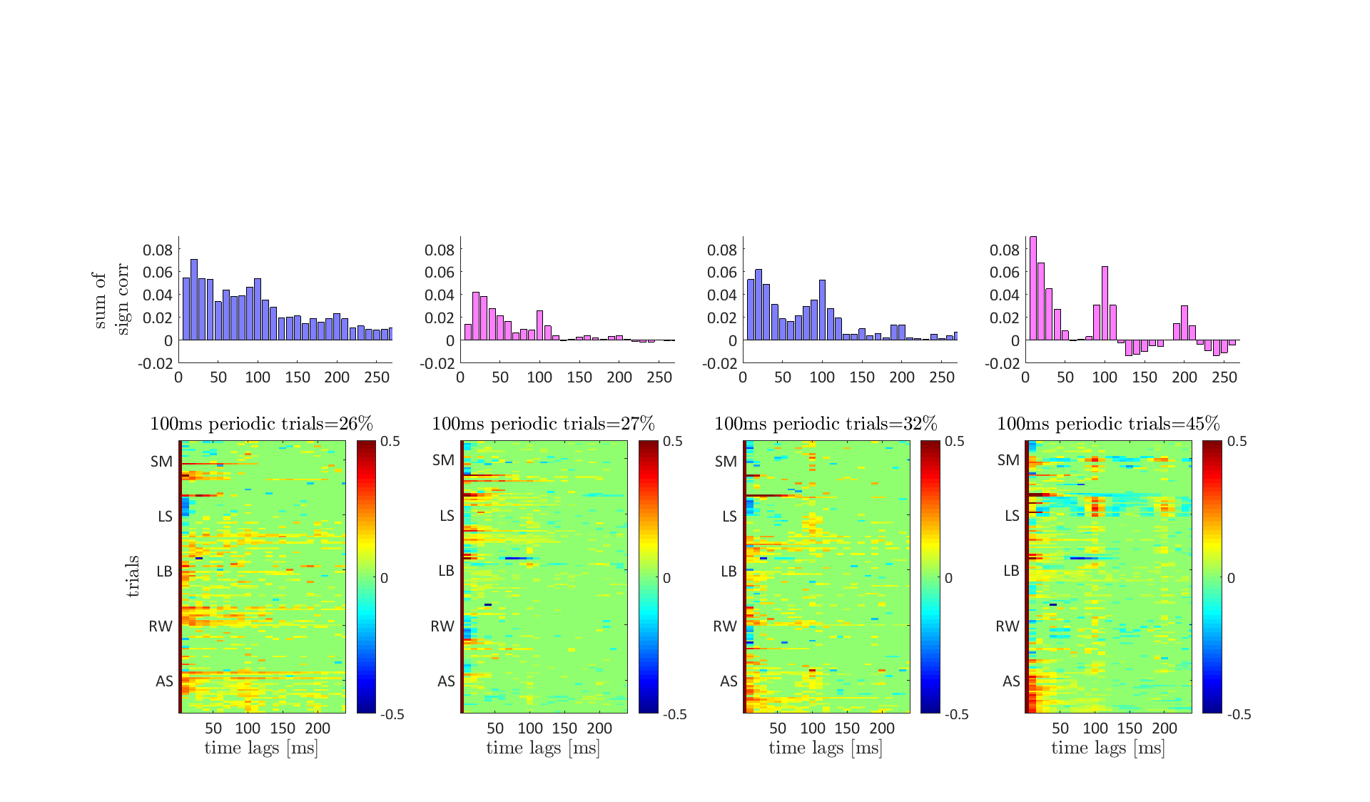
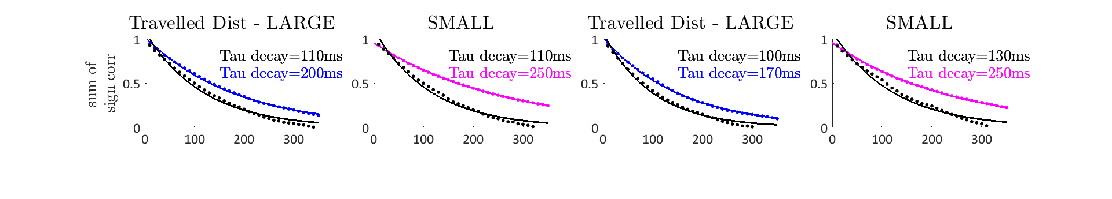
6 Instantaneous Velocity - Instantaneous Velocity - Traveled Distance
A
B
C

Slide 9
Results Summary
The mode of the distribution of visual gaze moved from the center of the images to their contours.
Majority of saccades followed the borders, where also drift shape was always straight.
Saccadic rate as well as drift velocity increased.
Saccadic and drift velocity were more variant.
More periodicity was found in drift velocity.

Slide 10
Conclusion
visual perception with limited sensory spatial bandwidth required strategical changes in the control of both saccades and drift.
s
d
Type/ Size | Natural | Tunneled
Big
Small
More saccades
Less saccades
Faster drift
Less saccades
More saccades
Faster drift
What is the controlled parameter?
Number of samples <-> Amount of information per sample
Information <-> Preciseness
Notes:
Natural - > Tunneled. more saccades and the drift velocity follows.
Big - > Small. Longer drift and the saccadic rate follows.

Slide 11




