Slide 1
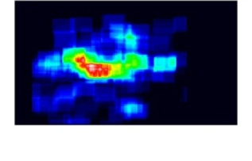
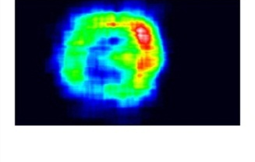
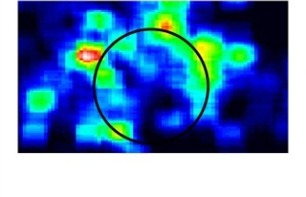
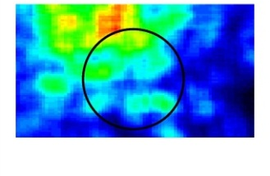
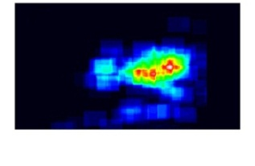
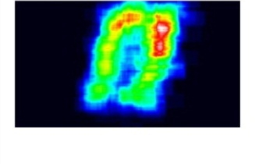
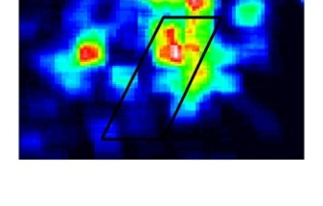
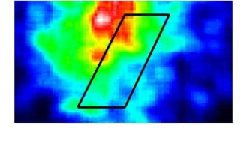
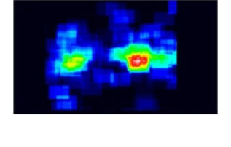
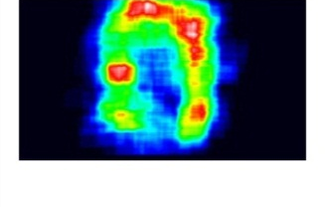
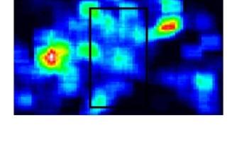
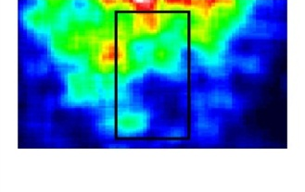
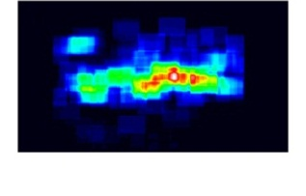
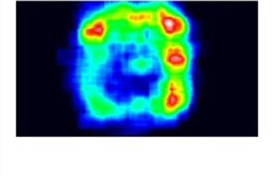
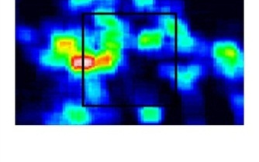
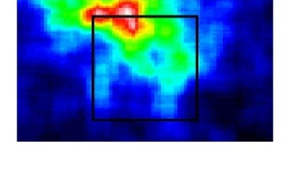
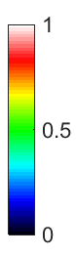
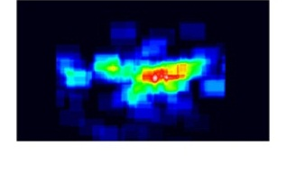
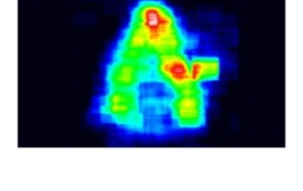
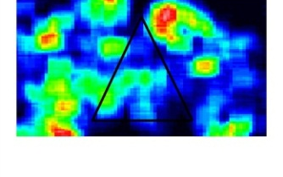
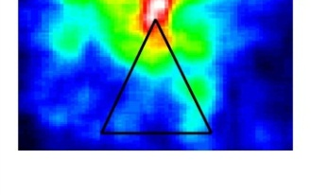

a b c d
5° 5° 0.5° 0.5°

Slide 2
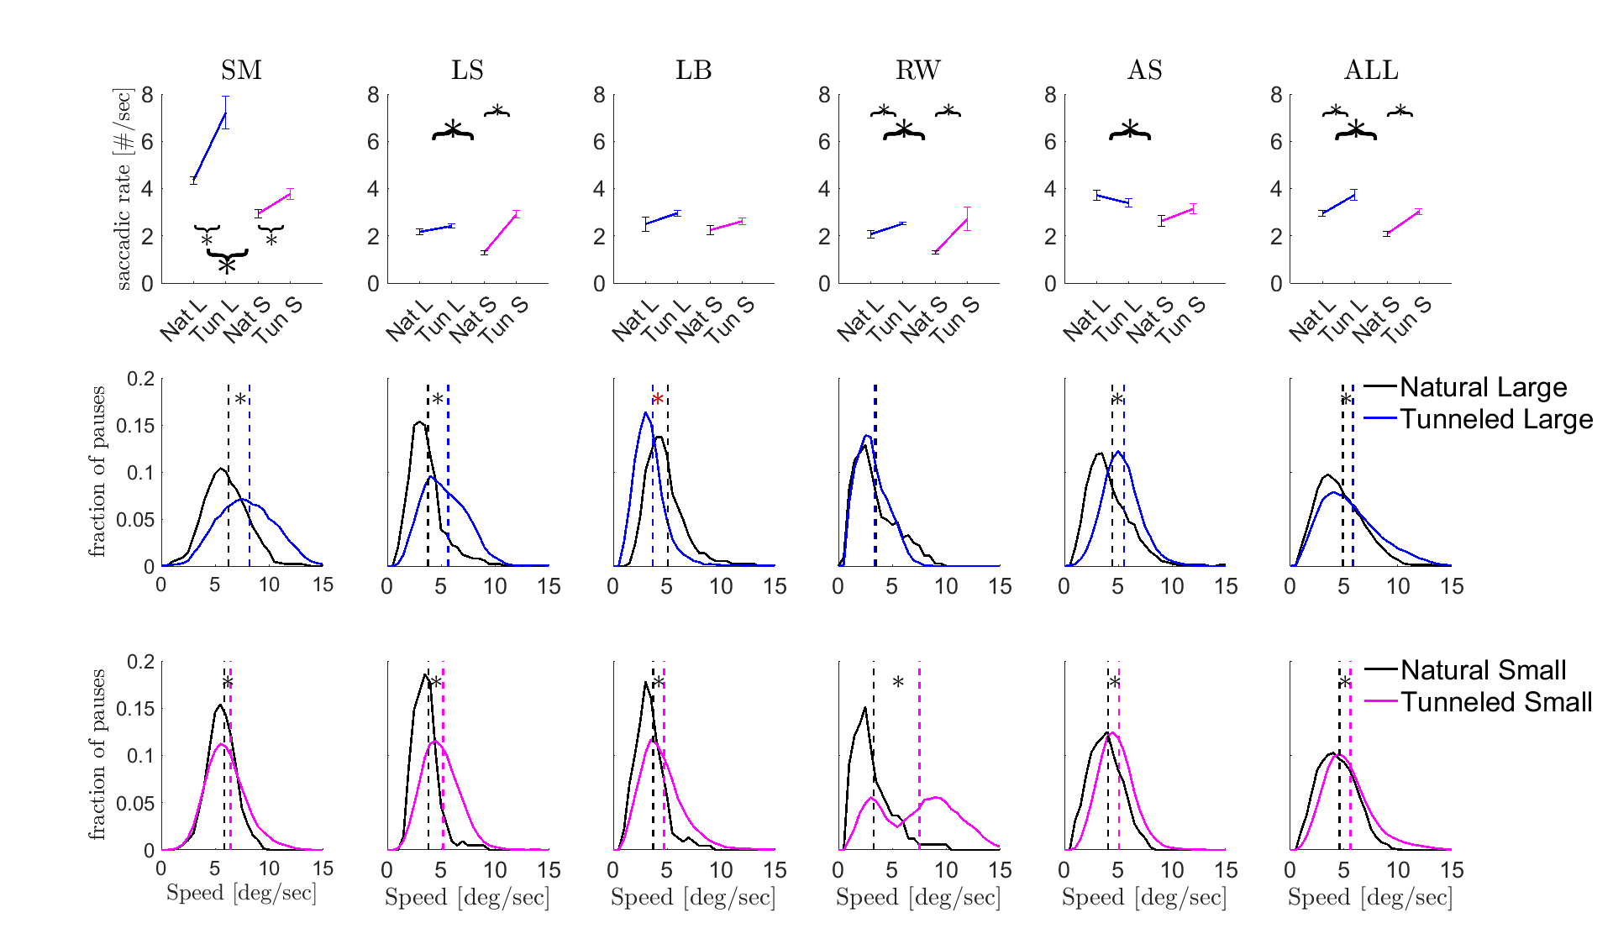
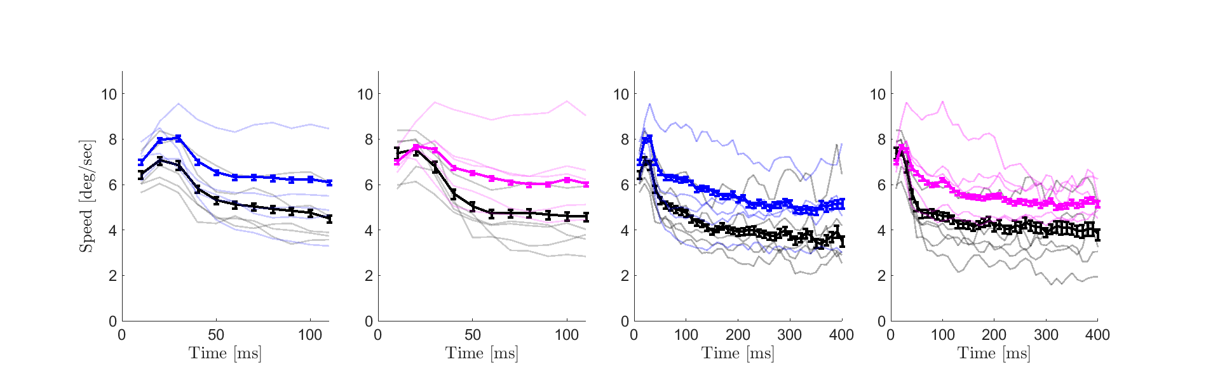
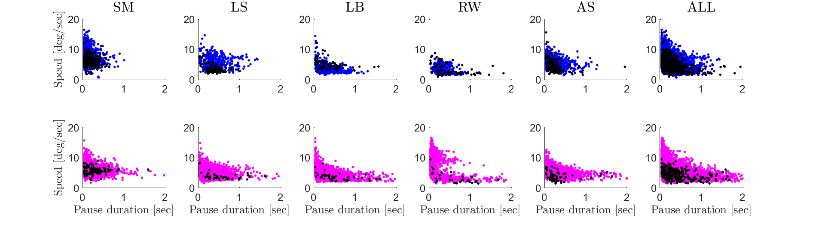
a
Saccadic rate [#/sec]
b
Fraction of pauses
Mean drift speed per pause [deg/sec]
c
Drift instantaneous speed
[deg/sec]
d
Time from pause onset [ms]
Mean drift speed per pause
[deg/sec]
Pause duration [sec]

Slide 3
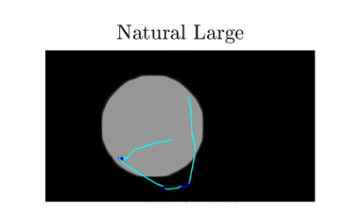
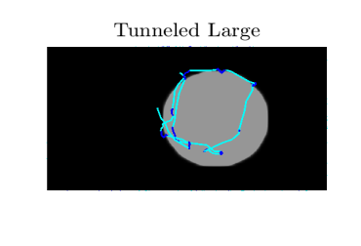
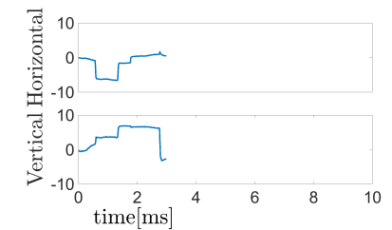
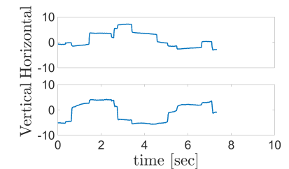
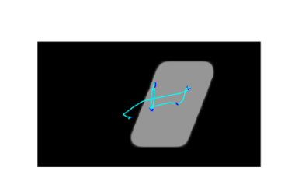
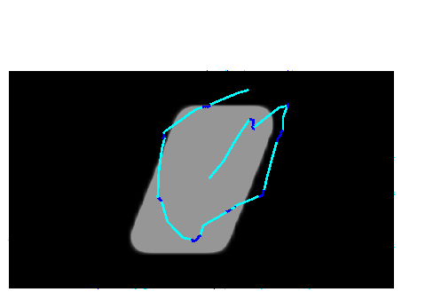
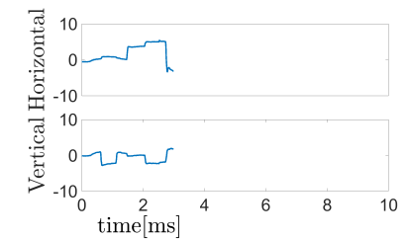
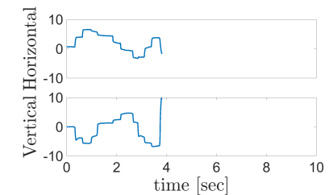
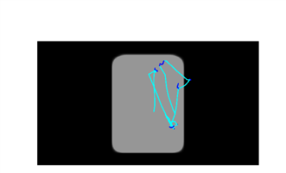
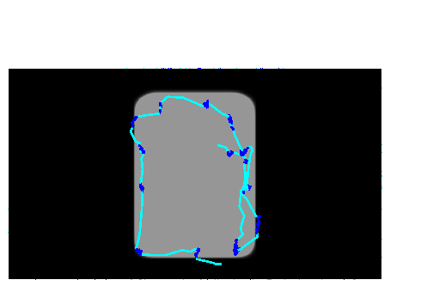
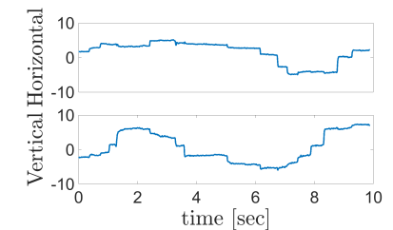
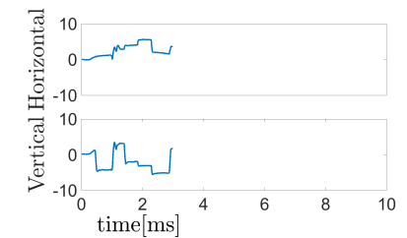
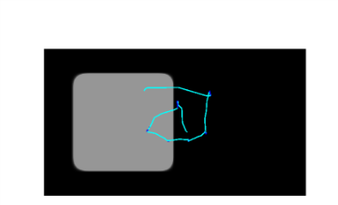
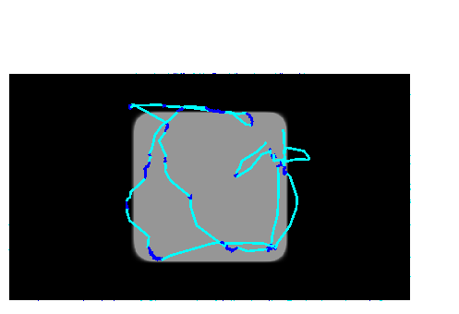
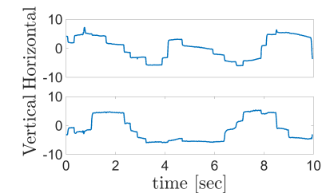
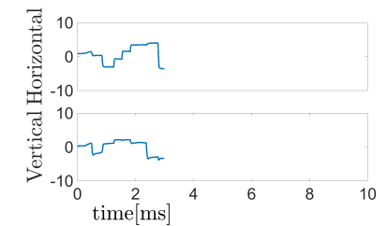
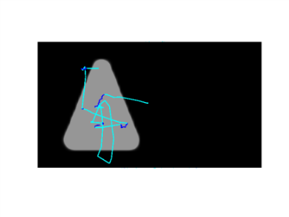
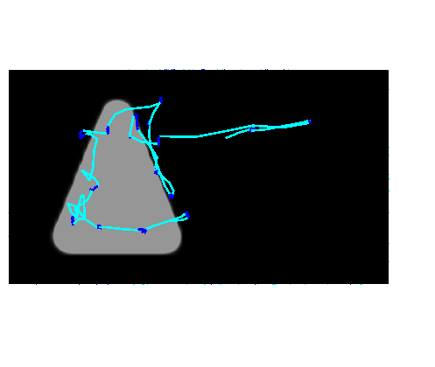
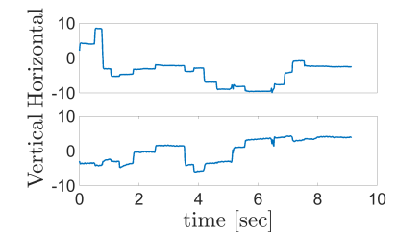
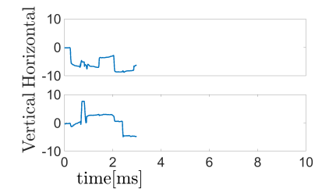
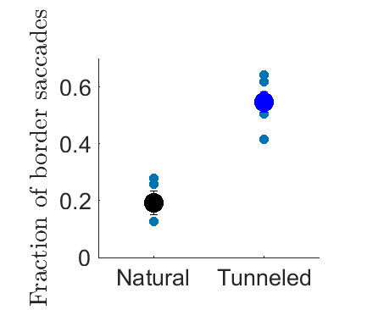
a
5°
5°
b

Slide 4
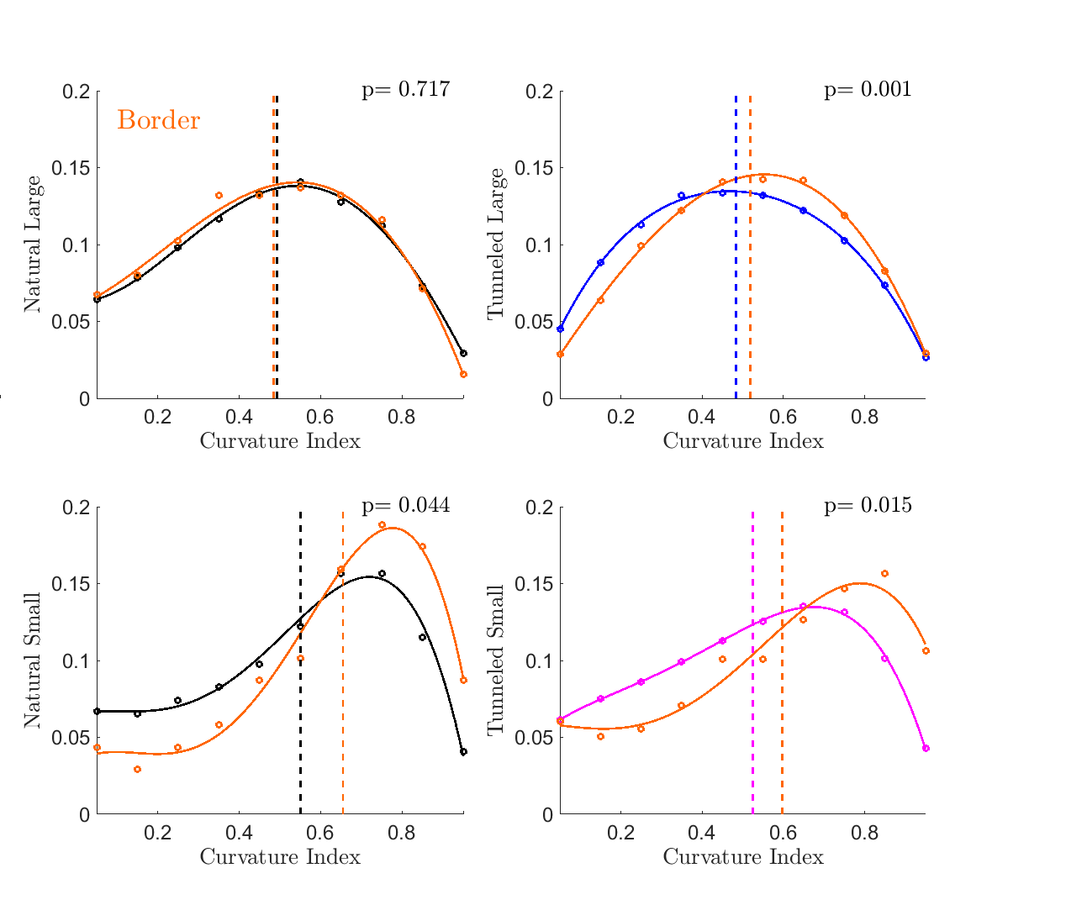
a b
c d

Slide 5
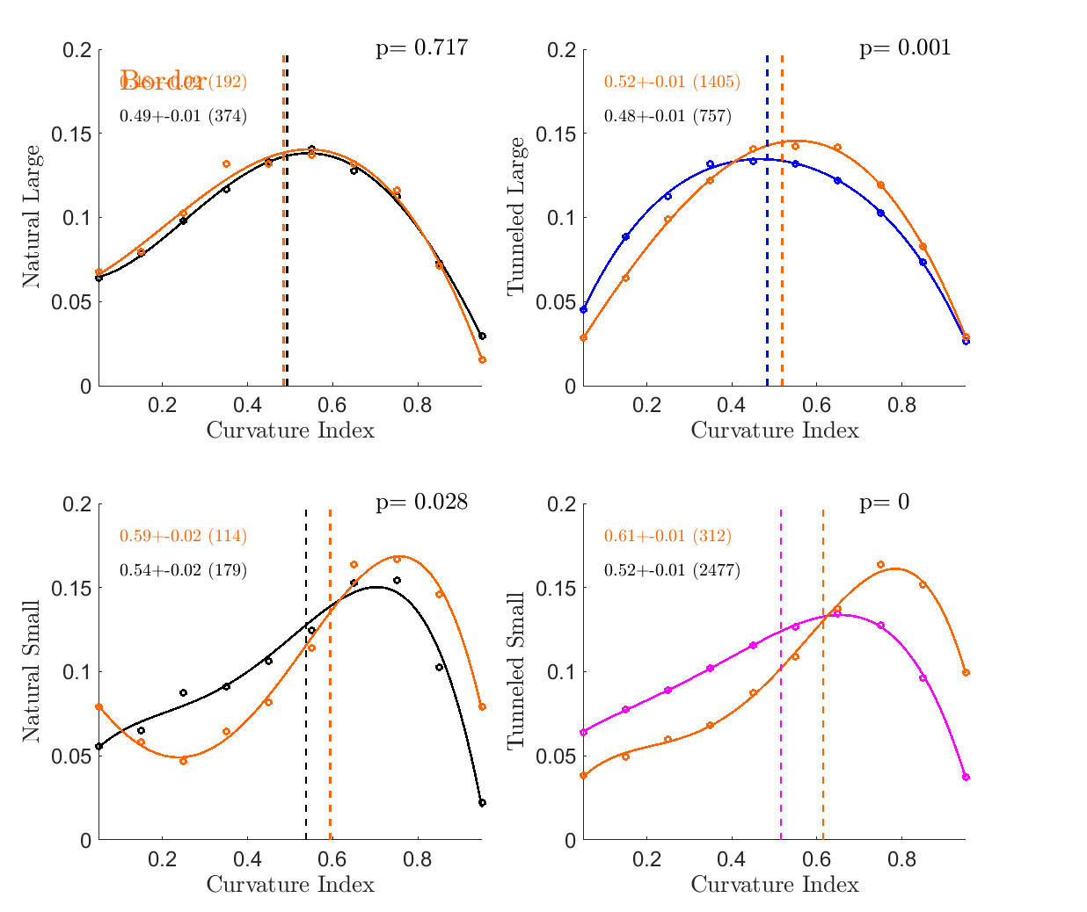
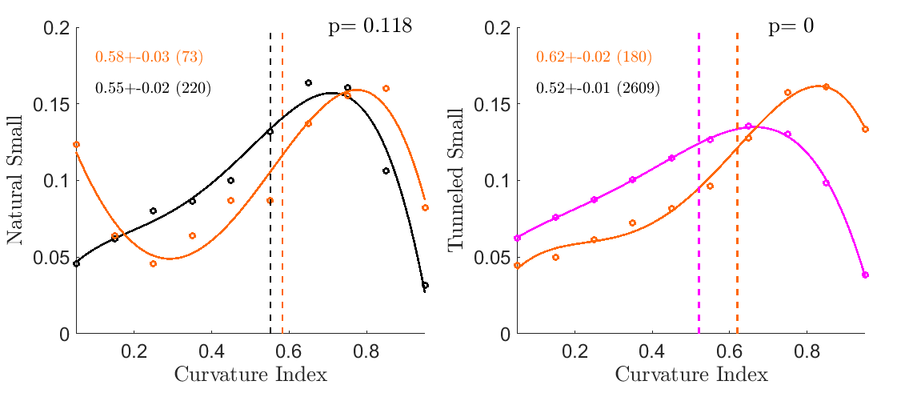
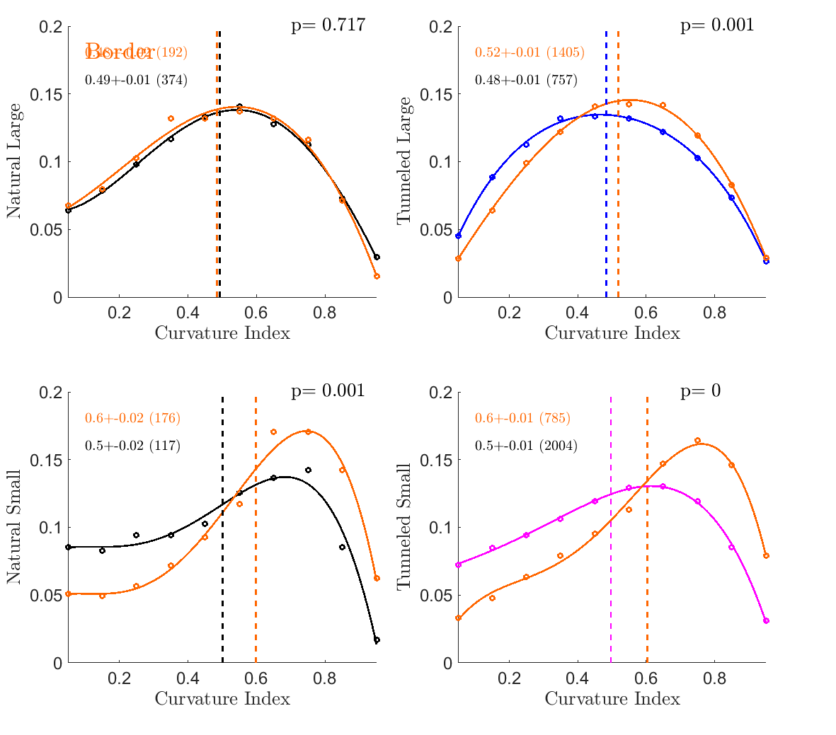
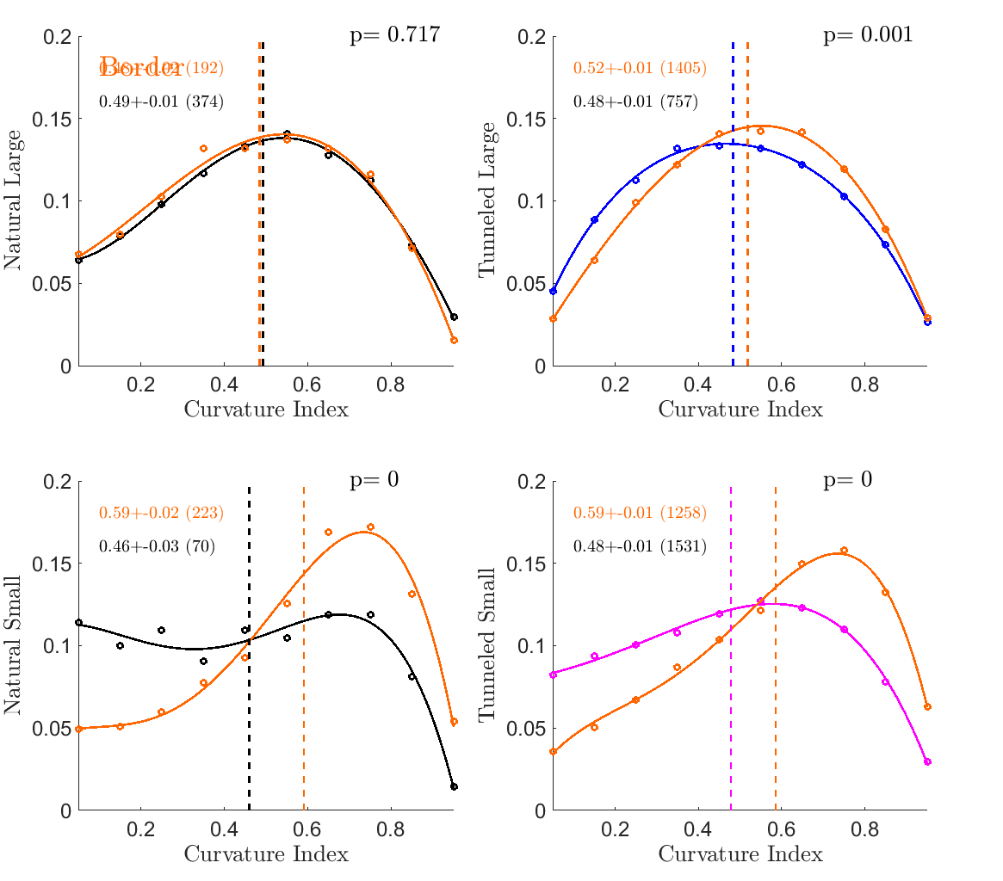
20
30
60
100

Slide 6
sup

Slide 7

Supplementary figure 1
Supplementary table 1
 | Natural Large | Tunneled full trials | Tunneled 3-seconds | Natural Small | Tunneled full trials | Tunneled 3-seconds
Saccadic rate [#/sec] | 2.9±0.1 | 3.7±0.2 (p<0.05) | 3.8±0.2 (p<0.05) | 2.0±0.1 | 3.0±0.1 (p<0.05) | 3.8±0.7 (p<0.05)
Drift speed [deg/sec] | 4.9±0.1 | 5.8±0.1 (p<0.05) | 5.3±0.1 (p<0.05) | 4.6±0.1 | 5.6±0.1 (p<0.05) | 6.7±0.3 (p<0.05)
Drift speed variance | 4.5±0.6 | 7.3±0.8 (p<0.05) | 7.8±0.7 (p<0.05) | 2.5±0.2 | 6.2±1.7 (p<0.05) | 5.6±0.6 (p<0.05)

Slide 8
Supplementary table 2
Tunneling effect: Xp is maintained per size |  |  | Size effect: Xt is maintained per task
Xp | Distance per Pause |  | Xt | Distance per Second
NB | 1.33±0.04 |  | NB | 3.85±0.23
B | 1.40±0.04 |  | NS | 3.54±0.31
NS | 1.77±0.08 |  | B | 5.18±0.41
S | 1.63±0.08 |  | S | 4.89±0.39
 | Drift speed | “Info per Pause” Drift amp | Saccadic rate | “Info per Second” Saccadic rate X Drift amp
NB | 4.86+0.09 | 1.33±0.04 | 2.9+0.1 | 2.9x1.33=3.85±0.23
B | 5.81+0.05 | 1.40±0.04 | 3.7+0.2 | 3.7x1.40=5.18±0.41
NS | 4.56+0.09 | 1.77±0.08 | 2.0+0.1 | 2.0x1.77=3.54±0.31
S | 5.6+0.03 | 1.63±0.08 | 3+0.1 | 3.0x1.63=4.89±0.39

Slide 9
EXTRA

Slide 10



Instantaneous Velocity - Instantaneous Velocity - Traveled Distance
a
b
c

