Slide 1
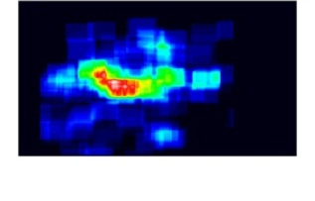
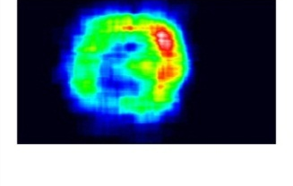
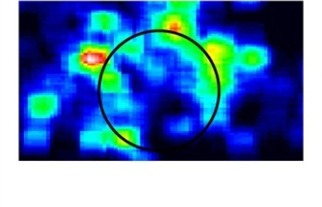
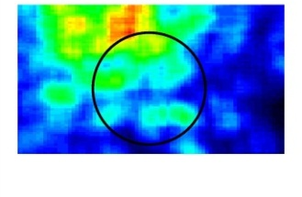
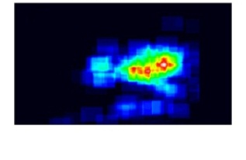
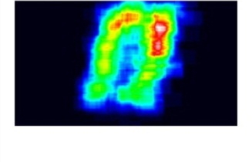
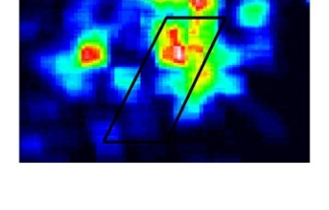
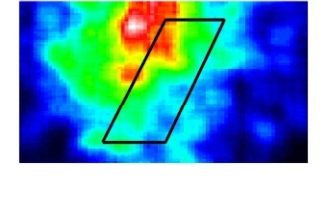
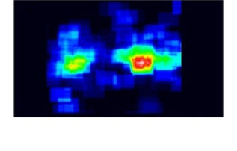
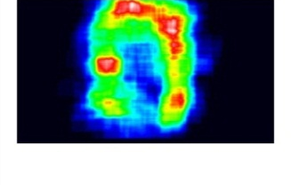
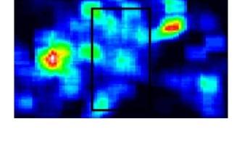
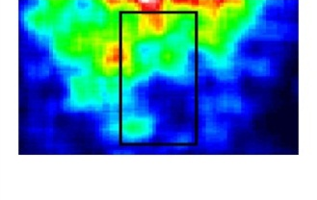
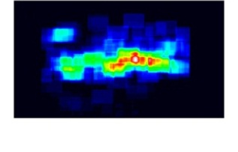
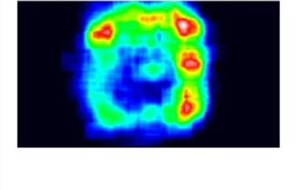
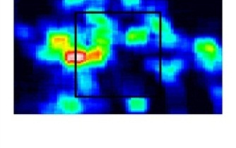
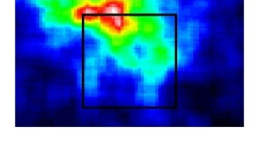
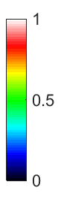
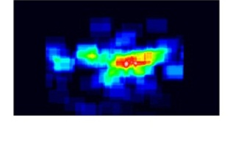
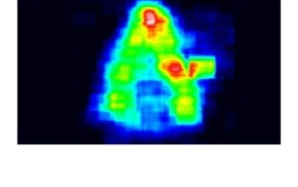
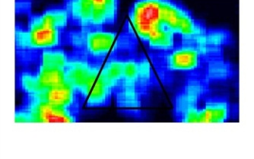
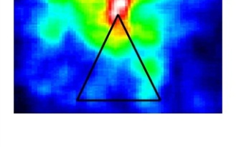
Gruber, Figure 1
a b c d
5° 5° 0.5° 0.5°

Slide 2
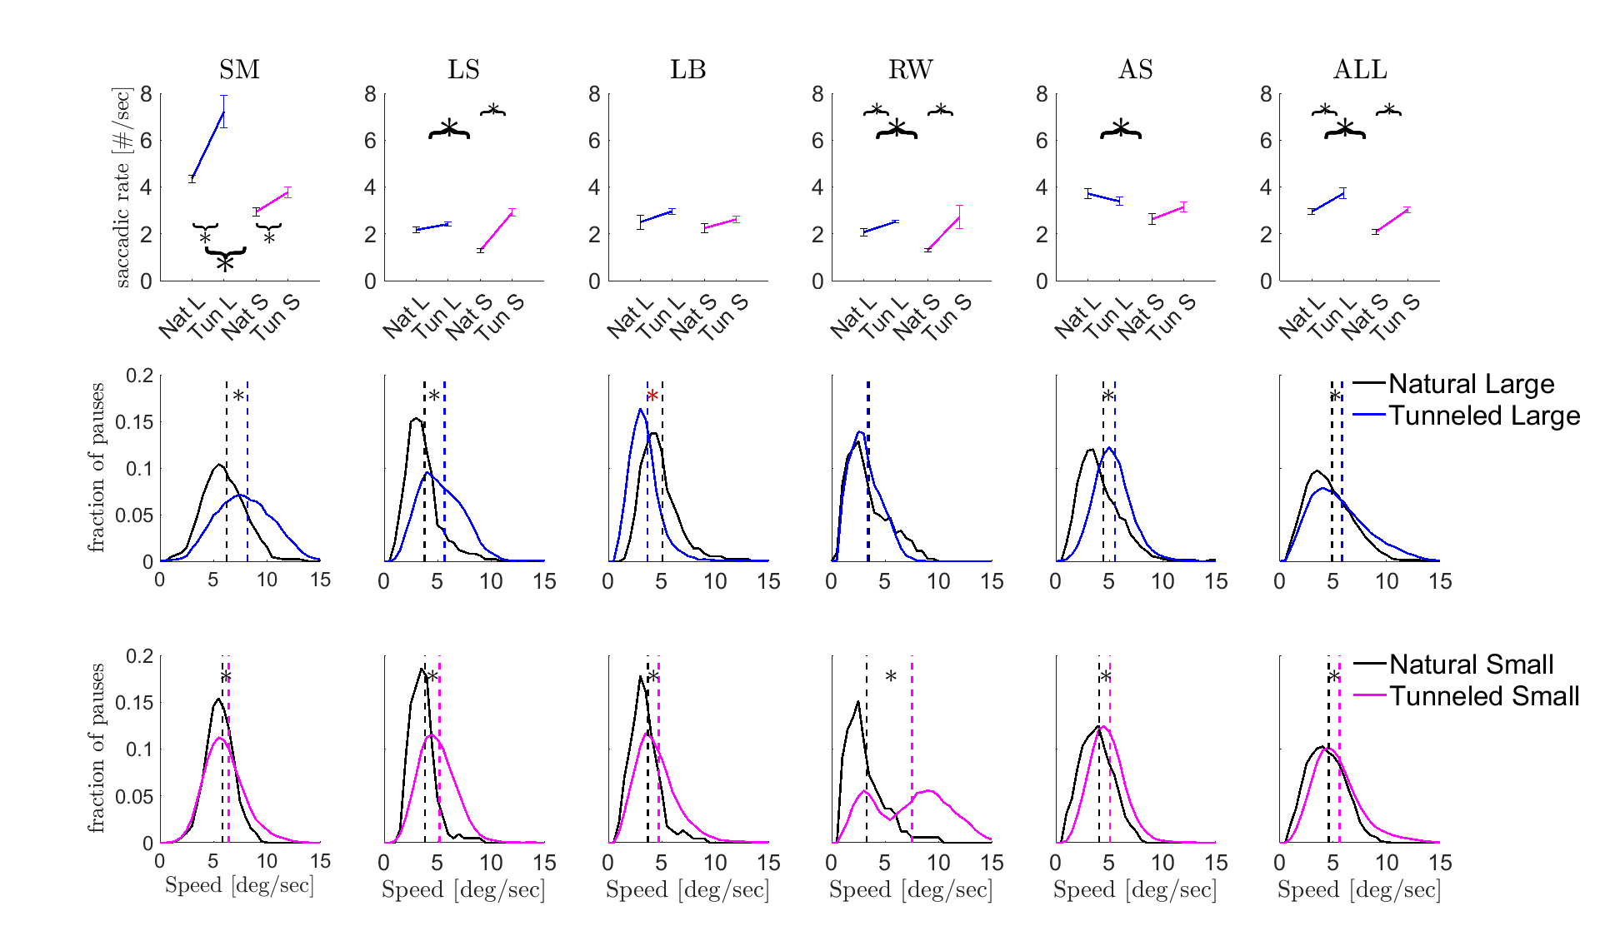
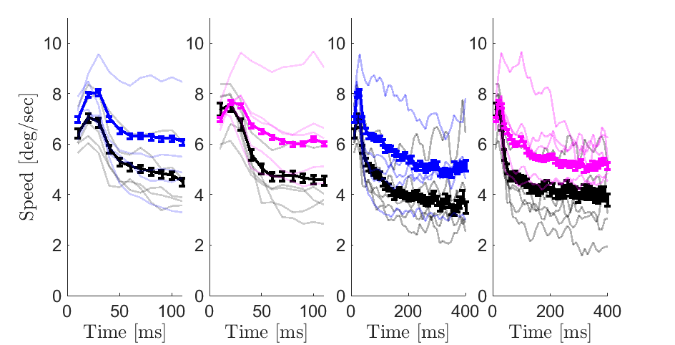
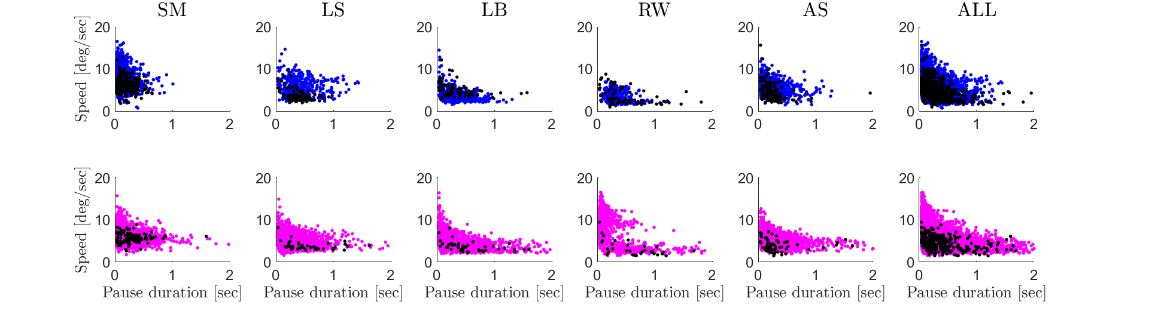
Gruber, Figure 2
a
Saccadic rate [#/sec]
b
Fraction of pauses
Mean drift speed per pause [deg/sec]
c
d
 | Sp | Xp | Rs
NL | 4.86+0.09 | 1.33±0.04 | 2.9±0.1
TL | 5.81+0.05 | 1.40±0.04 | 3.7±0.2
NS | 4.56+0.09 | 1.77±0.08 | 2.0±0.1
TS | 5.60+0.03 | 1.63±0.08 | 3.0±0.1
Drift instantaneous speed
[deg/sec]
e
Time from pause onset [ms]
Mean drift speed per pause
[deg/sec]
Pause duration [sec]

Slide 3
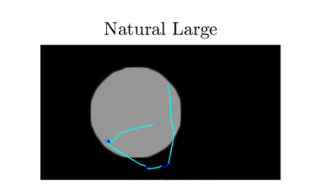
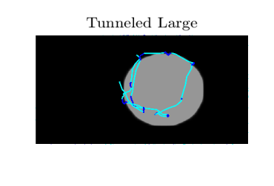
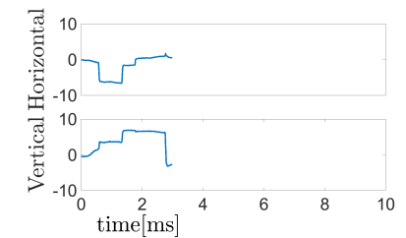
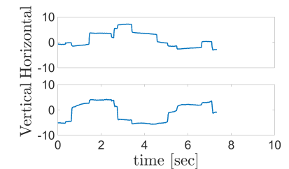
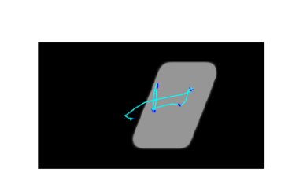
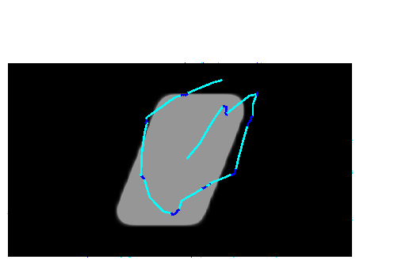
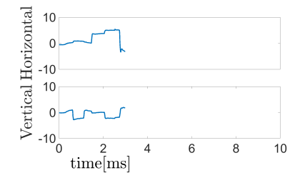
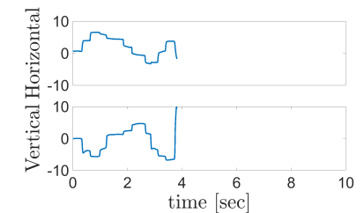
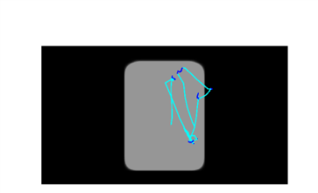
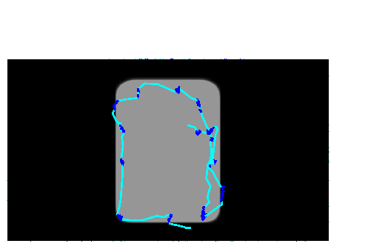
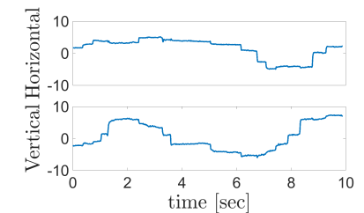
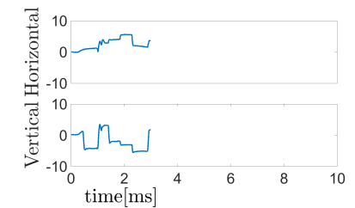
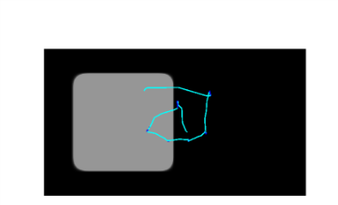
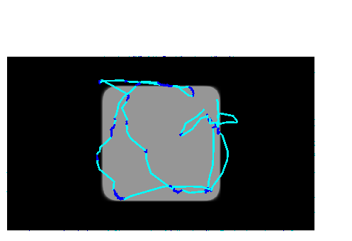
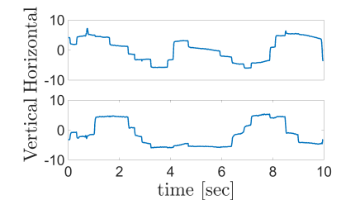
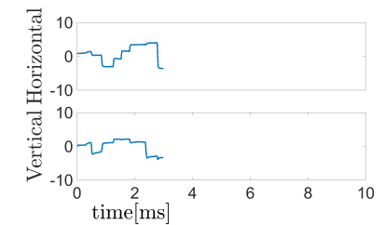
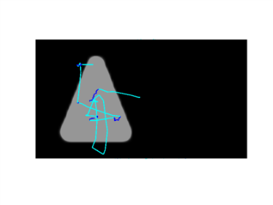
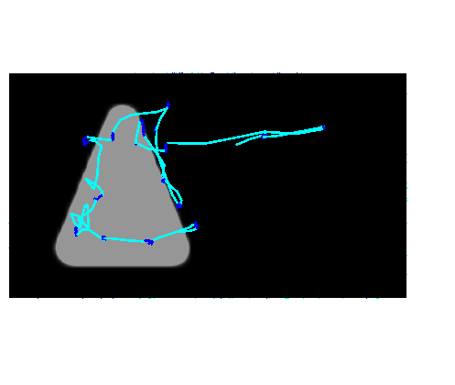
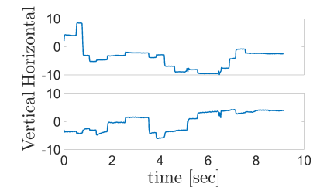
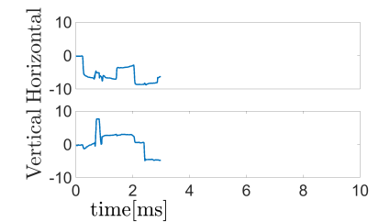
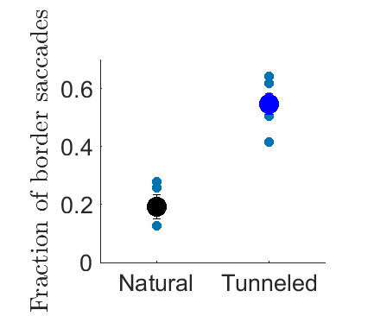
Gruber, Figure 3
a
5°
5°
b

Slide 4
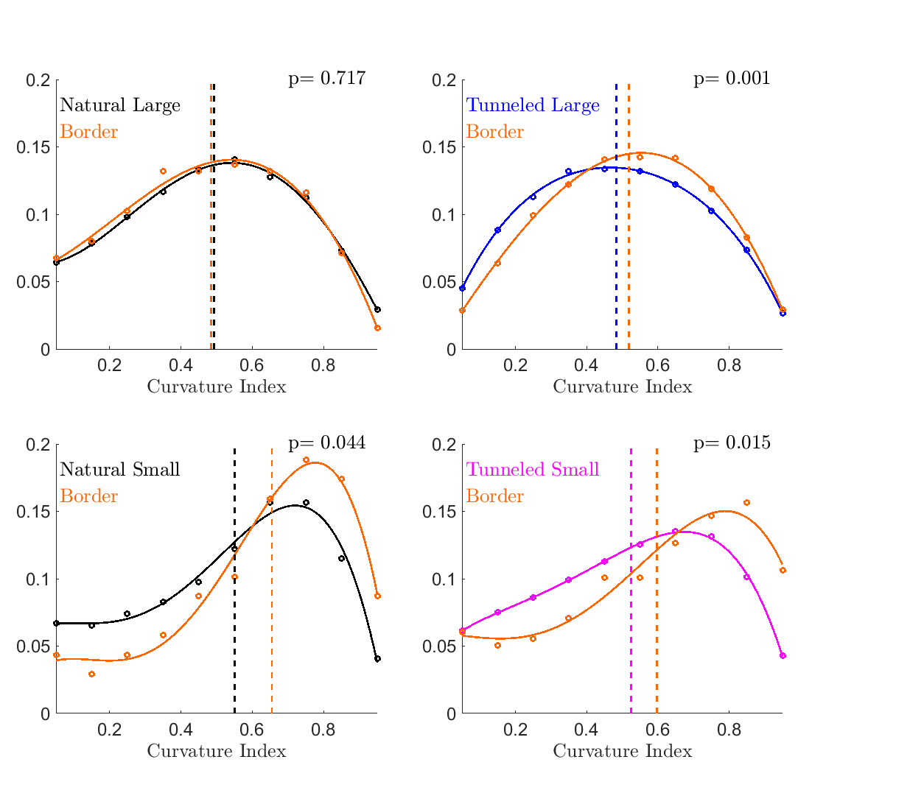
Gruber, Figure 4
a
b
Fraction of pauses
c
d

Slide 5
sup

Slide 6
Gruber, Extended Data Table 1
 | Natural Large | Tunneled full trials | Tunneled 3-seconds | Natural Small | Tunneled full trials | Tunneled 3-seconds
Saccadic rate [#/sec] | 2.9±0.1 | 3.7±0.2 (p<0.05) | 3.8±0.2 (p<0.05) | 2.0±0.1 | 3.0±0.1 (p<0.05) | 3.8±0.7 (p<0.05)
Drift speed [deg/sec] | 4.9±0.1 | 5.8±0.1 (p<0.05) | 5.3±0.1 (p<0.05) | 4.6±0.1 | 5.6±0.1 (p<0.05) | 6.7±0.3 (p<0.05)
Drift speed variance | 4.5±0.6 | 7.3±0.8 (p<0.05) | 7.8±0.7 (p<0.05) | 2.5±0.2 | 6.2±1.7 (p<0.05) | 5.6±0.6 (p<0.05)

Slide 7
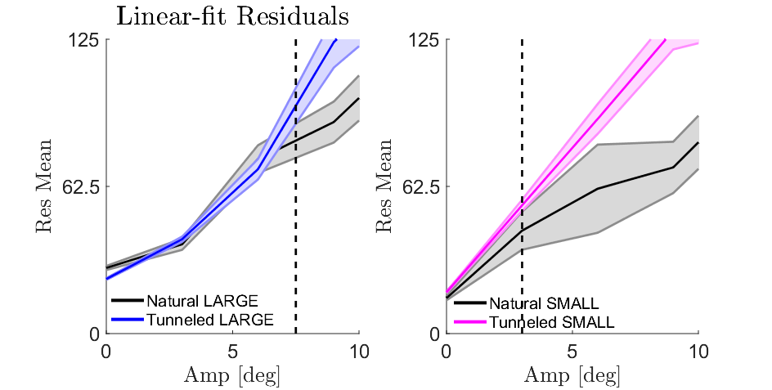
Gruber, Extended Data Figure 1

Slide 8
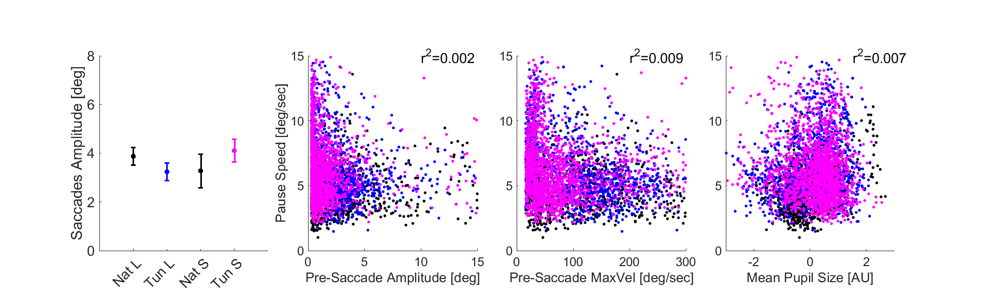
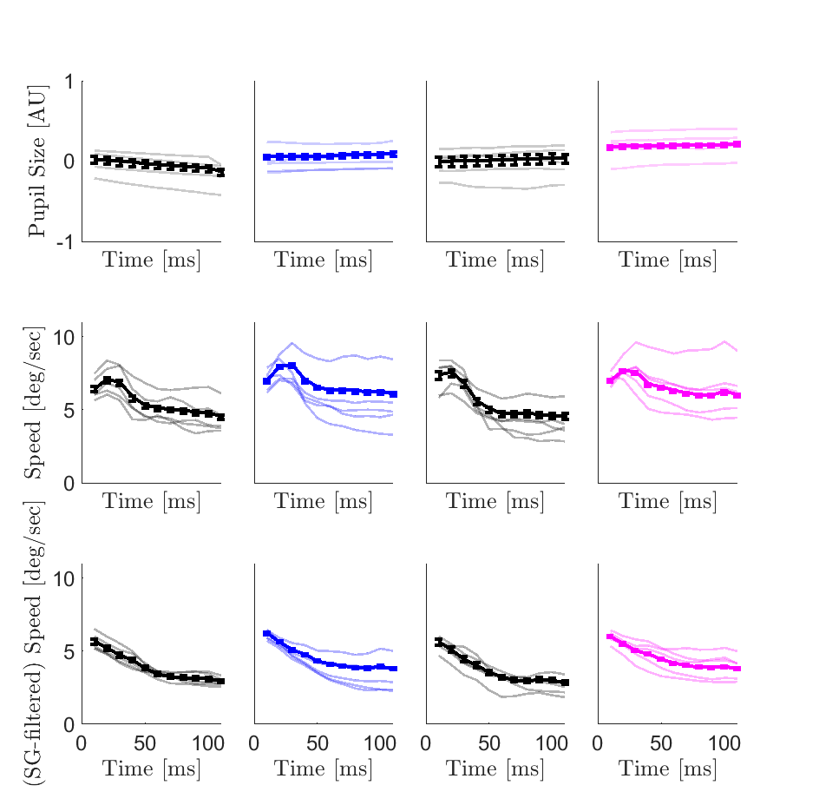
Gruber, Extended Data Figure 2
a
b
c
d
e
f
g
Time from pause onset [ms]

