Slide 1
SDN Load Balancer
By Michal Shagam
and Dekel Auster

Slide 2
Our project
Create a load balancer with a space-efficient set of rules, that splits traffic between severs based on the requester IP address.
Assume we have n servers. We split the entire IPv4 range into n portions: [0x00000000, r₁), …, [r_{n-1}, 0xFFFFFFFF). We would like to implement OF rules that send each packet to its matching server, while keeping the total number of rules minimal and the matching process efficient.

Slide 3
Naïve implementation
We do not have “less than” operations in OpenFlow rules for comparing source IP addresses. Hence we must use the bitwise “==“ (or “!=“) operation for comparison.
A naïve approach will be adding a large number of rules per server:
Assume we have two servers, and we decide to split them based on the IP “165.121.14.1”: 10100101011110010000111000000001b.
We can add one rule for each “1” bit in the above:
If the first bit is 0 → send to the first server.
If the first bits are 100 → send to the first server.
If the first bits are 101000 → send to the first server.
…
Else → send to the second server.
As the number of servers rises, the number of rules grows significantly.

Slide 4
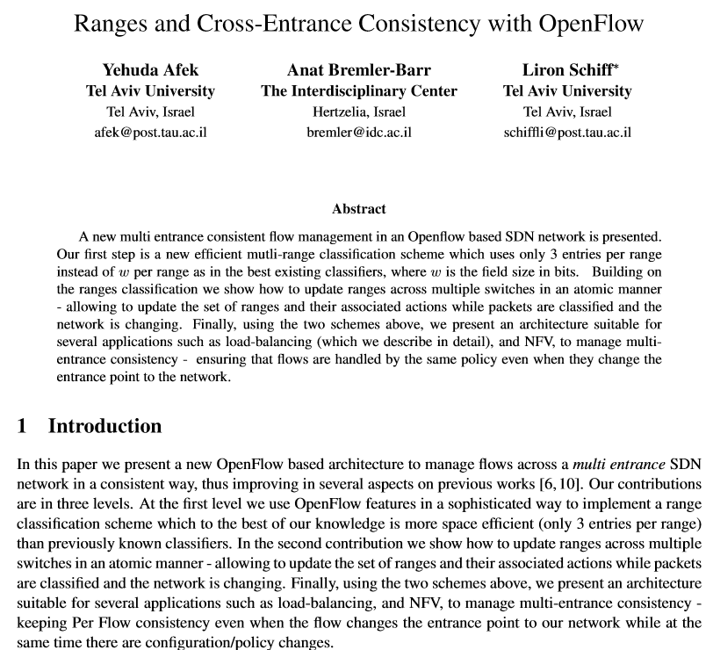
Efficient implementation
The efficient implementation that we implemented is based on multiple academic articles, written by Yehuda Afek, Liron Schiff and Anat Bremler-Bar.

Slide 5
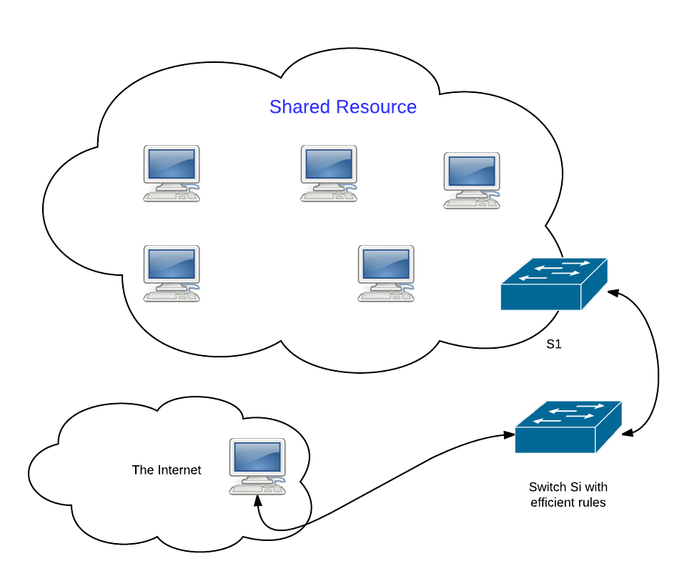
Topology
In order to simplify the project, we use two switches:
S1, under which all the servers of the shared resource reside.
S2, where all client hosts reside, and demonstrates the WAN port to the Internet.
Inside S1, we do not run the load balancing algorithm. Only for requests coming from S2 we run the LB rules.

Slide 6
General OF Terms
TCAM – ternary content addressable memory – high speed memory used for searching. Data can be stored and queried based on three types of input: zero, one and don’t care (wild card).
LCP – longest common bit prefix.
ELCP 0/1 – extended LCP. Adds a single differentiating bit and completed by wildcards.
Wildcard bits (displayed in diagrams as ‘*’) were implemented using masks (zeros for wildcard bits and ones for the rest).
OpenFlow switch table - TCAM tables with values for the packet fields (wildcards for the rest) and rules/instructions to perform on a matching packet.
OpenFlow Packet Metadata – packet section that can be set and matched, allows values to be passed between tables in a pipeline.
Rule prioritization – matching priority between rules placed in the same table. Rules with higher priority checked first.

Slide 7
OF Packet Handling Instructions
Goto action – instructs the switch to pass the packet matched to the specified table, continuing the process and creating a pipeline. This instruction can only be specified when the table is not empty.
Set field action – sets the value of a field. For example, this action can be used to replace the destination IP address of a packet.
Output action – sends the packet.
Write metadata instruction – sets the value of the metadata field.

Slide 8
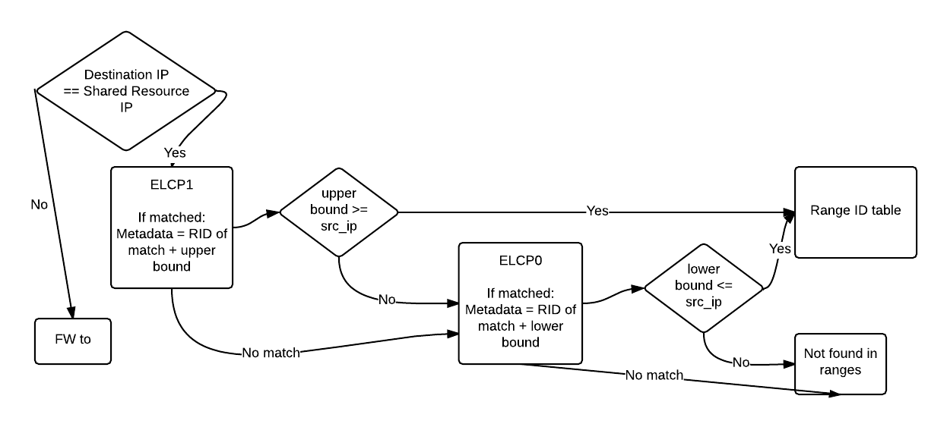
The match process

Slide 9
The load balancer directs traffic based on IP packets.
Each packet that is directed to the shared resource IP (load balancer virtual IP) is redirected to one of the resource hosts, according to the set of rules.
For our project, the range span covers the entire IPv4 address space.
Controller forwarding is slow and limited (packet loss) -> cannot be used for packet redirection. Therefore, we must use rule-based redirection.
As said before, finding the packet range is done by matching and comparisons.

Slide 10
ELCP Tables
List of the ELCPs defined for the ranges. As the ELCPs become longer, the rule has a higher priority (a more exact match).
When a match is found, the range ID and the range’s boundary are placed in the packet’s metadata section and forwarded to the comparator table.
The comparator table checks that the source IP is within the range boundaries.
Since our ranges span the entire address space, satisfying either one of the match and boundary pairs suffices.
When the packet reaches the RIDs table, the range ID is then matched to one of the entries and the shared resource virtual IP is replaced with the appropriate server’s IP address. The same happens on the way back from the server to the client.
The packet is then passed on to the common resource switch.

Slide 11
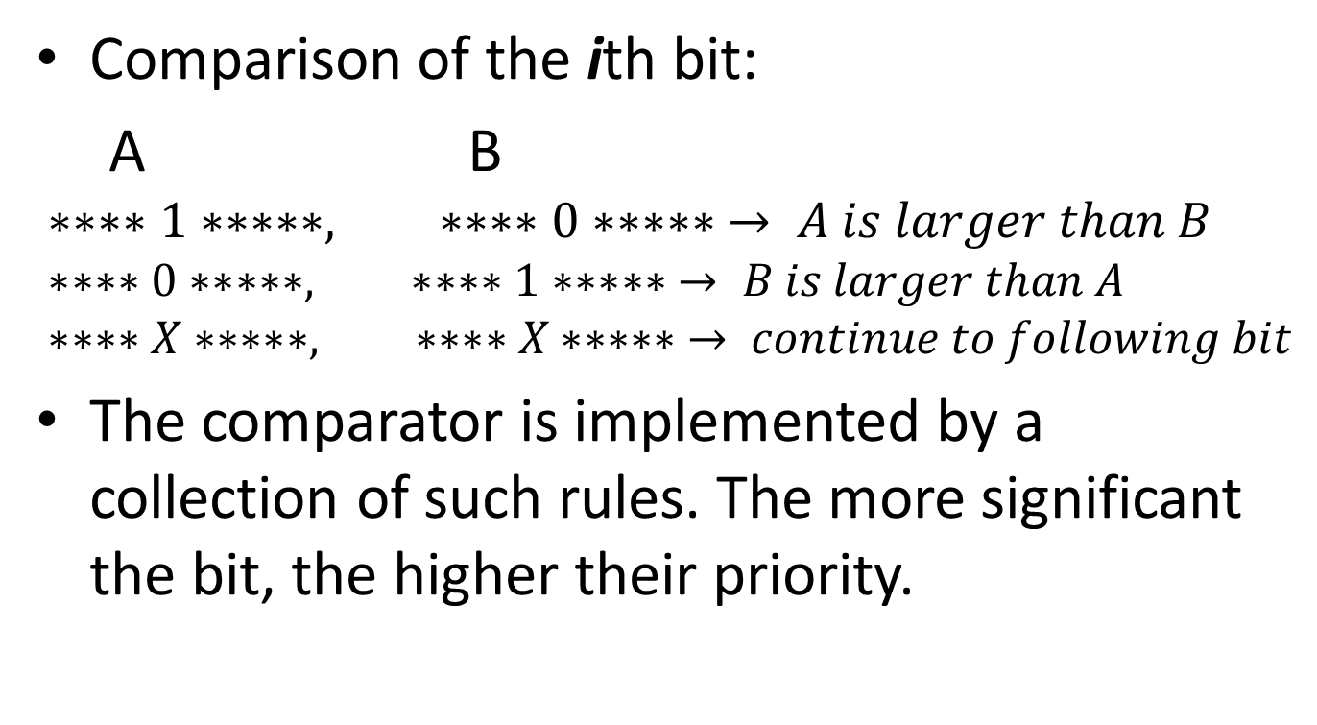
Comparator Implementation
Comparison of the ith bit:
A B
$$∗∗∗∗1∗∗∗∗∗, ∗∗∗∗0∗∗∗∗∗ → A is larger than B \\ ∗∗∗∗0∗∗∗∗∗, ∗∗∗∗1∗∗∗∗∗ → B is larger than A \\ ∗∗∗∗X∗∗∗∗∗, ∗∗∗∗X∗∗∗∗∗ → continue to following bit$$
The comparator is implemented by a collection of such rules. The more significant the bit, the higher their priority.

Slide 12
Pre-setting the set of ranges (r_{i})
A list of hosts with weights given in the configuration file. [(MAC address, IP address, weight), …]
Based on the resource host list weights, the ranges are created.
The configuration utility (helper) functions can be used to generate a number of resource hosts with random or even weights.

Slide 13
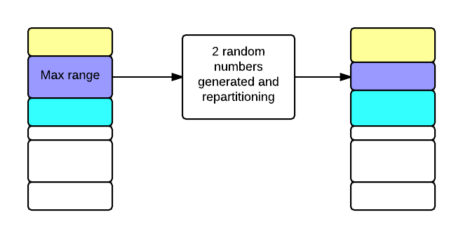
Dynamically updating the ranges
Packet counters for every range.
Every interval, the counter difference is checked.
The ranges are repartitioned when the max count/min count ratio is larger than two.
Probabilistic repartitioning:
A random portion of the range with the maximum packet count is transferred to the ranges above and below, leaving the rest of the ranges unchanged. The distribution between above and below was also determined by a generated random number.
After a certain amount of intervals, the counters are expected to reach equilibrium in terms of the packet count ratio.
The rules that depend on metadata matching – the values matched are located in the metadata (the comparator tables and the RIDs table) - don’t need to be changed since they are not range boundary dependent. This leaves the ELCP1/0 tables that require updating when the ranges change.

Slide 14
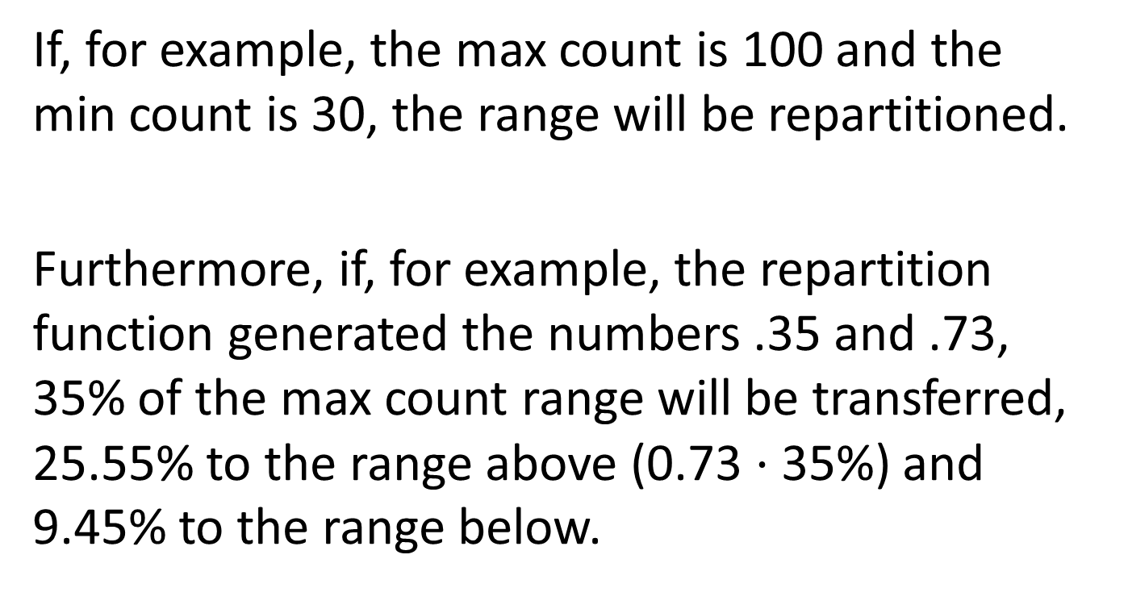
Repartitioning Example
If, for example, the max count is 100 and the min count is 30, the range will be repartitioned.
Furthermore, if, for example, the repartition function generated the numbers .35 and .73, 35% of the max count range will be transferred, 25.55% to the range above (0.73$⋅$35%) and 9.45% to the range below.

Slide 15
Statistics

Slide 16
The number of rules as a function of the number of resource hosts, independent of the weight distribution
The rule count y acts as a linear function of the number of resource hosts x:
y = 132 + 4x

Slide 17
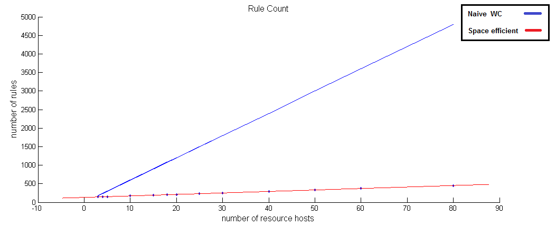
Comparison to the naïve load balancer

Slide 18
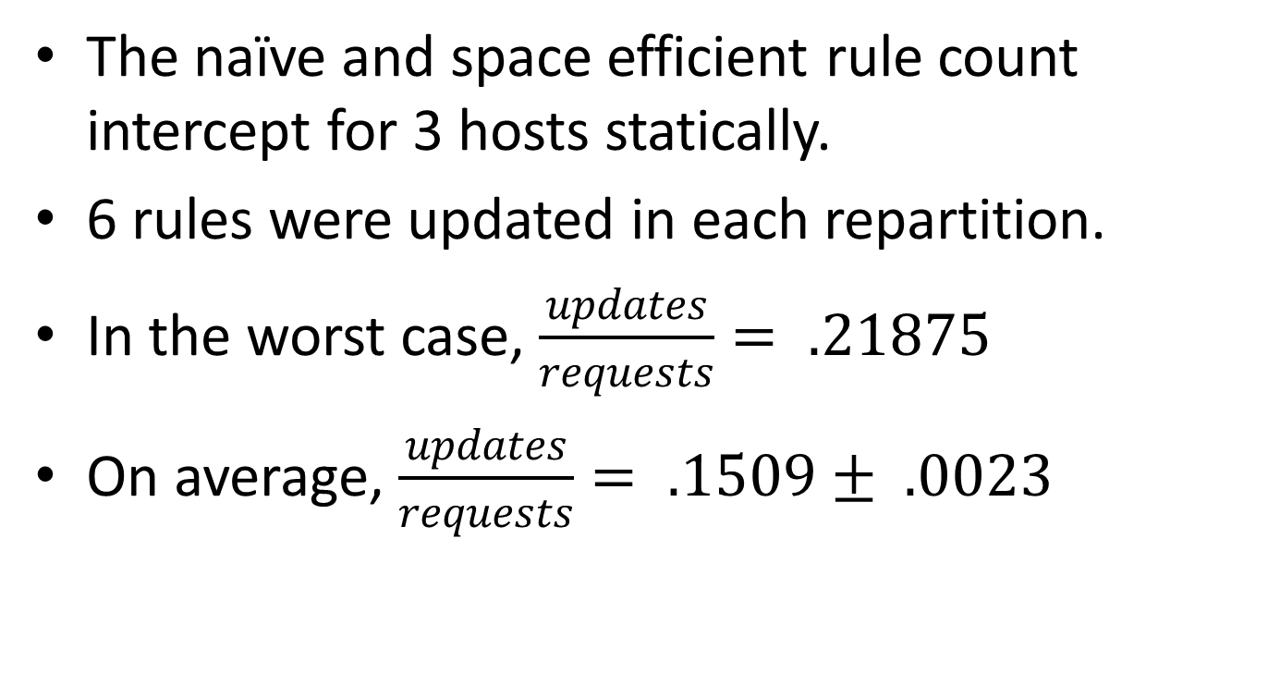
Dynamic efficiency - rule updating
The naïve and space efficient rule count intercept for 3 hosts statically.
6 rules were updated in each repartition.
In the worst case, $\frac{updates}{requests}= .21875$
On average, $\frac{updates}{requests}= .1509± .0023$

Slide 19


Latency – random weights
$RTT=a_{1}+a_{2}⋅\#(hosts_{resource})$
The results show us that the latency does not depend on the number of hosts. The slope, a2, is effectively zero since it is smaller than its error. Visually, it does seem like the slope is small but there. A feasible explanation would be the linear match in each table. The rules are each checked linearly by priority and the more ranges, the more rules.
The linear fit results:
$$a_{1}=0.0635±0.0080 msec$$
$$a_{2}=0.00007±0.00018 msec$$
$$χ^{2}=0.25 , χ_{red}^{2}=0.041 , Pvalue=0.00029$$

Slide 20
Latency – random weights
From the residuals plot above, we can see that a linear fit was a correct choice -the residuals do not show us a specific pattern or distribution. The errors are very large and this may be the reason the slope is effectively zero.

Slide 21
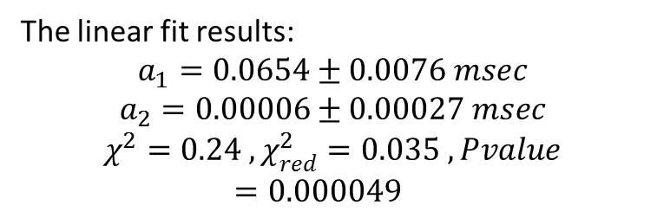
Latency – even weights
$RTT=a_{1}+a_{2}⋅\#(hosts_{resource})$
The results for an even weight distribution are very similar to those of the random weight distribution. The average response time is larger but not by much, less than the standard deviation.
The linear fit results:
$$a_{1}=0.0654±0.0076 msec$$
$$a_{2}=0.00006±0.00027 msec$$
$$χ^{2}=0.24 , χ_{red}^{2}=0.035 , Pvalue=0.000049$$

Slide 22
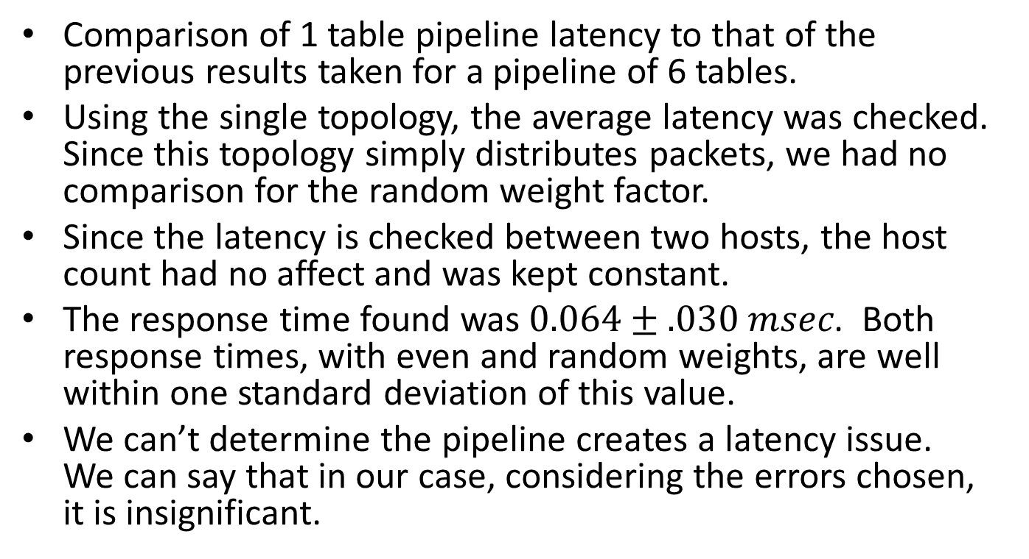
Latency of pipeline
Comparison of 1 table pipeline latency to that of the previous results taken for a pipeline of 6 tables.
Using the single topology, the average latency was checked. Since this topology simply distributes packets, we had no comparison for the random weight factor.
Since the latency is checked between two hosts, the host count had no affect and was kept constant.
The response time found was$0.064±.030 msec$. Both response times, with even and random weights, are well within one standard deviation of this value.
We can’t determine the pipeline creates a latency issue. We can say that in our case, considering the errors chosen, it is insignificant.

Slide 23
Usage and Configuration

Slide 24
Usage
The project is based on the Openflow1.3 protocol.
In order to create the switch with the custom topology: sudo mn --custom ./ryu/ryu/app/loadtopo.py --topo load,[number of resource hosts],[number of outside hosts] --mac --switch ovsk --controller remote or simply use the default parameters (4 resource hosts and 3 outside hosts): sudo mn --custom ./ryu/ryu/app/loadtopo.py --topo load --mac --switch ovsk --controller remote
For each switch, define the correct Openflow protocol: sudo ovs-vsctl set bridge s1 protocols=OpenFlow13 sudo ovs-vsctl set bridge s2 protocols=OpenFlow13
Starting the controller ryu-manager ryu/ryu/app/micdekload.py

Slide 25
Configuration
Before starting the controller, please check that the configuration in ryu/ryu/app/loadbalancerconfig.py is correct. These are later imported into the controller module.
We’ve added the toolset module, confighelper.py, for creating randomly distributed or even weights.
Parameters:
virtual_server – a tuple with the virtual MAC and virtual IP for the shared resource. For example: virtual_server = ("00:00:00:00:00:4", "10.0.0.4") Note that the virtual server needs to have the MAC and IP address of one of the hosts connected to s1 for the load balancer to work correctly.
servers – A list of tuples of the MAC address, IP address and the weight. The weights for all servers must be smaller than 1 and add up to 1. For example: servers = [("00:00:00:00:00:01", "10.0.0.1", 0.33), ("00:00:00:00:00:02", "10.0.0.2", 0.33), ("00:00:00:00:00:03", "10.0.0.3", 0.34)]

Slide 26
Use the following instruction to see the switch rule set: sudo ovs-ofctl dump-flows s2 –O OpenFlow13
The shared resource can offer access to a website for example: h1 python –m SimpleHTTPServer 80 & h6 wget [virtual IP]

