Slide 1
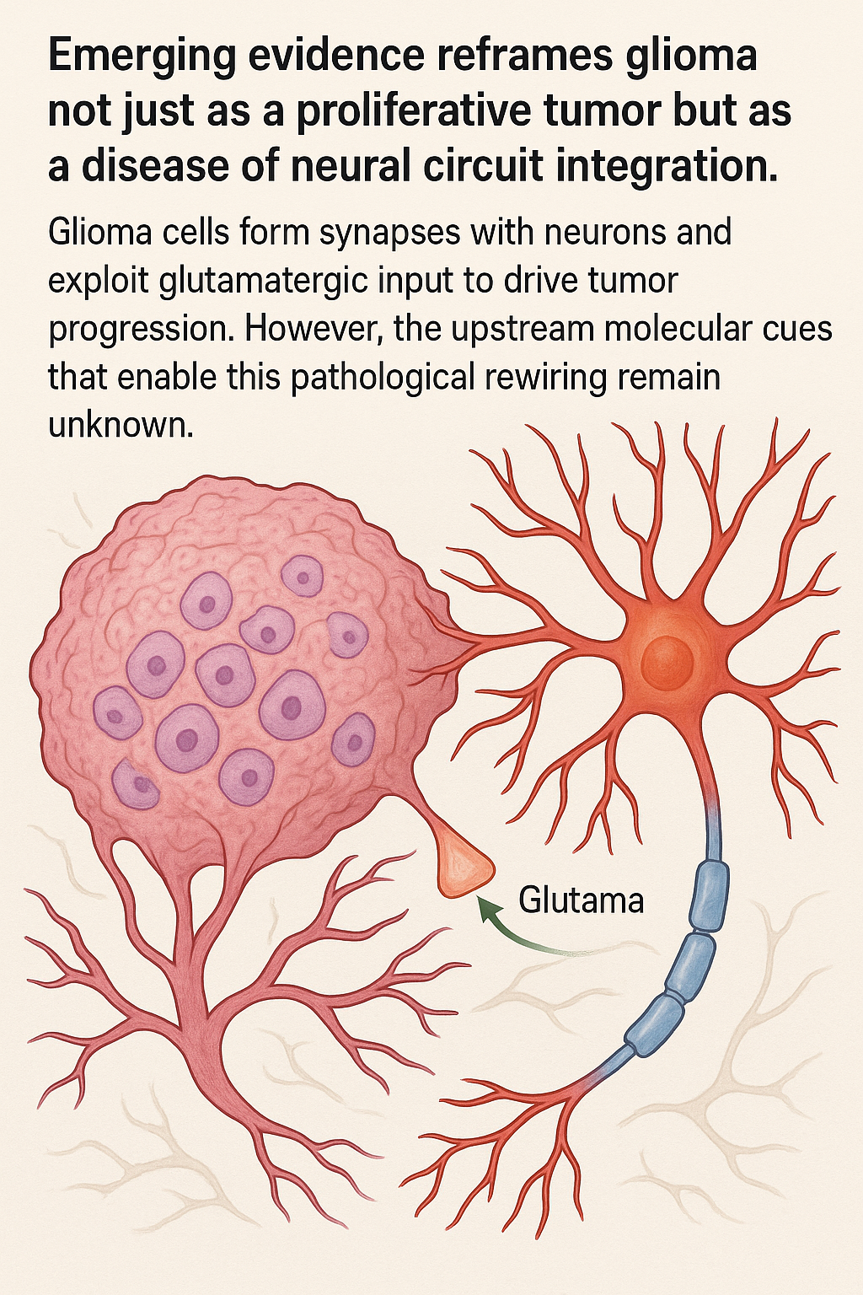
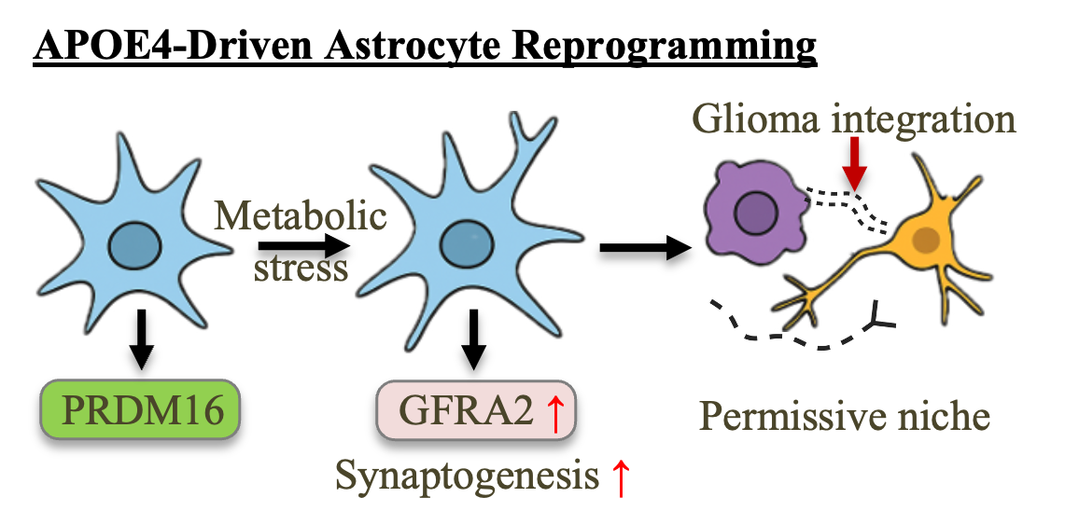
Measuring PRDM16 co-expression with APOE within APOE⁺ glioma clusters—especially using single-cell RNA-seq data—is a strategically valuable next step. Here's why:
🔍 Rationale:
The Monje lab’s study (Nature, 2019) used single-cell transcriptomics to reveal neuron–glioma interactions and cellular states in DIPG. Our hypothesis centers on:
PRDM16 suppression as a critical node for synaptogenic reprogramming.
A potential APOE–PRDM16–GFRA2 axis regulating tumor integration into neural circuits.
So, investigating whether glioma cells with high APOE expression exhibit reduced PRDM16 and enhanced synaptic/neurogenic pathways would directly test your model in patient-derived data.
✅ What this would accomplish:
Support a cell-intrinsic link between APOE expression and PRDM16 regulation in glioma cells.
Reveal whether low-PRDM16/hi-GFRA2/APOE⁺ subpopulations exist in tumors—paralleling your astrocyte findings.
Strengthen your argument that the APOE–PRDM16 axis is a shared vulnerability across both tumor cells and astrocytes in the glioma microenvironment.

Slide 2
✅ Step-by-Step Analysis Plan
📥 1. Download the data
Visit the GEO record for GSE134269 and download the processed scRNA-seq count matrix (typically provided as AnnData .h5ad or 10x files).
🐍 2. Load using Scanpy (Python)
import scanpy as sc
adata = sc.read_h5ad("path/to/GSE134269.h5ad") # or Read10X
sc.pp.normalize_total(adata, target_sum=1e4)
sc.pp.log1p(adata)
👥 3. Annotate APOE+ cells
adata.obs['APOE_pos'] = adata[:, 'APOE'].X.flatten() > adata[:, 'APOE'].X.flatten().mean()
🎨 4. Visualize PRDM16 in APOE+ vs APOE– cells
import seaborn as sns
import pandas as pd
df = pd.DataFrame({
'PRDM16': adata[:, 'PRDM16'].X.flatten(),
'APOE_pos': adata.obs['APOE_pos']
})
sns.violinplot(x='APOE_pos', y='PRDM16', data=df)
🔗 5. Correlate with astrocyte-related expression or synaptic modules
You can define gene modules or probe GFRα2 and synaptic genes (e.g., SYT1, PSD95) similarly and inspect their co-expression patterns in APOE+ PRDM16-low cells.
📊 What you're testing
You're specifically asking: Within the APOE+ glioma subcluster, is PRDM16 downregulated compared to APOE– or other glioma clusters? The analysis lets you test that directly and validate the link between APOE and PRDM16 in glioma cells.

Slide 3
✅ Step-by-Step Plan to Perform the Analysis:
1. Access the Dataset
Go to the Nature 2019 paper by Monje’s lab: https://www.nature.com/articles/s41586-019-1563-y
Under Data Availability, find the GEO accession (e.g., GSE131928 or similar).
Download the raw or processed .h5 or .loom file, or the matrix/barcodes/features from GEO or EMBL-EBI.
2. Load into Seurat (R) or Scanpy (Python)
If you use Seurat (R):
r
library(Seurat)
# Load 10x-style data
data <- Read10X(data.dir = "path_to_extracted_files/")
seurat_obj <- CreateSeuratObject(counts = data)
Or Scanpy (Python):
import scanpy as sc
adata = sc.read_10x_mtx('path_to_data/', var_names='gene_symbols', cache=True)

Slide 4
🔍 3. Identify APOE+ Glioma Clusters
# Seurat (after normalization and clustering)
FeaturePlot(seurat_obj, features = c("APOE", "PRDM16", "GFRA2"))
# Identify APOE-high cells
seurat_obj$APOE_high <- seurat_obj@assays$RNA@data["APOE", ] > 1 # or use quantile threshold
# Examine PRDM16 in APOE-high vs APOE-low
VlnPlot(seurat_obj, features = "PRDM16", group.by = "APOE_high")
🧠 4. Correlate PRDM16 with Synaptic Programs
Generate module scores:
synaptic_genes <- c("DLG4", "SYN1", "NRXN1", "SLC17A7", "VGLUT1", "PSD95") # adjust as needed
seurat_obj <- AddModuleScore(seurat_obj, features = list(synaptic_genes), name = "Synaptic")
FeaturePlot(seurat_obj, features = "Synaptic1")
Test whether APOE⁺PRDM16⁻ cells show higher synaptic scores:
📈 5. Save the Outputs
Use ggsave() or ggplot2 wrappers for clean figures that can be integrated into your LOI.

