Slide 1



Thesis title
Candidate:
Name
Supervisors:
Name
Name
Stage 3 Final Review
date
Date

Slide 2
Table of Contents
Declaration
Some text here …
CHAPTER 1:
Introduction
CHAPTER 2:
Literature Review
CHAPTER 3:
Chapter name
Acknowledgments
I would like …
CHAPTER 4:
Chapter name
CHAPTER 5:
Chapter name
CHAPTER 6:
Chapter name
CHAPTER 7:
Chapter name

Slide 3

CHAPTER 1
Introduction

Slide 5

CHAPTER 2
Literature Review

Slide 7
CHAPTER 3
Chapter title

Slide 8
..

Slide 9
CHAPTER 4
Chapter title

Slide 10
Methods

Slide 11
CHAPTER 5
Chapter title

Slide 12
Let’s dig deeper into the data collected from Chapter 4

Slide 13
CHAPTER 6
Chapter title

Slide 14
text
Notes:
The EMA Filter allows tracking the average polarity, where Chapter 5 results show that users more likely to rate based on entire interaction

Slide 15

CHAPTER 7
Summary and Contribution

Slide 16

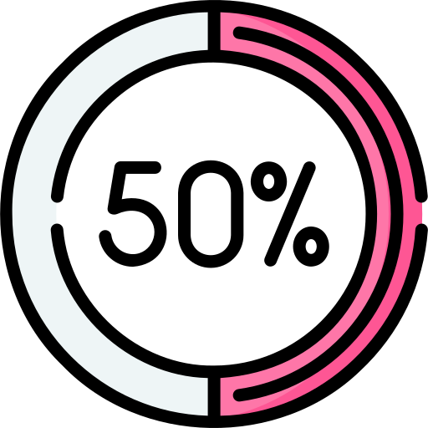





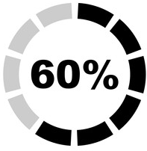
Research Outputs Communications
Chapter 1: Introduction
Chapter 2: Literature review
Chapter 3: chapter title
Chapter 4: …
Jul 2025
Jan 2026
Feb 2026
Chapter 5 Completed
Chapter 1 to be done
Chapter 7 to be done
Mar 2025
Chapter 4 Completed
Oct 2025
FINAL REVIEW
Oct 2024
PROGRESS REVIEW
Feb 2024
Chapter 3 Completed
Aug 2023
Dec 2025
CONFIRMATION
Chapter 2 to be done

Slide 17
Contribution Summary
Notes:
We have a pathway to control sentiment and thus affect intention to use SAVs, or beyond

Slide 18



