Slide 1
CAMP–II
Context 1
Context 2
Coding Agent Memory
Post-Training II
memory.md
write → read
Unlocking the Memory Potential of Pre-trained File Operations
for Long-Horizon Tasks via On-Policy Distillation
Lirui Luo · Kelong Mao · Xinwei Yang · Rongqing Li · Luyu Chen · Kieran Wong
Yudong Guo · Xinrui Wang · Jiayin Zhu · Gu Simiu · Sulong Xu · Cong Fang
Peking University · JD.com · Sichuan University
Beijing Institute of Technology · Renmin University of China · The Hong Kong University of Science and Technology
Teaching agents to remember through files.
liruiluo.github.io/agentmemorygym-v2/
Paper
Notes:
这篇工作讨论一个具体问题：长程 agent 的任务还没有结束，但上下文已经装不下了。我们用师生都熟悉的文件操作来蒸馏记忆。先看任务中的问题，再看为什么选择这个接口。
来源与口径：论文完整标题与现有网站作者/单位列表。约 30 秒。

Slide 2
The context ends. The task does not.
CAMP–II
Task: build a fitness-product showcase with products, collections, picks and comparisons.
Before the boundary
After the boundary
CONTR.txt
Styles are present.
The HTML body is missing.
The history is gone.
Read the plan and continue.
CSS only. No HTML body.
Rewrite all four sections.
Context is replaced
The file persists
The memory must preserve what the next context needs.
Visual case · explanatory schematic; actual trace on slide 12
02 / 15
Notes:
用真实 Visual 案例串起动机：模型发现页面只有 CSS、没有 HTML body，但此时需要换上下文。笔记保存问题和重写计划。换完后再读回来，任务才能连上。这里先画解释性示意，后面会展示原始轨迹；不把示意当新实验。
来源与口径：Figure 5。约 60 秒。

Slide 3
A strong teacher still needs a usable memory interface
CAMP–II
On-policy distillation learns from actions the student actually samples.
Student side
Teacher side
Sample a meaningful
memory action.
Give useful feedback
on that same action.
If a write never appears,
it receives no supervision.
A strong task model may still be
unfamiliar with the memory protocol.
Memory learning depends on both action coverage and teacher feedback.
Introduction; Figure 3
03 / 15
Notes:
现在才引入双边接口问题。OPD 教的是学生真实采出的动作，所以学生得愿意用这个接口，老师也得能够评分。一个模型很会解任务，不代表它熟悉任意新造的记忆协议。不要说陌生接口绝对无法工作；论文比较的是不同接口的学习条件和效果。
来源与口径：约 60 秒。

Slide 4
Use the file operations both models already know
CAMP–II
A shared Bash interface, an episode-persistent workspace, one task-acting policy.
Create / revise
Search / read
Continue
Save requirements, findings
and a plan.
Recover relevant state
when it is needed.
Use that state for the
next task decision.
Episode-persistent workspace
notes.md evidence/ CONTINUATION.md
Familiar operations provide the channel. Training teaches the memory.
CAMG-II interface; CAMP-II method
04 / 15
Notes:
采用普通文件，不是发明一组专用记忆 API。模型本来就会 bash 和文件操作；这些已有能力提供了可用的通道。训练要学的是保留什么、怎样组织、何时读取。普通记忆文件和有界 continuation 文件都在这个框架里。上下文重置后只给路径，不自动注入笔记内容。
来源与口径：文件名为接口示意，不是新增工具。约 60 秒。

Slide 5
The student acts. The frozen teacher scores.
CAMP–II
The teacher sees the student’s recorded context and scores the response it sampled.
01
02
03
Sample
Score
Update
Task actions and file writes
come from the student.
Scores the same tokens
in the same context.
Train the student on both
task and memory tokens.
Token feedback = teacher log-probability − student log-probability
Learn from the teacher during training. Act without it at inference.
Method · detached token-level OPD signal with clipped importance correction
05 / 15
Notes:
OPD 的顺序是学生先采样，教师再对同一个输出的每个 token 评分。教师与学生共享可见上下文，没有替学生执行动作，也不是给学生另一份答案。更新以 teacher 和 student 的 log probability 差构成 detached signal，并做 clipped importance correction；异步 rollout 的版本校正在实现中处理。监督覆盖任务与记忆输出，题面、观测和 padding 不训。
来源与口径：Method 方程。约 75 秒。

Slide 6
One policy learns across five task worlds
CAMP–II
Native task semantics stay intact. The file-memory interface is shared.
Shop
Coding
AutoResearch
General
Visual
Six linked
purchases
Repository
repair
ML experiment
iteration
Multi-tool
knowledge work
Website
development
Product evidence
Diagnosis + tests
Results + next trial
Requirements + outputs
Visual findings + plan
One joint policy · ordinary Bash · persistent workspace
CAMG-II · five long-horizon environments
06 / 15
Notes:
这是环境贡献 CAMG-II，不要和方法 CAMP-II 混为一个名字。五种任务分别需要保存购物约束、代码诊断、实验结果、知识工作中间输出和视觉开发计划。一个 policy 联合训练。Coding agent 指用文件管理记忆的形式，不是所有任务都写代码。
来源与口径：约 50 秒。

Slide 7
File-based OPD gives the largest average gain
CAMP–II
The full 4B comparison set. CAMP-I uses task RL; the memory baselines use OPD adaptations.
CAMP-II
64.6
CAMP-I
54.2
+12.8
MemOPD (w/ SFT)
51.8
HELM (single-model)
49.8
points over the strongest
memory OPD baseline
Hy-Memory
48.9
CompactOPD
48.2
Frozen 4B
45.3
ACM
39.2
2.97× the gain
HELM
36.6
From the same initial 4B:
+19.3 vs +6.5 points.
MemOPD
0.0
0
20
40
60
80
Table 1 · five-domain mean: four success rates + Visual panel-mean judge score
07 / 15
Notes:
先给完整主比较，不只挑一个弱基线。CAMP-II 为 64.6，最强 OPD 记忆基线 MemOPD 加 SFT 冷启动为 51.8，显示差 12.8 点。初始 4B 为 45.3，因此两个增量是 19.3 和 6.5，比例约 2.97。它不是最终分数高三倍。CAMP-I 是同文件记忆的 task-RL 参照。MemOPD 零分是无 SFT 冷启动的版本，不能拿它替代原始 recipe。
来源与口径：Table 1，差额为展示值算术。约 75 秒。

Slide 8
The average improves; Visual remains a trade-off
CAMP–II
CAMP-II versus the file-memory task-RL reference, CAMP-I.
CAMP-I
CAMP-II
100.0
100
85.2
81.2
64.1
68.8
50
46.5
37.5
38.3
40.2
32.0
0
Shop
Coding
AutoResearch
General
Visual
+14.8 pts
+5.5 pts
+25.8 pts
+12.4 pts
-6.3 pts
The largest gain over CAMP-I is in AutoResearch: +25.8 points.
Table 1 · Visual is a panel-mean judge score; other domains use task success
08 / 15
Notes:
平均更好不等于每个域都胜过 CAMP-I。最大差在 AutoResearch，General 也明显增加。Visual 40.2 对 CAMP-I 46.5，负 6.3 点，保留这个反例。Visual 的值是平均判分，不要当成功题数。这里的差额同样是表格显示值相减。
来源与口径：约 55 秒。

Slide 9
Files expose more memory actions to learning
CAMP–II
The file interface is familiar to both models and used more by the student.
Memory actions / all actions (%)
Lower surprisal
Nats per token · lower is more familiar
Files / Bash
21.6
Teacher
Student
Memory tools
7.8
Files
0.42
0.19
Compaction
5.9
Tools
0.91
0.70
Compact
1.40
0.98
0
5
10
15
20
25
A familiar channel gives OPD more memory actions to supervise.
Figure 3 · action share and frozen-model surprisal
09 / 15
Notes:
先看覆盖率：文件接口中记忆动作占 21.6%，工具为 7.8%，压缩为 5.9%。右边是冻结教师和初始学生对动作的 surprisal，以每 token 的 NLL 表示，越低越熟悉。不要把 NLL 说成实际美元费用，也不要把文件能力说成无需训练就已会最优记忆。
来源与口径：约 60 秒。

Slide 10
The teacher better recognizes task-matched notes
CAMP–II
Does the teacher prefer a note from this task over a note from another task?
Files / Bash
76.5
76.5%
Memory tools
63.8
on files
Compaction
70.0
0
25
50
75
100
50% chance
This tests task relevance. Next: isolate what the student learns.
Appendix D.3 · same-task versus foreign-task memory preference
10 / 15
Notes:
这页把“老师能不能评分”变成一个具体辨别问题：同一任务笔记和外来笔记，老师偏好哪一个。文件 76.5%，压缩 70.0%，专用工具 63.8%。只报告点估计，不声称显著；更不把老师的似然偏好直接等同于这条笔记能提高任务成功率。真正针对学习作用的控制在下一页。
来源与口径：约 55 秒。

Slide 11
Learning what to write carries the gain
CAMP–II
Mask memory-content supervision, or mask the same token budget at random.
CAMP-II
64.6
Compaction interface
48.2
−17.3
Dedicated memory tools
48.2
memory-content
loss masked
Memory-content loss masked
47.3
−1.3
Same budget masked at random
63.3
same budget
masked at random
0
20
40
60
80
Which tokens are taught matters—not only how many.
Figure 6 · controlled interface and loss-masking ablations
11 / 15
Notes:
遮掉记忆内容 token 的蒸馏损失，平均分从 64.6 掉到 47.3。随机遮掉同样多 token 仍有 63.3。这比只展示文件读写频次更直接：收益依赖对记忆内容的训练。更换记忆接口也会掉到 48.2。不要把这些不同干预混成一个单变量实验；每行的干预对象要说清楚。
来源与口径：约 75 秒。

Slide 12
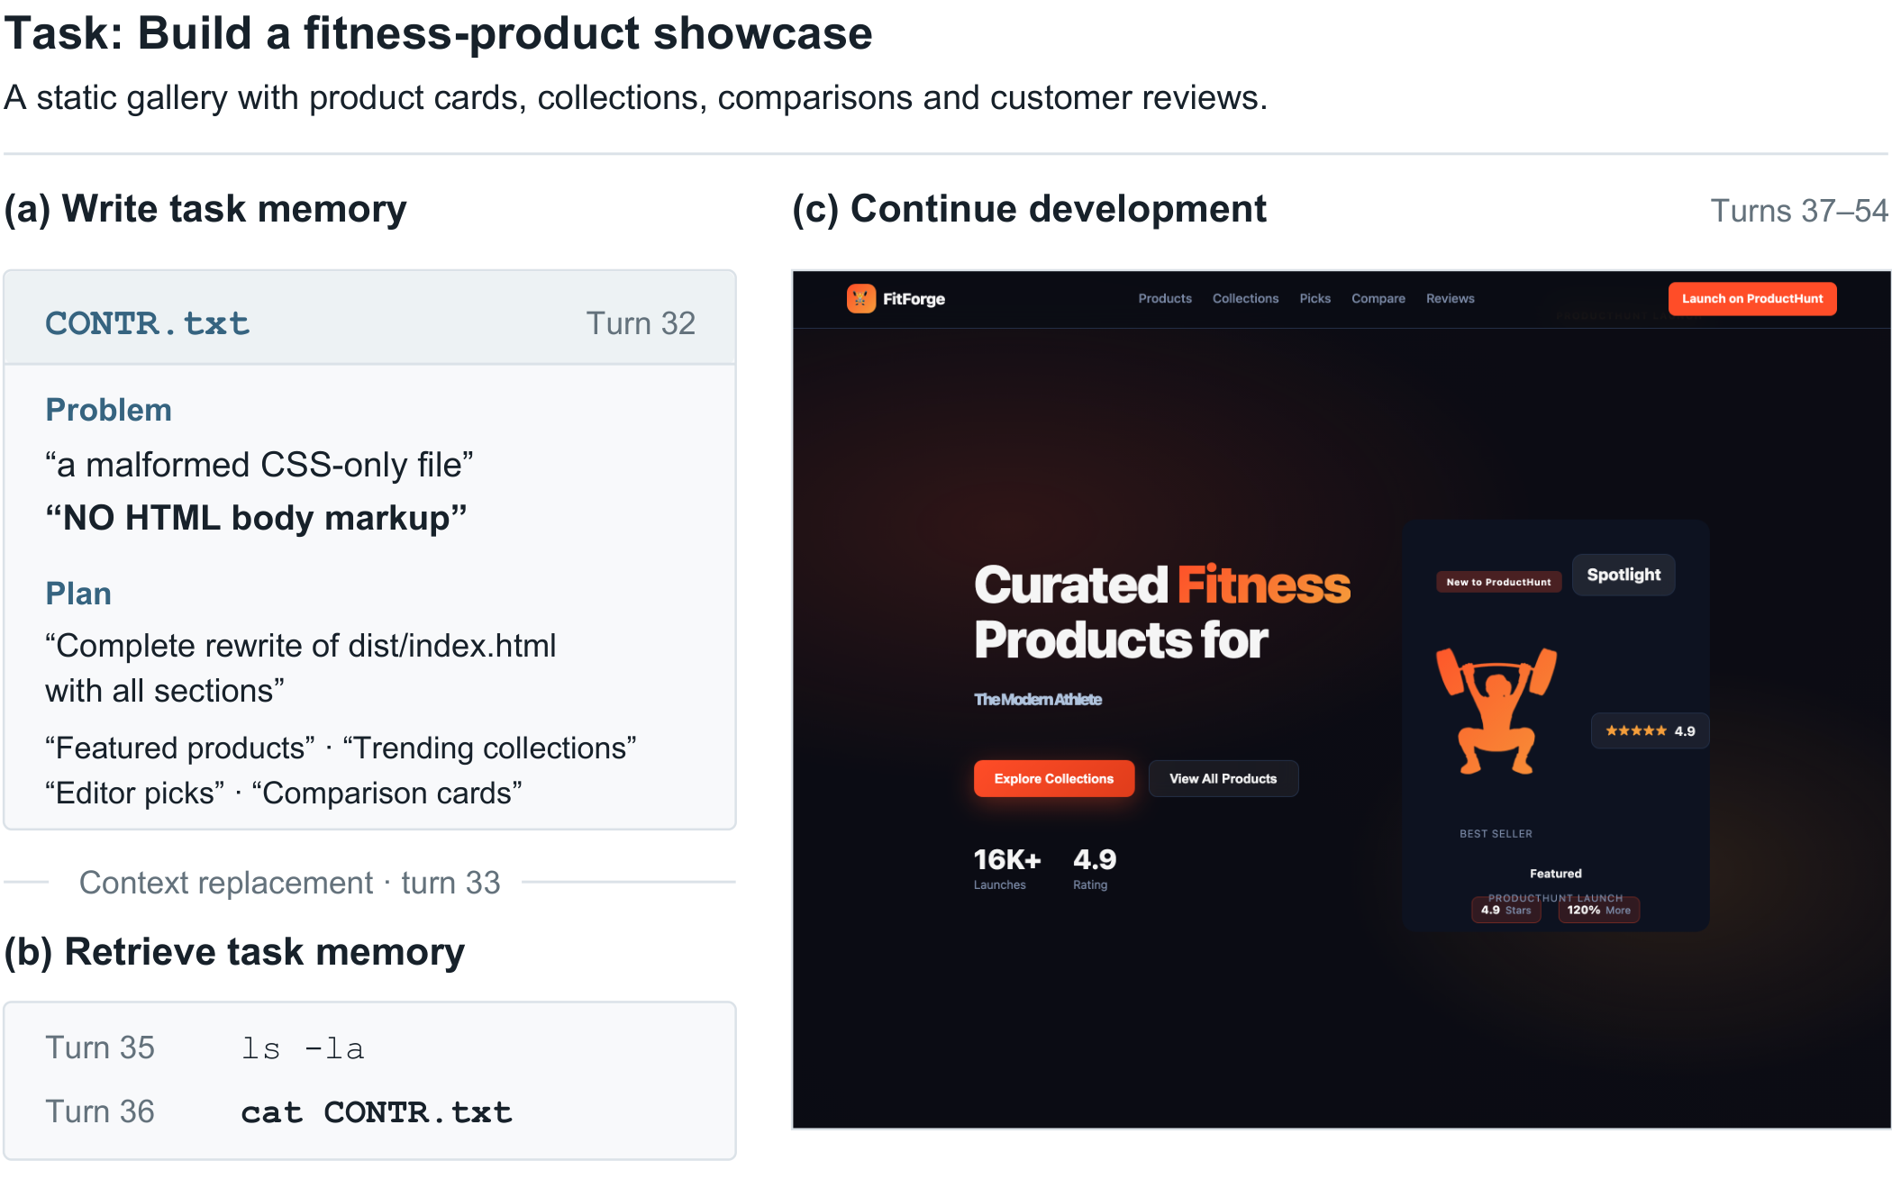
The agent resumes from a plan it wrote
CAMP–II
Write → replace context → read → continue
Paper Figure 5 · observed Visual training episode; not a causal intervention
12 / 15
Notes:
回到开场的真实例子。第 32 回合写 CONTR.txt，记录 CSS-only 和缺少 body 的问题，还列了四个待补板块。第 33 回合上下文被替换，35 回合 ls，36 回合 cat，后续继续重写页面。这里给观众看的是原图和原有轨迹，不是人为补造的成功演示，也不是“换笔记”的因果实验。
来源与口径：约 60 秒。

Slide 13
The result repeats across five training seeds
CAMP–II
Same CAMP-II recipe. Five independent training runs.
64.9 ± 0.5
Run 1
64.6
Run 2
65.5
Five-domain mean ± sample SD
Run 3
64.4
Run 4
65.0
Run 5
65.2
64
65
66
CAMG-II average score · expanded axis 64–66
The five reported averages range from 64.4 to 65.5.
Appendix C.3 · sample standard deviation across training seeds
13 / 15
Notes:
均值 64.9、样本标准差 0.5，是训练种子间的波动，不是标准误或置信区间。右侧用点图和显式 64 到 66 的局部坐标展示全部五点，避免用截断柱图夸大差异。不要据此声称每个对照也有五 seed 的配对显著性。
来源与口径：约 45 秒。

Slide 14
The learned policy improves on two external benchmarks
CAMP–II
Both model sizes improve over the checkpoints they start from.
Terminal-Bench 2.1
SWE-Bench Pro V2
4B initial
23.1
4B initial
11.2
4B CAMP-II
30.0
4B CAMP-II
18.1
9B initial
23.1
9B initial
23.1
9B CAMP-II
38.0
9B CAMP-II
30.1
0
25
50
0
25
50
35B-A3B reference: 33.8
35B-A3B reference: 27.4
Memory learned in the gym carries into new task benchmarks.
Table 2 · success rates (%); larger reference is Qwen3.5-35B-A3B
14 / 15
Notes:
两个外部评测都要报名称，别只给一个平均。4B 从 23.1/11.2 到 30.0/18.1，9B 从 23.1/23.1 到 38.0/30.1。下方保留当前表的 Qwen3.5-35B-A3B 33.8/27.4 参照，不替换成更新的中间回执。它是 MoE，不能说四分之一参数就等于四分之一推理成本。
来源与口径：约 70 秒。

Slide 15
Familiar operations make better teaching channels
CAMP–II
Teach memory through files.
The principle
Match the memory interface to both the student and the teacher.
The method
Distill the task policy’s own file actions with token-level feedback.
The evidence
Higher average scores, memory-specific ablations and external transfer.
One shared file-memory interface. Five long-horizon task worlds.
CAMP-II · Coding Agent Memory Post-Training II
15 / 15
Notes:
最后留一句话：接口不只是工程包装，它决定学生会产出什么动作，以及老师能提供什么监督。CAMP-II 用熟悉的文件操作把两边连起来；CAMG-II 提供五个长程任务世界。停在这页进入问答，理论和实现细节按问题解释。
来源与口径：约 30 秒。

