Slide 1
JD.com
Coding Agent Memory Post-training
Unlocking the Memory Potential of Pre-trained File Operations
for Long-Horizon Tasks via Reinforcement Learning
Lirui Luo · Kelong Mao · Heming Xia · Rongqing Li · Xinwei Yang · Luyu Chen
Kieran Wong · Yudong Guo · Xinrui Wang · Jiayin Zhu · Simiu Gu · Sulong Xu · Cong Fang
JD.com
Project: liruiluo.github.io/agentmemorygym
Paper: arXiv:2609.34422
Files as learned memory: 54.4% success across four task worlds.
Notes:
Public paper: arXiv:2609.34422v1. Approximately 15 minutes.

Slide 2
Long tasks need state that outlives context
JD.com
Earlier work
After context replacement
Active history
Context
only
Recover lost state
plan + evidence
intermediate results
Repeated work
Save working state
CAMG-RL
Read → act → finish
notes.md
CONTINUATION.md
Files persist across the boundary
Durable state lets the next context continue the same task.
Figure 1 · schematic of context-only and file-memory execution
Notes:
Slide 2. Source: public arXiv:2609.34422v1. See slides/outline.md for provenance and speaking notes.

Slide 3
Can task reward unlock the prior in file operations?
JD.com
A familiar action language
A learned memory strategy
shell_command
Write
Read
cat > notes.md # store
grep -n fact notes.md # find
cat notes.md # read
python revise.py # revise
use in the task
Task reward
Available from pre-training
learn when / what to retain
CAMG-RL trains the use of ordinary files from downstream task reward.
Introduction · the commands illustrate the common executable interface
Notes:
Slide 3. Source: public arXiv:2609.34422v1. See slides/outline.md for provenance and speaking notes.

Slide 4
CAMG connects four long-horizon task worlds
JD.com
Shop
Coding
DeepResearch
AutoResearch
Earlier choice
Repository
ML workspace
Search
Black case
items()
→ wrong order
patch + tests
train.csv
model.py
submission.csv
Visit sources
Answer
Later purchase
Match the earlier
color preference
Carry fixes and
test evidence
Retain facts and
source evidence
Reuse experiments
and intermediate files
Native tasks + shell access + episode-persistent workspace
Section 4 · task vignettes redrawn from the public examples in Appendix A
Notes:
Slide 4. Source: public arXiv:2609.34422v1. See slides/outline.md for provenance and speaking notes.

Slide 5
One policy learns across all four environments
JD.com
Parallel environment episodes
native task + file actions
Shop
Coding
CAMG-RL policy
DeepResearch
AutoResearch
observation + task reward
publish weights
Persistent files
completed
trajectories
Actor + critic
Episode queue
write / read
Fully asynchronous PPO overlaps rollouts and learning.
Figure 2 · shared policy and learner; task semantics remain in each environment
Notes:
Slide 5. Source: public arXiv:2609.34422v1. See slides/outline.md for provenance and speaking notes.

Slide 6
Context changes; the working files remain
JD.com
Current context
Mechanical reset
Fresh context
Policy-authored file
Ordinary read action
Clear active history
Keep task + file paths
CONTINUATION.md
plan + evidence
next steps
cd .agent_memory
cat CONTINUATION.md
Episode workspace: continuation · notes · evidence · task files
The policy writes and reads. The reset contributes no policy action.
Section 5.1 · reset supplies paths; it does not inject saved file contents
Notes:
Slide 6. Source: public arXiv:2609.34422v1. See slides/outline.md for provenance and speaking notes.

Slide 7
Task reward trains the entire memory-use chain
JD.com
One sampled action trajectory
Task action
Write
Retrieve
Use
Outcome
files as policy actions
native task
reward
GAE returns → token-level PPO
Task and memory responses share downstream credit.
Section 5; Appendix B · no separate memory reward or reset optimizer row
Notes:
Slide 7. Source: public arXiv:2609.34422v1. See slides/outline.md for provenance and speaking notes.

Slide 8
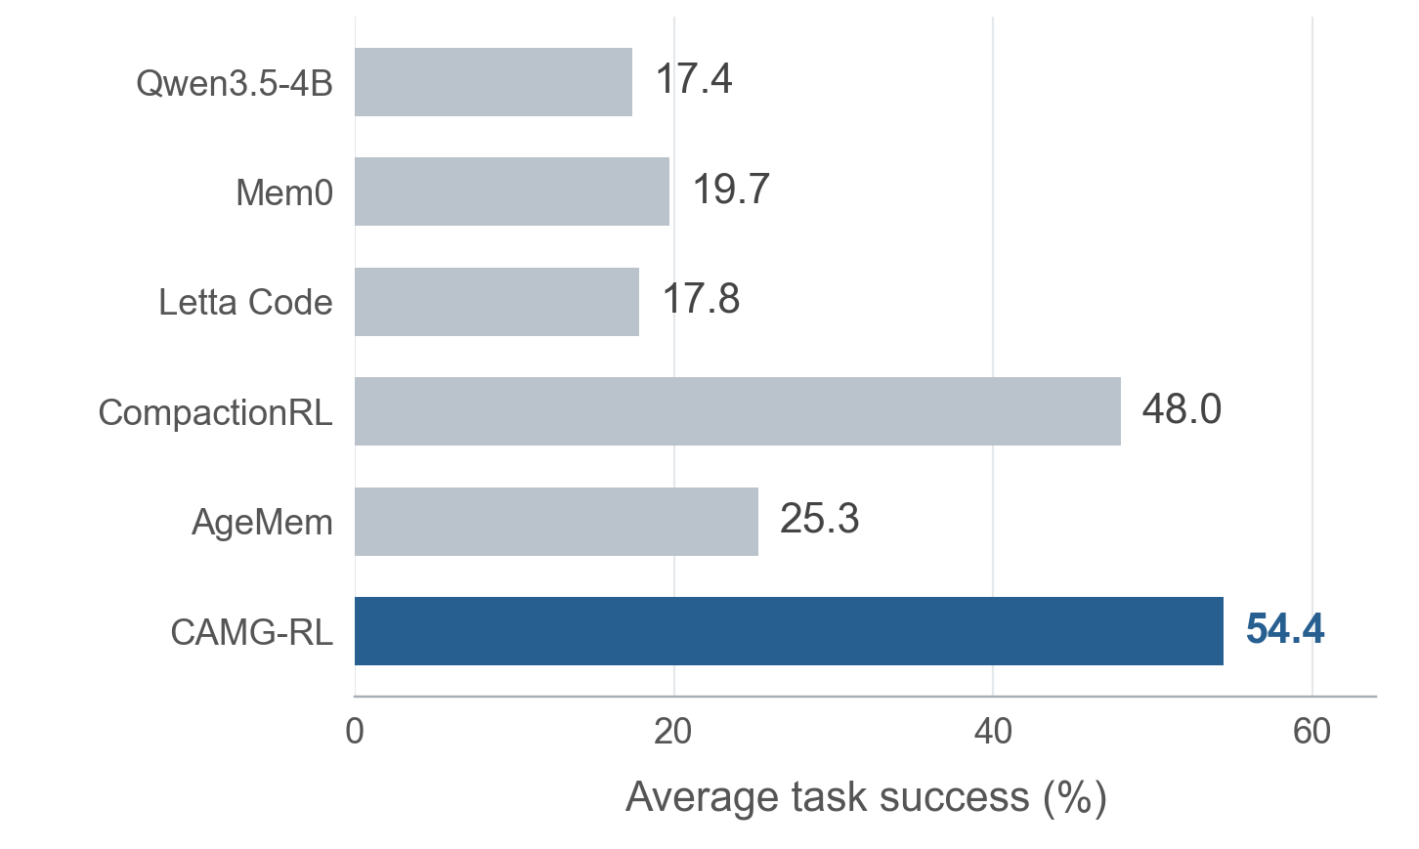
CAMG-RL reaches 54.4% average task success
JD.com
54.4%
four-environment average
+6.4 pp
over CompactionRL
Learning to use files outperforms the strongest memory baseline.
Table 2 · 128 test tasks per environment · paired difference 95% CI: [3.3, 9.5] pp
Notes:
Slide 8. Source: public arXiv:2609.34422v1. See slides/outline.md for provenance and speaking notes.

Slide 9
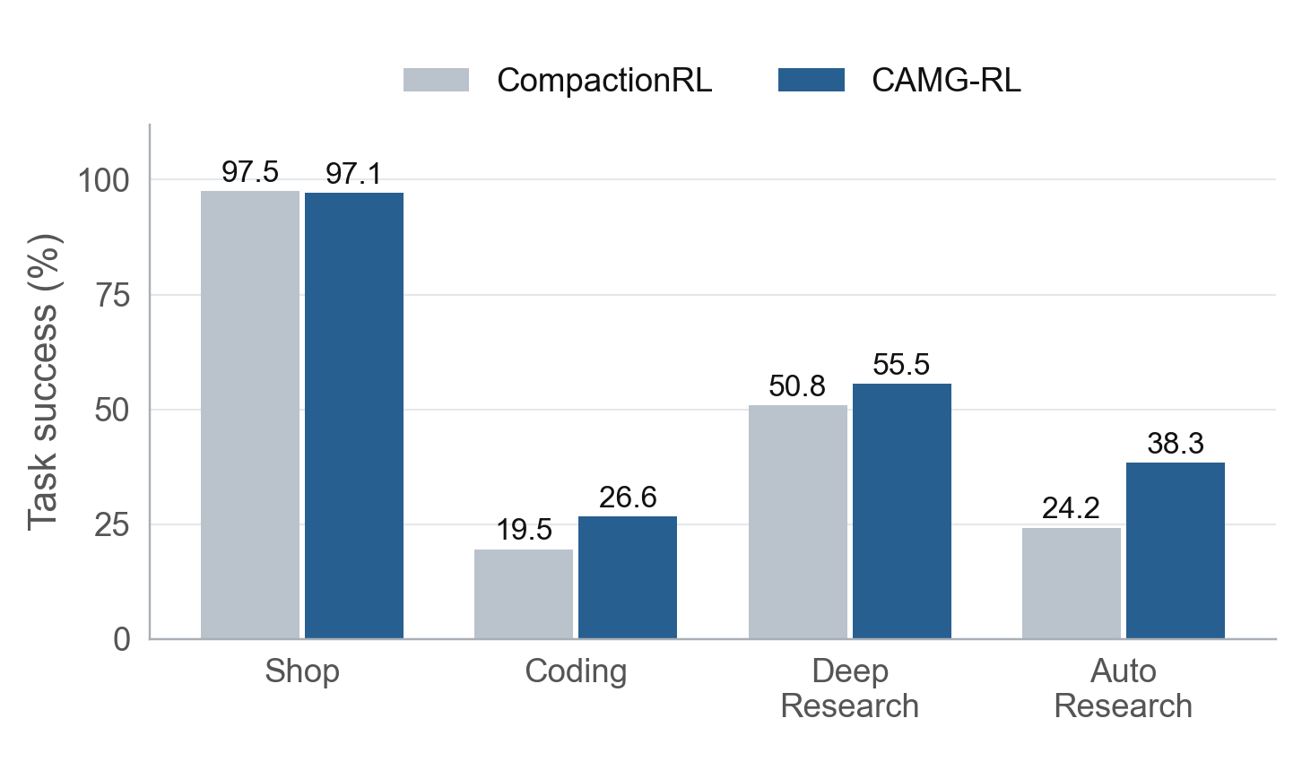
The largest gains are in Coding and AutoResearch
JD.com
+7.1 pp
Coding
+14.1 pp
AutoResearch
Shop is near saturation; Coding and AutoResearch open the gap.
Table 2; Appendix C.1 · paired improvements significant in Coding and AutoResearch
Notes:
Slide 9. Source: public arXiv:2609.34422v1. See slides/outline.md for provenance and speaking notes.

Slide 10
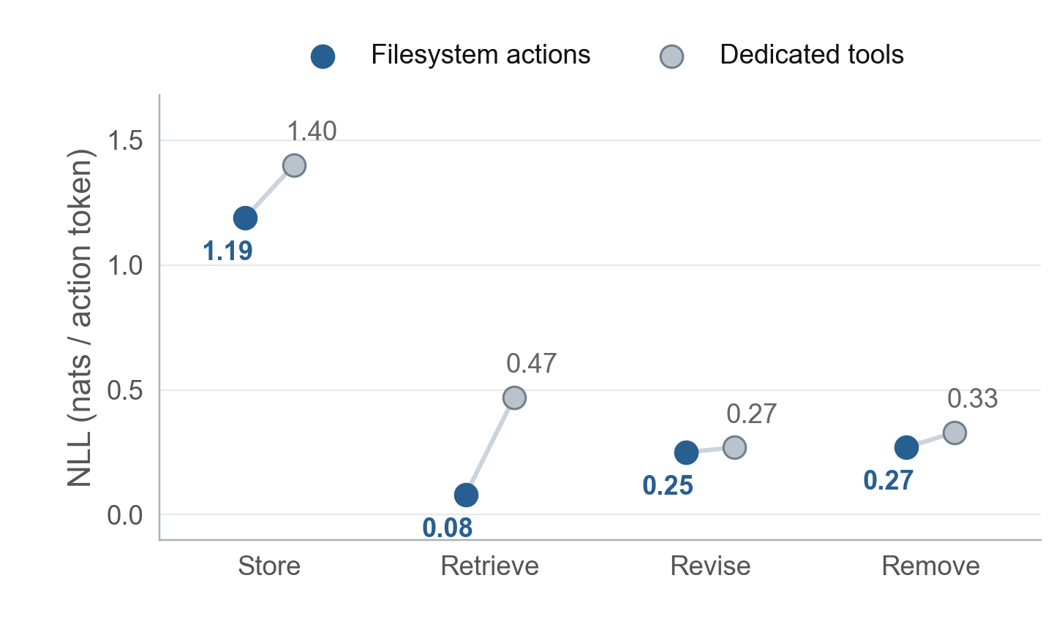
The frozen base already favors filesystem actions
JD.com
≤ 0.013
nats/token change
when the shell tool is renamed
The prior extends
beyond the tool name.
Familiar action rendering gives reinforcement learning a usable starting point.
Figure 3a; Appendix C.1 · frozen Qwen3.5-4B · lower NLL means more likely actions
Notes:
Slide 10. Source: public arXiv:2609.34422v1. See slides/outline.md for provenance and speaking notes.

Slide 11
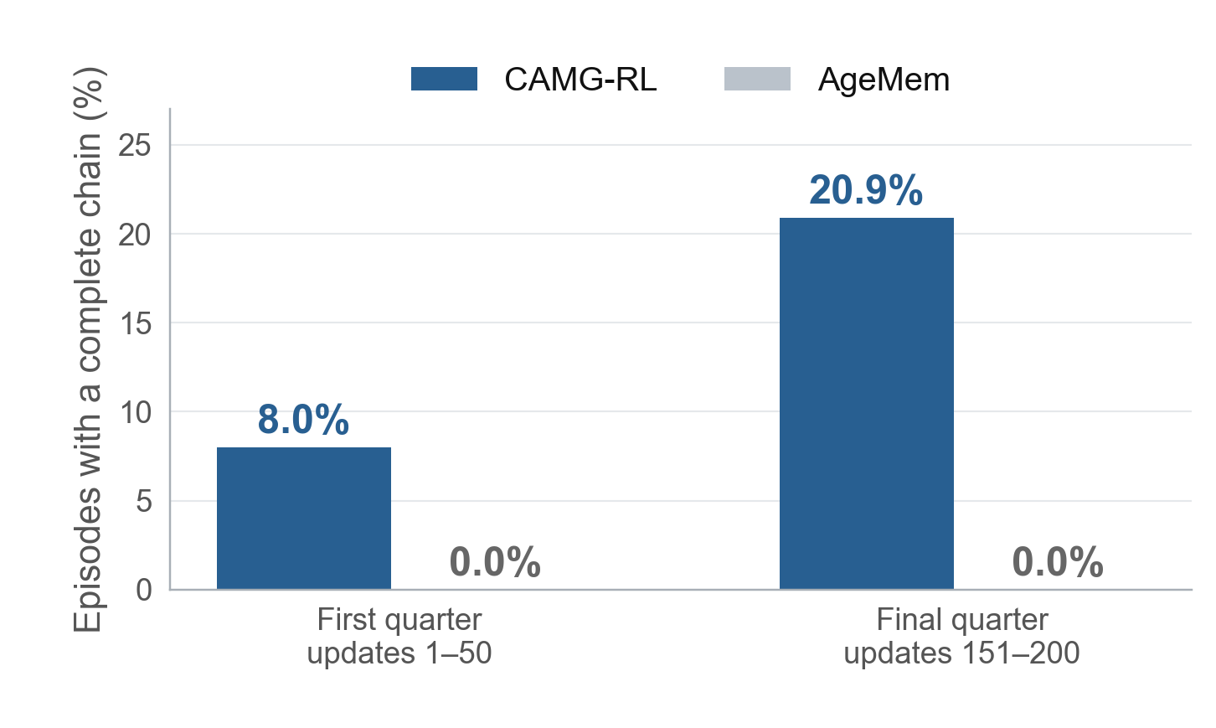
RL turns familiar actions into complete memory chains
JD.com
8.0 → 20.9%
episodes with a complete chain
Store → retrieve → use
Beyond the mandatory
continuation write
Voluntary memory use grows while AgeMem completes no chain.
Figure 3b; Appendix C.1 · first and last quarters of the common 200-update training protocol
Notes:
Slide 11. Source: public arXiv:2609.34422v1. See slides/outline.md for provenance and speaking notes.

Slide 12
Trained competence transfers to external benchmarks
JD.com
Success rate (%)
SWE-bench Verified
MLE-bench Lite
Qwen3.5-4B
7.6
0.0
CAMG-RL-4B
15.8
4.5
Qwen3.5-35B-A3B
15.6
4.5
Qwen3.5-9B
14.8
4.5
CAMG-RL-9B
27.6
9.1
Qwen3.5-122B-A10B
22.0
9.1
4B and 9B policies are competitive with much larger frozen models.
Selected rows from Table 3 · matched tasks, decoding, budgets and graders; all failures included
Notes:
Slide 12. Source: public arXiv:2609.34422v1. See slides/outline.md for provenance and speaking notes.

Slide 13
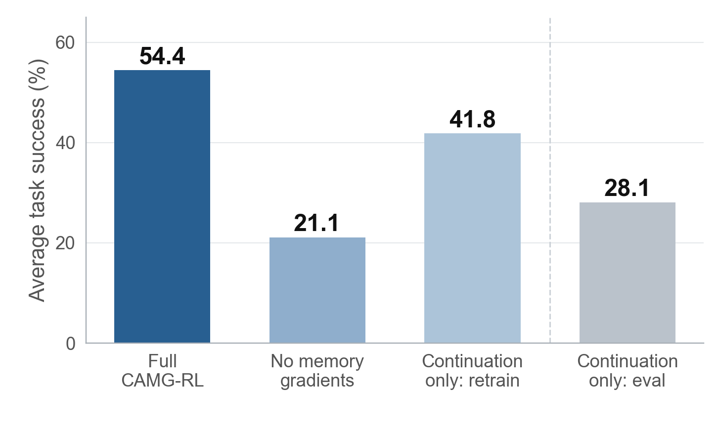
Memory-action credit and general files both matter
JD.com
−33.3 pp
without memory-action gradients
−12.6 pp
retrained with
continuation-only memory
Learning the file actions and using general memory files both help.
Figure 4 · last bar restricts the full policy only at evaluation; it is not a retrained model
Notes:
Slide 13. Source: public arXiv:2609.34422v1. See slides/outline.md for provenance and speaking notes.

Slide 14
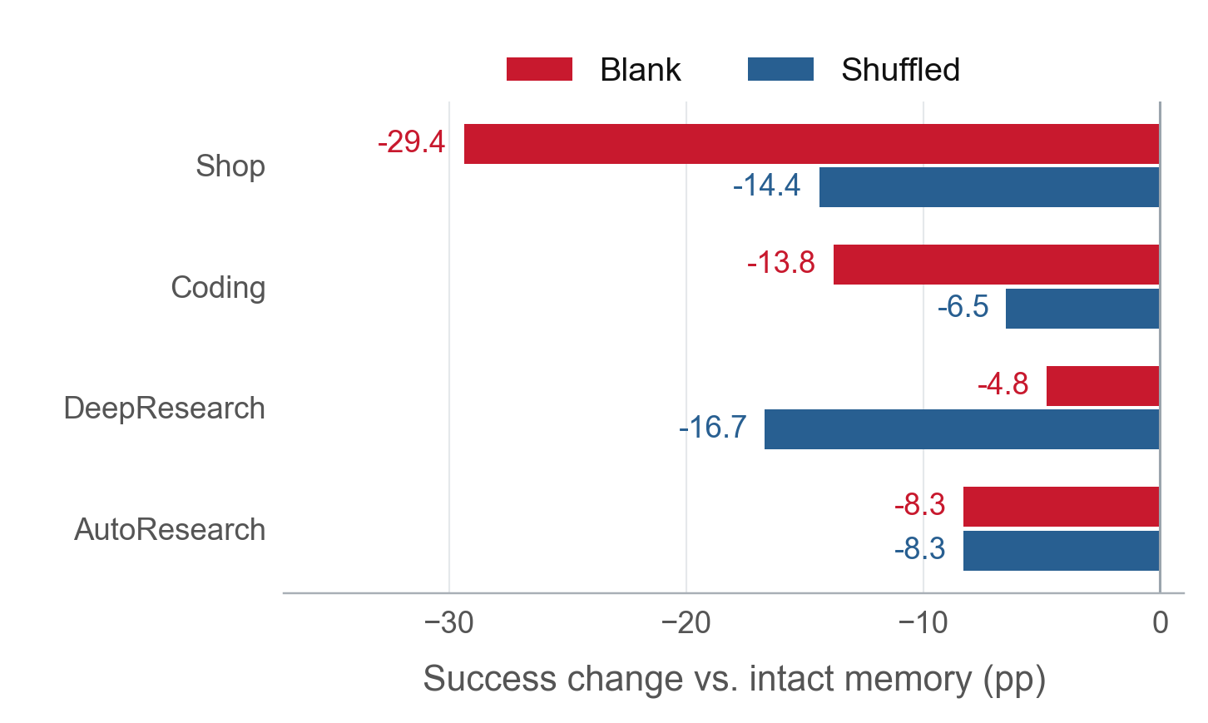
Changing saved content reduces subsequent success
JD.com
−14.1 pp
blank memory
equal-environment average
−11.5 pp
task-mismatched memory
equal-environment average
Saved content affects later decisions at the same post-reset state.
Appendix D.3 · eligible n = 128 / 29 / 60 / 23 · shuffled donors matched within environment and by length
Notes:
Slide 14. Source: public arXiv:2609.34422v1. See slides/outline.md for provenance and speaking notes.

Slide 15
A coding episode shows the write–read–use chain
JD.com
Scrapy: repair broken response logging
Before reset · round 18
After reset · rounds 19–30
objective: fix response logging
evidence: added _mqpush
in scrapy/core/scheduler.py
tested: no _mqpush error
next: run tests, confirm
logging, then submit
$ cat \
.agent_memory/CONTINUATION.md
$ python test_spider.py
$ python -m pytest \
tests/test_crawl.py -v
Hidden tests passed
.agent_memory/CONTINUATION.md
Return 1.00 · submitted at step 30 / 40
The saved fix and verification plan guide work in the fresh context.
Figure 5; Appendix A.4.3 · training trajectory · excerpts shortened for presentation; wrapped commands
Notes:
Slide 15. Source: public arXiv:2609.34422v1. See slides/outline.md for provenance and speaking notes.

Slide 16
Takeaways
JD.com
• CAMG makes long-horizon memory testable across four native task worlds.
• CAMG-RL learns to write, retrieve and reuse files from downstream task reward.
• Familiar file operations support learned memory chains and stronger task performance.
Project: liruiluo.github.io/agentmemorygym
Paper: arXiv:2609.34422
Coding Agent Memory Post-training
JD.com
Notes:
Slide 16. Source: public arXiv:2609.34422v1. See slides/outline.md for provenance and speaking notes.

