Slide 1
Optic-flow based estimation of angle of attack on a VTOL UAV
Brice Platerrier
Supervisor: Julien Lecoeur
Professor: Dario Floreano
Notes:
Hello everyone, I’m Brice Platerrier and this is the project I worked on, under the supervision of Julien Lecoeur.

Slide 2
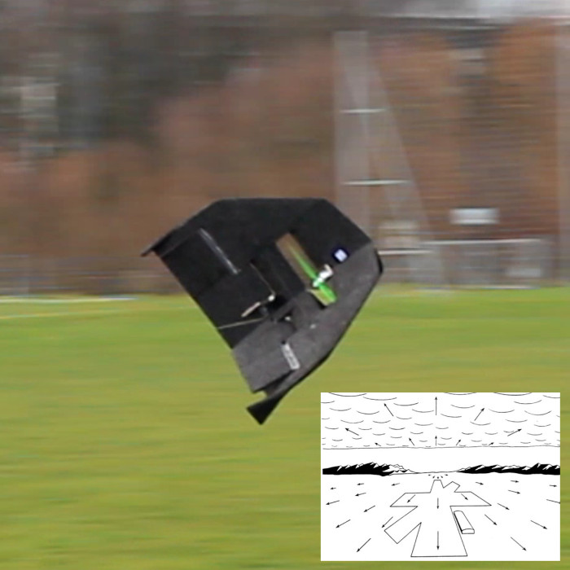
Introduction
wing chord
airflow
α
θ
horizon
Angle of attack α
≠
Pitch angle θ
The Y-wing
Method for direction of motion estimation
Characterization:
  Simulation on Matlab
  Motion capture
Brice Platerrier : brice.platerrier@epfl.ch
Notes:
In this project, we are interested in estimating the angle of attack of a vertical take off and landing drone, namely the Ywing.
In practice, the angle of attack cannot always be approximated to the pitch angle as the drone is not always flying at constant altitude or may undergo some wind.
Here we propose a method for estimating the direction of motion using high-frequency optic-flow measurements obtained from a wide field of view camera.
We then characterize it through both simulation and motion capture using embedded hardware..

Slide 3
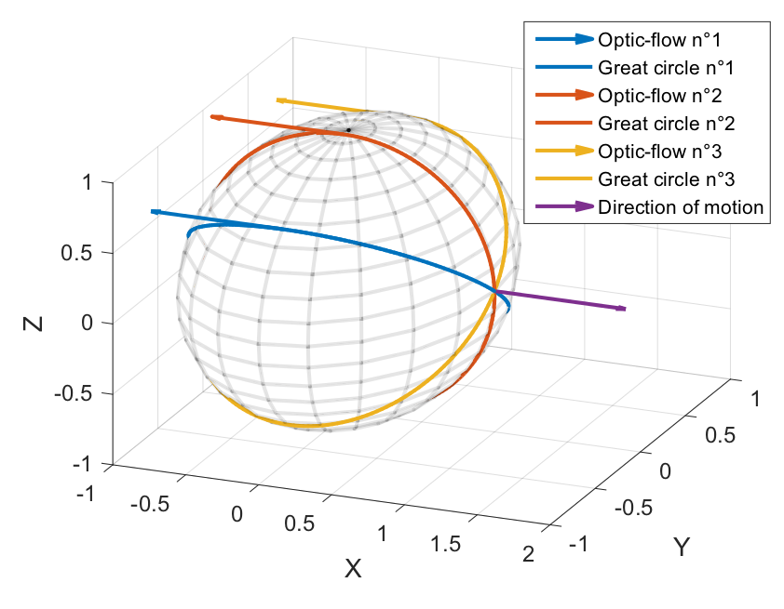
Basic principle
Constraint on FOE location:
1 Optic-flow vector = 1 Great circle
Brice Platerrier : brice.platerrier@epfl.ch
Notes:
- The optic-flow is the apparent motion of objects, surfaces and edges in a visual scene and is in our case obtained from the variation of pixel intensity using Lucas Kanade method.
- If we consider straigth motion (without any rotation), the optic-flow vectors seem to emanate from a single point which is called the focus of expansion and corresponds to the direction of motion.
- Each optical flow can be used to constrain the focus of expansion to lie on a great circle.
This great circle is defined as the intersection of the plane containing the optic-flow vector, the corresponding sampling direction and the center of the sphere.
- Hence, the location of the FOE can be reduced to the intersection of two or more great circles. Although only two great circles should be required, robustness against outliers and noise is obtained from using numerous optic-flow measurements and finding the position that corresponds to the consensus, that is the one that receives the higest number of votes.

Slide 4
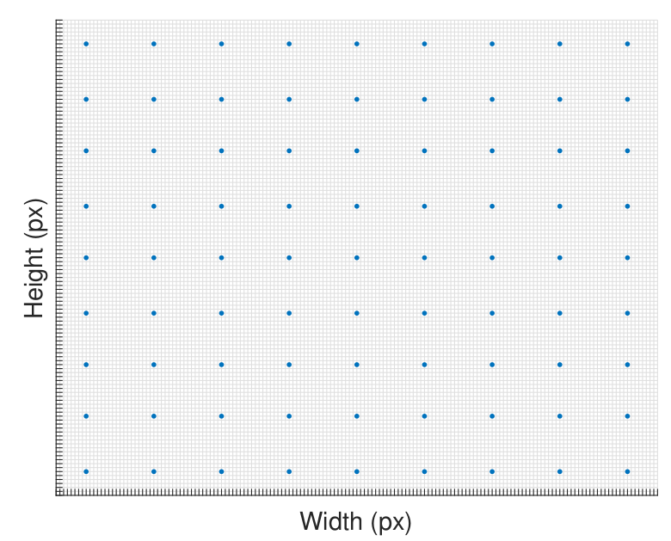
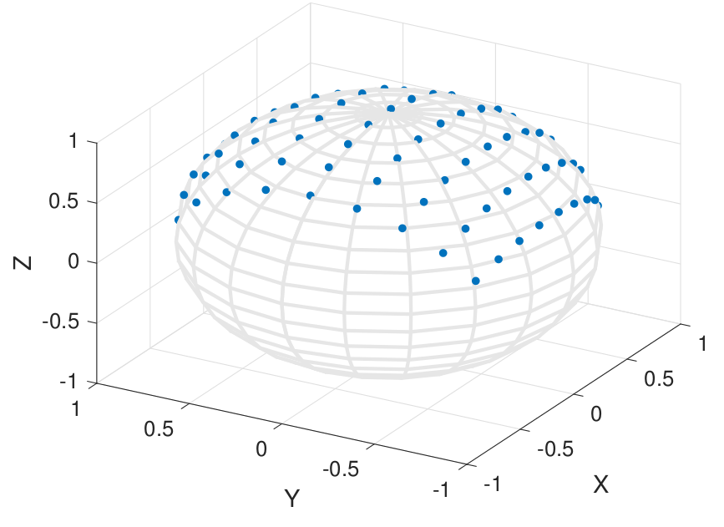
Method
Camera Model
Optic-flow back-projection
4th-order Taylor polynomial model
Derotation
Voting
Brice Platerrier : brice.platerrier@epfl.ch
Notes:
The first part of the method consists in mapping each pixel to the 3D scene.
Here, we only consider mapping these points on the unit sphere and do not bother determining the depth of the scene.
Because the fisheye camera is characterized by a high distortion away from the center, we need to determine an approximate model.
Using a calibration method proposed by Scaramuzza, we are able to estimate the coefficients of a 4th-order polynomial model that allows us to perform spherical projection as shown here.

Slide 5
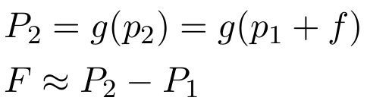
Method
Camera Model
Back-projection using Jacobian matrix
  Exact projection on the unit sphere
  Computationally heavy
Optic-flow back-projection
Back-projection under small angle assumption
  Approximate method
  Lower computational overhead
Derotation
Voting
Brice Platerrier : brice.platerrier@epfl.ch
Notes:
Now that we are able to project the pixel on the unit sphere, we need to project the optic-flow obtained from Lucas Kanade method as well.
A first approach is to use the Jacobian to compute the corresponding 3D flow. However, this method is computationally heavy.
Another possibility relies on small angles assumptions. Basically, we consider a virtual pixel p2 that is the sum of pixel p1 and its corresponding 2d flow. By projecting these two pixels on the unit sphere and then computing the difference, we are able to estimate the 3D flow.
Although approximate, this method allows the full framework to run at more than 160Hz whereas the first method typically exhibits a doubled runtime.

Slide 6
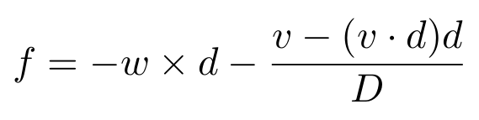
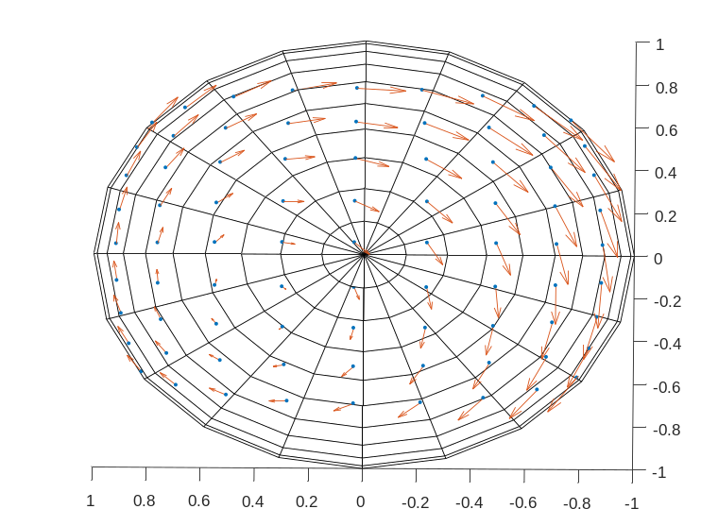
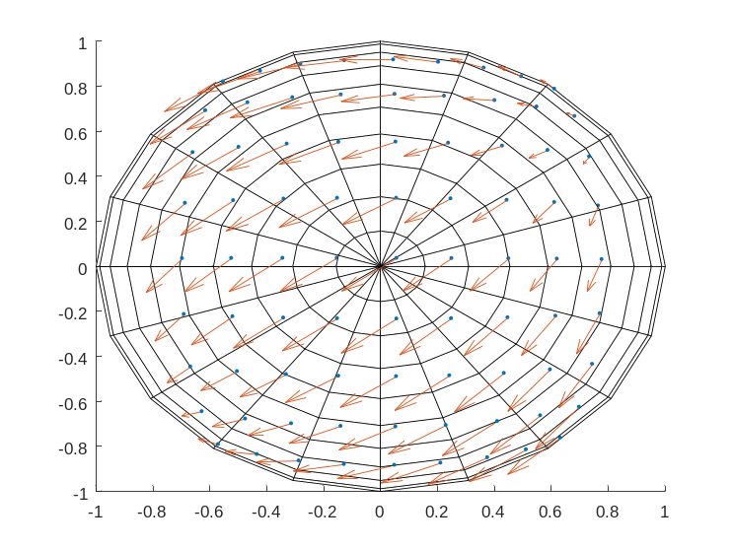
Method
Camera Model
Under differential motion assumption
Optic-flow back-projection
Derotation
Voting
Brice Platerrier : brice.platerrier@epfl.ch
Notes:
As we are only interested in the direction of motion, we must remove the rotational component of the optic-flow measurements. This can be achieved through a simple procedure called derotation.
Here, we assume differential motion (small translation and rotation of the camera between each frame), which is justified by our high refresh rate.
Thus, each optical flow measurements can be expressed as a 3D vector tangent to the unit sphere using the equation shown here:
where d is the unit vector describing the viewing direction and w is the angular speed vector, v is the translational velocity and D is the depth of the scene.
- By removing the rotational term, we end up with the translational part of the optic-flow and the problem becomes finding the focus of expansion (FOE), which is the point from which optic-flow vectors seem to emanate.

Slide 7
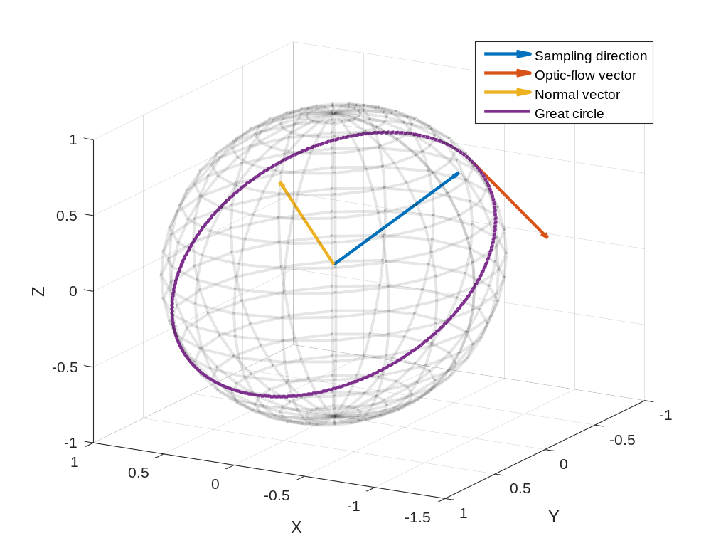
Method
Camera Model
Great circle encoded as unit normal vector
Optic-flow back-projection
Derotation
Voting
Brice Platerrier : brice.platerrier@epfl.ch
Notes:
Each derotated optical flow (or translational component of the optic-flow) is used to constrain the focus of expansion to lie on a great circle.
To ease up susbsequent computations, the great circle is encoded as its normal vector, i.e. the normalized cross-product between the optic-flow vector and the viewing direction.
One can then determine whether or not a point lies on the great circle using a simple dot product which is computationally cheap

Slide 8
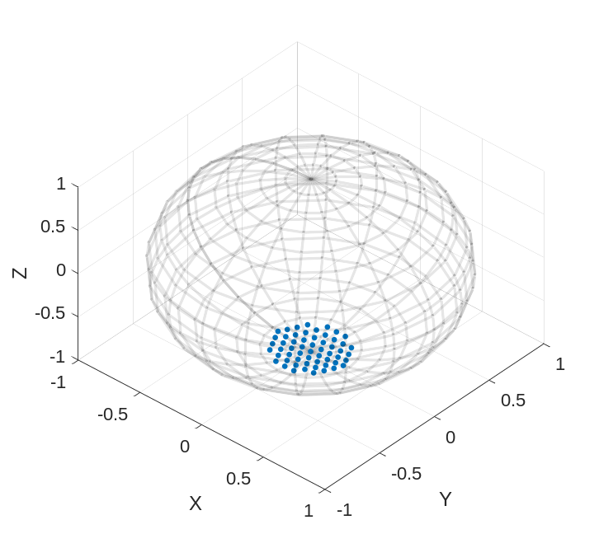
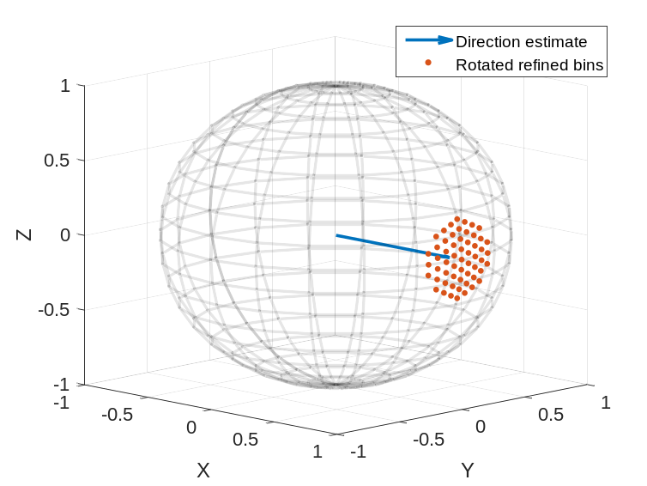
Method
Camera Model
  Several voting stages & No disambiguation
Coarse
  Evenly distributed on hemisphere
Refined
  Neighborhood of previous estimate
Optic-flow back-projection
Derotation
Voting
Brice Platerrier : brice.platerrier@epfl.ch
Notes:
- The voting procedure requires the storage of evenly distributed vectors on the unit sphere.
- For tractability reasons we can’t afford to vote on the complete unit sphere with a high resolution. Therefore, the voting procedure is divided into several voting stages.
- In addition, we do not disambiguate the FOE location and only consider one hemisphere.
- In the coarse voting stage, we compute a rough estimate of the direction of motion.
- This latter estimate is then refined iteratively using higher resolution grids centered around the latest estimate.
- The refined bins are precomputed for a predefined direction and stored. They are then efficiently rotated to be centered around the previous estimate, thus significantly reducing memory usage and computational overhead.

Slide 9
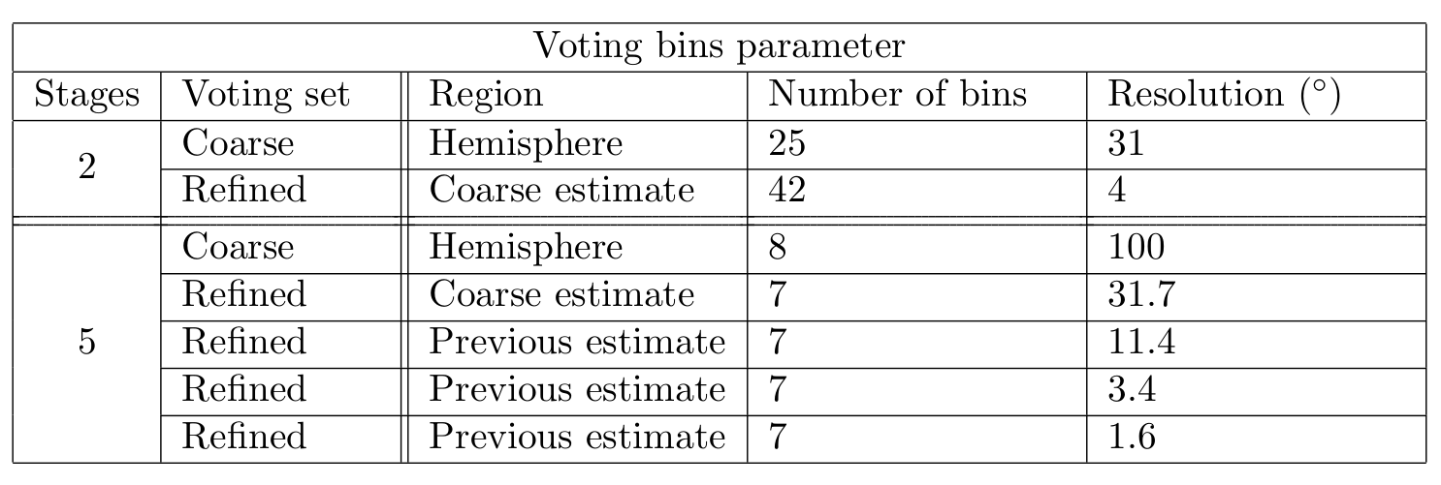
Characterization
Parameters
More stages
=
Better resolution
Reduced computational overhead
Brice Platerrier : brice.platerrier@epfl.ch
Notes:
Here are the parameters that were used for characterizing the algorithm. We first consider a 2-stages voting procedure that allows for a 4° resolution. Then we also consider a 5-stages voting procedure. This latter procedure allows us to reduce the computational cost at voting for a fixed resolution, which typically grows linearly with the product of the number of voting bins and the number of optic-flow samples. Due to the low runtime of the latter method, the resolution was slightly increased.

Slide 10
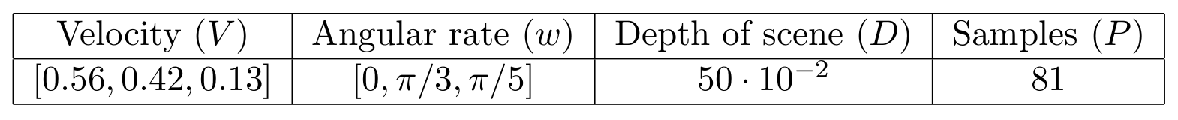
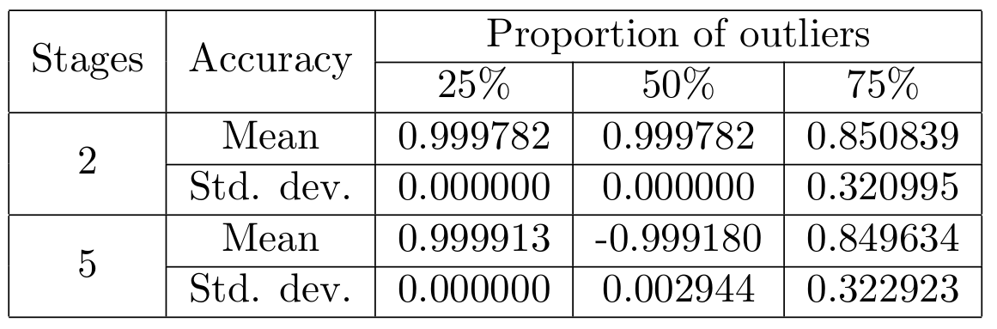
Simulation
Parameters
Results
Similar results
Fewer stages slightly less sensible to outliers
Brice Platerrier : brice.platerrier@epfl.ch
Notes:
The algorithm was first implemented in C so as to run on the optic-flow sensor chip. It was then translated into Matlab, as faithfully as possible to the code and the camera used on the optic-flow sensor, to validate the method and its implementation.
We used the same sampling pixels and the actual model of the camera to generate the synthetic optical flow vectors. Various proportions of outliers were simulated by adding randomly generated tangent vectors to the synthetic optic-flow vectors. The velocity and angular rate were set to the values shown here.
The results were averaged over 100 runs (randomly generated outliers) and are shown here.
As it can be seen, both methods yield similar results although fewer stages and thus lower resolution seems to be less sensible to outliers.
Nevertheless, due to its higher resolution and lower computational cost, the second case is favored and characterized in real-world experiment.

Slide 11
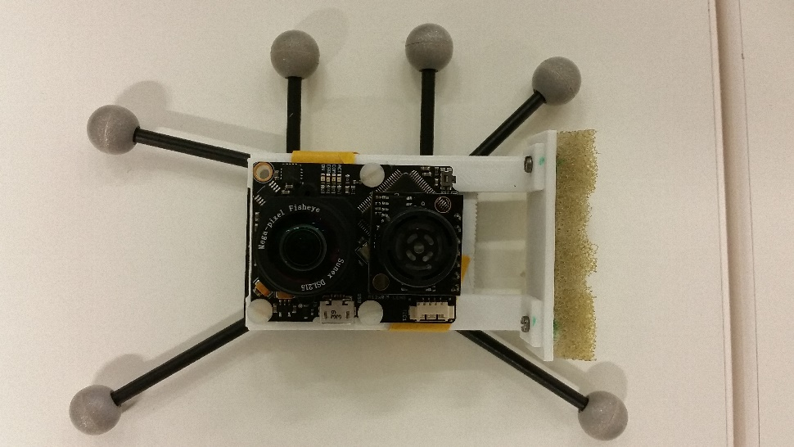
Motion capture
Setup
PX4Flow board
  Fisheye lens
  Full frame format
  160x120px
  10x10 image patches
OptiTrack
  21 IR cameras
  6 passive markers
Brice Platerrier : brice.platerrier@epfl.ch
Notes:
The algorithm was implemented in C and uploaded on a PX4Flow board equipped with a fisheye lens (image in full format 160x120px size and 10x10 patch for Lucas Kanade method).
The estimations and measurements obtained from the optic-flow sensor and its gyroscope were compared to the « ground truth » obtained from high precision motion capture system, namely the Optitrack. 21 cameras were tracking the 6 passive markers that were fixed on a frame and attached to the camera board.

Slide 12
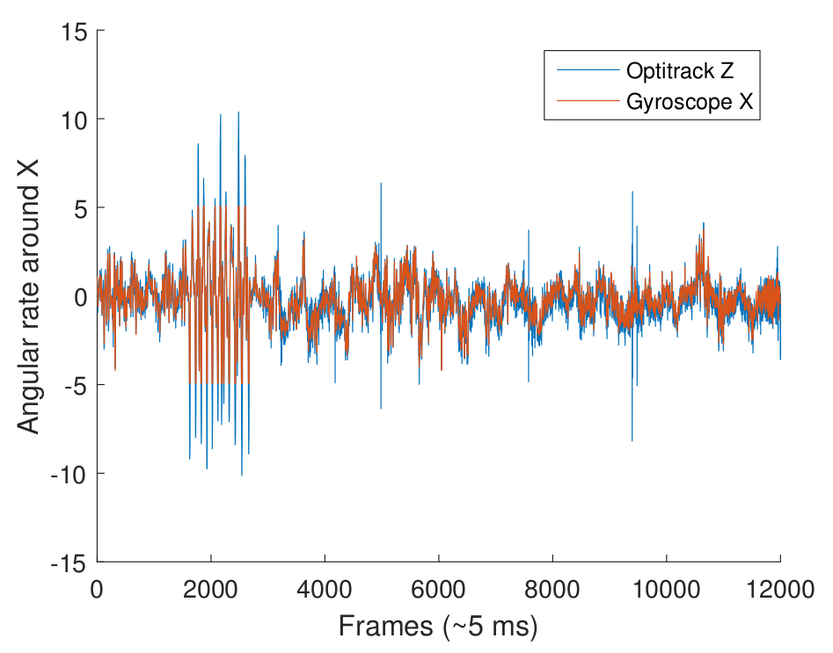
Motion capture
Synchronizing signals
Brice Platerrier : brice.platerrier@epfl.ch
Notes:
Before analyzing the results, the signals had to be synchronized since the measurements were not started simultaneously. A recognizable motion was perfomed so as to ease up this process. This enabled manual synchronization using distinguishable features of the signals, such as the one around 2000 frames.
As can be seen on the graph, both signals display comparable accuracy and noise though some spikes are visible on the Optitrack estimates. These spikes may be due to markers being lost by the motion capture system or the method to estimate the derivative of the angular position.

Slide 13
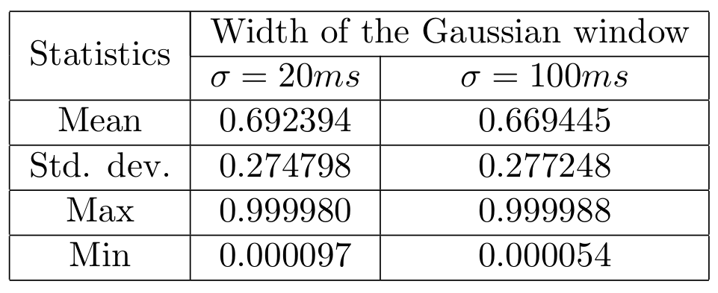
Motion capture
Results - Statistics
Poor accuracy:
  50° on average
  High variance
Brice Platerrier : brice.platerrier@epfl.ch
Notes:
To cope with oscillations observed in both signals, a gaussian window was applied on both estimates. Two widths were used: the first one corresponding to 20ms and the second one to 100ms.
The accuracy is assessed by computing the absolute value of the dot product between the normalized estimates of the direction of motion, over the full duration of the experiment.
Basically the closer to 1 the better the result.
Obviously the results seem poor both in terms of average value and standard deviation. Indeed, the algorithm exhibits a 50° accuracy which is pretty poor (awful) when compared to the resolution of the refined bins.

Slide 14
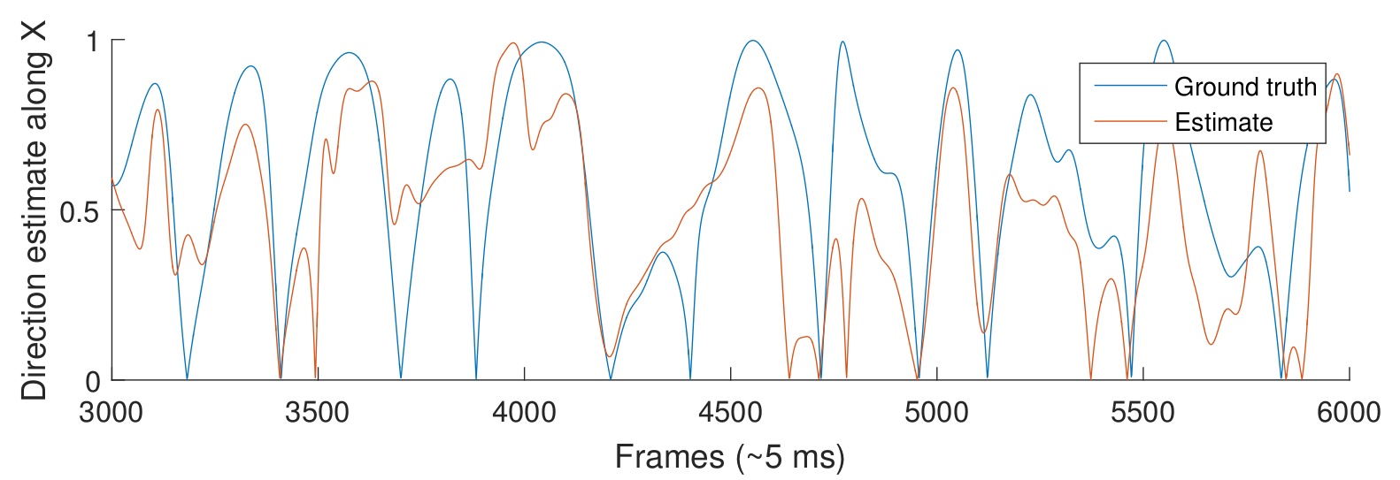
Motion capture
Results - Signals
Signals follow the same « trend »
Brice Platerrier : brice.platerrier@epfl.ch
Notes:
As the statistics are not fully representative of the results, let’s have a closer look at the estimates.
Both signals seem to follow the same trend with a good correlation between the two although we still notice high error in the optic-flow sensor estimates.

Slide 15
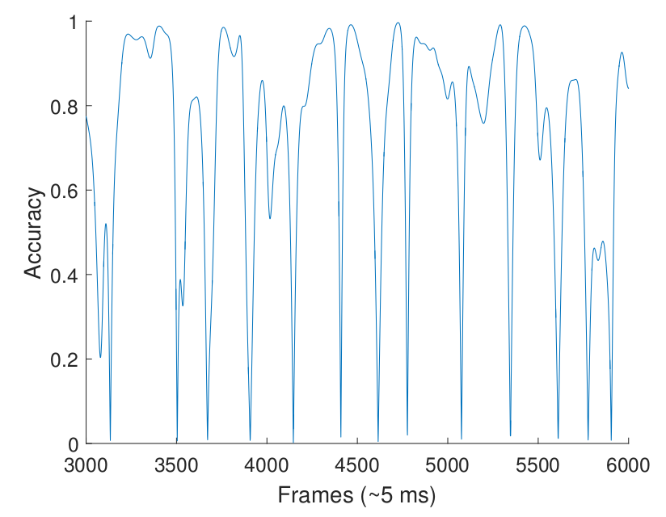
Motion capture
Results - Accuracy
Regular drops in the accuracy
Possible explanations:
Rapid changes in motion
Change in ambient lighting
Brice Platerrier : brice.platerrier@epfl.ch
Notes:
We can also have a look at the corresponding accuracy at each frame.
We observe regular drops in the accuracy for otherwise rather good estimates.
These drops may be related to rapid changes in the motion of the camera, especially in terms of angular rates which greatly influences the results because of the derotation procedure.
Another element to take into consideration is the fact that we used passive markers and that IR ligextent ht (at 250Hz) is sensed by the camera (200Hz). Same goes for the neon lights emitted at 50Hz. As a consequence, a frame was regularly lost (every 150ms or so) so as to allow the camera to adapt its luminosity. To which extent this issue has influenced the results remains an open question.

Slide 16
Conclusion
Method
  Computationally cheap
  High frequency & unscaled optic-flow
  Flexible iterative voting procedure
Performance
  Efficiency proven in simulation…
  … not really on embedded hardware
Improvements
  Cope with competing bins
  Adapted size of image patch
Brice Platerrier : brice.platerrier@epfl.ch

Slide 17
Method
Camera Model
Constraint on FOE location:
1 Optic-flow vector = 1 Great circle
Optic-flow back-projection
Derotation
Voting
Brice Platerrier : brice.platerrier@epfl.ch
Notes:
Each derotated optical flow (or translational component of the optic-flow) is used to constrain the focus of expansion to lie on a great circle.
This great circle is defined as the intersection of the plane containing the optic-flow vector, the corresponding sampling direction and the center of the sphere.
To ease up susbsequent computations, the great circle is encoded as its normal vector, i.e. the normalized cross-product between the optic-flow vector and the viewing direction.
One can then determine whether or not a point lies on the great circle using a simple dot product which is computationally cheap

Slide 18
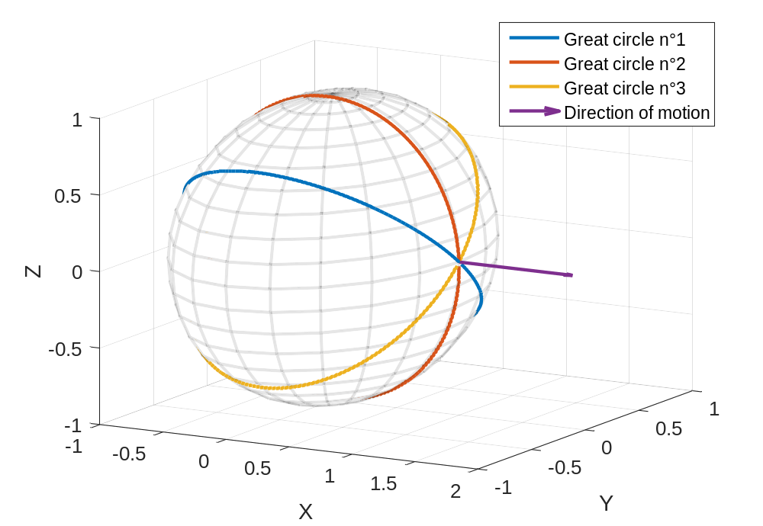
Method
Camera Model
Possible FOE location
=
Intersections of great circles
Optic-flow back-projection
Derotation
Voting
Brice Platerrier : brice.platerrier@epfl.ch

