Slide 1
Optic-Flow based estimation of angle of attack on a VTOL UAV
Brice Platerrier
Supervisor: Julien Lecoeur
Professor : Dario Floreano

Slide 2
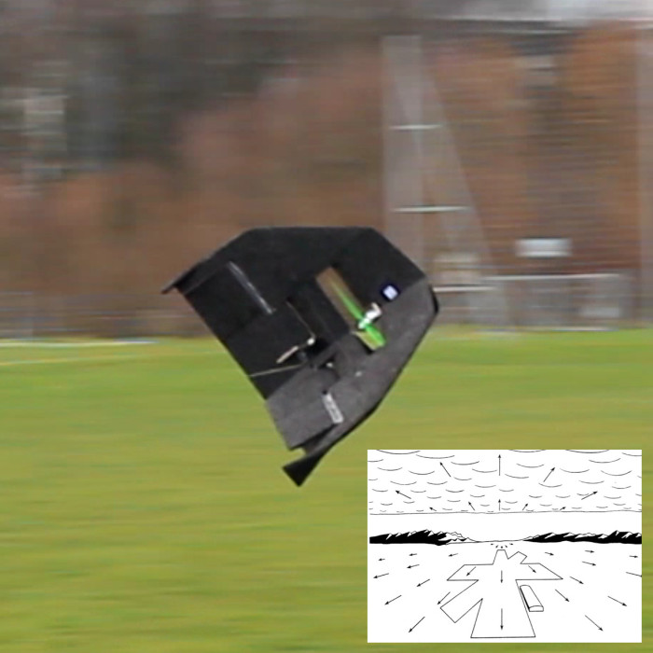
Introduction
Pitch angle ≠ Angle of attack
x_{b}
x_{a}
θ
α
γ
x_{o}
The Ywing
Goal: Use optic-flow measurements from wide field-of-view camera to estimate angle of attack

Slide 3
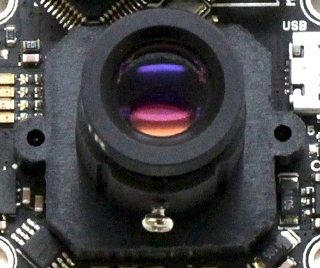
Omnidirectional Camera Model
Fisheye camera: view-angle ≥ 180 °
Benefits:
  Multiple optic-flow measurements
  Robustness for good arrangements
Drawback:
  High distortion => Need geometrical model
Solution: Unified model and automatic calibration (Scaramuzza, 2006)

Slide 4
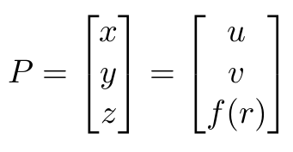

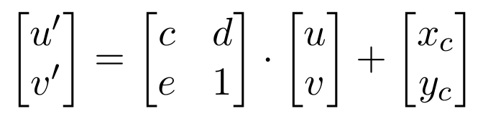
Omnidirectional Camera Model cont’d
Goal: Compute 3D direction from pixel on 2D image plane
(mapping to 3D scene)
(distortion compensation)
Given by calibration

Slide 5
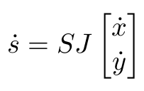

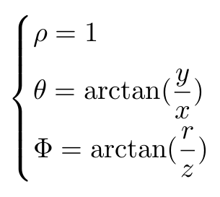
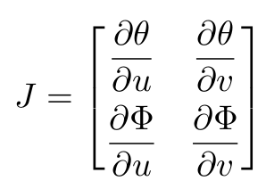
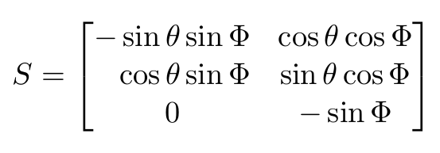
Optic-Flow Processing
Goal: Reduce distortion due to wide field-of-view
Projection on virtual retina (Shakernia, 2003)
Projection on unit sphere

Slide 6
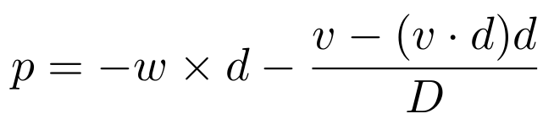
De-rotation of Optic-Flow
Goal: Remove rotational component to estimate translation direction only
(first order approximation)
Solution: Substract rotation-induced optic-flow (Srinivasan, 2009)
  Drawback: May introduce additional noise

Slide 7
Finding the Focus of Expansion
Goal: Derive constraints on translation direction from optic-flow
Solvers / Optimization
=>
Sensitive to noise & outliers
FOE
Robust algorithms:
  RANSAC and variants
  Voting (Lim, 2010)

Slide 8
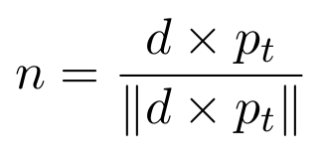
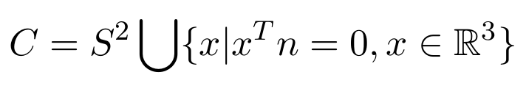

Finding the Focus of Expansion cont’d
Goal: Derive constraints on translation direction from optic-flow
n
d
Solutions:
  Vote for directions in C
  Compute intersections of pairs of great circles:
p_{t}

Slide 9
Conclusion
Camera board
Autopilot
Angular rates
Frames calibration
Optic-flow
Projection
De-rotation
Voting
Changing frame
Camera model
Angle of attack
Challenges:
  Optimize FOE estimation for on-board controller
  Compensate sensor readings delay
  Put everything together

Slide 10
