Slide 1








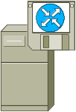







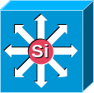

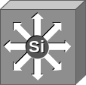









Icons: Cisco Products
Router-
Color and subdued
NetFlow
Router
100BaseT
Hub
Server
with
PC Router
Router
w/Silicon Switch
Workgroup
Director
CDDI/
FDDI Concentrator
Software-
Based Router on File Server
Protocol Translator
PC Adapter Card
SwitchProbe
Gateway
CiscoWorks
Workstation
PC Router
Card
Multilayer Switch,
with and without Text
and Subdued
Bridge
Terminal Server
Cisco
Hub
Workgroup Switch
Color/Subdued
ATM
Router
Comm
Server
Cisco 1000
Small Hub (10BaseT Hub)
ATM
Tag Switch Router

Slide 2


Slide 3


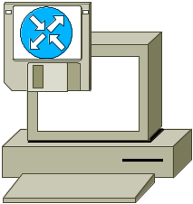




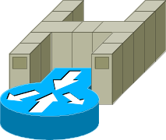









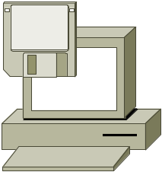



Icons: Cisco Products (Cont.)
Route/Switch Processor
with and without Si
PC with Router-Based Software
ATM
Switch
(Color and Subdued)
IP
Standard
and Old
(Some Prefer)
LAN2LAN Switch
MicroWeb
Server
Channel-Attached Router
Tag Router
Switch
ISDN
Switch
VIP
Switch Processor
Cisco 3800 (Right, Left, Up, Down
Multi-
Switch
Device
PC with
Software
NetFlow/
ATM Router

Slide 4
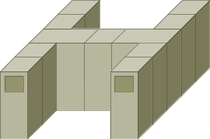

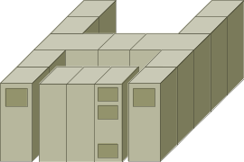

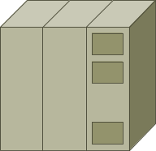

Icons: IBM
IBM
Mainframe
Cluster Controller/3174
(Desktop Model, Not Used Much)
IBM
Mainframe
with FEP
IBM Mini
(AS400)
FEP
(Front End Processor)
Cluster Controller/
3274 or3174
(Most Common Type)

Slide 5






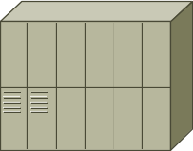



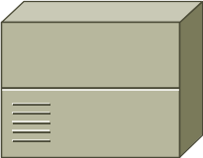

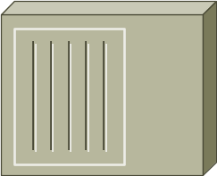


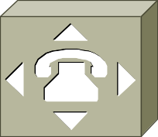
Icons: WAN
DSU/CSU
(Add Text in Powerpoint)
Network Cloud,
Dark
Distributed Director
WAN
Network Cloud,
Gold
Local Director
MUX
Network Cloud,
White
PIX Right and Left
PBX/
Switch
NAT
Hub
Gray and Blue
Network Cloud, Standard Color
PBX
(Small)

Slide 6
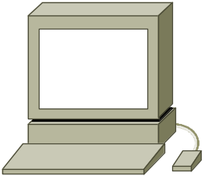
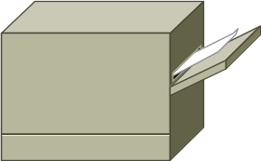

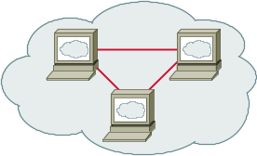

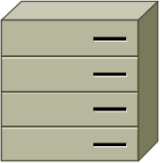

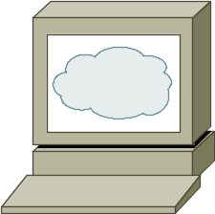

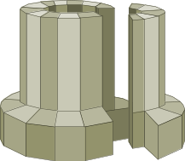
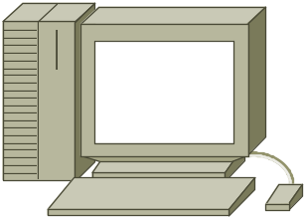

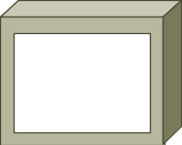
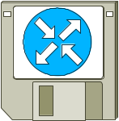
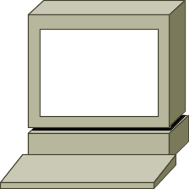
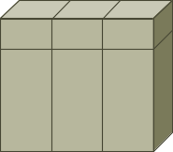
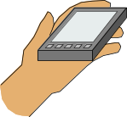
Icons: LAN
WWW Cluster
Workstation
(Sun)
Printer
ATM/FastGb Etherswitch
Laptop
HP Mini
WWW Server
PC
File Server
Super-
computer
Mac
Repeater
Monitor
LAN2LAN
Terminal
Mini or
VAX/VMS
with DECnet
Newton

Slide 7







Icons: Media
Token Rings, with and without Text
and Subdued
Line: Serial (Use Thicker where There Is Space)
FDDI Rings, with and without Text, Vertical and Horizontal
Line: Circuit-Switched
(Use Thicker where There Is Space)
Line: Ethernet
(Use Thicker where There Is Space)

Slide 8

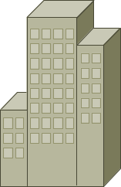
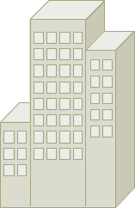
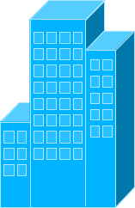
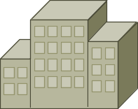
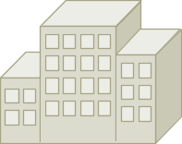





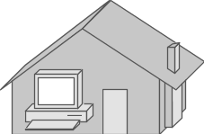
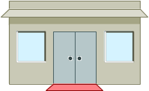
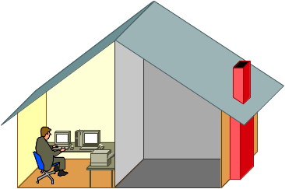
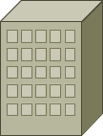


Icons: Buildings
Government
Headquarters, Regular, Subdued,
and Blue
University
House, Regular and Blue
Telecommuter
House (Color and Subdued)
Small
Business
Medium Building, Regular, Subdued,
and Blue
Home Office
Branch
Office,
Regular, Subdued,
and Blue

Slide 9





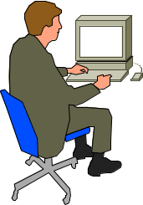










Icons: People
Symbol Woman, Various Colors
Symbol Man, Various Colors
Man
Woman
End User Male,
Left and Right
End User Female,
Left and Right
End User,
CiscoWorks
Running Man
(Color and Subdued)
Running Woman

Slide 10
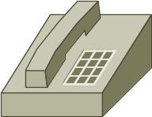




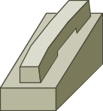
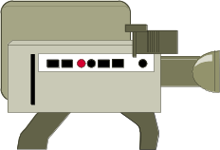

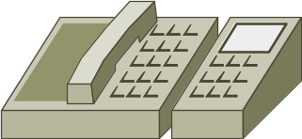
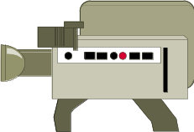
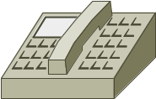
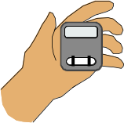


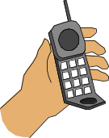
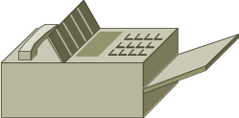
Icons: Multimedia/Voice/Phone
Phone
Phone Ethernet
Camera
PC/Video
Microphone
Phone 2
Phone Polycom
Camera
PC/Video
Speaker
Phone-Appliance
Phone Feature
Pager
Fax/
Phone
Headphones
Cell Phone
Fax

Slide 11


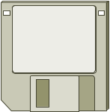




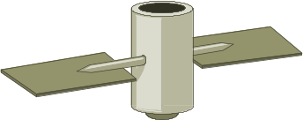







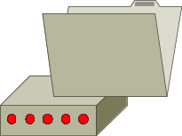
Icons: Miscellaneous
Firewall, Horizontal and Vertical, Subdued
Diskette
(3.5" Floppy)
Satellite
Dish
Breakout Box
Satellite
Lock
Host
MAU
Key
Lock and Key
PAD
Database, Relational
Modem
BBS
(Bulletin
Board
System)

Slide 12




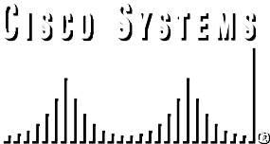
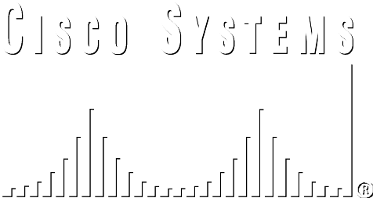

Logos: Cisco and Cisco IOS
Cisco Corporate and Cisco IOS Logos
In Two Sizes (Corporate Only) and Colors
(Use the Colored Logos Above on Lighter Backgrounds,
and the White Logos Below on Darker Ones)
The Cisco IOS Logo that Includes the Arrow
On the Left Is Not Used in Presentations and
Should Be Replaced with this One.

