Slide 1
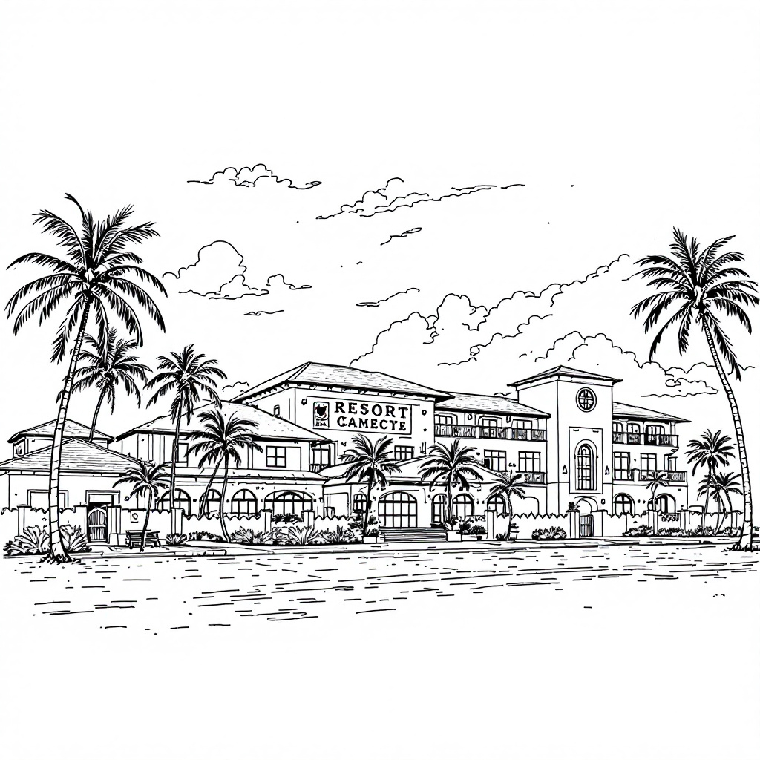
BUCKEYE RESORT INC.
FINDINGS FOR RESERVATION CANCELLATION DATA
Presentation by Samuel Jordan, David Mullins and Lisa Siefker

Slide 2
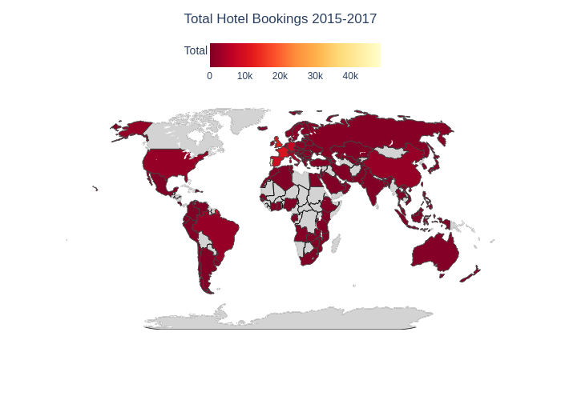
Problem Overview:
Business Need: BRI wants to reduce cancellation rates using targeted interventions. Why It Matters:
100,000+ reservations annually. Each cancellation costs BRI $500.
Even small improvements = big business impact. Proposed Solution: Predict at-risk reservations to offer $100 incentive.

Slide 3





Dataset Summary
119389
Bookings
2
Hotel types
3
Years of Data
30+
Features
Target:
Cancellations:
(1=Cancelled, 0=Not Cancelled)

Slide 4
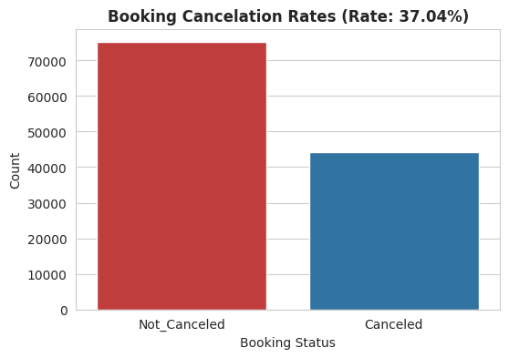
How Pervasive Are Cancellations?
119,389 Bookings
44,222 Cancellations
Rate of 37.04%
Cost Per Cancellation: $500
Total Estimated Cost: $22,086,465 (Current State)

Slide 5
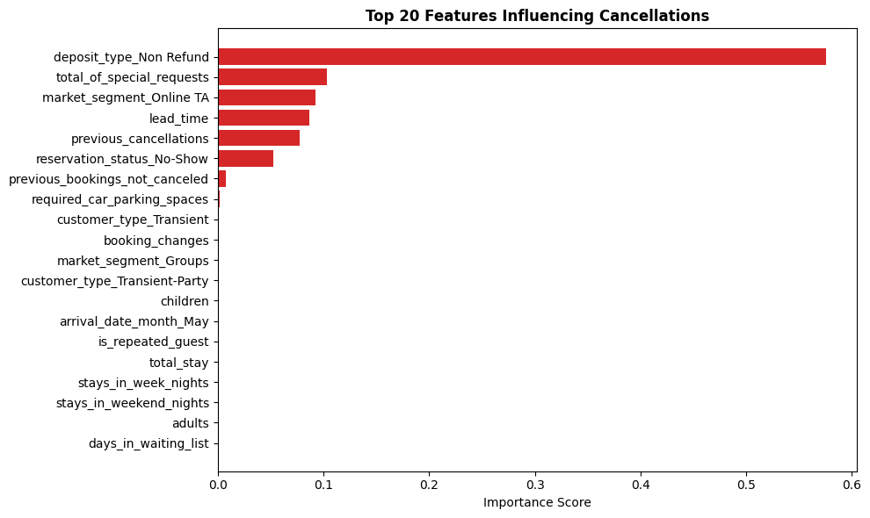
What Influences Cancellations?
To best predict which factors, influence cancellations, we used a tool that works like a smart flowchart. It asks a series of yes/no questions to sort through the data. Each question represents a variable, and the tool ranks them based on how much they influence the likelihood of a cancellation.

Slide 6
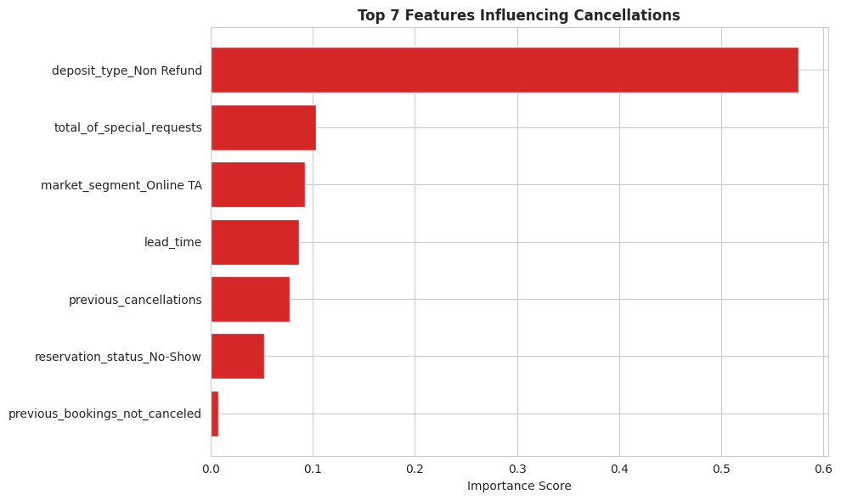
7 Top Factors
We identified 7 important variables that influence cancellations. These were used to train a model that predicts cost impacts. A confusion matrix helped us measure how accurate the predictions were.

Slide 7

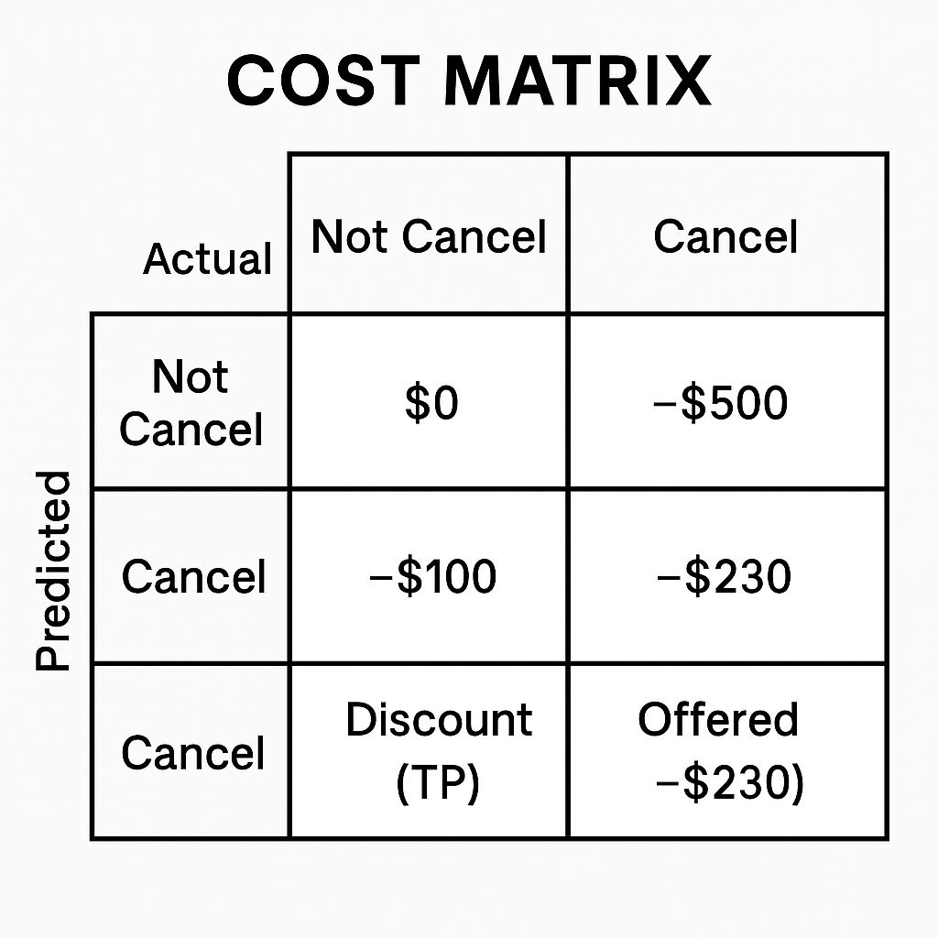


True Positive: Customer was at risk, received $100 discount.*
X
False Positive: Customer wasn’t going to cancel, but discount was applied. -$100
False Negative: Customer was at risk but received no discount. -$500
No Cancellation: $0
*$100 discount is only effective 30% average cost = $230

Slide 8
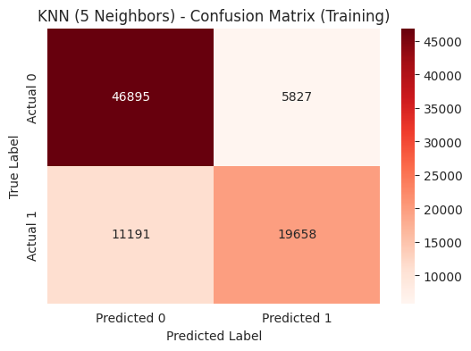
Training Model
Using the training data, the model resulted in a total estimated cost of approximately $10.7 million, averaging around $298.73 per booking.
The confusion matrix shows that the model:
Correctly predicted 46,895 non-canceled bookings (true negatives), and
Correctly identified 19,658 canceled bookings (true positives).

Slide 9
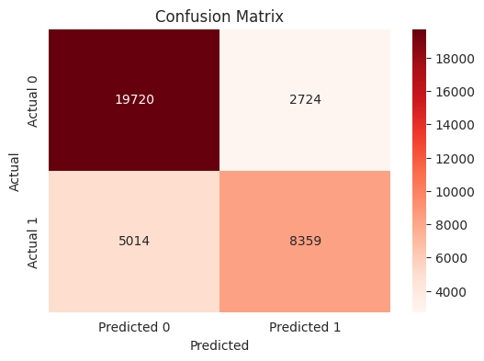
Test Model
Using the test data, the model achieved the following results:
19,720 bookings were correctly predicted as not canceled (true negatives).
8,359 bookings were correctly predicted as canceled (true positives).
2,724 bookings were incorrectly predicted as canceled but were actually not canceled (false positives).
5,014 bookings were incorrectly predicted as not canceled but were actually canceled (false negatives).
These predictions resulted in a total estimated cost of $4.7 million, which averages to approximately $131.28 per booking.

Slide 10
Model Performance & Business Impact
KNN model = 49 means the model checks the 49 most similar past bookings to make a cancellation prediction. This yielded 81% accuracy.
Loss reduced to 4.58 million from higher baseline losses.
Model does not eliminate loss but mitigates risk.
Enables more efficient use of $100 incentive.
Based on strong test model performance and significant cost reduction, we recommend BRI adopt this model to proactively reduce cancellation-related losses.

Slide 11
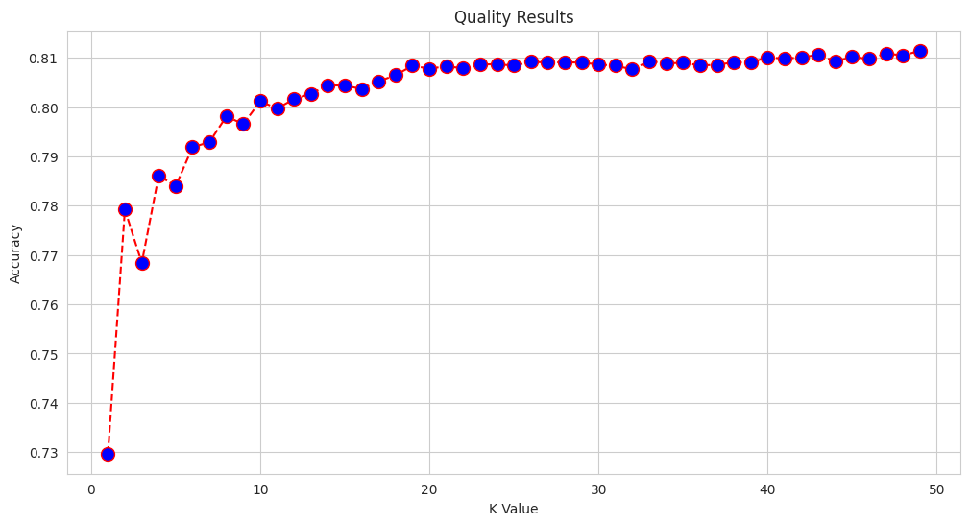
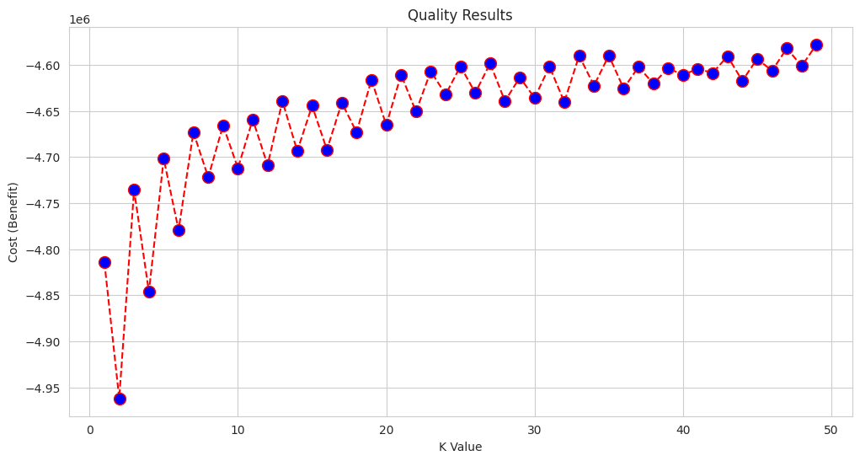
Appendix
Accuracy increases as more past reservations are used for comparison.
Best accuracy (~81%) achieved at K = 49.Higher K helps smooth out random variation and improve predictions.
Model reduces losses by targeting incentives more effectively.
K = 49 results in the lowest cost (~ -$4.58M).Larger K values lead to better decision-making for interventions.

