Slide 1

Part I: Intro NLP & Task at Hand

Slide 2
Outline
Intro NLP
Working Data
Task at Hand
Quanteda Universe
Notes:
kurz dazu sagen, dass wir hier keine tiefe theoretische einführung machen

Slide 3
Part I: Intro NLP & Task at Hand
Intro NLP

Slide 4

Intro NLP What is NLP?
Natural Language Processing (NLP) is a theoretically motivated range of computational techniques for analyzing and representing naturally occurring texts at one or more levels of linguistic analysis for the purpose of achieving human-like language processing for a range of tasks or applications (Liddy, 2001).
Notes:
über diese aspekte (in kursiv) sprechen wir im folgenden

Slide 5

Intro NLP Human-like Language Processing
How to make human language comprehensible to machines?
Numerical vector representation
Characterization by probabilities
...
Notes:
bildquelle: https://www.lifewire.com/what-is-binary-and-how-does-it-work-4692749

Slide 6
Intro NLP Naturally Occurring Texts
Basically, any form of human communication
Written text
Speech
Different types in different levels of formality
News articles
Customer reviews
Social media posts
...
Different languages

Slide 7
Intro NLP Levels of Linguistic Analysis
Morphological – how are words composed?
Lexical – what do single words mean?
Syntactic – what is the grammatical structure of a sentence?
Semantic – what meaning does a sentence convey?
Discourse – how do sentences interact to form a text?
Pragmatic – what is there between the lines?

Slide 8

Intro NLP Tasks
High-level tasks
Speech recognition
Word-sense disambiguation (WSD)
Named entity recognition (NER)
Relationship extraction
Error identification and recovery
Automatic summarization
Machine translation
Topic extraction
Sentiment analysis many more

Slide 9
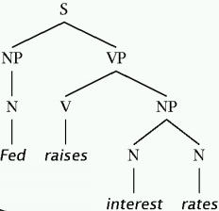
Intro NLP Tasks
Low-level tasks
Sentence boundary detection
Tokenization
Part-of-speech (POS) tagging
Stemming
Lemmatization
Shallow parsing
...

Slide 10

Intro NLP Computational Techniques
Available techniques largely depending on the task to solve
Standard machine learning techniques for classification tasks → E.g., sentiment analysis
Generative models for unsupervised tasks → E.g., topic modeling
Deep learning models for various tasks → E.g., translation with RNN
State of the art: transformer models (BERT, GPT-3)
Idea: teach them as much as possible about the language as a whole (pre-training) and fine-tune to specific tasks

Slide 11


Intro NLP Challenges
Variety of languages
Around 7,000 living tongues
Many low-resource languages
Large differences in grammatical structure, alphabet, scripting systems
Irregularities
Synonyms
Homonyms
Genera
Cases
„das Wachstum“ vs „der Reichtum“

Slide 12
Intro NLP Challenges
Contextual dependencies
Ambiguities
Domain-specific vocabulary
Varying formality
Complex constructs
Humor
Irony
Sarcasm
Colloquialisms
Individual expression
Style
Emotion
Errors
Transcription/translation errors
Misspelling
Evaluation of NLP tasks

Slide 13



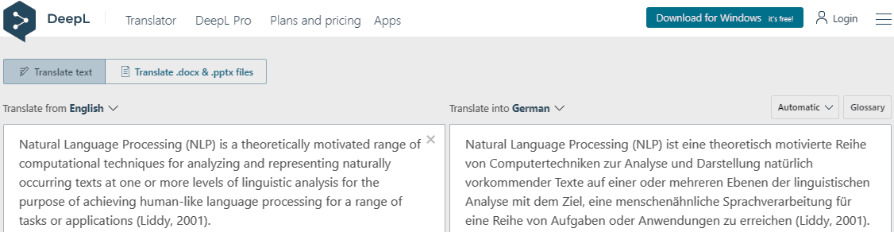
Intro NLP Applications
ad, unpaid

Slide 14
Part I: Intro NLP & Task at Hand
Working Data

Slide 15
Working Data Generation
All data generated by scraping the web
Various sources:
https://www.bundestag.de/abgeordnete
Individual party websites
Twitter API
scraping is legal so long as it does not involve breaking security barriers explicitly in place to guard against such automatic data extraction

Slide 16

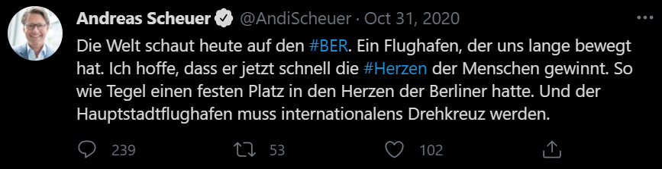
Working Data Structure
Required information (on MP level)
Name
Party
Electoral district & associated meta data
Twitter username
Posted tweets
Date
Text
Number of likes, retweets
Number of followers

Slide 17
Working Data Structure
Variable | Type | Description
last_name | chr | MP‘s last name
first_name | chr | MP‘s first name
wahlkreis_name | chr | MP‘s electoral district
party | factor | MP‘s political party
bundesland | factor | Federal state of MP‘s electoral district
unemployment_rate | num | Unemployment rate in MP‘s electoral district during 2017 election
share_pop_migration | num | Share of migrant population in MP‘s electoral district during 2017 election
username | chr | MP‘s username on Twitter
followers_count | num | MP‘s number of followers on Twitter at scraping time
created_at | date | Time stamp of tweet creation
text | chr | Tweet text
favorite_count | num | Number of likes for tweet at scraping time
retweet_count | num | Number of retweets for tweet at scraping time

Slide 18

Working Data Example
"Merkel-Regierung geht vor Erdogan in die Knie. Auf meine Frage, ob nach Auffassung der Bundesregierung die Ermordung der Armenier 1915/16 ein „Völkermord“ war, eiert sie nur rum. Ihr sei die Position des Bundestages dazu „bekannt“. Sie selbst hat dazu keine. #erbärmlich #feige https://t.co/bkwSflCJan"

Slide 19
Working Data Particularities
Twitter idiosyncrasies
Extremely short texts
Often in response to recent event without explicitly naming it
Informal language with tendency to containing spelling mistakes
Special tokens: emojis, hashtags
Political context
Specific vocabulary
Sometimes rather formal after all (and few emojis)
Many solely informative tweets
Tendency toward negative sentiment
German language

Slide 20
Part I: Intro NLP & Task at Hand
Task at Hand

Slide 21


Task Analytical Objective
Twitter + socioeconomic data on German MPs
Pre-processing
Topic extraction
Sentiment classification
Sentiment s ∈ {positive, negative} toward topic k ∈ {1, 2, ... , K}

Slide 22

Task Topic Extraction
... more on this later
Topic extraction aka topic modeling: finding latent thematic clusters within a collection of texts
Goal: assign each document a topic probability vector / topic label
Used for
Information retrieval
Clustering
Supporting upstream tasks
Unsupervised task: both topics and their number unknown
for instance, sentiment analysis

Slide 23
Task Sentiment Analysis
... more on this later
Sentiment analysis: identifying and analyzing affective states
Relevant subtask: polarity detection
Goal: assign each document a polarity label ∈ {positive, negative}
Used for
Customer relationship management
Social media analysis
Supervised task: requiring labeled training data (typically)
alternative, rule-based approaches exist

Slide 24
Task Topic-Specific Sentiment Analysis
Idea: domain- / topic-dependence of sentiment predictors → Combine topic extraction (1) and sentiment analysis (2)
Implementation
R: word embeddings per topic
BERT: aspect-based sentiment analysis
e.g., „Sozialleistungen“ possibly positively connotated in social security context but negatively connotated in asylum politics
underlying assumption: one aspect per document

Slide 25
ML Pipeline Analytical Sequence (R)
Scraping
Labeling
Data cleaning
Extraction of Twitter tokens
Extraction of lexical features
Extraction of dictionary features
Extraction of unigrams
Extraction of POS tags
Sentiment analysis
Word embeddings
Topic modeling
Dynamic features

Slide 26


ML Pipeline Static vs Dynamic Features
Fundamental principle in machine learning: dichotomy between training and test sphere → Avoid bias in performance estimation
Static features
Solely determined on single-observation level
E.g., POS tags
Dynamic features
Affected by surrounding observations
E.g., topic labels
may be computed before training
must be computed during training

Slide 27

ML Pipeline Static vs Dynamic Features
Raw data
static feature extraction
topic modeling
embeddings
Static features
sentiment analysis

Slide 28
Part I: Intro NLP & Task at Hand
Quanteda Universe

Slide 29

Quanteda Universe Package
Benoit et al. (2018)
Convenient text handling in R
Designated classes for textual data (with easy conversion to and from data.frame & friends)
User-friendly syntax
Fast computation
Compatibility with spacyr package (Benoit et al., 2020) → Wrapper for Python’s popular spaCy package used for, i.a., POS tagging
tutorials for getting started on https://tutorials.quanteda.io/

Slide 30
Quanteda Universe Basic Classes
[Word = smallest entity of text → words] [Sentence = sequence of w words → sentences] [Paragraph = sequence of s sentences → not relevant] [Document = sequence of p paragraphs → tweets]
corpus
Most basic class to handle text data
Collection of documents + document-level variables → tweets + meta data
lower-level corpora, e.g., as collections of paragraphs, also possible

Slide 31
Quanteda Universe Basic Classes
tokens
Representing documents as a collection of tokens → tokens per tweet + meta data
Token: sequence of characters grouped together as a useful semantic unit → Single words, n-grams, ...
During tokenization, we will often
Remove punctuation
Remove stopwords
Omit cases (e.g., lowercase everything)
Perform stemming / lemmatization
Goal: representation of texts by tokens that co-occur across documents
text normalization – to be continued

Slide 32
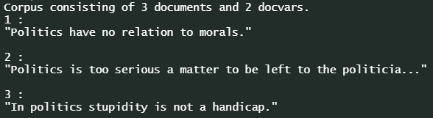
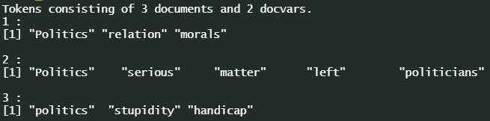
Quanteda Universe Basic Classes

Slide 33
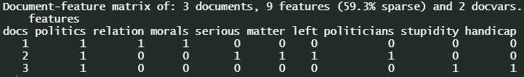
Quanteda Universe Basic Classes
dfm
Document-feature matrix
Token count per document → word occurrence per tweet + meta data
Methods
Weighting schemes, such as tf-idf
Counting matches with a list of words
Extracting top features
Performing dictionary look-ups

Slide 34
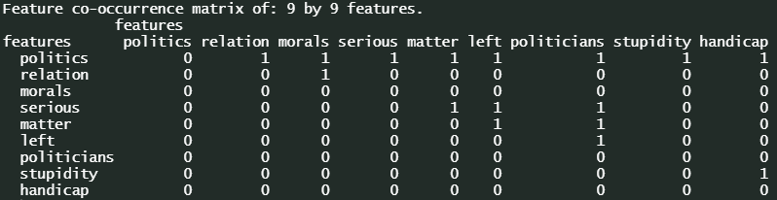
Quanteda Universe Basic Classes
fcm
Feature co-occurrence matrix
Tokens co-occurrence count across corpus → co-occurrence across tweets

Slide 35

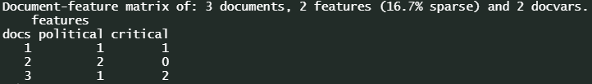
Quanteda Universe Basic Classes
dictionary
Essentially, named list
Specifying dimensions with associated items
Look-up on document level → dictionary item count per tweet

Slide 36


Quanteda Universe Scope
Purpose of quanteda: handling text corpora and performing basic analysis of their components
Within scope
Organizing text documents
Tokenization
Descriptive analyses
Out of scope
Higher-level text analysis, such as topic modeling or sentiment analysis
pre-processing with quanteda
downstream analyses with other tools

Slide 37
Part I: Intro NLP & Task at Hand
Literature and References

Slide 38
Eisenstein, J. (2019): Introduction to Natural Language Processing, MIT Press.
Liddy, E.D. (2001): Natural Language Processing, in: Encyclopedia of Library and Information Science, 2nd ed., NY. Marcel Decker, Inc.
Nadkarni, P. M., Ohno-Machado, L., and Chapman W. (2011): Natural Language Processing: An Introduction. Journal of the American Medical Informatics Association 18(5), 544–551, https://doi.org/10.1136/amiajnl-2011-000464.
Vayansky, I., and Kumar S.A.P. (2020): A Review of Ttopic Modeling Methods. Information Systems, doi: https://doi.org/10.1016/j.is.2020.101582.
Benoit, K., Watanabe, K., Wang, H., Nulty, P., Obeng, A., Müller, S., and Matsuo, A. (2018): quanteda: An R package for the Quantitative Analysis of Textual Data. Journal of Open Source Software 3(30), 774, https://doi.org/10.21105/joss.00774.

