Slide 1

Part II-3: Sentiment Analysis

Slide 2
Outline
Word Embeddings
Feature Collection
Sentiment Analysis
Machine Learning Background
mlr3 Universe
Evaluation
Visualization
Excursus: AutoML Pipeline
Notes:
kurz dazu sagen, dass wir hier keine tiefe theoretische einführung machen

Slide 3
Part II-3: Sentiment Analysis
Word Embeddings

Slide 4
Word Embeddings Setting
Recall our goal: numeric representation of texts by variables that co-occur across documents
Approaches
Vocabulary-based → done
Neural network representations → later: BERT
Word embeddings → let‘s see
Notes:
Goal: Represent words for text analysis with the help of numerical vectors
Hundreds of dimensions

Slide 5
Word Embeddings Vocabulary-Based
Revisited: BOW
Vocabulary with all occurring words in documents
Assumption: each word independent from others present in document
No accounting for word order
Each document represented by the term frequency vector (occurrence of all the distinct words that are present in the document)
Idea: weighting
Term Frequency - Inverse Document Frequency (TF-IDF)
Not implying that all terms are considered equally important
Idea: penalize words that are too frequent
Notes:
After Dealing with Special Character ,
term frequency - inverse document frequency (tf-idf)

Slide 6

Word Embeddings Example BOW
Documents
"Die Ausgrenzung von MigrantInnen ist inakzeptabel und rassistisch."
"Die Maskenpflicht ist sinnvoll."
"Die Diskriminierung von Frauen ist inakzeptabel."
Vector-space representations
 | die | ausgrenzung | von | migrantinnen | ist | inakzeptabel | und | rassistisch | maskenpflicht | sinnvoll | diskriminierung | frauen
Doc1 | 1 | 1 | 1 | 1 | 1 | 1 | 1 | 1 | 0 | 0 | 0 | 0
Doc2 | 1 | 0 | 0 | 0 | 1 | 0 | 0 | 0 | 1 | 1 | 0 | 0
Doc3 | 1 | 0 | 1 | 0 | 1 | 1 | 0 | 0 | 0 | 0 | 1 | 1
Notes:
After Dealing with Special Character ,
term frequency - inverse document frequency (tf-idf)

Slide 7
Word Embeddings Example TF-IDF
Documents
"Die Ausgrenzung von MigrantInnen ist inakzeptabel und rassistisch."
"Die Maskenpflicht ist sinnvoll."
"Die Diskriminierung von Frauen ist inakzeptabel."
Vector-space representations
 | die | ausgrenzung | von | migrantinnen | ist | inakzeptabel | und | rassistisch | maskenpflicht | sinnvoll | diskriminierung | frauen
Doc1 | 0 | .48 | .18 | .48 | 0 | .18 | .48 | .48 | 0 | 0 | 0 | 0
Doc2 | 0 | 0 | 0 | 0 | 0 | 0 | 0 | 0 | .48 | .48 | 0 | 0
Doc3 | 0 | 0 | .18 | 0 | 0 | .18 | 0 | 0 | 0 | 0 | .48 | .48
Notes:
Absolute Haufigkeitstabelle für jedes Wort, das in einem Dokument vorkommt. Jede Zeile stellt gleichzeitig die jeweilige Dokumentreprasentation im BoW-Modell dar

Slide 8
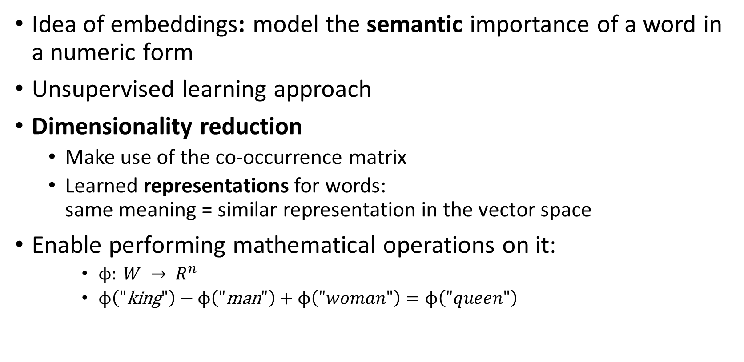
Word Embeddings Idea
Idea of embeddings: model the semantic importance of a word in a numeric form
Unsupervised learning approach
Dimensionality reduction
Make use of the co-occurrence matrix
Learned representations for words: same meaning = similar representation in the vector space
Enable performing mathematical operations on it:
$ϕ: {W → R}^{n}$
$ϕ\left(\text{"}\text{king}"\right)−ϕ\left(\text{"}\text{man}"\right)+ϕ\left(\text{"}woman"\right)=ϕ\left(\text{"}queen"\right)$
Notes:
Word embedding mapping from word space to n dimensional vector space, projecting the textual contents into Vector Space
Model, where text data is converted into vectors of numbers

Slide 9
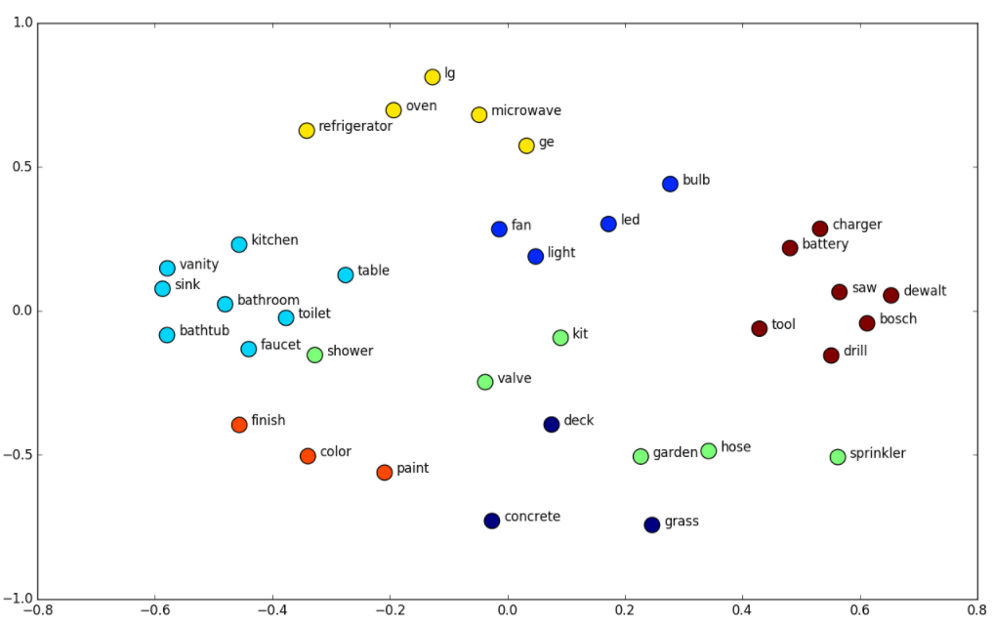
Word Embeddings Idea
https://www.shanelynn.ie/get-busy-with-word-embeddings-introduction/
Notes:
Word embedding mapping from word space to n dimensional vector space, projecting the textual contents into Vector Space
Model, where text data is converted into vectors of numbers

Slide 10
Word Embeddings Idea
Approaches
Notes:
Word embedding mapping from word space to n dimensional vector space, projecting the textual contents into Vector Space
Model, where text data is converted into vectors of numbers

Slide 11
Part II-3: Sentiment Analysis
Feature Collection

Slide 12

Feature Collection Task Structure
Raw data
static feature extraction
topic modeling
embeddings
Static features
sentiment analysis

Slide 13
Feature Collection Task Structure
Static features
Polarity clues
Negations, intensifications, punctuations, repetitions
Word/character n-grams
Part-of-speech (POS) tags
Twitter-specific features
Dynamic features
Word embeddings per topic

Slide 14
Part II-3: Sentiment Analysis
Sentiment Analysis

Slide 15
Part II-3: Sentiment Analysis
Excursus: AutoML Pipeline

Slide 16
Part II-3: Sentiment Analysis
Literature and References

Slide 17
Eisenstein, J. (2019): Introduction to Natural Language Processing, MIT Press.
Liddy, E.D. (2001): Natural Language Processing, in: Encyclopedia of Library and Information Science, 2nd ed., NY. Marcel Decker, Inc.
Nadkarni, P. M., Ohno-Machado, L., and Chapman W. (2011): Natural Language Processing: An Introduction. Journal of the American Medical Informatics Association 18(5), 544–551, https://doi.org/10.1136/amiajnl-2011-000464.
Vayansky, I., and Kumar S.A.P. (2020): A Review of Ttopic Modeling Methods. Information Systems, doi: https://doi.org/10.1016/j.is.2020.101582.
Benoit, K., Watanabe, K., Wang, H., Nulty, P., Obeng, A., Müller, S., and Matsuo, A. (2018): quanteda: An R package for the Quantitative Analysis of Textual Data. Journal of Open Source Software 3(30), 774, https://doi.org/10.21105/joss.00774.

