Slide 1

Part I: Intro NLP & Task at Hand

Slide 2
Part I: Intro NLP & Task at Hand
Intro NLP

Slide 3
Outline
Intro NLP
Task at hand
Working data
Machine learning pipeline
Quanteda universe
Notes:
kurz dazu sagen, dass wir hier keine tiefe theoretische einführung machen

Slide 4

Intro NLP What is NLP?
Natural Language Processing (NLP) is a theoretically motivated range of computational techniques for analyzing and representing naturally occurring texts at one or more levels of linguistic analysis for the purpose of achieving human-like language processing for a range of tasks or applications (Liddy, 2001).
Notes:
über diese aspekte (in kursiv) sprechen wir im folgenden

Slide 5

Intro NLP Human-like Language Processing
How to make human language comprehensible to machines?
Numerical vector representation
Characterization by probabilities
...
Notes:
bildquelle: https://www.lifewire.com/what-is-binary-and-how-does-it-work-4692749

Slide 6
Intro NLP Naturally Occurring Texts
Basically, any form of human communication
Written text
Speech
Different types in different levels of formality
News articles
Customer reviews
Social media posts
...
Different languages

Slide 7
Intro NLP Levels of Linguistic Analysis
Morphological – how are words composed?
Lexical – what do single words mean?
Syntactic – what is the grammatical structure of a sentence?
Semantic – what meaning does a sentence convey?
Discourse – how do sentence interact to form a text?
Pragmatic – what is there between the lines?

Slide 8

Intro NLP Tasks
High-level tasks
Speech recognition
Word-sense disambiguation (WSD)
Named entity recognition (NER)
Relationship extraction
Error identification and recovery
Automatic summarization
Machine translation
Topic extraction
Sentiment analysis many more
Notes:
bildquelle: https://fortune.com/2016/05/24/apple-siri-developers-echo/

Slide 9
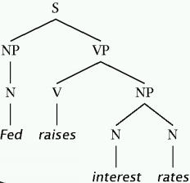
Intro NLP Tasks
Low-level tasks
Sentence boundary detection
Tokenization
Part-of-speech (POS) tagging
Stemming
Lemmatization
Shallow parsing
...
Notes:
bildquelle: https://cs.stanford.edu/degrees/phd/cs300/chris-manning.pdf

Slide 10

Intro NLP Computational Techniques
Available techniques largely depending on the task to solve
Standard machine learning techniques for classification tasks → E.g., sentiment analysis
Generative models for unsupervised tasks → E.g., topic modeling
Deep learning models for various tasks → E.g., translation with RNN
State of the art: transformer models (BERT, GPT-3)
Idea: teach them as much as possible about the language as a whole (pre-training) and fine-tune to specific tasks

Slide 11

Intro NLP Challenges
Variety of languages
Around 7,000 living tongues
Many low-resource languages
Large differences in grammatical structure, alphabet, scripting systems
Irregularities
Synonyms
Homonyms
Genera
Cases
das Wachstum vs der Reichtum ...

Slide 12
Intro NLP Challenges
Contextual dependencies
Ambiguities
Domain-specific vocabulary
Varying formality
Complex constructs
Humor
Irony
Sarcasm
Colloquialisms
Individual expression
Style
Emotion
Errors
Transcription/translation errors
Misspelling
Evaluation of NLP tasks

Slide 13



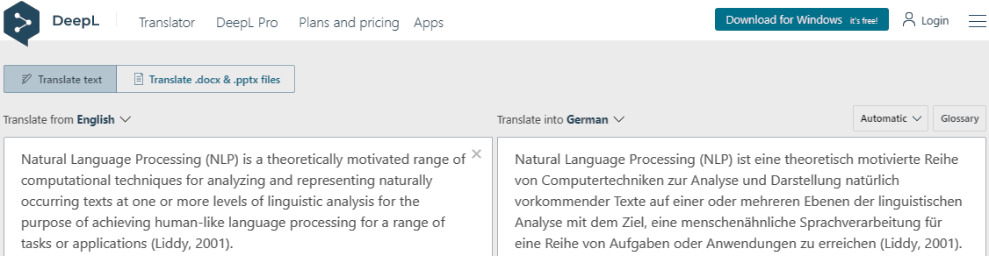
Intro NLP Applications
ad, unpaid

Slide 14
Part I: Intro NLP & Task at Hand
Task at Hand

Slide 15


Task at hand Analytical objective
Twitter data by German MPs
Data pre-processing
Topic extraction
Sentiment classification
Sentiment s ∈ {positive, negative} toward topic t ∈ {1, 2, ... , k}

Slide 16
Working data Generation
M

Slide 17
Working data Structure
M

Slide 18
Working data Example
M

Slide 19
Working data Particularities
M

Slide 20
ML pipeline Analytical sequence
M

Slide 21
ML pipeline Static vs dynamic features
M

Slide 22
Quanteda universe Package
M

Slide 23
Quanteda universe Basic classes
M

Slide 24
Quanteda universe Scope
M

Slide 25
Part I: Intro NLP & Task at Hand
Literature and References

Slide 26
Jacob Eisenstein (2019): Introduction to Natural Language Processing, MIT Press
Liddy, E.D. 2001. Natural Language Processing. In Encyclopedia of Library and Information Science, 2nd Ed. NY. Marcel Decker, Inc.
Prakash M Nadkarni, Lucila Ohno-Machado, Wendy W Chapman, Natural language processing: an introduction, Journal of the American Medical Informatics Association, Volume 18, Issue 5, September 2011, Pages 544–551, https://doi.org/10.1136/amiajnl-2011-000464

