Slide 1
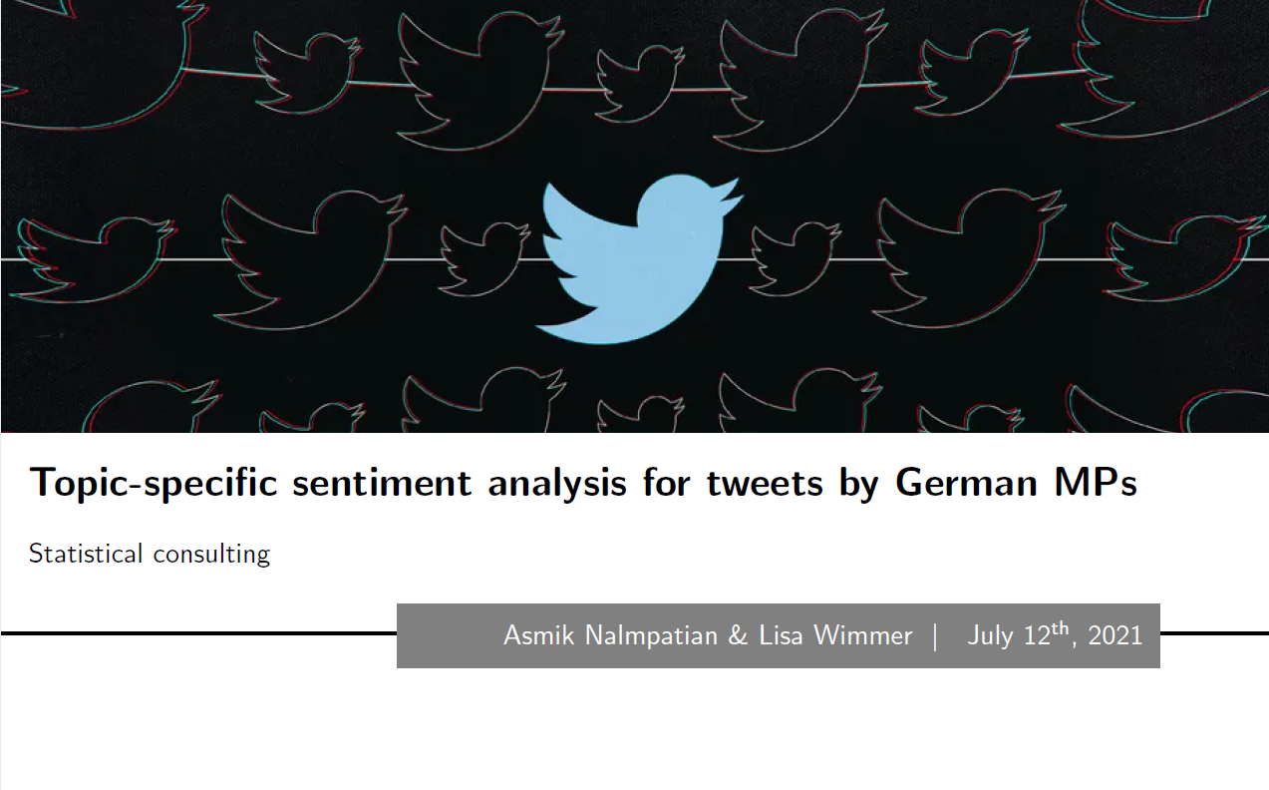
<number>

Slide 2
Table of Contents
Introduction
General Theoretical Context
Data
Standard Machine Learning Solution
Deep Learning Solution
Knowledge Transfer
Conclusion
<number>

Slide 3
Introduction
Twitter as a medium for political and source of constant information: Scraped tweets serve as a database
Primary goal: Analysis of public sentiment in a topic-aware manner for texts scraped from Twitter posts by German Members of Parliament (MPs)
We explore how topic-specific sentiment analysis can be implemented, considering (1) standard machine learning (ML) techniques and (2) more complex deep learning (DL) models.
Secondary goal: Make analysis of social media texts in a political context more easily accessible to researchers
We provide extensive teaching material on both approaches, composed as a coherent online course, to educate researchers on addressing NLP problems in their own work
<number>

Slide 4
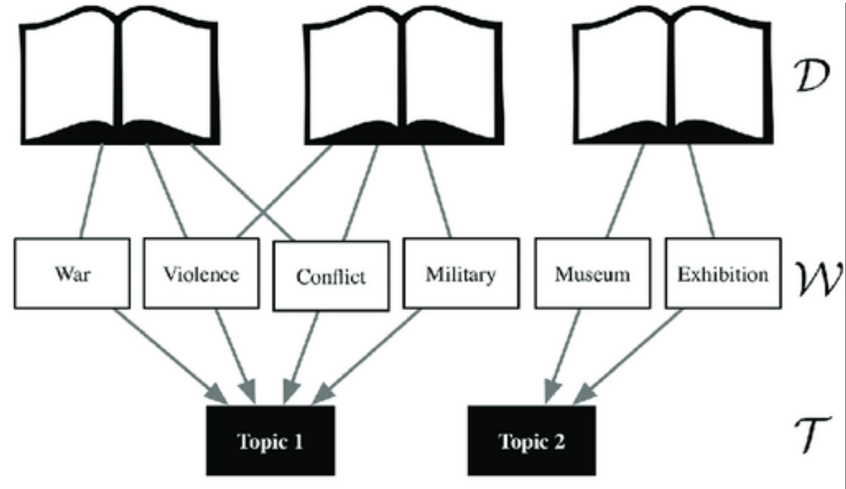
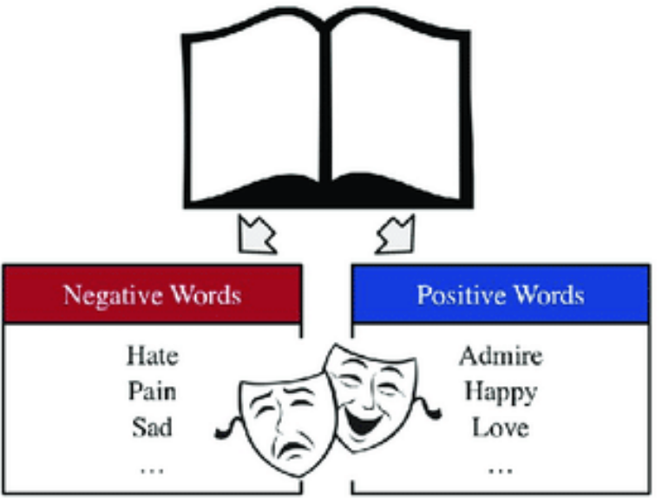
General Theoretical Context
Topic-
Specific
Sentiment
Analysis
+
=
Topic modeling
Sentiment Analysis
Fig. 1: Source (modified): https://www.researchgate.net/figure/Sentiment-analysis-and-topic-modeling-in-narrative-A-Sentiment-analysis-Words_fig2_337747374 (modified)
<number>

Slide 5
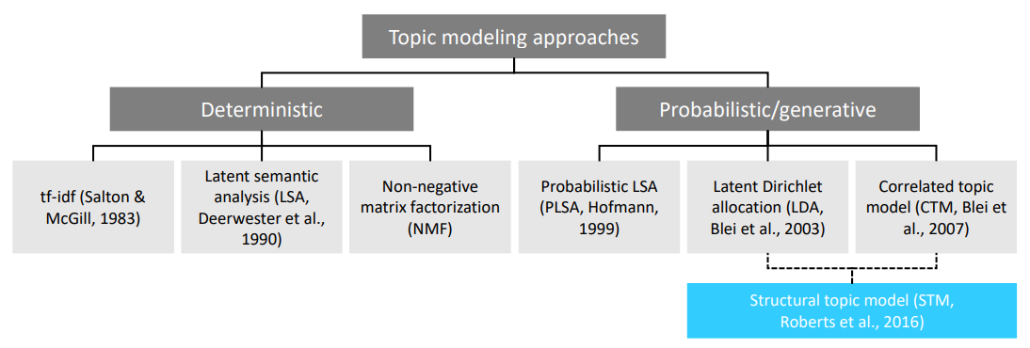
General Theoretical Context Topic Modeling
Fig. 2: Overview of topic modeling approaches. Source: Intro to NLP by Asmik & Lisa (https://lisa-wm.github.io/nlp-twitter-r-bert/)
<number>

Slide 6
General Theoretical Context Probabilistic/generative approaches
Idea: Hierarchical Bayesian mixture models ; reverse-engineer the imaginative process of document generation
For each of document d within a corpus draw a vector of topic proportions from the assumed distribution
For each word position n within d
draw a topic assignment from the assumed distribution
draw a word from the assumed distribution
<number>

Slide 7
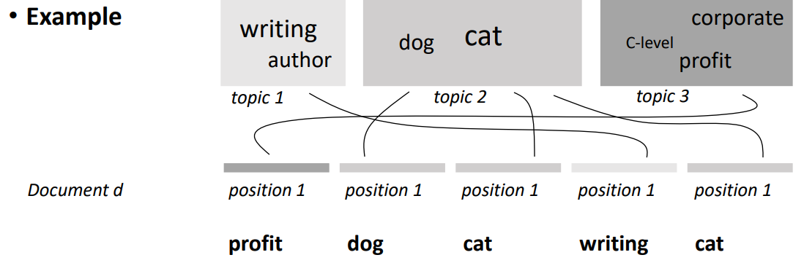
General Theoretical Context Example
1
2
3
4
5
Fig. 3: Example for Probabilistic/generative approach of topic modeling. Source: Intro to NLP by Asmik & Lisa (https://lisa-wm.github.io/nlp-twitter-r-bert/)
<number>

Slide 8
General Theoretical Context Sentiment Analysis
Idea: Find a model that maps from the space of input features into 2-dimensional space; Each observation / tweet represented by features is assigned to a probability of belonging to “positive” or “negative” class
Standard Machine Learning: Random Forests and Regularized Logistic Regression
Deep Learning: BERT, focus on fine-tuning to sentiment analysis task
<number>

Slide 9
General Theoretical Context Topic-specific sentiment analysis
Idea: Combine of Topic Modeling and Sentiment Analysis
Apply non-simultaneous methods mostly due to their complexity and our goal of making text analysis accessible to a broader audience
Standard ML approach:
Build tweet-clusters based on the topic modeling
Use the clusters to generate topic-specific embeddings that are afterwards fed to the classifier
BERT:
Aspect extraction: Extract the word from the tweet that containd the topic-specific information
Aspect sentiment classification: Using the information about the aspects as an additional feature fine-tune BERT to an Aspect Based Sentiment Analysis task
<number>

Slide 10
Data Data collection: Web Scraping
Idea: Collect tweets by members of the German parliament (Bundestag) issued after the last federal election in September 2017
Gather MPs' names and basic information from the official Bundestag website
Find Twitter account names
Acquire socioeconomic information for the time of the last federal election on a per-district level
Scrape actual tweets along with some additional variables like the number of retweets
Manually label 1215 tweets
<number>

Slide 11
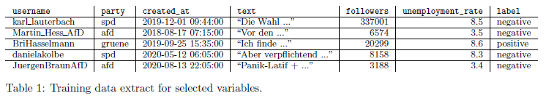
Data Data labeling
For each tweet: assign polarities “positive” or “negative”, and also topic descriptions required for BERT's ABSA task
Note: A large number of tweets do not appear to carry sentiment at all
<number>

Slide 12
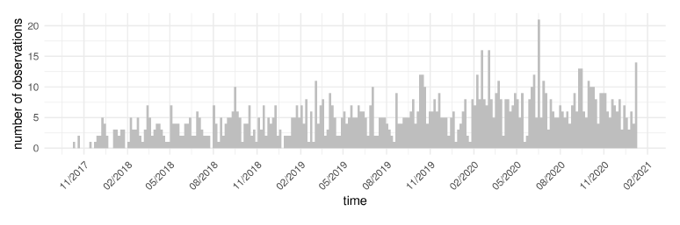
Data Periodical fluctuations in the number of tweets over time and a general upward-sloping trend
Fig. 4: Source - Report
<number>

Slide 13
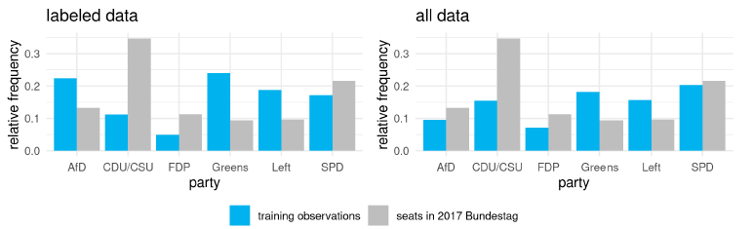
Data Observations per party in labeled training data (left) and entire scraped data example (right), both depicted against seat distribution in current parliament
Fig. 5: Source - Report
<number>

Slide 14
Data Data preprocessing
Basic text cleaning: Transcription of German umlauts and ligature s into standard-Latin characters and removal of non-informative symbols
Twitter-specific preparation: Identification, separate storage and subsequent removal of special characters (i.e., hashtags, emojis and user tags)
<number>

Slide 15
Data Challenges
Language-specific: Many analysis and tools are predominantly tailored to English; Possible complications with regards to German grammar and syntax
Twitter-specific: Limit of 280 characters, no explicit mentioning of the event or topical entities the authors are referring to, informal language style
Context-specific: Harder transfer of domain knowledge due to specificity of political context; sarcasm and irony
<number>

Slide 16
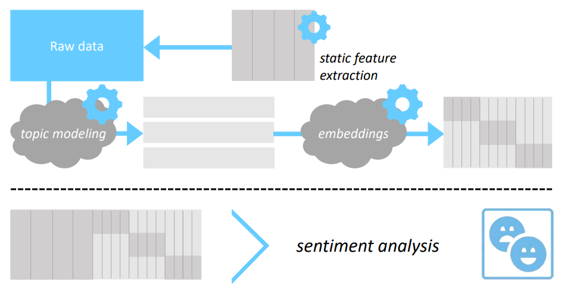
Standard Machine Learning Solution Static Features
Lexicon-based polarity counts
Twitter variables
Syntactic features
Character unigrams
Part-of-speech (POS) tags
Fig. 6: TSSA workflow
<number>

Slide 17
Standard Machine Learning Solution Dynamic Features
Assign topics to each tweet via STM, additonally based on a four prevalence covariates, namely the MP's party affliation and federal district (Bundesland) as well as the share of migrant population and overall employment rate.
Topic-specific word embeddings are created using Global Vectors (GloVE) for each subset corpus
Fig. 7: TSSA workflow
<number>

Slide 18
Standard Machine Learning Solution Word Embeddings
Model semantic importance of words in numeric form
Unsupervised learning task
Also achieved by BOW/TF-IDF, but: high dimensionality
Goal: dense representation
Dimensionality reduction via embeddings / factor loadings:
Characterize words by their surrounding context
Latent dimensions by which words can be represented
Similar meaning = similar representation in the vector space
<number>

Slide 19
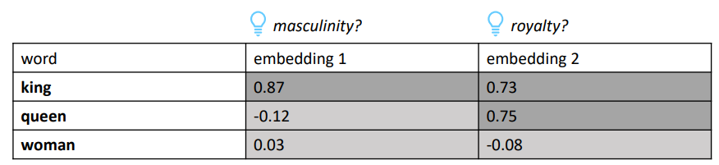
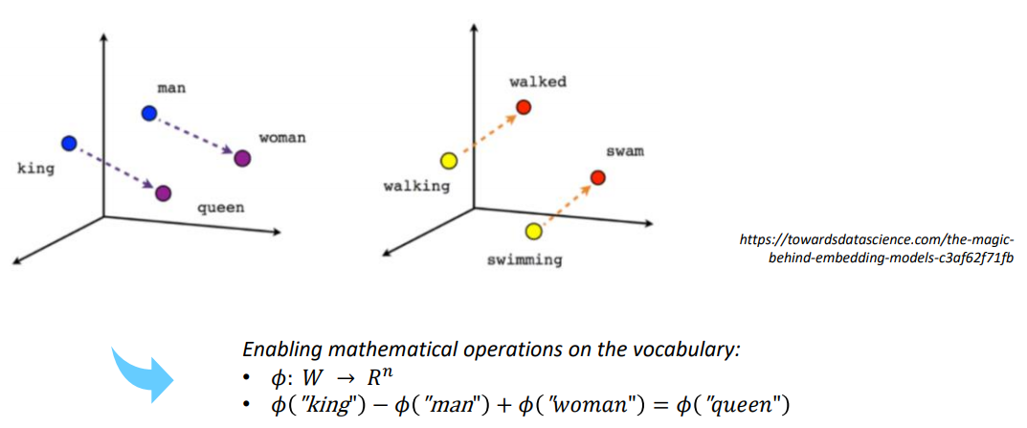
Standard Machine Learning Solution Example
Fig. 8: GloVe example
<number>

Slide 20

Standard Machine Learning Solution Word Embeddings: GloVe
GloVe: Global Vectors
Developed by Stanford University (2014)
Based on word co-occurrence matrix
Studying neighbourhood relations between words
Defined via window size (symmetric/asymmetric)
Underlying assumption: close-lying words are more strongly linked
Entry in i-th row & j-th column: how likely is word i to appear in the context of word j?
<number>

Slide 21
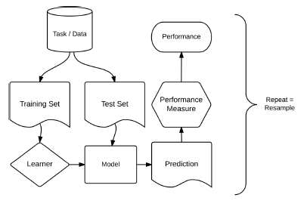
Standard Machine Learning Solution Sentiment Classification
Algorithms:
Random Forests
Logistic regression learner with elastic net penalty (glmnet)
Advantages of AutoML pipeline, integrating the process of dynamic feature generation
Dichotomy between train and test sphere
Automatization
Transferability
Fig. 9: Typical ML workflow (Becker et al., 2021)
<number>

Slide 22
To Do
Standard Machine Learning Solution Results
<number>

Slide 23
Deep Learning Solution Deep transfer learning with BERT
Bi-directional Encoder Representations from Transformers (2018)
Transfer Learning:
In case of limited labeled data or domain shift, the generalization ability of the learner is no longer reliable
Idea: First train a model on an original task and domain and then transfer the acquired knowledge to the target task and domain
This allows for using pretrained models for example provided by Hugging Face's Transformers library provides all
The pre-trained language representations can be then adapted to a specific target task in the fine.tuning procedure
Attention mechanism:
Avoid processing textual data sequentially
Allow for more parallelization and avoid the tendency to favor recent input
<number>

Slide 24
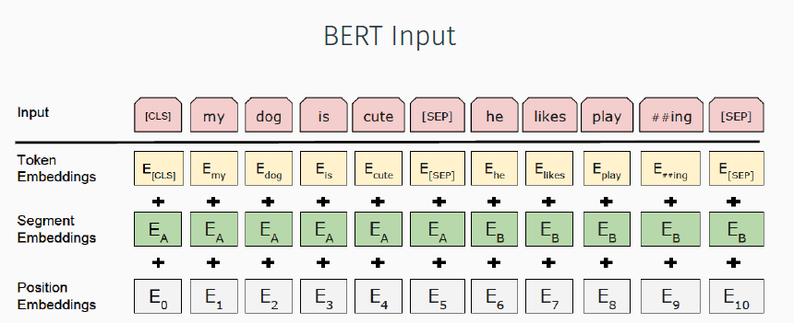
Deep Learning Solution Input pre-processing
Token embeddings from model-specific tokenization
Segment embeddings: ’0’ for A and ’1’ for B
Position embeddings indicate the position of each token in the sentence
Fig. 10: BERT input. Source: https://arxiv.org/pdf/1810.04805.pdf
<number>

Slide 25

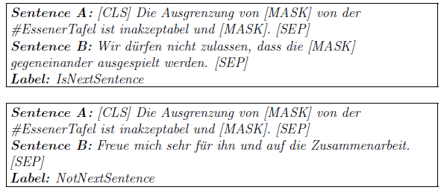
Deep Learning Solution Pre-training
Masked language modelling (MLM): Predict the masked words without considering its positioning
Next sentence prediction (NSP): Predict whether or not the second sentence in a pair is the subsequent one in the original document
<number>

Slide 26
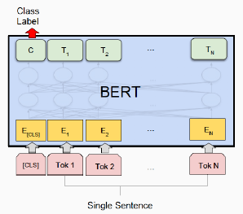
Deep Learning Solution Fine-tuning
Initialization with pre-trained weights
Replace the final layers from MLM and NSP with one classification layer
Loss: Cross-Entropy
Task in this case: Sequence classification
Fig. 11: BERT input. Source: https://arxiv.org/pdf/1810.04805.pdf
<number>

Slide 27
Deep Learning Solution Aspect-based sentiment analysis
Post-training
Further development of the basis-model: bert-base-german-cased, pretrained on German Wikipedia texts, news articles and Open Legal Datasets of German court decisions and citations.
Leverage both MLM and NLM with Germeval and unlabel scraped tweets in order to adapt the specific domain language to the model
Aspect extraction
Idea: Use a supervised learning technique to label each token from a sequence with one of these three labels:
“B“: Beginning of an aspect
“I“: Inside of an aspect term
“O“: Outside of an aspect
Requires exhaustive domain knowledge
Aspect Sentiment Classification
Classifies polarity of a given text, taking into account the given aspects as an extra feature
<number>

Slide 28
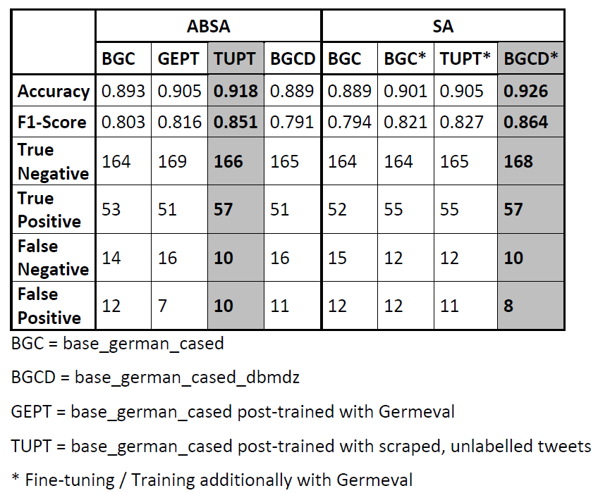
Deep Learning Solution Results
Fig. 12: BERT results
<number>

Slide 29
Knowledge Transfer Contents
Day 1: Kick-off Introduction to NLP and its applications Quanteda universe NLP-Analyse-pipeline Technical Setup Scraping Basic Text Cleaning Static feature generation | Topic modeling (incl. expert talk) Day 2 Word embeddings Classification task Background machine learning Analyse and visualize the results Introduction to Deep Learning and BERT Sentiment analysis with BERT
<number>

Slide 30
Knowledge Transfer Online material & feedback
We provide a website for the teaching material, demos, exercises and solutions: https://lisa-wm.github.io/nlp-twitter-r-bert/
Challenges:
Coverage of end to end NLP introduction and workflow within 2 days only
Create a common ground for people with different skill levels / backgrounds
<number>

Slide 31
Conclusion
ML: …
DL:
From standalone SA task the best performance was achieved by the dbmdz German BERT cased model and with additional fine-tuning with Germeval dataset (Pre-training source: Wikipedia dump, EU Bookshop corpus, Open Subtitles, CommonCrawl, ParaCrawl and News Crawl. This results in a dataset with a size of 16GB and 2,350,234,427 tokens)
The aspect based sentiment analysis leads to a worse performance, and reaches the best performance for the original base_german_cased model with post-training with scraped, unlabeled tweets
The topic modelling / aspect consideration seems to complicate the sequence classification task for both standard ML and DL approaches
We provide extensive teaching material on both approaches, composed as a coherent online course, to educate researchers on addressing NLP problems in their own work. However, the time frame for teaching should be extended
<number>

