Slide 1

Part II-3: Sentiment Analysis

Slide 2
Outline
Word Embeddings
Feature Collection
Sentiment Analysis
Machine Learning Background
Training & Prediction
Performance Evaluation
Visualization
Excursus: AutoML Pipeline
Notes:
kurz dazu sagen, dass wir hier keine tiefe theoretische einführung machen

Slide 3
Part II-3: Sentiment Analysis
Word Embeddings

Slide 4
Word Embeddings Setting
Recall our goal: numeric representation of texts by variables that co-occur across documents
Approaches
Vocabulary-based → done
Neural network representations → later: BERT
Word embeddings → let‘s see
Notes:
Goal: Represent words for text analysis with the help of numerical vectors
Hundreds of dimensions

Slide 5
Word Embeddings Vocabulary-Based
Revisited: BOW
Vocabulary with all occurring words in documents
Assumption: each word independent from others present in document
No accounting for word order
Each document represented by term frequency vector (occurrence of all distinct words present in the document)
Idea: weighting
Term Frequency - Inverse Document Frequency (TF-IDF)
Not implying that all terms are considered equally important
Idea: penalize words that are too frequent
Notes:
After Dealing with Special Character ,
term frequency - inverse document frequency (tf-idf)

Slide 6

Word Embeddings Example BOW
Documents
"Die Ausgrenzung von MigrantInnen ist inakzeptabel und rassistisch."
"Die Maskenpflicht ist sinnvoll."
"Die Diskriminierung von Frauen ist inakzeptabel."
Vector-space representations
 | die | ausgrenzung | von | migrantinnen | ist | inakzeptabel | und | rassistisch | maskenpflicht | sinnvoll | diskriminierung | frauen
Doc1 | 1 | 1 | 1 | 1 | 1 | 1 | 1 | 1 | 0 | 0 | 0 | 0
Doc2 | 1 | 0 | 0 | 0 | 1 | 0 | 0 | 0 | 1 | 1 | 0 | 0
Doc3 | 1 | 0 | 1 | 0 | 1 | 1 | 0 | 0 | 0 | 0 | 1 | 1
Notes:
After Dealing with Special Character ,
term frequency - inverse document frequency (tf-idf)

Slide 7
Word Embeddings Example TF-IDF
Documents
"Die Ausgrenzung von MigrantInnen ist inakzeptabel und rassistisch."
"Die Maskenpflicht ist sinnvoll."
"Die Diskriminierung von Frauen ist inakzeptabel."
Vector-space representations
 | die | ausgrenzung | von | migrantinnen | ist | inakzeptabel | und | rassistisch | maskenpflicht | sinnvoll | diskriminierung | frauen
Doc1 | 0 | .48 | .18 | .48 | 0 | .18 | .48 | .48 | 0 | 0 | 0 | 0
Doc2 | 0 | 0 | 0 | 0 | 0 | 0 | 0 | 0 | .48 | .48 | 0 | 0
Doc3 | 0 | 0 | .18 | 0 | 0 | .18 | 0 | 0 | 0 | 0 | .48 | .48
Notes:
Absolute Haufigkeitstabelle für jedes Wort, das in einem Dokument vorkommt. Jede Zeile stellt gleichzeitig die jeweilige Dokumentreprasentation im BoW-Modell dar

Slide 8
Word Embeddings Idea
Word embeddings aka word vectors aka word representations
Idea: model the semantic importance of a word in a numeric form
Unsupervised learning task
Also achieved by BOW/TF-IDF, but: high dimensionality
Goal: dense representation
we wish to embed words into the continuous space of real numbers
Notes:
Word embedding mapping from word space to n dimensional vector space, projecting the textual contents into Vector Space
Model, where text data is converted into vectors of numbers

Slide 9

Word Embeddings Idea
Dimensionality reduction
Embeddings / factor loadings
Characterize words by their surrounding context
Latent dimensions by which words can be represented
Similar meaning = similar representation in the vector space
masculinity?
royalty?
word | embedding 1 | embedding 2
king | 0.87 | 0.73
queen | -0.12 | 0.75
woman | 0.03 | -0.08

Slide 10
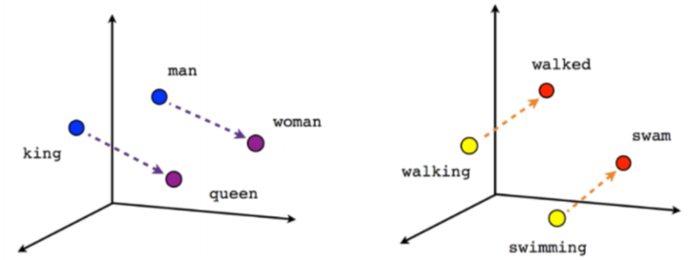
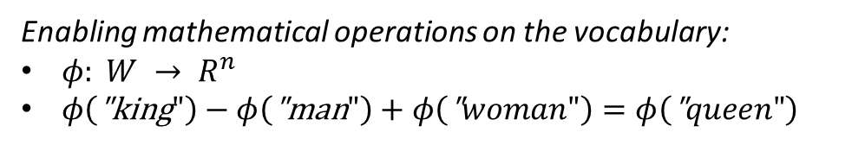
Word Embeddings Example
https://towardsdatascience.com/the-magic-behind-embedding-models-c3af62f71fb
Enabling mathematical operations on the vocabulary:
$φ: {W → R}^{n}$
$φ\left(\text{"}\text{king}"\right)−φ\left(\text{"}\text{man}"\right)+φ\left(\text{"}woman"\right)=φ\left(\text{"}queen"\right)$

Slide 11
Word Embeddings Approaches
Approaches: various possibilities, often adopted from general dimensionality reduction
Unifying idea: data observed in (extremely) high-dimensional space but truly much lower-dimensional → retrieve principal dimensions
GloVe
Word2vec
fastText
t-distributed stochastic neighbor embedding (t-SNE)
...

Slide 12
Word Embeddings GloVe
GloVe: Global Vectors
Developed by Stanford University (2014)
Based on word co-occurrence matrix
Studying neighborhood relations between words
Defined via window size (symmetric/asymmetric)
Underlying assumption: close-lying words are more strongly linked
Entry in i-th row & j-th column: how likely is word i to appear in the context of word j?
The quick brown fox jumps over the lazy dog.

Slide 13
Word Embeddings GloVe
Computation
R: package text2vec
Most important hyperparameters: number of embedding dimensions & skip-gram window size
Alternatively: pre-trained embeddings
Here: topic-specific embeddings
Subset corpus by topic labels
Compute embeddings for subsets
words have different meanings in different contexts

Slide 14



Word Embeddings Embeddings vs BOW
Both result in vector representations for each word in a corpus.
BOW
Easy to understand and implement
Feasible for any corpus
No accounting for order, semantics
High-dimensional representations
Embeddings
Capturing semantics and heeding word order
Low-dimensional representations
Large and „high-quality“ corpus required for meaningful embeddings
Pre-trained models often computationally demanding and not applicable to tasks with different domain (null vector for unknown words)
both suffer from the cold-start problem

Slide 15

Word Embeddings Example
Demo 8: Word Embeddings

Slide 16
Part II-3: Sentiment Analysis
Feature Collection

Slide 17

Feature Collection Recall: Task Structure
Raw data
static feature extraction
topic modeling
embeddings
Static features
sentiment analysis

Slide 18
Feature Collection Recall: Task Structure
Static features
Polarity clues
Negations, intensifications, punctuations, repetitions
Word/character n-grams
Part-of-speech (POS) tags
Twitter-specific features
Dynamic features
Word embeddings per topic

Slide 19
Part II-3: Sentiment Analysis
Sentiment Analysis

Slide 20
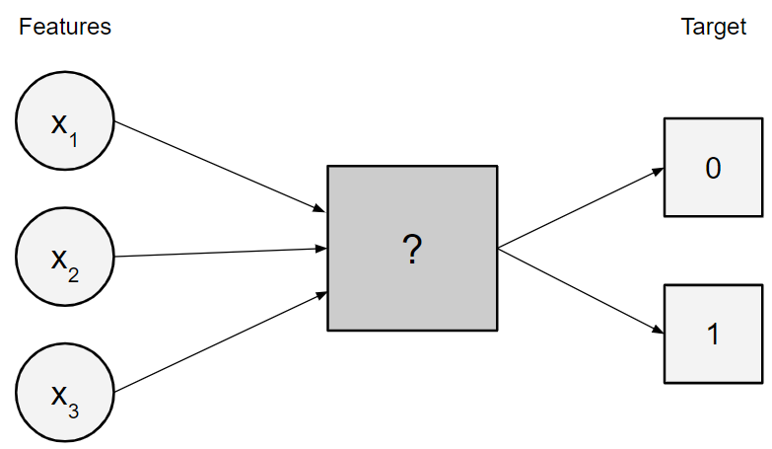
ML Background Overview
Machine Learning (ML)
Supervised learning
Unsupervised learning
Reinforcement learning
Deep learning methods for all three
Supervised learning
Learn feature-target relationship from labeled data
Classification: predict class label from data features
Regression: predict continuous response from data features

Slide 21
ML Background mlr3 Package
mlr3
Very extensive, all-purpose ML package developed and maintained by LMU‘s Statistical Learning & Data Science chair
Unifying framework for many ML functionalities
End-to-end programming from feature generation to prediction
Useful sources
Introduction to Machine Learning lecture https://introduction-to-machine-learning.netlify.app/
mlr3 book https://mlr3book.mlr-org.com/

Slide 22
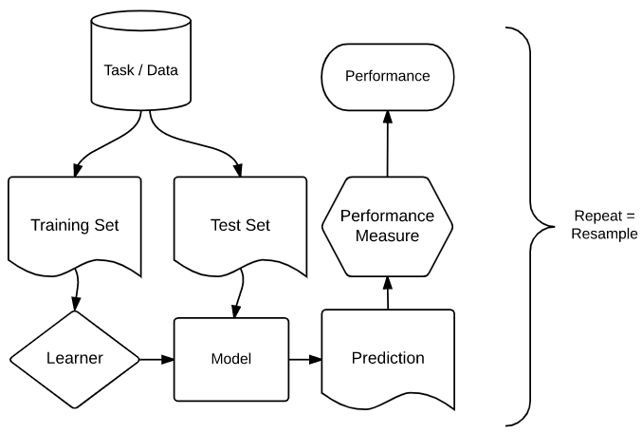
ML Background Components
ML components
Task
Train set
Test set
Learner
Hypothesis space
Risk
Optimization
Performance measure
https://mlr3book.mlr-org.com/

Slide 23


Training & Prediction Classification Tasks
Components of a (classification) task
Features X: all (numeric) variables describing our observations
Target y: class label, here ∈ {positive, negative}
Train-test split
Fundamental ML principle: dichotomy between training and test sphere → Avoid bias in performance estimation
Train on training data, evaluate on test data
Possibly create repeated splits (resampling)

Slide 24
Training & Prediction Learners
Components of a learner
Hypothesis space: defines what kind of model can be learned, e.g.,
Logistic regression model
Decision tree
Random forest
Risk: quantifies by how much our predictions deviate from the true target → To be minimized
Optimization: defines how to search for the best model
Empirical risk minimization (ERM)
Result: model with trained parameters

Slide 25
Training & Prediction Example
Demo 9: ML Training & Prediction

Slide 26
Performance Evaluation Idea
How well does our model perform on unseen data? → Generalization ability
Measured using the test set(s)
Aka outer loss ↔ inner loss used for training the model via ERM
We might or might not use the same metric for both.
Various evaluation metrics exist.
typically, test error > training error

Slide 27

Performance Evaluation Idea
Learner
Train
Classifier
Test
Evaluation

Slide 28
Performance Evaluation Metrics
Many different ones, reflecting what kind of error we wish to keep small
Special metrics for binary classification: ROC-based
 | Actual: YES | Actual: NO
Predicted: YES | True Positive (TP) | False Positive (FP)
Predicted: NO | False Negative (FN) | True Negative (TN)

Slide 29
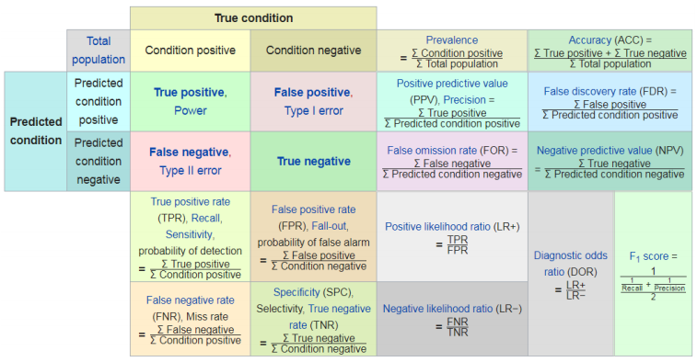
Performance Evaluation Metrics
https://en.wikipedia.org/wiki/F-score#Diagnostic_testing

Slide 30
Performance Evaluation Example
Demo 10: ML Evaluation

Slide 31

ML Pipeline Exercise
Exercise 5: ML Pipeline

Slide 32
Visualization Plotting Results
Demo 11: Visualizing Results

Slide 33
Part II-3: Sentiment Analysis
Excursus: AutoML Pipeline

Slide 34
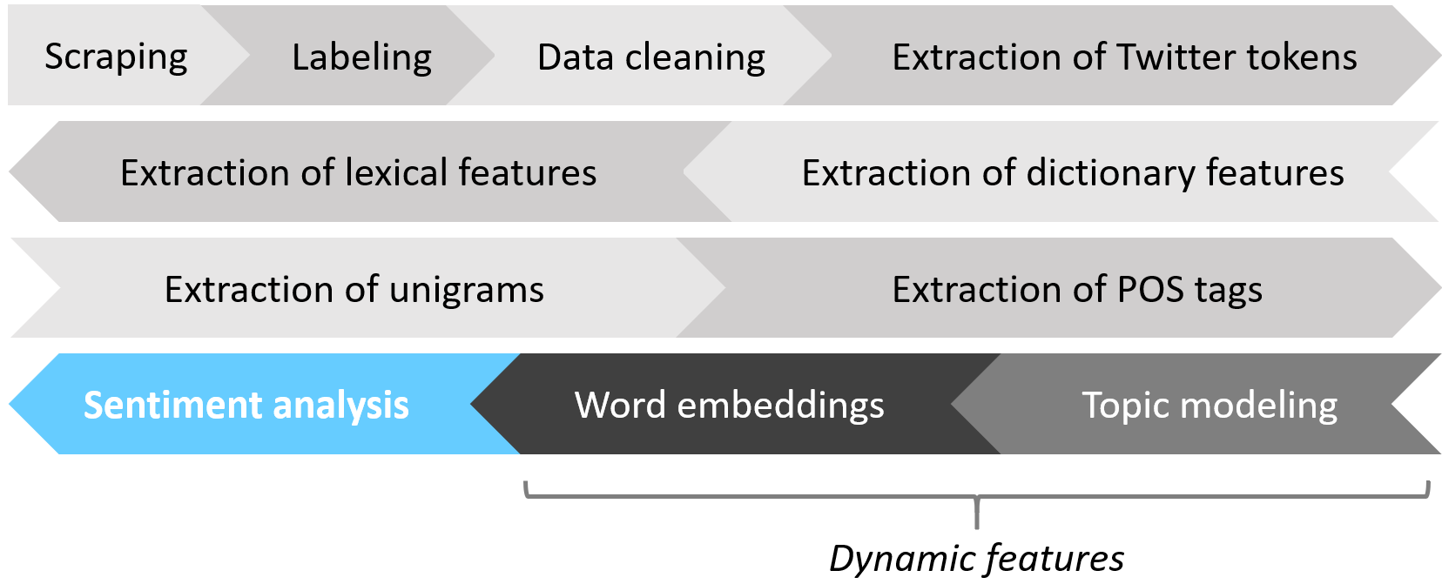
AutoML Pipeline Motivation
Recall: static vs dynamic features
Frequently, we are in situations where
we tune/evaluate multiple learners, and
feature generation affects surrounding observations.
These steps typically call for repeated train-test splits (resampling, nested resampling).
For predictions to remain unbiased this requires repeated training & evaluation of the entire (AutoML) pipeline.

Slide 35
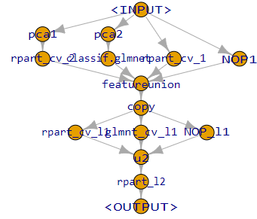
AutoML Pipeline Graph Learners
Building pipelines via graph learners
Encompassing all steps from pre-processing to evaluation
Modular building approach
All methods (training, prediction, tuning, ...) applicable as usual
Automatization of entire procedure possible to large extent
tutorial on creating AutoML systems on https://mlr3gallery.mlr-org.com/

Slide 36
Part II-3: Sentiment Analysis
Literature and References

Slide 37
Bishop, C. (2006): Pattern Recognition and Machine Learning, Springer.
Hastie, T., Tibshirani, R, and Friedman, J. (2017): The Elements of Statistical Learning. Data Mining, Inference, and Prediction, 2nd ed., Springer.
Japkowicz, N., and Shah, M. (2011): Evaluationg Learning Algorithms. A Classification Perspective, Cambridge University Press.
Mikolov, T., Chen, K., Corrado, G., and Dean, J. (2013): Efficient Estimation of Word Representations in Vector Space, arXiv:1301.3781.
Pennington, J., Socher, R., and Manning, C. (2014): GloVe: Global Vectors for Word Representation
https://introduction-to-machine-learning.netlify.app/
https://mlr3book.mlr-org.com/

