Slide 1
Part III: Feature Extraction & Machine Learning

Slide 2
Part III: Feature Extraction & Machine Learning
Theoretical Background

Slide 3
Outline
Word Embeddings
Feature Extraction
Background Machine Learning
Training
Evaluation
Implementation in R
Visualization in R

Slide 4
Feature Extraction
Preprocess input for ML or DL algorithms / classification tasks: convert the text data into a numeric, structured format
Goal: Mapping from vocabulary to real number vectors → Word Embeddings
Methods: Vocabulary based, Neural networks, Co-occurrence matrix (GloVE), etc.
Notes:
Goal: Represent words for text analysis with the help of numerical vectors
Hundreds of dimensions

Slide 5
Vocabulary based Feature Extraction
Bag-Of-Words (BOW)
Create a vocabulary with all occurring words in documents
Assumption: each word is independent from the others that are present in the document
No examination of word order
Each document is represented by the term frequency vector (occurrence of all the distinct words that are present in the document)
Term Frequency - Inverse Document Frequency:
→ Does not imply that all terms are considered equally important
→ Idea: Penalize words that are too frequent
Notes:
After Dealing with Special Character ,
term frequency - inverse document frequency (tf-idf)

Slide 6
Example (BOW)
Documents
"Die Ausgrenzung von MigrantInnen ist inakzeptabel und rassistisch."
"Die Maskenpflicht ist sinnvoll."
"Die Diskriminierung von Frauen ist inakzeptabel."
Vector-space representations
 | die | ausgrenzung | von | migrantinnen | ist | inakzeptabel | und | rassistisch | maskenpflicht | sinnvoll | diskriminierung | frauen
Doc1 | 1 | 1 | 1 | 1 | 1 | 1 | 1 | 1 | 0 | 0 | 0 | 0
Doc2 | 1 | 0 | 0 | 0 | 1 | 0 | 0 | 0 | 1 | 1 | 0 | 0
Doc3 | 1 | 0 | 1 | 0 | 1 | 1 | 0 | 0 | 0 | 0 | 1 | 1
Notes:
Absolute Haufigkeitstabelle für jedes Wort, das in einem Dokument vorkommt. Jede Zeile stellt gleichzeitig die jeweilige Dokumentreprasentation im BoW-Modell dar

Slide 7
Example (TF-IDF)
Documents
"Die Ausgrenzung von MigrantInnen ist inakzeptabel und rassistisch."
"Die Maskenpflicht ist sinnvoll."
"Die Diskriminierung von Frauen ist inakzeptabel."
Vector-space representations
 | die | ausgrenzung | von | migrantinnen | ist | inakzeptabel | und | rassistisch | maskenpflicht | sinnvoll | diskriminierung | frauen
Doc1 | 0 | 0.48 | 0.18 | 0.48 | 0 | 0.18 | 0.48 | 0.48 | 0 | 0 | 0 | 0
Doc2 | 0 | 0 | 0 | 0 | 0 | 0 | 0 | 0 | 0.48 | 0.48 | 0 | 0
Doc3 | 0 | 0 | 0.18 | 0 | 0 | 0.18 | 0 | 0 | 0 | 0 | 0.48 | 0.48
Notes:
Absolute Haufigkeitstabelle für jedes Wort, das in einem Dokument vorkommt. Jede Zeile stellt gleichzeitig die jeweilige Dokumentreprasentation im BoW-Modell dar

Slide 8
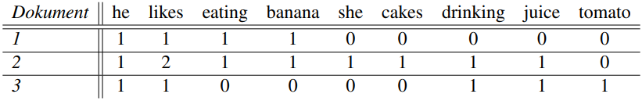
Vocabulary based Feature Extraction
Term frequency - inverse document frequency (BOW) – Example:
Dokument 1: he likes eating banana
Dokument 2: she likes eating cakes he likes drinking banana juice
Dokument 3: he likes drinking tomato juice
Notes:
Absolute Haufigkeitstabelle für jedes Wort, das in einem Dokument vorkommt. Jede Zeile stellt gleichzeitig die jeweilige Dokumentreprasentation im BoW-Modell dar

Slide 9
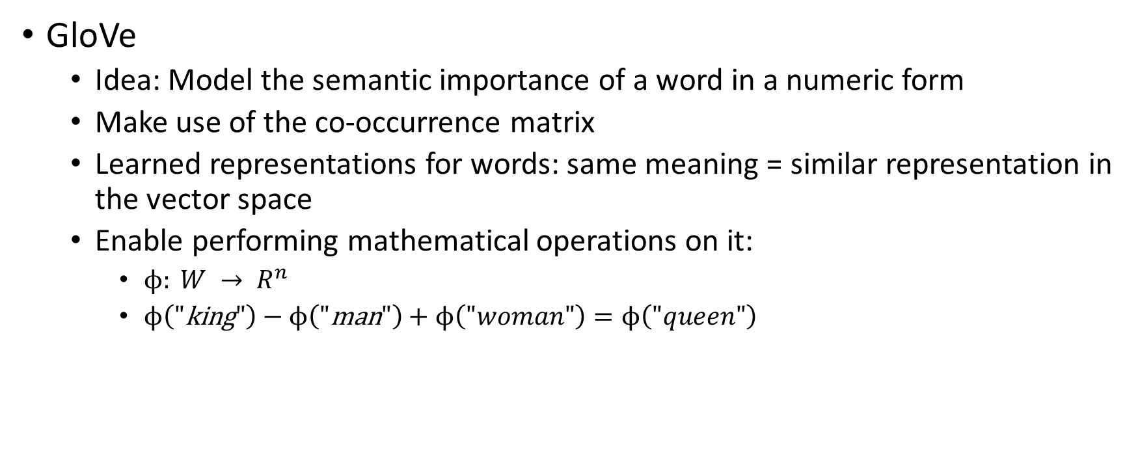
Unsupervised Word Vectors
GloVe
Idea: Model the semantic importance of a word in a numeric form
Make use of the co-occurrence matrix
Learned representations for words: same meaning = similar representation in the vector space
Enable performing mathematical operations on it:
$ϕ: {W → R}^{n}$
$ϕ\left(\text{"}\text{king}"\right)−ϕ\left(\text{"}\text{man}"\right)+ϕ\left(\text{"}woman"\right)=ϕ\left(\text{"}queen"\right)$
Notes:
Word embedding mapping from word space to n dimensional vector space, projecting the textual contents into Vector Space
Model, where text data is converted into vectors of numbers

Slide 10
Comparison of two approaches
Both result in vector represenation for each word contained in a corpus
BoW model does not consider the ordering, semantics
Lower dimensionality for GloVE (i.e. 100-300), whereas for BOW (i.e. 100000)
Approximate consideration of word semantics → large and “good” corpus for meaningfull vector representations needed
Pretrained models usually fail on target tasks with different domain (null vector for unknown, special context words)
Pretrained models Require large amounts of memory and computational resources
Notes:
Ausblick: Buchstaben-Level

Slide 11
Sentiment Classification
Classification as supervised machine learning task
Goal: Make predictions by training the model on annotated data
Given documents (features) and fixed amount of classes and classification algorithm(s) → learn a classifier → should predict best possible class for each document
We consider: Binary classification (2 Sentiments as output)
Our approach in ABSA: Create topic-specific word embeddings
Notes:
Ausblick: multiclass

Slide 12
Background Machine Learning
I. Train
ML Algorithm
Train
Documents
Feature Extraction method
Features
II. Evaluate
Classifier
Test
Documents
Feature Extraction method
Features
Model
Prediction
and
Evaluation
Notes:
Ausblick: multiclass

Slide 13
Background Machine Learning
Possible classification algorithm:
Logistic regression with regularization
Naive Bayes
Random Forests
Support Vector Machine
Train-Test-Split (Cross Validation) for a reliabel assessment
Evaluate the prediction goodness with metrics: Accuracy, Recall, Precision, F1-Score
Notes:
Ausblick: multiclass

Slide 14




Model evaluation via Confusion Matrix:
Evaluation metrics:
Accuracy:
F1-Score:
 | Predicted: NO | Predicted: YES
Actual: NO | True Negative | False Positive
Actual: YES | False Negative | True Positive

Slide 15
Visualization in R
Packages we recommend:
Quanteda: preprocessing, corpus construction, tokenization, document-feature matrix, wordscore, topic modelling, visualizations
Useful tutorial for the package: https://tutorials.quanteda.io/
Tidytext: preprocessing, feature extraction, visualizations; works well with other tools in wide use (dplyr, tidyr, wordcloud, ggplot2)
Useful tutorial for the package: https://www.tidytextmining.com/
Notes:
Quanteda: all-comprising
Stringr: many useful pattern matching functions
Text2vec: Transforms: basis for ML algorithms for textual data, , dtm: document term matrix, tcm: term co-occurrence matrix, vectorize text by creating a map from words or n-grams to a vector space

Slide 16
Visualization in R
Packages we recommend:
Stringr: easy working with strings, especially regarding regular expressions, pattern matching functions, character manipulation, whitespace management
Useful tutorial for the package: https://cran.r-project.org/web/packages/stringr/vignettes/stringr.html
Text2vec: construct dtm, tcm, word embeddings (i.e. GloVE), topic modelling (i.e. LDA)
Useful tutorial for the package: http://text2vec.org/index.html
Notes:
Quanteda: all-comprising
Stringr: many useful pattern matching functions
Text2vec: Transforms: basis for ML algorithms for textual data, , dtm: document term matrix, tcm: term co-occurrence matrix, vectorize text by creating a map from words or n-grams to a vector space

Slide 17
Visualization options
Wordclouds
Barplots
Word frequency plots
Lexical dispersion plots
Comparing word usage plots
Notes:
For Initial Desccription but also for Presention Results
Lexical dispersion plots: visualize the occurrences of particular terms throughout the text.
Comparing word usage plots: s find which words are more or less likely to come from each person’s account using the log odds ratio.

Slide 18
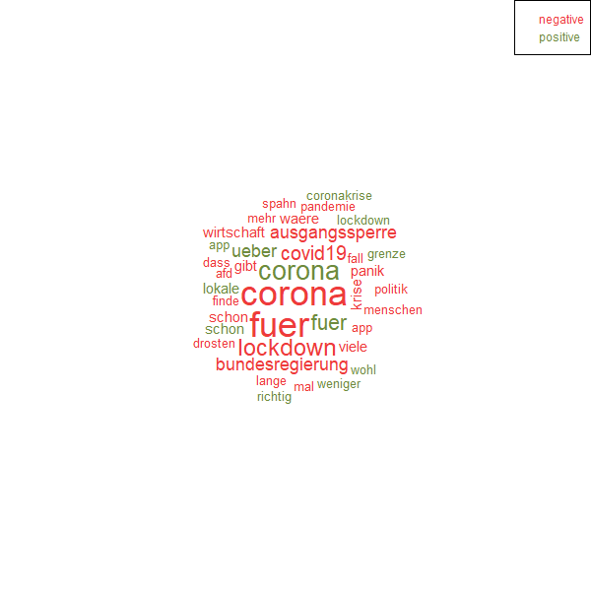
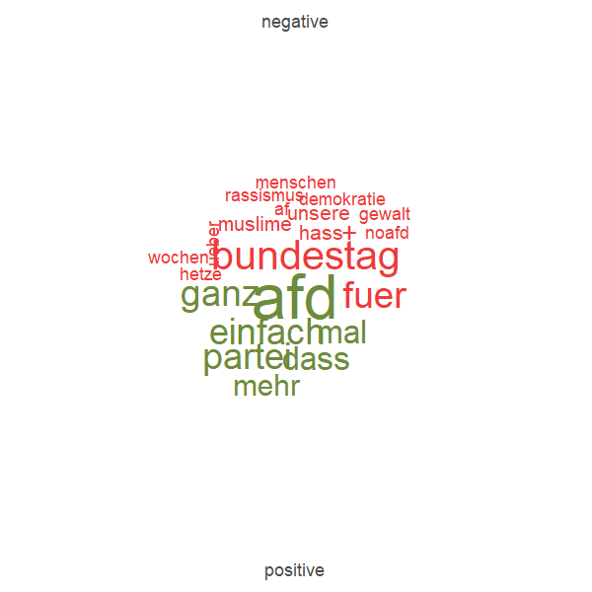
Visualization examples: Wordclouds
“AfD”
“Coronamassnahmen”

Slide 19
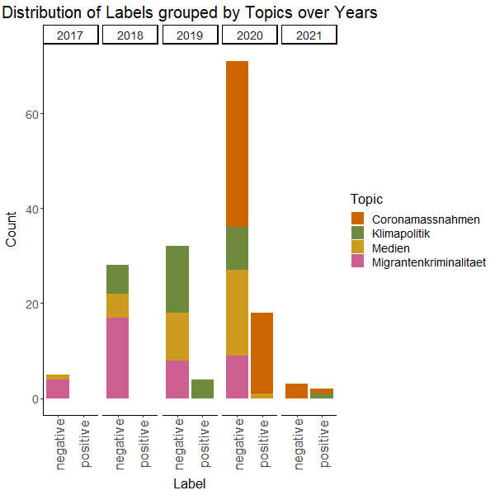
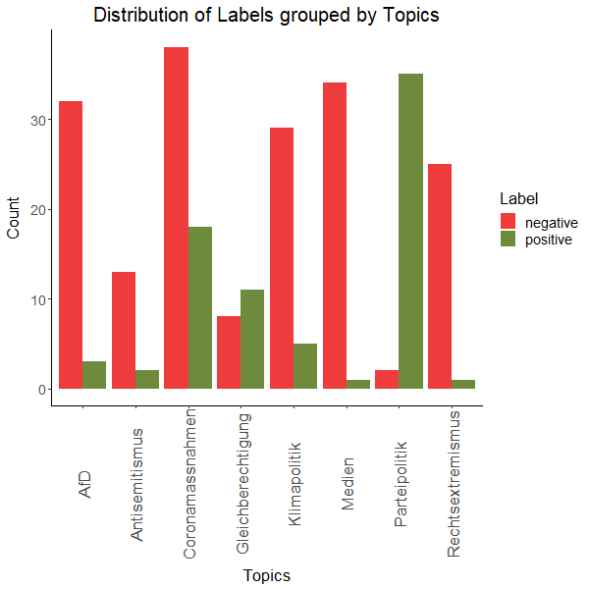
Visualization examples: Barplots

Slide 20
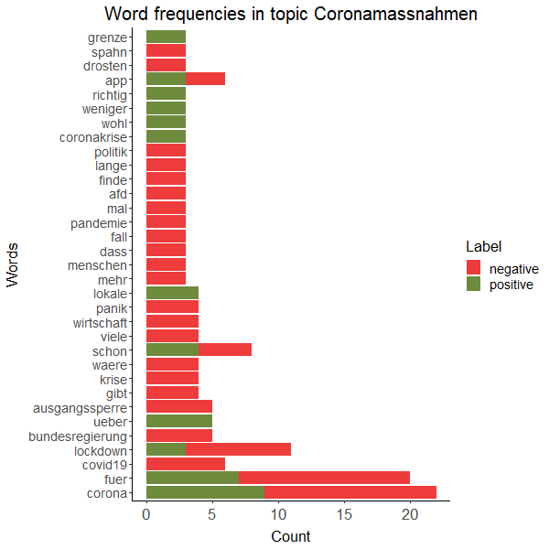
Visualization examples: Word frequencies

Slide 21
Part III: Feature Extraction & Machine Learning
Practical Application

Slide 22
Preparation:
Get an access to Google Collab
Open Jupyter Notebook: https://colab.research.google.com/drive/1l4ZhBsPsXTfWr8nwvuFHREpHeHgU0Po_#scrollTo=ZM0up_dlsg5e
Set Up R
Exercises:
Create numerical features from textual data:
Bow (?)
Tf-Idf (?)
Visualize different topics:
Print all existing Topics in the data set.
Add 2 other topics to the barplot “Distribution of Labels grouped by Topics over Years”. Choose 2 more colors.
Generate the Wordclouds and the word frequency plot for 1 other topic.

Slide 23
Part III: Feature Extraction & Machine Learning
Literature and References

Slide 24
Sharafi, A., Wolf, P. and Krcmar, H. (2010). Knowledge discovery in databases on the example of engineering change management., ICDM 2010.
Sarkar, D. (2016). Text analytics with python.
Pennington, J., Socher, R. and Manning, C. (2014). Glove: Global vectors for word representation.
Pennington, Jeffrey and Socher, Richard and Manning, Christopher (2014). Pre-trained word vectors. https://nlp.stanford.edu/projects/glove, abgerufen am 10. Mai 2019.
Miner, G., Elder IV, J., Fast, A., Hill, T., Nisbet, R. and Delen, D. (2012). Practical text mining and statistical analysis for non-structured text data applications, Academic Press.

