Slide 1

Part II-2: Topic Modeling

Slide 2
Outline
Overview
Topic Modeling Approaches
Structural Topic Model (STM)
Keyword-Based Topic Extraction

Slide 3
Part II-2: Topic Modeling
Overview

Slide 4

Overview Goal of Topic Modeling
Goal: discover latent semantic structures in a corpus & group documents into topical clusters
Exploratory method that does not require prior knowledge → Unsupervised learning
Often particularly useful in early phases of text analysis
Getting a better feeling for the corpus at hand
Facilitating/enhancing downstream tasks (e.g., sentiment analysis)
as opposed to: topic classification

Slide 5
Overview Terminology
So, what exactly is a topic?
Topic modeling revolves around the probability of words occurring in texts of a specific cluster.
Intuitively, we would expect some words to appear more frequently in documents about a certain topic than in others.
Topics are semantic clusters that are characterized by the probability of occurrence of associated words and with which documents can be associated to an extent determined by the words contained.
e.g., the word tasty should be more likely to occur in a text about food than in one about stock markets

Slide 6
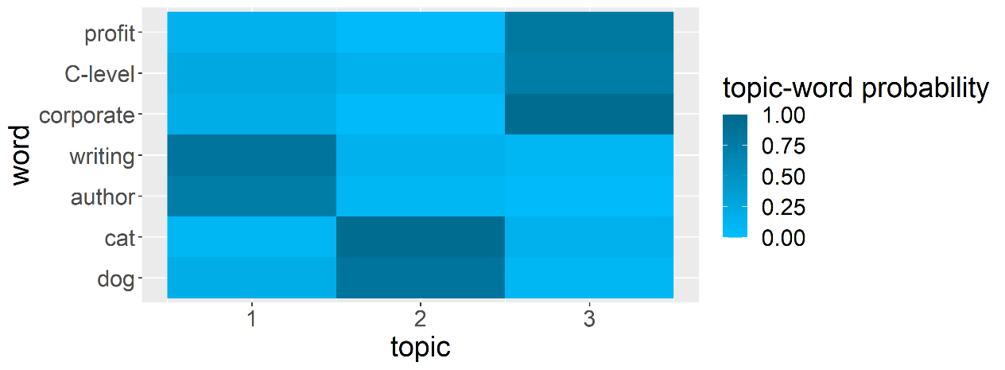
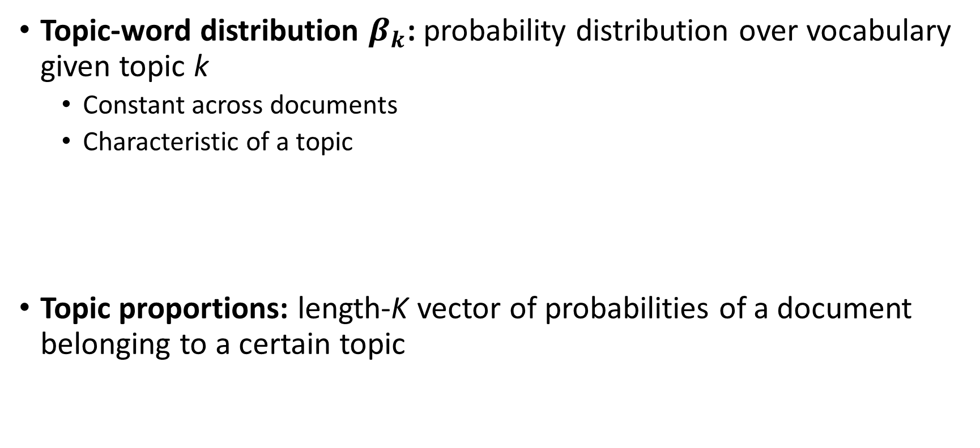
Overview Terminology
Topic-word distribution $β_{k}$: probability distribution over vocabulary given topic k
Constant across documents
Characteristic of a topic
Topic proportions: length-K vector of probabilities of a document belonging to a certain topic

Slide 7
Part II-2: Topic Modeling
Topic Modeling Approaches

Slide 8
Approaches Rough Taxonomy
Topic modeling approaches
Deterministic
Probabilistic/generative
tf-idf (Salton & McGill, 1983)
Latent semantic analysis (LSA, Deerwester et al., 1990)
Non-negative matrix factorization (NMF)
Probabilistic LSA (PLSA, Hofmann, 1999)
Latent Dirichlet allocation (LDA, Blei et al., 2003)
Correlated topic model (CTM, Blei et al., 2007)
Structural topic model (STM,
Roberts et al., 2016)

Slide 9
Approaches Deterministic
Deterministic approaches
Term-by-document matrix
LSA, NMF: matrix factorization to identify latent topics
Problems: inference & out-of-sample extension
V x D
V x K
≈
x
K x D

Slide 10
Approaches Probabilistic/Generative
Probabilistic/generative approaches
Hierarchical Bayesian mixture models
Idea: reverse-engineer the imaginative process of document generation
For each of document d within a corpus draw a vector of topic proportions from the assumed distribution
For each word position n within d
draw a topic assignment from the assumed distribution
draw a word from the assumed distribution

Slide 11
Approaches Probabilistic/Generative
Example
writing
corporate
cat
dog
C-level
author
profit
topic 1
topic 2
topic 3
Document d
position 1
position 1
position 1
position 1
position 1
profit
dog
cat
writing
cat

Slide 12
Overview Challenges
Hyperparameters: most importantly, number of topics
Extreme brevity of Twitter data
Problematic for most topic modeling approaches
Potential mitigation by pooling
Special models dedicated to short texts

Slide 13
Part II-2: Topic Modeling
Structural Topic Model (STM)

Slide 14

STM Expert Talk
Expert Talk: STM
Patrick Schulze & Simon Wiegrebe: Twitter in the Parliament –
A Text-based Analysis of German Political Entities

Slide 15

STM Approach
Demo 7: STM

Slide 16

STM Exercise
Exercise 4: Topic Modeling

Slide 17
Part II-2: Topic Modeling
Keyword-Based Topic Extraction

Slide 18
Keyword-Based TE Idea
Situation
(Statistical) topic modeling not always producing meaningful topics
Quite some human input required still
Also, unsupervised approach not always appropriate
Idea: specify keywords & find related documents
Approach
Specify list of keywords
Find similar words (both morphologically & semantically)
Assign all documents using these words to the associated topic

Slide 19
Keyword-Based TE Approach
Demo 8: Keyword-Based TE

Slide 20
Part II-2: Topic Modeling
Literature and References

Slide 21
Blei, D., Ng, A., and Jordan, M. (2003): Latent Dirichlet Allocation. Journal of Machine Learning Research 3, pp. 993-1022.
Blei, D., and Lafferty, J. (2007): A Correlated Topic Model of Science. The Annals of Applied Statistics 1(1), pp. 17-35.
Deerwester, S., Dumais, S., Furnas, G., Landauer, T., and Harshman, R. (1990): Indexing by Latent Semantic Analysis. Journal of the American Society for Information Science 41(6), pp. 391-407.
Hofmann, T. (1999): Probabilistic Latent Semantic Indexing. Proceedings of the 22nd Annual International ACM SIGIR Conference on Research and Development in Information Retrieval, pp. 50-57.
Roberts, M., Stewart, B., Tingley, D., and Airoldi, E. (2013): The Structural Topic Model and Applied Social Science. Advances in Neural Information Processing Systems Workshop on Topic Models.
Salton, G., and McGill, M. (1983): Introduction to Modern Information Retrieval, McGraw-Hill.
Vayansky, I., and Kumar S.A.P. (2020): A Review of Ttopic Modeling Methods, Information Systems, doi: https://doi.org/10.1016/j.is.2020.101582.

