Slide 1

Part II-3: Sentiment Analysis

Slide 2
Outline
Word Embeddings
Feature Collection
Sentiment Analysis
Machine Learning Background
mlr3 Universe
Evaluation
Visualization
Excursus: AutoML Pipeline
Notes:
kurz dazu sagen, dass wir hier keine tiefe theoretische einführung machen

Slide 3
Part II-3: Sentiment Analysis
Word Embeddings

Slide 4
Word Embeddings Setting
Recall our goal: numeric representation of texts by variables that co-occur across documents
Approaches
Vocabulary-based → done
Neural network representations → later: BERT
Word embeddings → let‘s see
Notes:
Goal: Represent words for text analysis with the help of numerical vectors
Hundreds of dimensions

Slide 5
Word Embeddings Vocabulary-Based
Revisited: BOW
Vocabulary with all occurring words in documents
Assumption: each word independent from others present in document
No accounting for word order
Each document represented by the term frequency vector (occurrence of all the distinct words that are present in the document)
Idea: weighting
Term Frequency - Inverse Document Frequency (TF-IDF)
Not implying that all terms are considered equally important
Idea: penalize words that are too frequent
Notes:
After Dealing with Special Character ,
term frequency - inverse document frequency (tf-idf)

Slide 6

Word Embeddings Example BOW
Documents
"Die Ausgrenzung von MigrantInnen ist inakzeptabel und rassistisch."
"Die Maskenpflicht ist sinnvoll."
"Die Diskriminierung von Frauen ist inakzeptabel."
Vector-space representations
 | die | ausgrenzung | von | migrantinnen | ist | inakzeptabel | und | rassistisch | maskenpflicht | sinnvoll | diskriminierung | frauen
Doc1 | 1 | 1 | 1 | 1 | 1 | 1 | 1 | 1 | 0 | 0 | 0 | 0
Doc2 | 1 | 0 | 0 | 0 | 1 | 0 | 0 | 0 | 1 | 1 | 0 | 0
Doc3 | 1 | 0 | 1 | 0 | 1 | 1 | 0 | 0 | 0 | 0 | 1 | 1
Notes:
After Dealing with Special Character ,
term frequency - inverse document frequency (tf-idf)

Slide 7
Word Embeddings Example TF-IDF
Documents
"Die Ausgrenzung von MigrantInnen ist inakzeptabel und rassistisch."
"Die Maskenpflicht ist sinnvoll."
"Die Diskriminierung von Frauen ist inakzeptabel."
Vector-space representations
 | die | ausgrenzung | von | migrantinnen | ist | inakzeptabel | und | rassistisch | maskenpflicht | sinnvoll | diskriminierung | frauen
Doc1 | 0 | .48 | .18 | .48 | 0 | .18 | .48 | .48 | 0 | 0 | 0 | 0
Doc2 | 0 | 0 | 0 | 0 | 0 | 0 | 0 | 0 | .48 | .48 | 0 | 0
Doc3 | 0 | 0 | .18 | 0 | 0 | .18 | 0 | 0 | 0 | 0 | .48 | .48
Notes:
Absolute Haufigkeitstabelle für jedes Wort, das in einem Dokument vorkommt. Jede Zeile stellt gleichzeitig die jeweilige Dokumentreprasentation im BoW-Modell dar

Slide 8
Word Embeddings Idea
Word embeddings aka word vectors aka word representations
Idea: model the semantic importance of a word in a numeric form
Unsupervised learning task
Also achieved by BOW/TF-IDF, but: high dimensionality
Goal: dense representation
we wish to embed words into the continuous space of real numbers
Notes:
Word embedding mapping from word space to n dimensional vector space, projecting the textual contents into Vector Space
Model, where text data is converted into vectors of numbers

Slide 9
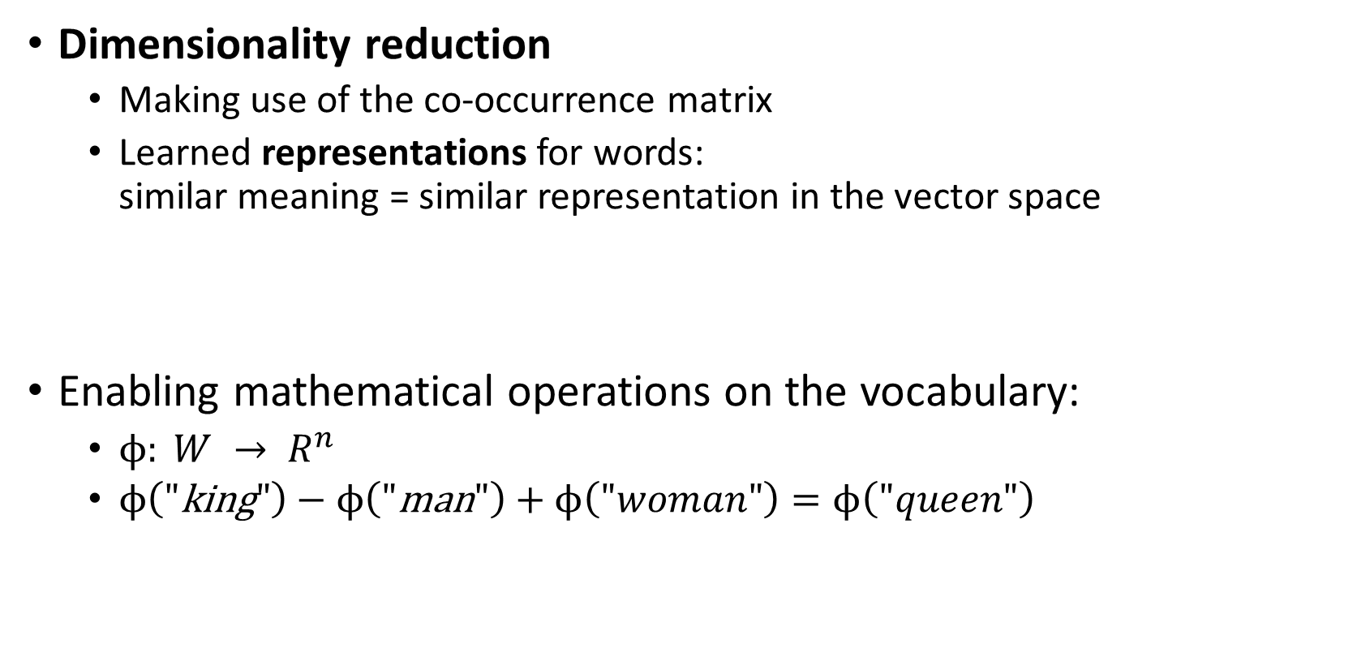
Word Embeddings Idea
Dimensionality reduction
Making use of the co-occurrence matrix
Learned representations for words: similar meaning = similar representation in the vector space
Enabling mathematical operations on the vocabulary:
$ϕ: {W → R}^{n}$
$ϕ\left(\text{"}\text{king}"\right)−ϕ\left(\text{"}\text{man}"\right)+ϕ\left(\text{"}woman"\right)=ϕ\left(\text{"}queen"\right)$
characterize words by their surrounding context

Slide 10
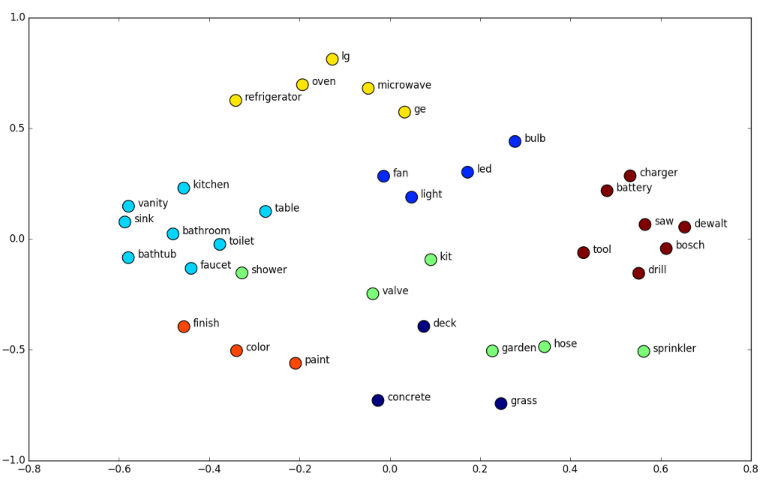
Word Embeddings Example
strongly depending on training corpus
https://www.shanelynn.ie/get-busy-with-word-embeddings-introduction/

Slide 11
Word Embeddings Approaches
Approaches: various possibilities, often adopted from general dimensionality reduction
Unifying idea: data observed in (extremely) high-dimensional space but truly much lower-dimensional → retrieve principal dimensions
GloVe
Word2vec
fastText
t-distributed stochastic neighbor embedding (t-SNE)
...

Slide 12
Word Embeddings GloVe
GloVe: Global Vectors
Developed by Stanford University (2014)
Based on word co-occurrence matrix
Studying neighborhood relations between words
Defined via window size (symmetric/asymmetric)
Underlying assumption: close-lying words are more strongly linked
Entry in i-th row & j-th column: how likely is word i to appear in the context of word j?
The quick brown fox jumps over the lazy dog.

Slide 13
Word Embeddings GloVe
Computation
R: package text2vec
Most important hyperparameters: number of embedding dimensions & skip-gram window size
Alternatively: pre-trained embeddings
Here: topic-specific embeddings
Subset corpus by topic labels
Compute embeddings for subsets
words have different meanings in different contexts

Slide 14



Word Embeddings Embeddings vs BOW
Both result in vector representations for each word in a corpus.
BOW
Easy to understand and implement
Feasible for any corpus
No accounting for order, semantics
High-dimensional representations
Embeddings
Capturing semantics and heeding word order
Low-dimensional representations
Large and „high-quality“ corpus required for meaningful embeddings
Pre-trained models often computationally demanding and not applicable to tasks with different domain (null vector for unknown words)
both suffer from the cold-start problem

Slide 15
Part II-3: Sentiment Analysis
Feature Collection

Slide 16

Feature Collection Recall: Task Structure
Raw data
static feature extraction
topic modeling
embeddings
Static features
sentiment analysis

Slide 17
Feature Collection Recall: Task Structure
Static features
Polarity clues
Negations, intensifications, punctuations, repetitions
Word/character n-grams
Part-of-speech (POS) tags
Twitter-specific features
Dynamic features
Word embeddings per topic

Slide 18
Part II-3: Sentiment Analysis
Sentiment Analysis

Slide 19
Part II-3: Sentiment Analysis
Excursus: AutoML Pipeline

Slide 20
Part II-3: Sentiment Analysis
Literature and References

Slide 21
Miner, G., Elder IV, J., Fast, A., Hill, T., Nisbet, R. and Delen, D. (2012): Practical Text Mining and Statistical Analysis for Non-Structured Text Data Applications, Academic Press.
Pennington, J., Socher, R., and Manning, C. (2014): GloVe. Global Vectors for Word Representation. Proceedings of the 2014 Conference on Empirical Methods in Natural Language Processing (EMNLP), pp. 1532–1543.
Pennington, J., Socher, R., and Manning, C. (2014): Pre-trained word vectors. https://nlp.stanford.edu/projects/glove.
Sarkar, D. (2016): Text Analytics with Python. A Practitioner's Guide to Natural Language Processing, Apress.

