Slide 1

Part II-1: Scraping, Text Normalization & Static Feature Extraction

Slide 2
Outline
Scraping
General Web Scraping
Scraping Twitter
Text Normalization
Regular Expressions
Stemming, Lemmatization
Static Feature Extraction
Notes:
kurz dazu sagen, dass wir hier keine tiefe theoretische einführung machen

Slide 3
Part II-1: Scraping, Text Normalization & Static Feature Extraction
Scraping

Slide 4
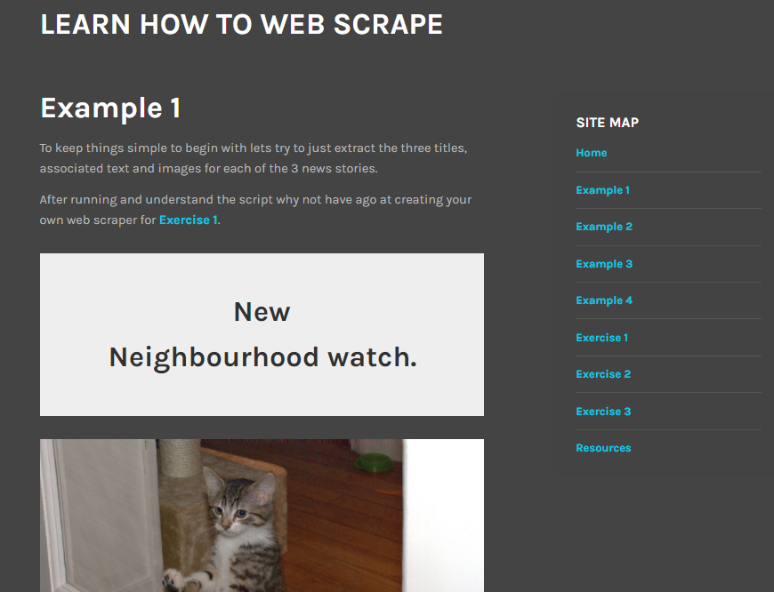
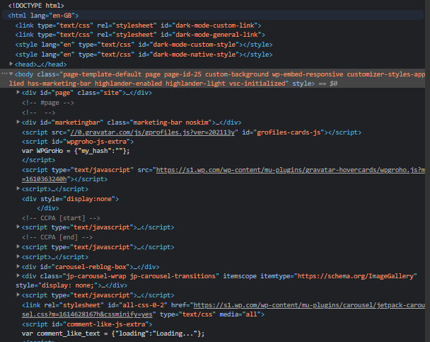
Scraping Idea
Goal: access, use & analyze data available on the internet
Problem: unstructured, HTML-formatted, non-downloadable data
https://practicewebscrapingsite.wordpress.com/example-1/
Notes:
popular feature films of 2016

Slide 5

Scraping Learning to Scrape
Sorry, but: it’s a tedious thing
Highly manual, time-consuming process
Need for adjustment every time the website source code changes
Harder with more complex websites optimized for UX
Examples
Text data from Wikipedia, labeled image data from Google
Social media data from Twitter, Facebook, ...
Reviews, feedbacks from Amazon
https://practicewebscrapingsite.wordpress.com/
Notes:
popular feature films of 2016

Slide 6

Scraping Steps
Basic steps
Parse (static) website content
Grasp page set-up
Extract information
Advanced: actual website navigation, i.e., clicking buttons and jumping to pages, with a remotely controlled browser
requiring CSS selectors – easier with https://selectorgadget.com/
Notes:
popular feature films of 2016

Slide 7
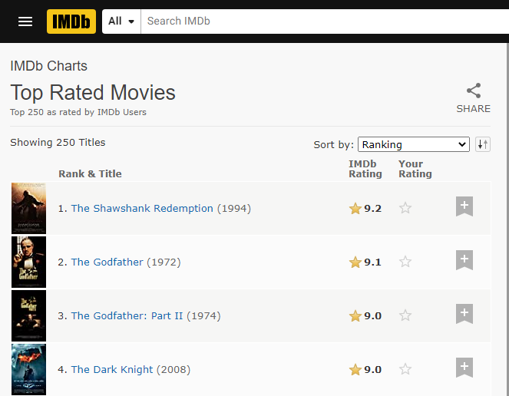
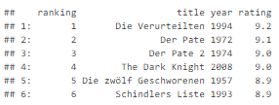
Scraping Example
Goal: get TOP 250 movie rankings and ratings from IMDb http://www.imdb.com/chart/top?ref_=nv_mv_250_6
Notes:
IMDb: Extract the top rated movies: Title, Year, Rank and Rating information from:
using Google chrome and I can access the extension in the extension bar to the top right
electorGadet allows the user to click on the page element of interest and have that element identifier presented to the user. This tool greatly reduces the time associated with locating CSS selectors through the websites developer section. Once installed, the selector gadget will be located in the upper-right corner of your web browser; click on it to open the interface.

Slide 8
Scraping Example
Guide
Install and load package rvest: install.packages(“rvest”); library(rvest)
Parse webpage: read_html()
Explore contents using Chrome’s developer tab (clicking F12) or some helper tool, e.g., SelectorGadget (does not require technical knowledge of HTML and CSS)
Extract information from the webpage: html_nodes()
Store extracted information in desired format: html_text()
Notes:
popular feature films of 2016
using Google chrome and I can access the extension in the extension bar to the top right
electorGadet allows the user to click on the page element of interest and have that element identifier presented to the user. This tool greatly reduces the time associated with locating CSS selectors through the websites developer section. Once installed, the selector gadget will be located in the upper-right corner of your web browser; click on it to open the interface.

Slide 9

Scraping Example
Demo 1: Web Scraping Example

Slide 10
Scraping Twitter Data
Guide
Install and load package rtweet
Set up Twitter API
Create Twitter account: http://twitter.com/signup
Apply for a developer account by filling out a short application form: https://developer.twitter.com/en/apply-for-access.html
Click on „key and access token“ and get your API access: consumer key (API key), consumer secret (API secret), access token, access token secret
Use the keys as arguments: rtweet::create_token(consumer_key, consumer_secret, access_token, access_secret)
keep somewhere safe
Notes:
popular feature films of 2016
using Google chrome and I can access the extension in the extension bar to the top right
electorGadet allows the user to click on the page element of interest and have that element identifier presented to the user. This tool greatly reduces the time associated with locating CSS selectors through the websites developer section. Once installed, the selector gadget will be located in the upper-right corner of your web browser; click on it to open the interface.

Slide 11
Scraping Twitter Data – Limitations
Using the standard (free) search API
Tweets only for a 6-9 days period (for more information see https://developer.twitter.com/en/docs/tweets/search/api-reference/get-search-tweets.html)
Scraping of up to 18,000 tweets possible
Package documentation: https://cran.r-project.org/web/packages/rtweet/rtweet.pdf
Worth considering: scraping in Python using beautifulsoup
useful tutorial on https://rtweet-workshop.mikewk.com/

Slide 12

Scraping Twitter Data – Example
Goal: scrape tweets and associated information
Screenshot from: https://twitter.com/JKasek/status/1377285533274083343

Slide 13
Scraping Twitter Data
Demo 2: Twitter Scraping Example

Slide 14
Scraping Twitter Data
Demo 3: Twitter Scraping Python

Slide 15
Scraping Exercise
Exercise 1: Scraping

Slide 16
Part II-1: Scraping, Text Normalization & Static Feature Extraction
Text Normalization

Slide 17
Text Normalization Purpose
Series of steps to clean and standardize textual data
Goal: representation of texts by meaningful tokens that co-occur across documents as much as possible
Basic techniques:
Removing stopwords: words with little or no significance
Removing special characters (symbols, punctuation, HTML entities etc.)
Stemming, lemmatization
Die Ausgrenzung von MigrantInnen von der #EssenerTafel ist inakzeptabel und rassistisch. Wir dürfen nicht zulassen, dass die Ärmsten gegeneinander ausgespielt werden.
Notes:
punctuation or special characters do not have much significance when we
analyze the text and utilize it for extracting features or information based on NLP and ML.

Slide 18
Text Normalization Regular Expressions
Focus of NLP in general: analysis and understanding of (unstructured) text
Regular expression (regex): pattern (= sequence of characters) defined to search text with a common structure
Used for
searching for a specific file name,
finding a text with a specific pattern,
replacing a specific pattern in a text, etc.
Standardized across many programming languages

Slide 19
Text Normalization Regular Expressions
stringr: useful R package to deal with all kinds of text wrangling
Important commands in base & stringr:
 | base | stringr
Identify | grep(., value = FALSE) | str_detect()
Extract | grep(., value = TRUE) | str_extract()
Locate | gregexpr() | str_locate()
Replace | gsub() | str_replace()
Split | strsplit() | str_split()

Slide 20
Text Normalization Useful Regex Patterns
Pattern | Function
\d or [:digit:] or [0-9] | Matches any digit
[:alpha:] or [A-Za-z] | Matches any character
[a-z] or [:lower:] | Matches any lowercase character
[A-Z] or [:upper:] | Matches any uppercase character
[abc] | Matches a, b or c
[^abc] | Matches anything except a, b, or c.
[:punct:] | Matches punctuation characters: ! " # $ % & ’ ( ) * + , - . / : ; < = > ? @ [ ] ^ _ ` { | } ~
a(b|c)d | Matches abd or acd
^x | Matches x if string begins with x
x$ | Matches x if string ends with x

Slide 21

Text Normalization Useful Regex Patterns
Pattern | Function
x? | Matches 0 or 1 occurrences of x
x* | Matches 0 or more occurrences of x
x+ | Matches 1 or more occurrences of x
x{n} | Matches exactly n occurrences of x
x{n,} | Matches n or more occurrences of x
x{,m} | Matches at most m occurrences of x
x{n,m} | Matches between n and m occurrences of x
x(?=...) | Matches x if followed by ... (for negation, replace = by !)
(?<=...)x | Matches x if preceded by ... (for negation, replace = by !)
https://cran.r-project.org/web/packages/stringr/vignettes/regular-expressions.html

Slide 22
Text Normalization Regular Expressions
Demo 4: Regular Expressions

Slide 23
Text Normalization Exercise
Exercise 2: Regular Expressions

Slide 24
Text Normalization Stemming
Idea: retrieve base form, the root stem
Example in German: Bruder – Bruders – brüderlich/e/n/r/s – Brüderlichkeit/en → bruder
S
W | O | R | K
E | D
word stem
I | N | G
Notes:
Ziel ist möglichst gute Suchergebnisse zu liefern
Dafür werden verschiedene Verfahren eingesetzt.
Stemming (Grundformenreduktion) ist ein Verfahren, mit dem verschiedene morphologische Varianten eines Wortes auf ihren gemeinsamen Wortstamm (stem) zurückgeführt werden
Die Idee: die eigentliche lexikalische Bedeutung eines Wortes ist in seinem Stamm zu finden

Slide 25
Text Normalization Lemmatization
Problem with stemming
Potentially erroneous
Overstemming: politics → polit
Understemming: travels → trav but travelled → travel
Alternative: lemmatization
Retrieving the root word (not root stem)
Difference: the lemma will always be present in the dictionary (lexicographically correct word)
Slower than stemming
Potentially more difficult for grammatically complex languages
Notes:
Slower bc an
additional step is involved where the root form or lemma is formed by removing the affix
from the word if and only if the lemma is present in the dictionary

Slide 26
Part II-1: Scraping, Text Normalization & Static Feature Extraction
Static Feature Extraction

Slide 27
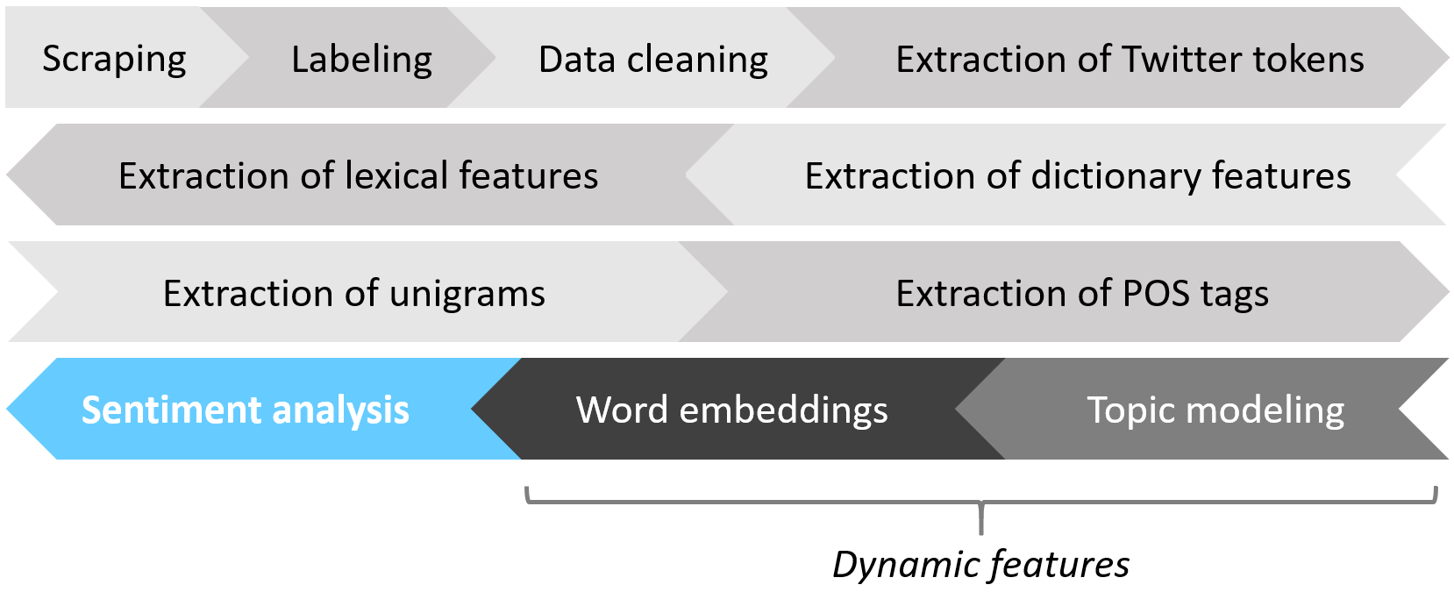
Static Feature Extraction Basic Text Cleaning
Now, back at our task
We need to
Perform basic text cleaning
Extract all static features we wish to use for sentiment classification

Slide 28
Static Feature Extraction Basic Text Cleaning
Demo 5: Basic Text Cleaning

Slide 29
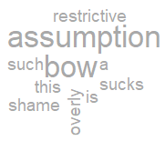
Static Feature Extraction Features
One central assumption in sentiment analysis with standard machine learning techniques: bag-of-words (BOW)
Why?
Standard machine learning only built for tabular data
Consequence: discarding all information about word order, sentence structure, ...
Eye-watering simplification, but it is what it is

Slide 30
Static Feature Extraction Features
Useful (static) features in sentiment analysis
Polarity clues
Negations, intensifications, punctuations, repetitions
Word/character n-grams
Part-of-speech (POS) tags
Twitter-specific features
Recall our goal: numeric representation of texts by tokens that co-occur across documents

Slide 31
Static Feature Extraction Features
Polarity clues
Idea: find sentiment-bearing tokens
Details
Presence/absence or count
Positive/negative, positive/negative/neutral, more fine-grained emotions, ...
Computation: look-up using publicly available dictionaries
if useful: modify/enrich
What a despicable thing to do, I hate him! → positive: 0, negative: 2

Slide 32
Static Feature Extraction Features
Negations, intensifications, punctuations, repetitions
Idea: capture meaning modifiers (lost with BOW assumption!)
Assumptions
Negations might flip sentiments.
Intensifications might indicate/strengthen sentiments.
Punctuations/repetitions might indicate sentiments.
Computation: look-up using regular expressions
I cannot recommend this movie......
A truly grand and deeply moving plot.

Slide 33
Static Feature Extraction Features
Word/character n-grams
Idea: count general tokens to represent texts
Details
n-gram: sequence of n words/characters – somewhat mitigating BOW effect
Unigrams, bigrams, trigrams, ...
The larger n, the lower the probability of n-grams occurring in multiple documents
Computation: count using available functionalities (e.g., in quanteda)
Bello the dog is a good boy.
bello | dog | good | boy | a | b | d | e | g | h | i | l | o | s | t | y
1 | 1 | 1 | 1 | 1 | 2 | 2 | 2 | 2 | 1 | 1 | 2 | 5 | 1 | 1 | 1

Slide 34
Static Feature Extraction Features
POS tags
Idea: capture grammatical structure
Details
Computed on full text
Assign each word a grammatical role (18 universal tags)
Assumption: presence of many adverbs/adjectives indicative of sentiments
Computation: use available parsers (e.g., in spacyR)
https://universaldependencies.org/u/pos/all.html
Bello | the | dog | is | a | good | boy | .
PROPN | DET | NOUN | AUX | DET | ADJ | NOUN | PUNCT

Slide 35
Static Feature Extraction Features
Twitter-specific features
Idea: exploit Twitter-inherent tokens
Details
Emojis: count/assign polarity
Hashtags: count/mine (for topics, meaning, ...)
Tags: count/mine
...
Computation: look-up using regular expressions
I love doing dishes #not 🙄

Slide 36
Static Feature Extraction Features
Demo 6: Static Feature Extraction

Slide 37
Static Feature Extraction Exercise
Exercise 3: Static Feature Extraction

Slide 38
Part II-1: Scraping, Text Normalization & Static Feature Extraction
Literature and References

Slide 39
Berry, M., and Kogan, J. (2010): Text Mining. Applications and Theory, John Wiley & Sons, Inc.
Kearney, M., Heiss, A., and Briatte, F. (2020): rtweet. Collecting Twitter Data, R package version 0.7.0, URL: https://CRAN.R-project.org/package=rtweet
Miner, G., Elder IV, J., Fast, A., Hill, T., Nisbet, R. and Delen, D. (2012): Practical Text Mining and Statistical Analysis for Non-Structured Text Data Applications, Academic Press.
Munzert, S., Rubba, C., Meißner, P., and Nyhuis, D. (2015): Automated Data Collection with R : A Practical Guide to Web Scraping and Text Mining, John Wiley & Sons, Inc.
Silge, J. (2017): Text Mining with R. A Tidy Approach, O’Reilly.
Wickham, H (2019): stringr. Simple, Consistent Wrappers for Common String Operations, R package version 1.4.0, URL: https://CRAN.R-project.org/package=stringr
Wickham, H (2021): rvest. Easily Harvest (Scrape) Web Pages, R package version 1.0.0, URL: https://CRAN.R-project.org/package=rvest

