Slide 1
Part II: Scraping & Text Cleaning

Slide 2
Part II: Scraping & Text Cleaning
Theoretical Background

Slide 3
Outline
Scraping
Web Scraping with rvest
Twitter
Basic Text Cleaning
Regular Expressions
Stemming
Lemmatization

Slide 4
Web Scraping
Access data available on the internet
Transform unstructured (HTML), not downloadable data to structured format
Goal: Easy access, usage and analysis
Demo exercise: Scrape data from a given webpage (https://practicewebscrapingsite.wordpress.com/example-1/)
Other examples: text data from Wikipedia, labeled image data from Google, social media data from Twitter, Facebook, revirews, feedbacks from Amazon
Notes:
popular feature films of 2016

Slide 5
Web Scraping
Possible Guide:
Step 1) Install and Load package “rvest”: install.packages(“rvest”), library(rvest)
Step 2) Download the webpage: read_html
Step 3) Access and download the Selector Gadget (does not require technical knowledge of HTML and CSS) or click F12 for more detailed examination of the browser’s developer tools
Step 4) Extract information from the webpage: html_nodes()
Step 5) Store extracted information in desired format: html_text()
Notes:
popular feature films of 2016
using Google chrome and I can access the extension in the extension bar to the top right
electorGadet allows the user to click on the page element of interest and have that element identifier presented to the user. This tool greatly reduces the time associated with locating CSS selectors through the websites developer section. Once installed, the selector gadget will be located in the upper-right corner of your web browser; click on it to open the interface.

Slide 6
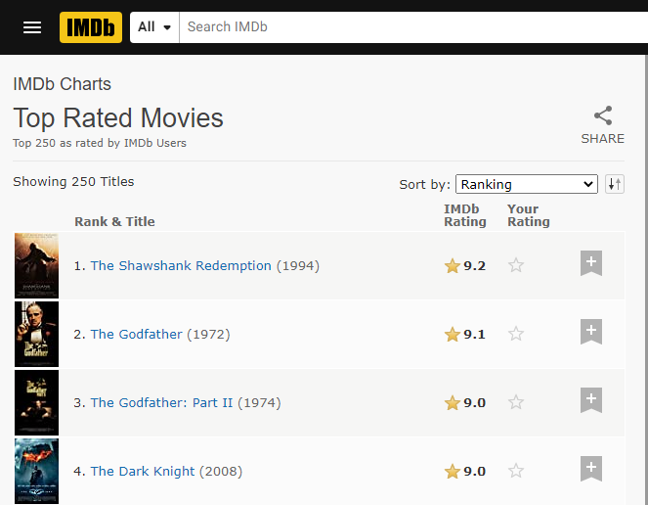
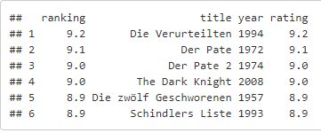
Web Scraping - Objective
*Details in: Web_Scraping_Example.html
Notes:
IMDb: Extract the top rated movies: Title, Year, Rank and Rating information from:
using Google chrome and I can access the extension in the extension bar to the top right
electorGadet allows the user to click on the page element of interest and have that element identifier presented to the user. This tool greatly reduces the time associated with locating CSS selectors through the websites developer section. Once installed, the selector gadget will be located in the upper-right corner of your web browser; click on it to open the interface.

Slide 7
Scraping Twitter Data
Install „rtweet“ package
Setup twitter account:
1) Create a twitter account: http://twitter.com/signup
2) Apply for a developer account by filling in a shor application form: https://developer.twitter.com/en/apply-for-access.html
3) Click on „key and access token“ and get your API access: Consumer Key (API Key), Consumer Secret (API Secret), Access Token, Access Token Secret
Use the keys as arguments:
rtweet::create_token(consumer_key, consumer_secret, access_token, access_secret)
Notes:
popular feature films of 2016

Slide 8
Scraping Twitter Data - Limitations
With the standard (free) search API, you can't get tweets for more than 6-9 days period (for more information see https://developer.twitter.com/en/docs/tweets/search/api-reference/get-search-tweets.html)
Scraping only up to 18.000 tweets possible
Package documentation:
https://cran.r-project.org/web/packages/rtweet/rtweet.pdf
Useful tutorial:
https://rtweet-workshop.mikewk.com/#1

Slide 9

Scraping Twitter Data - Objective
Screenshot from: https://twitter.com/JKasek/status/1377285533274083343
*Details in: Twitter_Scraping_Example.html

Slide 10
Part II: Scraping & Text Cleaning
Practical Application

Slide 11
Preparation:
Get an access to Google Collab
Open Jupyter Notebook: Tutorial_Scraping.ipynb
Set up R
Exercises:
Web Scraping: Extract the Titles and Texts from the following webpage and save in a data frame: https://practicewebscrapingsite.wordpress.com/example-1
Twitter Scraping:
Scrape 500 tweets with hashtag “covid” (exclude retweets)
Visualize the timeline by hours and by minutes. Which one is more appropriate?
Print the most retweeted tweet.

Slide 12
Part II: Scraping & Text Cleaning
Literature and References

Slide 13
https://www.analyticsvidhya.com/blog/2015/10/beginner-guide-web-scraping-beautiful-soup-python/ (Guide to webscraping in python)
https://flukeout.github.io/# (understand css)
https://selectorgadget.com/ (more on selector gadget)
https://cran.r-project.org/web/packages/rtweet/rtweet.pdf
https://rtweet-workshop.mikewk.com/#1
https://docs.tweepy.org/en/latest/ (scrape tweets in python)

