Slide 1
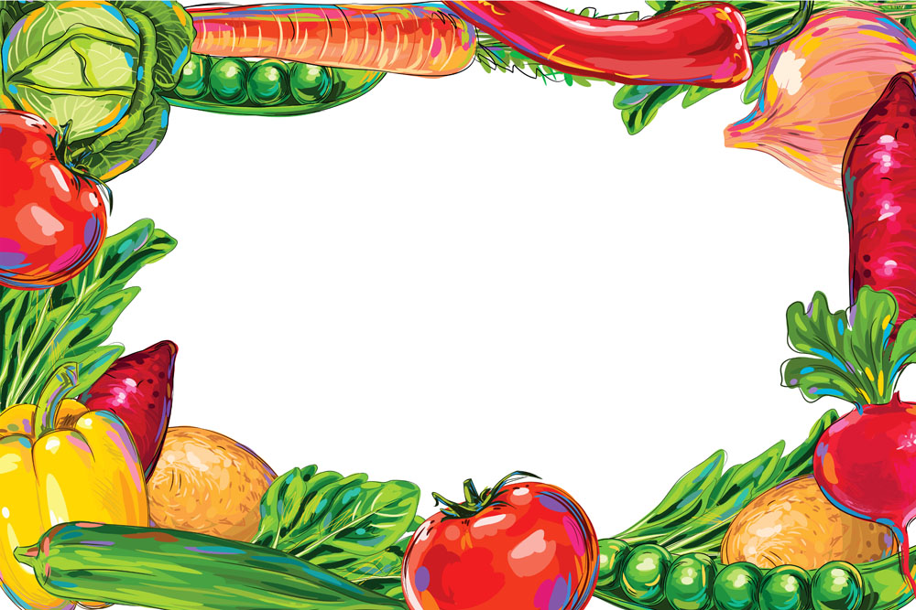
A Weekly Food Menu Planner
Team: FoodButler

Slide 2
Daily Struggles
Don’t know what to buy in the supermarket.
Want to purchase food ingredients efficiently and economically.
Don’t know how to do with some ingredients left in the fridge
Tired of thinking what to eat.
Addressing nutrition needs for fitness or disease

Slide 3
Goal
This application helps students/working professionals plan the food menu for a week, or any other preferred periods, which could cater to customized needs indicated optionally. Examples include dietary restrictions, fitness schedule (calories), ingredients that the user already has and would like to use, dinning style and taste preferences, and budget constraints. This application also helps generate the list of ingredients that is needed for the planned week’s menu and the associated prices for budgeting purpose. To further help the users in the cooking process, we will include the recipes for each food course planned and possibly a timer as well. To optimize user experience, we may further address dishes beyond the traditional three meals which could possibly include morning breaks, afternoon tea, and midnight snacks/fourth meal, all under user’s choice. If time permits, this project will include additional features such as recommending liquor and music along with each meal.

Slide 4
Potential Source
Allrecipes: http://allrecipes.com/
Recipe: www. recipe.com/
United States Department of Agriculture, Agricultural Research Service, National Nutrient Database for Standard Reference Release 28: http://ndb.nal.usda.gov/ndb/foods
Peapod: http://www.peapod.com/ (estimated cost of meals)
List of cuisines: https://en.wikipedia.org/wiki/List_of_cuisines
A food classification and description system developed by European Food Safety Authority (efsa): http://www.efsa.europa.eu/en/data/data-standardisation
Two good recipe sources: http://www.bbc.co.uk/food/cuisines http://cafeworld.wikia.com/wiki/List_of_Cuisines

Slide 5
Planned Schedule
(1) scraping websites and storing data into databases (end of 7th week)
(2) algorithms and functions for putting together a menu (end of 8th week)
(3) Django website structure ie. search engine, output/menu page, timer on recipe pages (end of 8th week)
(4) putting results on Django site (end of 9th week)
Work on scraping data ( #1) and experimenting Django (#3): week 5, 6, 7
Work on #2 with sample data and start building Django webpage (#3): week 6, 7, 8
#4: week 9
clean-up and minor adjustment to webpage: week 10
clean up codes: post-presentation

Slide 6
New Technology
interactive timer during cooking process
image (taken from source) that redirects you to the recipe page if you click on it
Django designs
Capability of synchronizing into iCalendar or Google Calendar
The selecting regime used for generating/optimizing food menu, innovative regression method possible

Slide 7
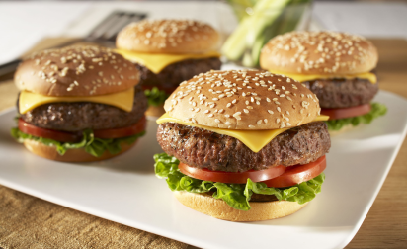
Meal/Day | Monday | Tuesday | Wednesday | Thursday | Friday | Saturday | Sunday
Breakfast
Lunch | Cheeseburger Calories: Estimated Cost: Time:
Dinner

Slide 8

Meal/Day | Monday | Tuesday | Wednesday | Thursday | Friday | Saturday | Sunday
Breakfast
Morning Breaks
Lunch | Cheeseburger Calories: Estimated Cost: Time:
Afternoon Tea
Dinner
Midnight Snacks

Slide 9
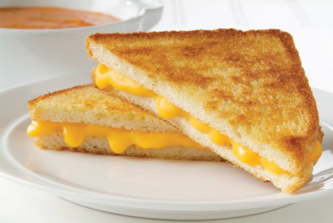
Alternatives
Grill Cheese Calories: Estimated Cost: Time:

Slide 10
Shopping List
Ingredient | Day | Amount
Lettuce | 3, 5, 6 | 2
Cheese | 1, 5 | 5 slices
Tomato | 2, 7 | 3
Noodle | 3 | 1 pack
Broccoli | 2 | ¼ pound

Slide 11
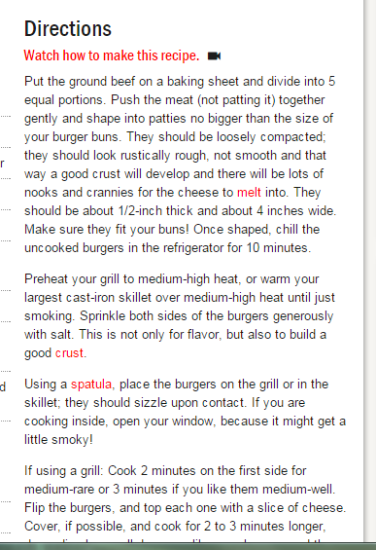

Cheeseburger
Calories:
Cook time:
Estimated Cost:
Ingredient:
(Timer)
BACK

