Slide 1
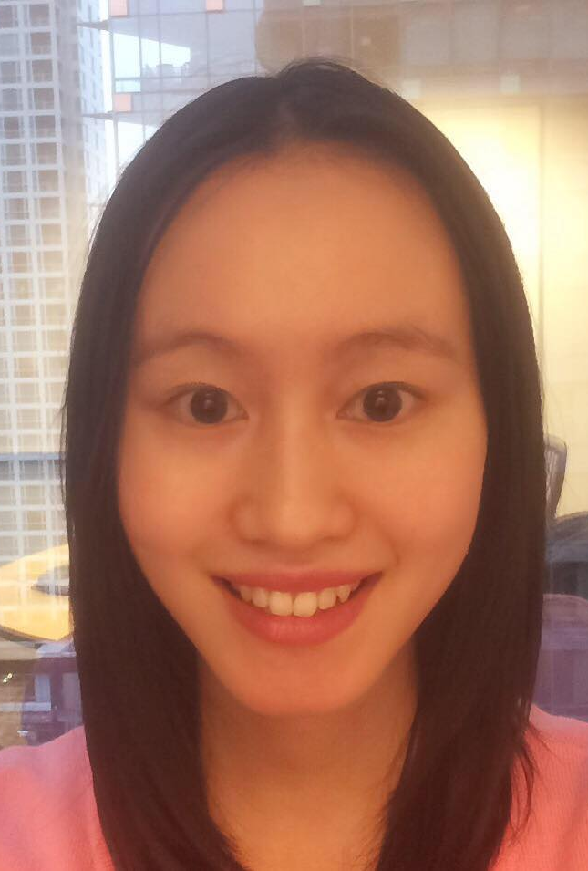
Microsoft Bot Framework
Lisa Wong
Technical Evangelist Intern | Microsoft Canada
miss.lisa19@hotmail.com | @misslisabear

