Slide 1
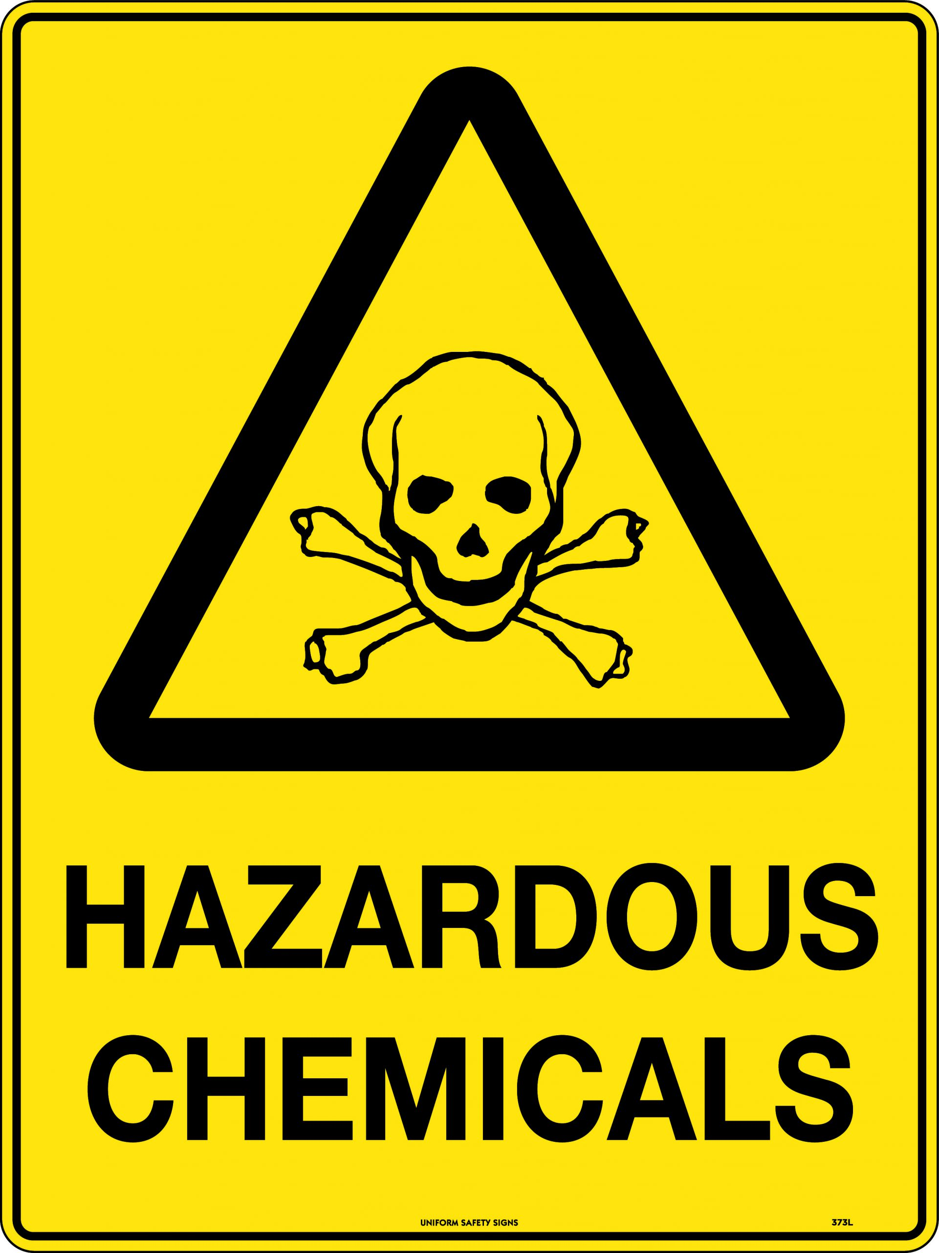
Global Chemicals Politics and Policy & The Rotterdam Convention
Agnes Dechêne Course: Ethics and Politics of Existential Global Risks
Chair of Environmental & Climate Policy
Munich, 31. October 2024
Notes:
Welcome, and thank you for joining today’s presentation. We’ll be discussing the global chemicals regime and specifically the Rotterdam Convention as a case study.
Through this, I’ll cover the main principles and mechanisms of global chemicals policy and evaluate their effectiveness in managing hazardous chemicals, especially in developing countries. Let’s dive in with an overview of the global chemicals regime.

Slide 2
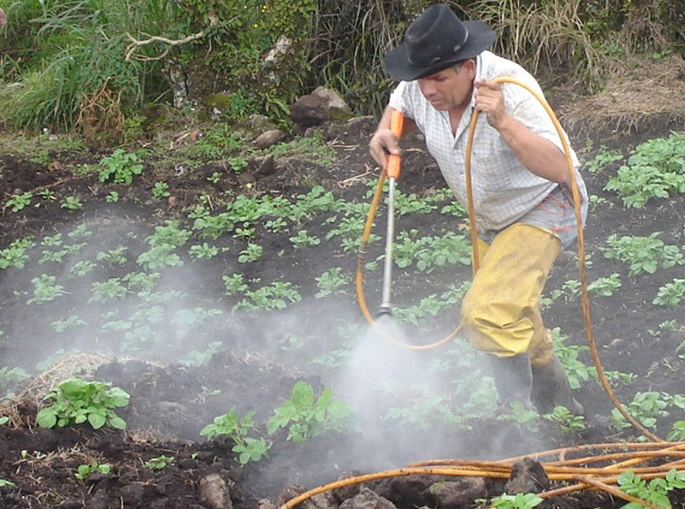
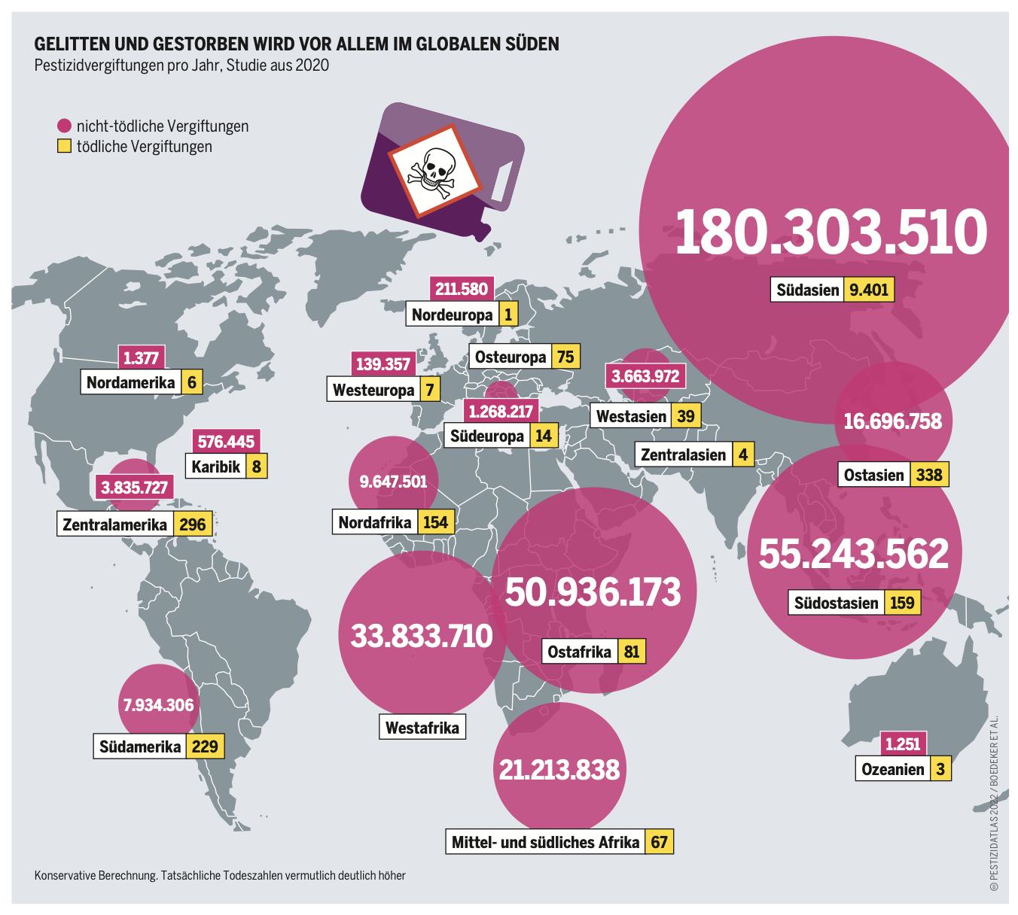
Health hazards due pesticides
(Boedeker, 2020)
Notes:
Boedeker W, Watts M, Clausing P, Marquez E 2020. The global distribution of acute unintentional pesticide poisoning: estimations based on a systematic review. BMC Public Health (2020) 20:1875 https://doi.org/10.1186/s12889-020-09939-0

Slide 3
Short about the 2 papers
Selin, H. (2013). Global chemicals politics and policy. The handbook of global climate and environment policy, 107-123.
Jansen, K., & Dubois, M. (2014). Global pesticide governance by disclosure: Prior informed consent and the Rotterdam convention. Transparency in Global Environmental Governance: Critical Perspectives, 107-131.

Slide 4
Agenda
Global chemicals politics and policy
Global pesticide governance by disclosure
Conclusion and Synthesis
Notes:
This is only the agenda of the Paper one. There is need of adding introduction, questions, what they could have done better in the treaties but as well as in the paper.

Slide 5
Agenda
Global chemicals politics and policy
Chemicals Regime
Main Argument of Paper One
Key Agreements in the Regime
Supporting Points
Critique
Global pesticide governance by disclosure
Conclusion and Synthesis
Notes:
This is only the agenda of the Paper one. There is need of adding introduction, questions, what they could have done better in the treaties but as well as in the paper.

Slide 6
Introduction to the Chemicals Regime
The chemical regime includes global and regional agreements aimed at mitigating environmental and health risks associated with hazardous chemicals.
Basel, Rotterdam, Stockholm Convention and the CLRTAP POPs Protocol
Addressing all stages of chemicals’ life cycles – production, use, trade, and disposal – trough both proactive and reactive measures.
Notes:
The global chemicals regime is a complex network of treaties and policies that collectively aim to protect health and the environment from hazardous chemicals. This regime involves key agreements: the Basel, Rotterdam, and Stockholm Conventions, along with the CLRTAP POPs Protocol.
Each plays a distinct role in managing different aspects of chemicals and hazardous waste. Today, we’ll look at how this regime functions and how effectively it meets its objectives

Slide 7
Key Agreements in the Regime - Treaties
Basel Convention – Manages hazardous waste transport and disposal due Prior Informed Consent (1989)
Rotterdam Convention – Informed consent requirement for certain hazardous chemicals and pesticides (1998)
Stockholm Convention – Regulates persistent organic pollutants (POPs) (2001)
CLRTAP POPs Protocol – Regional focus on long-range POP transport control in Europe and North America. (1997)
Notes:
Let’s briefly look at each of these key agreements.
The Basel Convention focuses on hazardous waste transport and disposal, requiring that waste shipments are managed safely and consent is obtained before moving waste across borders.
The Rotterdam Convention, our focus today, regulates international trade of specific hazardous chemicals through a process called Prior Informed Consent, or PIC.
The Stockholm Convention targets persistent organic pollutants, which are chemicals that remain in the environment for long periods, causing widespread harm.
Finally, the CLRTAP POPs Protocol addresses long-range transport of pollutants, primarily focusing on Europe and North America.

Slide 8

Discussion Question – Main Argument and Agreements
Question 1: If you had to rank, how would you rank those treatments regarding chemicals safety, importance, or influence?
Question 2: What do you think about, that such safety question is fragmented into several treaties?
Notes:
A1:Most Impactful Agreement: The Stockholm Convention may have the most significant impact because it addresses persistent organic pollutants (POPs) that cause long-term harm, which affects global health and ecosystems.
A2: Importance of Fragmentation: A fragmented structure can create coordination challenges, but it also allows for targeted approaches to different chemical hazards, which might be more effective than a single, broad framework.

Slide 9
Institutional Complexity
Fragmented yet Interconnected
SAICM Framework: Strategic Approach to International Chemicals Management is a voluntary, overarching framework to support policy coordination and capacity-building.
→ Needs of Coordination
Notes:
You seen the treaties, and fragmented that we just discussed it is fragmented, but yet interconnected.
So overall, the regime’s structure involves legally independent agreements that are functionally connected.
Fo help there is SAICM “reading second bulletpoint”.
->to unify efforts
Coordination Needs: Synchronizing meeting, secretariat functions, and regulatory practices are essential to avoid overlapping or conflicting obligations.

Slide 10
Capacity-Building and Compliance
Developing Country Focus: Regional centres under Basel and Stockholm aid in local capacity-building and technology transfer, especially in resource-limited countries.
Compliance and Monitoring: Many developing nations struggle to meet reporting requirements due to limited resources.
Role of IGOs, Donor Nations, and NGOs: Funding and expertise from these organizations are critical to enhancing compliance and capacity.
Notes:
A Focus also lies on the helping Developing countries.
However, resource limitations mean many developing countries struggle with compliance and reporting, reducing the impact of these agreements.

Slide 11
Discussion Question – Institutional Complexity and Capacity Building
Question 3:
Do you think voluntary frameworks are effective?
What can be a problem?
Are there any ideas or what measures can be taken?
Question 4: What challenges can you think of for developing countries in complying with these international chemical standards?
Notes:
Q4: Q3: Do you think voluntary frameworks are effective? What can be a problem? e.g. SAICM
Are there any ideas or what meassures can be taken? Would be doing the voluntary framework more binding help? A3: Effectiveness of SAICM: SAICM is valuable for supporting developing countries, but its voluntary nature limits its power; more binding elements could strengthen its impact on global chemical safety.
A4: Developing countries often face significant challenges in complying with international chemical standards due to limited financial resources, technical expertise, and regulatory infrastructure, as described in the papers. Many lack the capacity to conduct necessary risk assessments, maintain regulatory databases, or participate in required reporting procedures, which hinders effective participation in treaties like the Rotterdam Convention.

Slide 12
Life-Cycle Management
Comprehensive Approach
Proactive Measures
Reactive Measures
Governance by Disclosure
Notes:
Comprehensive Approach: The regime’s life-cycle management tackles production, usage, and disposal of chemicals.
Proactive and Reactive Measures: Balances proactive measures like green chemistry with reactive controls on trade and disposal of hazardous substances.
Governance by Disclosure: Increasing reliance on transparency and information-sharing as regulatory tools.

Slide 13
Discussion Question – Life-Cycle Management
Questions 5: Transparency as Regulation: Does transparency alone provide sufficient regulatory power, or are stricter measures needed?
Notes:
Solutions/Comments: As green chemicals are only possible in specific situations, as because of money or not possible. Green chemstriy are pretty impensive.
If you give you the money only if you did it etc.
If you give the necessary structure, finance, knowledgde why improving, give financial oppurtinites. A side effect.
You have to give countries, companies a positive effect, what they are interested if you want to change structures etc.
A6.2: Does Procedural Transparency Help? Transparency helps ensure informed decisions, but if procedural requirements distract from concrete safety measures, the regime may struggle to make meaningful progress on chemical risks.
Frage 5 und 6 A5: Green chemistry has the potential to reduce chemical hazards by promoting safer alternatives to harmful substances; however, widespread adoption is currently limited by economic and technological barriers, especially in developing countries. Its adoption could be accelerated by financial incentives, research funding, and stronger international regulations mandating safer alternatives, alongside capacity-building support for countries with fewer resources.
A6: Balancing proactive innovation with restrictions can be achieved by implementing policies that both encourage the development of safer chemicals and strictly regulate hazardous substances. For instance, offering subsidies for green chemistry while imposing higher taxes or outright bans on toxic chemicals could drive safer innovation within a structured regulatory framework.
A6.2: Does Procedural Transparency Help? Transparency helps ensure informed decisions, but if procedural requirements distract from concrete safety measures, the regime may struggle to make meaningful progress on chemical risks.

Slide 14
Linkage Politics and Synergies
Institutional Linkages: Cross-treaty governance for regulatory synergies and efficiency.
“Linkage Politics”: The strategy of using multiple policy forums to achieve desired outcomes, leading to forum shopping.
Ongoing Evolution: Effort to align policies and compliance requirements due to inter-treaty connections.
Notes:
There is a possibility to change the behaviour of countries, e.g. linkages politics etc. Giving incentives to change direction
Linking treaties like Basel, Rotterdam, and Stockholm enhances regulatory efficiency by creating synergies and aligning requirements, making it easier for countries to comply with multiple agreements.
Linkage politics, or forum shopping, involves countries choosing specific policy forums that best align with their goals, which can create inconsistencies across the chemicals regime.
The chemicals regime continues to evolve as treaties work to harmonize compliance and policy standards, aiming for a more unified global approach.

Slide 15
Discussion Questions – Institutional Linages and Critique
Question 7: How does “forum shopping” influence policy coherence within the chemicals regime? Is it beneficial or disruptive?
Question 8: In your opinion, should SAICM be made more binding, or does the voluntary approach have unique advantages?
Notes:
A7: Forum shopping allows countries or stakeholders to seek favorable outcomes in specific forums, which can lead to fragmented policies across the regime and hinder coherent global approaches. While it may benefit individual interests, it is generally disruptive to the regime’s overall coherence, as it can create inconsistent standards and weaken collective efforts to regulate hazardous chemicals
Asking it neitherless:
A8: Making SAICM more binding could strengthen its impact on global chemical safety, especially by ensuring consistent compliance across countries. However, the voluntary approach allows countries more flexibility, particularly those with limited resources, and can encourage gradual adoption of best practices without the pressure of binding obligations. Striking a balance—introducing more binding elements while retaining some flexibility—may be the optimal approach.

Slide 16
Critique of the Global Regime
Limited Empowerment: Developing countries struggle with participation due to limited resources.
Procedural Over Substance: Emphasis on transparency procedures may detract from substantive safe outcomes.
Civil Society Exclusion: Limited roles for NGOs and the public reduce engagement and awareness.

Slide 17
Discussion Question – Final Critique
Question 9: What monitoring strategies could improve compliance without overburdening developing nations?
Question 10: Should the burden of proof for chemical safety shift from regulators to producers? How might the change global chemical policy?
Notes:
A9: Monitoring strategies that could improve compliance include establishing regional centers for monitoring assistance, using digital tracking and reporting systems to streamline data collection, and providing technical and financial support tailored to local contexts. Regional collaboration, supported by IGOs and NGOs, could also help reduce the compliance burden on individual developing countries by sharing resources and expertise.
A10: Shifting the burden of proof to producers could create a more precautionary approach to chemical safety, requiring companies to demonstrate that a substance is safe before it reaches the market. This shift would likely lead to stricter global policies, as it places greater accountability on manufacturers and could prevent harmful chemicals from being widely distributed without proper risk assessments, particularly benefiting countries with limited regulatory capacity.

Slide 18
International Relations Theory
Which International Relation Theory could fit on the first Paper?
Realism
Liberalism
Constructivism
Notes:
schöner machen

Slide 19
Critique on the Paper
Adding more case studies
Exploring the limitations of transparency
SAICM’s Influence
4. Incentives for Safer Chemicals
5. Monitoring Challenges:
Notes:
Lack of caste studies on successful implementation and compliance. Maybe adding more case studies could illustrate the real-world challenges in capacity-building and help readers understand where support is most needed
The Paper Emphasizes transparency but does not fully address whether transparency alone in adequate as a regulatory tool. Exploring the limitations of transparency could provide a more balanced view of its effectiveness.
SAICM’s Influence: Questions around the effectiveness of voluntary frameworks in driving change.
Incentives for Safer Chemicals: Limited emphasis on promoting green chemistry innovation as part of global policy
Monitoring Challenges: Greater insight needed into limitations facing international monitoring, especially for resource-limited nations.

Slide 20
Wrap up and Take-Home-Message
Interconnected but Fragmented: The regime’s structure requires ongoing coordination to be effective.
Role of Capacity-Building: Developing countries need further support for compliance.
Balancing Interests
Notes:
Balancing interests in global chemicals governance requires navigating between precautionary measures to protect health and the environment, economic considerations, and the need for harmonized policies across treaties.
This balance is challenging, as countries must weigh regulatory costs against the benefits of stricter controls on hazardous chemicals.

Slide 21
Part B: The Rotterdam Convention Case Study
Objective: Dive deeper into the Rotterdam Convention as a case of governance by disclosure, exploring its mechanisms, challenges, and effectiveness in the global chemical's regime.

Slide 22
Agenda
Global chemicals politics and policy
Global pesticide governance by disclosure
Introduction to the Rotterdam Convention
PIC Mechanism and Annex III
Transparency and Empowerment
Implementation and Trade Impact
Critiques
Conclusion and Synthesis

Slide 23
Introduction to the Rotterdam Convention
Purpose: Regulates internation trade of hazardous chemicals through the Prior Informed Consent (PIC) procedure.
Goal: Empower countries to make informed import decisions and reduce risks associated with hazardous chemicals.
Core Concept: “Governance by Disclosure” – reliance on transparency rather than outright bans.
Notes:
The Rotterdam Convention represents a governance-by-disclosure approach, focusing on sharing information and obtaining consent before trading certain hazardous chemicals.
It doesn’t ban chemicals outright but instead requires prior informed consent from importing countries, giving them more control over what chemicals enter their borders.

Slide 24
PIC Mechanism and Annex III
PIC Procedure: Requires exporting countries to notify importing countries about risks, requiring informed consent before trade.
Annex III: List of chemicals subject to PIC procedure; requires two notification from different regions for listing.
Special Provisions for SHPFs: Less stringent notification for severely hazardous pesticide formulations used mainly in developing countries.
Notes:
Annex III of the Rotterdam Convention lists chemicals that are subject to the PIC procedure. To get a chemical listed, two countries from different regions must submit notifications, which often creates delays.
For severely hazardous pesticide formulations, or SHPFs, only one notification is required, acknowledging the specific challenges developing countries face with these substances.

Slide 25
Discussion Question
Question 1:
Do you think the PIC in promoting chemical safety is effective?
Does it truly empower developing nations, or are there limitation?
Notes:
A1: Effectiveness of PIC: The PIC mechanism supports chemical safety by requiring consent, but its reliance on information sharing rather than outright restrictions may not fully empower developing nations to regulate imports effectively.

Slide 26
Transparency and Empowerment
State Sovereignty: PIC strengthens state sovereignty by giving countries control over hazardous imports
Empowerment Limitations: Structural challenges and limites funding hinder developing countries’ ability to fully utilize PIC.
Transparency as a Substitute for Bans: While PIC informs rather than bans, some countries treat Annex III as an informal blacklist.
Notes:
While PIC strengthens state sovereignty, allowing countries to make informed decisions, empowerment is limited by resource constraints.
Some countries treat Annex III chemicals as a de facto blacklist, reflecting a lack of capacity to individually assess each chemical’s risks.
This means that while the Rotterdam Convention provides information, it doesn’t always result in the intended autonomy for all parties.

Slide 27
Discussion Questions
Question 2:
Transparency vs. Banning?
Question 3:
Should civil Society play a more significant role in the PIC procedure, or is state-to-state disclosure enough?
Notes:
A2:Transparency vs. Banning: While transparency allows countries to make informed choices, banning certain chemicals would provide a stronger safety net, especially where regulatory capacity is limited.
A3: Civil Society’s Role: Involving civil society could increase public awareness and accountability, making the PIC process more responsive to local concerns and needs.
: Does the convention’s focus on information disclosure detract from stronger regulatory actions, like bans?

Slide 28
Implementation and Trade Impact
Challenges in Implementation: Many developing countries struggle to submit necessary notifications due to resource limitations.
Market and Trade: PIC shapes trade by informing import choices rather than restricting trade, aligning with markets principles while regulating certain chemicals.
Notes:
Implementation of PIC remains challenging. Many developing countries struggle with the required notifications and data submissions due to limited resources.
Although the PIC shapes a trade by requiring consent for certain chemicals, it doesn’t fully restrict market activities, which can lead to inconsistent application

Slide 29
Critique of the Rotterdam Convention
Limited Scope and Impact: Focused only on a subset of chemicals; slow listing process and resistance from countries with economic interests in specific chemicals (e.g. asbestos)
Dependence on Procedural Mechanism: PIC is high procedural, which can limit substantive regulatory outcomes.
Techno-Statist Approach: Emphasizes state-led, expert-driven governance, reducing civil society and public engagement.
Notes:
Some critiques of the Rotterdam Convention include its limited scope—focusing only on a subset of chemicals—and slow listing process, which delays regulatory actions.
It also relies heavily on procedures, potentially at the expense of stronger regulatory outcomes.
Finally, its techno-statist approach means it’s largely state-centered and expert-driven, with minimal roles for civil society.

Slide 30
Critique on Paper
More in-depth exploration of the listing delays
Discussing case studies regarding resource limitations
Exploring multi-stakeholder involvement
Notes:
The paper focuses on the procedural nature of PIC without adequately analyzing how delays in listing affect chemical safety. A more in-depth exploration of the listing delays would strengthen the analysis, highlighting how these delays impact countries reliant on the PIC list for regulatory guidance.
Discussing specific cases where resource limitations led to non-compliance or in adequate enforcement would strengthen the argument on empowerment gaps. The authors don’t fully address how resource limitations undermine the empowerment goals of the convention.
The authors don’t fully consider alternatives to the techno statist model, such as involving civil society more actively. Exploring multi-stakeholder involvement, like integrating NGO input into the PIC process, could provide a more balanced governance approach

Slide 31
International Relations Theory
Which International Relation Theory could fit on the second Paper?
Realism
Liberalism
Constructivism
Notes:
schöner machen

Slide 32
Agenda
Global chemicals politics and policy
Global pesticide governance by disclosure
Conclusion and Synthesis

Slide 33
Conclusion and Synthesis
The Rotterdam Convention exemplifies the transparency-based governance approach within the broader chemical's regime.
Strengths and Limitations: Transparency and informed consent are valuable, but capacity gaps and procedural complexity limit implementation.
Future Directions: Increased civil society involvement, more substantive funding for developing countries, and faster listing processes could enhance the regime’s impact.
Notes:
To conclude, the Rotterdam Convention illustrates the transparency-based governance model within the broader chemicals regime.
While PIC empowers countries by providing information, there are clear gaps, particularly in the capacity of developing nations to fully participate.
Moving forward, increased funding, faster listing processes, and possibly a stronger role for civil society could improve the effectiveness of both PIC and the chemicals regime.

Slide 34
Final Discussion Questions
Question 4:
What changes can you think of, which could make the global chemicals regime, including the Rotterdam Convention, more effective in achieving safety goals?
Question 5:
Should the burden of proof for chemical safety shift from regulators to producers? How might this impact international chemical governance?
Notes:
A4: Future of the Chemicals Regime: Enhancing support for developing countries, streamlining listing procedures, and involving more stakeholders could make the regime more effective and inclusive.
A5: Shifting the Burden of Proof: Shifting the burden of proof to producers would make chemical management more proactive, placing responsibility on manufacturers to prove safety rather than on regulators to prove harm, potentially leading to safer products globally.

Slide 35
Thank you very much!
Any further questions?

