Slide 1
Mathematical Methods of Uncertainty Quantification in Hydrology
Task 1: Parameter Optimization
Fit Lumped HBV012a model to observed river flow data
Lisa Beer, Agnes Dechêne, Helena Franta
Munich, 08. November 2024
Notes:
Welcome, and thank you for joining today’s presentation. We’ll be discussing the global chemicals regime and specifically the Rotterdam Convention as a case study.
Through this, I’ll cover the main principles and mechanisms of global chemicals policy and evaluate their effectiveness in managing hazardous chemicals, especially in developing countries. Let’s dive in with an overview of the global chemicals regime.

Slide 2
Agenda
Global optimization of all parameters
Shutting off processes
Shutting off Snow
Shutting of Soil 0
Shutting of Soil 1
Shutting of Upper Reservoir
Shutting off Lower Reservoir
Conslusion
Notes:
This is only the agenda of the Paper one. There is need of adding introduction, questions, what they could have done better in the treaties but as well as in the paper.

Slide 3
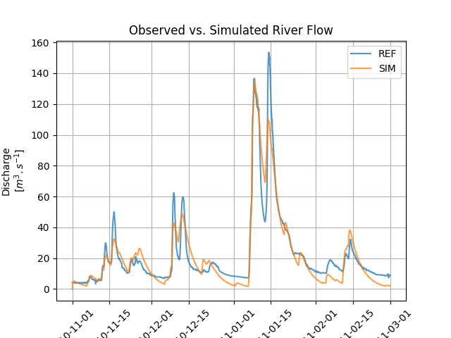
A. – Optimization of all parameters
Use Differential Evolution Algortihm
Parameter bounds as given on Moodle
Unlimited number of iterations allowed
Stopping criterion: tolerance of 0.01
Performance metrics used: nse

Slide 4
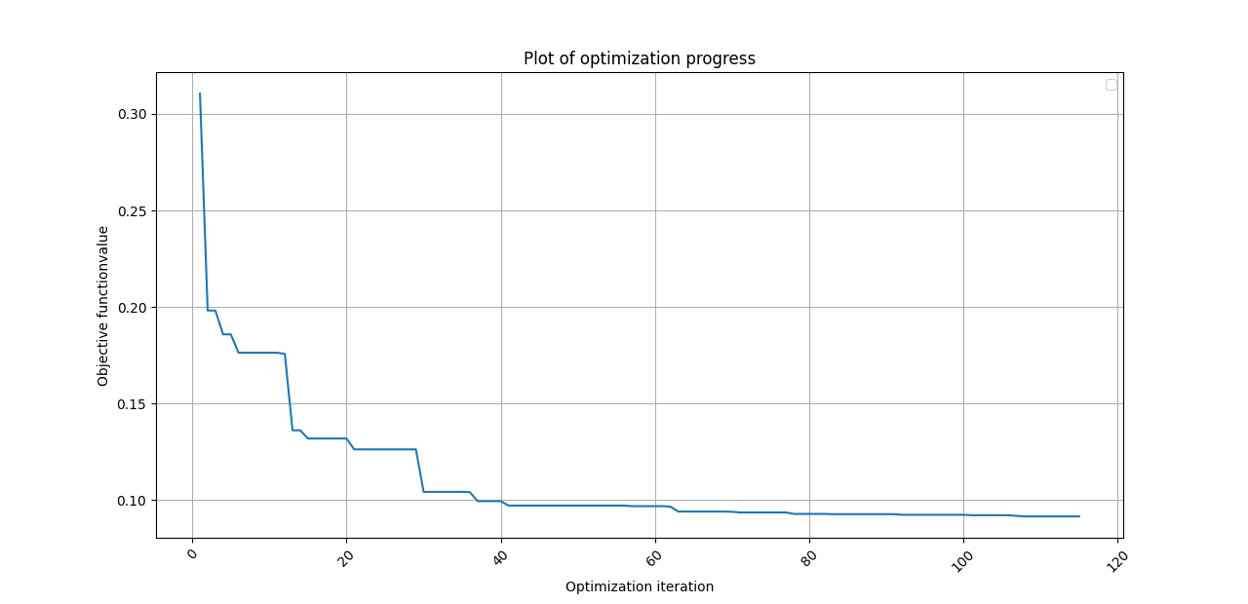
A. – Optimization of all parameters
Plot shows 1-nse
Final objective value lies at XXXX
Differential Evolution Algorithm performed XXXX iterations

Slide 5
A. – Optimization of all parameters
[scatter plots of the single parameters]
Notes:
The global chemicals regime is a complex network of treaties and policies that collectively aim to protect health and the environment from hazardous chemicals. This regime involves key agreements: the Basel, Rotterdam, and Stockholm Conventions, along with the CLRTAP POPs Protocol.
Each plays a distinct role in managing different aspects of chemicals and hazardous waste. Today, we’ll look at how this regime functions and how effectively it meets its objectives

Slide 6
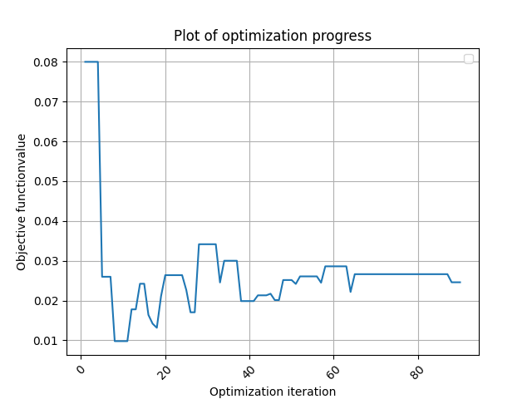
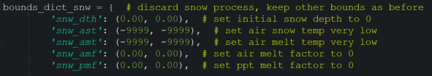
B. – Shutting of processes: Snow
Tolerance 0.01
Nse value: 0.585
Number of interations: 90
Adapted initial bounds:
Notes:
The global chemicals regime is a complex network of treaties and policies that collectively aim to protect health and the environment from hazardous chemicals. This regime involves key agreements: the Basel, Rotterdam, and Stockholm Conventions, along with the CLRTAP POPs Protocol.
Each plays a distinct role in managing different aspects of chemicals and hazardous waste. Today, we’ll look at how this regime functions and how effectively it meets its objectives

Slide 7
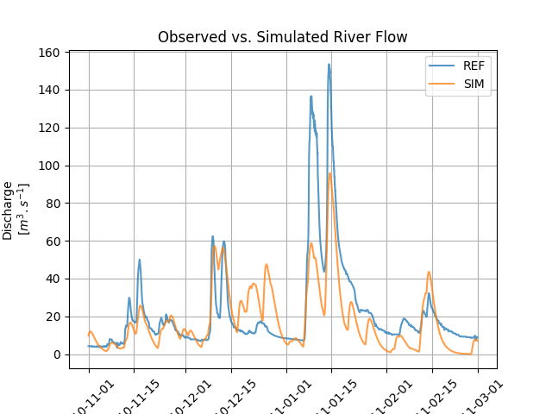
B. – Shutting of processes: Snow
Decently captures general dynamics
Misses high peak of discharge
Significantly over-estimates discharge right before high peak
Notes:
The global chemicals regime is a complex network of treaties and policies that collectively aim to protect health and the environment from hazardous chemicals. This regime involves key agreements: the Basel, Rotterdam, and Stockholm Conventions, along with the CLRTAP POPs Protocol.
Each plays a distinct role in managing different aspects of chemicals and hazardous waste. Today, we’ll look at how this regime functions and how effectively it meets its objectives

Slide 8
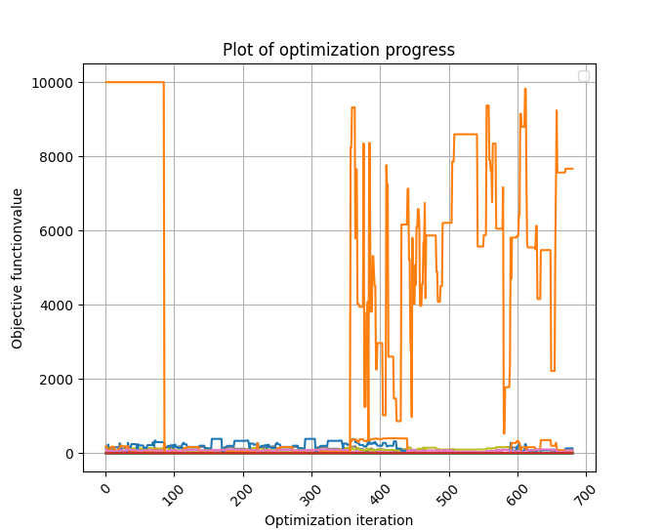
B. – Shutting of processes: Soil 0
Tolerance 0.01
Nse value:
Number of interations:
Adapted initial bounds:
Notes:
The global chemicals regime is a complex network of treaties and policies that collectively aim to protect health and the environment from hazardous chemicals. This regime involves key agreements: the Basel, Rotterdam, and Stockholm Conventions, along with the CLRTAP POPs Protocol.
Each plays a distinct role in managing different aspects of chemicals and hazardous waste. Today, we’ll look at how this regime functions and how effectively it meets its objectives

Slide 9
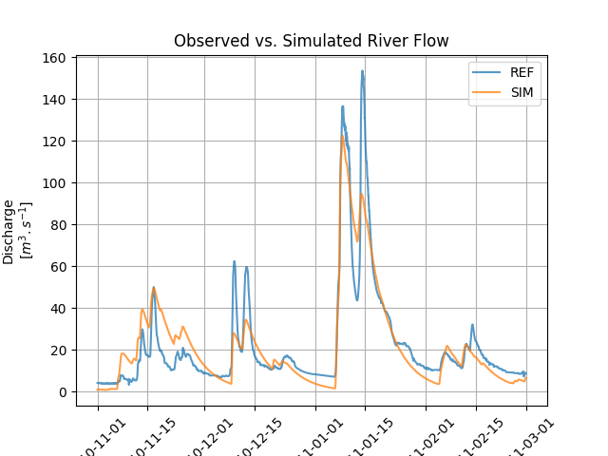
B. – Shutting of processes: Soil 0
…
Notes:
The global chemicals regime is a complex network of treaties and policies that collectively aim to protect health and the environment from hazardous chemicals. This regime involves key agreements: the Basel, Rotterdam, and Stockholm Conventions, along with the CLRTAP POPs Protocol.
Each plays a distinct role in managing different aspects of chemicals and hazardous waste. Today, we’ll look at how this regime functions and how effectively it meets its objectives

Slide 10
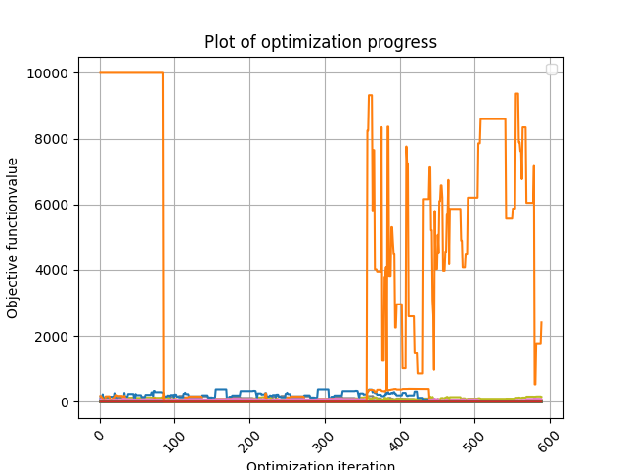
B. – Shutting of processes: Soil 1
Tolerance 0.01
Nse value:
Number of interations:
Adapted initial bounds:
Notes:
The global chemicals regime is a complex network of treaties and policies that collectively aim to protect health and the environment from hazardous chemicals. This regime involves key agreements: the Basel, Rotterdam, and Stockholm Conventions, along with the CLRTAP POPs Protocol.
Each plays a distinct role in managing different aspects of chemicals and hazardous waste. Today, we’ll look at how this regime functions and how effectively it meets its objectives

Slide 11
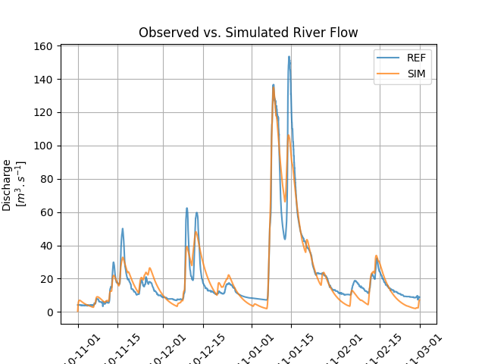
B. – Shutting of processes: Soil 1
Capturing of the smaller peaks
Notes:
The global chemicals regime is a complex network of treaties and policies that collectively aim to protect health and the environment from hazardous chemicals. This regime involves key agreements: the Basel, Rotterdam, and Stockholm Conventions, along with the CLRTAP POPs Protocol.
Each plays a distinct role in managing different aspects of chemicals and hazardous waste. Today, we’ll look at how this regime functions and how effectively it meets its objectives

Slide 12
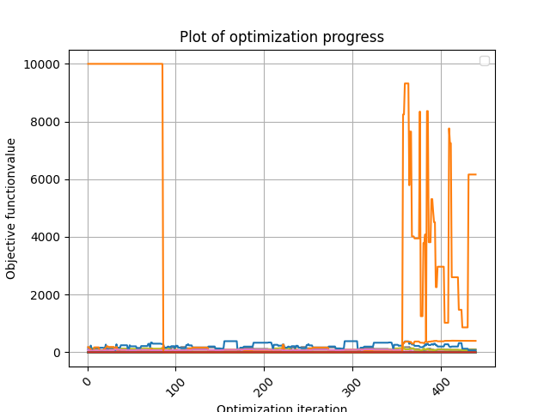
B. – Shutting of processes: Upper Reservoir
Tolerance 0.01
Nse value:
Number of interations:
Adapted initial bounds:
Notes:
The global chemicals regime is a complex network of treaties and policies that collectively aim to protect health and the environment from hazardous chemicals. This regime involves key agreements: the Basel, Rotterdam, and Stockholm Conventions, along with the CLRTAP POPs Protocol.
Each plays a distinct role in managing different aspects of chemicals and hazardous waste. Today, we’ll look at how this regime functions and how effectively it meets its objectives

Slide 13
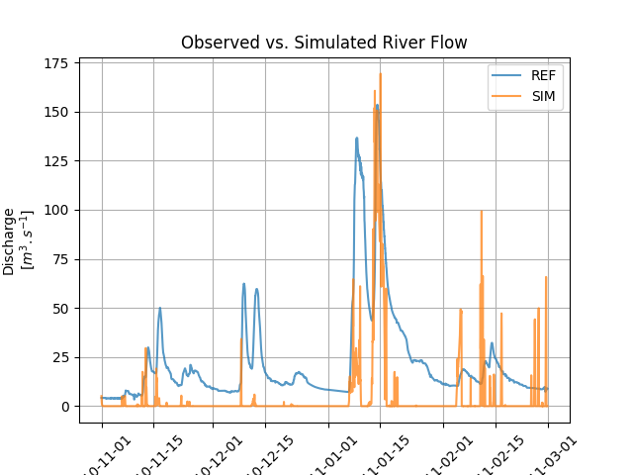
B. – Shutting of processes: Upper Reservoir
Capturing of the smaller peaks
Notes:
The global chemicals regime is a complex network of treaties and policies that collectively aim to protect health and the environment from hazardous chemicals. This regime involves key agreements: the Basel, Rotterdam, and Stockholm Conventions, along with the CLRTAP POPs Protocol.
Each plays a distinct role in managing different aspects of chemicals and hazardous waste. Today, we’ll look at how this regime functions and how effectively it meets its objectives

Slide 14
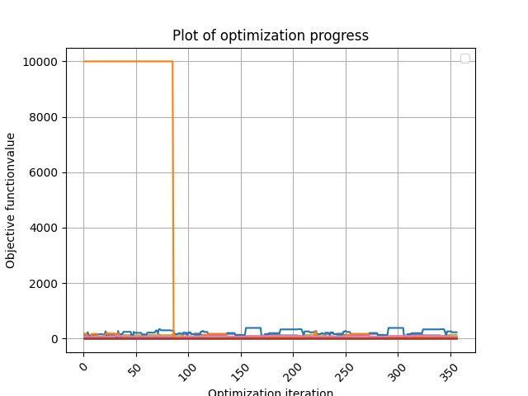
B. – Shutting of processes: Lower Reservoir
Tolerance 0.01
Nse value:
Number of interations:
Adapted initial bounds:
Notes:
The global chemicals regime is a complex network of treaties and policies that collectively aim to protect health and the environment from hazardous chemicals. This regime involves key agreements: the Basel, Rotterdam, and Stockholm Conventions, along with the CLRTAP POPs Protocol.
Each plays a distinct role in managing different aspects of chemicals and hazardous waste. Today, we’ll look at how this regime functions and how effectively it meets its objectives

Slide 15
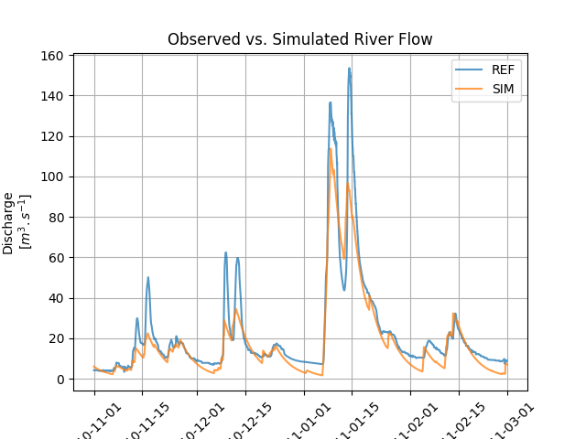
B. – Shutting of processes: Lower Reservoir
Capturing of the smaller peaks
Notes:
The global chemicals regime is a complex network of treaties and policies that collectively aim to protect health and the environment from hazardous chemicals. This regime involves key agreements: the Basel, Rotterdam, and Stockholm Conventions, along with the CLRTAP POPs Protocol.
Each plays a distinct role in managing different aspects of chemicals and hazardous waste. Today, we’ll look at how this regime functions and how effectively it meets its objectives

Slide 16
Conclusion
What is the least amount of processes required ?
Notes:
Let’s briefly look at each of these key agreements.
The Basel Convention focuses on hazardous waste transport and disposal, requiring that waste shipments are managed safely and consent is obtained before moving waste across borders.
The Rotterdam Convention, our focus today, regulates international trade of specific hazardous chemicals through a process called Prior Informed Consent, or PIC.
The Stockholm Convention targets persistent organic pollutants, which are chemicals that remain in the environment for long periods, causing widespread harm.
Finally, the CLRTAP POPs Protocol addresses long-range transport of pollutants, primarily focusing on Europe and North America.

Slide 17

Thank you very much!
Any further questions?

