Slide 1
Dual Porosity Modeling and Multi-scale Finite Volume Methods

Slide 2
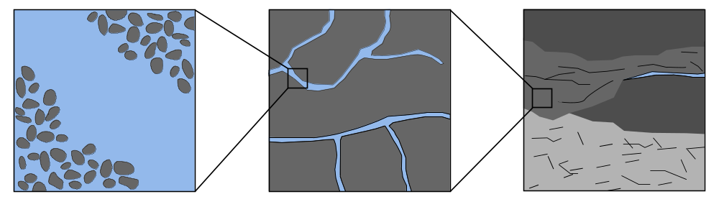
Motivation
Challenges:
heterogeneous parameters on multiple scales
strongly discontinuous material properties, e.g. K spans multiple length scales and has multiscale structure
→ all scales impact flow behaviour
high-resolution of all details computationally not possible
Notes:
high-permeable fractures embedded in a low-permeable matrix
Need for alternative modelling approaches, that reduce complexity of system but are able to reproduce important processes

Slide 3

Modeling Flow in Fractured Porous Media
Problem:
two-phase flow neglecting gravity and capillary pressure
Common modeling approaches
Continuum approaches
Discrete approaches
Multi-scale methods
Mass conservation for incompressible fluid α
Notes:
high complexity and variety of problems: not feasible to describe system in great detail , and development of a generally applicable model is difficult
different modeling approaches and numerical methods have been developed for certain types of problems on certain scales

Slide 4

Modeling Flow in Fractured Porous Media
Problem:
two-phase flow neglecting gravity and capillary pressure
Common modeling approaches
Continuum approaches
Discrete approaches
Multi-scale methods
Mass conservation for incompressible fluid α
multi-scale structure:
spans orders of magnitude
discontinuous (fractures)
Notes:
high complexity and variety of problems: not feasible to describe system in great detail , and development of a generally applicable model is difficult
different modeling approaches and numerical methods have been developed for certain types of problems on certain scales
multi-scale : fractures of different lengths

Slide 5
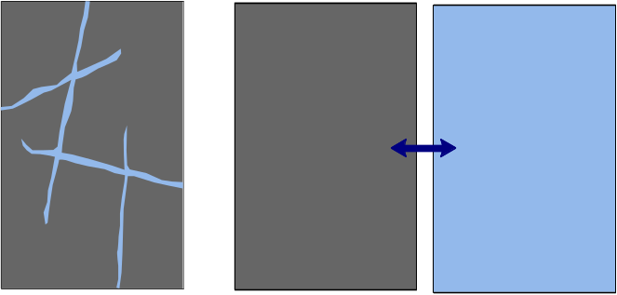
Modeling Flow in Fractured Porous Media
Continuum approaches
  upscaled representation of geometries and parameters
  → efficient at cost of losing fine-scale information
  → determination of effective parameters and exchange
  functions not straightforward
Discrete Approaches
Multi-scale methods
matrix-fracture transfer
fracture network
matrix continuum
fracture continuum
Notes:
continuum models aim at an averaged description of flow and transport in the fractured medium. They are based on an upscaling procedure, which introduces effective coefficients for one or several interacting continua. E.g. dual-porosity: matrix and fracture are upscaled into separate continua, which are coupled through a transfer term. Complexity of the problem and degrees of freedom are drastically reduced → efficient, suitable for large scale problems However, this efficiency comes at the cost of: - losing information on the fine-scale - additional assumptions → REV on the macro-scale, not only for matrix, but also for fractures, which is not always the case.

Slide 6
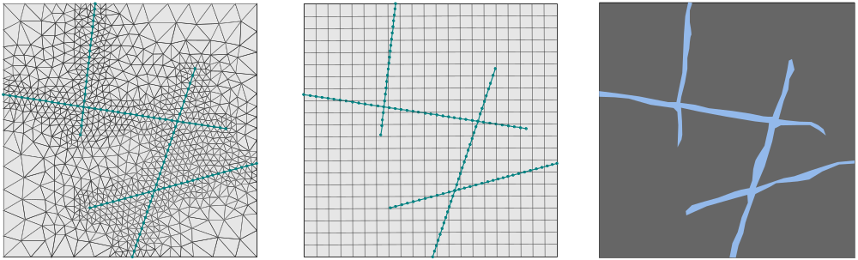
Modeling Flow in Fractured Porous Media
Continuum approaches
Discrete approaches
  explicit resolution of fractures in the domain
  → accurate
  → applicability limited to smaller scales (extensive data
  requirement, huge systems)
Multi-scale methods
fracture network
DFM
EDFM
Notes:
discrete fracture models (DFM) : fractures are discretely represented in the grid. that way, location and geometry of individual fractures is explicitly accounted for.
In classic DFM, it is assumed that the fracture length is considerably larger than the fracture width -> fractures are discretized using lower-dimensional elements.
Conforming matrix and fracture mesh, i.e. fracture cells are restricted to align with interfaces of matrix cells -> complex unstructured gridding techniques required.
often, many small and ill-shaped elements at intersections -> huge degrees of freedom, and time-step restrictions
alternative: Embedded discrete fracture models: independent grids for fractures and matrix. that way, expensive generation of conforming mesh is avoided. Transfer between matrix and fracture, which was calculated directly in the DFM, is now approximated by a well-like transfer function.
DFMs can provide very accurate predictions of the flow behaviour. However, computation time grows rapidly with increasing problem size due to expensive meshing and solving of large systems.

Slide 7
Modeling Flow in Fractured Porous Media
Continuum approaches
Discrete approaches
Multi-scale methods
  resolve fine-scale data, but solve coarse-scale system
Notes:
-> this lead to development of multi-scale methods for fractured media.
Concept of multi-scale methods successfully applied to heterogeneous media, where efficient way to cope with oscillating material parameters. Similar, to upscaling methods: based on a representation on a coarser scale. This is done by constructing local basis functions that capture fine-scale variations and are used to calculate the solution on a coarser scale.
However, important difference to upscaling: basis-functions do not only provide a mapping from fine to coarse – but also from coarse to fine.
-> this allows for reconstructing of the fine-scale solution.
Idea: add new degrees of freedom to coarse grid that represent fractures.
Multi-scale methods are able to give a detailed image of the flow pattern on the fine scale, without actually having to solve the fine-scale system

Slide 8
Motivation
Thought:
What and how can we learn from multi-scale basis functions concerning the applicability and parametrization of dual-continuum models?

Slide 9
Hierarchical Fracture Modeling (HFM)
y

Slide 10
Dual-Porosity Model
y

Slide 11
The Multi-Scale Restricted Smooth Basis
Method for Fractured Porous Media (F-MsRSB)
y

Slide 12
Closer Look at Basis Functions
y

