Slide 1
Excel (Stats 101 – Moving Average and Regression)
Day 3
The Data Bootcamp (Supplemental Slides)

Slide 2
Different Types of Data
Numerical – Numbers
Example – Temperature
Example – Stock Price
Categorical/Nominal – Category or Label (No real concept of order)
Example – Colors (Red, Blue, Black, Green)
Example – Types of Web Pages ( News, Sports, Entertainment, Arts, etc)
Example – Presence of Disease, (Yes or No)
Example – Images (Cat, Dog, House, Tree, etc)
Ordinal – Ranked Data (concept of order)
Example – Bad, Good, Excellent
Example – Freezing, Cold, Cool, Warm, Hot
Example – Low, Medium, High

Slide 3
Different Types of Analysis/Statistics
Descriptive Statistics (Exploratory Analysis) – summarizing the key properties of your data for what it is
Mean, Median, Mode, Max, Min, Counts, Percentiles, Cumulative distributions
Sorting
Filtering
Plotting (histogram, bar, line, scatter, etc)
Sample size
Standard deviation
Correlation
Taking logs (reduce noise)
Statistical Inference (Predictive Analytics) – Infer, predict, make decision
Confidence intervals
P-values
Regression (Curve fitting) - Forecasting
Classification
Clustering (sometimes can be used for descriptive statistics)
Descriptive Statistics, Wikipedia, https://en.wikipedia.org/wiki/Descriptive_statistics, Date Accessed – 2/24/2019
Statistical Inference, Wikipedia, https://en.wikipedia.org/wiki/Statistical_inference, Date Accessed – 2/24/2019

Slide 4
Time Series
Time series – type of data where X=time and Y=dependent variable
Components of a time series – what you are looking for?
Seasonal Component – Periodicity (repeating pattern -daily, weekly, etc)
Trend Component – Increase or decrease
Noise – Outlier
Cyclical Component – Significant Fluctuation (less regular than seasonal component)
Techniques to identify and analyze each
Seasonal component
Moving average (Useful for removing it)
Trend Component
Use regression to model it (curve fitting)
Y = mx + b (M describes slope)
Can remove it by subtracting real measurement by regression measurement
Noise/Random Outlier Detection – Extremely high or low values
D Standard deviations above/below average
T Threshold higher than modeled trend (regression result) or moving average (seasonality adjustment)
Time Series, Wikipedia, https://en.wikipedia.org/wiki/Time_series, Date Accessed, 2/24/2019

Slide 5
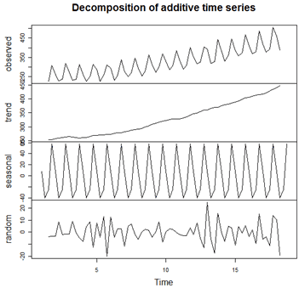
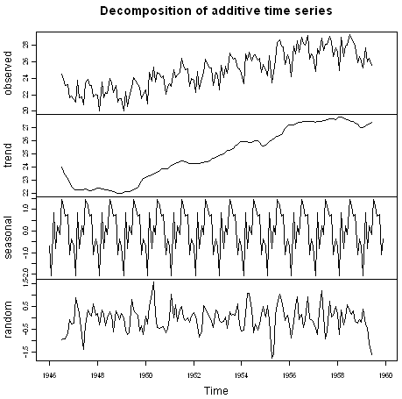
Decomposition of Time Series
Penn State University, https://newonlinecourses.science.psu.edu/stat510/node/69/, Date Accessed – 2/26/2019
Little Book on Time Series with R, https://a-little-book-of-r-for-time-series.readthedocs.io/en/latest/src/timeseries.html , Date Accessed – 2/26/2019

Slide 6
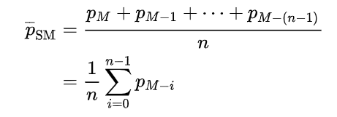
Moving Average
Primarily used as a denoising technique for time series data
Removing seasonal or periodical aspect of data
Other fluctuations that make it difficult to identify trend
Generally use moving average to remove seasonal component before modeling trend (regression)
Simple Moving Average Definition
Exponential Moving Average
Weighted Moving Average
There is not a good way to determine what the lag/interval or other parameters of moving average should be used given data.
Shorter lag/interval helps detects changes sooner
Generally try to make lag/interval as short as possible to reveal whatever trends you are looking for.
Moving Average, Wikipedia, https://en.wikipedia.org/wiki/Moving_average, Accessed 2/24/2019

Slide 7
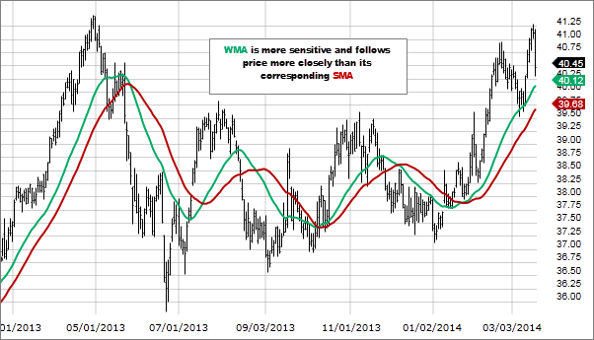
Moving Average Example
SMA – Simple moving average
WMA – Weighted moving average
Weighted Moving Average, Fidelity Investments, https://www.fidelity.com/learning-center/trading-investing/technical-analysis/technical-indicator-guide/wma, Date Accessed – 2/26/2019

Slide 8
Regression Analysis
High Level Goal – Approximate a function, F(x), to Predict Y given X
Y = F(x)
X is independent Variable
Y is dependent Variable
Only applies when dealing with Numerical Data (specifically, Y)
If X is Nominal or Ordinal you can still do regression (Aside)
F(x) that are commonly used for regression analysis include:
Linear – By far the most common for statistics and data analysis
Exponential
Logarithmic
Power
Polynomial
Regression Analysis, Wikipedia, https://en.wikipedia.org/wiki/Regression_analysis, Date Accessed – 2/24/2019

Slide 9
Simple Linear Regression Model (Single Variable) - Terminology Cheat Sheet
Simple Linear Regression
Y_{predicted} = AX + B + Noise
Y_{real} – Y_{predicted} = Noise
 | Machine learning/Computer Science | Statistics
X | Predictor, Feature, Attribute | Independent Variable, Explanatory Variable
Y | Target Variable, Label | Dependent Variable
A | Weight | Coefficient
B | Intercept | Intercept
Noise | Error | Residual
Simple Linear Regression, Wikipedia, https://en.wikipedia.org/wiki/Simple_linear_regression, Accessed 2/24/2019

Slide 10
Interpreting Regression Output – Two Reasons (1 of 2)
Determine which independent variables are useful for predicting dependent variable
P-value is a measure of whether of a independent variable is helpful or not for prediction.
Statistically significant p-values are usually less than 0.05 (independent variable has predictive power)
P-values greater than 0.10 not significant (nothing there)
P-values between 0.10 and 0.05 (maybe something)
P-values less than 0.05 (something there)
These thresholds are loose – simply use as a guide for identifying and possibly explaining differences.
Coefficients/Weights – A measure of he “strength” of the association between the independent and dependent variable.
Larger values yields stronger association between independent and dependent (whether positive of negative)
Positive values yields positive/direct association (one increase another increase)
Negative values yields negative/inverse association (one increase another decrease)
Smaller values, positive or negative, yield weak association

Slide 11
Interpreting Regression Output – Two Reasons (2 of 2)
2. Actually predict the dependent variable
R-squared is a measure of ability to predict the target variable
Ranges from 0 to 1
Values closer to 1 means greater ability to predict (higher is better)
In practice, judgement calls on model performance are based on other metrics – accuracy, prediction error (residuals), etc (easier to interpret)
Important Note:
Generally, you should always be able to do identify important independent variables and sometimes be able to make a good prediction --- depending on the performance/accuracy of the model.
Acceptable levels of accuracy/performance vary across problem areas and industries
Robert Nau, Duke University, School of Business, https://people.duke.edu/~rnau/mathreg.htm , Date Accessed – 2/27/2019

Slide 12
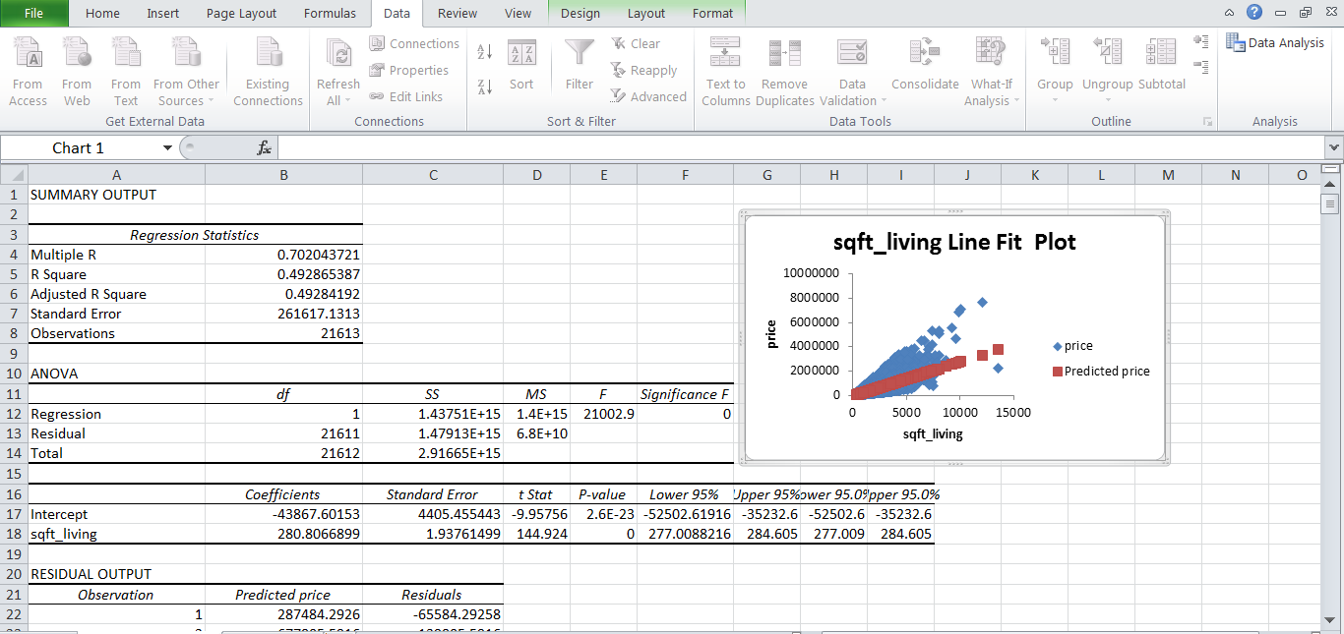
Example Regression Output - Excel
Robert Nau, Duke University, School of Business, https://people.duke.edu/~rnau/mathreg.htm , Date Accessed – 2/27/2019

Slide 13
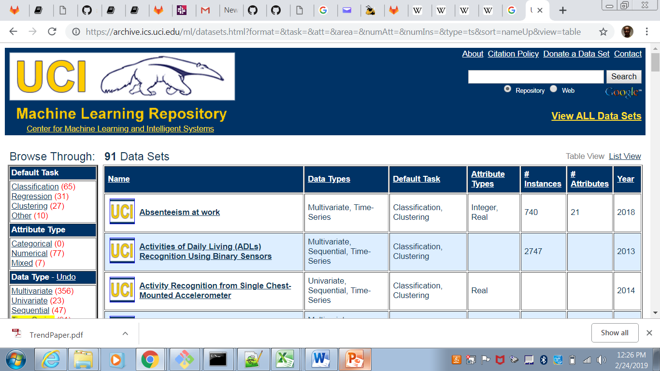
Want to Get Your Hands Dirty (Time series data)?
UCI Machine Learning Repository, https://archive.ics.uci.edu/ml/datasets.html?format=&task=&att=&area=&numAtt=&numIns=&type=ts&sort=nameUp&view=table, Date Accessed – 2/23/2019

