Slide 1
Temperature-conditioned
sequence modeling of
J-domain proteins
62
alignment positions
14,944
training sequences
Dataset construction and preliminary FeatureDCA results
Francesco Caredda
Preliminary research update
Notes:
Open with the biological objective: learn how J-domain sequence distributions change with the optimal growth temperature of the source organism. Clarify that these are preliminary generative-model diagnostics, not experimental thermostability measurements.

Slide 2
DATA SOURCE
TEMPURA dataset
8,639
8,090
549
1 row
prokaryotic strains with minimum, optimum, and maximum growth temperatures
bacterial strains
archaeal strains
per organism or strain, not per protein sequence
Temperature provenance
Authors manually collected Tmin, Topt, and Tmax from the oldest relevant study linked by NCBI Taxonomy, or from Bergey’s Manual when no linked study was available.
Additional organism information
Taxonomy ID, strain, lineage from superkingdom to genus, genome accession, genome GC content and size, and 16S rRNA accession and GC content.
Our proteins inherit these organism-level measurements through exact UniProt OX taxonomy-ID matching.
02
Notes:
TEMPURA contains organism-level growth phenotypes, not protein measurements. Source: Sato Y. et al. TEMPURA: Database of Growth TEMPeratures of Usual and RAre Prokaryotes. Microbes and Environments 35, ME20074 (2020). https://doi.org/10.1264/jsme2.ME20074

Slide 3
DATA SOURCE
Temperature variables and data completeness
Field
Meaning
TEMPURA
Final J-domain MSA
Tmin
Lowest reported temperature that supports growth
8,639 | 100%
14,944 | 100%
Topt_ave
Reported optimum, or midpoint when the optimum is a range
8,639 | 100%
14,944 | 100%
Topt_low
Lower bound when an optimum range was reported
3,088 | 35.7%
5,634 | 37.7%
Topt_high
Upper bound when an optimum range was reported
3,088 | 35.7%
5,634 | 37.7%
Tmax
Highest reported temperature that supports growth
8,639 | 100%
14,944 | 100%
Tmax−Tmin
Derived width of the reported growth-temperature range
8,639 | 100%
14,944 | 100%
Topt_high is the upper end of an optimum range. Tmax is the highest temperature at which growth occurs. TEMPURA has no field named Topt_max.
03
Notes:
Completeness counts come from 200617_TEMPURA.csv and data/processed_new/jdomain/jdomain.metadata.maxgap50.csv. TEMPURA excluded strains lacking the Tmin, Topt, Tmax triplet. Topt_low and Topt_high are populated together only when the source reported an optimum range.

Slide 4
STUDY DESIGN
Research question and validation strategy
Can a conditional autoregressive model learn temperature-associated sequence variation while preserving realistic J-domain statistics?
Natural data
Conditional model
Positive control
Stress test
UniProt sequences matched to TEMPURA organisms and aligned to a J-domain profile HMM
>
FeatureDCA trained with standardized Topt_ave as the feature vector
>
A second model conditioned on natural PC1 and PC2 tests whether generation can recover known coordinates
>
A 60–90 °C ladder tests likelihood calibration and extrapolation behavior
The controls separate temperature information from broader phylogenetic and functional sequence variation.
04
Notes:
Describe the logic before the details. The PCA-conditioned model is a positive control: if FeatureDCA can recover PCA clusters when given PC coordinates, failure under temperature conditioning reflects limited information in temperature rather than a broken generator.

Slide 5
MSA CONSTRUCTION
Source data and organism matching
62,074
17,895
8,638
16,786
candidate J-domain records in the corrected UniProt FASTA
distinct UniProt taxonomy IDs before filtering
distinct organisms in TEMPURA
records matched to TEMPURA by taxonomy ID
Matching rule
UniProt OX taxonomy ID = TEMPURA taxonomy_id
Strict taxonomy-ID matching avoided ambiguous species-name joins. No species-name fallback was used in the final dataset.
All temperature fields remained attached to each protein: Tmin, Topt_ave, Topt_low, Topt_high, Tmax, and Tmax−Tmin. Multiple homologs from the same organism were retained.
One TEMPURA organism appears twice: Methanopyrus kandleri, taxonomy ID 2320.
05
Notes:
Emphasize that we retained homologs intentionally. FeatureDCA later applies sequence reweighting, so redundancy is handled statistically rather than by discarding all but one protein per organism.

Slide 6
MSA CONSTRUCTION
J-domain sequence filtering and alignment
Corrected UniProt FASTA
TEMPURA tax-ID match
J-domain hmmsearch
hmmalign --trim
Maximum 50% gaps
>
>
>
>
62,074 sequences
16,786 sequences
14,954 significant hits
62 model positions
14,944 final sequences
HMM threshold
Sequence and domain E-value ≤ 10⁻⁵
Alignment cleanup
Lowercase insertions and dot columns removed
maxgap50 removes sequences with >50% alignment gaps, not sequences with more than 50 individual gaps.
Final coverage: 14,944 sequences from 4,855 organisms
06
Notes:
The supplied J-domain HMM has no curated GA cutoff, so hmmsearch used sequence and domain E-value thresholds of 1e-5. hmmalign with --trim retained only model columns. The gap filter removed only 10 additional sequences.

Slide 7
MODEL
Temperature-conditioned FeatureDCA model
P(zᵢ = a | z₁…zᵢ₋₁, y) ∝ exp[hᵢ(a) + Gᵢ(a)y + Σⱼ<ᵢ Jᵢⱼ(a, zⱼ)]
h fields
J couplings
G coefficients
Feature y
Baseline amino-acid preference at each alignment position
Dependence on amino acids at preceding positions in the autoregressive order
Change in residue preference per unit of temperature feature
One scalar per sequence for the first model
y = (Topt_ave − 31.3635 °C) / 7.7944 °C
Sequence weighting gives Meff ≈ 2,056 from 14,944 proteins. L2 regularization: λH = λG = λJ = 0.01.
07
Notes:
Explain that y is fixed input, not optimized. The optimizer fitted h, J, and G by minimizing weighted negative conditional log-likelihood plus L2 penalties. The saved model uses Topt_ave only. One standard-deviation increase in y corresponds to 7.79 degrees C.

Slide 8
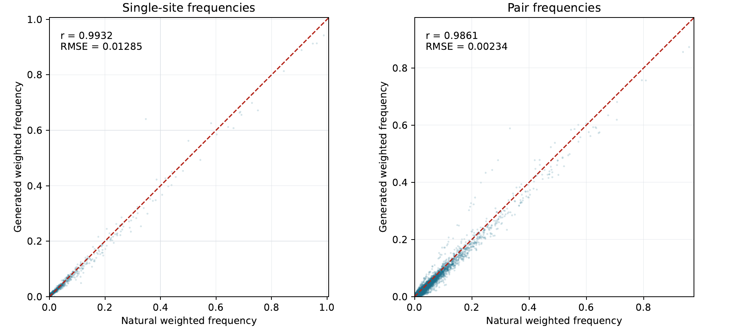
PRELIMINARY RESULTS
Generated samples preserve local sequence statistics
Generation test
One sample per natural sequence at that sequence’s Topt_ave
0.993
0.986
single-frequency r
pair-frequency r
Gap-frequency RMSE = 0.0517, larger than the amino-acid frequency errors.
The model captures local statistics well, but this does not guarantee recovery of global sequence-space structure.
08
Notes:
The comparison uses the same DCA sequence weights for natural and generated ensembles. FeatureDCA's frequency utility excludes the gap state, so gap frequencies were evaluated separately. Source: results/featuredca/jdomain_topt_ave_generation/summary.txt and frequency_scatter.pdf.

Slide 9
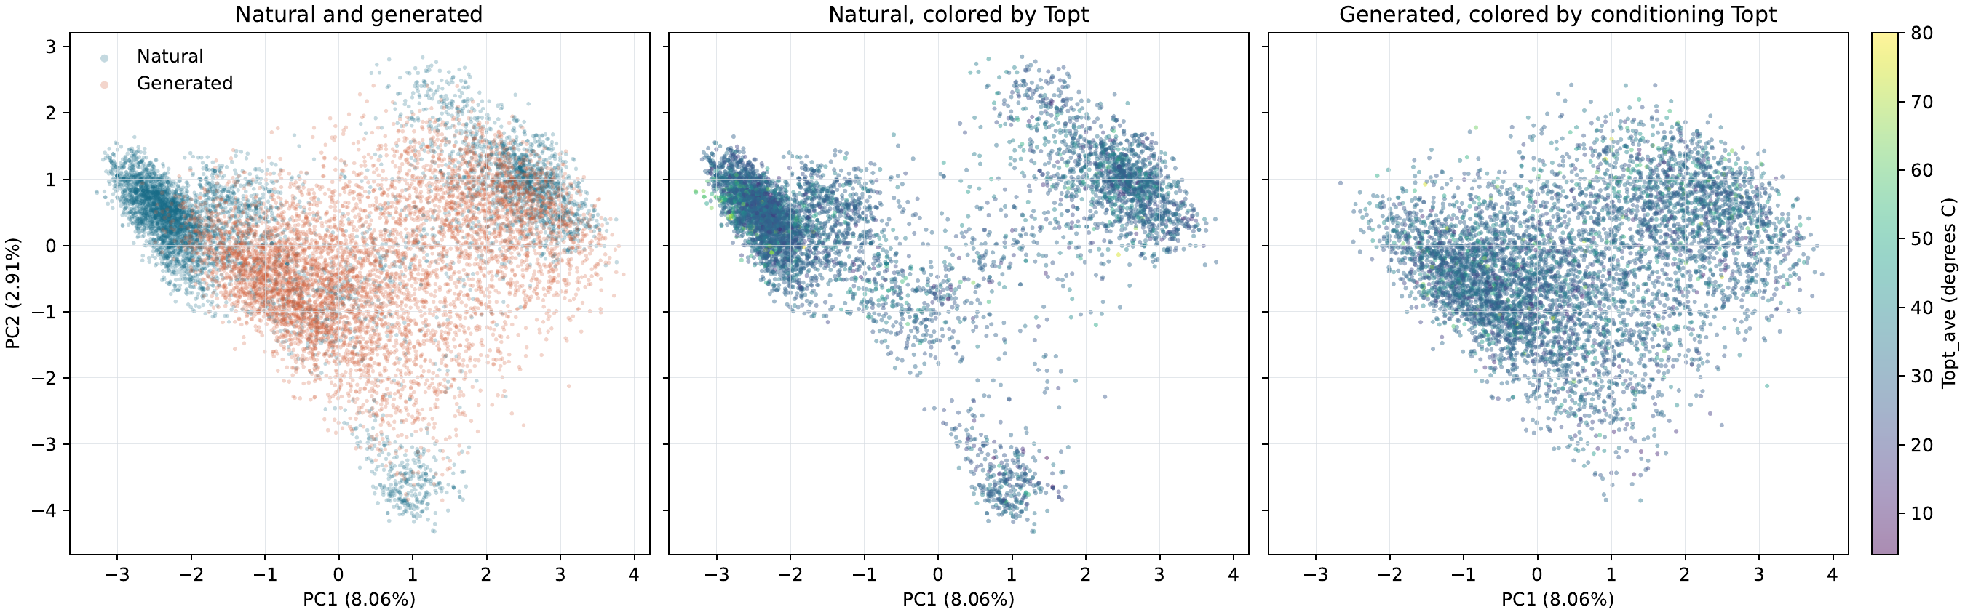
PRELIMINARY RESULTS
Temperature alone does not recover the natural PCA structure
Shared PCA basis
Natural and generated one-hot sequences were fitted together.
Temperature correlation
Natural PC1: −0.057
Natural PC2: 0.048
Generated sequences form a broader, smoother cloud and lose distinct natural subfamily clusters.
09
Notes:
This result suggests that optimal growth temperature is not a sufficient proxy for the leading sequence PCs. Phrase this carefully: weak global linear correlation and failed cluster recovery do not prove independence. Nonlinear or subfamily-specific temperature relationships may remain.

Slide 10
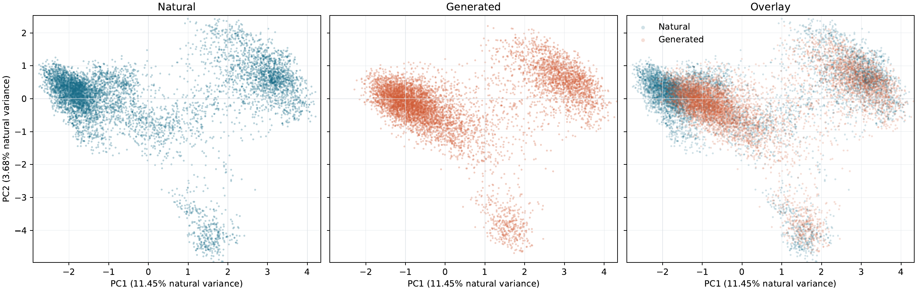
POSITIVE CONTROL
PCA conditioning recovers the major sequence-space clusters
Conditioning vector
y = (PC1, PC2)
Paired recovery
PC1 r = 0.951
PC2 r = 0.915
The same architecture can recover the natural clusters when the conditioning variables specify them.
10
Notes:
PCA was fitted only on the natural one-hot MSA. Generated sequences were projected through that same map. The generated distribution remains slightly shifted and compressed, but the main clusters return. This supports the interpretation that temperature lacks the information carried by PC1 and PC2.

Slide 11
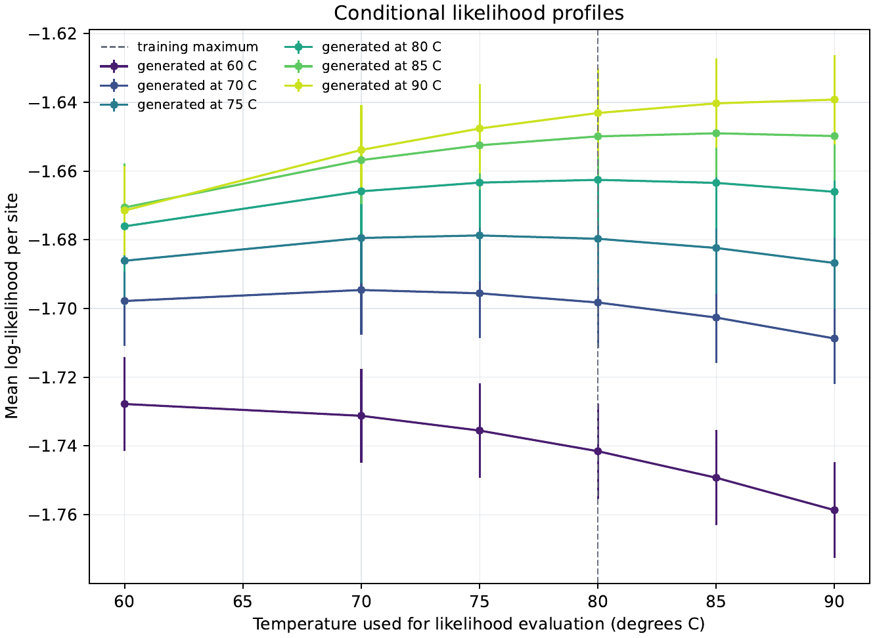
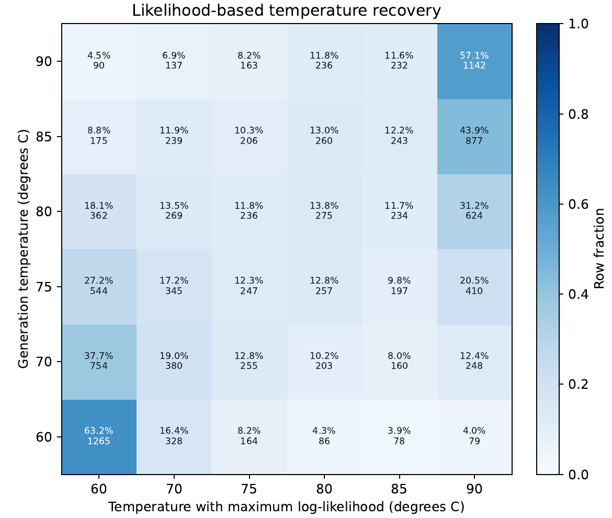
TEMPERATURE LADDER
Likelihood profiles recover the conditioning temperature in expectation
12,000 sequences: 2,000 each at 60, 70, 75, 80, 85, and 90 °C
Every ensemble’s mean log-likelihood peaks at its generation temperature. Individual exact recovery is 29.6%; same or adjacent ladder point is 61.1%.
11
Notes:
Higher log-likelihood means less negative. The interior groups overlap strongly, while 60 and 90 degrees benefit from being grid boundaries. The 85 and 90 degree conditions extrapolate beyond the 80 degree training maximum. Their self-consistency does not establish biological validity.

Slide 12
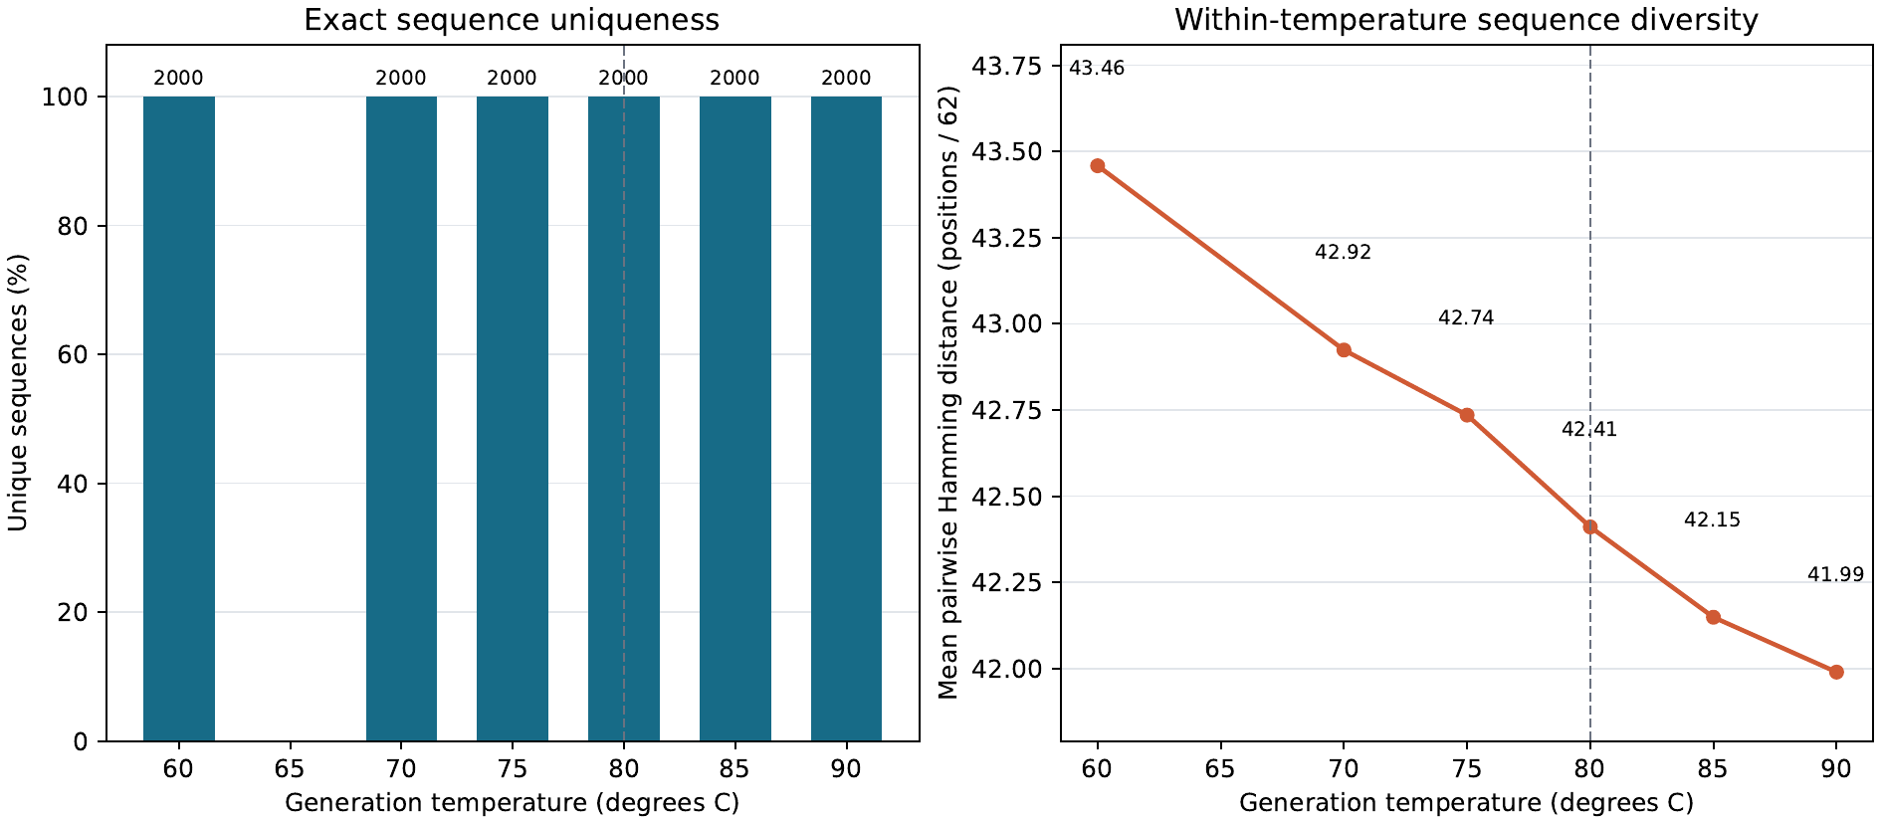
TEMPERATURE LADDER
High-temperature sampling retains substantial sequence diversity
Exact uniqueness
2,000 / 2,000
at every temperature
Mean Hamming distance
43.46 → 41.99
differing positions out of 62
from 60 °C to 90 °C
Diversity contracts gradually with temperature, including above the training maximum, but there is no duplicate-driven collapse.
Hamming distance includes gaps and all unordered sequence pairs. Duplicate samples would contribute zero distance.
12
Notes:
All generated sequences were distinct within each 2,000-sequence ensemble. Mean pairwise Hamming distance includes all 62 aligned positions, including gaps. It decreases from 0.701 to 0.677 as a fraction of alignment length. The trend indicates modest concentration, not mode collapse.

Slide 13
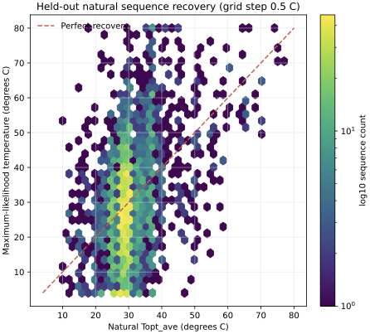
HELD-OUT VALIDATION
Natural sequences provide a harder temperature-recovery test
Organism-separated split
Train
11,942 sequences | 3,863 organisms
Test
3,002 sequences | 992 organisms
0.385
0.312
11.93 °C
Pearson
Spearman
MAE
Each sequence was evaluated from 4 to 80 °C in 0.5 °C steps. The maximum log-likelihood defines the inferred temperature.
Natural recovery is much weaker than generated-sequence self-recovery.
13
Notes:
The split used ten temperature quantiles and kept each taxonomy ID entirely in train or test. Temperature standardization and sequence weights came from the training fold only. Pearson and Spearman compare the natural continuous Topt_ave with the likelihood-grid argmax.

Slide 14
SENSITIVITY ANALYSIS
Coarser bins and more training data do not reduce the error
Grid
Split
Correct grid point
Pearson
Spearman
MAE
RMSE
0.5 °C
80 / 20
1.4%
0.385
0.312
11.93 °C
14.90 °C
10 °C
80 / 20
24.9%
0.377
0.304
11.77 °C
14.70 °C
10 °C
90 / 10
25.0%
0.363
0.289
11.85 °C
14.89 °C
10 °C
95 / 5
25.3%
0.378
0.319
12.11 °C
15.29 °C
The 10 °C grid raises exact bucket accuracy because the target has only eight classes. Correlation and absolute error remain nearly unchanged.
14
Notes:
For Pearson, Spearman, MAE, and RMSE, inferred grid temperatures were compared with the actual continuous Topt_ave. Only correct-grid-point accuracy used the nearest grid value as the target. Increasing the training fraction reduced test-set size without improving recovery.

Slide 15
ORGANISM-LEVEL ANALYSIS
Combining homolog evidence improves organism-level recovery
For organism o with M homologs
ℓ̄ₒ(T) = (1 / Mₒ) Σₘ log P(sₒ,ₘ | T) and T̂ₒ = arg maxₜ ℓ̄ₒ(T)
Individual sequences
Organism profiles
0.385
Pearson
0.534
0.312
Spearman
0.460
11.93 °C
MAE
9.11 °C
992 independent organism units
Pearson and Spearman permutation p < 10⁻⁴
15
Notes:
At every candidate temperature, the log-likelihoods of all homologs from one organism were averaged. Maximizing the average gives the same argmax as maximizing their summed log-likelihood. Bootstrap 95 percent intervals: Pearson 0.478 to 0.586, Spearman 0.404 to 0.512, MAE 8.63 to 9.59 degrees C. Organisms, not homologs, served as independent units for inference.

Slide 16
HIGH-TEMPERATURE ANALYSIS
Likelihood profiles identify high-temperature organisms
Held-out organism classification: Topt_ave ≥ 40 °C
0.834
76.8%
73.7%
79.9%
AUROC
balanced accuracy
sensitivity
specificity
High-temperature subset
Class imbalance changes the metric
95 of 992 organisms | 9.6% prevalence
A constant 31.43 °C prediction has overall MAE 5.47 °C, but high-temperature MAE 19.81 °C.
Pearson 0.494 Spearman 0.465
FeatureDCA lowers high-temperature MAE to 11.09 °C. Precision remains 28.0% because high-temperature organisms are rare.
MAE 11.09 °C bias −1.36 °C
AUROC permutation p < 10⁻⁴ | bootstrap 95% CI: 0.788–0.876
16
Notes:
The classification score compares the best high-temperature log-likelihood with the best lower-temperature log-likelihood. Counts: TP 70, TN 717, FP 180, FN 25. High-temperature recovery remained significant within the restricted range: Pearson and Spearman permutation p values were below 1e-4. This was an exploratory threshold analysis on a reused test set and should be confirmed on a fresh split.

Slide 17
CONCLUSIONS
Current interpretation and next experiments
What the results support
What remains unresolved
The filtered MSA provides broad organism coverage with explicit temperature metadata.
Whether generated high-temperature sequences are biologically stable or functional.
Temperature-conditioned FeatureDCA reproduces weighted single and pair frequencies.
How much of the held-out temperature signal reflects phylogeny or J-domain subclass.
Temperature does not specify the dominant PCA structure of J-domain sequences.
Whether a combined temperature plus PCA model can preserve lineage structure during design.
Organism-level likelihood profiles rank high-temperature organisms with AUROC 0.834.
Proposed next step
Repeat organism-level validation across splits, then prioritize generated sequences by high-temperature likelihood evidence.
17
Notes:
Close by separating precise temperature regression from ranking. Natural held-out recovery is modest at sequence level, but homolog aggregation and the high-temperature AUROC support likelihood-based prioritization. Next work should repeat organism-level validation across seeds, control explicitly for phylogeny and subclass, and then assess selected candidates structurally or experimentally.

