Slide 1
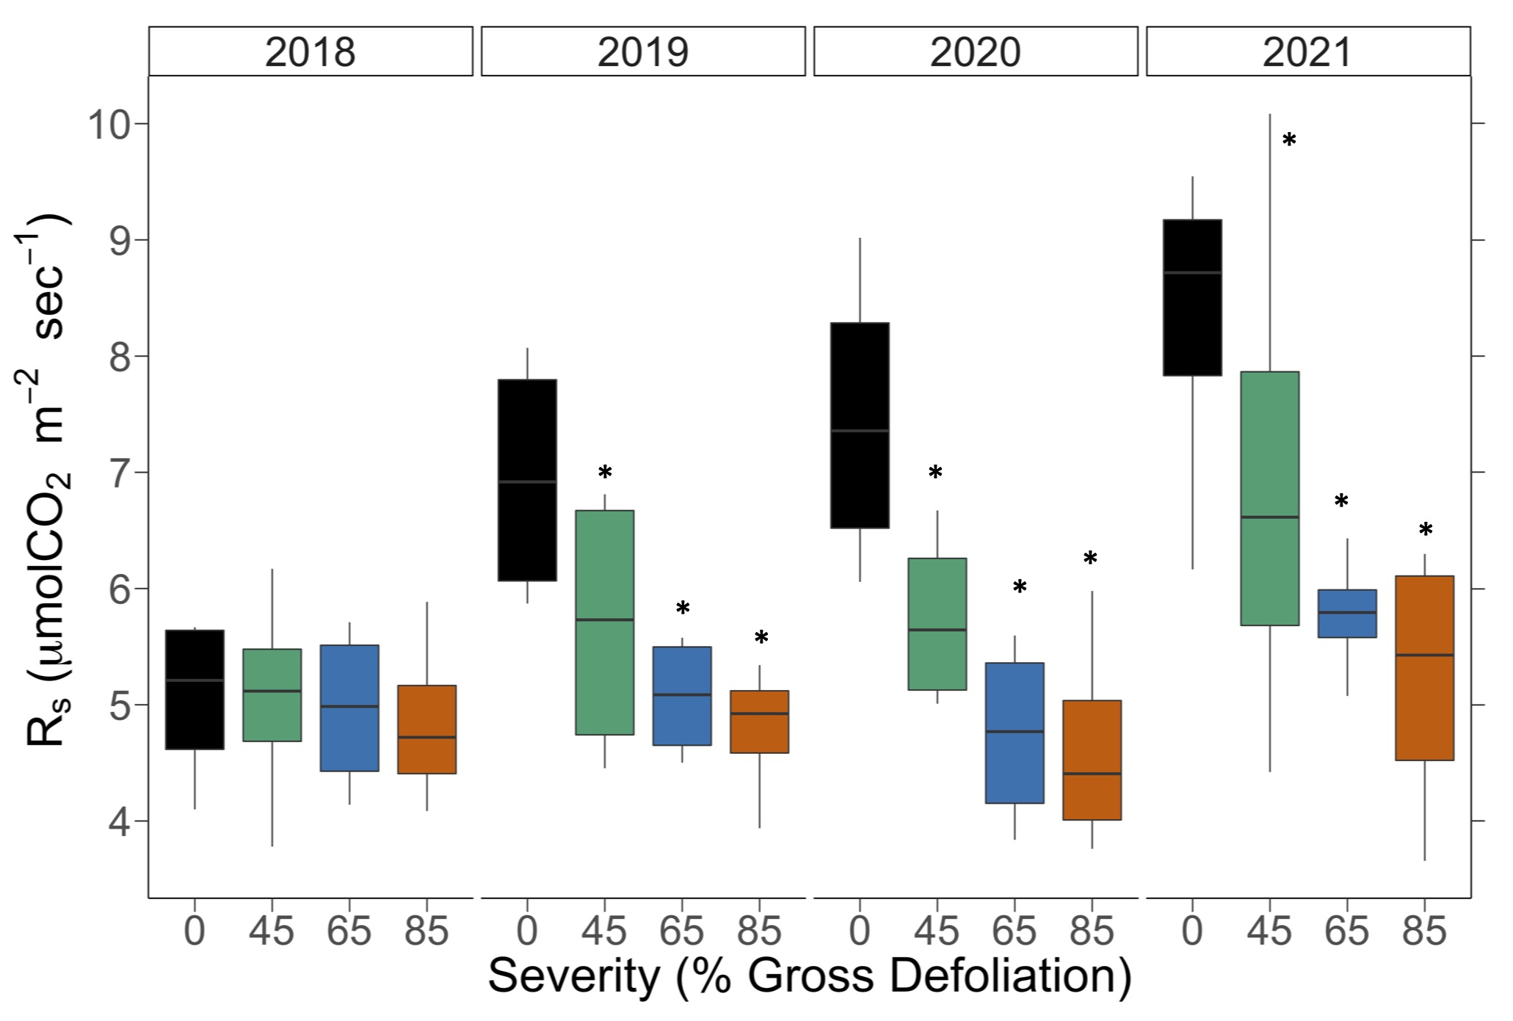
Soil respiration & disturbance severity
DRY
*p < 0.05
$$Y_{ijk}= μ+{Rep}_{i}+ {Year}_{j}+ {Severity}_{k|i}+Year∗{Sev}_{jk|i} [+ ε_{ijk}]$$

Slide 2
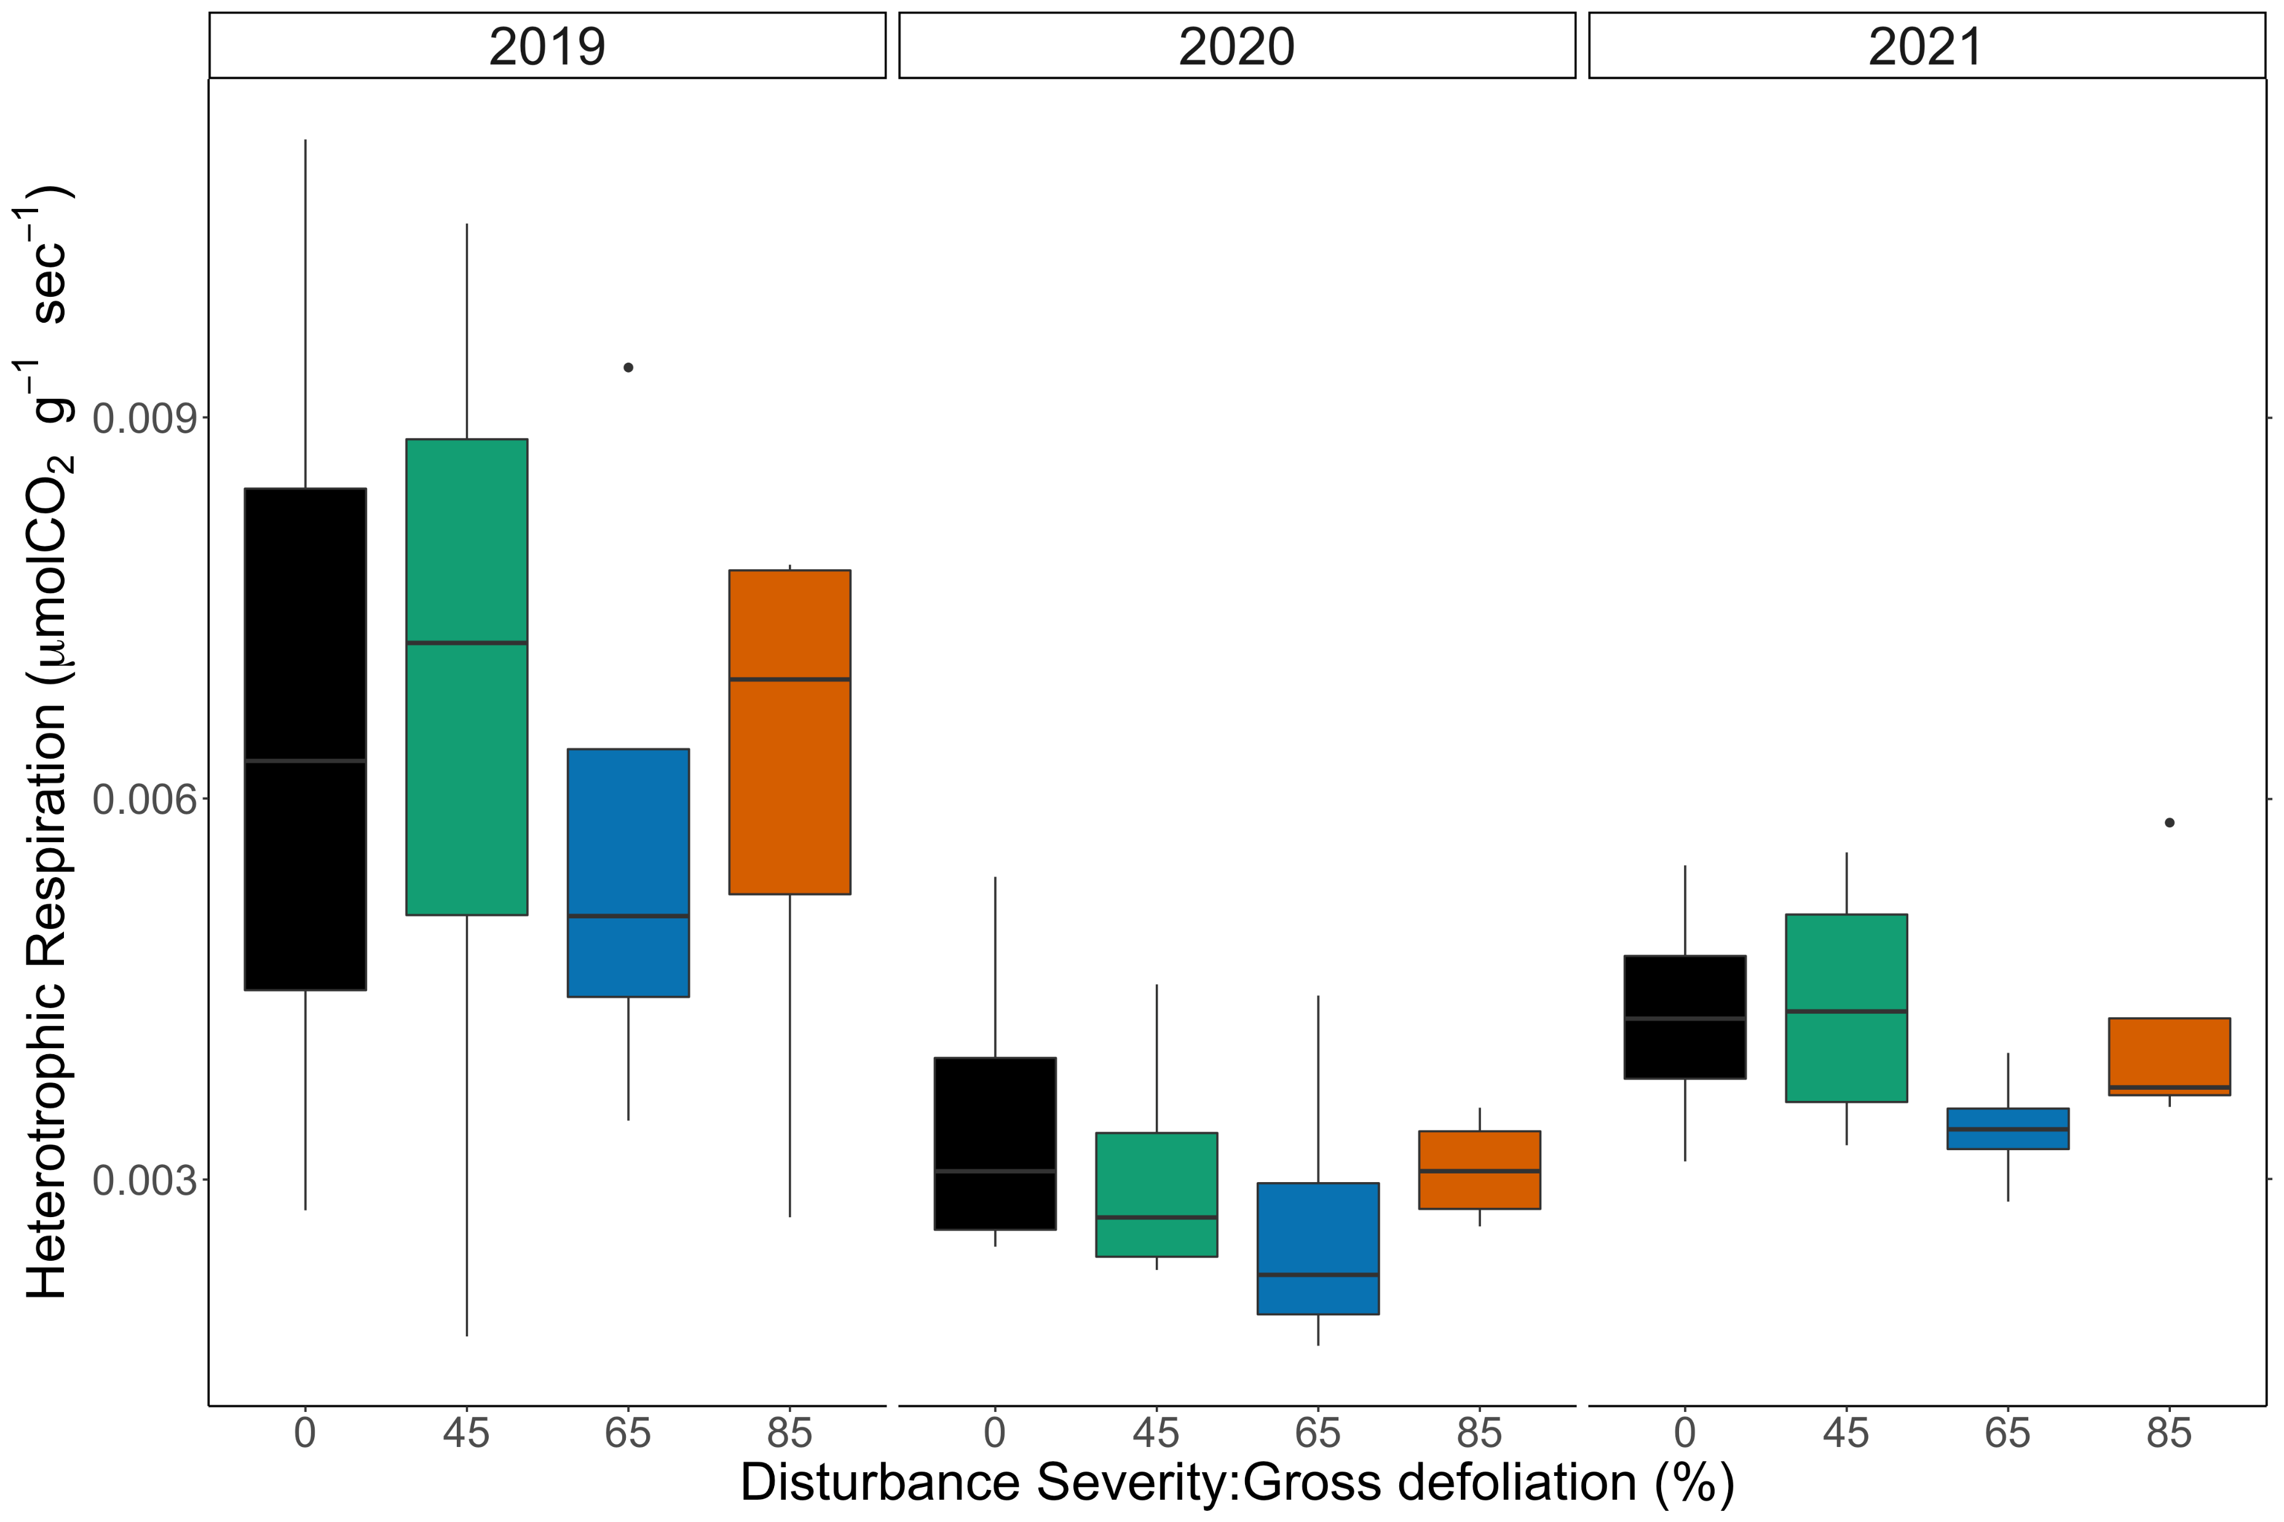
Heterotrophic Respiration & Disturbance severity
$${log⁡(Y}_{ijk})= μ+{Rep}_{i}+ {Year}_{j}+ {Severity}_{k|i}+Year∗{Sev}_{jk|i} [+ ε_{ijk}]$$

Slide 3
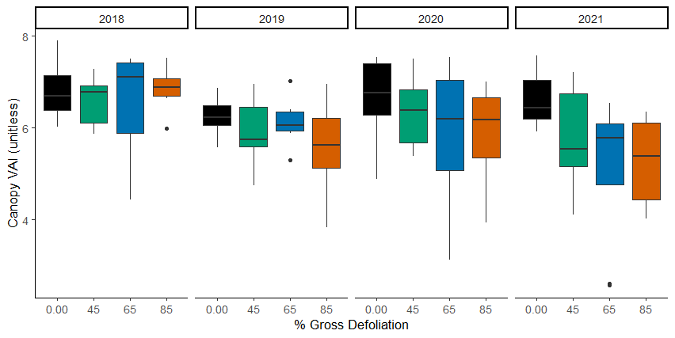

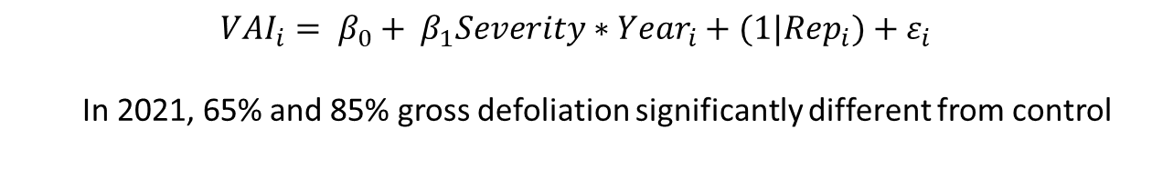
Canopy vegetative area index
*
**
* p < 0.05, ** p < 0.01
$${VAI}_{i}= β_{0}+ β_{1}{Severity∗Year}_{i}+{(1|Rep}_{i})+{ ε}_{i}$$
In 2021, 65% and 85% gross defoliation significantly different from control

Slide 4
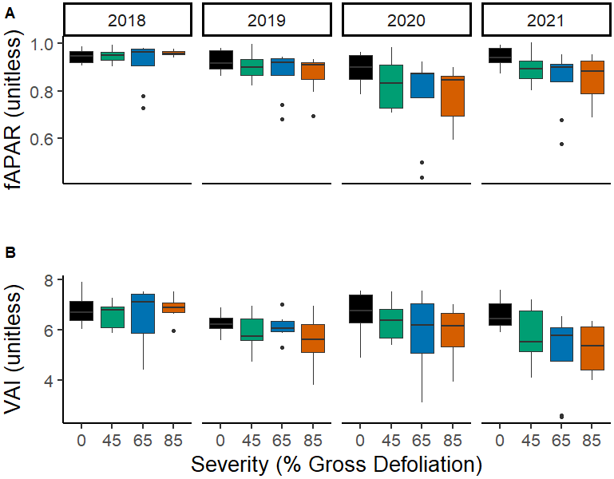
*
**
* p < 0.05
** p < 0.01
*
**

Slide 5
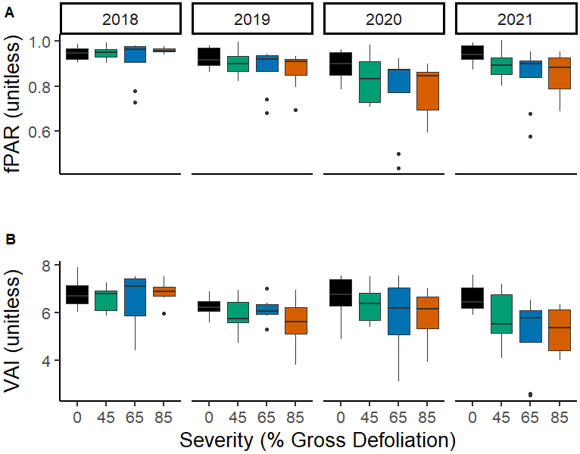
*
**
* p < 0.05
** p < 0.01
*
**

Slide 6
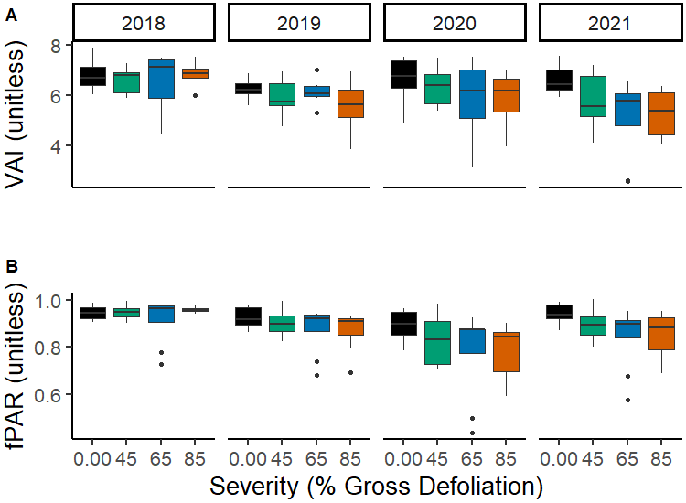
*
**
* p < 0.05
** p < 0.01
*
**

Slide 7
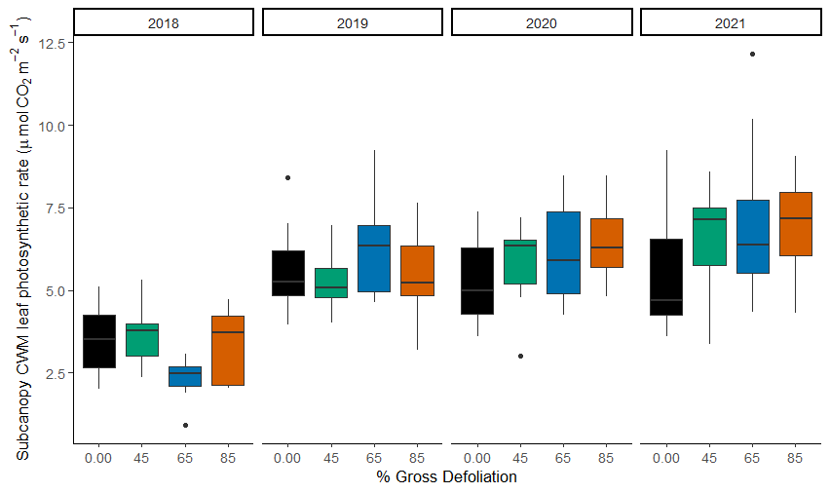
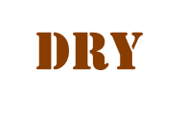
Subcanopy A_{sat}
*
*
*
* p < 0.05
$$Y_{ijk}= μ+{Rep}_{i}+ {Year}_{j}+ {Severity}_{k|i}+Year∗{Sev}_{jk|i} [+ ε_{ijk}]$$

Slide 8
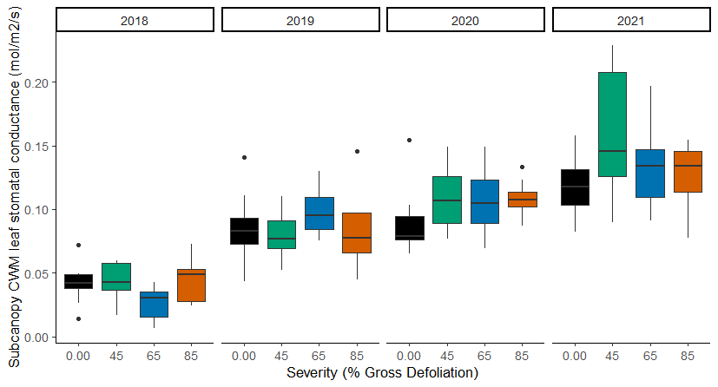
Subcanopy g_{s}
*
* p < 0.1

Slide 9
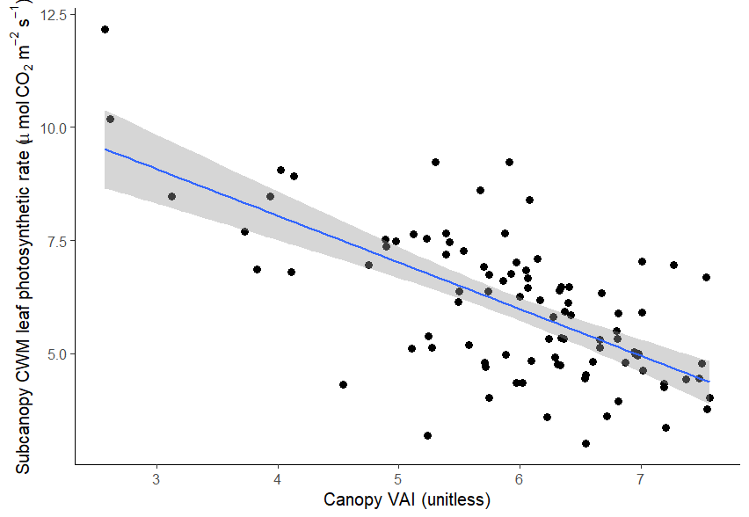
Following disturbance, canopy VAI predicts subcanopy A_{sat}
Higher disturbance drives lost canopy VAI over time
y = -1.03x + 12.16
p < 0.001

Slide 10
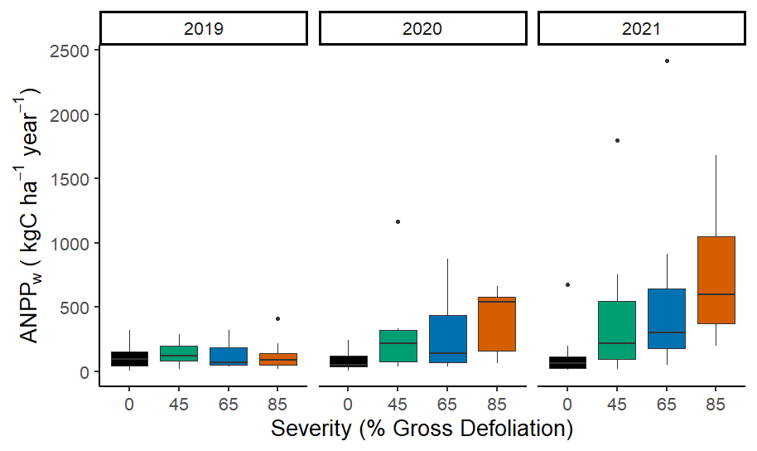
Subcanopy NPP
Neidermaier et al. in prep
Session B45P-04
*
*
*
*
*
*
* p < 0.05
$${log⁡(Y}_{ijk})= μ+{Rep}_{i}+ {Year}_{j}+ {Severity}_{k|i}+Year∗{Sev}_{jk|i} [+ ε_{ijk}]$$

Slide 11
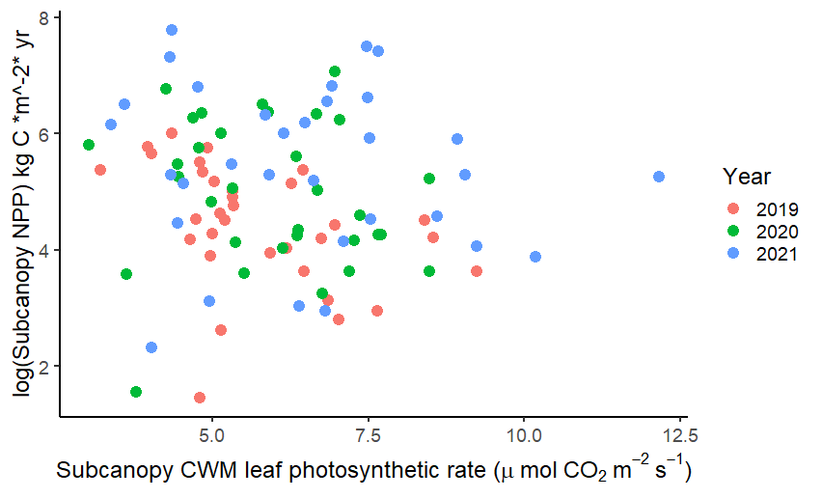
Subcanopy NPP is not well predicted by subcanopy A_{sat} alone

Slide 12
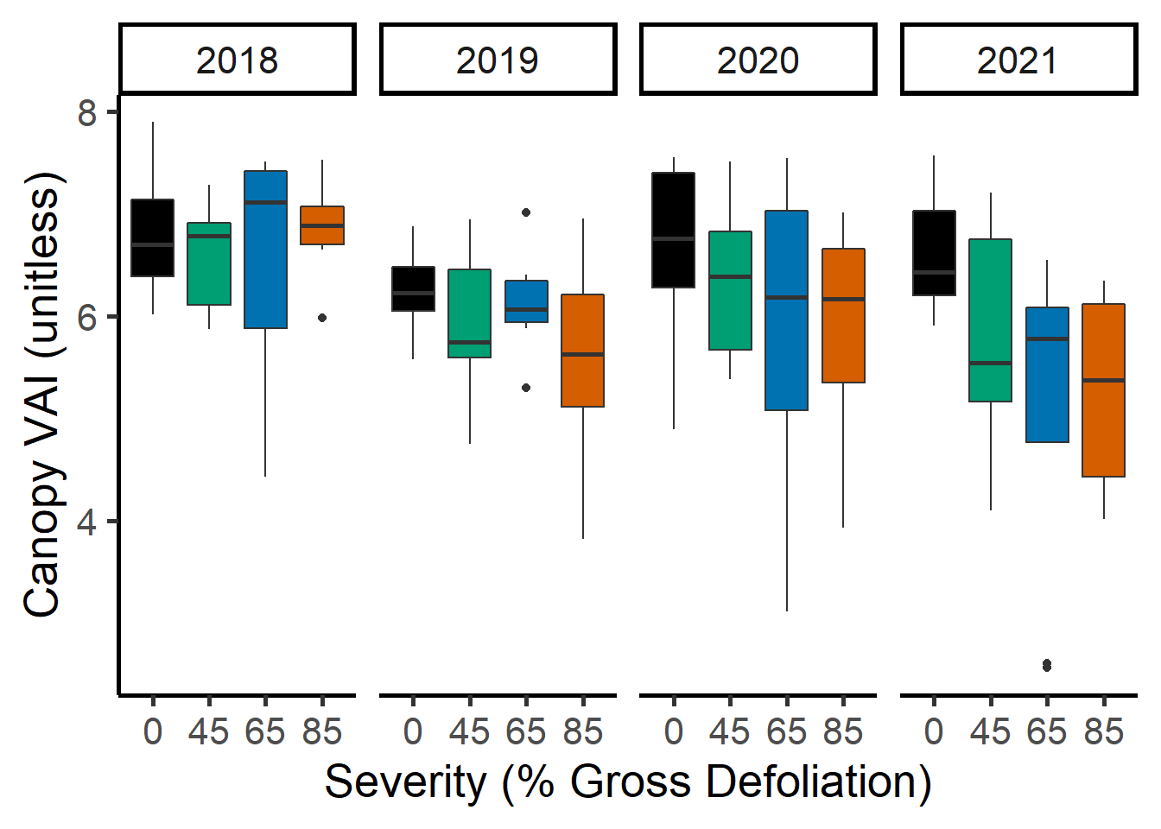
*
**

Slide 13
*
**
* p < 0.05
** p < 0.01

Slide 14
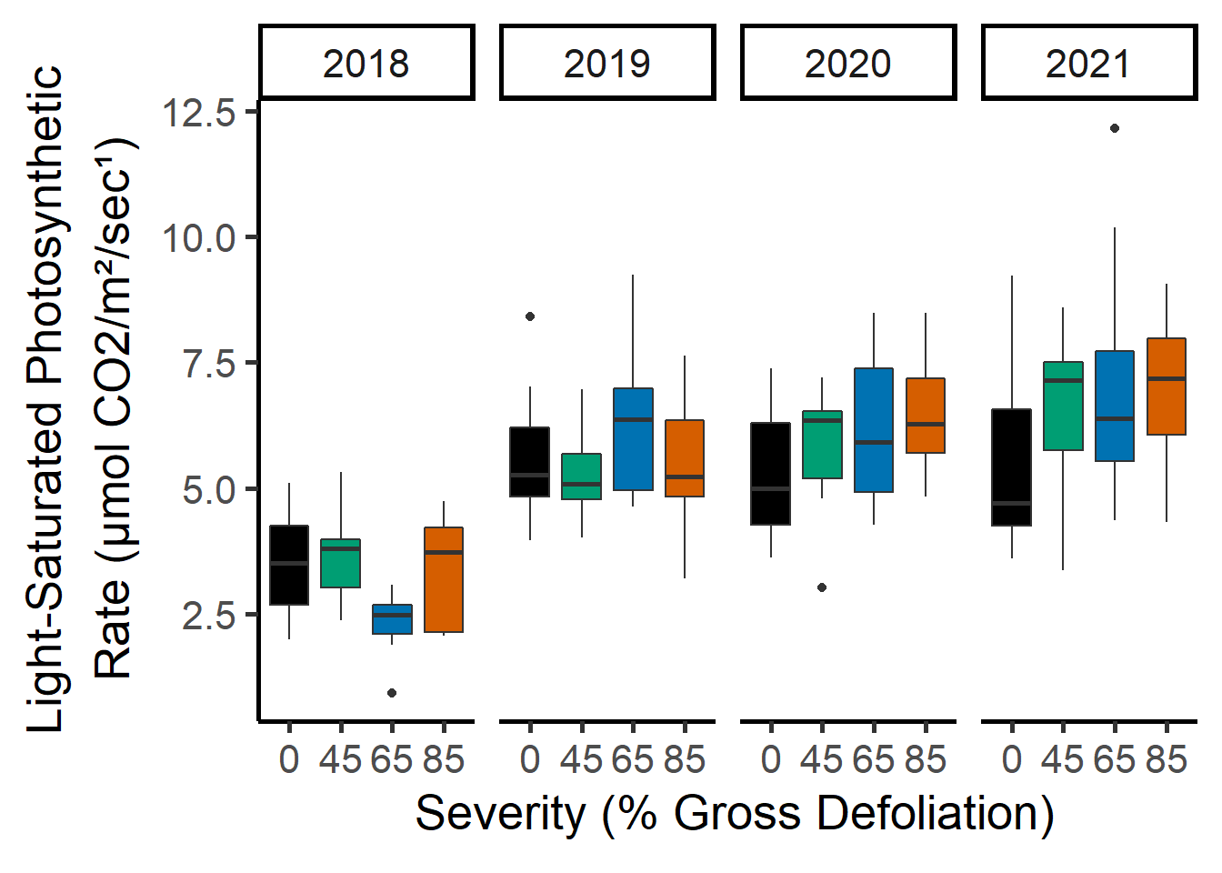
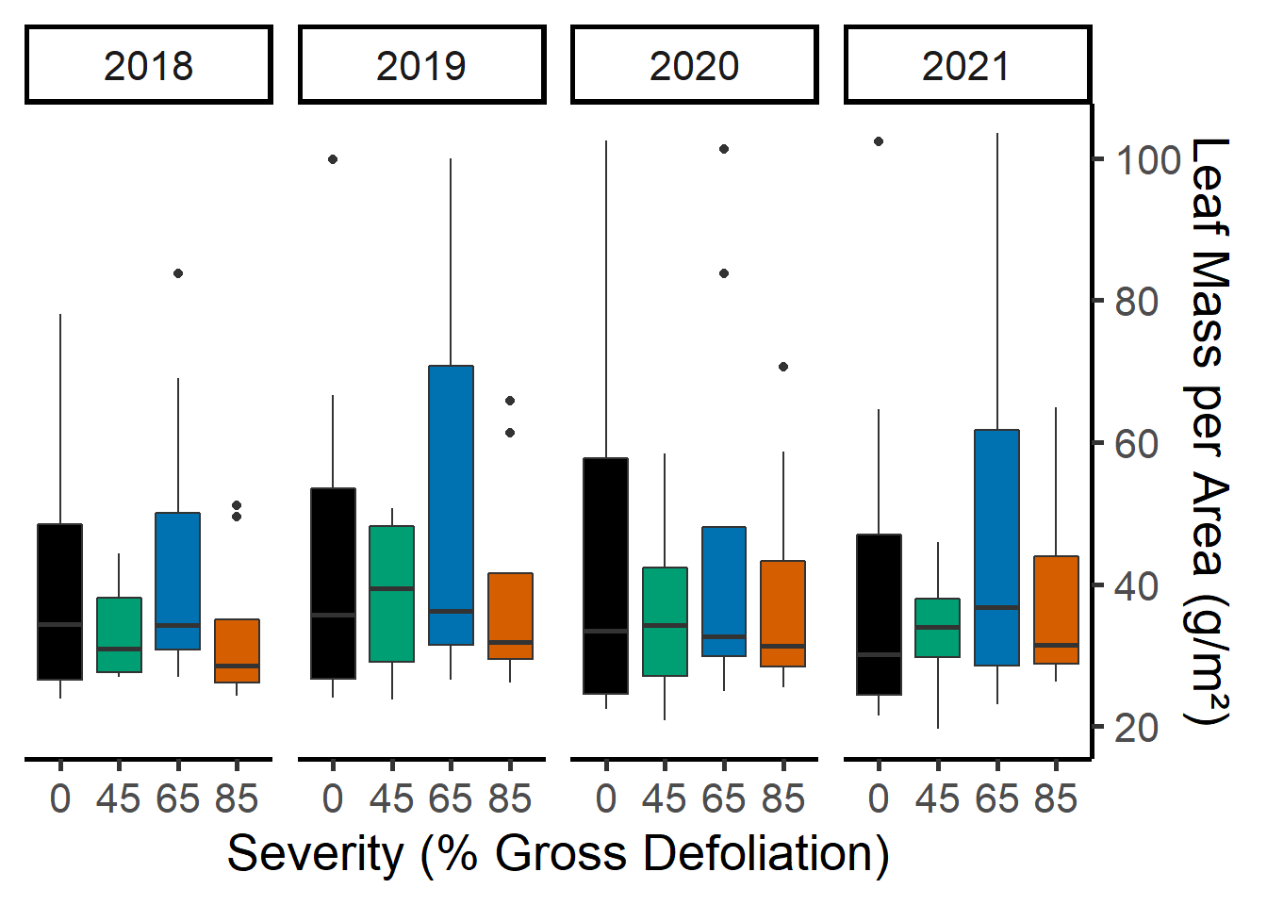
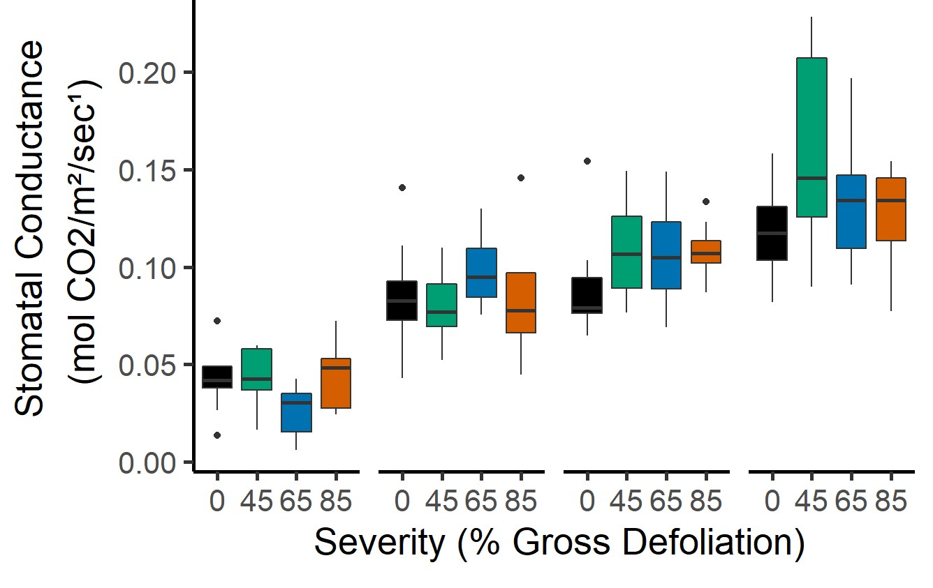
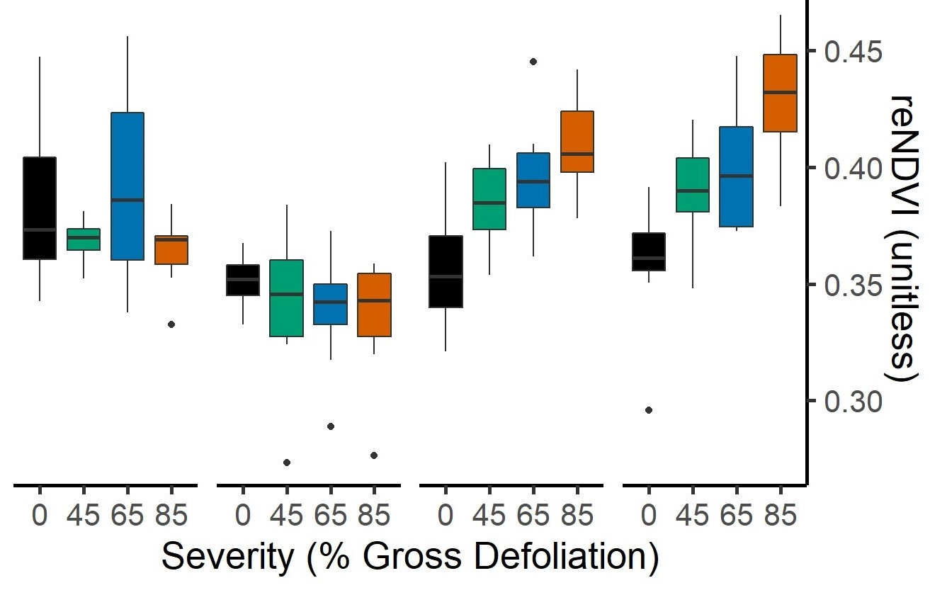

Slide 15
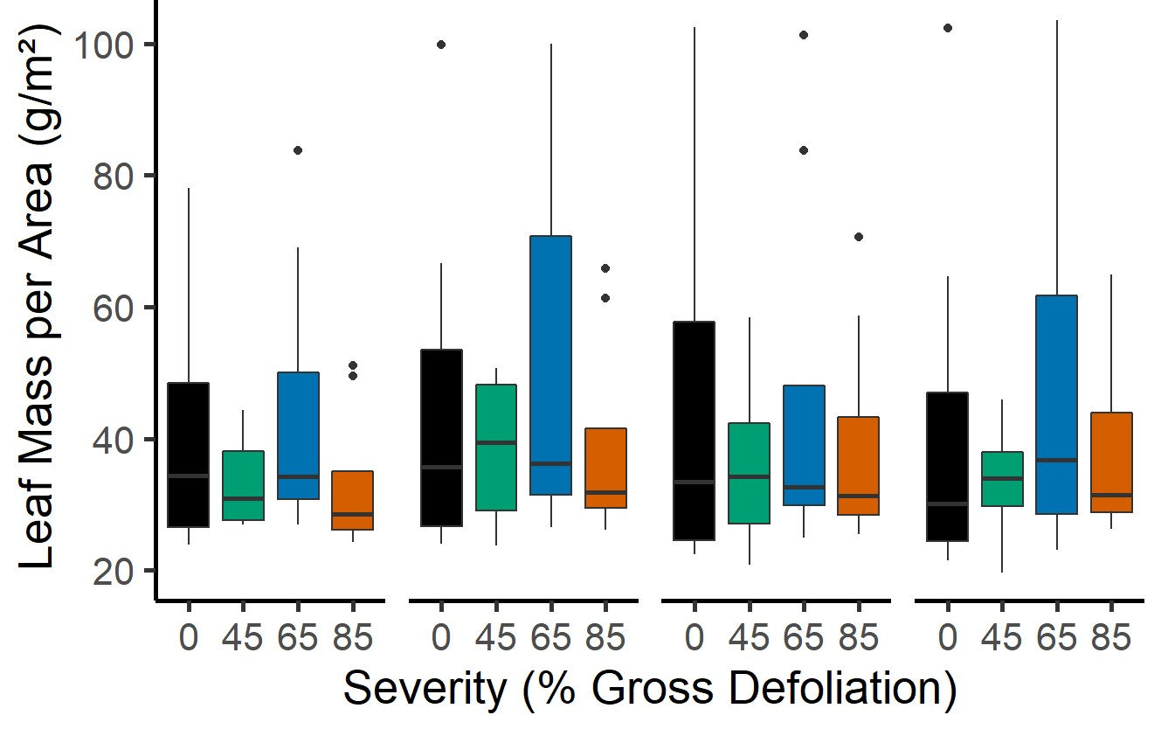
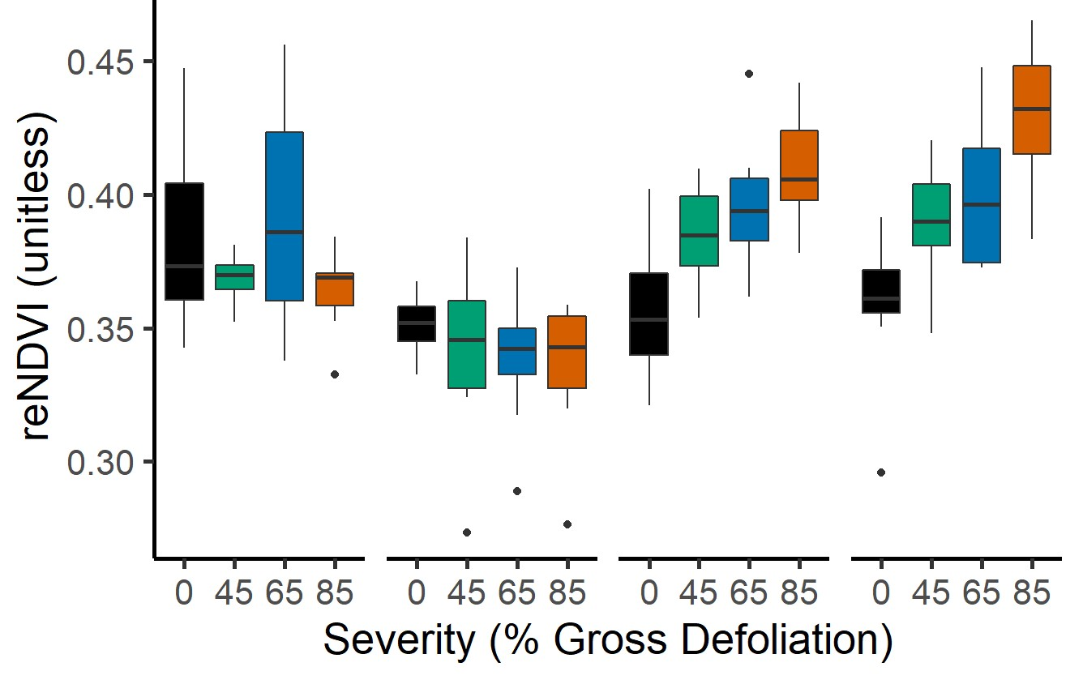
A
*
*
*
* p < 0.05
B
*
C
D
*
*
*
*
*
*
*

Slide 16
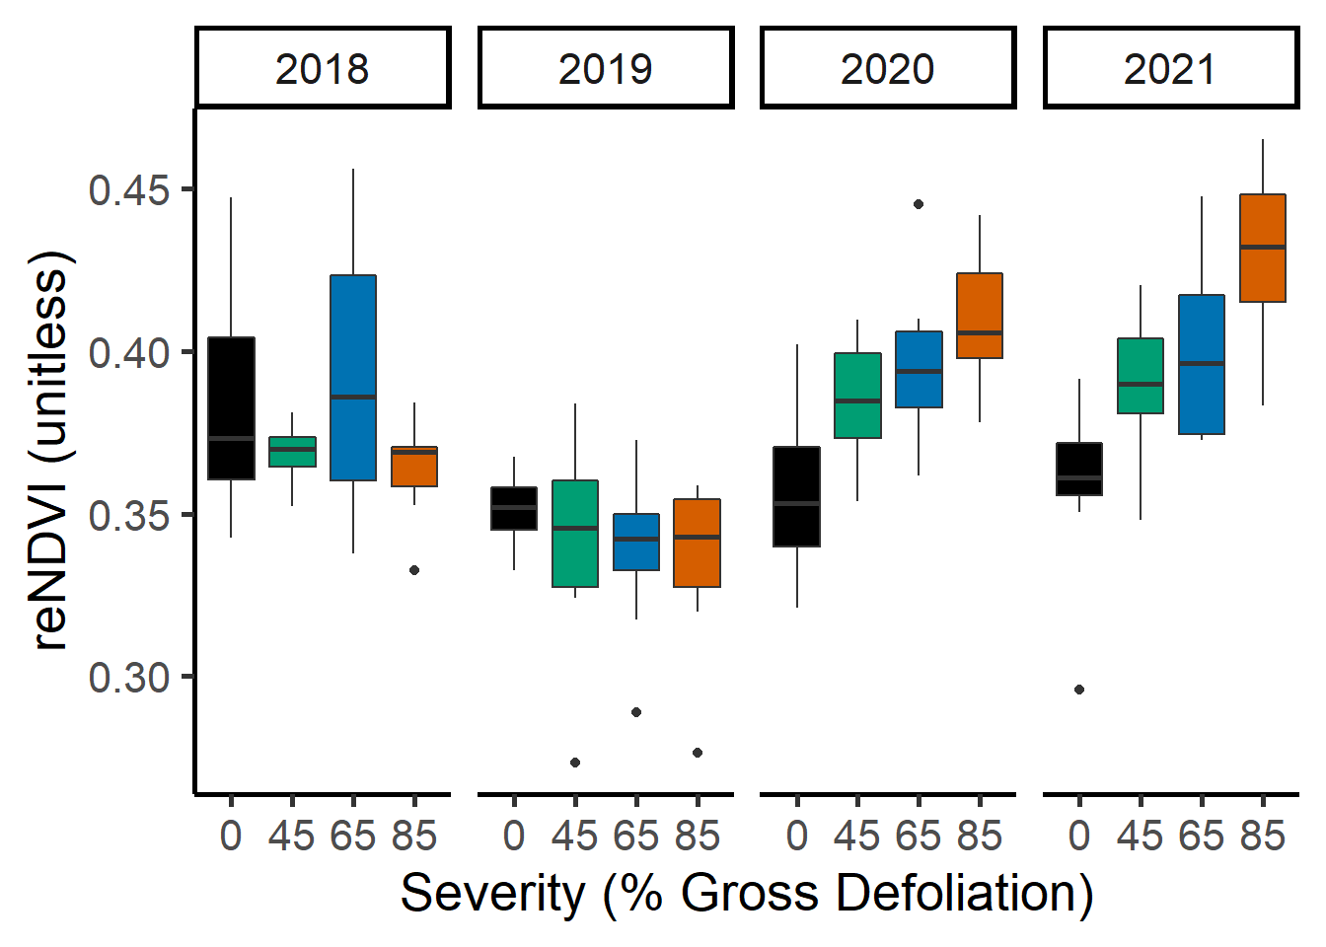
p < 0.05
*
*
*
*
*
*

Slide 17
p < 0.05
*
*
*

Slide 18
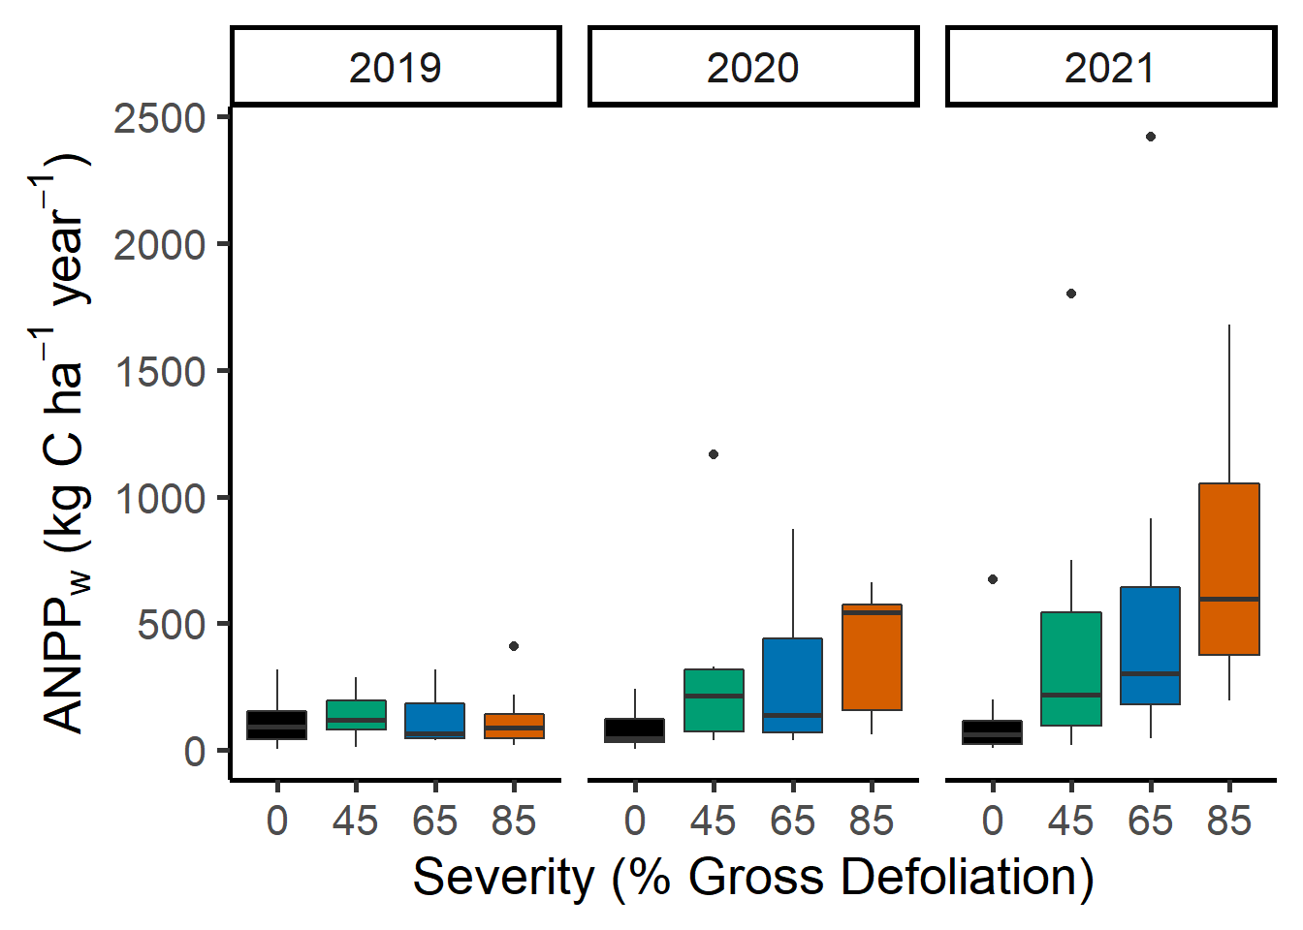
* p < 0.001
*
*
*
*
*
*

Slide 19
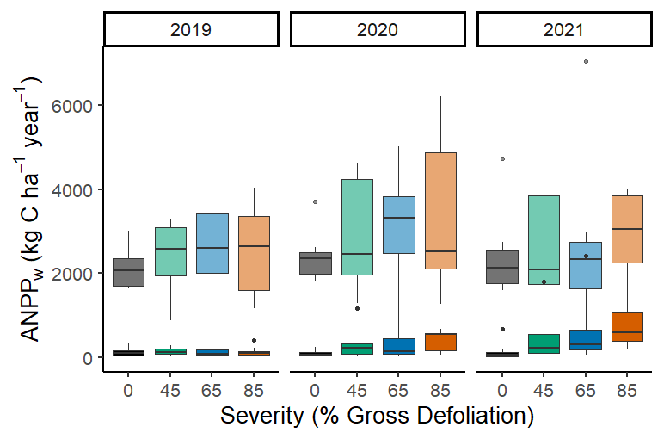
* p < 0.001
*
*
*
*
*
*

Slide 20
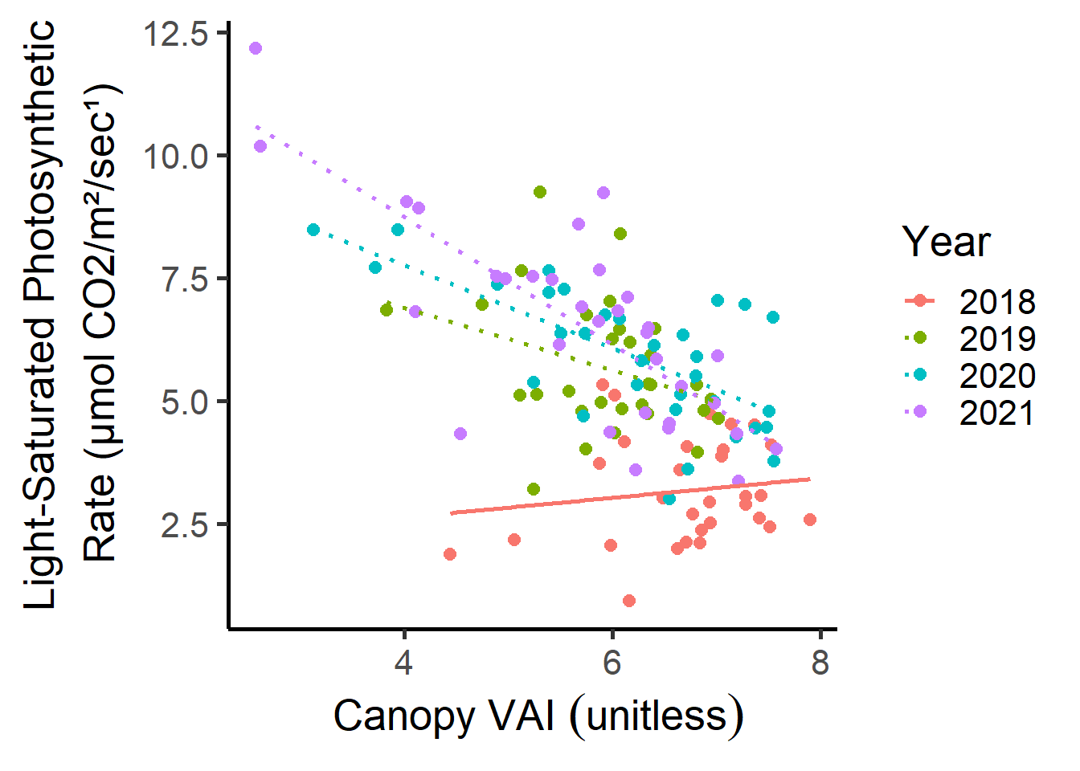
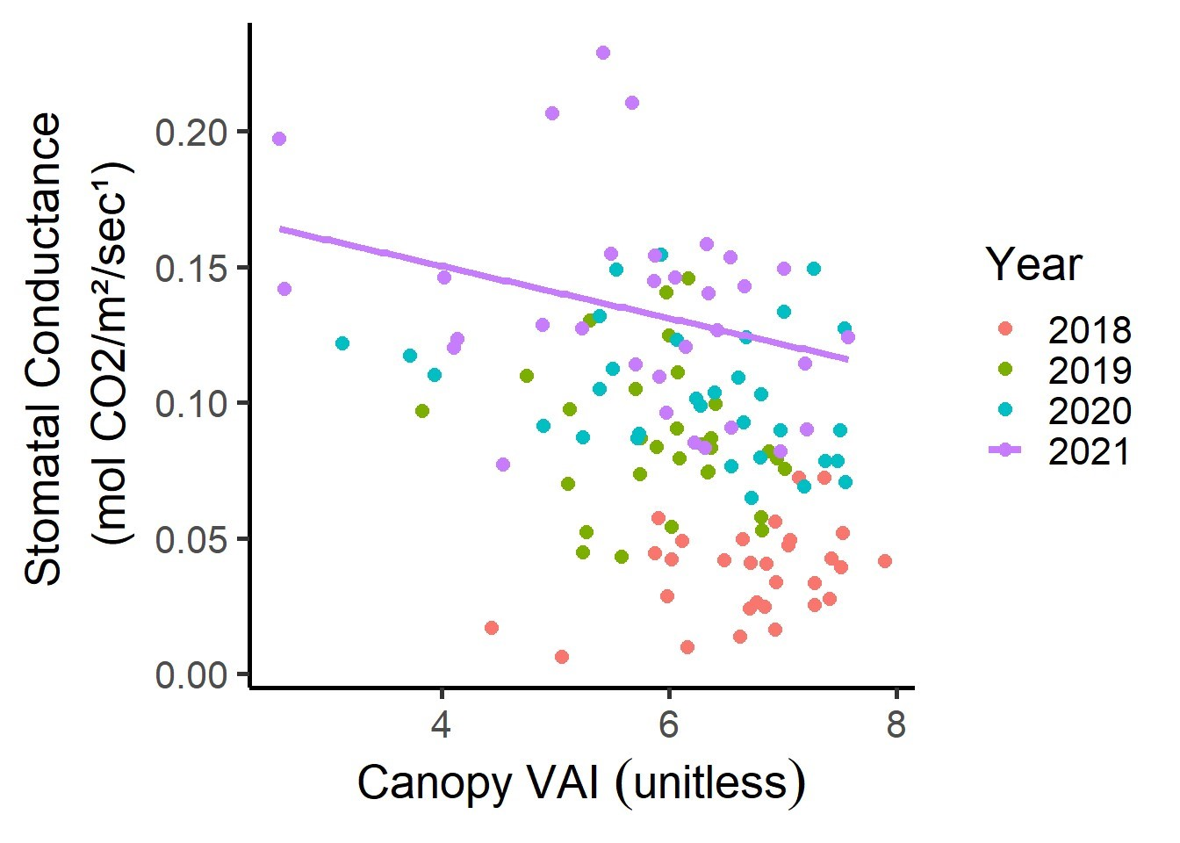
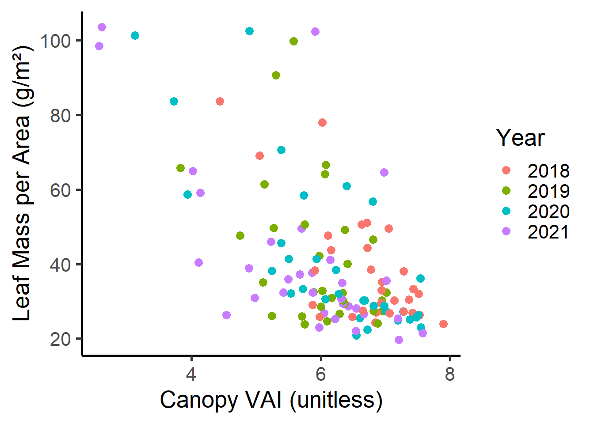
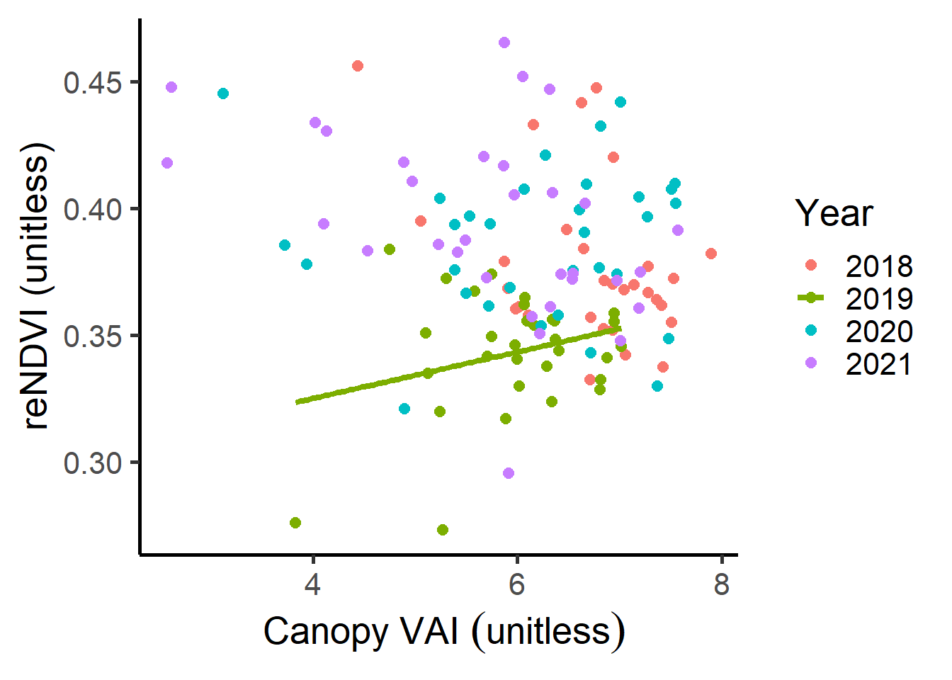

Slide 21
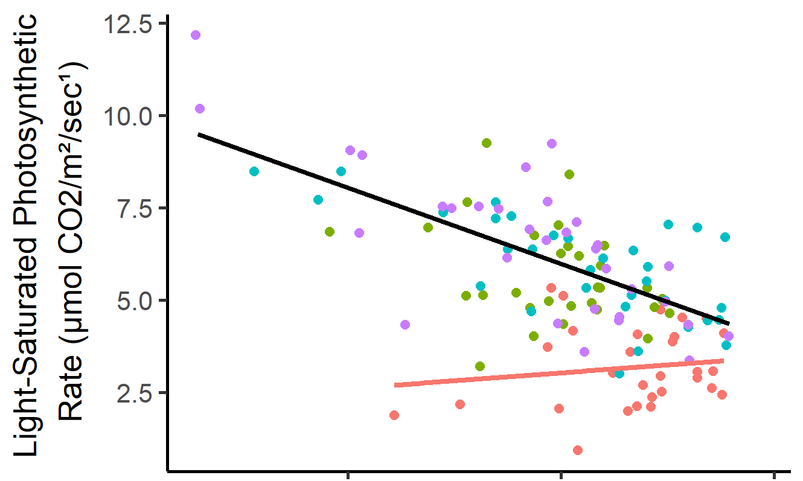
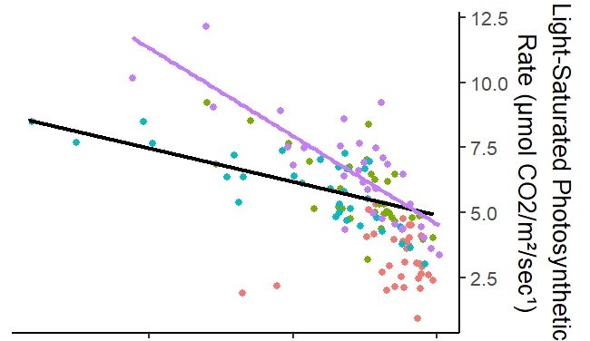
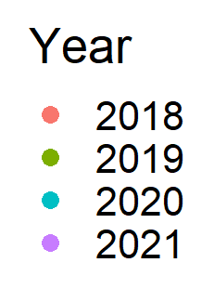
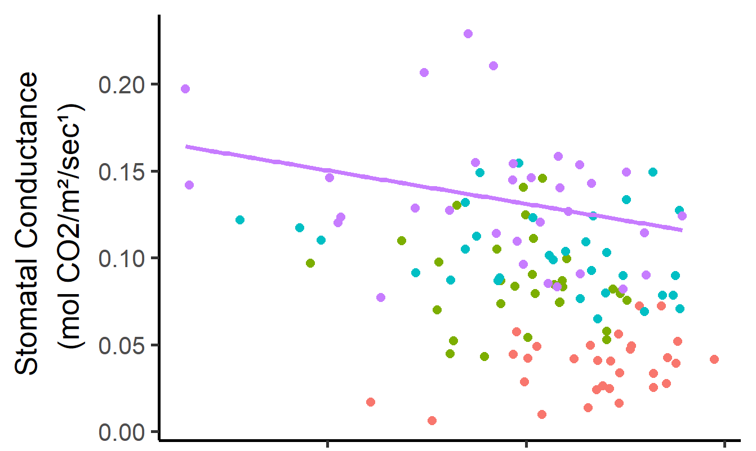
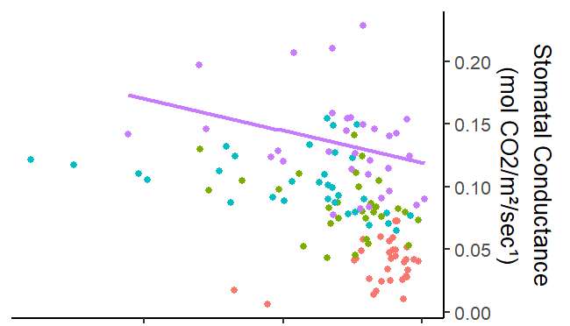
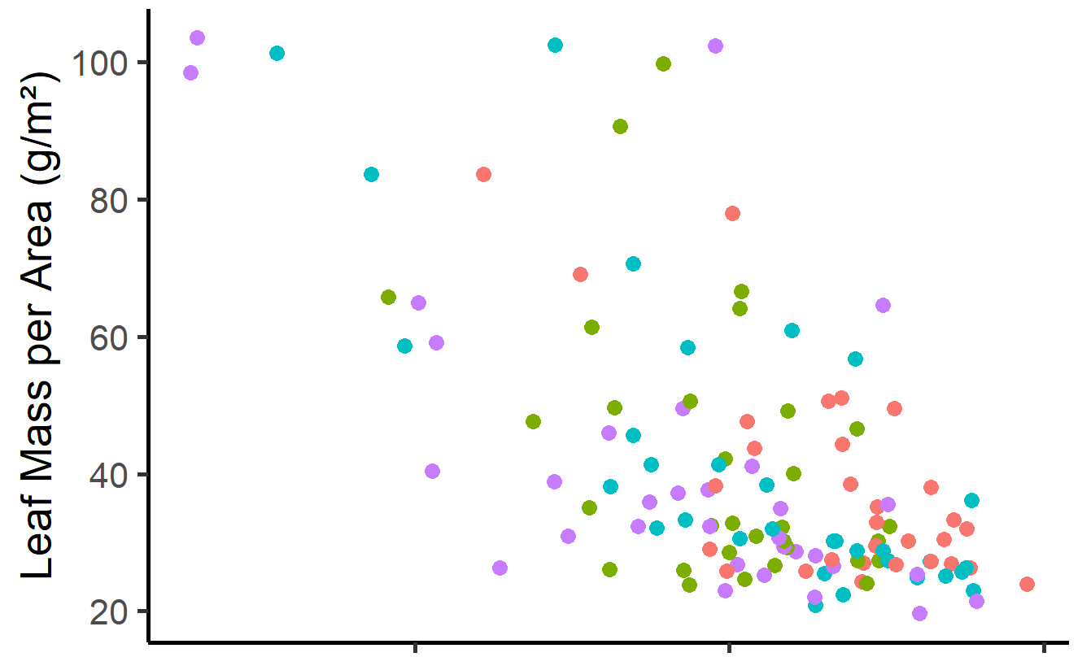
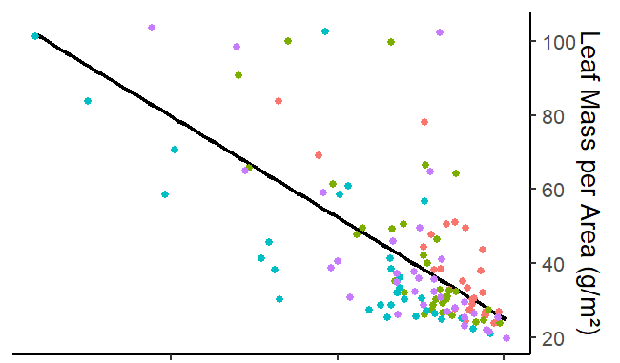
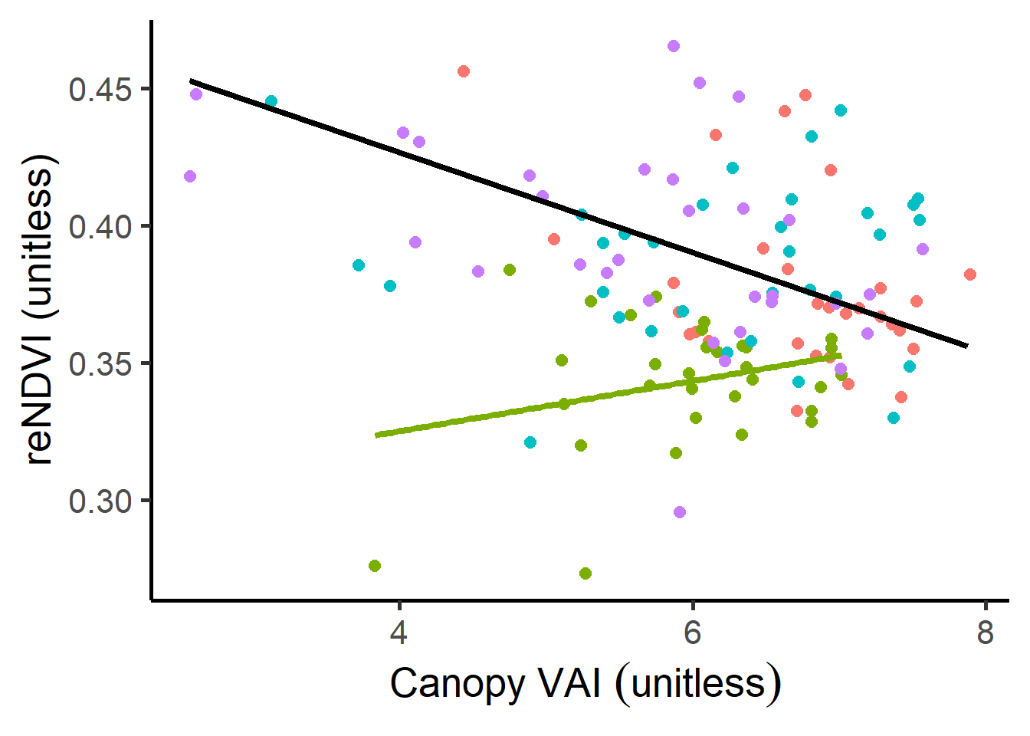
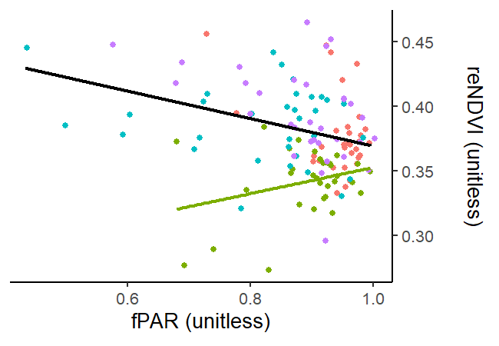
A
E
B
F
C
G
D
H

Slide 22
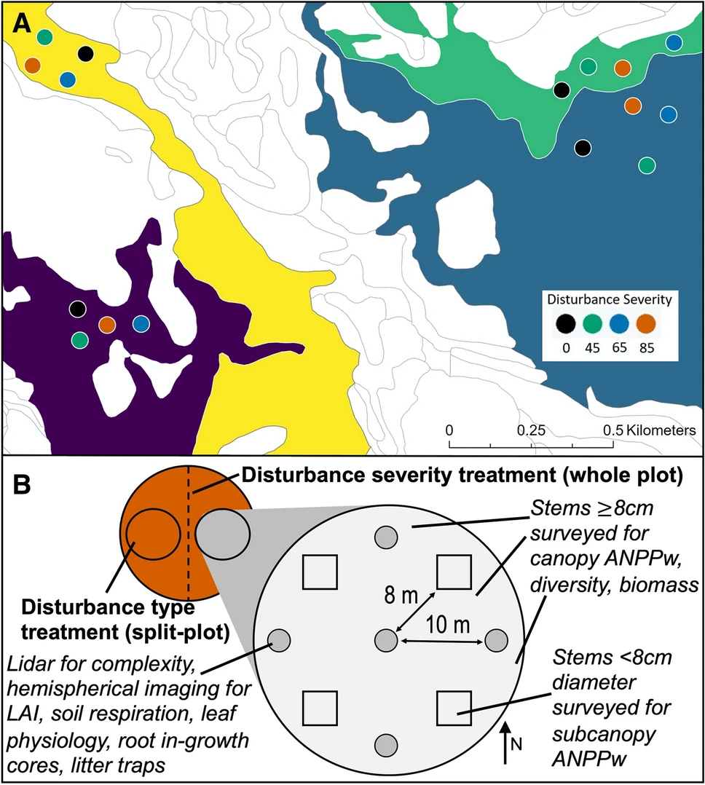

Slide 23
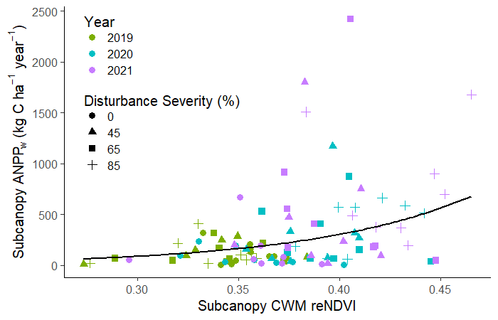

Slide 24
