Slide 1
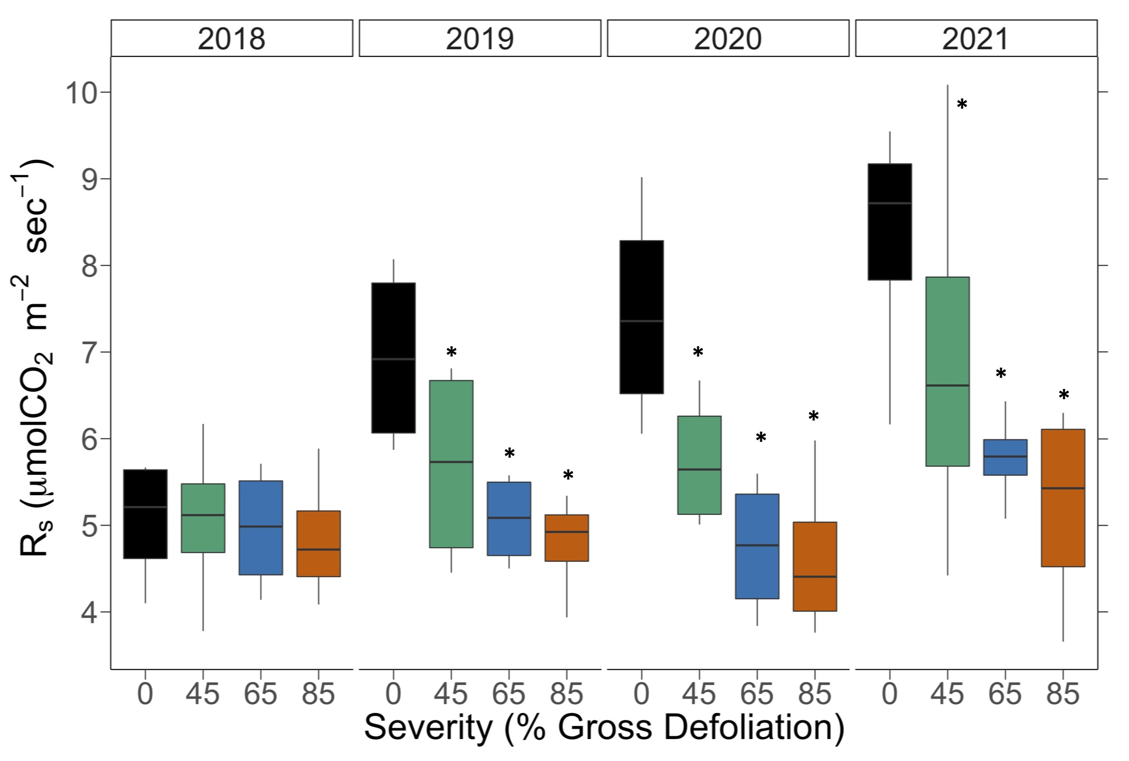
Soil respiration & disturbance severity
DRY
*p < 0.05
$$Y_{ijk}= μ+{Rep}_{i}+ {Year}_{j}+ {Severity}_{k|i}+Year∗{Sev}_{jk|i} [+ ε_{ijk}]$$

Slide 2
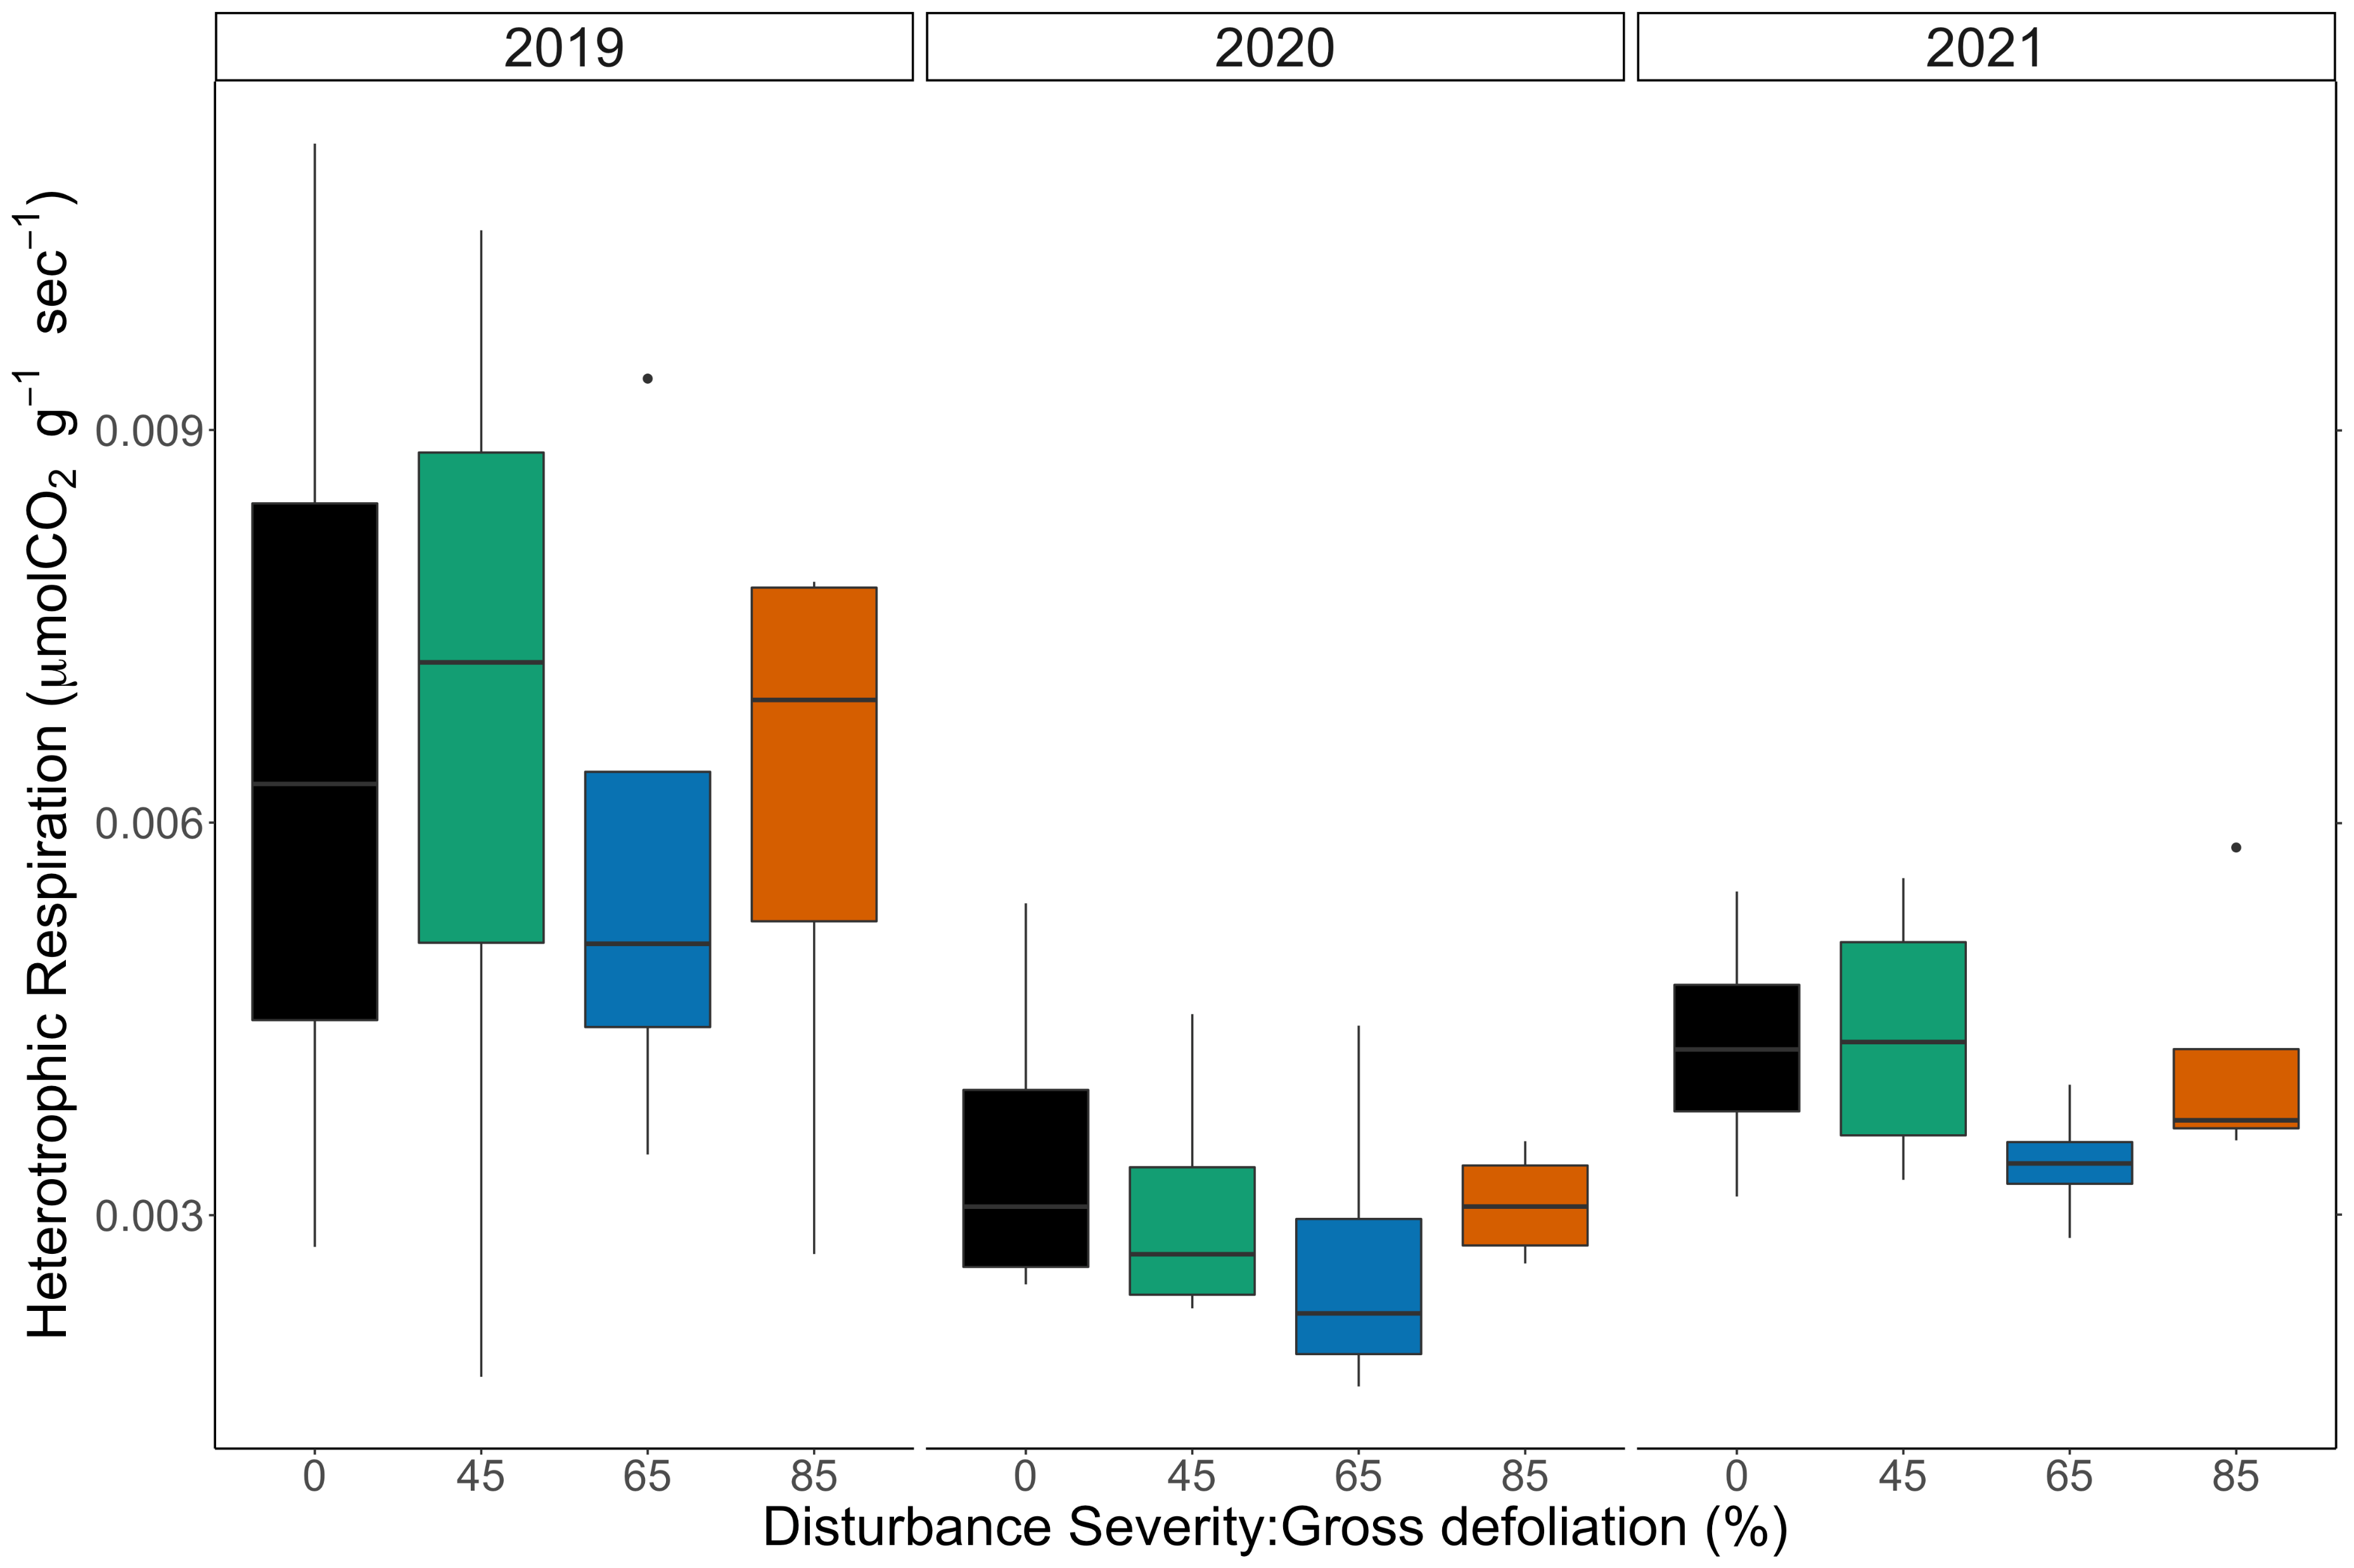
Heterotrophic Respiration & Disturbance severity
$${log⁡(Y}_{ijk})= μ+{Rep}_{i}+ {Year}_{j}+ {Severity}_{k|i}+Year∗{Sev}_{jk|i} [+ ε_{ijk}]$$

Slide 3
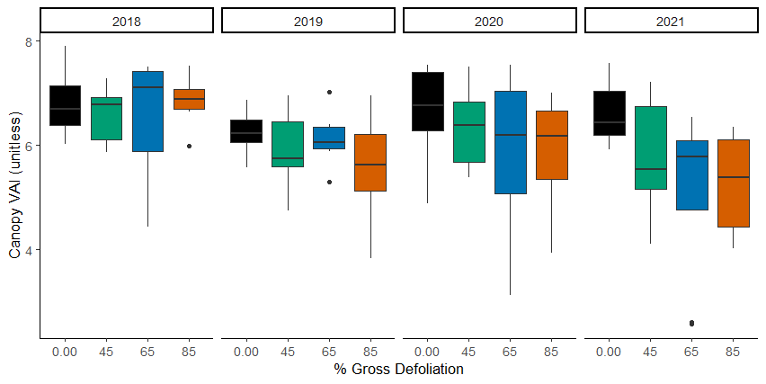

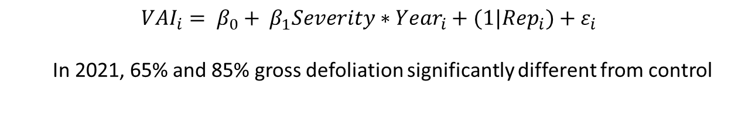
Canopy vegetative area index
*
**
* p < 0.05, ** p < 0.01
$${VAI}_{i}= β_{0}+ β_{1}{Severity∗Year}_{i}+{(1|Rep}_{i})+{ ε}_{i}$$
In 2021, 65% and 85% gross defoliation significantly different from control

Slide 4
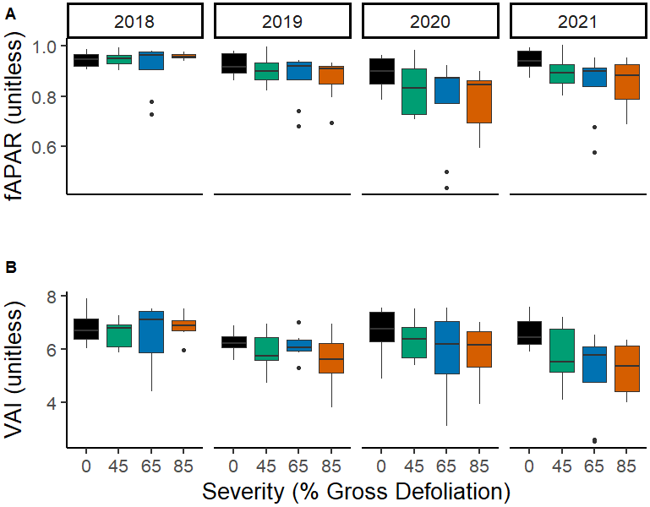
*
**
* p < 0.05
** p < 0.01
*
**

Slide 5
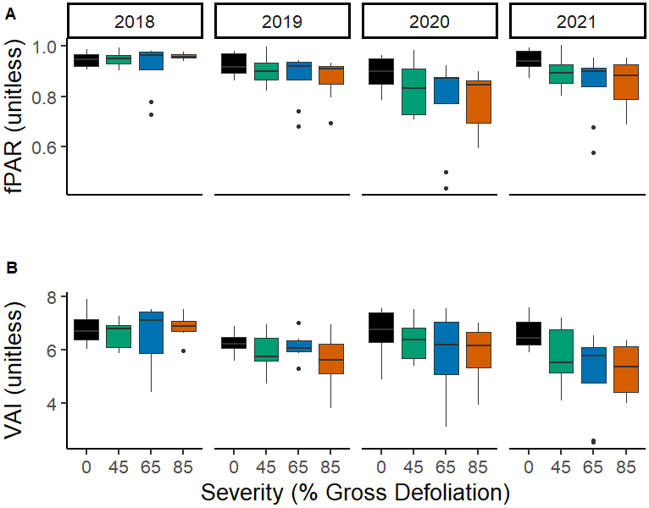
*
**
* p < 0.05
** p < 0.01
*
**

Slide 6
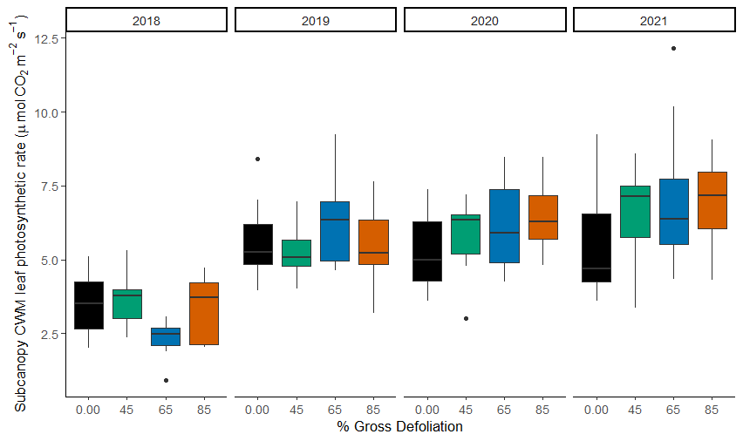
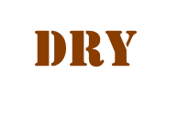
Subcanopy A_{sat}
*
*
*
* p < 0.05
$$Y_{ijk}= μ+{Rep}_{i}+ {Year}_{j}+ {Severity}_{k|i}+Year∗{Sev}_{jk|i} [+ ε_{ijk}]$$

Slide 7
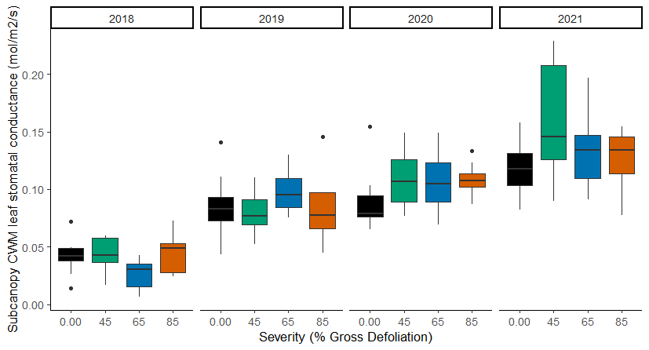
Subcanopy g_{s}
*
* p < 0.1

Slide 8
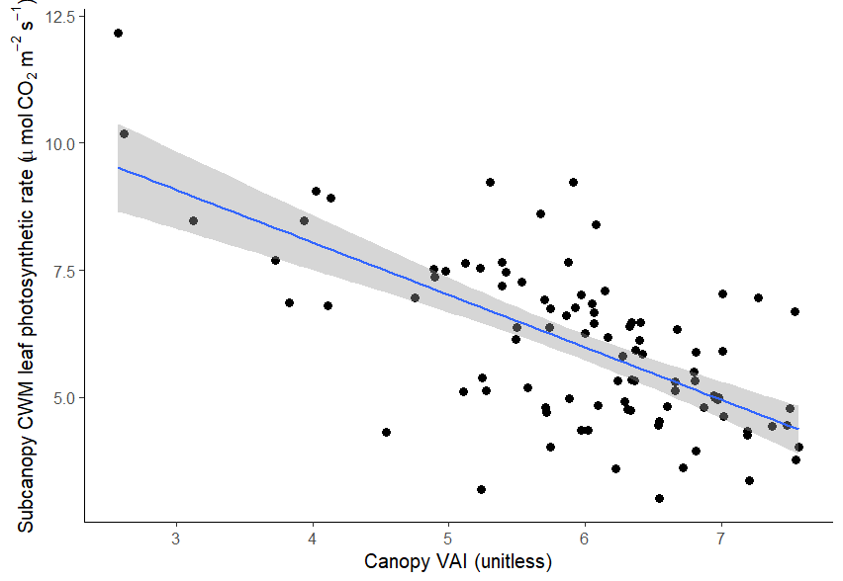
Following disturbance, canopy VAI predicts subcanopy A_{sat}
Higher disturbance drives lost canopy VAI over time
y = -1.03x + 12.16
p < 0.001

Slide 9
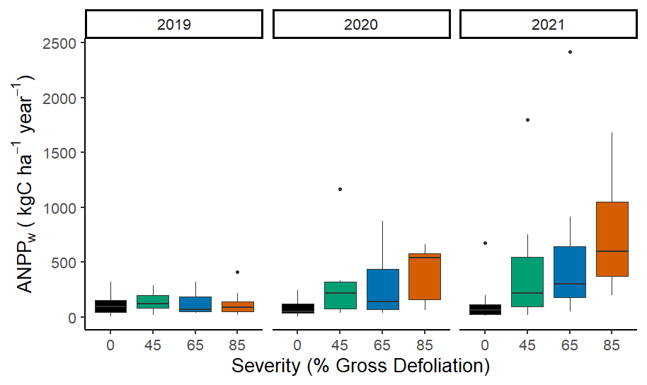
Subcanopy NPP
Neidermaier et al. in prep
Session B45P-04
*
*
*
*
*
*
* p < 0.05
$${log⁡(Y}_{ijk})= μ+{Rep}_{i}+ {Year}_{j}+ {Severity}_{k|i}+Year∗{Sev}_{jk|i} [+ ε_{ijk}]$$

Slide 10
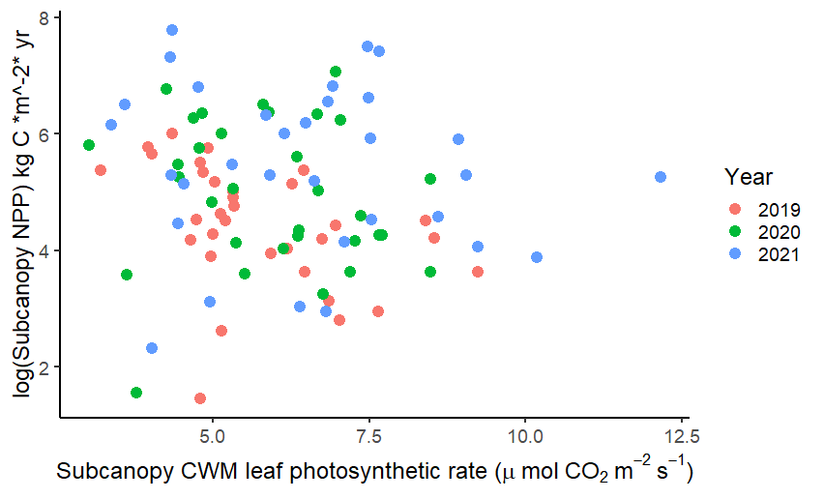
Subcanopy NPP is not well predicted by subcanopy A_{sat} alone

Slide 11
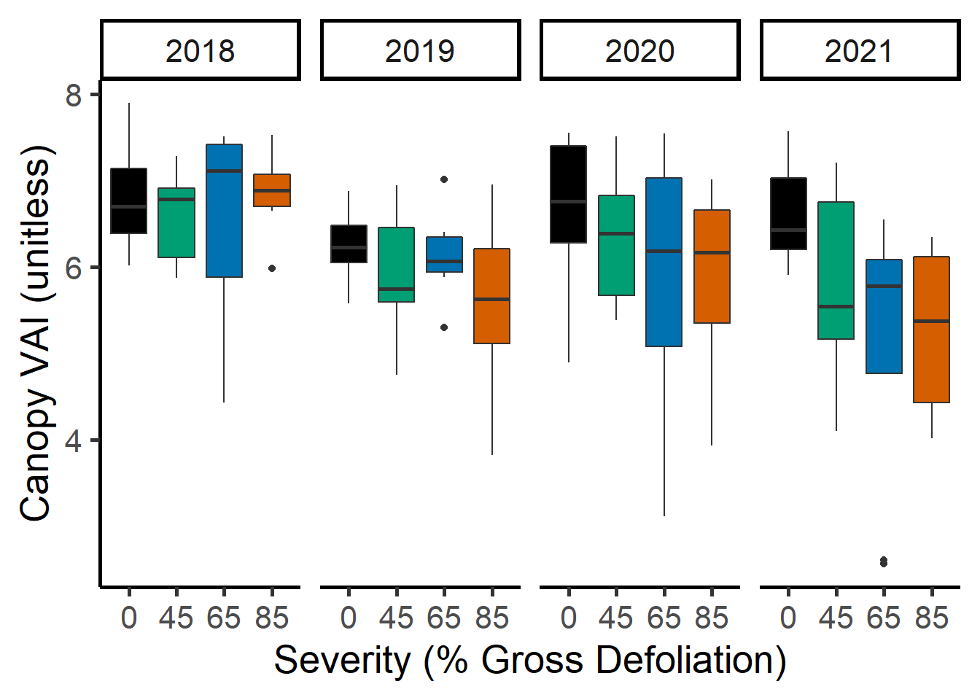
*
**

Slide 12
*
**
* p < 0.05
** p < 0.01

Slide 13
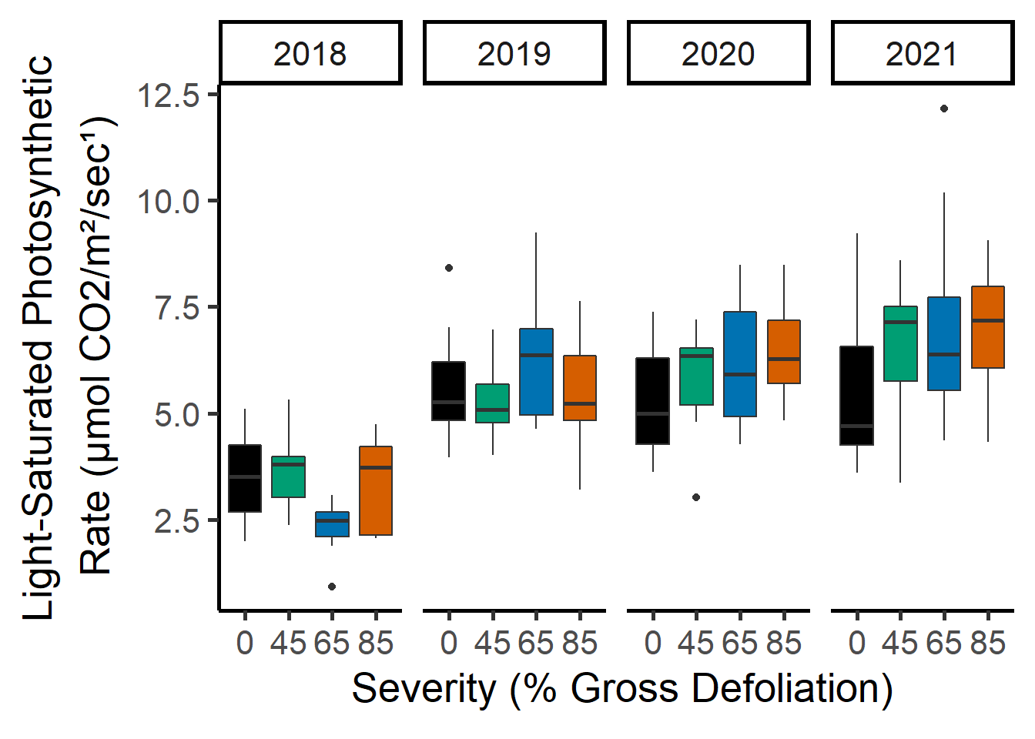
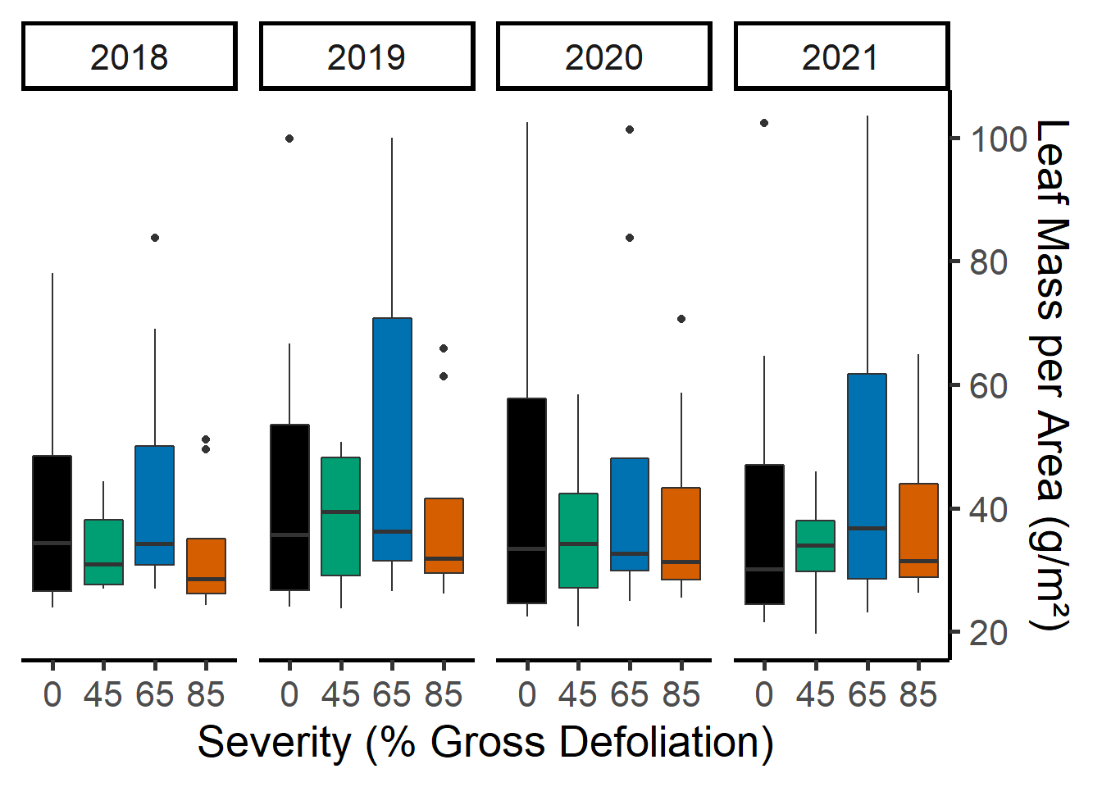
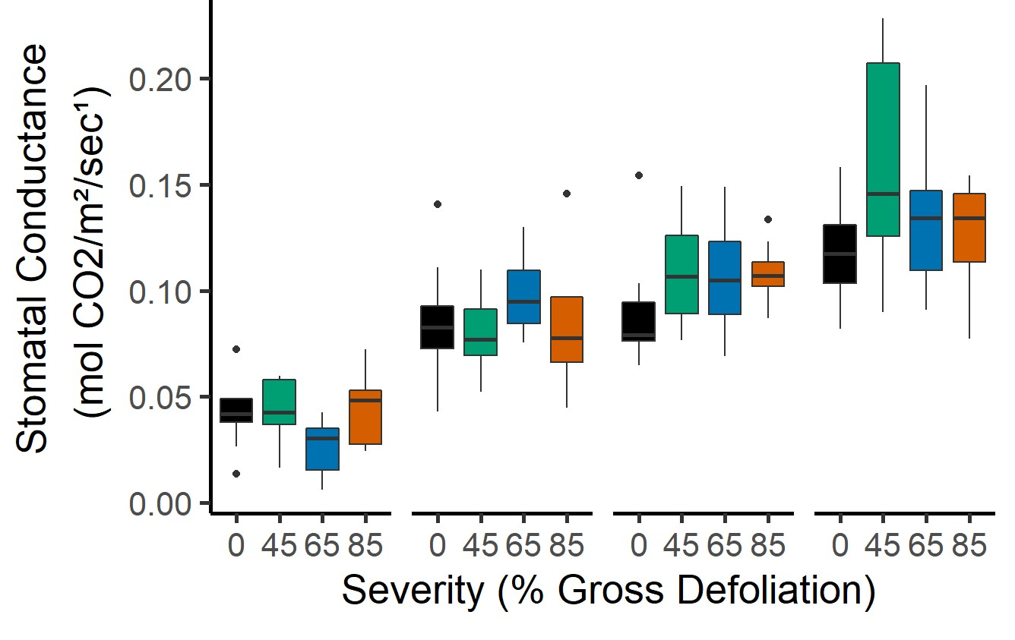
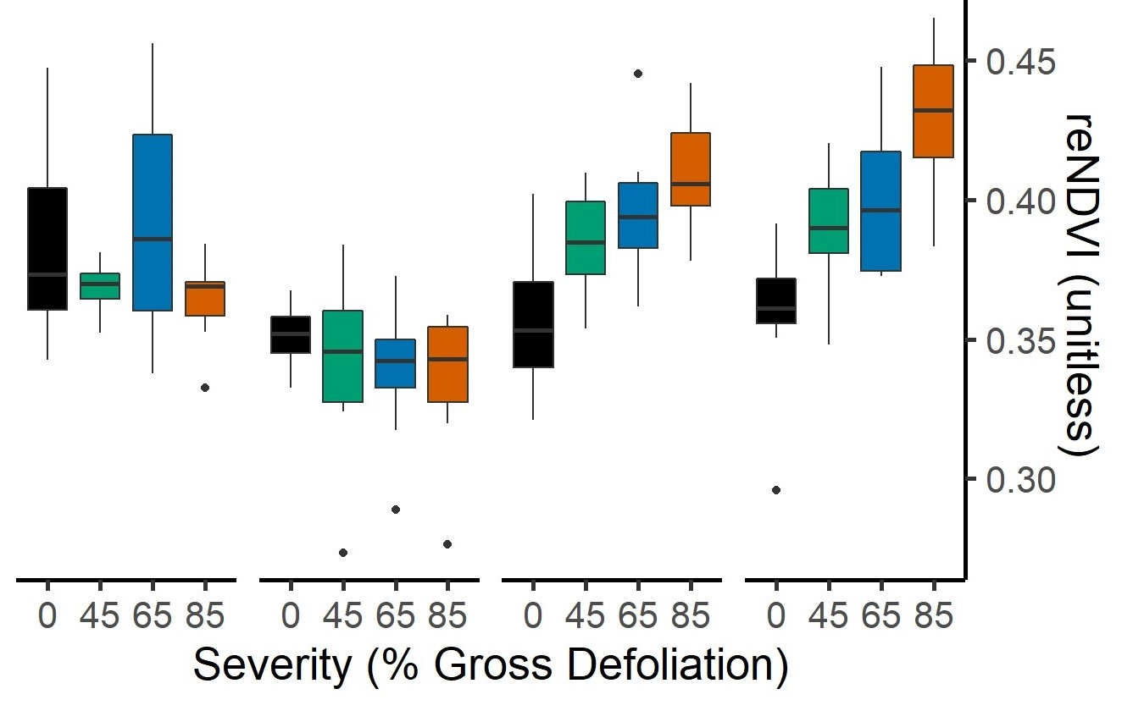

Slide 14
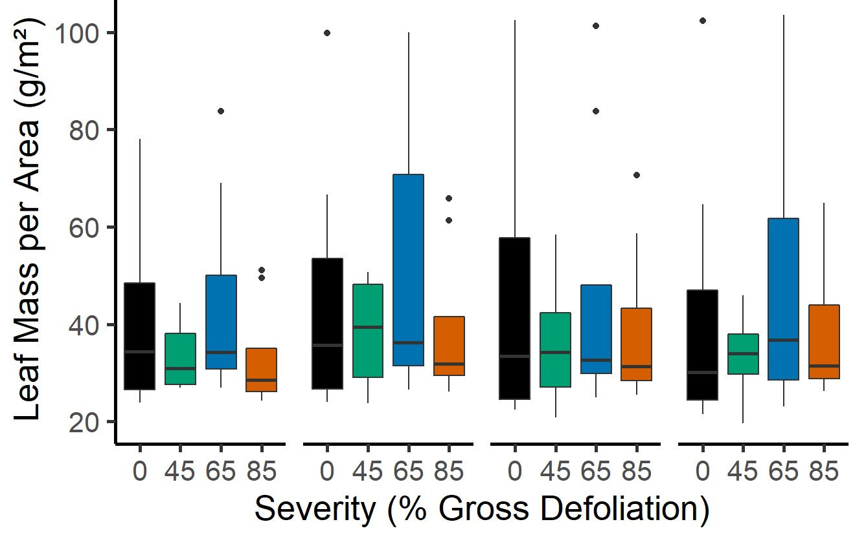
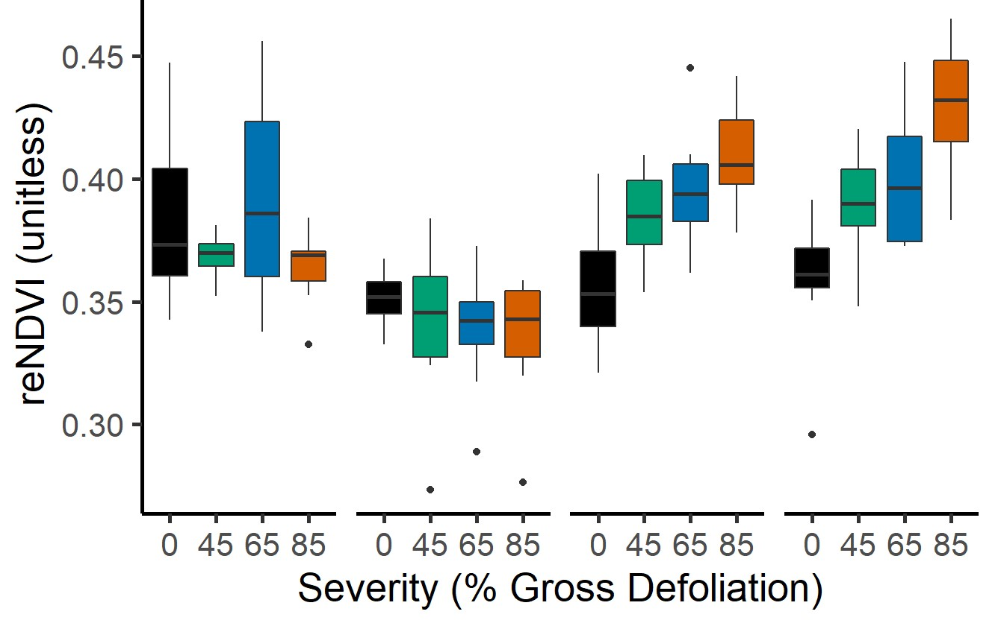
A
*
*
*
* p < 0.05
B
*
C
D
*
*
*
*
*
*
*

Slide 15
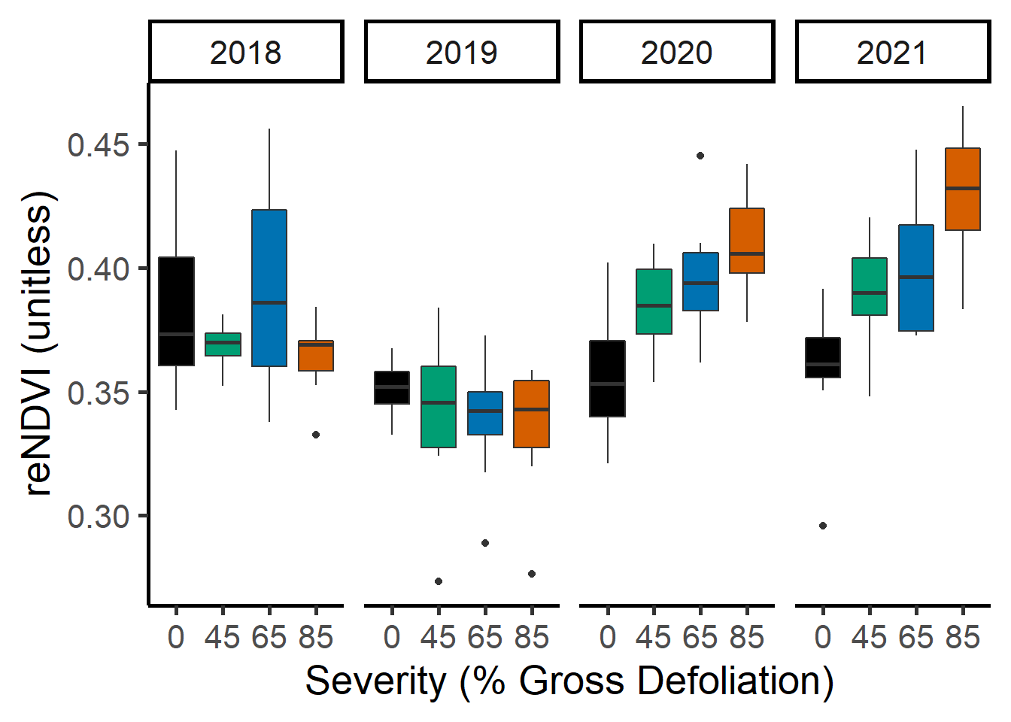
p < 0.05
*
*
*
*
*
*

Slide 16
p < 0.05
*
*
*

Slide 17
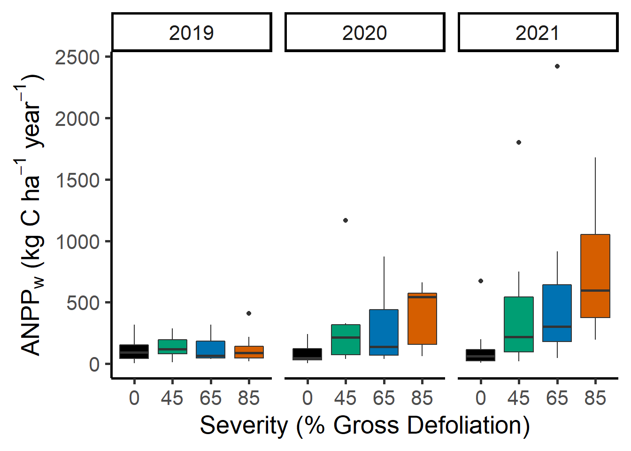
* p < 0.001
*
*
*
*
*
*

Slide 18
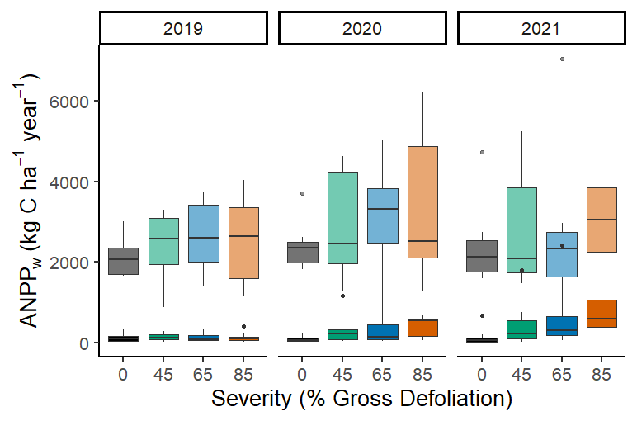
* p < 0.001
*
*
*
*
*
*

Slide 19
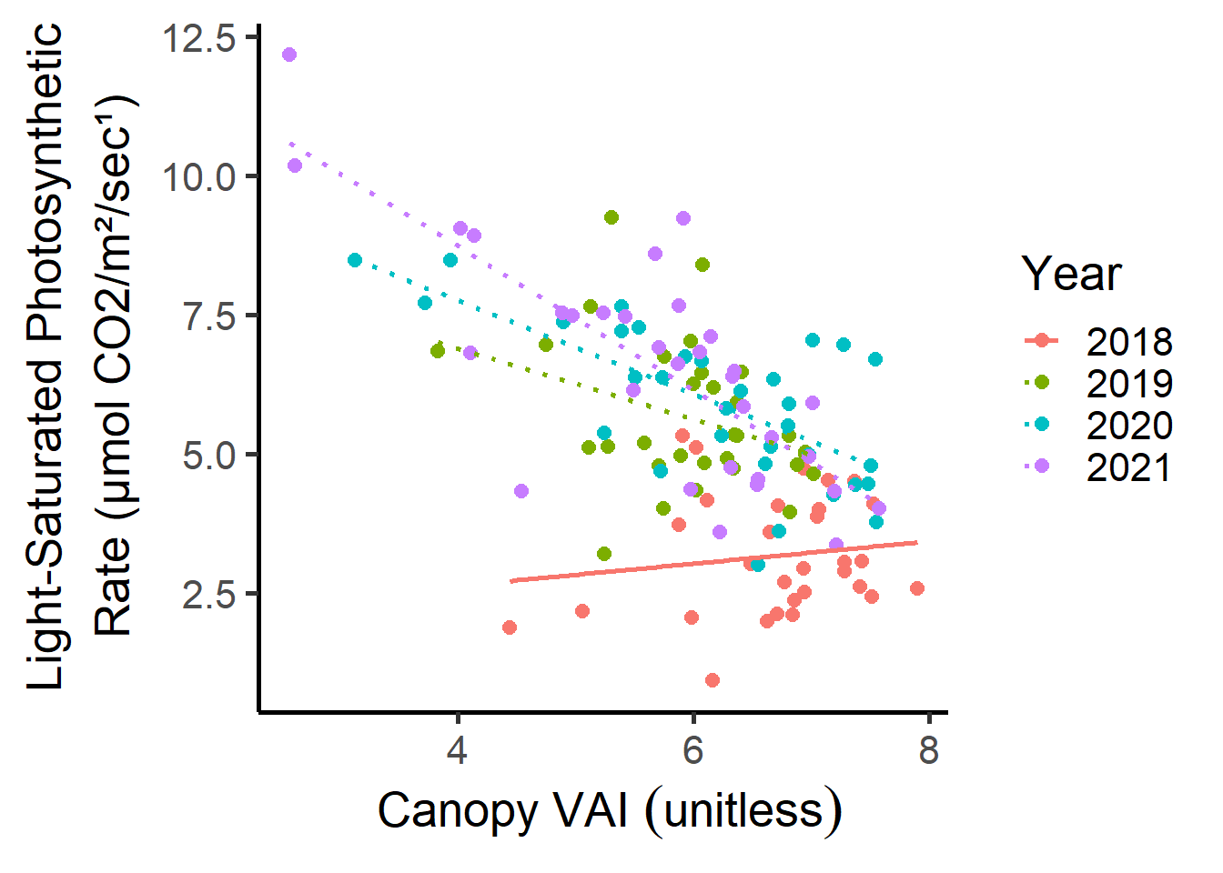
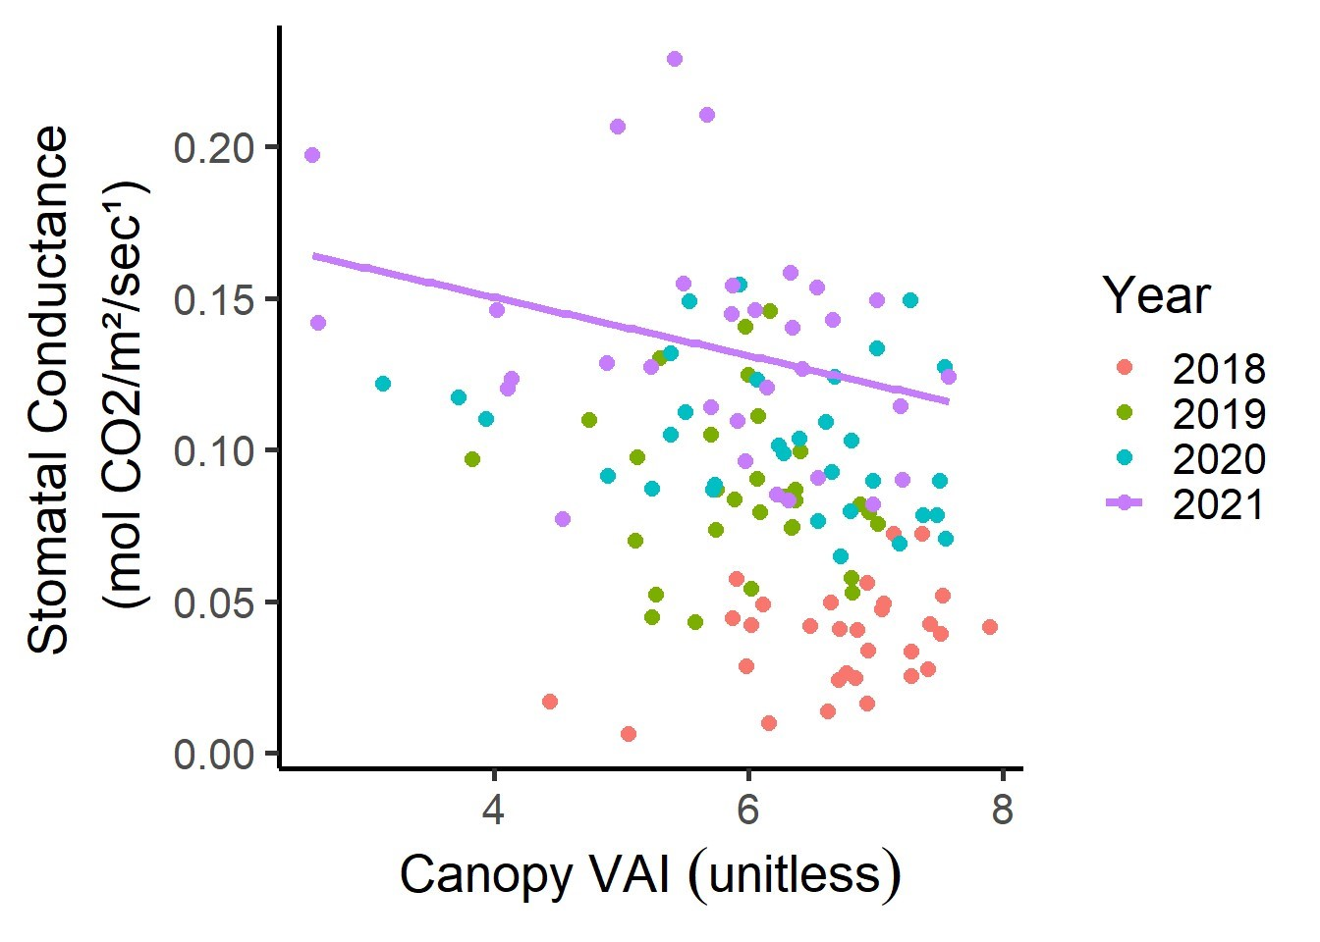
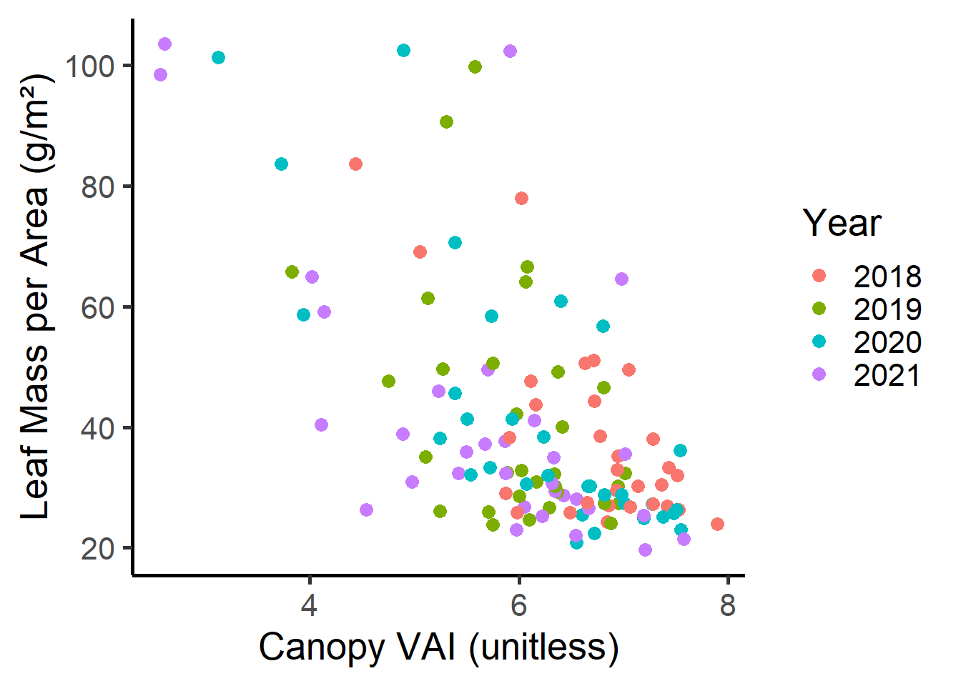
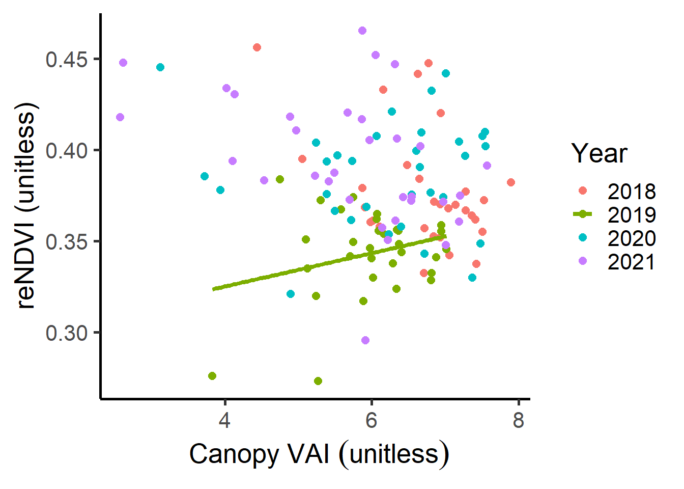

Slide 20
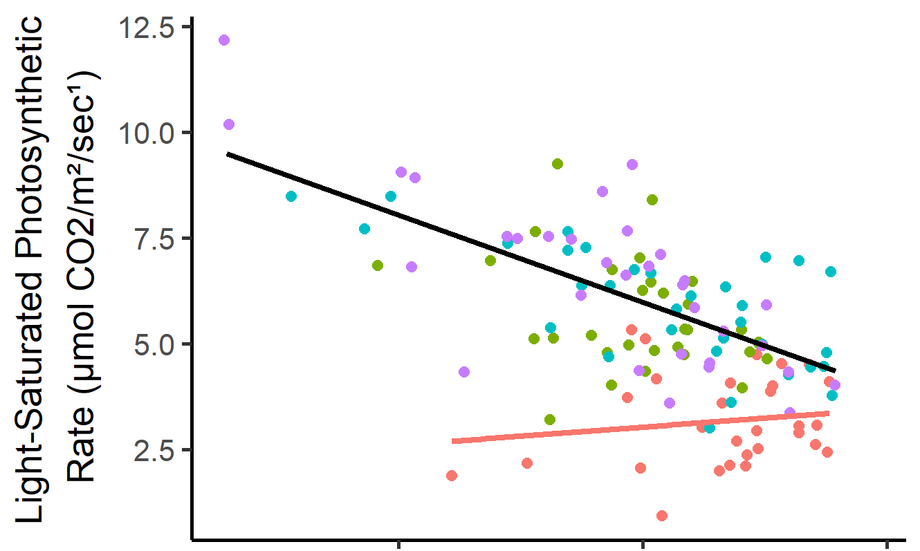
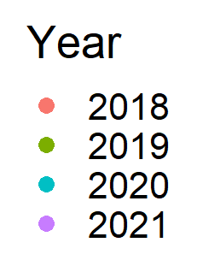
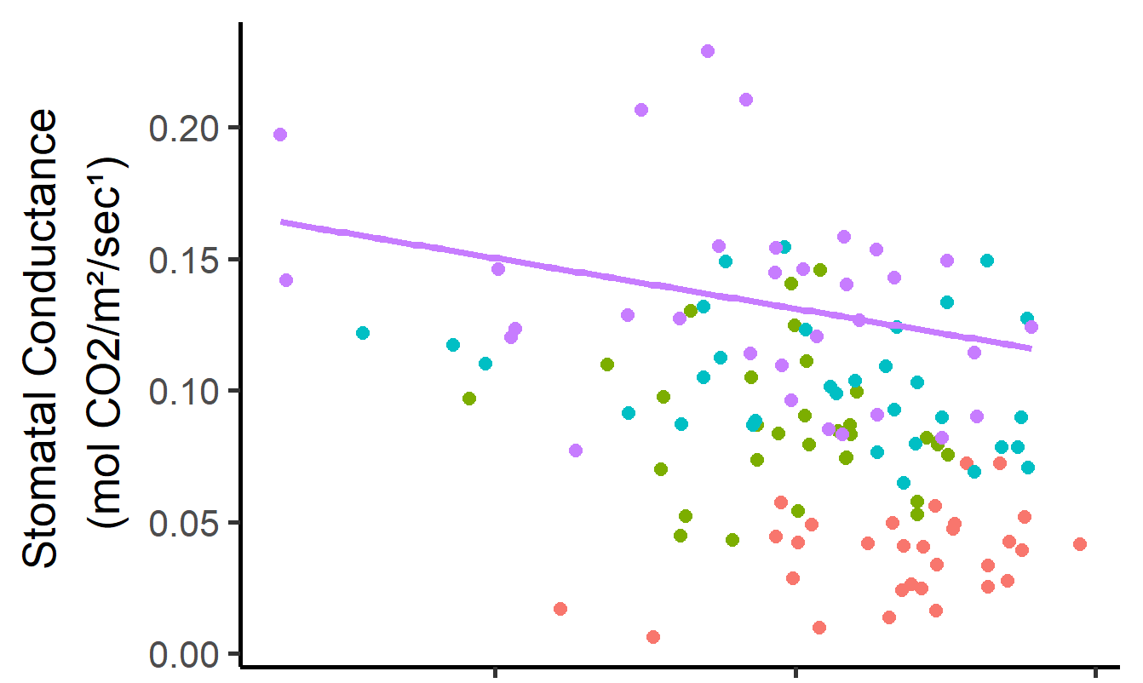
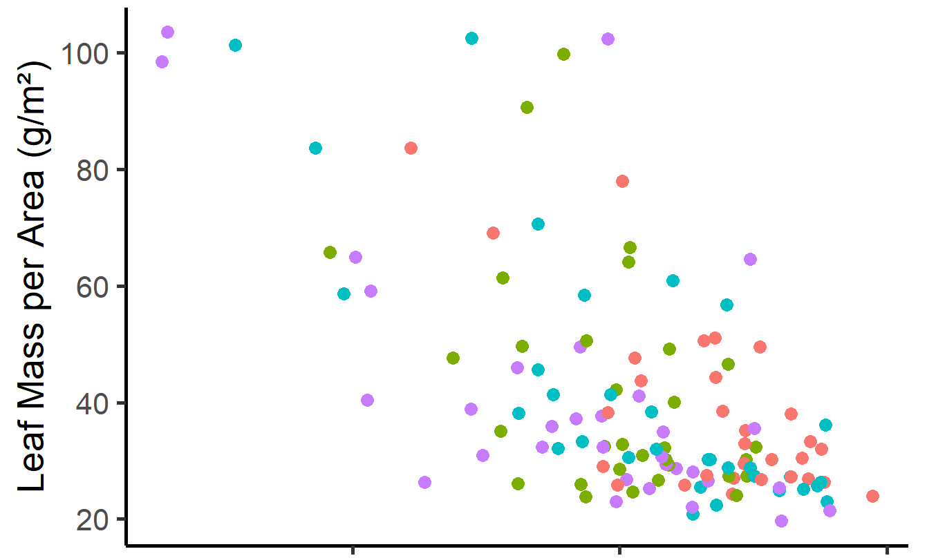
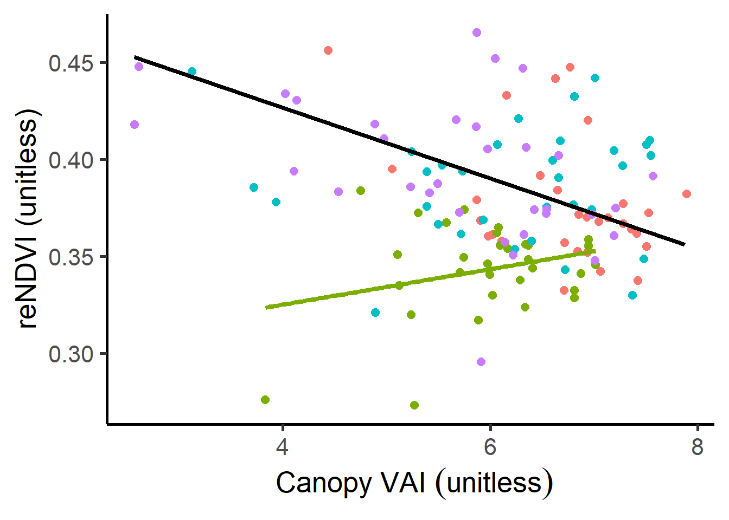
A
B
C
D

