Slide 1
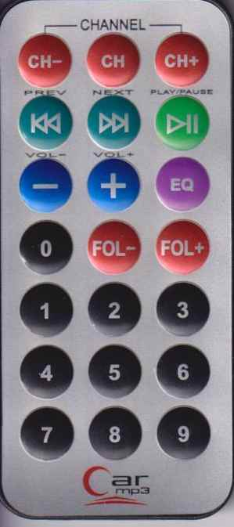
LED strip esp32 mongoose-os instructions
save custom settings number (after this green press number of custom settings)
red, green, blue color of active part (left down, right up)
apply saved custom settings number (after this EQ press number of custom settings)
white led (left down, right up)
simply press number - activate/deactivate part number

