Slide 1
FUTURE SALES PREDICTION
PRESENTED BY:
C.Lisalini
912421104018

Slide 2
PuTTinG desiGn inTo innoVaTion:
Generating the model
Cleaning the data set
Exploratory Data Analysis
Building a model
Check model accuracy
Save the model into a pickle file

Slide 3
Generating the model
We are going to use a dataset from the Video Games sales prediction hackathon which ran on the Machine Hack website. First, create an account on MachineHack and register for the hackathon on this link.
Once registered go to the Data tab and download the zip file which will have three files viz Train, Test, and Sample Submission.
Next steps will be covered in Google Colab notebook which you can open and clone from this link: Google Colab Notebook or if you would like to download and run the notebook locally or on other platforms then download the notebook from this GitHub link: Jupyter Notebook Link

Slide 4
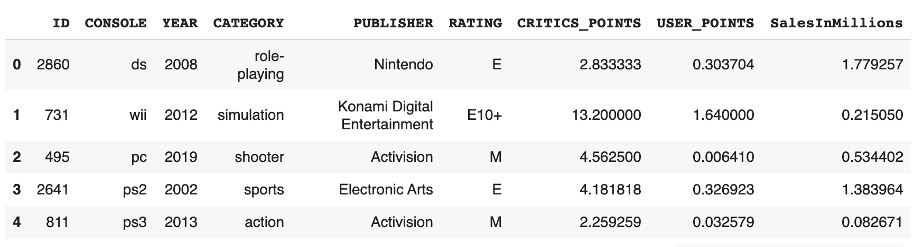
Cleaning the data set;
First, let’s import Train.csv into a pandas dataframe and run df.head() to see the columns in the dataset.

Slide 5
First, we check for null values by running input.isnull().sum() command.input.isnull().sum() #Output: ID 0 CONSOLE 0 YEAR 0 CATEGORY 0 PUBLISHER 0 RATING 0 CRITICS_POINTS 0 USER_POINTS 0 SalesInMillions 0 dtype: int64
We can see that there are no null values in the dataset. Next, we can drop unnecessary ID column since it does not play a role in target sales by running below command:- input = input.drop(columns=['ID'])
Next, we can split the dataframe into training and test dataset using train_test_split command:-train, test = train_test_split(input, test_size=0.2, random_state=42, shuffle=True)

Slide 6
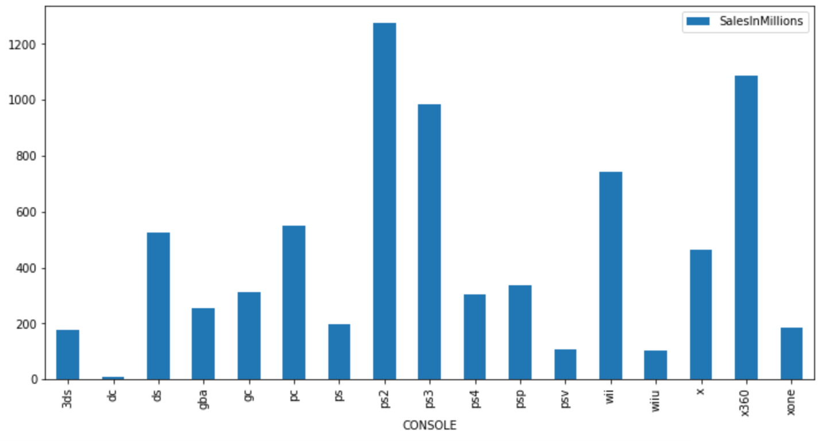
Descriptive Statistics; Using df.shape command we can find a count of total rows in the dataset and df.nunique() command can be used to find unique values in each of the columns.CONSOLE 17 YEAR 23 CATEGORY 12 PUBLISHER 184 RATING 6 CRITICS_POINTS 1499 USER_POINTS 1877 SalesInMillions 2804In the EDA section, we make use of pandas profiling and matplotlib packages to generate graphs of various columns and observe their relationships with the target column.A few insight gained from EDA are:-Sales were highest for the PS3 platform. It was followed by Xbox360:

