Slide 1
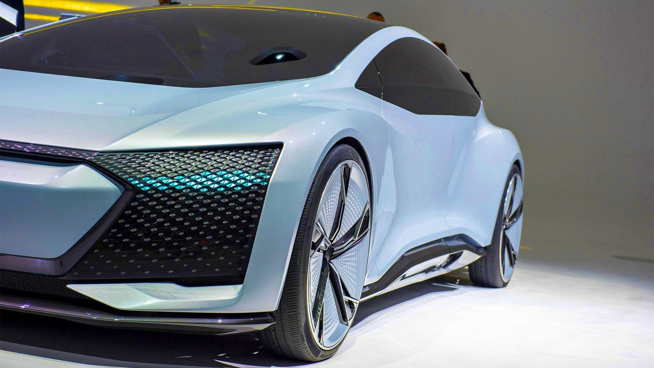
Data Analytics Power BI Presentation
BAA1026 - Dr. Mathieu Mercardier
Presented by: Laeeq Ur Rehman, Lisa Lucky, Jia Wen Cheng, Boon Chin Look & Liam Cummins

Slide 2
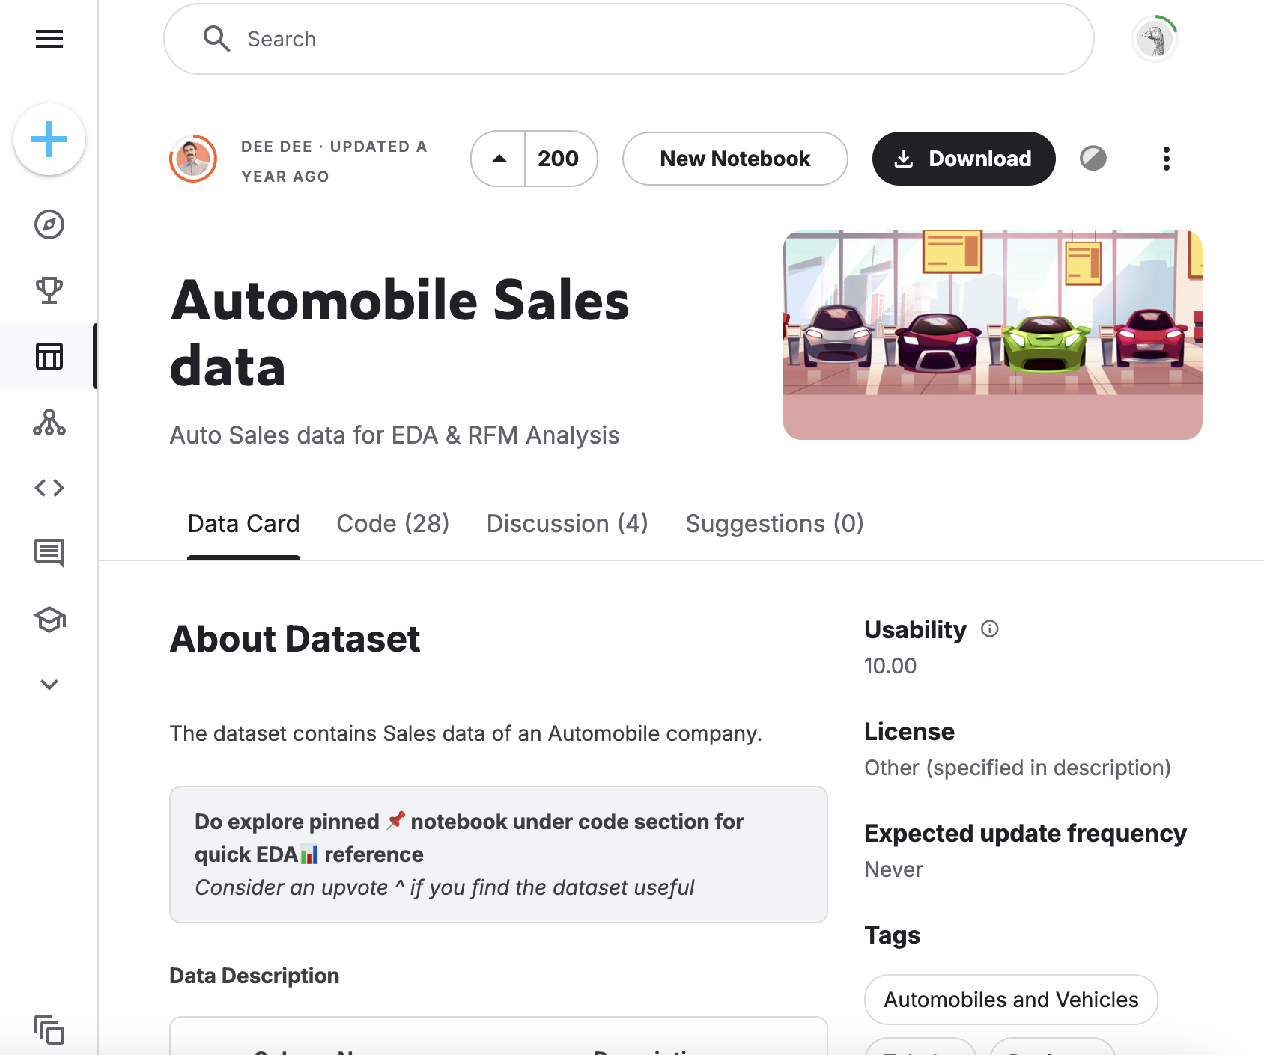

Info on the dataset:
2748 rows
18 columns
Automobile sales of a company.
Company consultants – Heading into 3rd Quarter.
Good for research, insights, etc.

Slide 3
Power BI Demonstration

Slide 4
Limitations faced
“Small”, “medium” & “large” not specified.
Delivery times obsolete.
Missing data/partial data missing.
USA is an outlier + no specific states mentioned (skew).
Location of shipment (from where) unknown.
MSRP = profit?

Slide 5
Recommendations
Splitting funds between Europe and the US.
Expansion into the EU to be considered.
No following of MSRP - set price point.
Consider further expansion into electric market (FBD Insurance, n.d).
Replicating November.
Add quality control to track lost orders.
Electric cars by 2030 initiative (FBD Insurance, n.d).

Slide 6
Q & A

Slide 7
Sources
FBD Insurance (n.d)., “What will the future of electric vehicles look like in Ireland”. FBD Insurance. Available at: https://www.fbd.ie/protection-stories/car/future-of-electric-vehicles-in-ireland/#:~:text=In%202020%2C%20the%20government%20announced,zero%20carbon%20emissions%20by%202050. [Accessed 29th October 2024].
Link to dataset: https://www.kaggle.com/datasets/ddosad/auto-sales-data [Accessed 29th October 2024]..
Background picture: https://www.acea.auto/fact/passenger-cars-what-they-are-and-why-they-are-so-important/ [Accessed 29th October 2024].
Tape used in second slide: https://pin.it/mzr5bNyW9 [Accessed 29th October 2024].

