Slide 1
Medical Device Failure & Healthcare Financial Risk BI Project
Executive summary of device failures, downtime, maintenance cost, replacement review, and financial impact

Slide 2
Business Problem
Hospitals rely on medical devices, maintenance schedules, staffing, equipment, and supplies to support care delivery. Device failures, downtime, and high maintenance costs can create operational disruption and financial risk.
This project analyzes device failure patterns, maintenance cost, downtime, replacement review needs, and healthcare expense categories using Python, SQL, Excel, and Power BI.

Slide 3
Data & Tools
Area | Details
Primary Dataset | Medical device failure dataset
Financial Dataset | Healthcare financial expense dataset
Tools | Python, SQL, Excel, Power BI, PowerPoint
Final Dashboard Pages | Executive Overview, Device Risk Analysis, Financial Impact Analysis, Data Quality & Validation

Slide 4
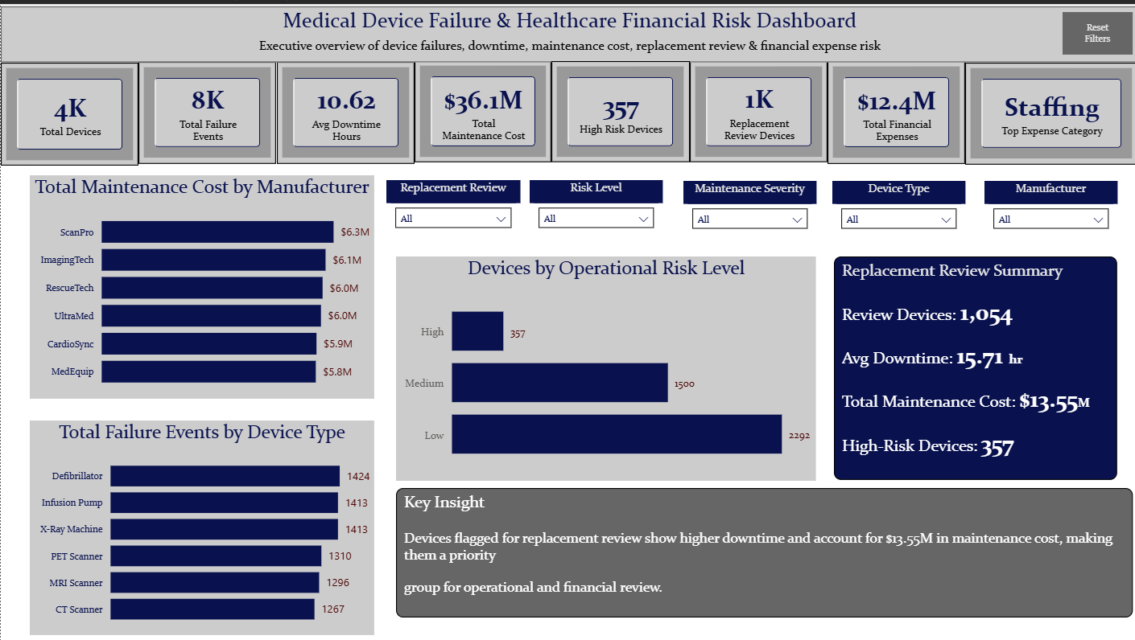
Executive KPI Summary
Total Devices: 4,149
Total Failure Events: 8,123
Avg Downtime: 10.62 hours
Total Maintenance Cost: $36.1M
High-Risk Devices: 357
Replacement Review Devices: 1,054
Total Financial Expenses: $12.4M
Top Expense Category: Staffing

Slide 5
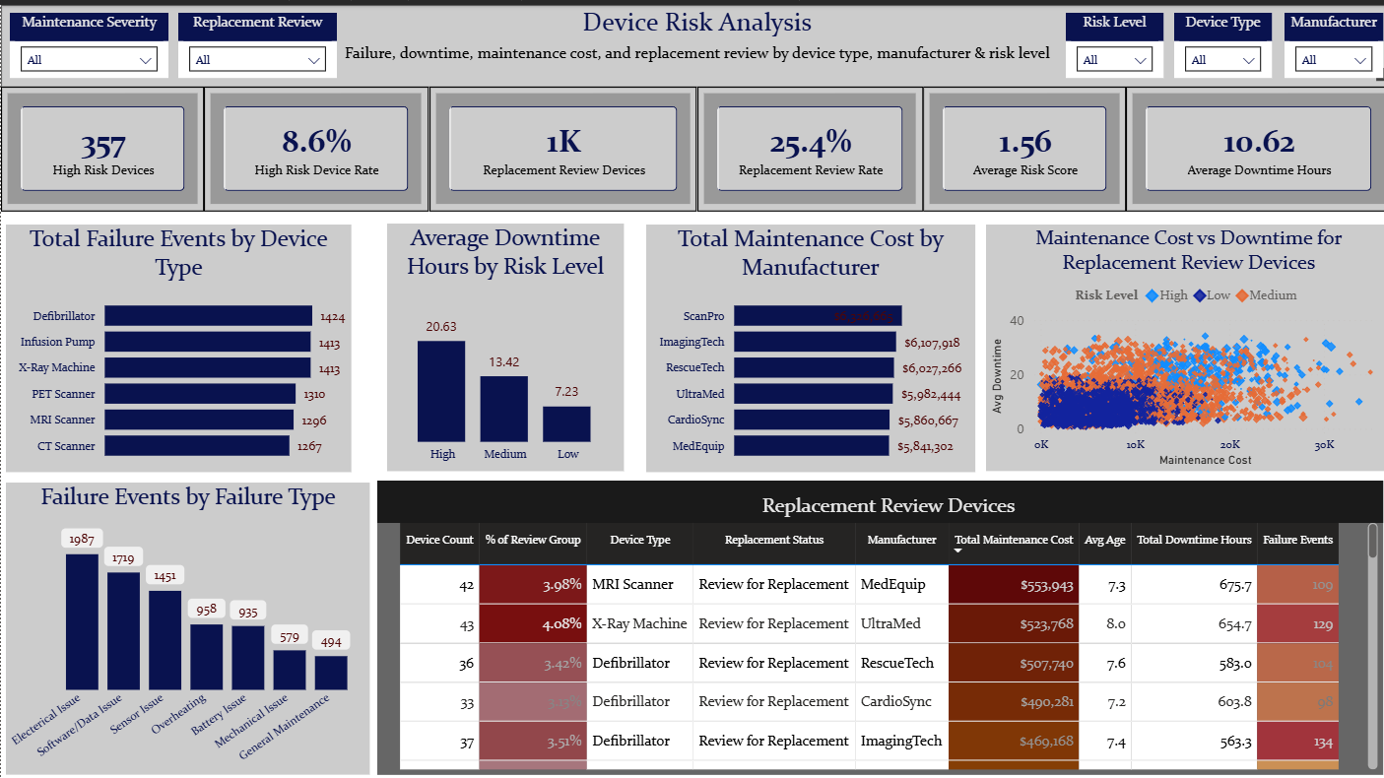
Device Risk Findings
Defibrillators, Infusion Pumps, and X-Ray Machines had the highest total failure events.
Devices marked for replacement review showed higher downtime and represented a priority group for operational and financial review.
High-risk devices accounted for 357 records, while 1,054 devices were flagged for replacement review.

Slide 6
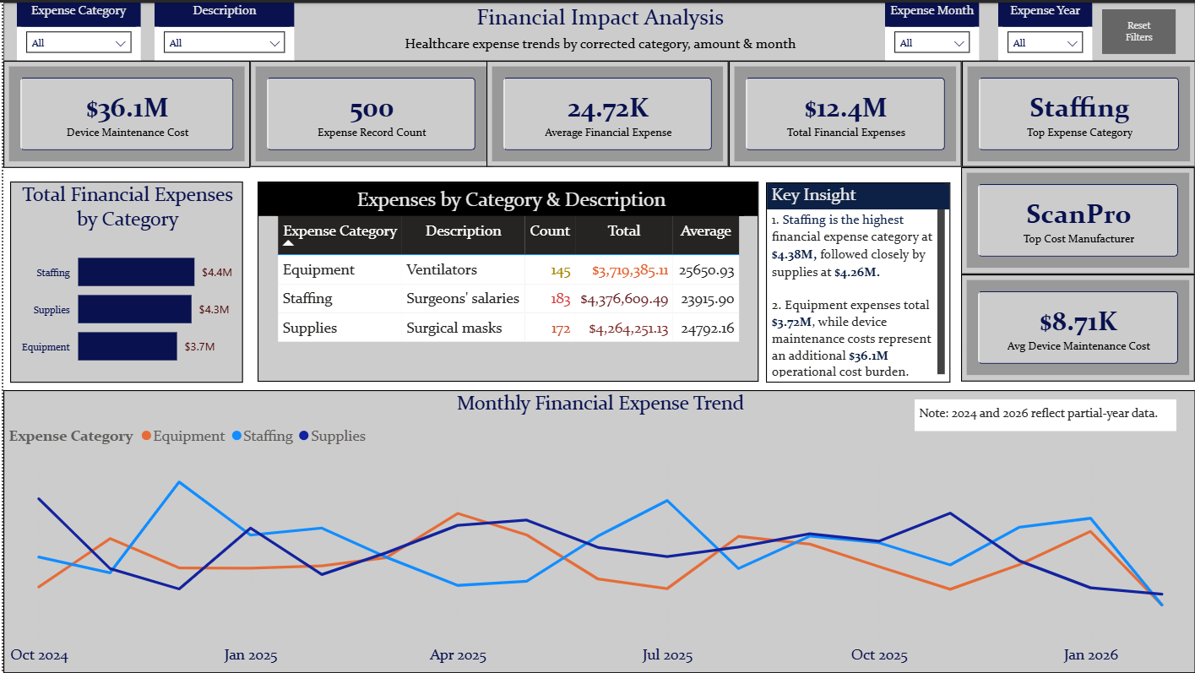
Financial Impact Findings
Total financial expenses were $12.4M across 500 expense records.
Staffing was the highest expense category, followed by supplies and equipment.
Device maintenance cost represented an additional $36.1M operational cost burden, with ScanPro showing the highest maintenance cost by manufacturer.

Slide 7
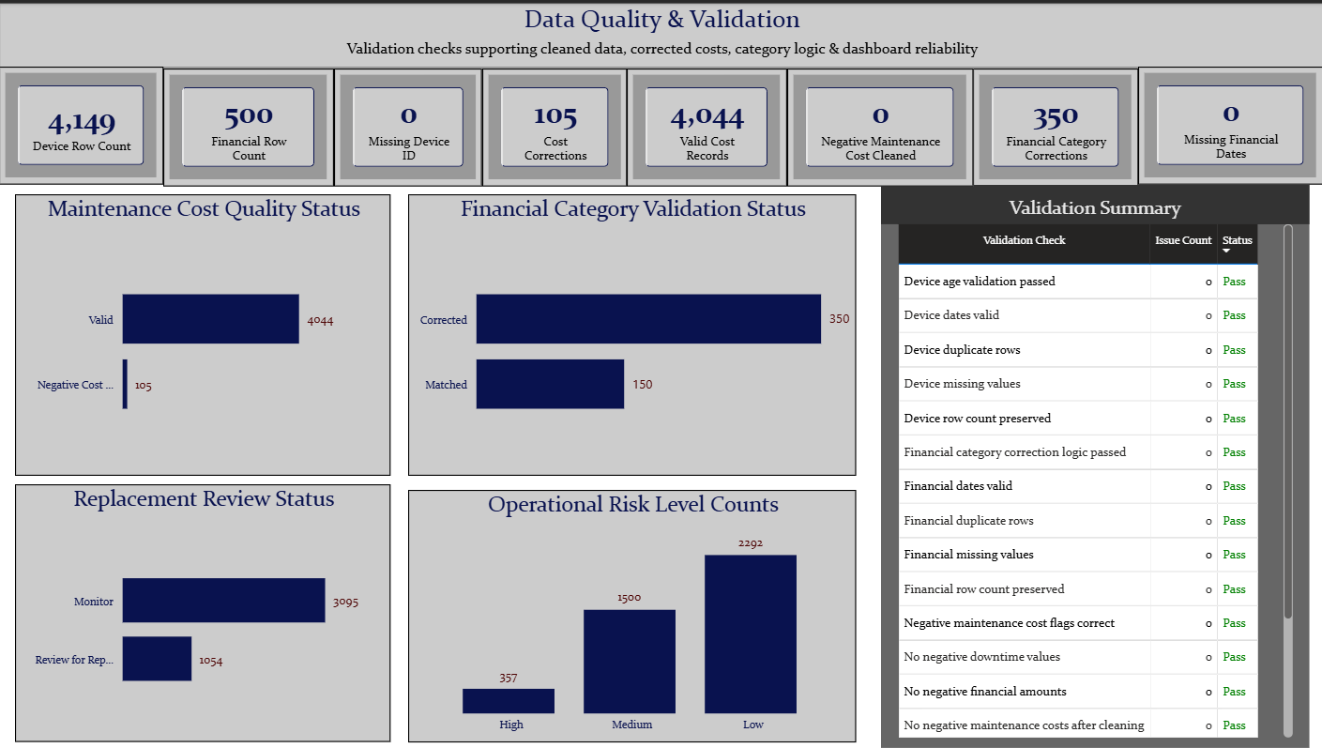
Data Quality & Validation
The cleaned datasets passed major validation checks.
Validation confirmed preserved row counts, no missing key fields, no duplicate records, corrected negative maintenance costs, corrected financial categories, and validated risk/replacement fields.
All major validation checks returned Pass status.

Slide 8
Recommendations
1. Prioritize replacement review devices with high downtime and high maintenance cost.
2. Monitor failure-heavy device types, especially Defibrillators, Infusion Pumps, and X-Ray Machines.
3. Review manufacturer-level maintenance cost trends, especially ScanPro.
4. Continue tracking financial expense categories alongside device maintenance burden.
5. Use the Power BI dashboard as an operational monitoring tool for device risk and financial impact.

