Slide 1
Cell Lineage Construction via Registration of Nuclei in Pre-Implantation Mouse Embryos
Jan 25, 2022

Slide 2
Registration Approaches
Supervised
Real ground truth: aligned images of real data
Simulated ground truth transformations on real (or simulated) data
Artificial DVFs from segmented regions of interest with different frequencies
Ground truth using a GAN Network
Augment data using statistical appearance models & biomechanical simulations to regularize the network
Unsupervised (self supervised, weakly supervised)
Similarity metric to determined image alignment: normalized cross correlation, DICE overlap, adversarial loss, mean square intensity difference, cross entropy over smoothed segmentation maps

Slide 3
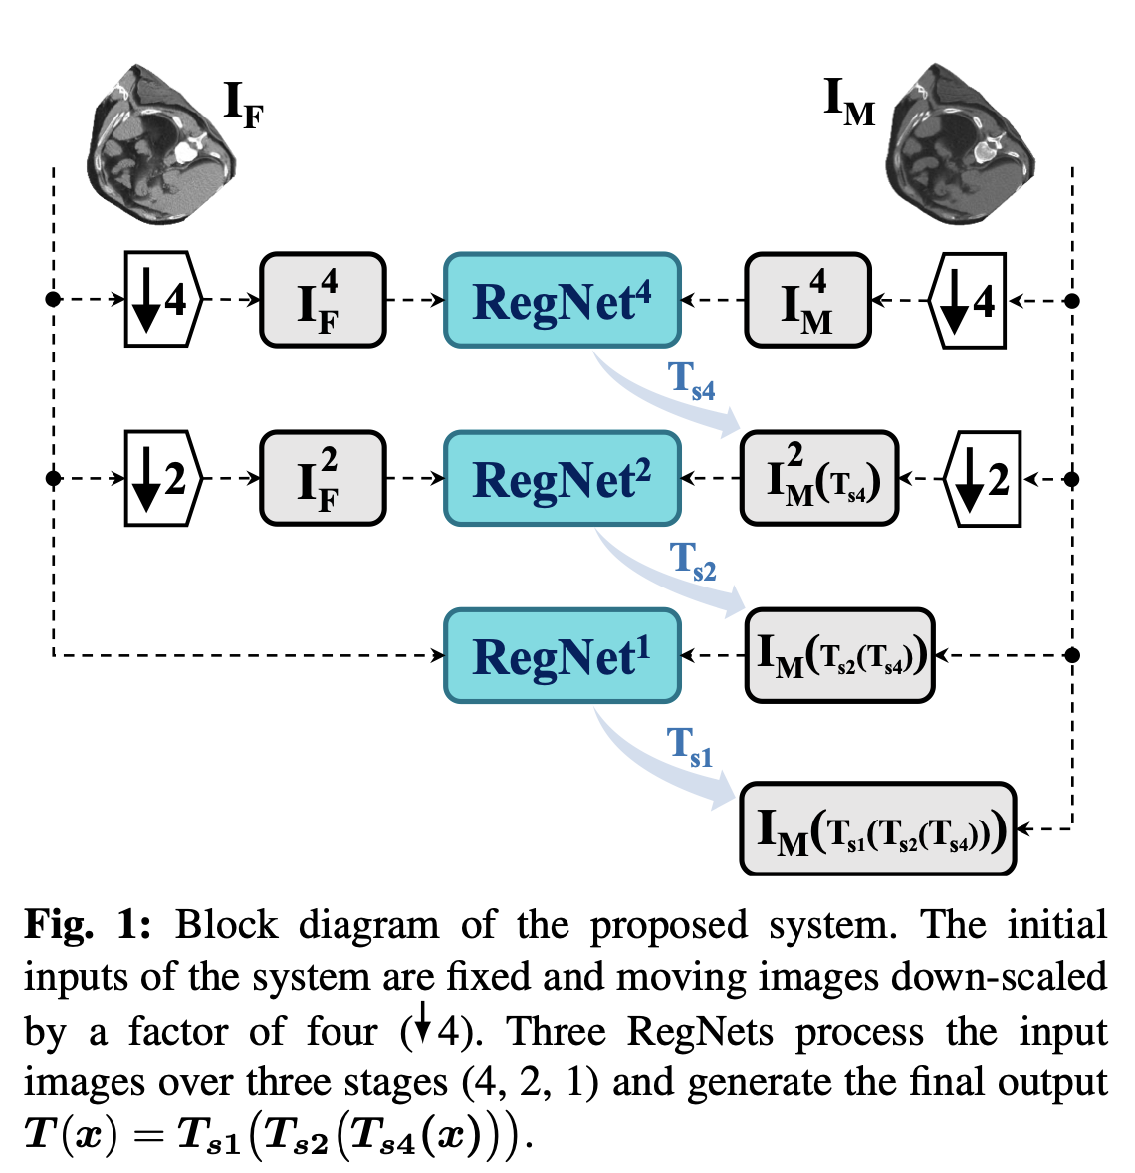
Our Plan
Multi-Scale RegNet
DVF: displacement vector fields
Hayden: [Sokooti 2019 paper] RegNet supervised registration network which learns DVF
Binglun: End-to-end Instance Segmentation -> 2-frame Instance Segmentation
Lisa: Use simulated data and transformations to train U-Net to learn DVF

Slide 4
2D U-net Semantic Segmentation & Registration
Input: 2 channels: Image(t) and transformed/displaced Image(t+1)
256x256 images of 6 ‘blobs’ randomly placed with Gaussian noise with s.d. = 5
Output: 4 channels: Semantic segmentation(t), segmentation(t+1), x-displacement, y-displacement between two time points
Three Losses:
Semantic Segmentation Loss: Binary Cross Entropy (for both input images and their labels)
Registration Loss: Mean Square Error (ground truth displacement in (x,y) vs. predicted displacement in (x,y) )
Smoothness Penalty: mean square difference of displacement vector with its 8 neighbors

Slide 5
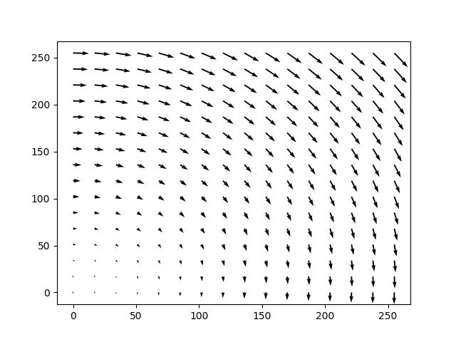
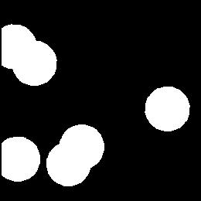
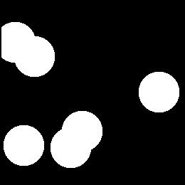
Ground Truth Rotation Displacement Vector Field
Time t
DVF
Time t+1

Slide 6
Summary 2D DVF U-net Results on Simulations
Model | Simulated Input | Number of Epochs | MSE DVF | IoU Segmentation
Registration Loss Only | +/- 5 degree rotations | 2K | 34 | 0.12
Registration & Segmentation | +/- 5 degree rotations | 2K | 25 | 0.82
Registration, Segmentation & Smoothness Penalty | +/- 5 degree rotations | 2K | 1 | 0.94
Registration, Segmentation & Smoothness Penalty | +/- 10 degree rotations | 10K | 120 | 0.50
MSE DVF Loss Weight = 1.0
Seg Loss Weight = 0.01
Smoothness Penalty = 7.0
Notes:
Model trained on registration and segmentation, Input simulations +/- up to 5 degrees of rotation, MSE < 25, IoU > 0.82
Model trained on registration and segmentation and regularization penalty, Input simulations +/- up to 5 degrees of rotation, 2K epochs, MSE < 1.0, IoU > 0.94
Model trained on registration and segmentation and regularization penalty, Input simulations +/- up to 10 degrees of rotation with +/- 5 pixel translation, 10K epochs, MSE < 120.0, IoU > 0.5

Slide 7
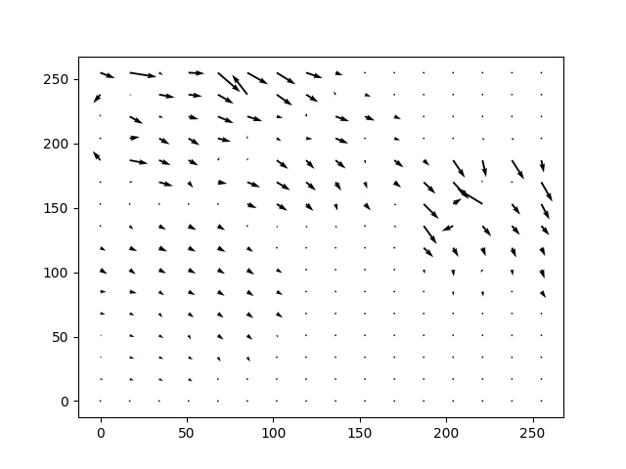
Predicted Vector Field
Ground Truth Vector Field
Model trained on registration only
Input simulations +/- up to 5 degrees of rotation
Example +3 degree rotation
Displacement vectors are drawn to scale in pixels
MSE < 34, IoU > 0.12

Slide 8
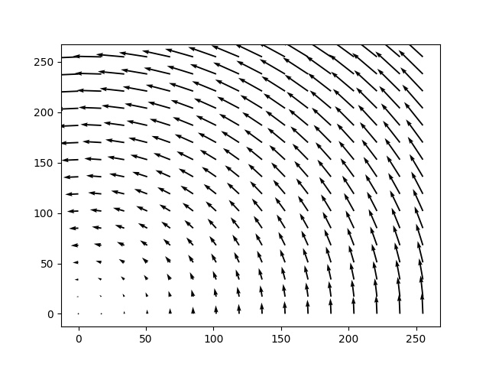
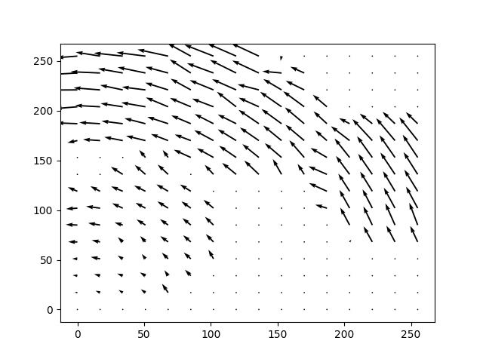
Ground Truth Vector Field
Predicted Vector Field
Model trained on registration and segmentation
Input simulations +/- up to 5 degrees of rotation
Example -5 degree rotation
MSE < 25.0, IoU > 0.82

Slide 9
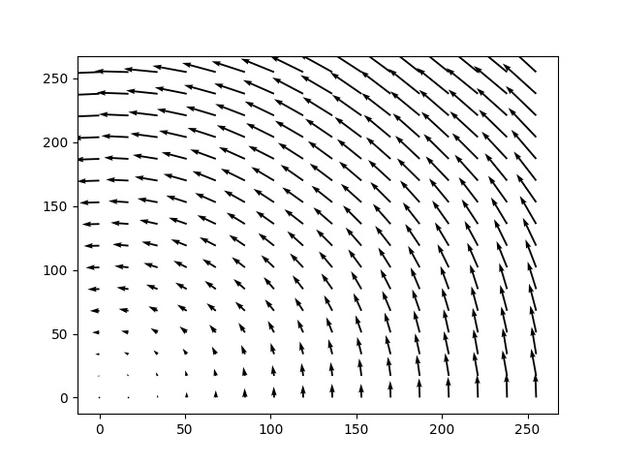
Ground Truth Vector Field
Predicted Vector Field
Model trained on registration and segmentation and regularization penalty
Input simulations +/- up to 5 degrees of rotation
Example -5 degree rotation
2K epochs, MSE < 1.0, IoU > 0.93

Slide 10
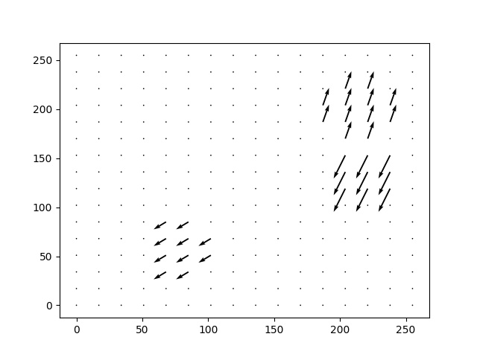
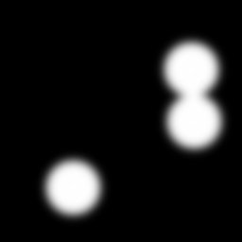



Simulation of small local deformations

Slide 11
Results with Local Deformations
Simulation of 6 ‘blobs’ – randomly placed with added Gaussian noise, if overlapping, watershed is used to separate
each blob displaced by 2D translation (x,y) where both x and y are sampled uniformly from (-20,+20) or (-30,+30) pixels
Currently GT DVF not smooth and using very small smoothness penalty 0.01
Seg Loss Weight = 0.01, MSE DVF Loss Weight = 1.0
Simulation | Number of Epochs | MSE DVF | IoU Segmentation
Up to +/- 20 pixel blob displacement | 500 | 0.30 | 0.97
 | 1000 | 0.26 | 0.98
Up to +/-30 pixel blob displacement | 300 | 2.70 | 0.87
 | 500 | 2.60 | 0.90

Slide 12


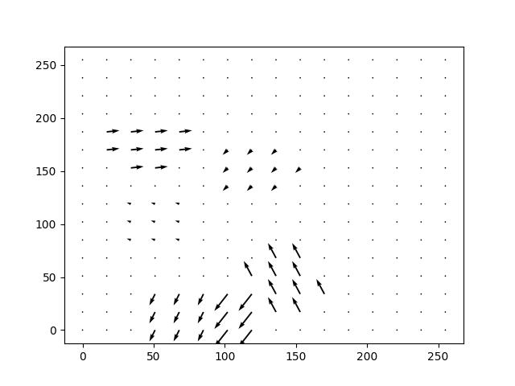

Up to +/- 20 pixel blob displacement
Time
t
Time
t + 1
Ground
Truth
DVF
Predicted
DVF

Slide 13
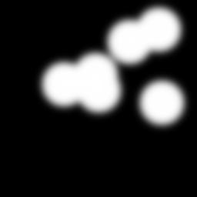

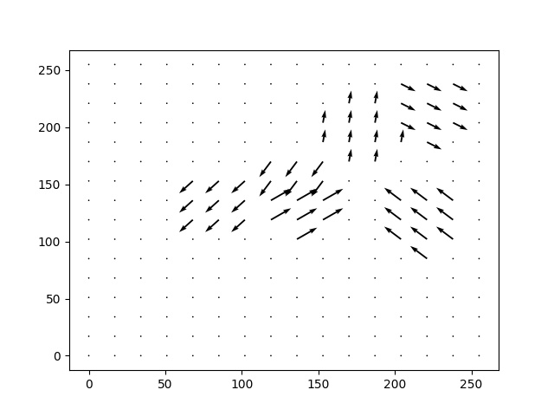
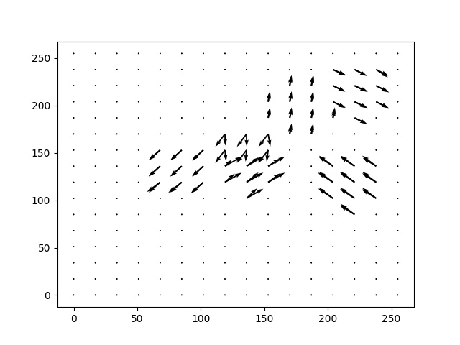
Up to +/- 30 pixel blob displacement
Time
t
Time
t + 1
Ground
Truth
DVF
Predicted
DVF

Slide 14
Next Steps
Simulated cell divisions
More realistic data (more variation, more noise, denser ..)
Real data: creation of DVF from GT lineage tree
Real data augmentation: nuclei displacement
3D network and data
Evaluation based on ground truth lineage
Notes:
Loss with regularization & measure of underlying rigid transform: Combination of 2D rigid transformation (3 dof), SMALL local deformation and model of mitotic splits
Evaluation/Loss with lineage GT – how to go from displacement vector field to a lineage mapping
Compute loss only where foreground in ground truth
Organize ground truth data: lineage map across adjacent time points

Slide 15
Next Steps
Simulated cell divisions
More realistic data (more variation, more noise, denser ..)
Real data: creation of DVF from GT lineage tree
Real data augmentation: nuclei displacement
3D network and data
Evaluation based on ground truth lineage
Notes:
Loss with regularization & measure of underlying rigid transform: Combination of 2D rigid transformation (3 dof), SMALL local deformation and model of mitotic splits
Evaluation/Loss with lineage GT – how to go from displacement vector field to a lineage mapping
Compute loss only where foreground in ground truth
Organize ground truth data: lineage map across adjacent time points

Slide 16
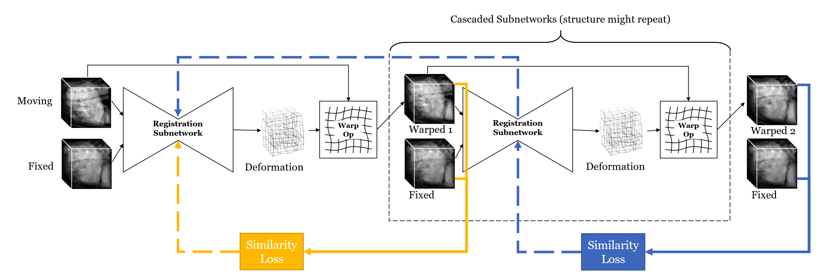
Unsupervised 3D End-to-End Medical Image Registration with Volume Tweening Network
S. Zhao et al. Microsoft Research, Tsinghua U., .. 2019

Slide 17
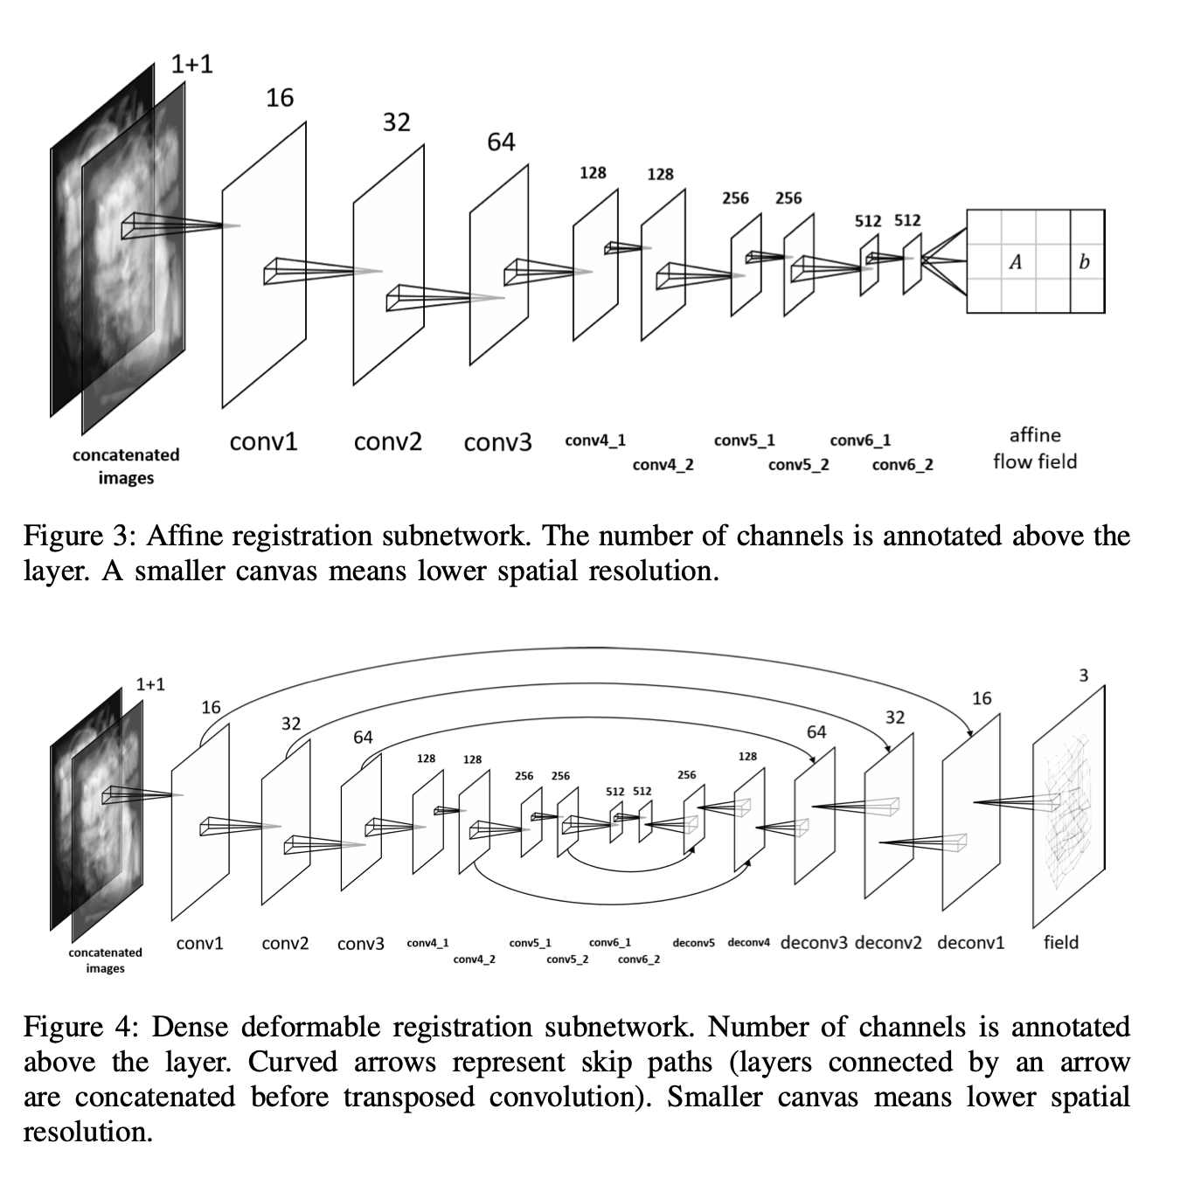
Unsupervised 3D End-to-End Medical Image Registration with Volume Tweening Network
S. Zhao et al. Microsoft Research, Tsinghua U., .. 2019
Notes:
The affine registration subnetwork aims to align the input image with an affine transform. It is only used as our first sub- network. As illustrated in Figure 3, the input is downsampled
by strided 3D convolutions, and finally a fully-connected layer is applied to produce 12 numeric parameters as output, which represents a 3 × 3 transform matrix A and a 3-dimensional displacement vector b. As a common practice, the number of channels doubles as the length of resolution halves. The flow field produced by this subnetwork is defined as
f (x) = Ax + b. (11)
The moving image is then transformed according to the output affine parameters and fed into the subsequent deformable registration subnetworks.
The dense deformable registration subnetwork is used as all subsequent subnetworks, each of which refines the registration based on the output of the subnetwork preceeding it. It follows an encoder-decoder architecture, as illustrated in Figure 4, which is commonly used for dense prediction. We use strided 3D convolution to progressively downsample the image, and then use deconvolution (transposed convolution) [8] to recover spatial resolution. As suggested in U-Net [29], skip connections between the convolutional layers and the deconvolutional layers are added to help refining dense prediction. The subnetwork will output the dense flow field, a volume feature map with 3 channels (x, y, z displacements) of the same size as the input.

Slide 18
Thank you

Slide 19
Find Optimal Linear Transform
Given predicted Displacement Vector Field Pred_{DVF} use original coordinates of image (x_{i} , y_{i} ) to compute their predicted transformed positions (x’_{i} , y’_{i} )
Find linear transform between these two sets of points using least squares and use it to compute A_{DVF}
for all i
(x_{i} , y_{i} , 1) (a₁₁, a₁₂, t_{x})^{T}= (x’_{i} )
(x_{i} , y_{i} , 1) (a₂₁, a₂₂, t_{y})^{T}= (y’_{i} )
Find local deformations L_{DVF} = Pred_{DVF} - A_{DVF}
Minimize mean square size of local deformation L_{DVF}
Regularize penalty based on smoothness of L_{DVF}

Slide 20
Four loss terms
Segmentation Loss: Binary Cross Entropy (for both input images and their labels)
Registration Loss: Mean Square Error (ground truth displacement field GT_{DVF} vs. predicted displacement field PRED_{DVF} )
Local Deformation Size: mean square size of local deformation L_{DVF}
Smoothness Penalty: based on smoothness of L_{DVF}

