Slide 1
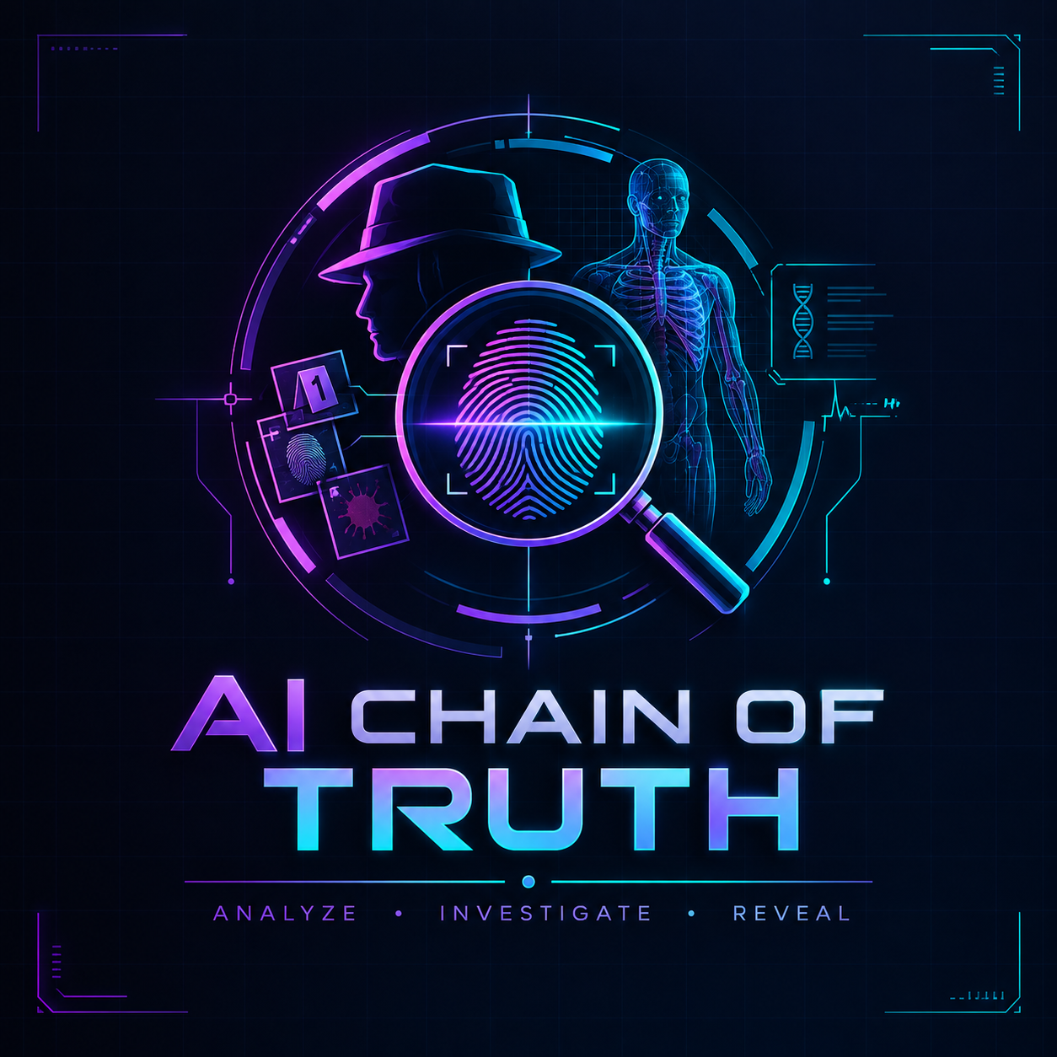
CHAIN OF TRUTH
EVIDENCE · INTELLIGENCE · JUSTICE
AI-assisted evidence integrity & investigation system for police and the judiciary.
Tamper-evident evidence. AI that cites what it says. Officers who decide.
BLOCK 00
sha256 · linked
BLOCK 01
sha256 · linked
BLOCK 02
sha256 · linked
BLOCK 03
sha256 · linked
BLOCK 04
sha256 · linked
BLOCK 05
sha256 · linked
BLOCK 06
sha256 · linked
AI Builders Hackathon 2026 · Team: Lisa Mehta · Source: github.com/lisamehta0791/AI-Truth-Chain · Demo video: (add link)

Slide 2
PROBLEM STATEMENT
The case file is where investigations go wrong
▸ Evidence is easy to alter and hard to prove intact — a photo re-saved, a record back-dated, a statement quietly rewritten. Courts throw cases out on custody doubts alone.
▸ The file never reads itself — CCTV logs, call records, statements and the post-mortem sit in separate folders. The contradiction that decides a case — the witness says 21:15, the camera says 20:47 — is found late, or never.
▸ Everyone gets the same screen — a Constable, an Inspector and a prosecutor need different authority, and every action needs to be attributable to a rank.
▸ AI tools that guess are worse than none — an assistant that invents a time or a name is not admissible and not safe.
Who feels it
Investigating officers drowning in paper, forensic reviewers cross-checking by hand, prosecutors who discover the gap in court.
What is at stake
Wrongful releases and wrongful convictions both start with an unreliable record. Integrity is the product, not a feature.
Design commitment
AI assists; humans decide. Nothing becomes fact until an officer confirms it — and that confirmation is logged.
CHAIN OF TRUTH · Evidence · Intelligence · Justice · AI assists, humans decide
02 / 09

Slide 3
SOLUTION OVERVIEW
One system: seal it, read it, question it, decide it
SEAL
READ
QUESTION
DECIDE
Every item SHA-256 hashed on arrival and chained to the previous one. Second officer for physical exhibits; field ranks add a live camera capture.
The AI extracts every dated event, person, place and vehicle from each item and lays them on one timeline.
Sources are compared against each other; contradictions surface with a severity, a confidence and the two excerpts side by side.
An officer of the right rank confirms or dismisses each hypothesis. The decision, the rank and the time go to the audit trail.
Then the file is checked before it leaves the station:
▸ Post-mortem findings mapped on an anatomical figure and cross-checked against statements and cameras · a draft chargesheet checked claim by claim · statement versions diffed word by word
▸ Case similarity across every file the officer can see — has this happened before? — with the shared names, places, vehicles and modus operandi listed, never a hidden score
▸ A hash ledger that re-hashes every file, anchors the chain outside the database, and includes a tamper drill for the sceptic in the room
CHAIN OF TRUTH · Evidence · Intelligence · Justice · AI assists, humans decide
03 / 09

Slide 4
TARGET USERS
Built for the whole chain of command
Constable / field ranks
Sub-Inspector / Inspector
Forensic medical officer (DSP)
Logs evidence at the scene with a live capture. Sees only their own cases.
Confirms or dismisses AI findings, reviews contradictions, reads the audit trail.
Reviews post-mortem hypotheses on the figure; cross-checks against the file.
Superintendent / Commissioner
Public prosecutor (view-only)
Judiciary & auditors
Sees every case, provisions accounts top-down, anchors the ledger, drives the demo.
Reads everything at clearance, changes nothing — every write is refused server-side.
An independent, verifiable custody record: re-hash the files, check the anchor, read the trail.
Rank + role are independent axes; eleven ranks from Constable to DGP; every threshold enforced on the server, the interface is only a courtesy.
CHAIN OF TRUTH · Evidence · Intelligence · Justice · AI assists, humans decide
04 / 09

Slide 5
PRODUCT FEATURES
Sixteen working modules, one case
Evidence intake
Chain of custody
Hash ledger
Timeline
Hash + chain, second officer, live capture
Every touch, with the hash at that moment
Re-hash, anchors, tamper drill, checkpoint export
AI-extracted, officer-confirmed chronology
Contradictions
Investigation Copilot
Autopsy cross-check
Evidence graph
A vs B, severity, confidence, decision
Next steps citing BNSS/BSA + grounded Q&A
Findings on the figure, checked against the file
People, places, devices, exhibits — connected
Predictive location
Statement reliability
Chargesheet QA
Case similarity
Real map, movement track, explained scores
Every version kept, word-level diff
Claims vs the verified record
Has this happened before? Side-by-side compare
Case review
Offline sync
Audit trail
Personnel & access
Closure readiness with the arithmetic
Field captures keep their original hash
Every action, every rank, every result
Top-down provisioning, view-only accounts
Every module ships with demo data: a ten-stage fictional case plus three earlier cases that share its signature.
CHAIN OF TRUTH · Evidence · Intelligence · Justice · AI assists, humans decide
05 / 09

Slide 6
HOW IT IS BUILT
Technical architecture
Frontend — React 18 + TypeScript
Backend — FastAPI + SQLAlchemy 2
AI layer
Vite · Tailwind · Motion · MapLibre (OpenStreetMap) · d3-force graph · anatomy viewer · live WebSocket updates · 17 pages
One router per module · rank/role permissions on every route · audit log on every action · WebSocket manager · demo scenario engine
Groq (openai/gpt-oss-120b) or Anthropic · extraction, contradiction, guidance, autopsy, copilot · RAG over pgvector · Voyage embeddings (deterministic fallback)
PostgreSQL 16 + pgvector
Integrity core (no AI)
MinIO (S3) object storage
Cases, evidence, custody events, timeline, contradictions, entities, anchors, audit log, embeddings · Alembic migrations
SHA-256 per file · previous-hash chain · HMAC-signed anchors kept outside the DB · custody events with hash-at-event · rule-based location scoring · closure arithmetic
Evidence files and live captures · re-downloaded and re-hashed on every ledger verification
Flow: upload → hash + chain + store → AI extraction → timeline & entities → contradiction detection → guidance → WebSocket push → officer decision → audit.
Docker Compose for Postgres/MinIO (and the full stack in production); 60 automated checks (API smoke, rank permissions, evidence rules, browser suite) run against the live stack.
CHAIN OF TRUTH · Evidence · Intelligence · Justice · AI assists, humans decide
06 / 09

Slide 7
AI TECHNOLOGIES USED
AI where it helps, arithmetic where it must be certain
Extraction
Deliberately NOT AI
LLM reads each item and returns dated events, entities and excerpts. Rules: never invent a date; time only when the source states it.
▸ Hash chain and ledger — SHA-256, previous-hash links, HMAC anchors — deterministic cryptography.
▸ Location scoring — 0.5 × recency + 0.5 × reliability, every factor shown on the map.
▸ Case similarity — Jaccard over named entities, evidence types and a fixed modus-operandi vocabulary — the shared items are listed, so a match is inspectable.
▸ Closure readiness — 100 − penalties, printed on the page.
▸ Every AI output is a hypothesis — magenta until an officer of the right rank confirms it (mint). The model never writes to the verified record.
Contradiction detection
Each new event is compared with the existing chronology; conflicts carry a severity, a confidence and both excerpts.
Investigation Copilot
Next-step suggestions grounded in a curated legal knowledge base (RAG over pgvector) with the section cited; a Q&A that answers only from this case's evidence and admits gaps.
Autopsy & chargesheet
Post-mortem findings mapped to body regions with confidence; chargesheet claims judged pass / warning / conflict / unsupported against the verified timeline.
Stack: Groq API (openai/gpt-oss-120b) with Anthropic as a drop-in alternative · pgvector · Voyage AI embeddings with a deterministic local fallback · provider-agnostic adapter layer.
CHAIN OF TRUTH · Evidence · Intelligence · Justice · AI assists, humans decide
07 / 09

Slide 8
WHY IT MATTERS
Impact & value proposition
Admissible by construction
The contradiction found on day one
Hours back to the officer
A custody record a court can verify independently: re-hash the files, walk the chain, check the anchor. Integrity doubts stop being a defence strategy.
The 21:15 / 20:47 clash surfaces the moment the statement is logged — not in cross-examination months later.
Timeline, entity graph, statement diff and chargesheet check are done in seconds and cited; the officer spends the time deciding, not collating.
Patterns across files
Safe AI
Would use it tomorrow
Three earlier cases with the same knife, door and hatchback surface as a lead in one click — the question every investigator asks, answered with evidence.
Grounded, cited, rank-gated, logged. An assistant that says "the file does not establish this" is one investigators can trust.
Runs on a laptop with Docker; every module carries a full demo case; provisioning, audit and offline capture are built for stations, not slides.
CHAIN OF TRUTH · Evidence · Intelligence · Justice · AI assists, humans decide
08 / 09

Slide 9
WHAT COMES NEXT
Future roadmap
Next 30 days
Next quarter
Beyond
▸ Full-resolution anatomical imagery and per-region injury cards
▸ Replay offline captures through the whole pipeline automatically
▸ Verified legal knowledge base with citations reviewed by counsel
▸ Public timestamping of chain anchors (RFC 3161 / blockchain notary)
▸ Multi-station deployment: Redis pub/sub for live updates, per-station data isolation
▸ Redaction workflow for PII when files leave the station
▸ Court-facing read-only portal for defence and judiciary
▸ Speech-to-text intake for statements in Indian languages
▸ Cross-district pattern search with privacy-preserving matching
Guiding rule for every item: AI assists, humans decide — no roadmap item lets the model write to the verified record.
CHAIN OF TRUTH · Evidence · Intelligence · Justice · AI assists, humans decide
09 / 09

