Slide 1
TraceHold
EXATHON INDIA 2026 · TRACK 01
THE WORKED EXAMPLE
 | FROZEN | SUPPORTED
Account A | ₹30,000 | ₹30,000
Account B | ₹1,90,000 | ₹70,000
Account C | ₹4,50,000 | ₹50,847
Total | ₹6,70,000 | ₹1,50,847
Trace the stolen money. Hold only what the records support.
₹5,19,153 of the account holders' own money would be held without support.
Lisa Mehta · Built on Exasol Personal · github.com/lisamehta0791/TraceHold
Notes:
TraceHold sizes cyber-fraud account holds: how much of each balance the transaction records can actually trace to a reported fraud. In the worked example from our problem statement, freezing three whole accounts locks ₹6,70,000, while the records support at most ₹1,50,847.

Slide 2
Holds come too late for victims, and too broad for everyone else
THE PROBLEM
IN ONE SENTENCE
₹1,261 cr
lost to online fraud in Bengaluru up to Aug 2025, only about 4% traced and returned
Too late for victims · Deccan Herald, city police data
An officer deciding how much of an account to hold in a cyber-fraud case can't tell how much of the victim's stolen money actually reached that account, because the money is split, mixed with other funds and moved on within minutes, and requests often arrive without the amount or the trail.
105 petitions
whole accounts frozen for disputed sums sometimes under ₹100, freezes continuing after a clean chit
Too broad for innocent recipients · Rajasthan High Court, Aug 2026 (as reported)
If this worked, holds would match what the records support, the victim's money would be held sooner, and a person who received one payment would not have their whole balance locked.
Notes:
Both failures have one root: there is no quick, defensible way to work out how much of the disputed money is in each account.

Slide 3





Five people live with this problem every day
WHO IS AFFECTED
WHAT THEY NEED
WHAT GOES WRONG TODAY
Fraud victim
Wants the money held before it moves on
Recovery is slow and low; the hold depends on how fast the trail is understood
Holder of a downstream account
A restriction limited to what is disputed
Whole-balance freezes, often without notice or a stated amount
Officer at the police cyber cell
To state the amount and basis of a hold
The trail spans many accounts; mixed funds blur the disputed share
Bank nodal officer
To act lawfully and promptly
No way to check a requested amount, so blanket freezing is the safe default
State oversight officer
To spot prolonged or disproportionate freezes
No consolidated view of how long holds last or how big they are

Slide 4
The rule exists. The calculator does not.
WHY TODAY'S APPROACH FAILS
1
Money moves in minutes
2
Requests arrive incomplete
Requests are made before the full trail is known.
Missing reference, legal provision, transaction or amount.
3
Mixed money has no label
4
Holds outlive their purpose
Which part is 'disputed' depends on a convention; without one, the only safe choice is the whole balance.
Freezes continue after closure; holds above ₹50,000 have no timeline.
The rule already exists: hold the disputed sum, not the account (MHA procedure, Jan 2026). What is missing is the calculator. TraceHold is that calculator.

Slide 5
TraceHold sizes the hold the records can defend
THE SOLUTION
₹1,00,000 is stolen and passes through three accounts. The police ask to freeze all three.
₹5,19,153
of the account holders' own money does not need to be restricted
Every account gets a range under two disclosed methods (pro-rata and FIFO), a status, and the full calculation.
A proportionate hold instruction is drafted for the officer.
Every rupee of the loss is accounted for: a conservation check.
Notes:
This is the worked example from the project document, reproduced to the paisa by the SQL engine. B and C hold far more than the records can tie to the fraud.

Slide 6
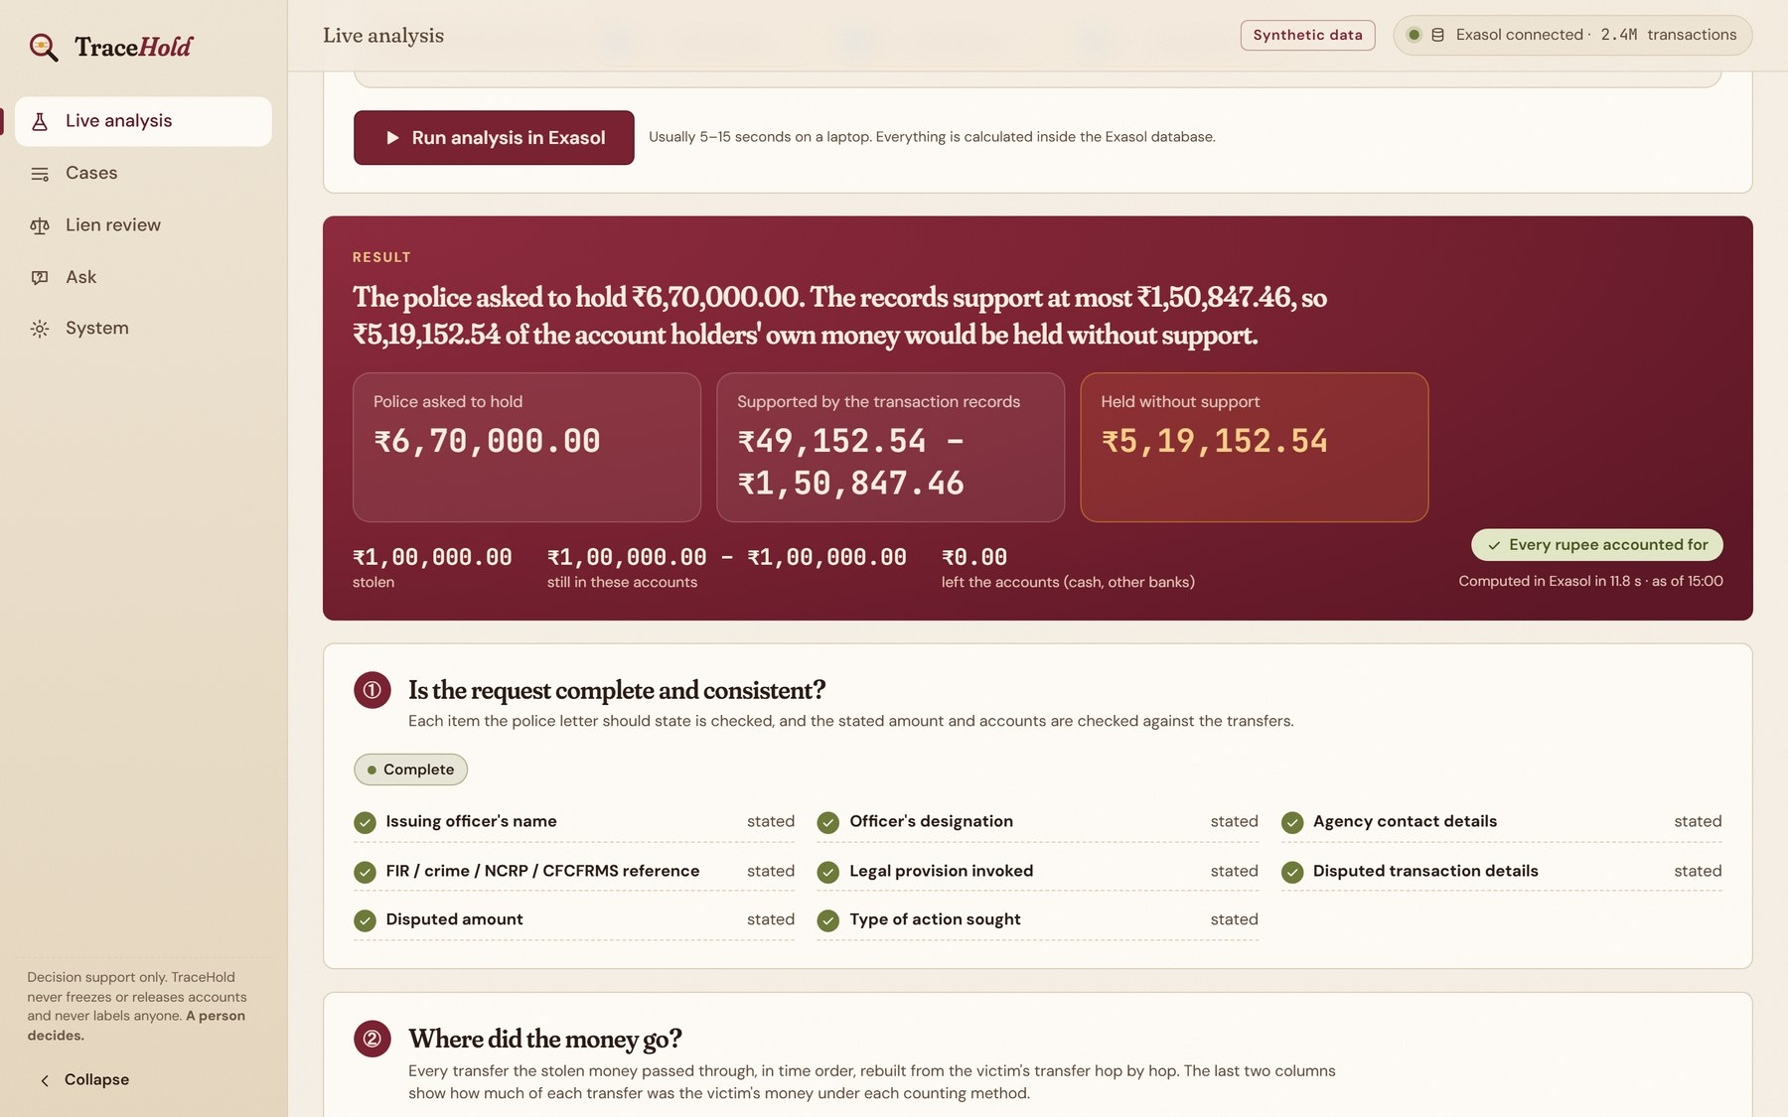
The verdict comes first: asked to hold vs supported by the records
THE PRODUCT
1
Pick a case or paste a police letter
Five demo cases, your own values, or a free-text letter read with AI.
2
Run it inside Exasol
Around 10 seconds; every figure computed by SQL.
3
Read the verdict, then the six steps
Request check, money trail, sizing, comparison, hold draft, and the SQL that ran.

Slide 7





From a vague request to a figure you can defend
HOW IT WORKS
01
02
03
04
05
Check the request
Rebuild the trail
Size every account
Compare with the request
Hand over the evidence
Checklist from court directions; AI reads free-text letters, rules verify every field
Hop by hop, through splits, merges, loops, reversals, duplicates and clock skew
Pro-rata and FIFO ranges, traceable share, status; abstains when records are missing
Within evidence, within range, exceeds evidence, or cannot determine
Evidence packet, plain-language letter, proportionate hold, forwarded requests
A person decides at every step. TraceHold never freezes, releases or labels anyone, and no AI model ever produces a figure.

Slide 8






Everything needed to size, review and explain a hold
WHAT THE OFFICER GETS
Live analysis
Every case, explained
Lien review queue
Type in any case or paste a police letter; the verdict comes first: asked to hold vs supported by the records.
2,400 cases on 2.4M transactions, each with the step-by-step maths. Re-trace any case live on the full ledger in about 10 s.
Existing holds ranked for a person: over-held, closed but still frozen, past 90 days, no update.
Ask the results
Proportionate hold draft
Evidence for everyone
Plain-English questions answered through Exasol's MCP server; the SQL and rows are always shown.
Per account, a hold limited to the supported range, ready for the officer to review and send.
Evidence packet citing every transaction, and a neutral letter for the account holder.

Slide 9
Exasol is the engine, not just the storage
HOW EXASOL IS USED
Set-based SQL, no row-by-row code. Window functions rebuild every running balance; the trail expands one layer per pass until nothing changes.
The whole analysis as one script. EXECUTE SCRIPT TRACEHOLD.RUN_ANALYSIS(): a Lua script generated from the same SQL; same checksum.
Governed questions. Exasol's open-source MCP server, as a read-only user that sees only results views.
Privileges as protection. The analysis user cannot change source data or history; Exasol refuses it.
Exasol does the tuning. Every index is created by Exasol itself, none by hand; transactions compressed 2.3× in memory.
2.4M
transactions analysed in one run
16.7M
rows processed in one analysis run
≈ 4 min
for the complete analysis of 2,400 cases
Notes:
Exasol is not a storage layer here: it is the engine. The Python layer only sequences SQL. The timing is on a laptop with 8 GB of RAM and Exasol limited to 3 GB; close other apps before a live run.

Slide 10
Same SQL, same laptop: Exasol pulls ahead as data grows
BENCHMARK
1.4×
faster at 241k transactions
7.8×
faster at 958k transactions
With 4× more data, Exasol took 1.6× longer and PostgreSQL 8.8× longer. PostgreSQL is faster on tiny single queries; both answer those within seconds. Synthetic data; only these workloads were measured.

Slide 11


Protected data, and AI only at the edges
BUILT TO BE TRUSTED
The records cannot be damaged
AI never touches a figure
Source data is read-only for the analysis: enforced by Exasol privileges, not by code alone
History is append-only: every run's results, every live analysis, every AI call
Each run fingerprints the source data before and after, and fails if anything changed
Live proof in the app: 10 damaging statements sent, 10 refused by Exasol
AI reads free-text police letters; every value must quote the letter and pass rule checks
Held-out letters: 98.8% precision, 99.2% recall, 0 values used without a quote
Answers over results: every number must appear in the rows, or the wording is rejected
With AI switched off, every figure is identical (tested)

Slide 12
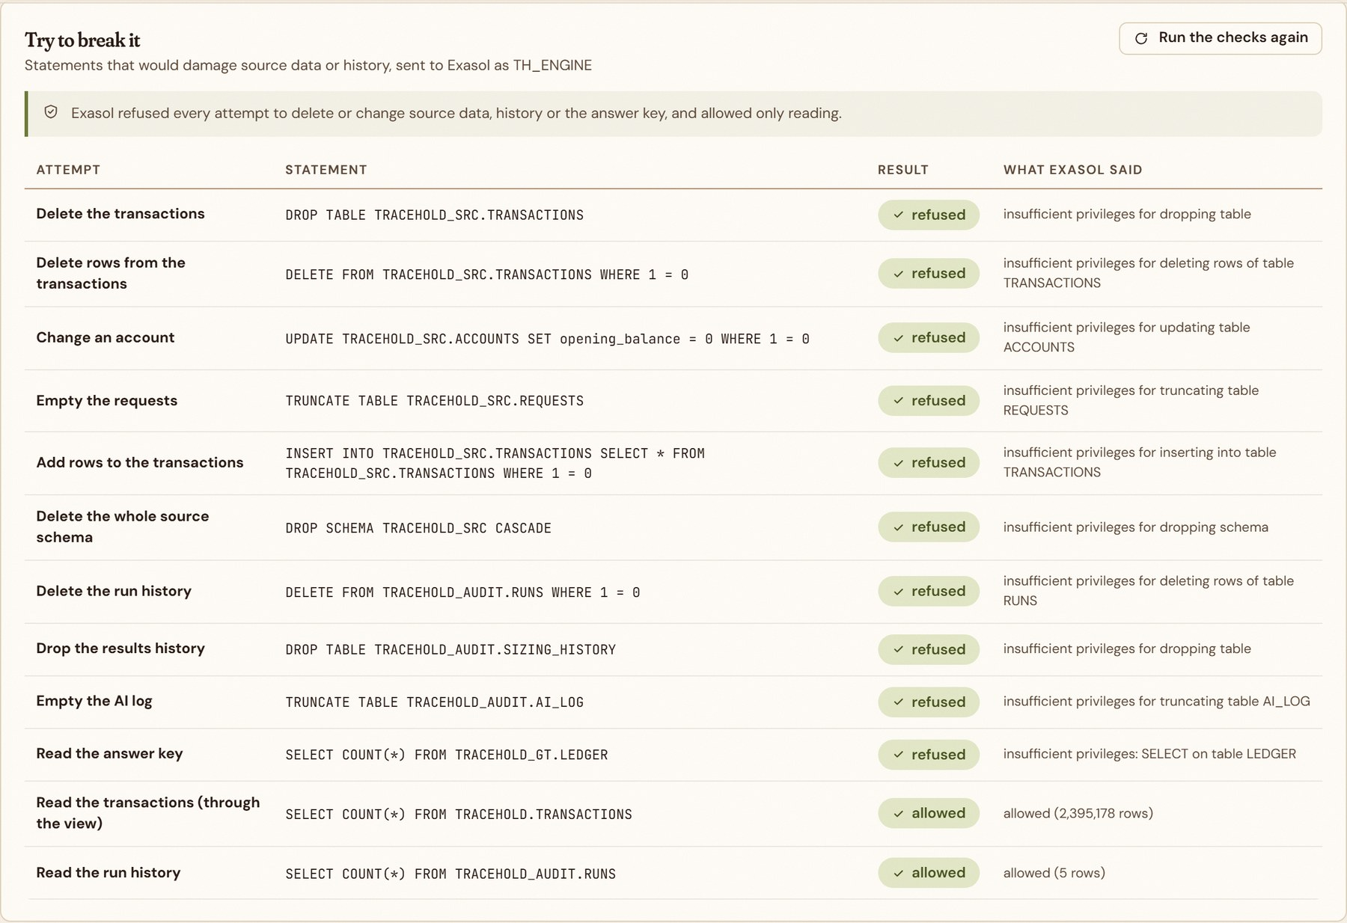
Try to break it: Exasol refuses every damaging statement
PROOF, NOT PROMISE
10 / 10
attempts to delete or change source data, history or the answer key refused
Sent live from the app as the analysis user, on System → Runs & history.
DROP, DELETE, UPDATE, TRUNCATE and INSERT on source tables, run history and the answer key.
Only reading is allowed, and the reply comes from Exasol itself: "insufficient privileges".

Slide 13
Measured on 2,400 synthetic cases and 2.4M transactions
RESULTS
7,200 / 7,200
99.9%
100%
conservation checks pass: every rupee accounted for
of account figures within one paisa of an independent ledger
precision and recall on 946 planted request defects (14 types)
99.4% / 99.9%
3,588 of 3,589
Same checksum
precision / recall of money-trail reconstruction
over-broad requests flagged, with no false flags
on every re-run of the same data, either way it is run
The worked example from the problem statement is reproduced to the paisa. All results are on synthetic data with a separate answer key the analysis never reads; they are not evidence of real-world performance.

Slide 14
Others trace or detect. TraceHold sizes and reviews the hold
WHY IT IS DIFFERENT
 | CFCFRMS / NCRP | MuleHunter.AI | Fund-trace tools | TraceHold
Coordinate reporting across banks and police | ✓ | — | — | uses its output
Detect suspicious (mule) accounts | — | ✓ | — | not by design
Trace the money across accounts | — | — | ✓ | ✓
Size the supportable hold per account | — | — | — | ✓
Show uncertainty as a range under stated methods | — | — | — | ✓
Check the request and flag over-broad holds | — | — | — | ✓
Review existing holds by size and age | — | — | — | ✓
Evidence packet citing every transaction | — | — | reports | ✓
Based on public descriptions of existing systems; capabilities inside banks may differ. TraceHold does not claim to be first.

Slide 15
Careful by design, honest about its limits
RESPONSIBLE USE
1
A person decides
2
No labels, no scores
TraceHold never places, changes or releases a hold, and never decides guilt.
It reports facts for exceptional cases and never calls anyone a mule.
3
Conventions are estimates
4
Abstains when unsure
Pro-rata and FIFO are disclosed methods, not legal findings about ownership.
Missing records give 'Undeterminable', never a guessed number.
5
One bank's view
6
Synthetic data only
Money leaving the records gets a forwarded request, not a guess.
Patterns mirror the real problem in shape only; rules follow commentaries to be checked against primary texts.

Slide 16
Open source, reproducible, runs on a laptop
BUILD AND RUN
Database and analytics
Exasol Personal (nano runtime in Docker)
RUN IT
Analysis
Set-based SQL and an Exasol Lua script
Generate synthetic data
Load it into Exasol (protected layout created)
Run the analysis inside Exasol
Start the API and open the website
Backend
Python, FastAPI, pyexasol
AI (optional)
Groq model; Exasol MCP server
Frontend
React, TypeScript, Vite
github.com/lisamehta0791/TraceHold
MIT licence · README with the full run guide and screenshots
Quality
47 tests, 54 browser checks, WCAG AA checked

Slide 17
References
SOURCES
ExaThon India 2026 challenge page: exasol.com/events/exathon-india-2026
Deccan Herald: Bengaluru citizens lose over ₹1,200 crore to online fraud with low recovery rate
Ministry of Home Affairs, reply in the Rajya Sabha on CFCFRMS (Feb 2026)
Pink City Post: Rajasthan High Court directions on lien versus blanket freeze (Aug 2026)
LiveLaw: Problem with CFCFRMS, reading MHA's new account-freeze SOP (2 Jan 2026 procedure)
MediaNama: RTI reply on MuleHunter.AI adoption by 23 banks (Dec 2025)
Voice&Data: iAcuity launches Fund Trail (Mar 2023)
Exasol: MCP server, Exasol Personal, developer documentation
Court and procedure references are context, not legal advice; the Rajasthan order binds Rajasthan only. All project data is synthetic.

Slide 18

TraceHold
THANK YOU
Hold the victim's money sooner. Leave everyone else's alone.
Scan for the code
github.com/lisamehta0791/TraceHold
Lisa Mehta · github.com/lisamehta0791/TraceHold · Built on Exasol Personal

