Slide 1

Preparing a Quote in Salesforce
Process Change for Quote Preparation

Slide 2

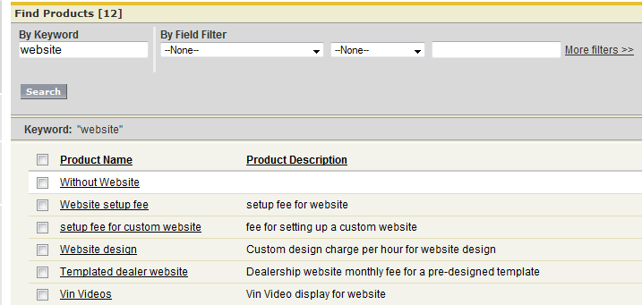
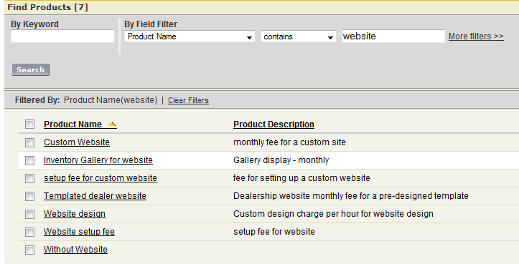
Creating a Quote- Adding Product
Click on “Add Product”
Search by Keyword
Search by Filter
1
Search by Keyword -Keywords you enter return
matches in standard or custom text fields. Will return products where keyword is in the Product name or Product description
2
3
Search using Filters- Select your filter criteria to refine your search further. Search will return the products that match your filter criteria.

Slide 3
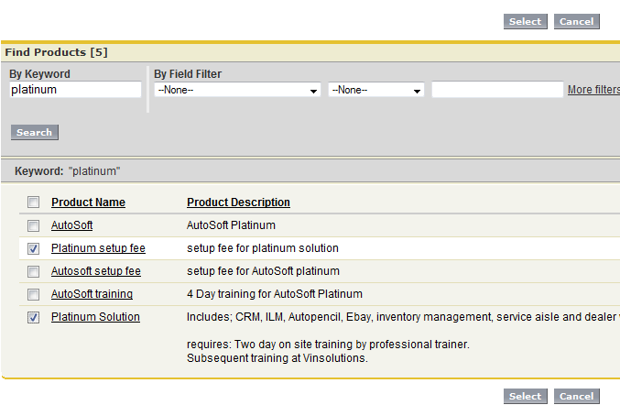
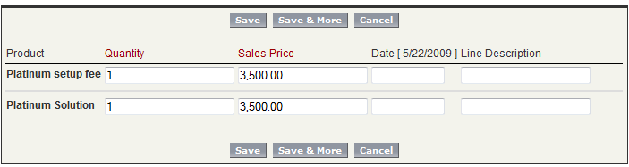
Creating a Quote- Adding Product
Select Product and click on “Select”
Enter Quantity, Line Description (optional, defaults to Product Description but can be overwritten), edit Sales Price
Select “Save” to end “Add Product” or “Save & More” to add additional products
1
2
3

Slide 4
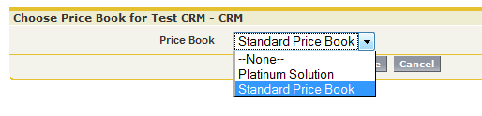
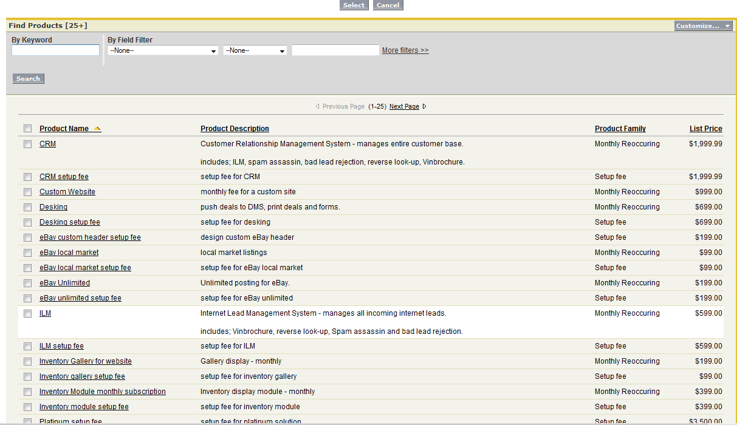
Creating a Quote- Solution Products
1
Select “Choose Price Book”
Drop Down to Find applicable Price Book, then “Save”
Select “Add Product”. Use keywords or filters to find products. Make selections and click on “Select”
2
IMPORTANT – if you are selling a bundled solution (Platinum, Gold, Silver, etc) you MUST select all the products included and excluded in the package: CRM, ILM, Inventory, Website, etc
3

Slide 5
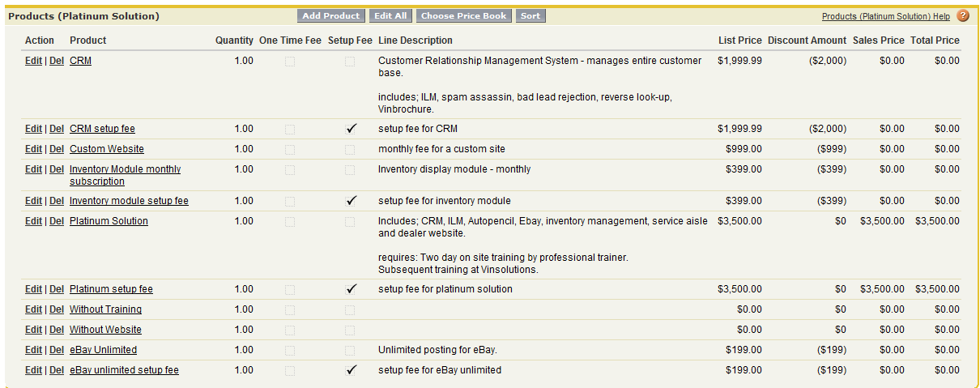
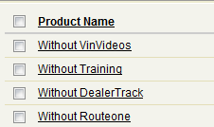
Creating a Quote- Solution Products
2
Select Edit to change the Sale Price
Select Edit All to edit all products
1
IMPORTANT – if you are selling a bundled solution and you have discounted the package because you are not including a product you need to add the product that is listed in the price book with the word “without”.

Slide 6
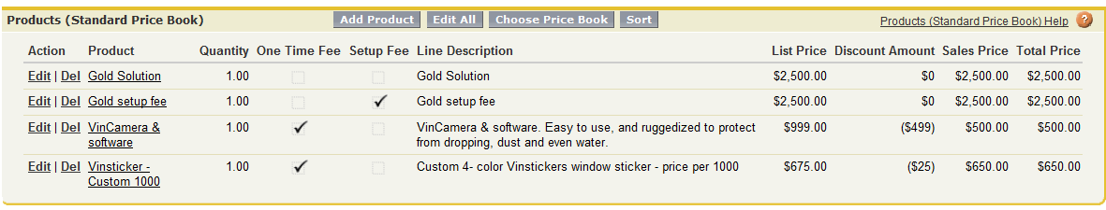
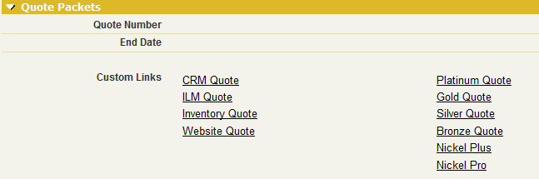
Creating a Quote
Creating a Quote
Review Products
Update Good Thru Date
Click on Applicable Quote Link
Save Quote to your Desktop or any other designated folder
1
2
3

Slide 7
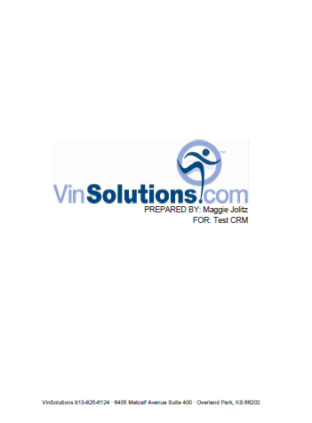
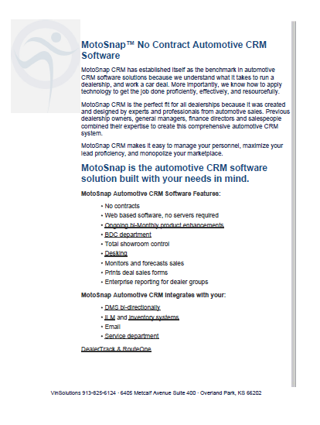
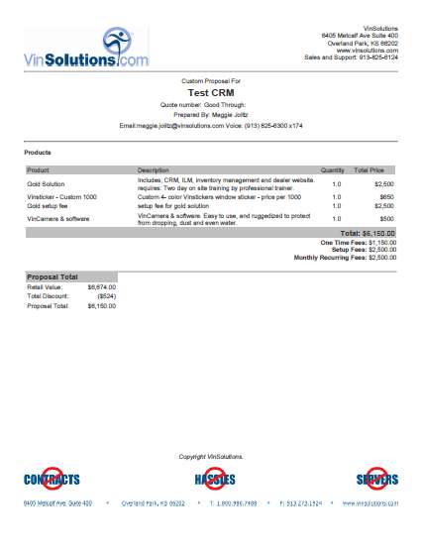
Reviewing Quote
Cover Sheet
Collateral Materials
Quote
1
2
3

Slide 8
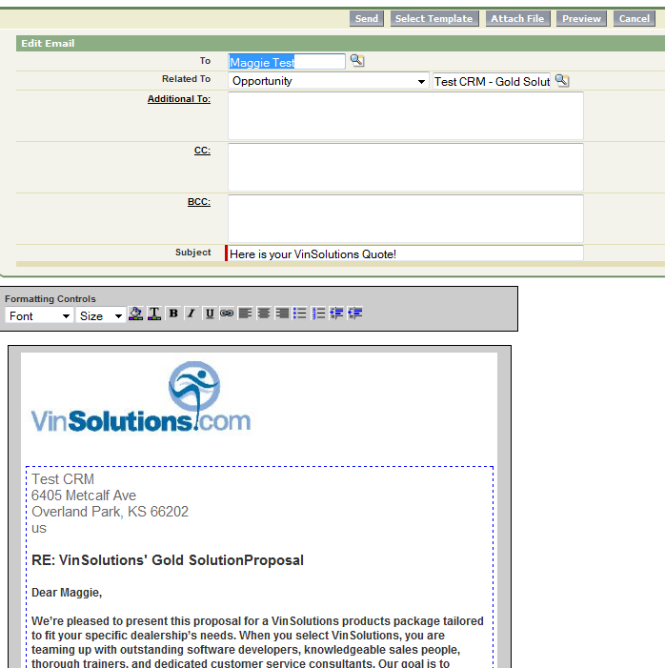
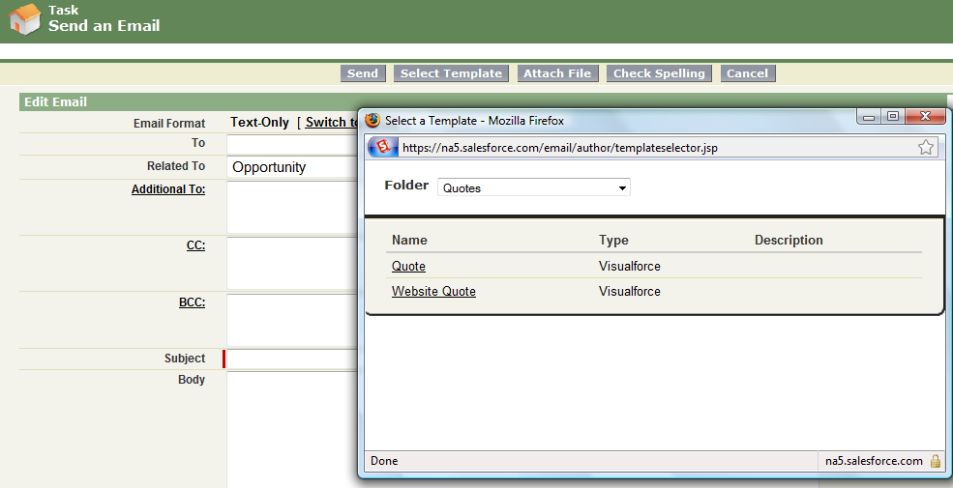

Sending a Quote
1
Select “Send An Email”
Select Template “Here is your Proposal”
Select “Send” to send Quote
Activity Logged
3
2
4

Slide 9
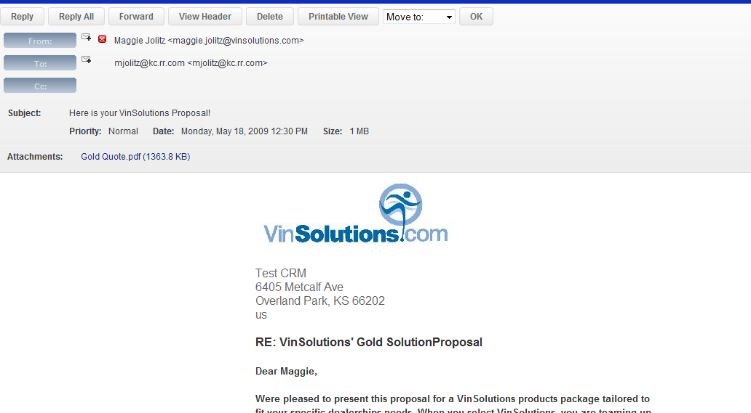
What the Customer Gets…
Intro Email
Quote Attached
2
1

